Slide 1
Tribes and the
Health Home Program
Elizabeth Greil, DSHS ALTSA Tribal Initiative Program Manager
Tamara Gaston, DSHS ALTSA Tribal Affairs Administrator
Christine Del Buono, Home Health Contract Manager

Slide 2

Health Home Program
Created by Affordable Care Act (ACA) section 2703 in 2013
States provide Health Home benefits and care coordination services to high-cost, high risk Medicaid and Medicare/Medicaid (duals) eligible participants.
Offers a set of services to individuals living with a chronic condition that can lead to additional chronic conditions if not managed.
The participant, their specific health needs and goals are central to service delivery.

Slide 3
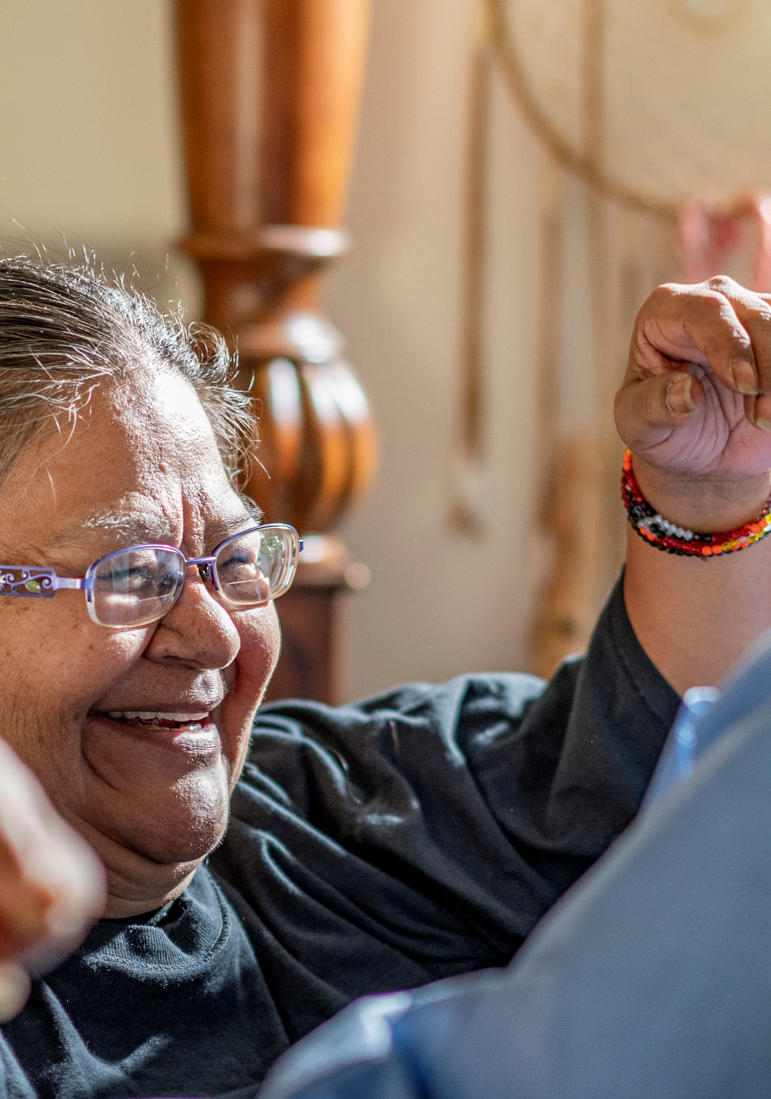
Value
Reduce the progression of chronic disease for participants
Decrease the likelihood of additional chronic conditions
Decrease emergency department visits and preventable hospital readmissions
Improve health and self-management of chronic conditions for the participants
Ensure care coordination and care transition for participants returning home after a health event
Reduce medical expenditures for both the state and federal governments

Slide 4
6 Specific Services Beyond Typical Medical Services
Comprehensive care management
Care coordination
Health promotion
Comprehensive transitional care and follow-up
Individual and family support
Referrals for community and social services support

Slide 5

Washington’s Health Home Program
Available to all Apple Health participants who meet the minimum qualifications.
Assists participants in accessing medically necessary services.
Services may be delivered face to face or telephonically.
Participant and care coordinator can meet at a location of the participants choice: a clinic, the participants home or other community location.
This program is designed to:
  decrease the effects of chronic medical conditions on day-to-day life,
  increase the participants ability to self-manage their care,
  support participants to play an active role in their medical treatment, and
  Assist participants to meet their self-identified goals.

Slide 6

Who Can Provide Health Home Services?
Community organizations and Managed Care Organizations (MCOs) contract with HCA/DSHS as “Lead” Organizations. Leads may provide participant services or sub-contract with community organizations and tribes.
“Care Coordination Organizations” (CCOs) include mental health clinics, area agencies on aging, chemical dependency providers, HIV/AIDs networks, child social service agencies, community health centers, and tribes.
Tribal Nations can choose to provide services as a Lead, CCO, or both.

Slide 7
Health Home Chart
HCA/DSHS
Care Coordinators may work directly for Leads
Or work for a Care Coordination Organization
Lead
Care Coordination Organizations
Care Coordinators deliver participant care
Care Coordinators deliver participant care

Slide 8
Lead Agency Role
  Administers the Health Home program through a Qualified Health Home contract with the state
  Assumes substantial financial risk (upfront funding to procure the needed technology, software, staffing, and physical office space).
  Creates policies and procedures for the program.
  Translates and creates HIPAA transactions (specifically 820, 834, 835, 837 files) or contracts with a vendor to do this function.
  Contracts with Insignia (for use of Flourish to score the AM assessments) and Collective Medical Technologies (CMT) or another vendor to provide hospital admission notifications.
  Maintains on staff, a Health Home trainer to provide one two-day Care Coordinator (CC) training per year to any CC regardless of their Lead agency, minimally.

Slide 9
Lead Agency Role - 2
  Creates .xml files to upload Health Action Plans (HAPs).
  Ensures the Electronic Health Record (EHR)/platform network can be used to document visit notes, HAP’s, consents, etc.
  Is experienced at operating broad-based regional provider networks.
  Assigns HH Participants to Care Coordination Organizations (CCO’s) using smart assignment process whenever possible.
  Maintain Memoranda of Agreement (MOA) with the organizations needed to support the HH program. (Ex: Hospitals for transitional care)
This list is not all inclusive but does provide some examples of the financial, technical, and experiences needed to qualify as a Lead agency.
*Smart Assignment is a shared process with a tribal CCO.

Slide 10

Leads are Responsible for Administrative Oversight
Leads agencies are responsible for ensuring participant records are created and maintained.
Required clinical records include:
  Health Action Plan
  Contact log and
  Progress notes
Records are maintained in the participant’s file in the clinic office or participant electronic health record.
Required HCA quarterly reports for Lead Agencies
Report number of participants
  enrolled
  engaged (signed a consent form and completed their initial Health Action Plan)
Identify program barriers to enrollment and engagement success
Describe Program participant success stories

Slide 11

Care Coordination Organization Role
Subcontract with the Lead agency.
Hire Care Coordinators (CC) and assign them to provide the HH services.
Ensure HH CC actively engage participants in developing a Health Action Plan (HAP) centered around their individual needs and goals.
Assist participants in getting the right care, at the right time, in the right setting, to avoid duplication of services.
Establish methods to share critical events with the HH CC within established time periods.
Use the Lead Agency provided software platform to track and share participant information and care needs across providers to:
  monitor processes of care and outcomes,
  initiate recommended changes in care, and
  address achievement of heath action goals.

Slide 12
Care Coordination Organization Role - 2
Use informed interventions that recognize and are tailored for the:
  medical, social, economic,
  behavioral health, substance use, function impairment, and
  cultural and environmental factors affecting health and health care choices.
Provide culturally competent Health Home services that address health disparities.
Ensure HH CC’s will discuss with the treating/authorizing entities:
  time sensitive situations that may impact the participant current status,
  changes in participant circumstances, conditions, or HAP
  need for changes in treatment and services.
Once you have mastered the CCO world, it becomes easier to work towards becoming a Lead agency. There are many requirements to fulfill in becoming a Lead agency and as a CCO initially, you will possess a better understanding of the financial and programmatic risk you take on as a Lead agency.

Slide 13
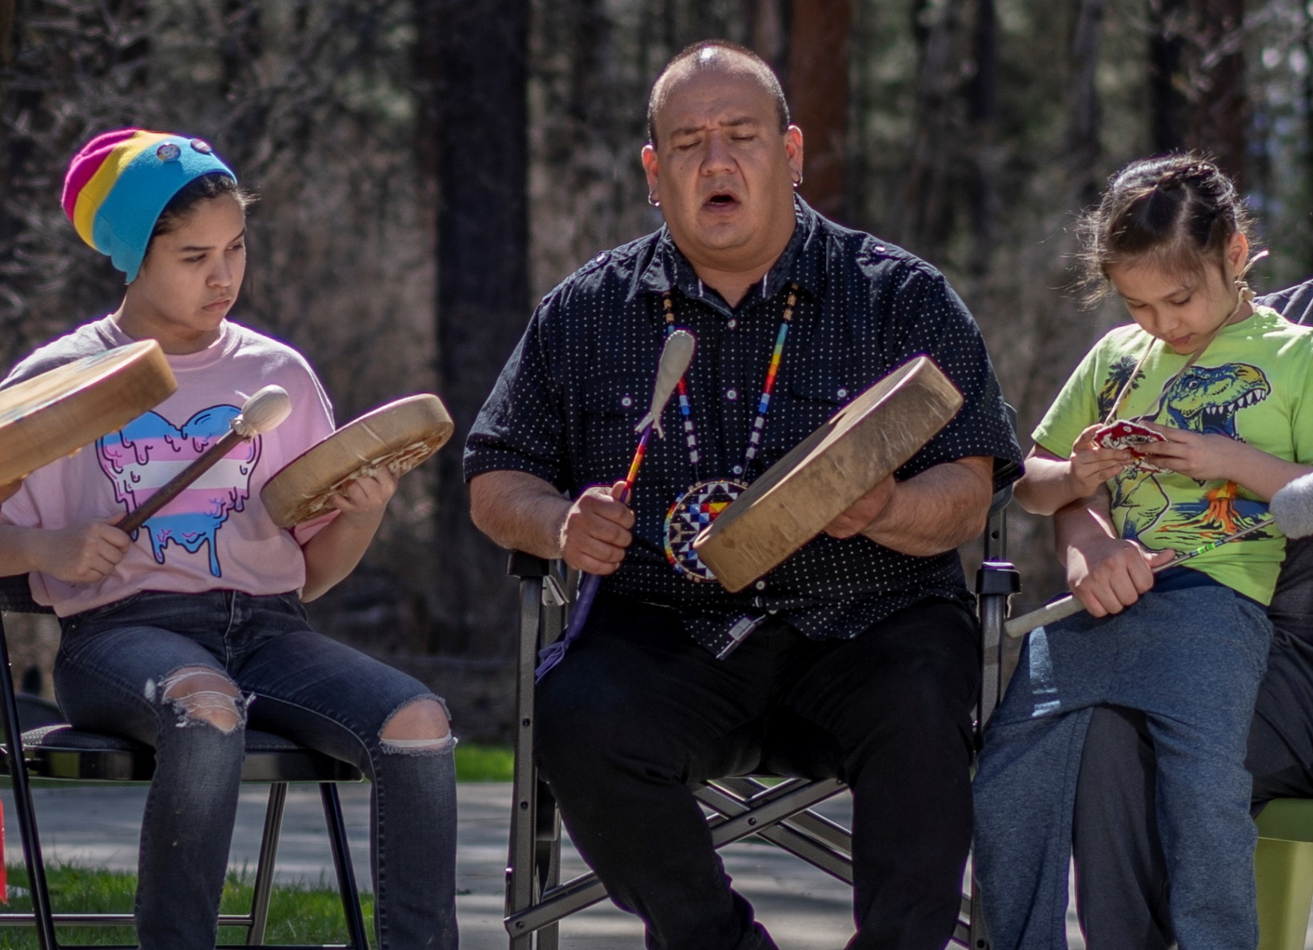
Who can be a Health Home Care Coordinator?
A variety of professionals
A Care Coordinator is the central person developing and updating the HAP and must be a “professional” according to our State Plan Amendment.
Indian Health Services (IHS) Certified Community Health Representatives (CHR).
Register Nurse (RN)
Advanced Registered Nurse Practitioner (ARNP)
Licensed Practical Nurse (LPN)
Psychiatric Nurse
Psychiatrists
Physician’s Assistant (PA)
Clinical Psychologists
Licensed Mental Health Counselor (LMHC)
Agency Affiliated Certified Mental Health Counselor
Licensed Marriage and Family Therapist (LMFT)
Master’s or Bachelor’s in Social Work (MSW), Psychology, Social Services, Human Services, or Behavioral Sciences
Certified Chemical Dependency Professionals
Certified Medical Assistants with an Associate Degree
If you hold a license to practice, it must be current to meet qualifications.

Slide 14

Health Home Program Success Stories
Success Story 1: 18-year-old pregnant female with Type 1 Diabetes
Participant has struggled to check and manage blood sugar during her pregnancy.
She did not have access to a penlet to gauge the depth of the needle in her finger. Each time she had to check her levels the needle would go too deep causing sore fingers and a reluctance to monitor blood sugar levels.
She expressed fears about how her diabetes could affect the health of her baby and her delivery.
She shared her desire to return to school and complete her high school education.
Care Coordinator:
Talked with the participant about labor and delivery to help answer questions and alleviate her fears.
Secured a penlet to alleviate sore fingers and encourage regular monitoring of her blood sugar levels.
Provided a referral for educational resources.
Outcome:
Participant has welcomed the Care Coordinator’s support and understanding.
She has been able to improve checking and managing her blood sugar levels.
The stability in her and her unborn child's health has allowed her to focus on working towards her goal of completing her high school education.

Slide 15

Health Home Program is Changing Lives
Success Story 2: Jane is 72 years old. She, her daughter, and two grandchildren live together. She watches her grandchildren while her daughter works.
Jane weighs 327 lbs.
Takes insulin daily for diabetes.
Has COPD from long term smoking.
Jane’s goals include being able to walk to the mailbox to get her own mail and have the ability to lift her 3-year-old granddaughter.
Care coordinator:
The Care Coordinator helped Jane take small steps to increase stamina and strength by helping Jane create a manageable daily schedule to walk more steps each day until she reaches her goal to get to the mailbox on her own.
The CC supports Jane by acknowledging her progress, celebrating with Jane small gains in stamina and assists Jane to update her plan as she gets stronger.
Outcome:
Jane has found a new confidence in her ability and a desire to continue to work on her long-term goal of better overall health to ensure she is present for her family for many years to come.

Slide 16

Who is eligible for the Health Home program?
Apple Health participants of all ages, including Medicaid/Medicare dual eligible participants, may be eligible for the Health Home program if they:
Have at least one chronic condition and are at risk for another as determined by a PRISM risk score of 1.5 or higher
Meet Apple Health (Medicaid) eligibility criteria
2,966 Health Home participants self-identified as American Indian/Alaskan Native, met the Health Home eligibility criteria as of December 2021

Slide 17
Who is Not Eligible for Tribal Health Home?
Participants enrolled in another care management program such as the PACE (Program of all-inclusive care for the elderly).
Participants enrolled in a Primary Care Case Management (PCCM) program. participants must dis-enroll from their PCCM to enroll in the Health Home Program.
Participants who have comparable health insurance such as Medicare Advantage Part C, Tricare or private insurance.

Slide 18
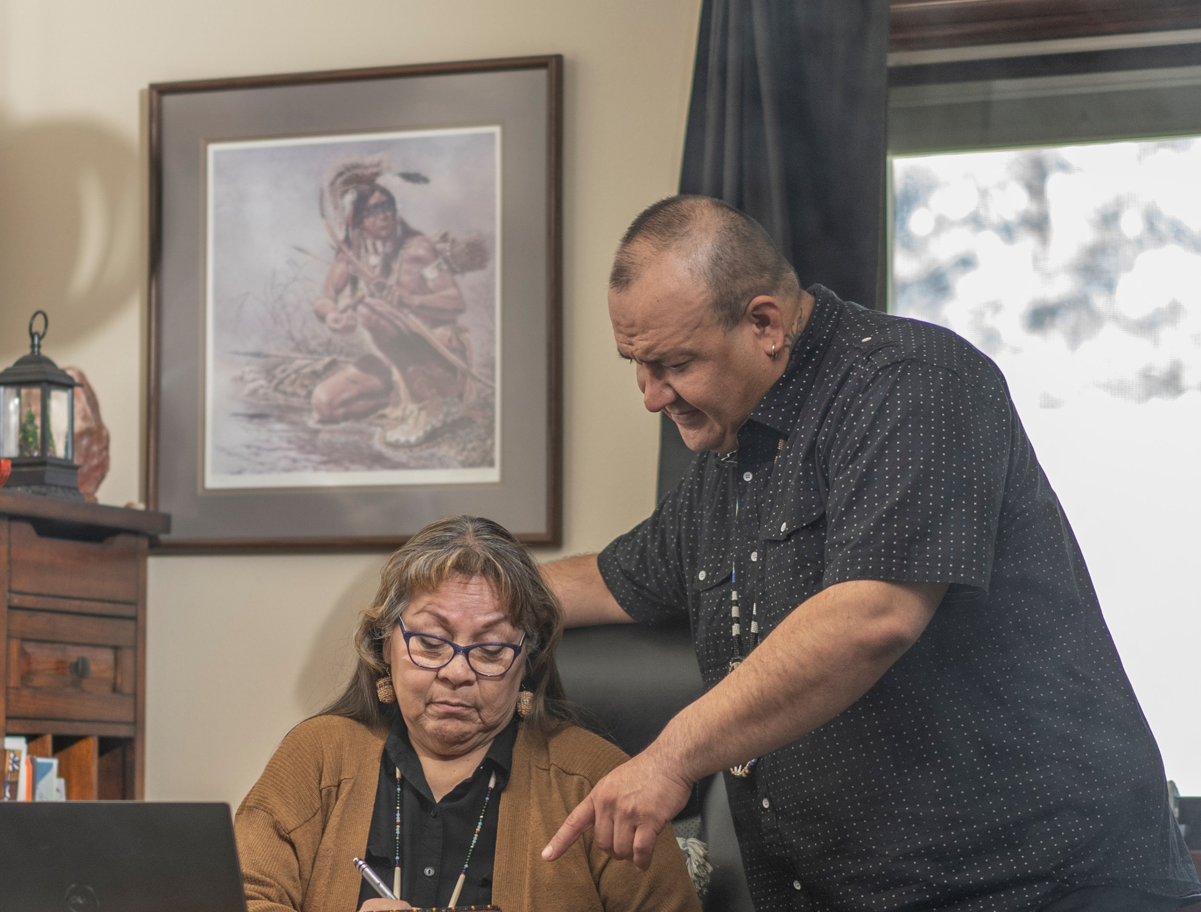
What is PRISM?
PRISM (Predictive Risk Intelligence System) is a DSHS tool that looks at medical, behavioral health, substance use disorders, and long-term care service claims data to predict what future medical costs might be.
A risk score is assigned to the participant based on this data. The risk score is one way to measure the participant’s risk of higher-than-average medical costs, using historical cost data.
PRISM provides:
a secure profile of a participant’s past use of Medicaid and Medicare health services.
clinical support tools like drug adherence screens and risk factors.
assist care coordinators to identify areas where participants have opportunities to create change and improve their health.
Contact PRISM.admin@dshs.wa.gov for more information.

Slide 19
WA Health Home Program Enrollment for December 2021
FFS Leads | Total # of FFS participants
- | -
Community Health Plan of WA | 309
Coordinated Care of WA | 4
Molina Health Care | 346
United HealthCare | 345
Olympic AAA | 452
NW Regional Council | 2,704
Full Life Care | 2,054
Elevated Health | 1,122
Pierce County Heath Services | 918
Area Agency on Aging & Disabilities of SW WA | 1,244
Community Choice Action Health Partners | 1,683
SE WA Aging & Long Term Care | 1,706
Managed Care Leads | Total # MCO participants | Total # of all participants
Amerigroup | 5,984
Community Health Plan of WA | 9,671 | 9,980
Coordinated Care of WA | 7,375 | 7,379
Molina Health Care | 27,222 | 27,568
United HealthCare | 4,444 | 4,789
-
-
-
-
-
-
-
-
Enrollment varies from month to month.
Data will be updated semi annually.

Slide 20

Health Home and Tribal Communities
AI/AN participants must give their consent to be enrolled
When contracting as a Care Coordination Organization or a Lead Agency, Tribes can specify what eligible participants they will serve
AI/AN participants only
Dual Eligible coverage only
All eligible participants
Fee for Service participants (FFS)
Managed Care Organization participants (MCO)
Both FFS and MCO participants

Slide 21

How do AI/AN Participants Enroll With a Health Home Care Coordination Organization (CCO)?
AI/AN participants are not automatically enrolled in the Health Home Program. As an AI/AN, you have to choose to opt in. Opting in can occur at any time after opting out, as long they still meet the eligibility criteria.
Tribal Health Home CCO submits a list of likely eligible participants to the Lead agency.
Potential CC participants may be identified from HCA Medicaid Roles or Tribal Health Services roles.
The Lead agency confirms participants’ eligibility for Health Homes with the HCA and returns updated list to the Tribal CCO.
Tribal Care Coordinator describes the program to the participant and/or his/her caregiver. If they chose to opt in to the HH program, the CC obtains participants consent to enroll.
Participants who are currently enrolled in non-tribal Health Home program may have the option to switch to a Tribal CCO if they are contracted with the participants MCO.

Slide 22
Comparison PCCM and Tribal Health Home Care Coordination Organization (CCO)
PCCM Provider | Tribal Health Home CCO
No requirement to deliver services | Provider must deliver services including, completing a Heath Action Plan (HAP) before payment. Services may be provided on multiple days but may only bill 1x per month.
Receives $6 PMPM for each participant on roster | Can bill the IHS encounter rate for all Tiers of service when completed face to face. Indian Health Service rates (2023 = $654.00) for face to face . The Non-Tribal and/or not face to face HH tier rates (Tier 1 = $796.40; Tier 2 = $274.14; Tier 3 = $183.86) HH Care coordination rates (wa.gov)
No billing requirement | Tribal CCO’s submit an invoice to their Health Home Lead for payment. Payment is generally received within one month of submitting an invoice.

Slide 23
How are Care Coordination Organizations Paid For Encounters?
Care Coordination Organizations submit an encounter to the Lead agency monthly.
Upon receipt, the Lead agency completes required administrative tasks and send a check for the monthly encounters to the CCO.
Often, this process is set up during contract negotiations between the Tribe and the Lead agency.
There may be some software needed to facilitate the sharing of information and securing payments. This will be provided by the Lead agency.

Slide 24
Lead Agency Billing Requirements
A Lead Agency
Systems must be able to receive and read 820, 834, and 835 files.
Create 837P HIPAA encounter data file to submit billing to Provider1.
Receive the 835 file confirming encounter received and/or rejected and the rejection reason.
Receive 834 eligibility file.
Receive payment explanation on 820 file
Required to submit new Health Action Plans (HAPs) electronically each month.

Slide 25

Next Steps
If interested in contracting as a Lead Organization or Care Coordination Organization to provide Health Home services, contact:
If interested in contracting as a Tribal Lead or Care Coordination Agency contact:
Tamara Gaston– DSHS ALTSA Tribal Affairs Administrator
360-725-3489
Tamara.Gaston1@@dshs.wa.gov
Elizabeth Greil– DSHS ALTSA Tribal Initiative Program Manager
360-725-3489
elizabeth.greil2@dshs.wa.gov
Christine Del Buono- HCA Home Health Contract Manager
360-725-0832
christine.delbuono@hca.wa.gov

Slide 26
Health Home Program Information
Send questions regarding Tribal Health Homes to:
elizabeth.greil2@dshs.wa.gov
Tamara.Gaston1@dshs.wa.gov
Visit the website:
Health Home | Washington State Health Care Authority https://www.hca.wa.gov/billers-providers-partners/programs -and-services/health-homes
Stakeholders | DSHS (wa.gov) (Current list of all Aging and Long-Term Support Administration projects and programs) https:/www.dshs.wa.gov/altsa/stakeholders

