Slide 1
Thinking about Ventilation for Long Term Care July 30, 2020
Mary Catlin BSN, MPH, CIC, DOH, Office of Communicable Disease Epidemiology
Source: Andrew Lichtenstein
Notes:
This is a photo of migrant housing taken 12 years ago. Note the closed windows, close placement of beds, ACH is likely to be windows and infiltration from leaks. Air flow unclear unless windows are on the opposite wall as well. Fan moves air, but doesn’t bring in clean air or exhaust contaminated air.
We see rapid transmission
In congregate settings without universal testing
-Prisons with crowded, low ventilation (1-3 ACH)
-Student and dormitories (military screening recruits and isolating 2% pos, 60% symp).
-Cruise ships (3 ACH with recirculated air)
-Nursing homes (WA 4 ACH with 2 in corridors, recirculated air)
-Migrant farm workers (15 persons per housing unit, no ACH standards.
Army and navy are screening and isolating all new recruits upon arrival to base and quarantining. Finding 2% positive and 60% symptomatic rate.
35 sq. feet if celling 10 feet
10 CFM/350 =

Slide 2
Outside of hospitals we have had large COVID outbreaks
In prisons
Nursing homes
Farm workers residential communities
Dormitories and barracks
Cruise ships
One thing these may have in common is low rates of air exchange, air that recirculates and is shared by large numbers of people.
Notes:
Out door events with good ventilation have much lower attack rates.

Slide 3
We know rates of respiratory infections are lower when:
-Military recruits in barracks “are less crowded” (72 sq. ft./trainee).
-Dorms increase Air Changes per Hour (ACH)
-Taiwanese dorms increase ACH

Slide 4
Military respiratory infections
Five studies saw lower rates of respiratory infections when military recruits in barracks “are less crowded” (72 sq. ft./trainee).
Sanchez, JL et al. Respiratory Infections in the U.S. Military: Recent Experience and Control. Clinical Microbiology Reviews Jun 2015, 28 (3) 743-800; DOI: 10.1128/CMR.00039-14
Also military saw no change with head to toe sleeping arrangements, increasing distance between cots, or hanging cloth between cots.
No change in ARI rate when 60 person barracks changed air flow, but didn’t increase ACH with outside air. Lower ARI rates in 8 person barracks.
White DW, Feigley CE, McKeown RE, Hout JJ, Hebert JR. Association between barracks type and acute respiratory infection in a gender integrated Army basic combat training population. Mil Med. 2011;176(8):909-914. doi:10.7205/milmed-d-10-00418
Notes:
So we need studies in which occupancy stayed the same and ACH increased.
Changing pattern of air flow (but same ACH) in 60 unit dorm had no effect. Persons in 8 unit dorms had less respiratory disease.

Slide 5
Maryland dorm rooms with more air changes per hour had 75% fewer lab confirmed infections:
Low vent (2.3 L/s outside air) = 2.83 infections per person per year
High vent 6.6 L/s outside air = 0.7 infections per person per year
Opening
Windows ventilation 2.3- 7.5 L/s
Doors: 3.6 L/s
Windows and doors: 8.8 L/s
Zhu S et al. Ventilation and laboratory confirmed acute respiratory infection rates in college resident halls in College Park, Maryland. Environment International. Vol 37.April 2020.https://www.sciencedirect.com/science/article/pii/S0160412019341108
Notes:
About 120 total participants.
Zhu S et al. Ventilation and laboratory confirmed acute respiratory infection rates in college resident halls in College Park, Maryland. Environment International. Vol 37.April 2020.https://www.sciencedirect.com/science/article/pii/S0160412019341108
The dormitory building that is referred to as a low ventilation building (LVB) is an 8-story building with 288 dormitory rooms, among which are 58 single, 210 double, 14 triple rooms, and 6 quadruple rooms. The dormitory rooms are located on the 2nd through 8th floor and assigned to two separated heat zones, i.e. north and south wings. Each dormitory room in the building has an FCU for air-conditioning, but no outside air supply. This building only has exhaust air returns in the bathrooms on every residential floor as well as study lounges on the first floor and the basement, which are driven by four exhaust fans. Therefore, ventilation of the dormitory rooms is based on air infiltration through leakage pathways at windows and exterior walls.

Slide 6
Room across from infectious patient developed infection: air flow
Source: "Ventilation and laboratory confirmed acute respiratory infection (ARI) rates in college residence halls in College Park, Maryland": https://www.sciencedirect.com/science/article/pii/S0160412019341108
Notes:
"Ventilation and laboratory confirmed acute respiratory infection (ARI) rates in college residence halls in College Park, Maryland": https://www.sciencedirect.com/science/article/pii/S0160412019341108

Slide 7
Chinese University, 2712 students in 13 buildings
Self reported URI ≥ 6 times greater in students with lower ventilation rates (1 L/s/person) compared to higher (5 L/s person)
Tiny rooms averaged 5 meters per person or < 180 f3: (8 X 8 X 3 ft.).
Is crowding different from poor ventilation?
Sun Y, Wang Z, Zhang Y, Sundell J. In China, students in crowded dormitories with a low ventilation rate have more common colds: evidence for airborne transmission. PLoS One. 2011;6(11):e27140. doi:10.1371/journal.pone.0027140
Notes:
But one of the issues is always crowding versus air flow: in these door rooms 6 BA to one room, 4 master students or 3 PhD students share room of 50-70 m3. They had 5 m3 per person average.
If the ceiling is 8 feet high that is 22 sq feet or 7 X 3. US ilitary found recruits needed 72 sq. feet and not less than 40 to stay well.
3712 students in 1569 rooms in 13 buildings, reported retrospectively. Air, RH, CO2 measured. Air flow calculated based on CO2.
6-8 students share a 215 sq. foot room or 4 master students, or 3 PhD.
Sun Y, Wang Z, Zhang Y, Sundell J. In China, students in crowded dormitories with a low ventilation rate have more common colds: evidence for airborne transmission. PLoS One. 2011;6(11):e27140. doi:10.1371/journal.pone.0027140

Slide 8
Shared Air Space, Korean Call Center: 43.5% attack rate
Park S, Kim Y, Yi S, Lee S, Na B, Kim C, et al. Coronavirus Disease Outbreak in Call Center, South Korea. Emerg Infect Dis. 2020;26(8):1666-1670. https://dx.doi.org/10.3201/eid2608.201274
Notes:
“Abstract
We describe the epidemiology of a coronavirus disease (COVID-19) outbreak in a call center in South Korea. We obtained information on demographic characteristics by using standardized epidemiologic investigation forms. We performed descriptive analyses and reported the results as frequencies and proportions for categoric variables. Of 1,143 persons who were tested for COVID-19, a total of 97 (8.5%, 95% CI 7.0%–10.3%) had confirmed cases. Of these, 94 were working in an 11th-floor call center with 216 employees, translating to an attack rate of 43.5% (95% CI 36.9%–50.4%). The household secondary attack rate among symptomatic case-patients was 16.2% (95% CI 11.6%– 22.0%). Of the 97 persons with confirmed COVID-19, only 4 (1.9%) remained asymptomatic within 14 days of quarantine, and none of their household contacts acquired secondary infections. Extensive contact tracing, testing all contacts, and early quarantine blocked further transmission and might be effective for containing rapid outbreaks in crowded work settings.”

Slide 9
Princess Cruise Ship
Preprint: (needs peer review) from Kings College:
Persons who roomed with an symptomatic case did not have higher attack rates than other persons who had recirculated air.
Concluded risk of disease from shared air space, low ACH and recirculating air.
Reference: https://www.medrxiv.org/content/10.1101/2020.07.08.20148775v1

Slide 10
Ventilation and crowding are flip sides of the same coin
Crowding measured by number of persons per sq foot, and repeated CO2 concentrations (< 1000 ppm).
Ventilation is volume of outside air per time. Measure Air Changes/ Hour, filtration, direction, rate exhausted to outside.
Notes:
In very small quarters, crowding can be droplet and airborne exposure.

Slide 11
We know that respiratory infections can occur without touching > 6 feet
Bus
Restaurant
Wards
Apartments
SARS Amoy Garden toilet U traps dry – every time a toilet flushed droplets went into sewage vent pipe and up 8 floors. 1 case spread to 321 cases. https://www.info.gov.hk/info/sars/pdf/amoy_e.pdf

Slide 12
Transmission on bus to others

Slide 13
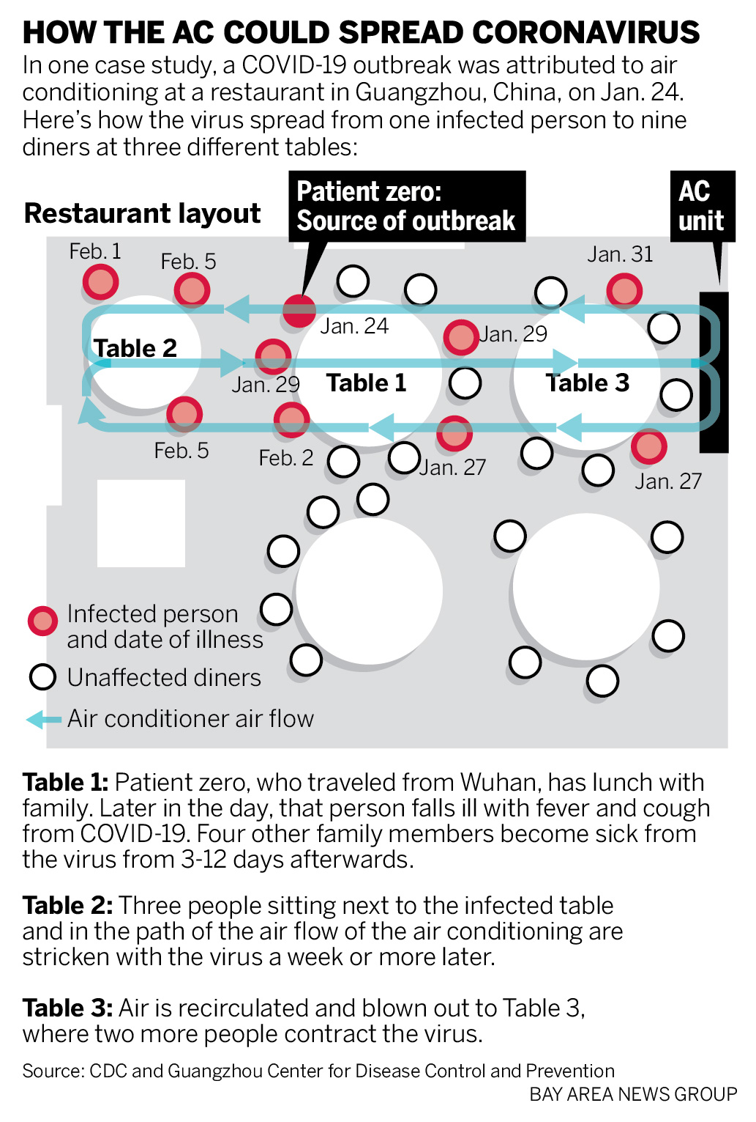
Guangzhou, China. AC flow implicated in airborne spread.
Source, CDC and Guangzhou CDC. Bay Area News Group
Notes:
Lu J, Gu J, Li K, et al. COVID-19 Outbreak Associated with Air Conditioning in Restaurant, Guangzhou, China, 2020. Emerg Infect Dis. 2020;26(7):1628-1631. doi:10.3201/eid2607.200764.
Led to 3 family cluster.
Commentary by Lidia Morawska from Queensland University “For example, a recent study analyzed the data and video records in a restaurant where three separate groups of diners contracted COVID-19, observed no evidence of direct or indirect contact between the three groups, but modeled how the transmission occurred through the air.”

Slide 14
Letter from 239 scientists documenting airborne transmission
Provide sufficient and effective ventilation
Avoid overcrowding
Minimize recirculated air at least in hospitals, schools and workplaces
Use germicidal UV lights in air filtration systems
Lidia Morawska, Donald K Milton, It is Time to Address Airborne Transmission of COVID-19, Clinical Infectious Diseases, , ciaa939, https://doi.org/10.1093/cid/ciaa939

Slide 15
Lawrence Berkeley National Laboratory for Indoor Air Quality (EPA) 2007
“There is strong and sufficient evidence” to demonstrate that lower ventilation rates and indoor airflow from infected to uninfected people are associated with increased transmission of infectious diseases.”
Review supports AIIR in hospitals but “data insufficient to specify minimum ventilation rates” for other types of buildings.
Li, Y., et al., Role of ventilation in airborne transmission of infectious agents in the built environment - a multidisciplinary systematic review. Indoor Air, 2007. 17(1): p. 2-18.
Notes:
Li, Y., et al., Role of ventilation in airborne transmission of infectious agents in the built environment - a multidisciplinary systematic review. Indoor Air, 2007. 17(1): p. 2-18.

Slide 16
Industry standards set for energy efficiency not respiratory health
HVAC industry focuses on reducing energy costs, “comfort”, control of moisture and mold.
ASHRAE ventilation rates are too low to prevent respiratory infections.
Older buildings are exempted.
Image source: https://www.greenbuildingadvisor.com/article/plugging-air-leaks-would-save-billions
Notes:
Compared to clean water and clean air standards, indoor air standards are 70 years behind.

Slide 17
So the question is
Droplet transmission of COVID is primary, but airborne transmission exists,
Can we reduce a portion of respiratory transmission in congregate settings by improving ventilation?
Are there a few easy fixes or things to avoid?
Notes:
By improving ventilation I mean by increasing air exchanges, changing flow, and exhausting or filtering air?
While identifying and isolating infectious persons is paramount
And close, prolonged contact to source within 3-6 meters without has high risk of transmission regardless of ACH,

Slide 18
Beginners Guide To HVAC watching
Source: Creative Commons, WikiHow
Notes:
So to talk with them we need to know what we are looking at
Not all of us are born knowing the immature northern exhaust grill. So let’s start with here

Slide 19
What to look for
Where does outside air come in?
Where does air go out?
What is the crude direction of air flow?
Is air recirculating from one area to another?
Do windows open?
Have they made any changes to the system?
Fans or filters or new exhaust path?

Slide 20
If COVID-19 enters congregate settings with low ACH…
Source: Andrew Lichtenstein
Notes:
This is a photo of migrant housing taken 12 years ago. Note the closed windows, close placement of beds, ACH is likely to be windows and infiltration from leaks. Air flow unclear unless windows are on the opposite wall as well. Fan moves air, but doesn’t bring in clean air or exhaust contaminated air. You would measure the openable size of the window, measure air flow with anemometer, multiple then divide by the volume of the space.
We see rapid transmission
In congregate settings without universal testing
-Prisons with crowded, low ventilation (1-3 ACH)
-Student and dormitories (military screening recruits and isolating 2% pos).
-Cruise ships (3 ACH with recirculated air)
-Nursing homes (WA 4 ACH with 2 in corridors, recirculated air)
-Migrant farm workers (15 persons per housing unit, no ACH standards.
Army and navy are screening and isolating all new recruits upon arrival to base and quarantining. Finding 2% positive and 60% symptomatic rate.
35 sq feet if celling 10 feet
10 CFM/350 =

Slide 21
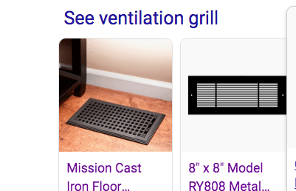
Grills
Notes:
Grills cover the openings (vents). Grills can be for incoming or existing air. Note placement in floor or walls. Floor is generally for incoming air. But there are exhaust used to go between floors.

Slide 22
Registers are grills with adjustable dampers
Source: home depot
Notes:
Example for use in ceiling. Note switch to adjust. The simplest way to increase air flow is to open the dampers.
Be aware if you are recirculating air or bringing in new air.

Slide 23
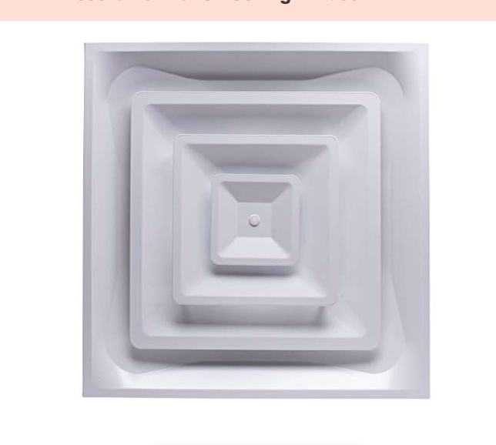
Air Diffuser (Air in)
Diffusers change the incoming direction of air flow.
They can reduce the noise of the system, and give more even air supply around the room.
Often in the ceiling.
Source: Accord
Notes:
If people complain about “drafts” consider diffusers rather than blocking off vent.

Slide 24
Not Mutually Exclusive
Notes:
You can see this is a grillE, which is an ooo laaa laaa grill to covers the vent
It is a damper because it has a level to use to decrease the air flow
It is a register because you can change the direction of air flow.

Slide 25
Filters
Source:https://www.wikihow.com/Change-a-Home-Air-Filter
Notes:
Mage sure HVAC filters are changed on a regular basis: pressure drop or schedule and always if visibly dirty.

Slide 26
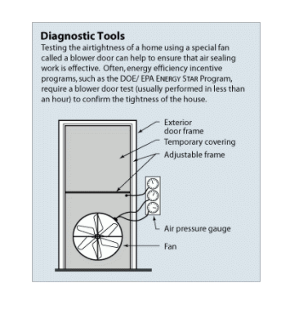
Focus on energy efficiency lowered ACH leakage in new homes and businesses (can’t exceed 7 ACH)
Older wood frame homes had 5-12 ACH from leaks
Insulated concrete homes with concrete roof may be as low as .15 ACH
Commercial building standard is .35 ACH/hr
Tight buildings need mechanical ventilation (HVAC)
Wood houses don’t always have central HVAC
door blower https-//www.energy.gov/energysaver/blower-door-tests
Notes:
Source: Healthy Air for Tight Homes. ICF Magazine May 5, 2014.
If building has 30% of surface windows that open, has enough leakage to have OK ventilation.

Slide 27
HVAC systems: Gas furnace move air through ducts
Source: Service Champtions

Slide 28
Boiler and radiators: Don’t supply or exhaust air. Move heated H20.
Source: Hudsonread.com
Notes:
Hot air rise, but not be diluted or vent outside.

Slide 29
Mini-split for heat and air: Don’t provide or exhaust Air
Notes:
The fan is a heat exchanger that blows over refrgerant or convention coils and removes heat. Can control temperature by room. They do not have ducts.

Slide 30
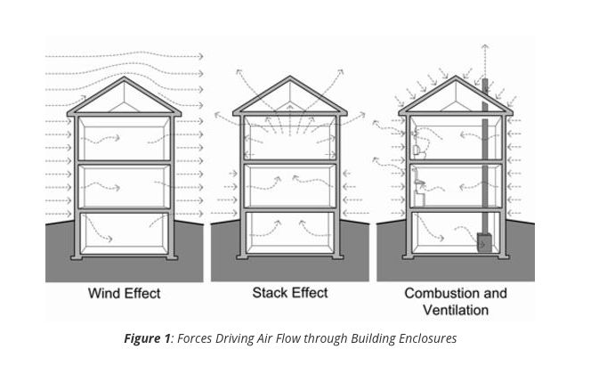
Air flow in a wood building
Source: John Strab
Notes:
Credit: Straub. Air Flow Control in Buildings, October 15, 2007. Building Science Corporation.
For adult family homes, if a wood home, lack of HVAC doesn’t mean lack of air flow.
Stack effect is biggest in climates with 40 degree difference in temperatures, and is a major driver of air flow

Slide 31
Where to look for in coming air vent
In homes, source registers (air in) are often near the floor, so hot air will rise.
At least 6 inches from corner
If in the wall, heating is generally across from window.
Heating and cooling can have separate registers or use the same one.

Slide 32
Location of external residential intakes
Not on roof
10 feet away, and not directly above from exhaust fan, plumbing drain, appliance vent
Away from idling cars, rodent, pests and rain
Don’t put generators or barbeque grills near intakes.
Notes:
Exhaust fans: kitchen, dryer, bathroom, shop.

Slide 33
Cluster of deaths from carbon monoxide poisoning
After a windstorm in King County in 2006,
250 cases of poisoning when HVAC on generators brought in CO from outside, or exhaust failed to purge houses of CO from charcoal stoves.
https://www.ncbi.nlm.nih.gov/pmc/articles/PMC2724456/

Slide 34
Don’t cover exhaust vents, without making a new way for air to leave
If you have air that recirculates from room to room, place COVID patients in rooms that vent to the outside
Or use hepa filter and fan to vent to outside.
Don’t exhaust into enclosed courtyards
Avoid facing into prevailing winds.

Slide 35
Be aware of ventilation flow: in, out, flow
Actual room air flow is highly turbulent, non-linear, modeled by computational fluid dynamics
Reality is pockets of dead air, and lack of air mixing. Heat sources, furniture, windows changes flow.

Slide 36
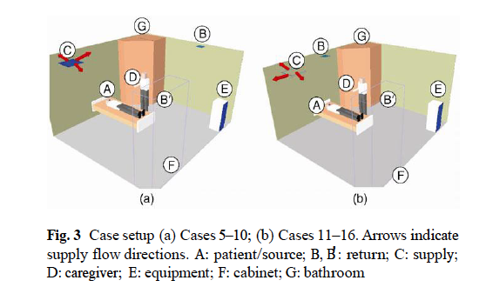
Ideal for COVID: Air moves clean to dirty
Source: Memarzadeh 2012
Notes:
Path of air move air from clean to dirty, and exhaust near patient. IN this example of tiny

Slide 37
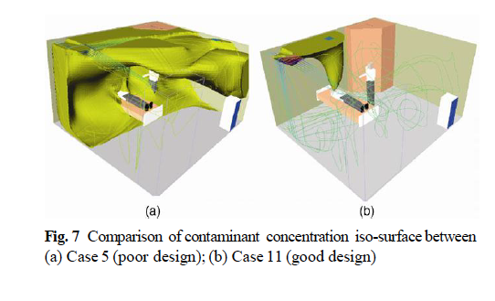
Position of supply and exhaust changes air flow
Source: Memarzadeh 2012
Notes:
Memarzadeh, F and Weiran X. Role of air changes per hour (ACH) in possible transmission of airborne infections BUILD SIMUL (2012) 5: 15 – 28
DOI 10.1007/s12273-011-0053-4. National institutes of Health Researchers who modeled air flow with computational Fluid dynamics air exchanges and air flow, caution that the air flow matters as much, and effort should not be put into increaseing air ventialtion exclusively without considering the directional air flow. Remember the Hierarchies of Cotnrol and First try to remove the hazard, rather than just dilute it.

Slide 38
What about HEPA fans?
As an neg. air flow room?
Select room with door
Set up window adapter
Set up HEPA machine
Seal return air grill
Turn on HEPA filter and adjust flow
Notes:
Fans that are not linked to incoming or exhausting air are usually a problem.

Slide 39
What about fans? Fan + New Air = Yes
Window, box, tower fans in front of window.
Fans can to blow air out and/or blow air in.
If single fan, use in same direction air normally flowing.
Don’t blow from infected person to others
Don’t block window needed for fire escape

Slide 40
What about “air purifiers”?
EPA technical guide https://www.epa.gov/sites/production/files/2018-07/documents/residential_air_cleaners_-_a_technical_summary_3rd_edition.pdf
Filters: yes, but start with routine replacement of furnace filters.
Size HEPA filter units to room. Close door.
UVGI: yes, upper vents and upper ceiling in crowded rooms with flow ACH. More info: http://www.stoptb.org/wg/ett/assets/documents/MaintenanceManual.pdf
Generally, say “no” to the exotic untested
Ozone generators: none are approved by feds for use in occupied spaces
Plasma air cleaners: use high voltage and high current. May form harmful byproducts.
Photocatalytic oxidation (PCO) Cleaners. “ “
Electrostatic precipitator: some have high ozone and nitrogen oxide generation, high electric power.
Ionizers and ion generators: generate ozone and low effectiveness
Notes:
Air purifiers can include HEPA filtration units.

Slide 41
In, Out, Flow: What can make things worse?
Dampers, windows closed to avoid “drafts”
Patients placed within air flow path of COVID
Exhaust vents covered or blocked
Fans moving air from patient (dirty) to clean, recirculating in multiple rooms.
Locating crowds in areas with least ACH
Notes:
Assess in out flow

Slide 42
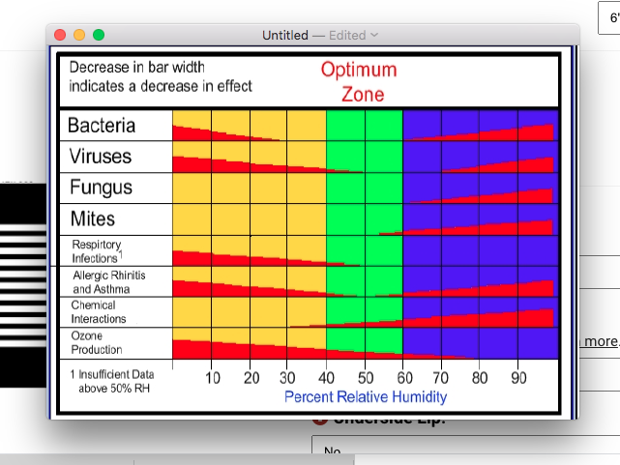
Humidity?
Notes:
There has been talk that increasing humidity is an easy fix. Seattle averages 76%. But increased humidity increases allergies, bacteria and viral transmission, fungus, etc. Since Seattle is often above the optimal 60-80%. It is not an easy fix for us. Air conditioning usually decreases humidity. Opening windows increases humidity.
Evaporative coolers (swamp coolers) in dry climates blow water across water and if attached to open window increase air and humidity. EPA has an evaporative cooler website. https://dicon.medicine.duke.edu/sites/dicon.medicine.duke.edu/files/respiratory_therapy_guidance_during_covid_19_response_05072020_final.pdf

Slide 43
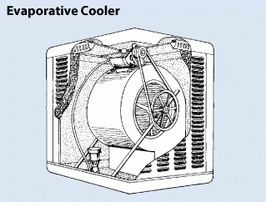
Evaporative coolers
https://www.energy.gov/energysaver/home-cooling-systems/evaporative-coolers
Notes:
Air conditioning usually decreases humidity. Evaporate coolers increase humidity. Opening windows increases humidity.
Evaporative coolers (swamp coolers) in dry climates blow water across water and if attached to open window increase air flow and humidity. EPA has an evaporative cooler website. https://dicon.medicine.duke.edu/sites/dicon.medicine.duke.edu/files/respiratory_therapy_guidance_during_covid_19_response_05072020_final.pdf

Slide 44
What CDC recommends for businesses is also appropriate for LTC
https://www.cdc.gov/coronavirus/2019-ncov/community/office-buildings.html
Open windows and doors and use fans.
Disable demand control ventilation that reduce air supply based on temperature or occupancy.
Increase air filtration of recirculated air, if air handling system can manage
Move air clean to dirty, move workers to clean zones.
Use exhaust fans in restrooms and operate at full capacity
Maintain HVAC systems, including filter changes.
Consider use of UV GI irradiation in upper room air.
Identify crowded areas and remove furniture.
https: www.ashrae.org/technical-resource/commercial offers pandemic advice as well
Notes:
ASHRAE Standard 180-2018, Standard Practice for the Inspection and Maintenance of Commercial Building HVAC Systemspdf icon

Slide 45
Take home advice:
On LTC assessments, do look for air supply, flow, exhaust: IN OUT FLOW
Starting points to discuss with their HVAC expert
Be aware HVAC staff are be trained to save energy costs and decrease drafts
When all else is complicated, eliminate crowding and use outside air whenever possible.

Slide 46
Converting L/s to cubic F/hour
ACH formula uses CFH/room volume
Find calculator at https://www.convertunits.com/from/litre/second/to/cubic+foot/hour

