Slide 1


Nursing Care Quality Assurance Commission Overview, Highlights and updates
Washington State Department of Social and Health Services Nurse Delegation Conference

Slide 2
Nursing Care Quality Assurance Commission Overview
Establish
Monitor
Enforce
  Licensing & Continuing Competency Mechanisms
  Consistent Standards of Practice
  Discipline
  Nursing Education Programs

Slide 3
NCQAC Structure
NCQAC
7 RNs, 2 ARNPs, 3 LPNs, 3 Public Members
Programs
Operations, Licensing, Complaints/Investigations/Discipline, Legal, Practice, Education
Subcommittees
Pro Tems
Panels
Consistent Standards of Practice
Advanced Practice Subcommittee
Licensing Subcommittee
Discipline Subcommittee
Legislative
Nurse Program Approval Panel
Nursing Assistant Program Approval

Slide 4
NCQAC Highlights and Updates
Suicide Prevention Training Requirements for Nurses
Washington Center for Nursing
National Council State Boards of Nursing (NCSBN) Nursys E-Notify
Washington Health Professional Services (WHPS) Program
Licensed Practical Nurse Scope of Practice Workgroups
Notes:
Suicide Prevention Training Requirements for Nurses
Required for all RNs, LPNs and ARNPs except for CRNAs
Beginning July 1, 2017, must come from an approved course from the DOH model list
Prior to July 1, 2017, will count as long as it includes 6 hours of suicide prevention assessment, treatment and management and if it was taken on or after June 12, 2014
Attestation at your 3 year cycle
WCN – NCSBN grants funds to WCN who’s mission is to
supports a healthy Washington by engaging nurses’ expertise, influence, and perspective and by building a diverse, highly qualified nurse workforce to meet future demands.
NCSBN Nursys has 3 services – Enotify, Nurse Licensure QuickConfirm and Nurse Licensure Verification. I want to stress E-Notify for employers to use as a primary source for nurse licensure verification. The system is free for employers and tracks and automatically notifies the employer of license changes and discipline. It also can be used by an individual nurse to use as a reminder that his or her license is due for renewal.
WHPS – If you know a nurse or you think you might have a substance use disorder, WHPS is available to all licensed nurses in our state. Sometimes this is used for nurses we get complaints on, but it is also open for self-referral. WHPS provides free training on substance use disorders and the WHPS Program.
LPN Workgroups – working on Advisory Opinion and FAQs

Slide 5
NCQAC Highlights and Updates
Nursing Rules (WAC) Updates
  Nursing Assistants
  Nursing Education
  Nursing Substance Use Disorder Monitoring
  Nursing Licensing Fees
  Nursing Temporary Practice Permits
  Nursing Collection of Demographic Data
  Opioid Prescribing - HB 1427 Opioid Prescribing, Monitoring and Treatment
  Epinephrine
  Opioid Antagonists
Notes:
Nursing Rules Updates
Nursing Assistant – Coded Reviser (CR101) rescinded at last commission meeting – this is because it sounds like WSNA is planning to try and get legislation to promote a bill updating the entire nursing assistant laws. The Commission felt it would be confusing to make the minor changes we were proposing and then have to rewrite rules if legislation was passed.
Nursing Education – many changes in the nursing education rules – if you have questions, please contact Mindy Schaffner at 360 236-4745
Substance Use Disorder Monitoring – to align with the NCSBN guidelines for the WHPS program
Nursing Licensing Fees - $20 increase
Temporary Practice Permits – plan to change from 6 months to 1 month while waiting for fingerprints – it used to be 6 months but now the licensing program is routinely receiving these within 1 month
Collection of Demographic Data for nurses – new rules approved at the 9-8-17 commission – RNs and LPNs are required to complete demographic data and attest to it’s completion upon initial licensure and with the 3 year continuing competency cycle – this will be verified by the commission licensing staff during the continuing competency cycle. ARNPs will do this under their RN licensure. The NCQAC will implement this rule using the Nursys Program in which we have been encouraging nurses to register for a couple of years. The demographic data will be used to look at supply, demand and distribution of the nursing workforce. The work using the demographic information will be done through the Washington Center for Nursing. Only aggregate data will be shared with WCN and others as requested.
Opioid Prescribing – new law HB 1427 requires the nursing commission as well as other health care commissions and boards to develop rules re: opioid prescribing, monitoring and treatment. Three of our commission members have been assigned to work with the other boards/commissions and DOH/HSQA to develop these so they align and do not contradict other health care profession rules as these are developed using national guidelines and recommendations.

Slide 6

NCQAC Strategic Plan 2017-2019
FBI Criminal Background Checks/RAPBACK
NCSBN Optimal Regulatory Boards System (ORBS)
Nurse Licensure Compact
Best Practices based on NCSBN Commitment to Ongoing Regulatory Excellence (CORE) Reports
Nursing Assistant Rules
Action Now! Coalition
National workforce minimum data sets
NCQAC obtain licensing and disciplining authority of nursing assistants, home care aides, and medical assistants
Notes:
FBI Criminal Background Checks/RAP Back
NCSBN ORBS
Nurse Licensure Compact
Best Practices based on CORE Reports
Nursing Assistant Rules
Action Now! Coalition
Actively participate in the Action Now! Coalition to find solutions to the following pressing issues facing the education of nurses:
Academic Progression
Clinical Practice Experiences
Faculty Recruitment & Retention
Adequate Funding
National workforce minimum data sets
NCQAC obtain licensing and disciplining authority of nursing assistants, home care aides, and medical assistants

Slide 7
NCQAC Highlights and Updates
Jurisprudence Module
Opioid Crisis:
  Substance Use Disorder Conference 10-13-17
  HB 1427
  WA DOH Unintentional Poisoning Workgroup
  NCQAC Pain Management Resources for Nursing
National Cannabis Summit – Denver CO
Health Education Resource for Washington State (HEALWA)
Notes:
A jurisprudence training and exam is an educational activity including a test of the Washington State laws and rules. This will be a voluntary module/exam. A survey of WA nurses shows that less than 60% of nurses stated they understood their nursing scope of practice. The Commission thinks this would be a way provide an opportunity for nurses to ensure they understand the laws and rules re: nursing in WA state.
We are in early stages but it is anticipated that this will be hosted on the NCSBN website. They provide similar modules/training/exams for a few other states.
Opioid Crisis – there will be a lot of work and different activities re: the Opioid Crisis – We are holding a Substance Use Disorder Conference at SEATAC today - the NCQAC also had a workshop in Spokane in September on Opioids in the morning and in the afternoon what the commission member roles are re: nurses with SUD. We are participating in the WA DOH Unintentional Poisoning Workgroup that focuses on opioid overdoses. I am sure there will be lots more to come as far as practice guidelines, recommendations, nursing roles, nursing education in assessment, treatment and prevention of overdoses. We do have some resources on our website and will update these as we find additional information that may be helpful.
National Cannabis Summit Denver CO in August - Overview
HEALWA – nurses pay part of their licensing fee to get access to the HEALWA system. It provides access to a nursing reference center, evidence based research, CINAHL, PubMed Medline, as well as continuing education/training

Slide 8
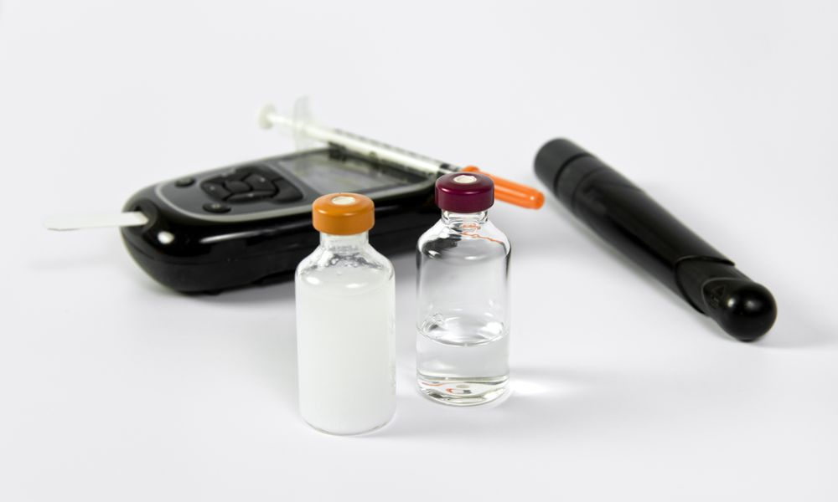
Highlights and Updates:
Nurse Delegation in Community-Based Settings and Home Care
Diabetes
Capillary blood glucose Clinical Laboratory Improvement Amendment (CLIA)-waived point-of-care screening
Administration of injectable (SQ) insulin and non-insulin medications for Diabetes treatment
Notes:
In July, the NCQAC clarified that a registered nurse may use nursing judgment to determine the appropriateness of delegating to nursing assistants and home care aides in community-based or in-home care settings the following task: Piercing of skin to obtain a blood sample for the purpose of measuring blood glucose monitoring for the purpose of administering medications (including injections) for diabetes or for monitoring response to treatment of a patient with diabetes. RCW 18.79.260(3)(e)(iv).
The commission also determined that, for purposes of interpreting its own practice act, chapter 18.79 RCW, the word “insulin” shall also include non-insulin injectables, such as exenatide (Byetta®, liraglutide (Victoza®), when injectable diabetes medications are FDA-approved and prescribed with similar purpose and effect for treatment of diabetes mellitus.

Slide 9
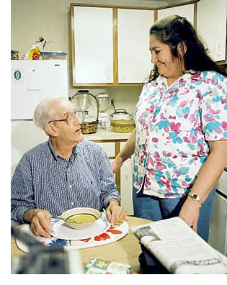
Delegation: Other Issues and Questions
Prothrombin (PT)/International Normalized Ratio (INR) CLIA-waived screening
Supervision requirements for delegation of insulin injections
Notes:
PT/INR is not within the scope of an RN to delegate to Nursing Assistant (NA) or Home Care Aid (HCA)
Supervision Requirements
19) The registered nurse must supervise and evaluate the performance of the nursing assistant or home care aide with delegated insulin injection authority at least weekly for the first four weeks. After the first four weeks the supervision shall occur at least every ninety days.
that there are more ways to supervise than direct observation.
(34) "Supervision" of licensed or unlicensed nursing personnel means the provision of guidance and evaluation for the accomplishment of a nursing task or activity with the initial direction of the task or activity; periodic inspection of the actual act of accomplishing the task or activity; and the authority to require corrective action.
The intent for the 4 visits for insulin delegation was to ensure that the NA/HCA understands how to do the task and educate the provider about diabetes and ensure that the client remain stable and predictable. Nurse delegation is a 1-1 process with each provider they train and that there must be ongoing competency of each provider he/she delegates. The RND can determine the competency of the provider in a variety of ways; i.e. observation or documentation, direct observation, verbal description or record review.
There are many other questions that come up and as we go forward in working with WSNA in trying to revise the nursing assistant laws and rules, we want to make sure we address those So if you have any questions or activity/tasks you would like to try to resolve, please let me know and I will track these for future use.

Slide 10

Questions
Contact Information
Deborah Carlson, MSN, RN, CPM
Associate Director of Nursing Practice
360 236-4725
NursingPracticeConsultation.NCQAC@doh.wa.gov
NCQAC.Education@doh.wa.gov
Nursing@doh.wa.gov

