Slide 1
2025 Q#1 PDN Provider Meeting
Tuesday, February 11, 2025
PDN Program Manager: Kaila O’Dell, BSN, RN

Slide 2
Agenda
10AM to 11:30 AM
PDN Rate Update January 2025
PDN Info to Know
Review of PDN renewal process
PDN Insurance requirements (Troy)
Common PDN FAQ
Learning Opportunities
Q&A

Slide 3
PDN Rates Update
Service Code | Modifier | Contract Type | 15 minutes | Hourly
T1000 | TD | Individual RN | $14.15 | $56.60
T1000 | TE | Individual LPN | $11.62 | $46.48
T1000 | TD | Agency RN | $16.97 | $67.88
T1000 | TE | Agency LPN | $13.95 | $55.80
T1000 | TD, TV | Individual RN, Holiday | $21.22 | $84.88
T1000 | TD, TV | Individual LPN, Holiday | $17.44 | $69.76
T1000 | TE, TV | Agency RN, Holiday | $25.46 | $101.84
T1000 | TE, TV | Agency LPN, Holiday | $20.92 | $83.68
T1020 | TD | PDN AFH |  | Daily $898.95

Slide 4
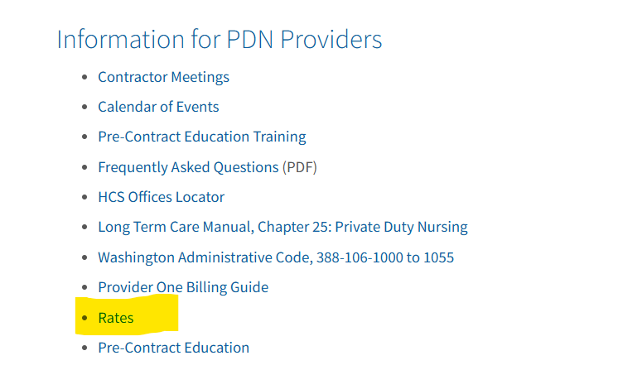
PDN Rates Update
Where can rates be found?
All_HCS_Rates.xlsx
*** There is nothing different you need to do as this information will update the payment rate for you.

Slide 5
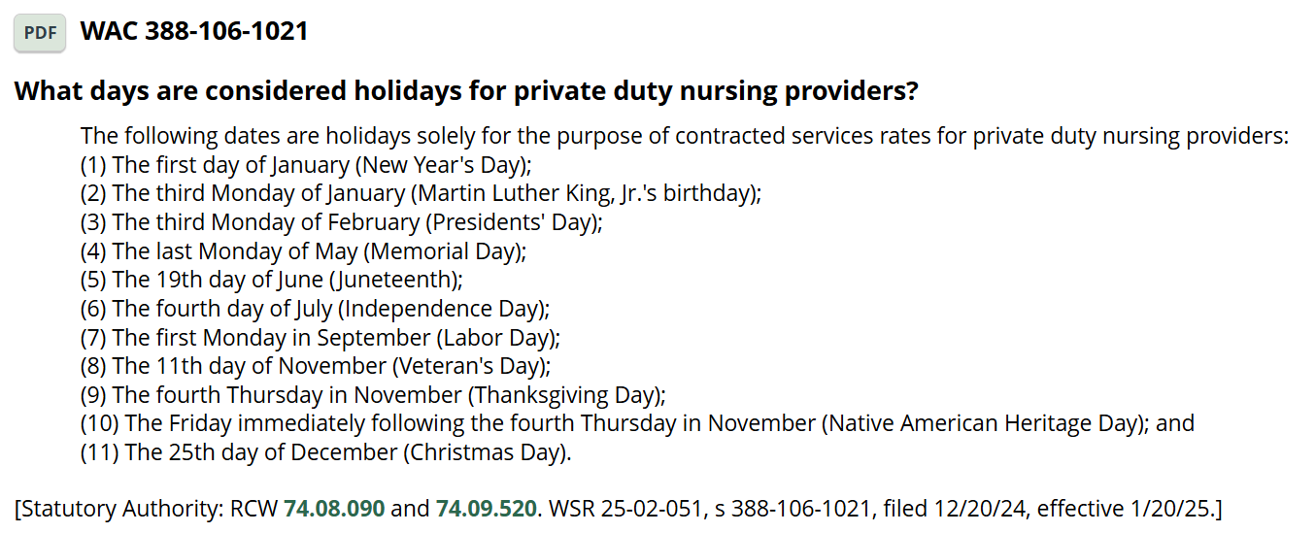
PDN Info to Know:
New PDN WAC 388-106-1021
What days are considered holidays for private duty nursing providers?
Notes:
On the PDN Website: Private Duty Nursing | DSHS

Slide 6
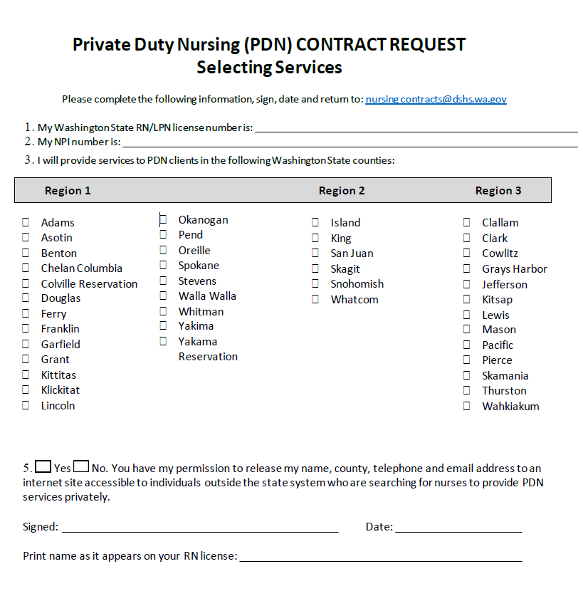
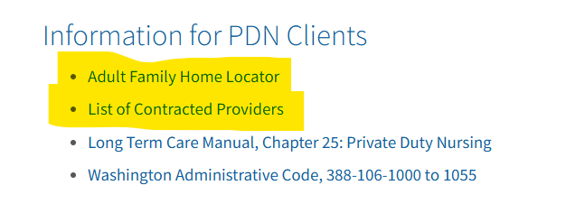
PDN Info to Know:
Notes:
On the PDN Website: Private Duty Nursing | DSHS

Slide 7
PDN Re-Contracting 2025
We will be reaching out to each PDN contractor in March/April 2025.
You will receive an email from PDN program letting you know that it is time to recontract.
(nursingcontracts@dshs.wa.gov)
It is important to understand that you must complete all required items and send back via e-mail to help this process.

Slide 8
PDN Re-Contracting 2025
Contractor Intake
Medicaid Provider Disclosure Statement
Background check within 2 years
W9
RN License
Photo ID
Business License
Insurance

Slide 9
PDN Insurance
Proof of Insurance that meets the minimum requirements of PDN contract.
Minimum limits: Each Occurrence $1,000,000 and General Aggregate $2,000,000.
The State of Washington, Department of Social & Health Services (DSHS), its elected and appointed officials, agents, and employees of the state, shall be named as additional insureds.

Slide 10
Helpful Ways to be Prepared
Ensure you have a system in place for your business to keep your files organized.
Ensure that you are using secure ways of communication.
Ensure you are storing items securely.
Keep frequently visited links accessible. For example, nursing license, business license lookup, PDN website, WACs, etc.

Slide 11
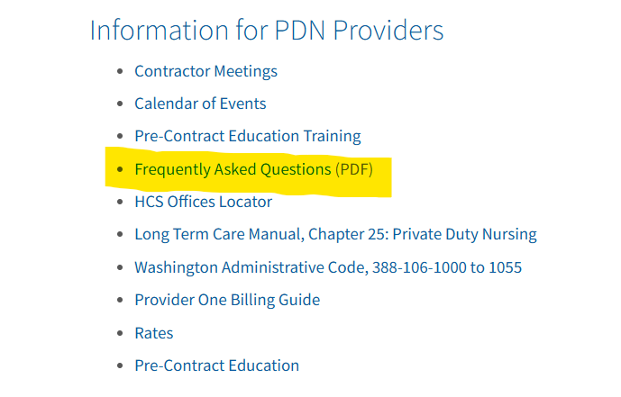
FAQ’s
How to become PDN contractor?
How many hours in a day can I work?
What is my work schedule?
How much do I get paid?
How do I find clients?
Can I work multiple jobs?

Slide 12
Learning Opportunities
Tracheostomy And Ventilator Virtual Training Lab | Tracheostomy Education
BreatheWell Inspiration | The best place for hands-on tracheostomy and ventilator education in a simulation lab environment..
Tracheostomy Safety and Education for Caregivers-Safe Care at Home
Mental Health Resources for Nurses | Washington State Board of Nursing
Suicide Prevention Training for Health Professions | Washington State Department of Health
Washington State Business Training
Small Business Training and Education Center – Washington State Department of Commerce
Washington State Small Business Training & Education Center
Health Equity Continuing Education | Washington State Department of Health

Slide 13
Questions?
Next Meeting: April 15 @ 10AM
Kaila O’Dell, BSN, RN, PDN PM
Kaila.ODell@DSHS.WA.gov
Nursingcontracts@DSHS.WA.gov

