Slide 1
ANNUAL COST REPORT TRAINING
DDA RESIDENTIAL SUPPORT PROGRAMS
Reporting Year 2025
MANAGEMENT SERVICES DIVISION
OFFICE OF RATES MANAGEMENT

Slide 2
PURPOSE OF COST REPORTING
Provides accountability and transparency for the use of public tax dollars;
Provides program cost data to regional managers and residential providers;
Provides information to reconcile payments and/or allocate appropriated funds;
Determines settlement for the ISS staff cost centers;
Provides information to department leadership for budget development and policy decisions.

Slide 3
COST REPORT SCHEDULES
  Schedule A – General Information & Certification
  Schedule B – ISS Payroll Expenses
  Schedule C – Non-ISS Expenses
  Schedule D – Revenue
  Schedule E - Residential Staffing
  Schedule F – Healthcare Expenses
  Schedule G – ISS Settlement
  Schedule H – Rate History (Optional)
  Schedule I – Allocations (Optional)

Slide 4
SCHEDULE A
GENERAL INFORMATION
PART A – PROVIDER IDENTIFYING INFORMATION
This schedule is used to provide basic information about the agency and the report preparer contact information. Complete all sections applicable.
Item 1 – Provider will select from a drop-down list.
Item 1 – Select the correct agency name & region as some agencies are listed in two or more regions.
Item 2 will auto-fill once the correct provider's name is selected for item 1.
Be sure to list the Administrator, Report Preparer, & Federal ID information

Slide 5
SCHEDULE A
PROVIDER CERTIFICATION
PART B – PROVIDER CERTIFICATION
“Service Provider” is a person or entity contracted to provide residential services under Chapter 388-101 and 388-101D WAC.
The service provider as authorized in 71A RCW must certify under penalty of perjury that the cost report or an amendment to it is a true, correct, and complete representation of actual costs related to patient care prepared in accordance with applicable instructions provided by the department in its policy, identified through 388-825 WAC, and chapter 71A RCW.

Slide 6
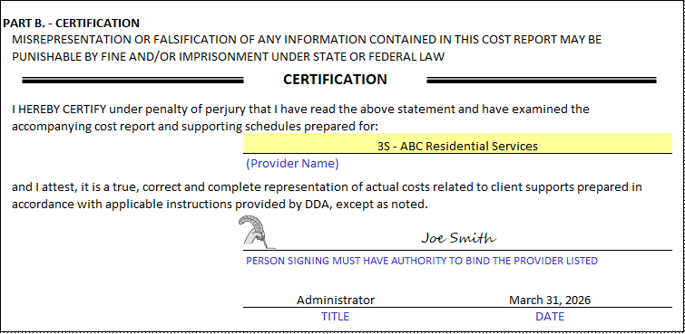
SCHEDULE A
PROVIDER CERTIFICATION
PART B – PROVIDER CERTIFICATION
Enter the signer’s title and the date signed
Scan & email the original signed Schedule A, in PDF format to your rates analyst, along with your completed cost report

Slide 7
SCHEDULE A
PROVIDER CERTIFICATION
PART B – PROVIDER CERTIFICATION
  Single owner providers
    the owner or administrator may sign
  Legal entity providers
    Corporations
    - an officer (i.e. CEO, CFO, or COO) needs to sign
    Partnerships
    - one of the partners needs to sign
    Non-profits
    - the person who signs the federal tax return needs to sign
    Subsidiary of a larger corporation
        - an officer of the larger corporation may sign
  Recertify Schedule A each time a cost report is submitted

Slide 8
SCHEDULE B
ISS Payroll Expenses
Reporting ISS Payroll Expenses Do’s & Don’ts
  Do not report payroll expenses for
    Staff who only perform Administrative work
    Staff who do not perform contracted ISS
    Administrator’s that do not perform ISS
    Administrator’s not eligible to claim ISS payroll expenses
      Supported living and combined agencies with 21 or more ISS FTE’s are not eligible to claim ISS payroll expense

Slide 9
SCHEDULE B
ISS Payroll Expenses
Reporting ISS Payroll Expenses Do’s & Don’ts
  Do report payroll expenses for
    Employees that perform only contracted ISS
    Employees that perform contracted ISS and also perform non-ISS/Administrative or non-contracted work
    Administrator’s that perform ISS and wish to claim wages as ISS
      Applies only to agencies with 20 or fewer ISS FTE’s for supported living and combined programs

Slide 10
SCHEDULE B
ISS Payroll Expenses
Reporting ISS Payroll Expenses
  Accrual basis
    ISS payroll expenses paid in January 2026 for work performed in 2025 are included
    ISS payroll paid in January 2025 for work performed in December 2024 are not included
  Payroll Reporting Period
    Monthly or Quarterly (March, June, September, and December)
    Data is not submitted to department until Cost Reports are due
  Administrative/non-ISS payroll data (no ISS duties) is reported on Schedule C
  Schedule A must be complete & the reporting period selected for formulas to work properly.

Slide 11
SCHEDULE B
ISS Payroll Expenses
Reporting ISS Payroll Expenses, cont.
Four rows/lines for each month/quarter to report payroll by position & duties performed
  A job description outlining employee’s ISS and/or Non-ISS duties must be available upon the department’s request
    Line/Row 1 – ISS & Professional Service Staff
      Staff that perform ISS 51% of their wages or greater
    Line/Row 2 – ISS & Administrative or Non-contracted Staff
      Staff that perform ISS 50% of their wages or less & also perform Administrative and/or Non-contracted duties
    Line/Row 3 – GH/GTH Only – Administrator Payroll (single employee)
    Line/Row 4 – SL or Combined SL/GH/GTH – Administrator Payroll (single employee)
      Agencies with 20 or fewer ISS FTE’s (Full-Time Equivalent) are eligible
      Schedule B calculates FTE’s and determines maximum allowable amount of Administrator’s compensation that can be claimed as ISS
      Maximum allowable ISS Administrator compensation is based on a regression table

Slide 12
SCHEDULE B
ISS Payroll Expenses
Reporting ISS Payroll Expenses, cont.
  Schedule B, Line/Row 2
    Staff perform ISS 50% of their wages or less & also perform Non-ISS Administrative and/or Non-contracted
    Report all payroll data (ISS & non-ISS) as appropriate for automated allocation formulas in columns R, S, and T
    Paid time off, other compensation and employer paid taxes & benefits are allocated based on gross wages reported as ISS, Administrative, and/or Non-contracted business
    Employees that perform non-contracted work are only reported if they also perform contracted ISS

Slide 13
SCHEDULE B
ISS Payroll Expenses
Reporting ISS Payroll Expenses, cont.
Select the reporting period (Monthly/Quarterly) from the drop-down list in column A for automated calculations (formulas) in column C to work properly.
The agency name on Schedule A must also be complete for Schedule B formulas to calculate accurately.
For each reporting period record the following:
  Column D – ISS PAYROLL FOR STAFF (REGULAR PAY)
  Column E – ISS PAYROLL FOR STAFF (OVERTIME PAY)
  Column G – ADMINISTRATIVE/ NON-ISS PAYROLL FOR STAFF (REGULAR PAY)
  Column H – ADMINISTRATIVE/ NON-ISS PAYROLL FOR STAFF (OVERTIME PAY)
  Column J – PAYROLL FOR NON-CONTRACTED BUSINESS (REGULAR & OVERTIME)
  Column L – PAYROLL FOR PAID TIME OFF (HOLIDAYS, VACATION, & SICK LEAVE)
  Column M – PAYROLL OTHER COMPENSATION (BONUS)
  Column O – TOTAL EMPLOYER PAID PAYROLL TAXES (SOCIAL SECURITY & MEDICARE, FUTA, SUTA, L&I, etc.) & B&O TAXES ON ISS PORTION OF REVEUE
  Column P – TOTAL EMPLOYER PAID TAXABLE & NON-TAXABLE FRINGE BENEFITS (AS DESCRIBED BY THE IRS)

Slide 14
SCHEDULE B
ADMINISTRATOR REGRESSION TABLE
Calculates the maximum allowable ISS payroll costs an Administrator can claim towards settlement for performing work in an ISS capacity.
Only agencies with 20 or fewer ISS FTE’s are eligible to claim Administrator payroll costs as ISS expenses. FTE’s are automatically calculated (Sch B, col C).
Agencies with 21 or more ISS FTE’s would report their Administrator payroll costs on Schedule C – Non-ISS Expenses, line 1.
Maximums are reduced 5% for every ISS FTE until the agency reaches 21 ISS FTE’s, at which time the agency will no longer be eligible to claim Administrator payroll costs as ISS for settlement purposes.
Maximums are based on working in an ISS capacity fulltime and are adjusted for Administrators that perform ISS less than fulltime.

Slide 15
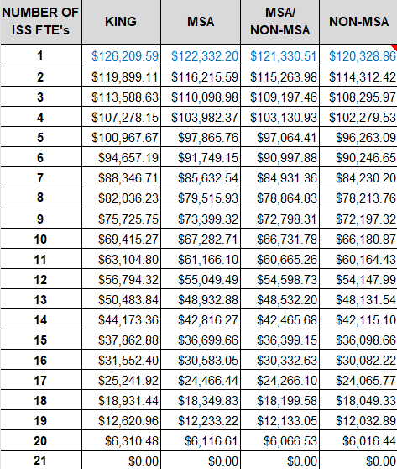

SCHEDULE B
ADMINISTRATOR REGRESSION TABLE
Maximums are 2.5% higher than 2024
Compensation maximums change at the same percentage rate as ISS tiered rates
The number of FTE’s are calculated by dividing Schedule B ISS Staff Gross Payroll for Regular Time by the wages listed above. Schedule B automatically calculates the number of FTE’s and allowable Administrator ISS expenses

Slide 16
SCHEDULE B
ISS Payroll Expenses
ISS Payroll Review
  Retain ISS payroll records and other supporting documentation
    Supporting documentation may be requested upon submitting the cost report
    Payroll records must be by employee and include job titles and descriptions
    Documentation should easily tie to ISS payroll reported
    Payroll records for employees performing ISS & non-ISS must be clearly illustrated
    Payroll tax & fringe benefit expenses reported as ISS may be requested for verification, as well as, purchased professional services
    All ISS expenses reported are subject to the departments review

Slide 17
SCHEDULE B
ISS Payroll Expenses
ISS Payroll Review, cont.
  Providers may submit payroll supporting documentation using staff names or distinct employee numbers.
    If names are not provided and the department finds the information is necessary to complete the payroll review the agency will submit the requested sample of employee names.
  Provider may rename non-benefit employee deduction headers (garnishments, child support, draws)
    Does not apply to employee deductions for benefit contributions (medical, dental, vision, life insurance, 401K, HSA)

Slide 18
SCHEDULE C
PROGRAM INFORMATION SECTION
Schedule C – Business & Program Information
Line 1: Indicate if the agency is a non-profit.
Line 2: Indicate if the agency pays B&O taxes to DOR
Line 3: Indicate if the agency pays city B&O tax, if yes select city
Line 4: Indicate if the agency claims accruals on Schedule B
Line 5: Indicate if the agency contracts or purchases professional services such as nurses, doctors, or sign language interpreters.
Line 6: Allocation of Shared Costs
      Indicate if your agency operates multiple programs
      Indicate if you allocate program costs
      Indicate the method used to allocate costs
Schedule I (optional) can be used for allocating costs

Slide 19
SCHEDULE C
ADMINISTRATIVE & OPERATING COSTS (NON-ISS)
Schedule C is used to report non-ISS/Administrative expenses (Select program type Col A-C)
Non-Client Related Expenses
Administrative/Non-ISS Payroll Expenses
Program Operations Expenses
Capital & Property Expenses
Interest & Tax Expenses
Client Related Expenses
Maintenance/Laundry/Housekeeping/Dietary Expenses (GH & GTH only)
Transportation Expenses
Other Non-ISS Client Related Expenses
Expense descriptions are listed on the schedule & on the cost report instructions
Use Schedule I for allocating costs

Slide 20
SCHEDULE C
Allocating Costs
Schedule I – Allocations
Schedule I – Non-ISS Expenses tab
  Columns A-G select program types to be allocated from the drop-down list
  Line 1 enter the basis to be used for allocating costs (SS Direct Care, Revenues, etc.)
  Allocated & Non-allocated Sections:
    - For sections labeled “Allocated” enter amounts in the “Expense Total” column. The allocated amount for each program will auto-fill based on the percentages on row 2. (Expenses listed here must apply to all programs selected on Line 1, otherwise use the non-allocated sections to report agency specific expenses)
    - For sections labeled “Non-Allocated” enter program specific/non-shared expenses in columns A-G. The “Expense Total” column will auto-fill the sum of each row of data
Schedule I Totals to Schedule C tab
  This tab summarizes all the amounts entered on the Non-ISS expenses tab
  Easily transfer all columns of data for GH, GTH, and/or SL to the related Schedule C, Columns A-C, Lines 1-7

Slide 21
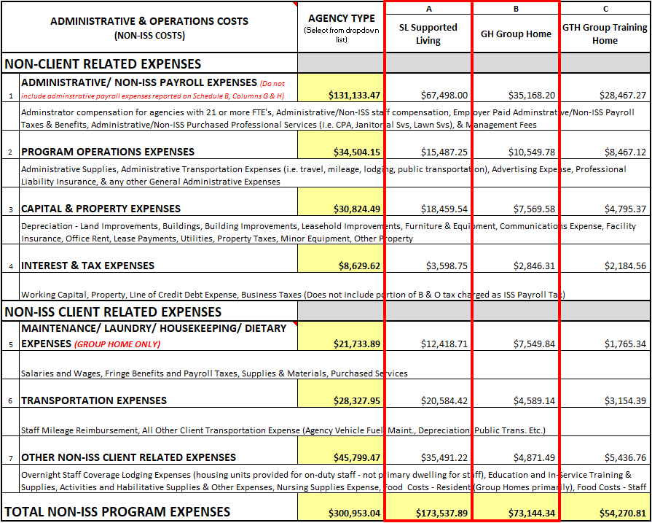
SCHEDULE C
Allocating Costs
Schedule I – Allocations
Transfer Group Home, Group Training Home, and Supported Living program amounts from Schedule I Summary tab columns (below) to the relative columns on Schedule C (left)

Slide 22
SCHEDULE D
PROGRAM REVENUES
REVENUE EARNED DURING THE REPORT PERIOD
(Revenue for residential services must be reported on an accrual basis)
Amounts reported in the Revenue for Services section must be earned during the reporting year regardless of when the payments were received (accrual basis - include revenues earned in 2025 but not reimbursed until 2026 and do not include revenues reimbursed in 2025 for services provided in 2024 and prior)
Line 1 Revenue for Services Provided includes total ISS & Non-ISS reimbursements
Line 2 Other Operating Revenue
Revenues reported in the Other Operating Revenue and Non-Operating Revenue sections may be reported on an accrual or cash basis

Slide 23
SCHEDULE E
Community Residential Staffing Information
The semiannual reporting period for calendar year 2025 is: January - June & July – December
The schedule must be completed and submitted with your cost report due March 31, 2026
  The 2024 and prior year Community Residential Staffing Information Results are located here.

Slide 24
SCHEDULE E
Community Residential Staffing Information
Complete one schedule for each provider service location & for each program type, for example:
  Multiple programs (SL/GH) in different communities/counties
    One Schedule for GH Clark
    One Schedule for SL Clark
    One Schedule for GH Mason
    One Schedule for SL Mason
  Same location with 2 program types (SL/GH)
    One Schedule for GH
    One Schedule for SL
Section 6 - 1A instructions are in comment boxes in the header for each column. They are also available in the Cost Report Instructions.

Slide 25
SCHEDULE E
Community Residential Staffing Information
For each schedule enter the following:
Agency Information
  Program Type, Name, City, County
Contact Information
  Person completing the form
Client Information
  Monthly average number of clients
Employee Benefits
  Select yes or no for each benefit type
Recruiting
  - Select from drop down list for level of difficulty to recruit new staff

Slide 26
SCHEDULE E
Community Residential Staffing Information
For each schedule enter the following: (continued)
6) Staffing Information
Section 1A – For each Position Type
Column 1 – Number of staff on January 1, 20xx
Column 2 – Number of staff on December 31, 20xx
Column 3 – Number of staff needed for full
employment (no available positions)
Column 4 – Number of ISS staff hired during (4a) January –June and (4b) July - December
Column 5b – Number of ISS staff who left or were terminated Jan 1 – June 30
Column 5d – Number of ISS staff who left or were terminated within 90 days of hiring date
Column 8 – Average number of days to fill vacant positions (Estimates allowed)

Slide 27
SCHEDULE E
Community Residential Staffing Information
For each schedule enter the following: (continued)
6) Staffing Information
Section 1B – Lines 6-10
1st Column – Enter the starting wage for the position type (January – June)
2nd Column – Enter the average hourly wage for the position after 2 years of employment (January – June)
3rd Column – Enter the starting wage for the position type (July – December)
4th Column – Enter the average hourly wage for the position after 2 years of employment (July – December)
Section 1C – Using the total ISS staff in Section 1A, Column 2 & Section 1A Column 5a enter the number of staff for each length of time on lines 11-13

Slide 28
SCHEDULE F
Affordable Care Act Information
Schedule F is used to report Healthcare expenses
The reporting period is December 1, 2025 – December 31, 2025.
The schedule must be completed and submitted with your cost report due March 31, 2026.
All program types & locations are reported on a single Schedule

Slide 29
SCHEDULE F
Affordable Care Act Information
Enter the following:
Provider Information (Number, Program Name, City & County)
Contact Information (Person completing the form)
Health Insurance Information:
1) Total number of employees
2) Number of employees from #1 averaging 29 or fewer hours per week
3) Number of employees from #1 averaging 30-39 hours per week
4) Number of employees from #1 averaging 40 or more hours per week *The sum of question #2, 3, & 4 must equal the total number of employee’s reported on question #1
5) Number of ISS staff with company provided health insurance?
6) Number of ISS hours per week for an employee to receive health insurance

Slide 30
SCHEDULE F
Affordable Care Act Information
Health Insurance Information (continued)
7) Amount per employee the agency pays for health insurance
8) Number of staff not eligible for health insurance but work 30+ hours per week
9) Number of employees from #1 averaging 30-39 hours per week
10) Considering the responses to #4, 7 & 8, enter the estimated number of employees
enrolling in 2026 to comply with ACA (Total amount anticipated to be on the
company health insurance plan).
11) Percentage change in cost per employee five-year period for health Insurance
12) For same five years were benefits reduced to decrease the cost per employee
13) Number of clients served

Slide 31
SCHEDULE G – ISS SETTLEMENT
Schedule H - Rate History
For cost report training purposes Schedule H – Rate History will be used to complete Schedule G – Settlement, lines 1-16.
Schedule H can be used to record the tier level and daily rates associated with each client. The rates and number of days for each client are constructed using contract Exhibit C and COCA information received throughout the year.
This is an optional form and is intended for provider use only. Do not submit this form with your cost report, it will contain client names and ID numbers. As an alternative, billing and payment remittance documentation can also be used to complete Schedule G.
Providers that choose to use this schedule will need to compile the information (Exhibit C’s & COCA’s) and fill out the form using the template available on the web.

Slide 32
SCHEDULE G – ISS SETTLEMENT
Schedule H – Rate History
Although Schedule H – Rate History is optional there are benefits to using it:
  Provides program reimbursement data such as:
    Individual client rate history
    Individualized rate components
    ISS, admin & total daily rates
    Resident days paid
    Annualized amounts
  Allows providers, at any point in time during the year, to compare or reconcile ISS payroll expenses (Schedule B) to total ISS reimbursements (Schedule G, lines 1-16). This would allow providers to monitor throughout the year whether they have overspent or unspent ISS reimbursements (Schedule G, line 24).
For training purposes Schedule G instructions will refer to Schedule H – Rate History for information to complete settlement. Providers have the option of using other sources or processes to obtain the necessary data.

Slide 33
SCHEDULE G – ISS SETTLEMENT
Program Settlement
Schedule G is used to determine settlement for SL, GH, GTH, & Combined programs that are subject to the settlement process as explained in DDA policy 6.04, Section VI.
Settlement compares the actual ISS staff payroll expenses paid by the provider (Line 23) to the ISS staff reimbursements (Line 17) paid by the department, for the reporting period. If reimbursements (Line 17) is greater than provider payroll expenses (Line 23), the difference will produce a Settlement (Line 24).
Reimbursement Summary section (Lines 1-16)
  Used to report total ISS reimbursements paid by DSHS
  Reported on an accrual basis (report reimbursements earned in 2025 but not paid until 2026 & deduct reimbursements paid in 2025 but earned in 2024 and prior years)
Settlement Section (Lines 17-24)
  Auto-fills total allowable ISS staff payroll expenses
  Add authorized Purchased/Contracted Professional Services, if any
  Calculates preliminary settlement

Slide 34
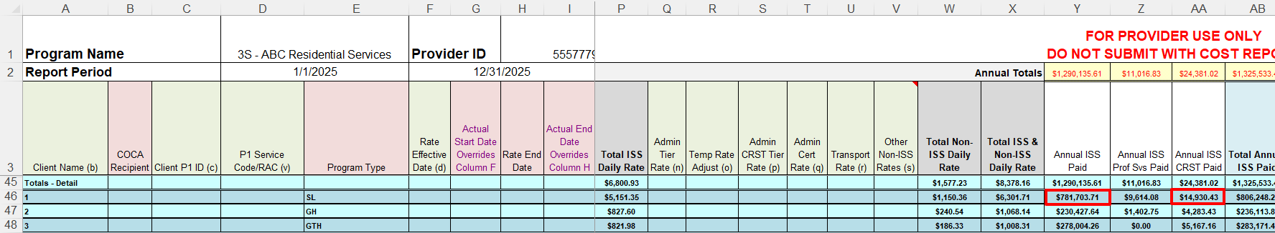
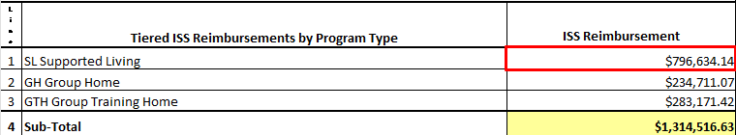
SCHEDULE G – ISS SETTLEMENT
Reimbursement Summary
Tiered ISS Reimbursements by Program Type
Use Schedule H, bottom 3 rows, Column Y plus column AA to record the annual ISS tier and CRST reimbursements on Schedule G, lines 1-3 for applicable programs
  Example: Supported living (796,634.14) = $781,703.71 (Column Y) + $14,930.43 (Column AA)

Slide 35
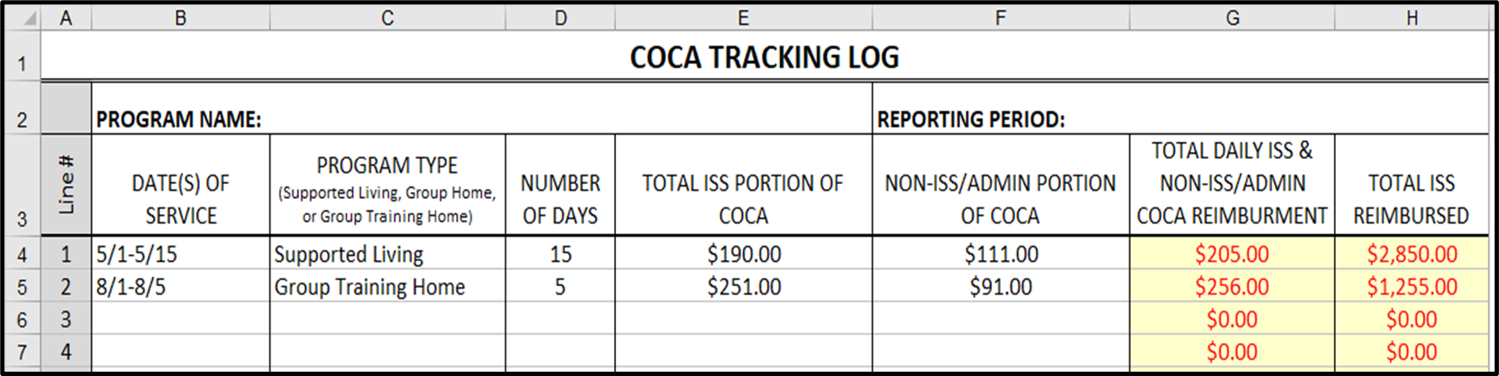
SCHEDULE G – ISS SETTLEMENT
Schedule I
Schedule I - COCA Tracking & Reporting
COCA’s are entered as received & added to lines 1-3 on Schedule G
*If Schedule H or some other form of COCA tracking is used do not use Schedule I

Slide 36
SCHEDULE G – ISS SETTLEMENT
Reimbursement Summary
Nurse Delegation & Staff Add On Reimbursements (Lines 5-11)
Nurse Delegation
  9-hour & 3-hour, 1 time training allowing a nurse to delegate to staff
  Provider One Service Code SA452 & SA453
Staff Add On & Nurse Delegation tracking & reporting (use 1 source)
  Provider One payment report (service codes: SA719 & SA725)
  Documentation provided by RM
  Billing & payment remittance documentation

Slide 37
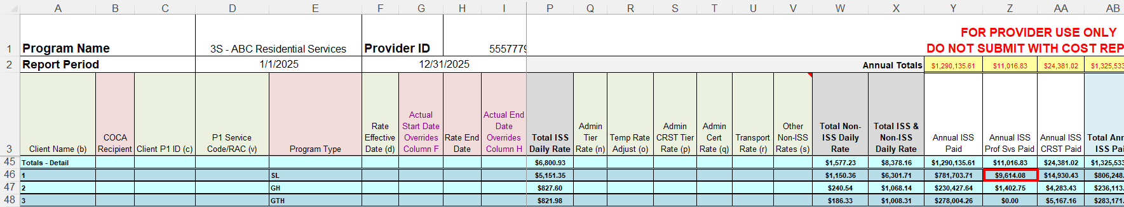
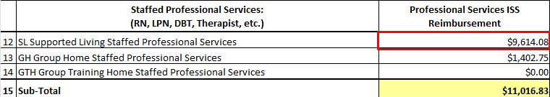
SCHEDULE G – ISS SETTLEMENT
Reimbursement Summary
Professional Services Reimbursed
Use Schedule H, bottom 3 rows, column Z to record professional services reimbursements on Schedule G, lines 12-14 for applicable programs
Example: Supported Living = $9,614.08 (Column Z)

Slide 38
SCHEDULE G – ISS SETTLEMENT
Settlement
Settlement Section (Lines 17-24)
  Line 17 (auto-filled) is the total reimbursements carried forward from lines 1-16
  Line 18-19 auto-fills total allowable ISS staff payroll expenses from Schedule B
    Schedule B, cell R65 less cell E65 automatically posts to Line 24
    Schedule B, cell E65 automatically posts to Line 25
  Lines 20-22 add authorized purchased (non-staff) Professional Services, if any
    Record any professional services purchased through an outside source
    Select the appropriate program type to report expenses
    Must be authorized by DDA resource manager and be a part of the client assessment
    Professional services performed by staff are reported on Schedule B
  Line 23 subtotals lines 18-22
  Line 24 preliminary settlement
    Line 24 displays a preliminary settlement amount due if line 17 (total reimbursements) is more than line 23 (total allowable ISS expenses)

Slide 39
MISCELLANEOUS INFORMATION
2025 Cost Report Template
  available on the web January 1, 2025
    Ability to enter payroll data throughout the year
    Ability to compare ISS payroll expenses with ISS reimbursements
Regression table maximums and FTE calculation wages increased by 2.5% effective 1/1/2025
Any cost report template functionality/calculation questions please contact the rates department

Slide 40
COST REPORT RESOURCES
Ken Callaghan, DDA Rates Manager
Phone: (360)725-3206
kenneth.callaghan@dshs.wa.gov
Tod Johnson, Analyst, Region 1, SOLA, & RRDD
Phone: (360)725-2347
tod.johnson@dshs.wa.gov
Michelle Andis, Analyst, Regions 2N & 3S (A-L)
Phone: (360)725-2476
michelle.andis@dshs.wa.gov
David Carter, Region 2S & RHC
Phone: (360)725-3202
david.Carter@dshs.wa.gov
Tammy Paulk, Analyst, Region 3N (M-Z), 3S, & SRH
Cell Phone: (360)725-2498
tammy.paulk@dshs.wa.gov
2025 Cost Report - Template
2025 Schedule H Rate History - Template
2025 Schedule I Allocations – Template
2025 ABC Sample - Cost Report
2025 ABC Sample - Schedule H Rate History
2025 ABC Sample - Schedule I Allocations
2025 PowerPoint Presentation
2025 Cost Report Instructions
2025 Schedule H Rate History - Training
DDA Policy 6.04
All the resources above can be found here.

