Slide 1
Nursing Assistant Certification (NAC) Reimbursement Requests
How To Fill Out a Reimbursement Request

Slide 2
How to Fill out a Reimbursement Request
Use Form 06-123 for all reimbursement requests.
We will review Sections A-E on the form.
A. Provider Information
B. Direct Care Costs
C. Operating Costs
D. Total Costs and Reimbursement Request
E. Provider Authorization
NOTE: Some totals on the form are automatically calculated, but some totals need to be entered manually. See instructions for details.
Additional information can be found at:
https://www.dshs.wa.gov/altsa/management-services-division/nursing-assistant-certified-reimbursement-forms

Slide 3
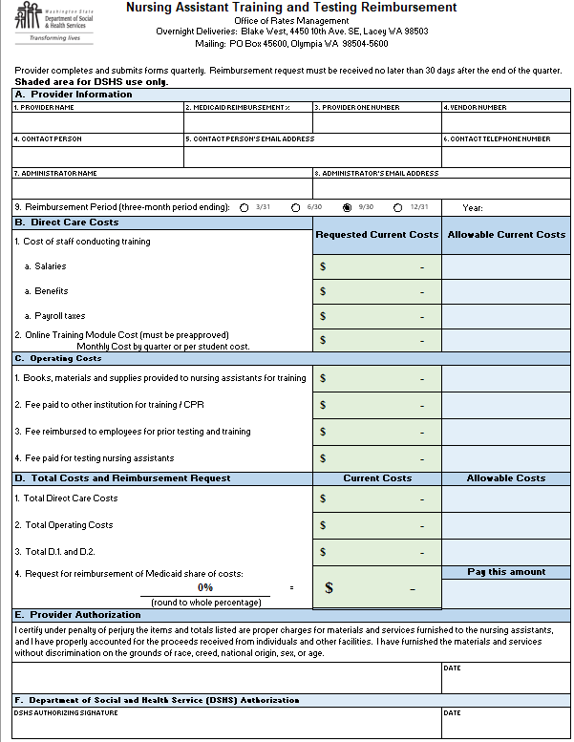
Use Form 06-123 for NAC reimbursement requests.
Found at: https://www.dshs.wa.gov/altsa/management-services-division/nursing-assistant-certified-reimbursement-forms

Slide 4
Summary Page Automatic Amount Transfers
The summary page contains the “Requested Current Costs” which automatically transfer from each respective page containing the total amounts calculated per item/service listed.
Automatically calculates Direct Care and Operating Costs above.
Automatically calculates Facility Reimbursement amount based on Direct Care plus Operating costs multiplied by the Medicaid Reimbursement %.

Slide 5
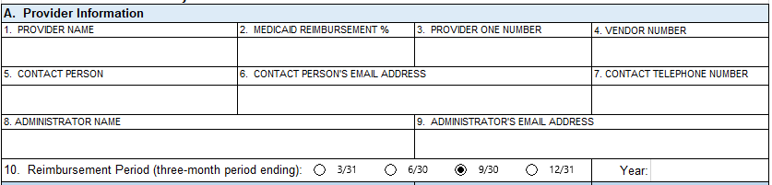
Section A. Provider Information
Enter the Provider name. If a name change occurred within the last (2) years, enter that name, too.
Enter the Medicaid Reimbursement Percent. NOTE: The reimbursement percentage is calculated by taking the number of Medicaid patients days reported on your cost report Schedule N divided by the total patient days on the same schedule. The reimbursement percentage is updated July each year and posted on our website.
Enter your Provider One number.
Enter your seven-digit Medicaid Vendor Number.
Enter the name of the Contact Person for questions concerning this form.
Enter the Contact Person’s e-mail address.
Enter the Contact Person’s Telephone Number.
Enter the Administrator Name.
Enter the Administrator’s Email Address.
Check the appropriate box for the Reimbursement Period (three-month period ending) and enter the Year.
Notes:
Please fill out the entirety of Section A. so we can reach the contact person for questions/clarification/additional documentation. We will make 3 attempts. We will reach out to the contact email and phone number. If unsuccessful, we will again reach out to the contact and Administrator via email. If we are unable to reach the contact or administrator in a timely manner, the facility will forfeit reimbursement for the quarter.

Slide 6
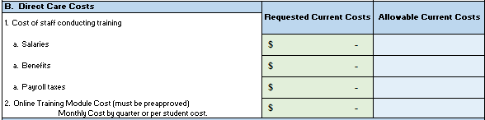
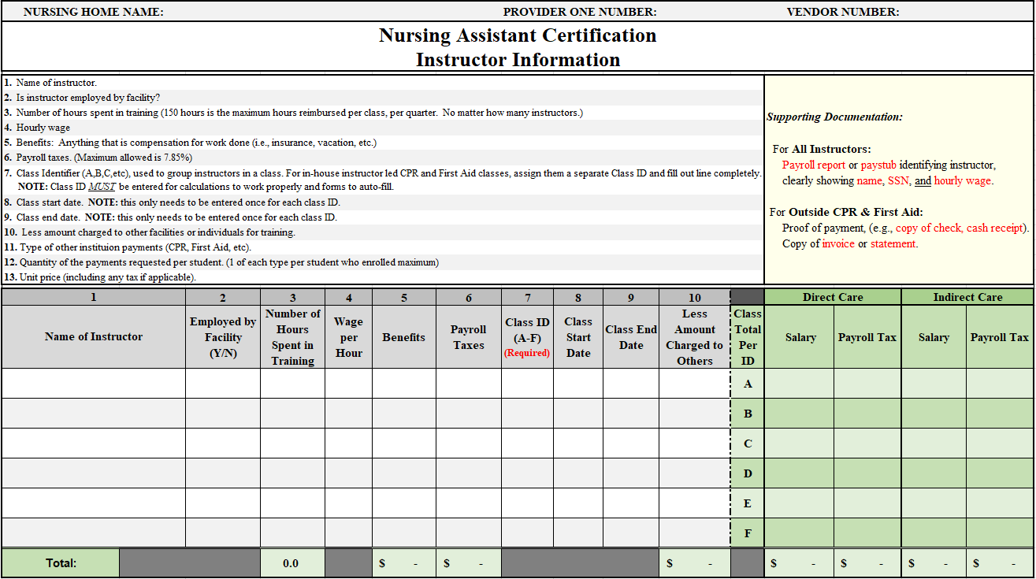
Section B. Direct Care Costs (1. a, b, c)
1. Follow instructions on the Instructor Information page (page 2) and the amount automatically transfers to the Summary Page.
NOTE: This section applies only if you have instructor-led training provided by the facility.
NOTE: A facility can claim up to 150 hours TOTAL for all teachers and helpers per class.
NOTE: Instructor payroll taxes are limited to 7.85% of total hourly pay for training, regardless of the amount actually paid.

Slide 7
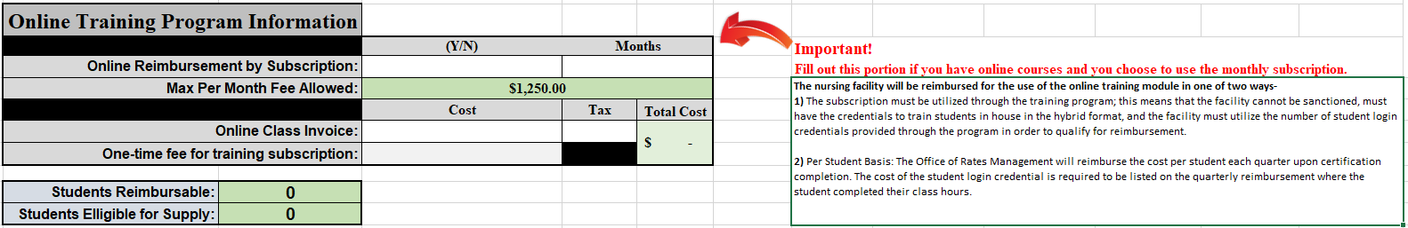
Section B. Direct Care Costs (2. Online Training)
2. If a facility paid for a subscription for an online hybrid-training program, fill out the bottom of the Student Information page (page 3) and the amount automatically transfers to the Summary Page.

Slide 8
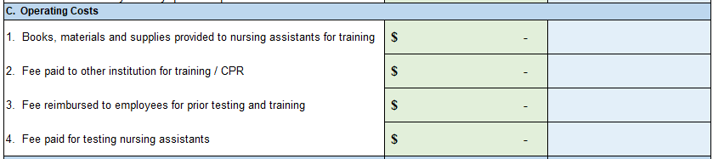
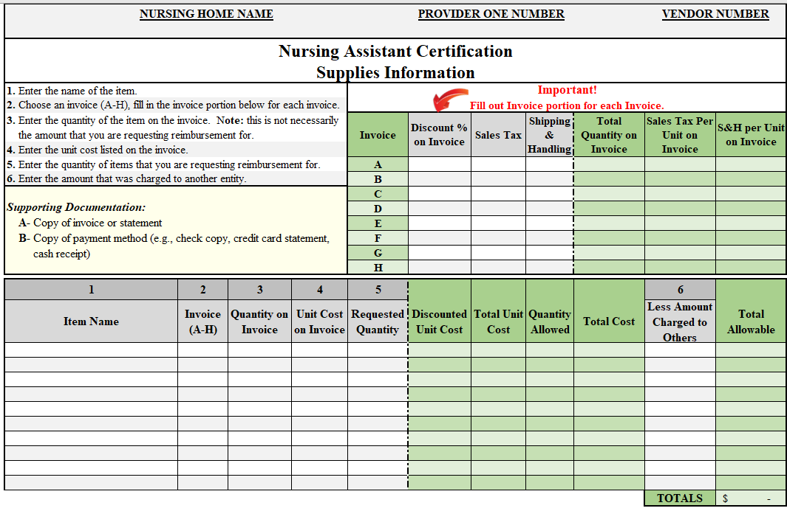
Section C. Operations Costs (1. Supplies)
Fill out the Supplies Information page (page 4) and the amount automatically transfers to the Summary Page.
NOTE: Supplies are limited to the number of students taught for the quarter.

Slide 9
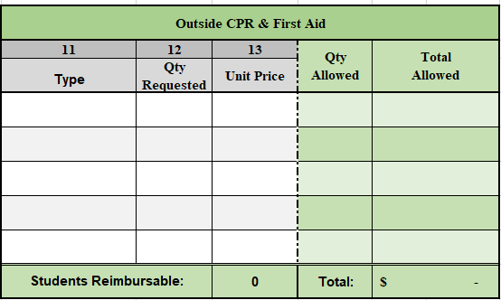
Section C. Operations Costs (2. CPR & First Aid)
2. If an outside entity conducted CRP and/or First Aid training, fill out the bottom of the Instructor Information page (page 2) and the amount automatically transfers to the Summary Page.

Slide 10
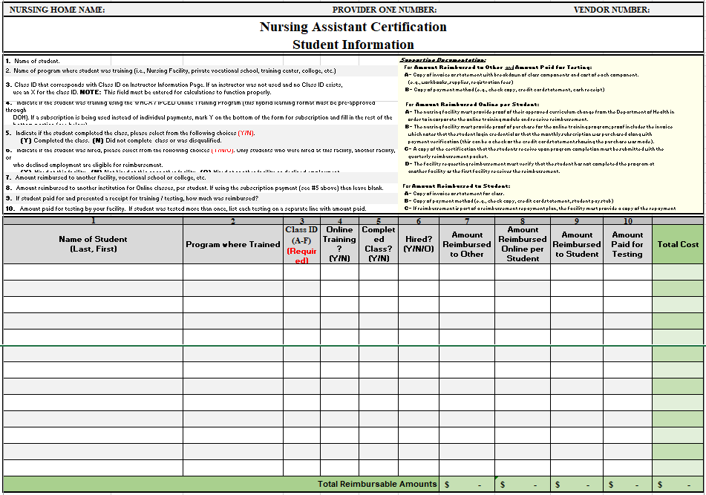
Section C. Operations Costs (3. Fees Reimbursed to Students)
3. If a student was reimbursed for prior testing and training, fill out the Student Information page (page 3) and the amount automatically transfers to the Summary Page.
NOTE: This section must be filled out for each student that participated in a training program regardless if the training was or was not completed by the student.
NOTE: All facilities with a Medicaid contract must offer reimbursement to NAC students, provided that the nursing facility is the first one the student works at within a year of completing their training and their training wasn’t paid for with a scholarship or some other form of public funding

Slide 11
Section C. Operations Costs (4. Testing Fees)
4. If testing fees for nursing assistants were incurred, fill out the Student Information page (page 3) and the amount automatically transfers to the Summary Page.
NOTE: Department of Health expenses (including nursing license application fees) are non-allowable expenses.

Slide 12
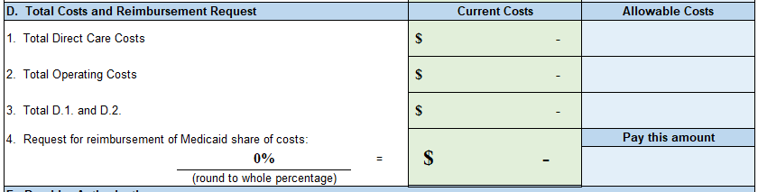
Section D. Costs and Reimbursement Request
  Total Direct Care Costs (Section B, items 1. a-c & 2.) is automatically calculated.
  Total Operating Costs (Section C, items 1. through 4.) is automatically calculated.
  Total D.1. and D.2 is automatically calculated.
  Your Medicaid percentage entered in Section A, item 2 is automatically entered (Section D, item 4) to calculate the amount of reimbursement for the quarter.

Slide 13
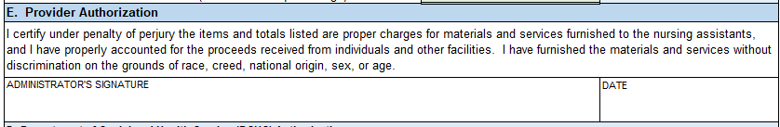
Section E. Provider Authorization
The Nursing Home Administrator must sign and date this form. Submit originals signed in ink.

Slide 14
Submitting the Packet
Send the completed and signed reimbursement form, along with all support documentation, by the quarterly due date in .pdf format to the email address below. The submission email address is a secure email address
*NOTICE FOR SUBMISSION OF CONFIDENTIAL INFORMATION*
Beginning January 31, 2022, All CONFIDENTIAL information contained in a NAC reimbursement request MUST BE SENT VIA SECURED EMAIL OR IN AN EMAIL REPLY to a secured email originated by DSHSALTSANACReimbursement@dshs.wa.gov. If you do not have the ability to secure an email and did NOT receive a secure email to reply to, contact the email address above with the Subject: Secure Email Needed.
All NAC reimbursement packet submissions to be sent via secured email OR in a secured reply to the email above.
In your secured email or secured reply, change the Subject: xx Quarter 202x NAC Submission.
If you did not receive a secured email, please send an email to DSHSALTSANACReimbursement@dshs.wa.gov with the Subject: Secure Email Needed.
You have up to thirty (30) days from the end of the quarter to submit a reimbursement request. It must be emailed by the last day of the month following the reimbursement quarter. No late reimbursement packets will be accepted unless there are extenuating circumstances and approval from the NAC Lead is obtained prior to submission.
Due dates are as follows:
1st Quarter: July 31st (processed with 2nd quarter to accommodate the cost report review)
2nd Quarter: July 31st
3rd Quarter: October 31st
4th Quarter: January 31st the following year (example - the quarter ending December 31, 2020, would be due by January 31, 2021)
Use the forms found on our website https://www.dshs.wa.gov/altsa/management-services-division/nursing-assistant-certified-reimbursement-forms to request reimbursement for nursing assistant training and testing costs. Submit forms and supporting documents at the end of the quarter in which training and/or testing was completed.

Slide 15
NAC FAQs
Please submit one request packet per quarter with all costs pertaining to that quarter.
If a class went over into the next quarter by a week or two, you must include it in the quarter in which it ended.
Listing the facility’s full-time instructors as Outside CPR & First Aid expenses is incorrect; this should be listed under Direct Care Costs in the instructor section.
If listing “Other” as a reason for not completing the class, you must explain the reason.
Supplies and moveable asset expenses over $750 per item will be paid through the NAC training program. This is for classroom specific items only and should correspond to average class sizes. For instance, if a facility generally only teaches 10 students, we will not allow 20 computers/tablets/etc. to be reimbursed. We would not allow items such as a bed hoist, since that is equipment that is normally used in the nursing home and could be borrowed the class.
Use the DSHS NAC Supplies Form. Please itemize all expenses and fill out the invoice section of the form for each invoice.
If the forms are incomplete, an email will be sent to the facility requesting documents etc. If no response is received from the facility within a week, the request will not be processed for reimbursement. Please make sure your contact information is updated and correct; especially your email address, as this is our main form of contact for questions.
You must write the name of the student(s) on the copy of the check submitted for proof of payment.
When a student is trained at an outside facility, proof of payment for student testing and a detailed invoice, including cost breakdown, is required.
Proof of payment and proof of purchase is required for reimbursement.
Proof of employment, which must contain the hourly wage, is required for facility employed training instructors.

Slide 16
Questions?
Visit the ALTSA Website: https://www.dshs.wa.gov/altsa/management-services-division/nursing-assistant-certified-reimbursement-forms
Or contact the NAC Reimbursement Lead, Melissa Ayala, at:
E-mail: Melissa.Ayala@dshs.wa.gov
Telephone: 360-725-2416

