Slide 1
OBRA NURSE AIDE REGISTRY
COMPLETING AND SUBMITTING A
NURSING ASSISTANT REGISTRY INQUIRY FORM
DSHS 16-193 (REV. 09/2016)

Slide 2
AT THE END OF THIS PRESENTATION YOU WILL BE ABLE TO
Understand the purpose of the OBRA Nurse Aid Registry
Accurately complete and submit a Nursing Assistant Registry Inquiry Form for each type of OBRA Inquiry
When needed, accurately resubmit forms with further information.

Slide 3
What is the OBRA Nurse Aide Registry?

Slide 4
The Registry ensures NACs working in nursing homes do not go longer than 24 months without at least one shift of compensated, nursing-related duties.

Slide 5
Established by Federal Regulation 42 CFR § 483.12 - “Freedom from Abuse, Neglect, and Exploitation”
at least one shift
6-8 hours
every 24 months
calculated from previous official last date of work
for compensation
money, transportation costs (gas, bus fare, etc.), meals, lodging, etc.
providing nursing/nursing related services
Personal hygiene (bathing, dressing, grooming, oral care)
Mobility (transfer and ambulation)
Continence management
Feeding
In hospital, home health, private care, etc.

Slide 6
What the OBRA Nurse Aide Registry IS NOT

Slide 7
The OBRA Registry is NOT involved in the licensing, credentialing, or testing of NACs.
The OBRA Registry is NOT part of the Department of Health’s licensing/credentialing function.
The status of an NAC on the OBRA Registry is NOT influenced by the status of their license/credential at the Department of Health, and vice-versa.

Slide 8
THE NURSING ASSISTANT REGISTRY INQUIRY FORM (Inquiry Form)
It is against federal regulations for an NAC to be hired as an NAC without an inquiry being submitted and verification being received as active on the OBRA Registry.
An employee cannot begin working for a facility until the date verified by the OBRA Registry. There is NO provisional employment allowed in nursing facilities/homes.

Slide 9
THE FACILITY MUST SUBMIT AN INQUIRY FORM FOR
New Employee
Employee Renewal
Employee Termination

Slide 10
Inquiry Form – NEW EMPLOYEE
WHAT IS A NEW EMPLOYEE?
Not currently an NAC at your facility
A rehire
An NAR moving into an NAC position
REMEMBER:
Submit BEFORE you hire. Must have a future start date (cannot be backdated).

Slide 11
Inquiry Form – RENEWAL
WHAT IS A RENEWAL?
Current NACs need to be re-verified every 24 months.
REMEMBER
Need the original start date as NAC at your facility

Slide 12
Inquiry Form – TERMINATION
WHAT IS A TERMINATION?
A current NAC ending employment with your facility, whether voluntary or enforced.
REMEMBER
Need original date of hire as NAC at your facility
Need last official day of work at your facility
Submit after last official day of work at your facility

Slide 13
FACILITY Information Needed to Complete Form
IF ANY OF THIS INFORMATION IS INCORRECT OR MISSING, THE INQUIRY WILL BE RETURNED AS INCOMPLETE.
Facility Name (facility employing NAC)
Contact Person (can answer questions about submission)
Contact Person’s Phone Number (direct number is preferred, please provide extension number)
Return E-Mail Address (Only one e-mail per form. The Registry does not store e-mail addresses, the information provided here is literally cut and pasted for the return response.)
Facility Physical Address

Slide 14
WHERE TO SUBMIT INQUIRY FORMS
Inquiry forms must be submitted by e-mail to:
OBRARegistry@dshs.wa.gov
For questions, please contact us at:
Message Line: (360) 725-2597 E-Mail: OBRARegistry@dshs.wa.gov

Slide 15
NAC Information Needed to Complete Form
Full Name
Birthdate
Social Security Number
NAC Credential Number
Action Requested (New Hire, Renewal, Termination)
Effective Date of Action
Work History (if needed) - Places and Dates
IF ANY OF THIS INFORMATION IS INCORRECT OR MISSING, THE INQUIRY WILL BE RETURNED AS INCOMPLETE.

Slide 16
WORK HISTORY
Only work performing compensated NAC duties qualifies as work history.
A list of previously held employment.
For facility, include: name of facility, and the start and end dates of employment.
For private client, include: start and end dates of employment, specific nursing-related duties performed, and what type of compensation was received.
NAC nursing/nursing-related skills include assisting patient(s) with:
Personal hygiene (bathing, dressing, grooming, oral care)
Mobility (transfer and ambulation)
Continence management
Feeding
in hospital, home health, private care, etc.

Slide 17
MOST COMMON REASONS NAC INQUIRIES ARE NOT VERIFIED

Slide 18
INQUIRIES WILL BE RETURNED FOR THE FOLLOWING REASONS:
Form is incomplete or is handwritten
Name does not match database (different/misspelled)
Social security number does not match database
Person has expired from the Registry
Work history is needed
Work history is not compensated, NAC nursing-related duties
Effective date of action is not provided
Effective date for New Hire is not a future date
(continued)

Slide 19
INQUIRIES WILL BE RETURNED FOR THE FOLLOWING REASONS: (continued)
Inquiry is not for NAC position
NAC is not on the OBRA Registry
Person was originally hired without an inquiry being submitted for a pre-hire check
Multiple forms are submitted within a short time period with only one or two names per form

Slide 20
THINGS TO REMEMBER
Employee MUST BE VERIFIED in order to work in your facility
Employee is not eligible to work until date verified by the Registry
Form must be typed
Form must be complete
Inquiries are processed in the order received (no exceptions)
Inquiries are responded to within two working days (contact the Registry if not)
Contact name you provide should be the person able to answer any questions about the inquiry

Slide 21
RESUBMITTING INQUIRY FORM FOR A RETURNED UNVERIFIED INQUIRY

Slide 22
HOW TO READ THE RESPONSE TO YOUR INQUIRY
A CERTIFIED NURSING ASSISTANT CANNOT WORK IN YOUR FACILITY UNTIL VERIFIED AS ACTIVE
When you receive an inquiry response, check that the “Registry Status” field says “Active.”
If it is “Active” then your inquiry has been verified.
If it is not “Active”, read the NOTE section for that person. This note will explain why the person cannot be verified and what action(s) to take to resolve the issue(s).
Follow the instructions exactly by correcting or adding information requested and resubmitting an updated inquiry form .
(CONTINUED)

Slide 23
HOW TO READ THE RESPONSE TO YOUR INQUIRY
(CONTINUED)
The original action requested should remain on the inquiry form. (All information regarding a person’s inquiry should be together on one inquiry form.)
Any documents requested in the response must be included with the resubmitted inquiry form.
The facility is responsible for obtaining and providing the employee’s information. Please do not instruct an employee or potential employee to contact the Registry.
A CERTIFIED NURSING ASSISTANT CANNOT WORK IN YOUR FACILITY UNTIL VERIFIED AS ACTIVE

Slide 24
EXAMPLES OF COMPLETED INQUIRY FORMS

Slide 25
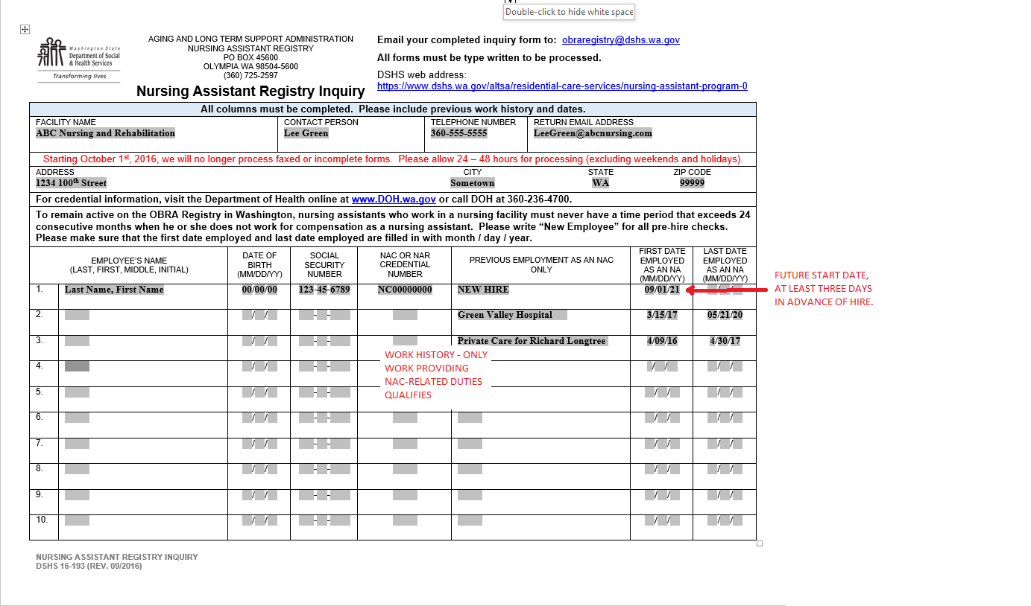
EXAMPLE:
NEW EMPLOYEE

Slide 26
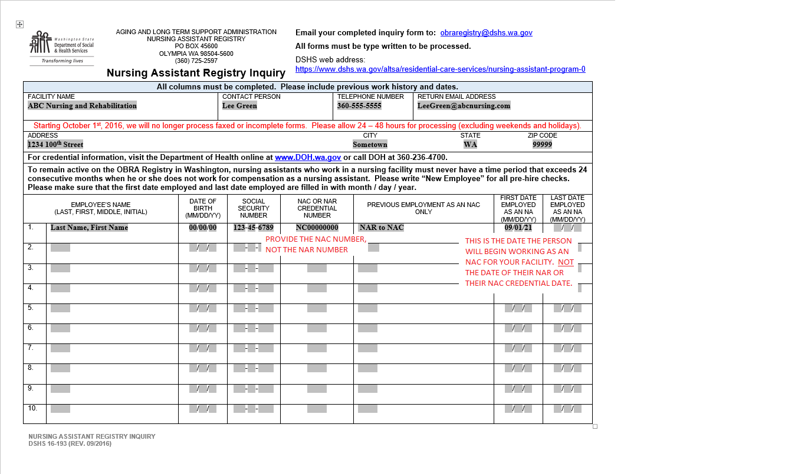
EXAMPLE:
NAR TO NAC

Slide 27
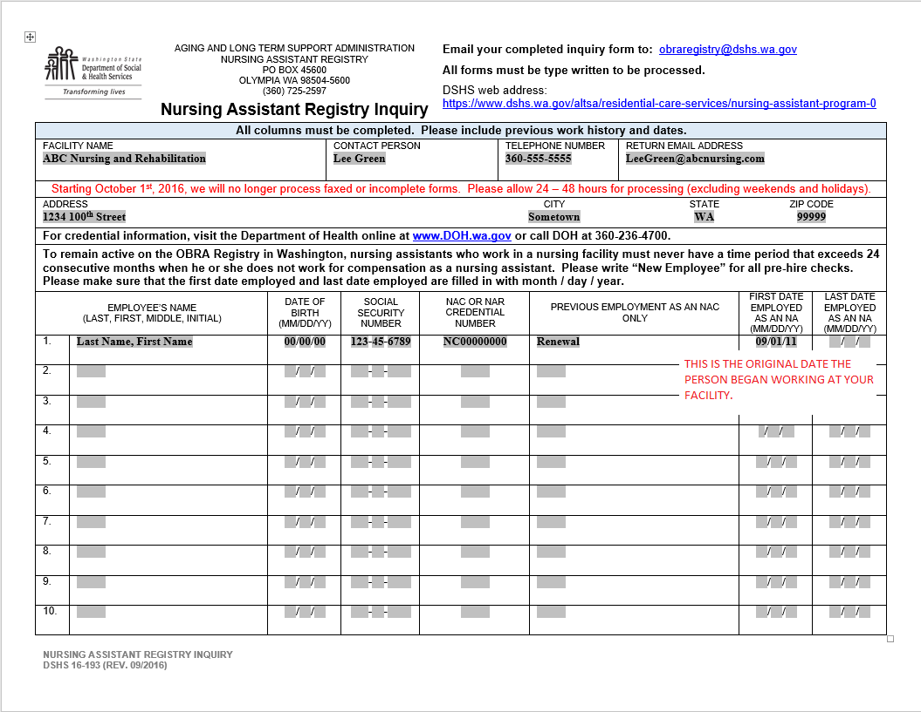
EXAMPLE:
RENEWAL

Slide 28
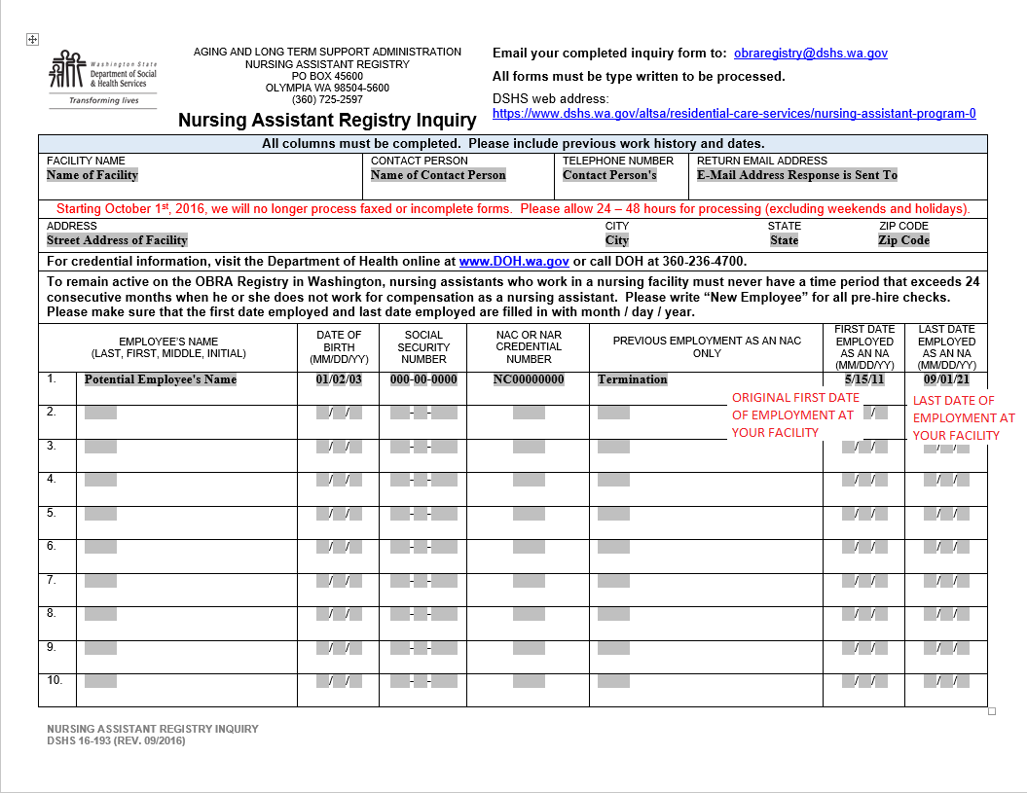
EXAMPLE:
TERMINATION

Slide 29
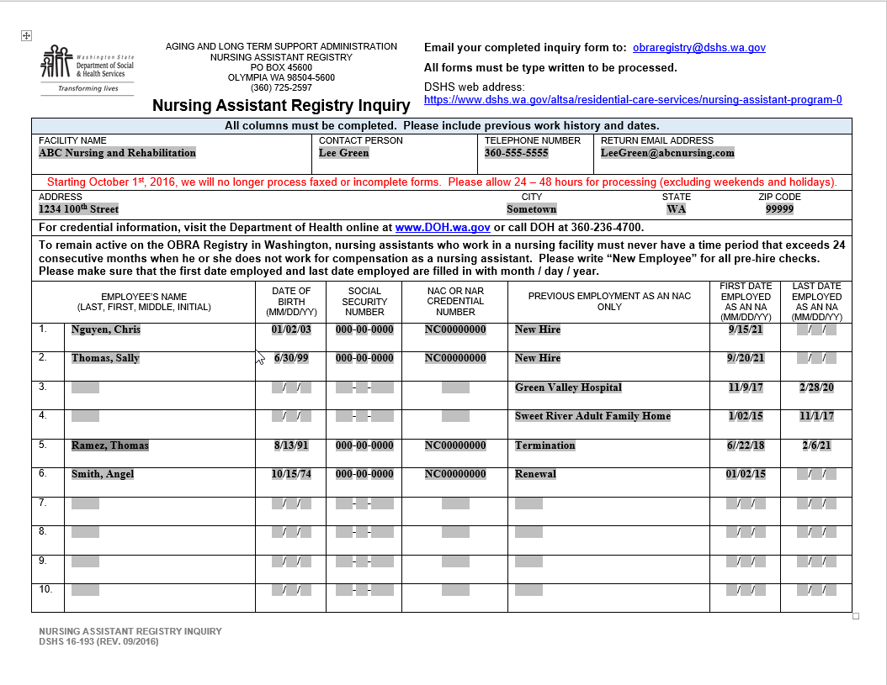
EXAMPLE:
COMBINED
ACTIONS

Slide 30
IF YOU HAVE ANY QUESTIONS,
PLEASE DON’T HESITATE TO CONTACT US
Message Line: (360) 725-2597 E-Mail: OBRARegistry@dshs.wa.gov

