Slide 1
Health Home Care Coordinators Basic Training
June 2018
Notes:
Introduce yourself, your professional experience, and experience with the Health Home Program.
Provide logistics:
bathrooms, emergency exits
breaks
options for lunch and/or coffee
special security considerations of the venue if applicable

Slide 2
I diagnosed ‘abdominal pain’ when the real problem was hunger, I confused social issues with medical problems
in other patients, too. I mislabeled the hopelessness of
long-term unemployment as depression and the poverty that causes patients to miss pills or appointments as noncompliance. In one older patient, I mistook the inability
to read for dementia. My medical training had not prepared me for this ambush of social circumstance. Real-life obstacles had an enormous impact on my patients’ lives, but because I had neither the skills nor the resources for treating them, I ignored the social context of disease altogether.
  —Laura Gottlieb, MD
  University of California San Francisco
Notes:
Used with permission from Dr. Laura Gottlieb, MD.

Slide 3
Introductions
Your name?
What do you do?
What agency do you work for?
What Lead Organization/s will you work with?
Briefly state, your relevant work experience.

Slide 4
Purpose
Provide the core curriculum for Health Homes in Washington State for Lead Organizations and Care Coordination Organizations (CCOs)

Slide 5
Learning Objectives and Agenda Overview
The six Health Home services
Outreach and engagement strategies
Care coordination key components and delivery mechanisms
Administration of Insignia’s Patient Activation Measures ® and how to use the level of activation to develop a Health Action Plan
TRAINING
Notes:
DSHS and the Health Care Authority are not requiring one system for documentation so your Lead Organization will establish how you will add to your existing system of documentation or create a new system for documenting services for your Health Home clients.

Slide 6
Learning Objectives and Agenda Overview (cont.)
Administration of mandatory screens and optional screens
Documentation of the delivery of Health Home Services
in progress notes and Health Action Plans
Required elements for Care Transitions

Slide 7
Overview of the Curriculum
Classroom Training Manual with important forms
and documents
Location of the manual on the DSHS training Website:
https://www.dshs.wa.gov/altsa/stakeholders/washington-health-home-program-core-training
Notes:
All participants must receive a Classroom Training manual. Trainers with Internet access should show participants the location of the online training resources during the training.

Slide 8
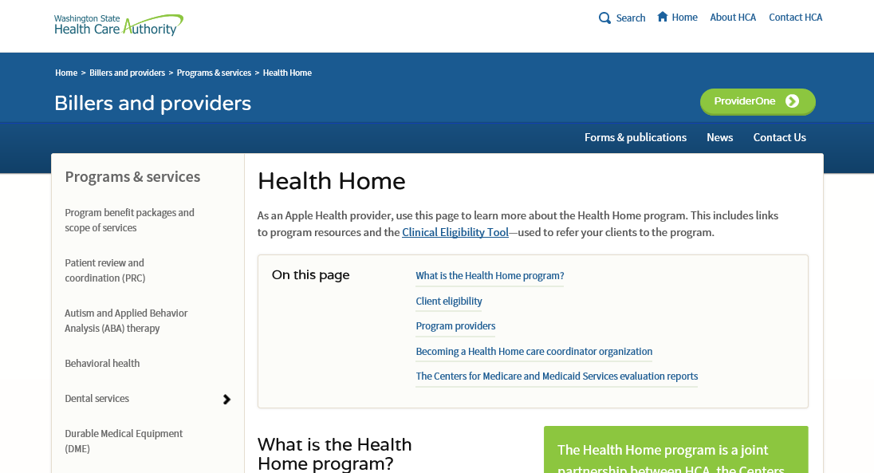
The Health Care Authority (HCA) Website http://www.hca.wa.gov/billers-providers/programs-and-services/resources-0#care-coordinator-training
Training materials may be accessed from the HCA website
Notes:
This is a screen shot of the HCA’s website. The web address is contained in a slide near the end of this PowerPoint.

Slide 9
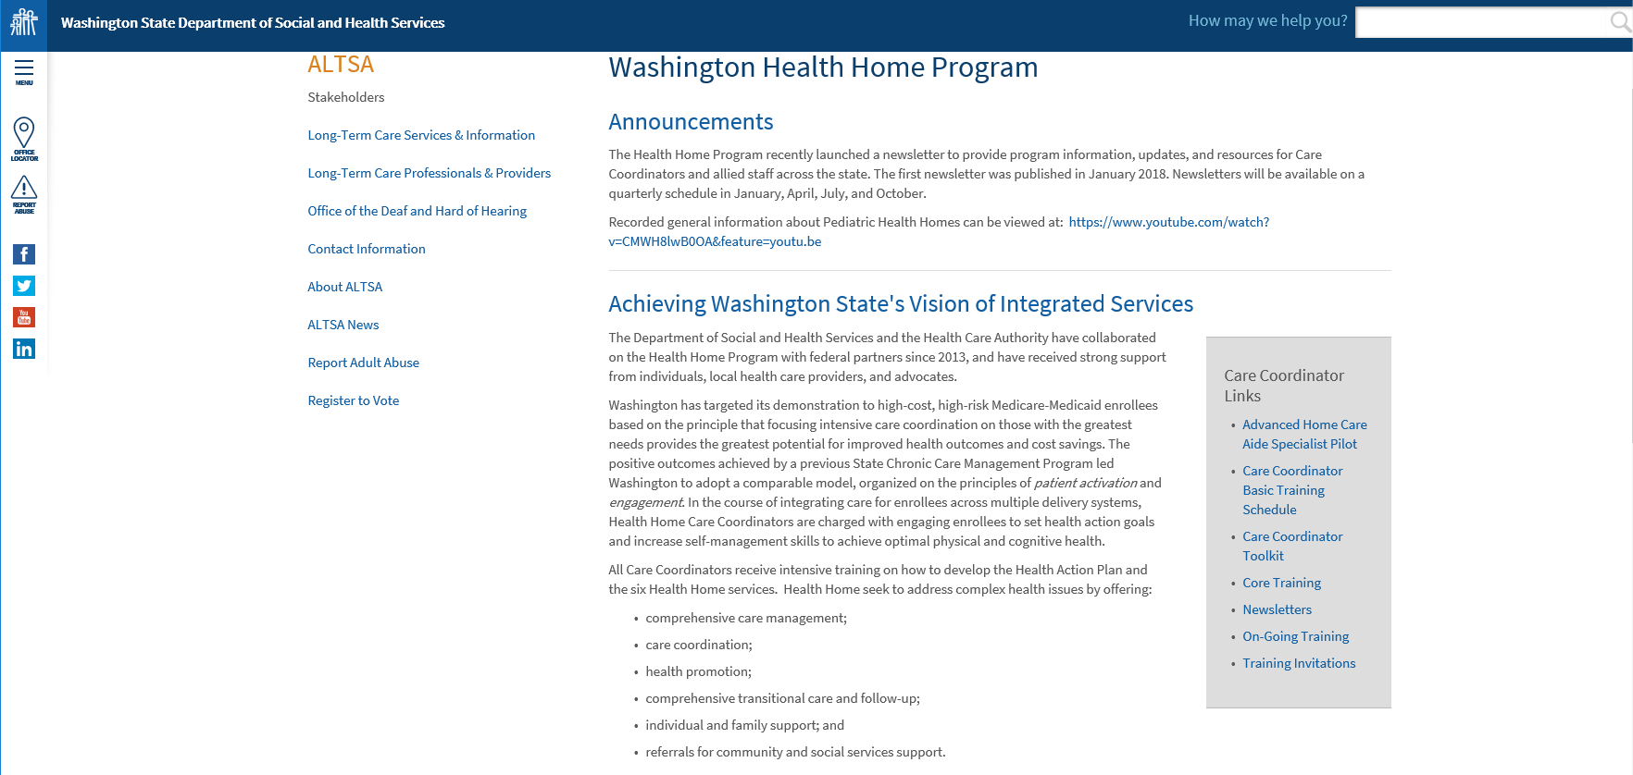
The DSHS Website https://www.dshs.wa.gov/altsa/washington-health-home-program
Training, resources,
and webinar presentations are located
on the DSHS ALTSA website
Notes:
This is a screen shot of DSHS’s website.

Slide 10
Fundamentals
Health Homes and the Affordable Care Act
Washington’s model
Eligibility
The Health Home services
Health Home tiers and billing

Slide 11
What are Health Home Services?
Clients receiving Health Home services will be assigned a Health Home Care Coordinator who will partner with client, their families, doctors and other agencies providing services to ensure coordination across these systems of care.
The primary role of the Health Home Care Coordinator is to work with their client do develop a Health Action Plan that is person-centered.
In addition, the Health Home Care Coordinator will make in-person
visits and be available by telephone to empower the client to take charge of their wellness.

Slide 12
Let’s look at a sample Health
Action Plan (HAP)
TRAINING
Notes:
Provide an overview of the sample HAP for Jordan Larson contained in the Classroom Training Manual.

Slide 13
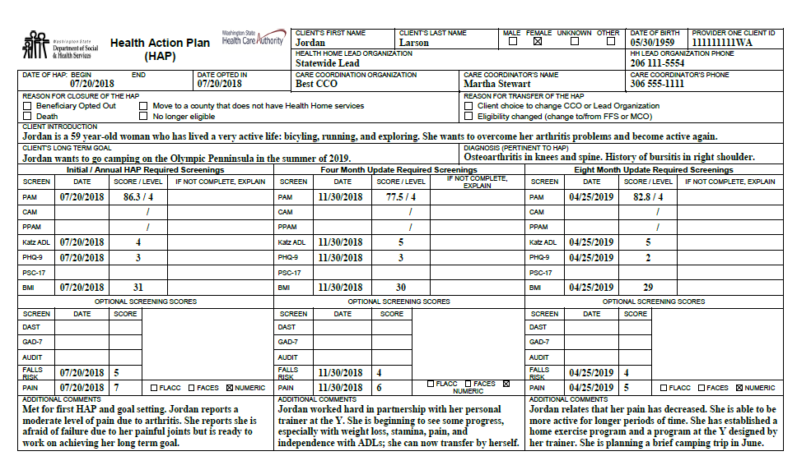
Sample HAP for Jordan Larson
Notes:
Do not review the entire document. Highlight the diagnosis, long-term goal and short term goal. Point out that this HAP provides an example of a HAP that has been completed for a 12 month cycle covering three activity periods.

Slide 14
The Patient Protection and
Affordable Care Act
Health Homes are described in:
Section 2703. State option to provide health homes
for clients with chronic conditions.
http://www.hhs.gov/healthcare/rights/law/index.ht
Notes:
Funding for this program is authorized through the Affordable Care Act. Any shared savings is shared with the federal government and the states.
The six services are defined for states but the states can define who can receive the services and the service areas.
As of 1/29/18 this link to the ACA was still in operation. The section on Health Homes is located in Section 2703.

Slide 15
Washington Opts In
The primary goals of the Health Home Program include:
Improve the quality and coordination of care across systems of care
Reduce expenditures
Increase confidence and self management of health goals
Provide a single point of contact to bridge systems of care

Slide 16

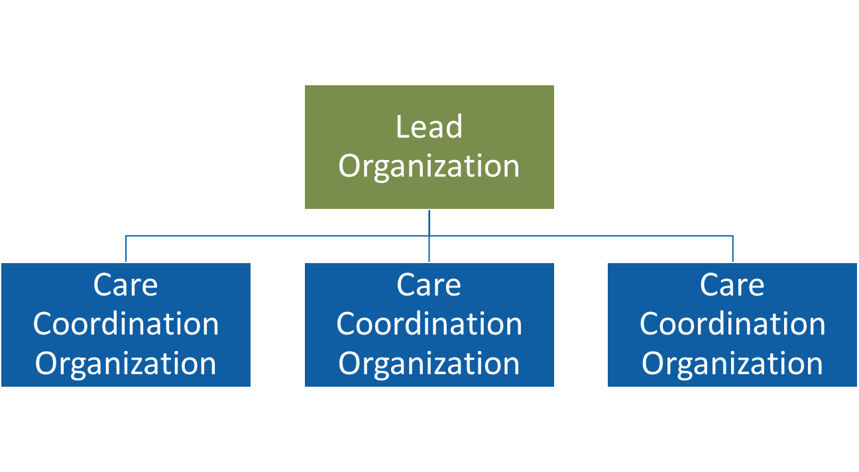
Washington State Model of Health Home
Notes:
This graphic shows Washington’s Health Home model. HCA and DSHS established guidelines to qualify Health Home Lead Organizations.
This image provides a graphic representation of the types of agencies that provide Health Home services:
Managed Care Health Insurance Plans:
MCOs acting as Lead Organizations
Amerigroup, Molina, UnitedHealthcare, Coordinated Care of Washington and Community Health Plan of Washington
Lead Organizations: agencies that have a contract to provide these services
Fee-for-Service providers for Medicaid
For example, Community Choice, Optum and some Area Agencies on Aging
Care Coordination Organizations: health and social service agencies in your local community
For example, Compass Mental Health Services, Sea-Mar Community Health Centers, Multicare clinics, and some Area Agencies on Aging
Each coverage area has Lead Organizations that have contracted with the HCA. Each Lead Organization established a network of Care Coordination Organizations to bridge all service domains including medical, mental health, chemical dependency and long term services and supports.
A requirement of the program is a mandate for the Leads to contract with Care Coordination Organizations to provide services. The CCOs, as they are called, may include federally qualified health centers, HIV/AIDS organizations, Area Agencies on Aging, pediatric clinics and other community based medical and social service organizations. For example: a number of Lead Organizations have contracted with Sea-Mar Community Health Center. Sea-Mar is working in a number of coverage areas and counties. The Lead Organizations are responsible for administrative functions, data collection and reporting and payment of their contracted Care Coordination Organizations.
Lead Organizations may also provide direct Health Home services. For example Northwest Regional Council and Southeast Washington Aging and Long Term Care are Leads and also provide care coordination as a subcontracted Care Coordination Organization.
The Lead Organizations are still in the process of contracting care coordinators to increase the network’s capacity to serve our clients.

Slide 17
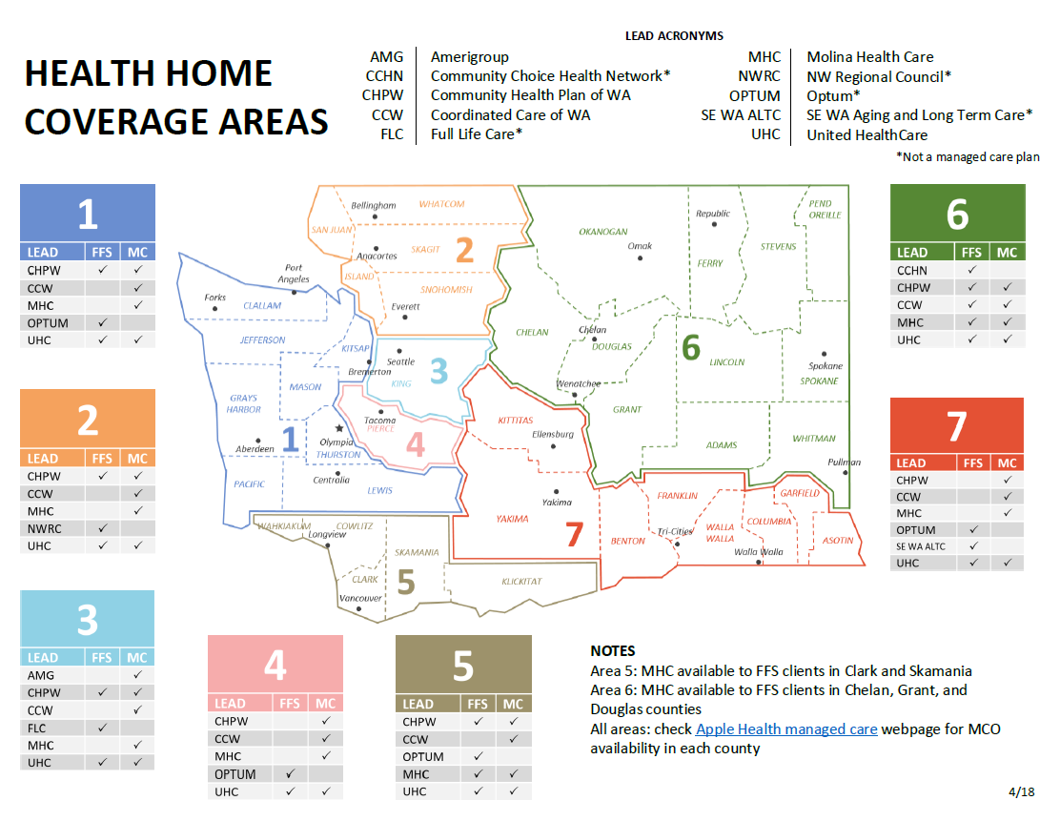
Health Home Coverage Areas
Notes:
ProviderOne is the payment mechanism to pay the Lead Organizations and the Lead pays the Care Coordination Organization or CCO.
There are seven coverage areas with multiple Leads and multiple CCOs.
When the program began in June 2013, 8,000 clients were identified as eligible for the services.

Slide 18
Who May Become a Health Home Care Coordinator?
Care Coordinators may be employed by:
Lead Entity or
Care Coordination Organization that has contracted with a Lead
Required education or licensure:
Registered nurse, licensed practical nurse, bachelor or master’s prepared social worker, licensed social worker, licensed mental health counselor, chemical dependency counselor, certified medical assistants with an Associate Degree, and Indian Health Services Certified Community Health Representative
Notes:
The list of credentials does not include all classifications. There are a few other degrees that qualify. The point is that Care Coordinators are not lay staff.

Slide 19
Who May Be Covered By Health Homes?
Dual Eligible
Eligible for Medicare and Medicaid
  Uses Fee-For-Service (FFS) traditional Medicare/Medicaid providers
Apple Health
Managed Care Organizations (MCO) plans
Fee-for-Service: traditional Medicaid coverage for those
not dually eligible
Notes:
If you are asked if Hospice clients are eligible for health home services please refer to the answer below. Otherwise, do not include discussion about hospice as this may create confusion.
Clients who receive Hospice care:
If a Managed Care enrolled client is eligible for Health Home services and enters/chooses Hospice care benefits through the Managed Care Organization (MCO), the client continues to be enrolled with the MCO and therefore eligible for continued Health Home services.
If the client is no longer eligible for Managed Care but continues to be eligible for Health Home services as a Fee-for-Service or Dual eligible client and then enters/chooses Hospice care, the client is no longer eligible for Health Home services and will not be enrolled with a Qualified Health Home lead.
Medicaid clients including Dual Eligible clients, not enrolled in managed care, who are receiving Hospice services are not eligible for Health Home enrollment.
If a Health Home client goes into Hospice they do not automatically lose Health Home eligibility, but if their enrollment is disturbed for any reason ProviderOne will not (may not) allow us to re-enroll them into the Health Home program.
I suspect that this is not what you wanted to hear. My best recommendation is to check enrollment prior to servicing Hospice clients. But of course that is true of all clients.

Slide 20
Eligibility for Health Home Services
Must have one chronic condition and
Must have a PRISM score of 1.5 or higher
  Indicates a risk for a second chronic condition
Note: includes all ages
Notes:
The Centers for Medicare and Medicaid Services, known as CMS, wanted the states to focus on diagnoses. Washington state wanted to look at a constellation of needs and conditions that we wanted to consider for this program. In addition, Washington chose to have a predictive risk score of 1.5 or greater. We identify this through the PRISM system. PRISM is updated weekly and looks at services used by all SSI Medicaid client to determine the norm for services used. PRISM then compares individual clients against this norm and identifies their risk scores. Once you have a risk score of 1.5 you are eligible. Once enrolled if their risk score decreases they are still eligible. We close the case only when the client chooses to opt out of the program or is no longer eligible for Medicaid.

Slide 21
The Health Home Services
Health Home services are designed to:
Conduct screenings to identify health risks and
referral needs
Set person-centered goals that will improve
client’s health and service access
Improve management of health conditions through
health action planning, education, and coaching
Notes:
Clients who agree to engagement are eligible to receive all health home services. Which services they receive will be based on their individual needs and local resources.

Slide 22
The Health Home Services (cont.)
Support changes to improve client’s ability to function in their home and community and increase self-management of their chronic disease/s
Slow the progression of disease and disability
Access the right care, at the right time, the right place,
and the right provider
Notes:
For example, the right time and right place should be with primary care providers during regular clinic hours as opposed to emergency departments on evenings and weekends.

Slide 23
The Health Home Services (cont.)
Successfully transition from hospital to other care settings and get necessary follow-up care
Reduce avoidable health care costs
Make health care decisions during evenings or weekends when the Health Home Care Coordinator is not available
Note: Health Home services do not duplicate other services

Slide 24

Let’s Pause to Check for Understanding
Do you have any experience with the program that you wish to share?
Do you have any questions?

Slide 25
The Six Health Home Services
1
Comprehensive care management
2
Care coordination
Health promotion
3
Comprehensive transitional care
4
Individual and family support
5
6
Referral to community and social support services
TRAINING
Notes:
Refer to the Classroom Training manual and refer to “The Health Home Services” document.
A best practice is to document in the client’s narrative record which of these services were provided.

Slide 26
Comprehensive Care Management
1
Provides in-person periodic follow-up using
face-to-face visits and telephone calls
Includes state approved required and optional
screenings and assessments
Notes:
Stress the idea that visits must be face-to-face at least monthly. Phone contacts do not meet this requirement except in special situations which must be clearly documented, for example, the Care Coordinator was meeting with the guardian to work on applications for subsidized housing.

Slide 27
Comprehensive Care Management (cont.)
1
Assesses the client’s readiness for self-management and promotes self-management skills so the client is
better able to engage with health and service providers
Initiates discussion about advance care planning and assists the client and family (with the client’s consent) to access assistance if they wish to pursue advance care planning or an advanced directive
Notes:
Note that this assistance was offered in the client’s narrative section of their file. For ongoing clients if the record does not indicate that advance care planning was discussed in the past then the Care Coordinator must offer this assistance and note it in the client record.

Slide 28
Comprehensive Care Management (cont.)
1
Monthly (or more often as needed) contacts:
  Provides continuity of care
  Supports the achievement of self-directed health goals
  Improves functional or health status or prevent or slow declines
  in functioning

Slide 29
Care Coordination
2
Provides cross-system care coordination to assist the client to access and navigate needed services
Uses the Health Action Plan (HAP) as the person-centered
care management plan
Notes:
This includes integrating mental health, substance use, long term services and supports and primary care.

Slide 30
Care Coordination (cont.)
2
Fosters communication between the providers of care including:
  Primary Care Physicians (PCPs)
  Medical and behavioral health specialists
  Entities authorizing behavioral health and
  Long Term Services and Supports (LTSS)
Notes:
Long Term Services and Supports (LTSS) are authorized by DSHS and Area Agency on Aging (AAA) case managers.
Case resource managers work for the Developmental Disability Administration at DSHS.
Social service specialists and nurses work for Home and Community Services at DSHS.
Case managers and nurses work for the Area Agency on Aging.
Social workers work for Children’s Administration.

Slide 31
Care Coordination (cont.)
2
Bridges all of the client’s systems of care, including non-clinical support such as food, housing, legal services, transportation, etc.
Notes:
This includes integrating mental health, chemical use, long term services and supports and primary care.

Slide 32
Care Coordination (cont.)
2
Coordinates and may supervise the work of allied, lay, or administrative staff
Provides informed interventions that recognize and are tailored to the medical, behavioral, social, economic, cultural, and environmental factors impacting a client’s health and health care choices

Slide 33
Care Coordination (cont.)
2
Promotes:
  Optimal health outcomes through health action planning
  Outreach and engagement activities that support the client’s participation in their care
Uses peer supports, support groups, and self-care programs to increase the client’s knowledge about their health care conditions and improve adherence to prescribed treatment

Slide 34
Care Coordination (cont.)
2
Provides opportunities for mentoring and modeling communication with health care and other providers by:
  Modeling or monitoring phone conversations with health care staff and others
  Rehearsing a visit with a provider to prepare the client for their appointment
  Participating in joint office visits and appointments

Slide 35
Health Promotion
3
Uses self-management, recovery, and resiliency principles including supports identified by the client
Considers the client’s activation level to determine the coaching, teaching, and support plan for the client

Slide 36
Health Promotion (cont.)
3
Provides wellness and prevention education to include routine and preventative care (e.g. immunizations)
Links the client with resources to promote a healthier lifestyle
Notes:
For example:
Wellness and prevention may include encouraging the parent to make certain their child gets well child check-ups and immunizations.
Care coordinators working with older adults may work with client to get flu shots and shingles and pneumonia vaccinations.

Slide 37
Comprehensive Transitional Care
4
Prevents avoidable readmission after discharge from an inpatient facility (hospital, rehabilitative, psychiatric, skilled nursing, substance use disorder treatment facility, or residential habilitation setting)
Ensures proper and timely follow-up care
Notes:
We will go in greater depth on Comprehensive Transitional Care or Care Transitions on Day Two of the training.

Slide 38
Individual and Family Support
5
Recognizes the unique role the client may give family, identified decision makers and caregivers in assisting the client to access and navigate the health care and social service delivery system
Supports health action planning

Slide 39
Individual and Family Support (cont.)
5
Identifies the role that families, informal supports, and
paid caregivers provide to:
  Educate and support self-management, self-help, and recovery
  Achieve self-management and optimal levels of physical and cognitive function

Slide 40
Individual and Family Support (cont.)
5
Educates and supports family informal supports and caregivers
  Increases their knowledge of chronic conditions
  Promotes the client’s engagement and self-management
  Helps the client adhere to their prescribed medications
  and treatments
Notes:
Care Coordinators help increase the client and caregiver’s knowledge of the client’s chronic conditions, promote the client’s engagement and self-management capabilities and help the client improve adherence to their prescribed treatment.

Slide 41
Individual and Family Support (cont.)
5
Includes:
  Discussions about advance care planning with clients and their families
  Communication and information sharing with clients and
  their families and other caregivers
  Consideration of language, activation level, literacy, numeracy, and cultural preferences

Slide 42
Referral to Community and Social Support Services
6
Provides assistance to obtain and maintain eligibility for health care services, disability benefits, housing, LTSS, and legal services
Completes referrals to community and social support services to support the client in achieving health action goals including:
  LTSS
  Mental health and substance use disorder providers
  Other community and social services support providers as needed

Slide 43
Referral to Community and Social Support Services (cont.)
6
Provides support by:
  Identifying community based resources
  Actively managing referrals
  Advocating and assisting on behalf of the client to access care
  and community and social supports
Notes:
Long Term Services and Supports (LTSS) were formerly known as community based care services offered through Home and Community Services, the Developmental Disabilities Administration and Area Agencies on Aging.

Slide 44
Multidisciplinary Care Teams and Allied Staff
As a Care Coordinator you may coordinate and facilitate multidisciplinary care teams:
  Establishing a team to provide cross systems care coordination on behalf of the client
  Establishing or working with an existing multidisciplinary care team to discuss discharge planning with hospitals, nursing facilities, and other institutions
As a Care Coordinator you may work with allied staff:
  Care Coordinators may enlist the help of allied staff including:
    Community Health Workers, mental health peer support specialists, outreach specialists, Community Connectors, patient navigators, wellness coaches, and other lay staff
TRAINING
Notes:
Refer participants to refer to the Guidelines for HH Staff Roles and Responsibilities in Section B of the Classroom Training Manual.
Other institutions could include in-patient mental health or substance use disorder treatment facilities. Or Residential Habilitation Centers for clients with intellectual disabilities.

Slide 45
Health Home Tiers
Tier One
Tier Two
Tier Three
Initial engagement and action planning
Intensive level of care coordination
Low level
of care coordination
TRAINING
Notes:
Refer the trainees to the Health Home Tiers Guidelines in the Reference section of the Classroom Manual.
If there is staff from an Area Agency on Aging in the training session explain how these clients may already have case managers with HCS, DDA, and AAA. This does not replace the work they are doing as part of Long Term Services and Supports (LTSS). Care Coordinators may not duplicate these services nor any services provided by their mental health providers.

Slide 46
Tier One Services
Tier One
Tier Two
Tier Three
Requires a face-to-face visit to:
  Introduce Health Home services
  Assess the client’s health and other needs
  Confirm the client’s agreement to participate
  Obtain signatures for participation authorization and information sharing consent
  Complete required and optional screenings

Slide 47
Tier One Services (cont.)
Tier One
Tier Two
Tier Three
Develop the first Health Action Plan (HAP)
Document activities
Complete the HAP within 90 days that the client was assigned to your agency
Bill one time only
Notes:
Tier One may only be billed one time, even if the client moves between Leads and/or Care Coordination Organizations.

Slide 48
Tier Two Services
Tier One
Tier Two
Tier Three
Requires at least one face-to-face visit each month
Typically includes multiple calls to client, family, caregivers,
legal representatives, and providers
Includes other activities as needed:
  Health education and coaching
  Referrals to providers
  Care transitions planning and follow up
  Consultation with care providers and medical and behavioral
  healthcare providers
Notes:
Emphasize that a monthly face-to-face visit is required. The Lead Organization may grant an exception to the face-to-face visit requirement.

Slide 49
Tier Three Services
Tier One
Tier Two
Tier Three
Low level Health Home care coordination
  Care Coordinator supports maintenance of the client’s
  self-management skills with periodic face-to-face visits
  and/or phone calls
Client may request fewer contacts
  Movement to this tier is not for the Care Coordinator’s convenience
The client’s chronic condition stabilizes and demonstrates a high level of activation in self-management of health
Notes:
The Health Home Tier documents provides information about movement between tiers and unsuccessful outreach and engagement which participants may need to access once they begin providing Health Home services.
Stress that we are not looking to “graduate” clients from the program. It is the consistent and regular contact by the Care Coordinator that helps the client to maintain positive behavior change to improve their health.

Slide 50
Tier Three Services (cont.)
Tier One
Tier Two
Tier Three
The HAP must be reviewed with every contact:
  The HAP is the foundation of your relationship
  Review progress toward goals
  Identify new or unidentified care opportunities
At least one of the six Health Home services must
be provided:
  When a client requests fewer contacts they may not want to be contacted each month so do not bill for months when
  no contact or no services were provided

Slide 51
Billing for Services
Contact may not occur monthly depending on the client’s needs and the Health Action Plan (HAP)
  Bill only for months when service was provided
The HAP must be reviewed at least once during each four month activity period or more often as needed to monitor and update the goals and action steps and administer the required screenings
Document the core service/s provided to support billing
Notes:
For example, a client may not be available for an entire month or you may lose contact. In these cases you would not bill for services.

Slide 52
Let’s Pause to Check for Understanding
Do you have any questions about the six core services or the 3 payment tiers?

Slide 53
Outreach
Client outreach
Client enrollment materials
Consent and opting out
Client engagement

Slide 54
Client Outreach
Using “smart assignment” the Lead Organization will provide the
CCO with a list of clients who meet the eligibility requirements for Health Home services
The Health Care Authority (HCA) will send Fee-for-Service clients the Health Home letter and “Your Washington State Health Home Booklet”
Lead Organizations that are Managed Care Organizations (MCO) will send their enrollment materials to their members
Care Coordinator, support staff, or Outreach Specialist may make first contact and schedule a face-to-face visit

Slide 55

Welcome Booklet for Fee-for-Service Clients
Flyers and brochures are available under the HCA’s website:
http://www.hca.wa.gov/billers-providers/programs-and-services/resources-0#care-coordinator-training
Notes:
This welcome booklet is mailed by the Health Care Authority to clients who are receiving Fee-for-Service Medicaid coverage. A letter is inserted in the booklet listing the Health Home Leads that are available in their county. The booklet is available to print from the HCA website and has been translated into nine languages. The web address is on the slide.
The first document in the Forms and Tools section of the Classroom Training Manual contains a sample of another promotional flyer that can be accessed from the HCA website.

Slide 56
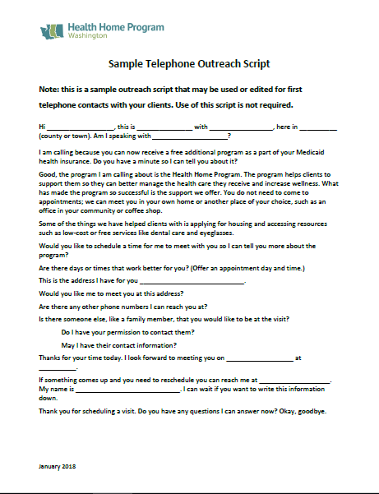
Sample Outreach Script
Tips for effective outreach calls:
  Keep it brief
  Don’t rush
  Ask questions and listen
  Ask if someone else should be present at the first visit
  Wrap up, confirming the visit date and time
  Thank them for their time and interest
TRAINING
Notes:
Ask participants to pull the Sample Telephone Outreach Script from the manual and review. Encourage them to practice and edit the script to meet their needs. Many of the Lead Organizations have developed their own outreach script so ask you Leads for their sample.

Slide 57
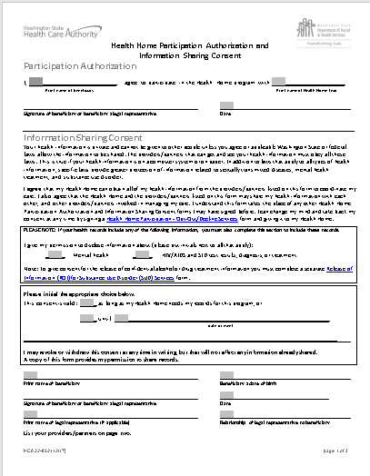
Participation Authorization and Information Sharing
Consent Form
TRAINING
Notes:
Refer to the Classroom Training Manual for a copy of the form. It is also available on the HCA Website. This form is required because it documents the client’s agreement to participate in Health Homes. The client must sign the form in order to participate in the program.
Leads and CCOs may also use their own release of information forms.

Slide 58
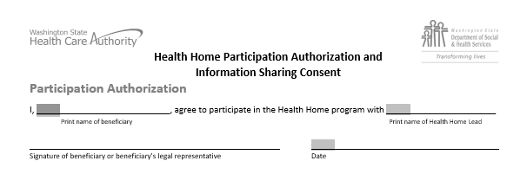
Part 1 of the form
Participation Authorization portion of the form must be signed

Slide 59
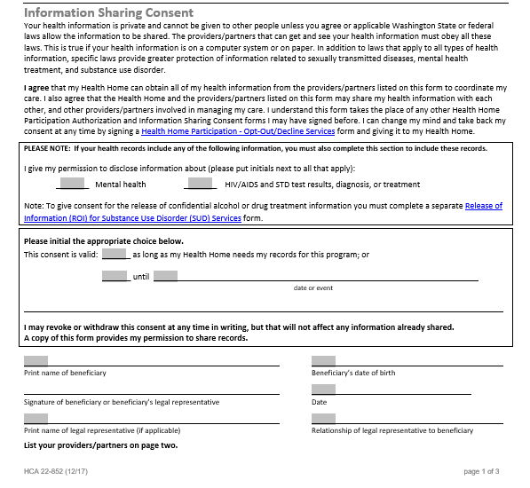
Part 2 of the form:
Information Sharing Consent portion of the form must be signed in order to release information to any party listed on the back of the form

Slide 60
Participation Authorization and Information Sharing Consent Form
Best practice is to take it to face-to-face visits and appointments to amend as needed
  If able, scan a copy into the client electronic health record (EHR) for other staff and providers to access
Use the back of the form to add and delete providers
  Enter the date and have the client initial

Slide 61
Outreach to Foster and Adoptive Children
The DSHS Fostering Well Being Unit (FWB) must be contacted before contacting foster parents
  Foster parent contact information is confidential and can only be released
  by the Children’s Administration Social Worker
  The FWB unit can identify the social worker assigned to the child so care coordinators can reach out to them regarding the child
Adoptive Children
  The Foster Care Medical Team at HCA can also assist with identifying the child’s adoptive parents. Call the HCA’s Customer Service line at: 1-800 562-3022 Ext. 15480 (you will need your agency’s NPI number in order to speak to a representative)
Most adoptive and foster care children receive managed care through Coordinated Care of Washington
Notes:
To determine contact information for children receiving Adoption Support services, the HH Lead or Care Coordinator should contact the Foster Care Medical Team (FCMT) through HCA’s Customer Service line at: 800-562-3022 ext: 15480. This team will be able to provide contact information of the child’s adoptive parents who are the caregivers for the child.
The Foster Care Well Being Unit only handles children in foster care.
Coordinated Care has also offered to assist in locating children.

Slide 62

Special Release of Information for Adolescents
Children ages 13 through 17 years must sign
a consent form to release their information
related to:
Mental health
Reproductive health
Chemical dependency
Notes:
For example: the parent will sign the Information Sharing Consent form and the adolescent must be asked, in private, if they consent to allow this protected information shared with the parent. Be sensitive to the adolescent’s wish to keep use of birth control confidential from parents, privacy related to the need for chemical dependency services, or information that is only shared between the child and their mental health counselor.

Slide 63
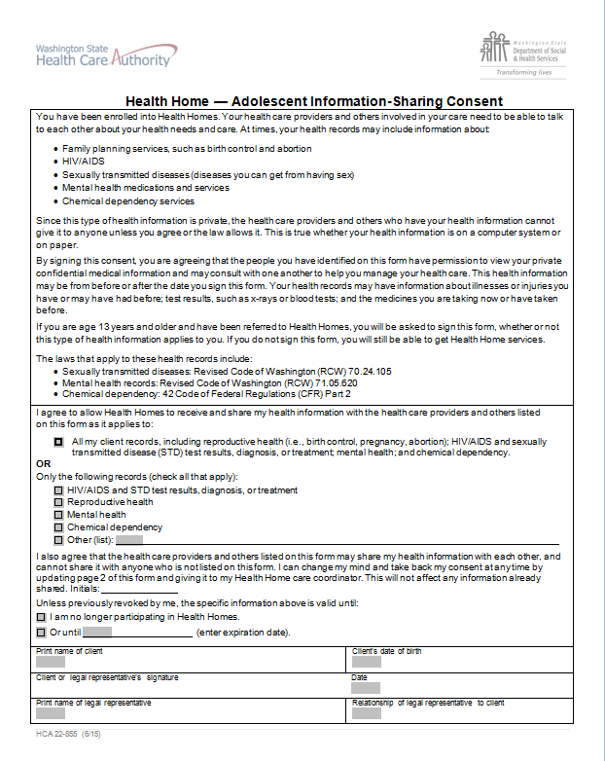
Adolescent
Consent Form
For children 13–17 years of age
TRAINING
Notes:
This form and translations are posted on the HCA website. Again, Leads and CCOs may choose to use their own forms.
Refer to the Adolescent Information Sharing Consent Form in the Classroom Training Manual and cover in detail the types of reproductive health information consent may include.

Slide 64
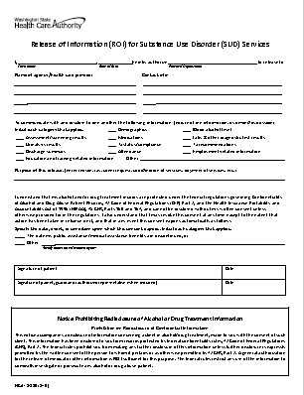
Release of Information Form for Substance Use Disorders
HCA form 13-335 (3/16)
TRAINING
Notes:
Refer to the form contained in the Classroom Training Manual.

Slide 65
Tribal Relations
Each tribe is a sovereign nation
Work with your Lead to determine the process for contacting tribal members
  Each tribe will have different processes and contact people
  Always respect tribal policy when entering tribal lands even if your client is not a tribal member
  Consider notifying law enforcement for the tribe that you will be entering their land

Slide 66
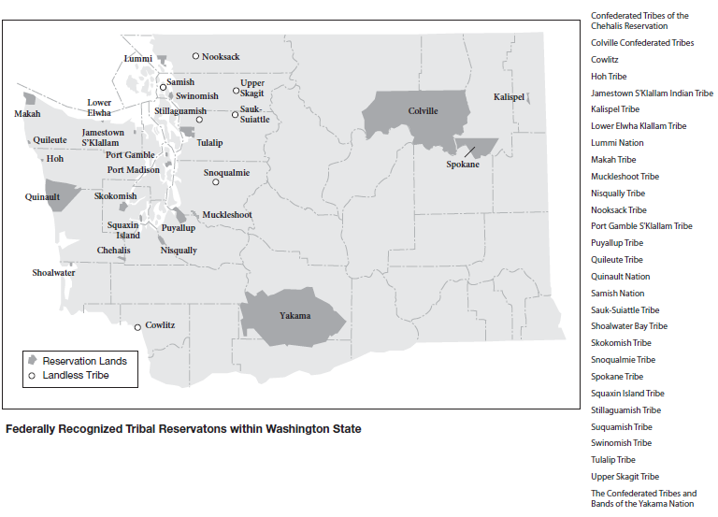
Federally Recognized Tribal Reservations
Notes:
Unfortunately there is no comprehensive list for contact persons for all of the tribes. This varies from tribe to tribe. Leads have established working agreements with tribes to contact your Lead before contacting a tribal member and follow their agreement.

Slide 67
Motivational Interviewing and Coaching
Notes:
Care coordination and health homes promote motivational interviewing as a method for guiding clients on their self-determined health journey. Care Coordinators are encouraged to take advantage of any Motivational Interviewing training sponsored by their Leads.
Motivational interviewing is one approach that can be used to aid our clients in developing a Health Action Plan to take control over their health and healthcare services.

Slide 68
The Spirit of Motivational Interviewing (MI)
Empathic “way of being”
Collaborative – Partnership of experiences
Evocative – Draws out, elicit ideas, identifies barriers,
and explores solutions
Encourages autonomy and provides support
Notes:
One way to incorporate the spirit of MI is through skillful listening and guiding, conveying a message of acceptance, hope and compassion. This approach helps to elicit from the client their own good motivations for making behavior changes in the interest of their health.
“Empathy” differs from “sympathy” - - empathy conveys a deep understanding or awareness of another persons situation. Sympathy requires judgment of a situation.

Slide 69
Engagement – Setting the Agenda
Begin with an attitude of curiosity and a desire to
understand more
Learn how the client’s behaviors or concerns fit into the person’s situation or world view
Be transparent and communicate your intentions and purpose

Slide 70
Join the Client on their Health Path
Explore:
GOALS
VALUES
IMPORTANCE
CONFIDENCE
BARRIERS
ACTIVATION AND ABILITY
Notes:
These are six factors that may impact a client’s motivation. Give your own examples or use the following for each of the factors.
Goals: is there something specific the client would like to achieve?
Values: is stable housing important to a client with no permanent housing?
Importance: is self-care less important to our client than providing care to an aging spouse?
Confidence: have previous attempts at behavioral change failed and are these failed attempts influencing the client’s level of confidence to try again?
Barriers: what barriers does the client see that may prevent change? For example, is the ability to pay for non-medical transportation to go to their local Community Center a barrier?
Motivation and ability: does the client have any prior experience with exercise programs? Are they interested in adding exercise into their routine?

Slide 71
Join the Client on their Health Path (cont.)
ENGAGE
FOCUS
Five Steps for Success:
EVOKE
PLAN
REVIEW
Notes:
Use Motivational Interviewing to:
Engage: the client, family, and/or caregiver
Focus: on the behaviors they would like to change
Evoke: draw from the clients their concerns, perceived barriers, confidence level, and willingness to consider a change in self-management of their chronic conditions
Plan: create a Health Action Plan to address their concerns and desires for improving their health
Pursue and review: support the client in pursuing their health changes by offering the six health home services
Five key steps for success:
Engage: using Motivational Interviewing such as asking open-ended questions can help engage the client in examining their health and move toward developing a Health Action Plan
Focus: work with the client to identify one long term goal that they would like to focus on
Evoke: work with the client to draw out their own inner resources
Plan: work with the client to develop a plan using short term goals and action steps to move them toward their long term goal
Review: monthly visits and telephone calls provide an opportunity to review the Health Action Plan to identify progress and reinforce the positive changes

Slide 72
Keys to Successful Care Coordination
Meeting the client where they are
Engagement
Collaboration
Consistent and regular contacts
Transitional care supports
Confidence and skill building for self-management of chronic disease/s

Slide 73
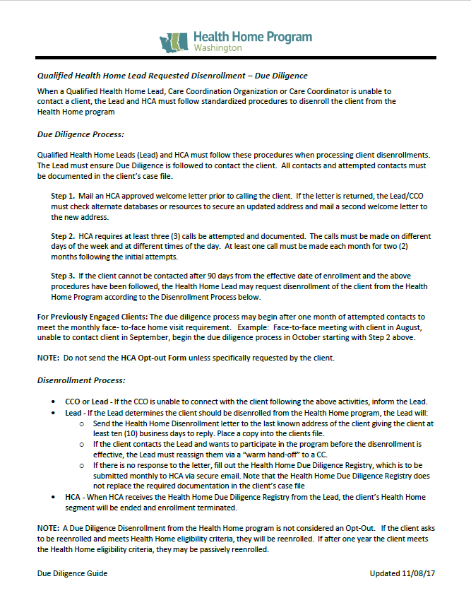
Due Diligence
TRAINING
Notes:
Ask participants to pull out the procedure from the Reference Section of their manuals.

Slide 74
Due Diligence (cont.)
Three telephone calls must be attempted: note in narrative
One introduction letter must be mailed
Document your actions and discuss with your Lead if unable to contact
Notes:
Calls must be placed over three months and at varying times during the week and day.
So, we don’t want the CC or outreach specialist to call the client three times within an afternoon and then report that they cannot contact the client.
The calls must be completed each months for three months (the months do not have to be consecutive).

Slide 75
Opting Out
Clients have the right to:
Opt out of the program before services begin
Opt out at any time after services begin
If your client requests to re-enroll in the program the Care Coordinator can contact the Lead to request re-enrollment
Notes:
A protocol for hard-to-serve clients has been established so contact your Lead and they will discuss re-enrollment with the HCA Enrollment Specialist.

Slide 76
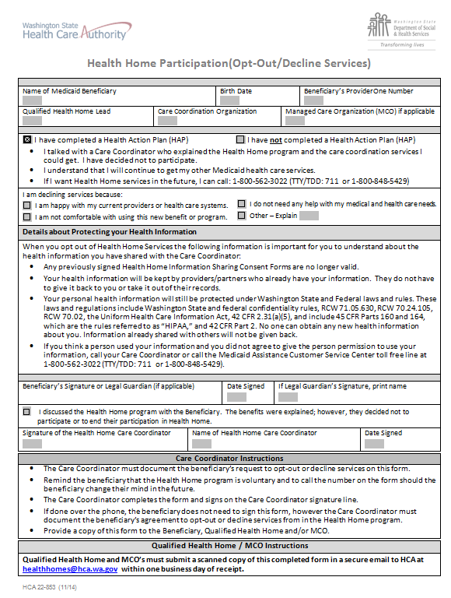
Opt Out Form
The client may complete and sign the form or the Care Coordinator or allied staff may complete the form on the client’s behalf
Mail a copy to the client because it contains information on how to re-enroll in the program if they change their minds
TRAINING
Notes:
Refer to the Opt Out form located in the Classroom Training Manual and on the HCA’s Website. Note that this should be taken to face-to-face visits in case a client decides to opt out. If the client does not want to complete and sign the document the Care Coordinator or other allied Health Home staff may complete the form on behalf of the client. The completed form is submitted to the Lead Organization. Retain a copy in the client’s file or electronic health record.

Slide 77
Client Vignettes
We will use these vignettes throughout our training activities:
    Sacha
    Carmella
    Luchita
    Tom
    Jacob
TRAINING
Notes:
Refer to the profiles for the vignettes in the Classroom Training Manual in the Reference section.

Slide 78
Small Group Work
Review the profile of your client
Record the following on your flip chart:
Client profile: briefly describe your client
What actions would you take to reach out to the client and engage them in the program?
Notes:
Have the students break up into small groups using the vignette profiles contain in Section B of the Classroom Training Manual. Ask them to assign a recorder and a reporter. The recorder will write the group’s ideas on the flip charts and the reporter will report out to the entire class.
Then have the small groups brainstorm how they will engage with their client. They will record their responses on separate flip charts.
1. First ask them to write a brief description of their client.
2. Ask them how they will engage the client on the phone and what would be the plan for your first face-to-face visit (you have no release of information at this point). Consider what is “coordination of care” and if the Care Coordinator can begin to work on behalf of the client without written consent.
Note that if they will be working with children that at age 13 the child must provide permission to release information about MH, chemical dependency, and reproductive health.

Slide 79
Let’s Pause to Check for Understanding
What experiences have you had when you have initially contacted new clients in the past? What worked or didn’t work?
Do you have any questions?
Notes:
Ask participants to share their experiences with “cold calling” clients in previous jobs.

Slide 80
PRISM
A Care Coordination Tool
Predictive Risk Intelligence SysteM
Notes:
Question: what is the highest score possible in PRISM? Pierre Katona reports that there isn’t a programmatic maximum for the “Risk Score” – this means that there is no cap to the value, though there may be a “practical” maximum.
The “IP Admit Risk Score” of 95% is the highest score possible.

Slide 81

Today’s Presenter
Candace Goehring, MN, RN
  Director of Residential Care Services
  Dept. of Social and Health Services
  Aging and Long Term Support Administration
Notes:
Introduce Candace Goehring. She developed the Chronic Care Management Program for DSHS ALTSA which evolved into the Health Home Program in 2013. She wrote the original Health Home Care Coordinator Basic Training and much of her training is still contained in this PowerPoint and the training manual.
Play the video. Note that there is a point at which the video should be paused to allow for dialogue and questions. Advance the slides to Slide 114 to cue for this discussion.
The video portion of the training ends on Slide 124. The instructor resumes training at this point in the PowerPoint when the video ends.
If the instructor is unable to play the video then the instructor must review all of the slides for this section and include review of Sacha’s PRISM Excel workbook. Each tab/screen of the PRISM Excel worksheets must be reviewed with explanations on how to interpret the information.

Slide 82
PRISM
A Decision Support tool designed to support care management interventions for high-risk clients
Identification of clients most in need of comprehensive care coordination based on risk scores developed through predictive modeling and other indicators
Integration of information from medical, social service, behavioral health, and long term care payments and assessment data systems
Intuitive and accessible display of client health and demographic from administrative data sources
Notes:
PRISM, with it’s big picture perspective, is a good complement to clinic-specific electronic health record systems containing clinical values.

Slide 83
Risk Tools
Future Medical Cost Risk Score
  Calculates expected level of future costs relative to a comparison group
Inpatient Admission Probability
Calculates the probability of an inpatient admission in the next 12 months
Mental Illness Flag
Substance Use Flag
Notes:
The secure on-line PRISM application contains multiple methods or ways to identify those clients in most need of care coordination
The future Medical Cost Risk Score, often referred to as the PRISM score: This risk score relates to the client’s risk to incur future medical costs.
A second tool is the Inpatient Admission Probability which indicates the probability of inpatient admission in the next 12 months.
Two important factors affect appropriate utilization of health services : an indication of either mental illness or substance use

Slide 84
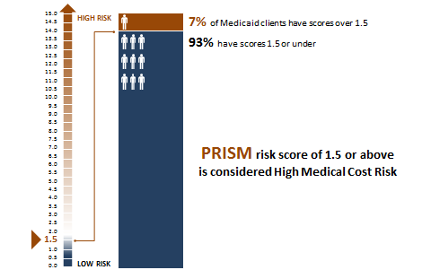
Defining High Future Medical Cost Risk
Notes:
The medical risk score was developed for identification of clients where care coordination would most likely result in reducing future costs. It estimates the expected future medical costs relative to a comparison group, and considers a person’s age, gender, diagnoses, and medications based on paid claims in the past 15 months for adults, 24 months for children.
A client with a risk score of 1.0 means that their future medical expenditures are expected to be the same as the average medical cost for a person qualifying for Medicaid due to disability. Adult and child risk weights are calibrated separately to the disabled adult and disabled child populations, respectively.
A client with a risk score of 1.5 means they are expected to incur 50% higher costs in the next year than the average cost for a disabled Medicaid (SSI) client. Roughly 7% of all Medicaid clients have a risk score of 1.5 or above. For some groups the percentage is higher, others lower, but on average high medical risk accounts for 7% of the population.
Since care coordination resources are limited, a policy decision was made to target health homes and care coordination to the top 5-7% of the Medicaid population, those with a risk score of 1.5 or above. If care coordination can be proven to contain costs and improve care for this population, health homes will more likely be supported for a larger portion of the Medicaid population in the future.
The score is only a starting point – don’t place too much emphasis on the exact numeric value. A client with a score of 1.20 will generally be less complex than a client with a score of 7.0, but the differences between 1.2 and 1.3 are likely to be negligible from a care management perspective. The score is a tool to start identifying those who have higher, more costly needs. The score can vary somewhat every week, based on changes in age or new claims being processed. However, once a Medicaid client is identified as “clinically qualified”, they stay qualified regardless if their PRISM score drops to lower than 1.5.
We do not use changes in the PRISM score as a performance measure for the effectiveness of care coordination, rather we look to reductions in avoidable utilization of hospital, emergency department, and skilled nursing home services.

Slide 85
Prospective Inpatient Admission Probability
Example condition within risk group
Notes:
This is another feature in PRISM: the probability of a general acute hospital admission within the following year.
For each condition, there is a probability of the client having an inpatient admission in the following year. Not all conditions are included in the calculation.
For example:
For those will sickle-cell disease, there is a 27.7% chance of being admitted to a hospital in the next 12 months.
To find the total probability add together each relevant factor.

Slide 86
Prospective Inpatient Admission (cont.)
Hospital Admission Impact . . .
Outpatient Emergency Room Utilization Impact . . .
PATIENT EXAMPLE
Jane Doe has been diagnosed with congestive heart failure (9.4%), poorly controlled type 1 diabetes (6.0%), and chronic obstructive asthma (5.3%)
She was hospitalized once in the prior 31-90 days (5.8%), and twice in the prior 183-365 days (2 x 2.1% = 4.2%)
She has been to the Emergency Department twice in the past month without being admitted to the hospital
(2 x 1.7% = 3.4%)
Her risk of an inpatient admission in the next 12 months is 28.3%
Notes:
Prior hospital use also increases a person’s probability of an inpatient admission in the following year.
Here is an example of Jane Doe, with multiple risk factors, hospital admissions, and outpatient emergency department visits.
Understanding the risk for future hospital admission within the next 12 months can assist the Care Coordinator and client in identifying health risks and the need for health action planning to prevent avoidable admissions.

Slide 87
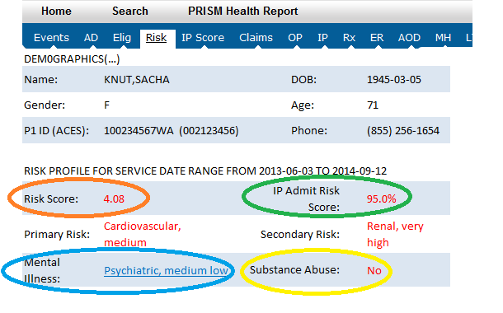
Risk Profile
Notes:
Four key tools are found on almost every client-specific page in the on-line PRISM tool – the client’s Risk Profile
1. The medical cost risk score shown in the orange oval represents our client’s risk for incurring medical costs as compared to the base group. For PRISM the base group referenced is the disabled Medicaid (SSI) population. This base group has a risk score of 1.0.
2. The Inpatient Admission Risk probability is show in the green oval.
3. We all know the interrelated connections between mental and physical health. The blue oval highlights the latest diagnosis or prescription that may indicate mental health treatment need. A user can click on the link and look at the underlying psychiatric diagnoses and prescriptions.
4. The substance abuse flag (the yellow oval) indicates whether there are indications of potential need for substance use treatment. This flag does not indicate whether the client is receiving substance use treatment. – substance use treatment information is not shared through PRISM due to the restrictions imposed by 42 CFR Part 2. Indicators of alcohol and drug use disorders are derived from diagnoses from other health service events, like emergency room visits or prescribed medication. A user can click on the link and look at the claims and make their own determination on whether the client may have a dependence issue or whether the pattern suggests possible abuse.

Slide 88
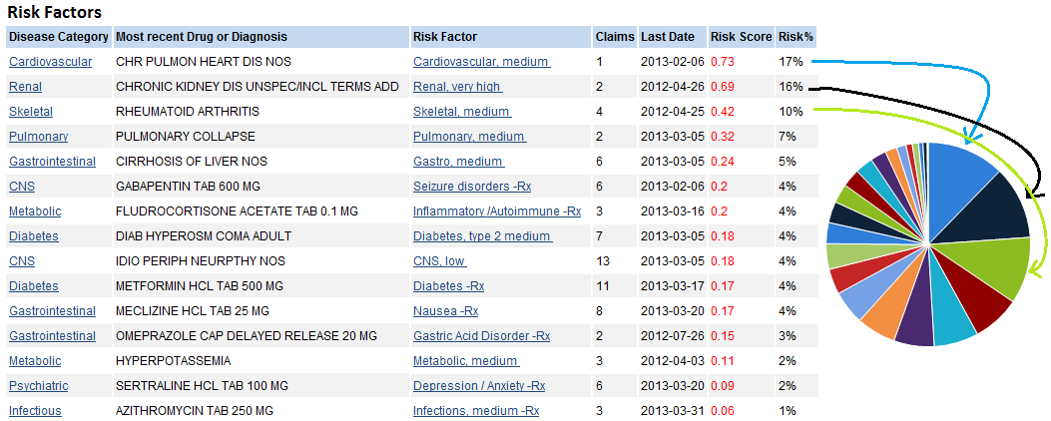
Risk Factors
Notes:
A medical cost risk score can be broken down into risk factors.
We start with disease categories. Each disease category is broken down into risk factors, which are groups of diagnoses and/or prescriptions reflecting their relative contribution to future expected medical expenditures, for example: “high cost, medium cost, or low cost ”.
The risk factor screen in PRISM show the disease category, the most recent drug or diagnosis and links to the underlying claims.
On each PRISM screen you will see the pie chart which serves as a visual reminder of the different risk factors identified for the client. You can see that the size of the pie chart pieces corresponds to the Risk % in the list.

Slide 89
Risk Factor Methodology for Identifying Eligible Clients:
Medical expenditure risk factors include the following:
  Age
  Gender
  Diagnoses
  Prescriptions
Note: the Health Home program was designed only to identify the top 5-7% of the Medicaid population and cannot accommodate everyone who could benefit from care coordination

Slide 90

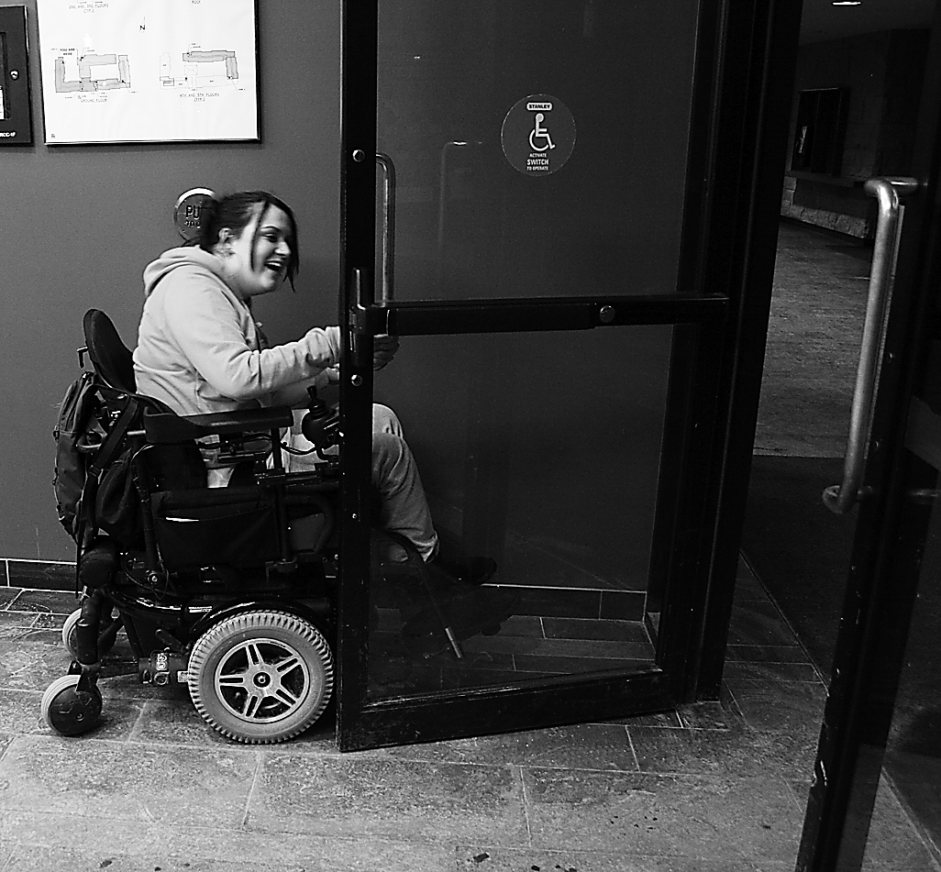
Why Do We Focus on Risk?
Notes:
In summary, we have different risk tools and the breakdown of risk factors to help understand potential priorities for care coordination.

Slide 91
What We Have Learned About Dual-Eligible Clients
Chronic conditions are more prevalent for dual-eligible clients
Notes:
People who are covered by both Medicare and Medicaid are called, “Dual Eligible” clients. In the past, PRISM only contained Medicaid claims. Now that we are receiving Medicare claims data in addition to Medicaid, we are understanding the prevalence of chronic diseases for those covered by both Medicare and Medicaid.
Not all Lead Organizations or CCOs will work with dual-eligibles.

Slide 92
Duals with High Risk Scores
Disproportionate share of Medicare Inpatient costs
High-Risk Dual Elders
High-Risk Dual Disabled
Share of total Medicare
Inpatient
dollars spent
Share of total Medicare Inpatient dollars spent
Percent
of the population
Percent
of the population
$s
$s
Notes:
Why do we focus on high-risk dual-eligible clients?
Those people with a PRISM score of 1.5 or above (comprised of age, gender, diagnosis, and medications) account for a disproportionate share of total costs. Here is an example of total costs for inpatient costs.
There are two distinct groups within those who are dual eligible. Those who are over 65 years old (dual elders) and those who are under 65 and dual eligible due to a disability.
High risk dual elders make up 38% of the dual elder population, but 89% of total Medicare inpatient expenditures.
Likewise high risk dual disabled make up 34% of the dual disabled population, but 87% of the inpatient dollar spend.

Slide 93
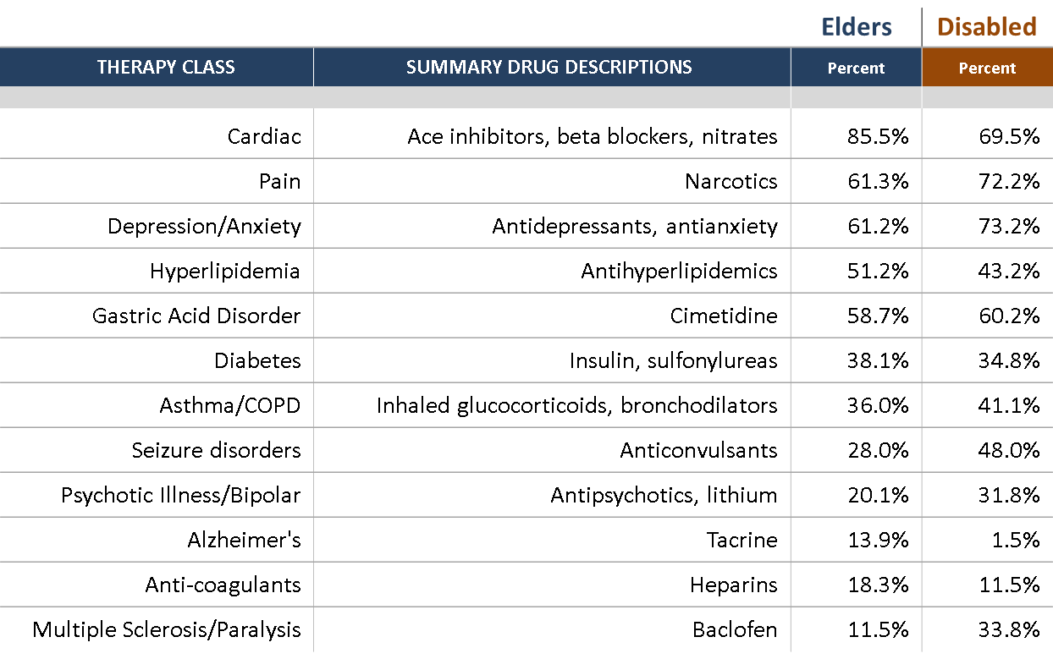
Pharmacy Profiles: High-risk Dual Eligibles
Persons with at least 1 month of dual Medicaid/Medicare enrollment in SFY 2010
Notes:
Dual-eligible elders show a slightly different pattern of pharmacy usage than the disabled duals. For both types of dual-eligibles, cardiac drugs, pain and depression/anxiety therapy classes top the list. Dual elders will likely use more medications for chronic diseases such as DM or cardiac disease; dual disabled will utilize more medications for MS and seizure disorders.
This knowledge and understanding direct care coordination, health action planning , and referral and resource supports.

Slide 94
Why Focus on Coordination Across Delivery Systems?
High-risk clients are likely to have service needs in multiple delivery systems
Dual elders
Alcohol/drug treatment services
Treatment for serious mental illness
Long term care or developmental disability services
Dual disabled
Alcohol/drug treatment services
Treatment for serious mental illness
Long term care or developmental disability services
Medicaid only, disabled
Alcohol/drug treatment services
Treatment for serious mental illness
Long term care or developmental disability services
Medicaid only, not disabled
Alcohol/drug treatment services
Treatment for serious mental illness
Long term care or developmental disability services
Notes:
A key aspect of Health homes is coordination across delivery systems. The types of coordination needs vary, with distinctly different patterns of service needs by type of client such as alcohol/drug treatment services, treatment for serious mental illness, and long term care or developmental disability services.
The dual elders and dual disabled clients will be primarily served under the fee-for-service payment system, while most of the Medicaid only disabled and Medicaid only, not disabled will be enrolled in managed care.
The teal colored column represents the percentage of clients receiving Alcohol or drug treatment services
It captures a 2-year window based on:
Diagnosis of substance use disorder
Receipt of substance abuse treatment or detox services (including medication assisted treatment)
Arrested for a substance-related offense
The olive green colored column represents the percentage of clients receiving Treatment for Serious Mental Illness
It includes one or more of the following . . . .
Received RSN or state mental hospital services in the fiscal year
Diagnosis of the following (2-year window):
Psychotic disorder
Mania/bipolar disorder
Recurrent depression
Receipt of the following within a 2-year window:
Antipsychotic medications
Anti-mania medications
The final dark blue colored column represents the percent of clients receiving:
Long term care or developmental disability services
It includes any costs in the following LTC service categories in the fiscal year:
In-home personal care
Nursing facility
Adult family home
Adult residential care
Assisted living
It also includes any costs in the following DD service categories in the fiscal year:
Personal care
Residential Habilitation Center
State Operated Living Alternatives
Other residential programs

Slide 95
Accessing PRISM
Notes:
Why PRISM is highly secured
How to gain access to PRISM
Initial and ongoing training requirements

Slide 96
PRISM User Responsibilities
Your Lead Organization’s PRISM coordinator will:
  Instruct you on the registration process
  Determine the type of access you receive
Keep contents confidential and private
Don’t share your password
Annually update your agency’s IT security and HIPAA confidentiality training
Contact your Lead Organization if your profile information changes
Notes:
How to gain access to PRISM:
fill out the PRISM user agreement form
complete your agency’s HIPAA and IT security training
Submit this information to your Lead Organization. The Lead Organization will then submit the request to the DSHS PRISM coordinator
Your agency’s IT security and confidentiality training must be completed yearly.
User responsibilities and restrictions:
Keep contents confidential and private.
Access, use and disclose the minimum information necessary to perform your job.
Only authorized and authenticated PRISM Users may access and use the PRISM application. Do not share your username or password.
Actual or potential security breaches involving PRISM information must be reported immediately to your Lead Organization and to PRISM.admin@dshs.wa.gov
Use of the PRISM system is continuously monitored. Access privileges may be suspended or terminated for unusual or potentially unauthorized activity. Electronic stripping of data off PRISM is not allowed.

Slide 97
PRISM Use
Only access, use, and disclose the minimum amount of data to perform your job and assist the client
Report suspected or actual security breaches to your Lead Organization immediately
PRISM is monitored continuously and access may be suspended or terminated for unusual or potentially unauthorized activity
Violations of RCW and HIPAA may result in severe criminal or civil penalties
Notes:
Only review the clients that are assigned to you. Do not release reports without the client’s written consent to release PRISM information.
Check with your organization for accessing and printing PRISM data for use while in the field.

Slide 98
How Do I Use PRISM in my Role as a Care Coordinator?

Slide 99
Uses of PRISM
Triaging high-risk populations to efficiently allocate scarce care management resources
Identification of health risk indicators for high-risk patients
Identification of behavioral health needs
Medication adherence monitoring
Identification of other potential barriers to care
  Homelessness
  Hearing impairment
  Limited English proficiency
Notes:
Homelessness, hearing impairment, and limited English proficiency may influence how you reach out and engage your clients. For example, sending mail to a person known to homeless may not be successful. Calling a client on the phone may not be the best strategy for contacting a client with hearing impairment.

Slide 100
Uses of PRISM (cont.)
Access to treating and prescribing provider contact information for care coordination
Creation of health summary reports to share with providers
Identification of care opportunities

Slide 101
Keys for Effective PRISM Use
Be bold! You can’t hurt anything
Check eligibility tab to determine completeness and coverage gaps
Consider possibility of false positive diagnoses
  Can include “Rule Out” diagnoses
  Diagnoses reflect standard uses of medications, not off-label uses
Notes:
Be bold – you can’t hurt or change anything in PRISM, so feel free to click on the tabs and hyperlinks, those items with a blue underline, that you need to understand the needs of the client you are working with.
Tips for interpreting PRISM data:
Consider the client’s Medicaid eligibility coverage status. PRISM contains data for services paid for by the Washington State Health Care Authority and the Washington State Department of Social and Health Services. Services paid out of pocket, through private insurance or received for free will not be reflected in PRISM. Check the eligibility screen first to find gaps in Medicaid coverage.
Use information with care. PRISM displays information recorded on reimbursement claim forms. In some cases, it is possible that diagnoses recorded may not accurately reflect a patient’s current health conditions. For example, lab claims may capture “rule out” diagnoses for conditions that are ultimately determined not to be present.
Don’t assume that the medication is being used for a specific diagnosis. For example, gabapentin is prescribed for seizures but it also used for mental health and diabetic nerve pain. So use of gabapentin may not indicate that the client has seizures.

Slide 102
Keys for Effective PRISM Use (cont.)
Consider lag times – PRISM updates weekly but providers may be slow to submit their claims
Out of pocket payments or private insurance payments will not display in PRISM
Alcohol and drug treatment services are redacted and will not appear. If alcohol or substance use have been noted by a provider in other health services events then a flag (yes) will display
Notes:
Tip for interpreting PRISM:
Consider lag times. Although PRISM is generally updated on a weekly basis, lags in processing claims will result in lags in data availability. As a consequence, you may not be able to view all of the client’s most recent health service events.
Use information with care. PRISM displays information recorded on paid claims and accepted encounter data. In some cases, it is possible that diagnoses recorded in claims and encounters may not accurately reflect a patient’s current health conditions. For example, lab claims may capture “rule out” diagnoses for conditions that are ultimately determined not to be present. Also different billing practices (up-coding) may imply a greater health intervention or problem than occurred.
Alcohol/drug treatment information is not available. Alcohol/drug treatment information is not displayed due to federal law. Indicators of alcohol and drug use disorders are derived from diagnoses from other health service events. You will not be able to determine whether clients with indications of substance use problems have been or currently are in treatment.

Slide 103
Keys for Effective PRISM Use (cont.)
Mental Health: this is created as a flag that the client may need mental health services. It is based on either prescriptions or diagnoses from other health service events.
Tailor how you will use PRISM data with your client
  How much information will you share?
  Will this information serve to activate your client and reinforce their changes?
Notes:
Tip for interpreting PRISM:
Consider lag times. Although PRISM is generally updated on a weekly basis, lags in processing claims will result in lags in data availability. As a consequence, you may not be able to view all of the client’s most recent health service events.
Use information with care. PRISM displays information recorded on paid claims and accepted encounter data. In some cases, it is possible that diagnoses recorded in claims and encounters may not accurately reflect a patient’s current health conditions. For example, lab claims may capture “rule out” diagnoses for conditions that are ultimately determined not to be present. Also different billing practices (up-coding) may imply a greater health intervention or problem than occurred.
Alcohol/drug treatment information is not available. Alcohol/drug treatment information is not displayed due to federal law. Indicators of alcohol and drug use disorders are derived from diagnoses from other health service events. You will not be able to determine whether clients with indications of substance use problems have been or currently are in treatment.
When reviewing PRISM data consider how the client may react if they know that you have access to all of this information about their health and healthcare. Would it be more effective to be aware of hospital or ED use and instead of pointing this out ask a more open ended question that does not imply judgment such as, “can you tell me about your healthcare providers?” “Where do you first go when you need to see a doctor?”

Slide 104
PRISM Data

Slide 105
PRISM Screens
Events Event timelines for Inpatient, Outpatient, ED, Medicare and Medicaid
AD Drug adherence timelines for all prescription drugs
Risk Factors Key Medical and Behavioral Health Risk Areas
Eligibility Detailed eligibility and demographic data
Claims All medical claims and encounters
OP Outpatient claims
RX Prescriptions filled
IP Inpatient admissions
ER Outpatient emergency room visits
LTC Long term care services
Lab Laboratory
Providers Provider list with links to contact information
MH Mental health services
CARE Long-term care functional assessments
HRI Health risk indicators (for Children)
Notes:
These are the categories and tabs for the ribbon across the top of the PRISM screen. Note that there are tabs for AOD (Alcohol or Drug) and PAM (Patient Activation Measure) but these fields are no longer functional.
HRI or Health Risk Indicators can be used to identify if the child is keeping up with immunizations and other routine care.
Some PRISM screens will contain information about payments authorized in 2015 using the Social Service Payment System known as SSPS under the LTC tab. This payment system is no longer used and providers for LTSS services are now being paid by ProviderOne. ProviderOne downloads claims data to the PRISM system.
At this time only medical claims for services will display within the Claims section of PRISM. For example, nurse delegation and client training claims can be seen. These medical providers will also pull up if you go to the Providers section of PRISM.
Non-medical claims do not currently show in the Claims section. So, for example, you will not be able to see claims for an individual provider providing in-home services to an LTSS client. Non-medical claims for payment to adult family homes and assisted living facilities are also not shown.
Adding non-medical claims for LTSS services in PRISM is under consideration at this time

Slide 106
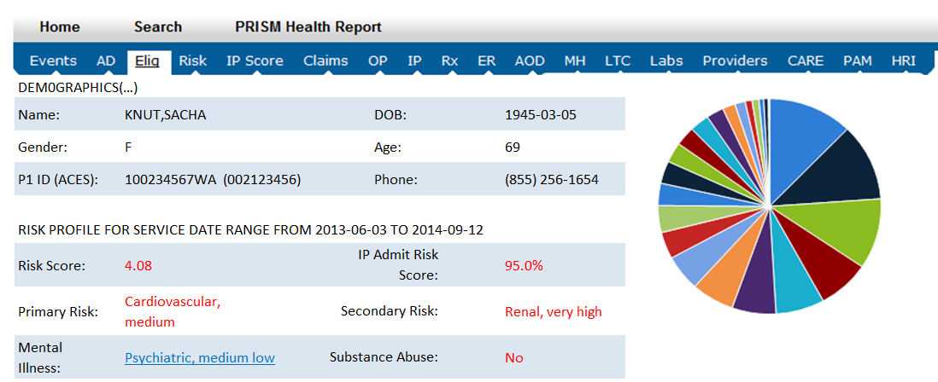
Let’s Look at a De-identified Case
TRAINING
Notes:
If the video is not used then the instructor must open one of the PRISM spreadsheets for the vignettes and review each tab. Sacha’s PRISM report is contained in the Classroom Training Manual and students should be instructed to refer to this during review of a case. Instructors should consider reviewing Sacha’s PRISM report since it is contained in the manual.
Here is Sacha’s PRISM data. In her case the total risk score is 4.08, so her expected future cost of medical care is 4 times that of the average client.
The largest contributors to the clients future expected costs are cardiovascular diagnoses at 17%, followed by renal, skeletal and pulmonary conditions.
Because of their importance as underlying drivers of behavior, a mental illness flag and substance abuse flag are added to the risk profile.
While the risk factors and other indicators point to what statistics tell us are most strongly associated with a clients future expected costs, they don’t tell us the behavior drivers or areas where care coordination may be most effective.
That is where your clinical judgment comes in, to look at the whole person and work with them to identify goals.

Slide 107
PRISM Screens
PRISM can assist you in your care coordination duties

Slide 108
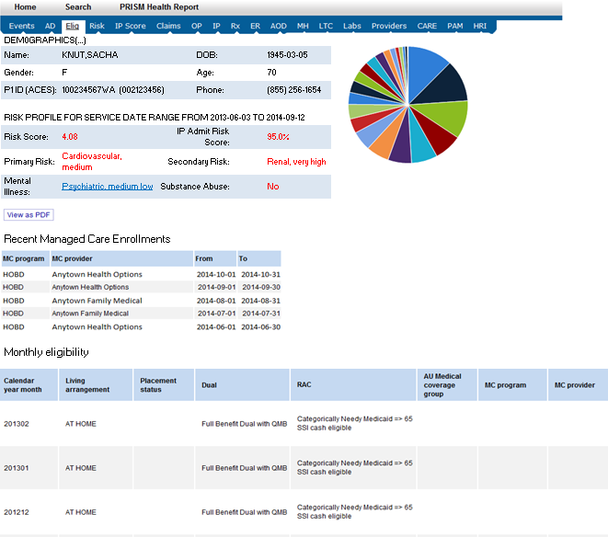
Use the Eligibility Screen to Verify Current Coverage and Gaps
Has the client been previously covered by another MCO?
  If so there may be a HAP already in the system
Is the client currently eligible?
Are there any gaps in coverage?
Notes:
Encourage participants to always check the eligibility screen to ensure that their client is currently covered by Medicaid. Access to PRISM data varies among Care Coordinators. If the Care Coordination Organizations is not contracted to serve Medicare clients then Medicare claims data will not appear.
Check the eligibility screen to review recent managed care enrollment. This may be an indication that the client already has a HAP somewhere in the system that you should access.
Review the eligibility screen to identify gaps in coverage. These gaps may indicate periods of incarceration or homelessness resulting in a loss of coverage which could identify a challenge to locating the client.

Slide 109
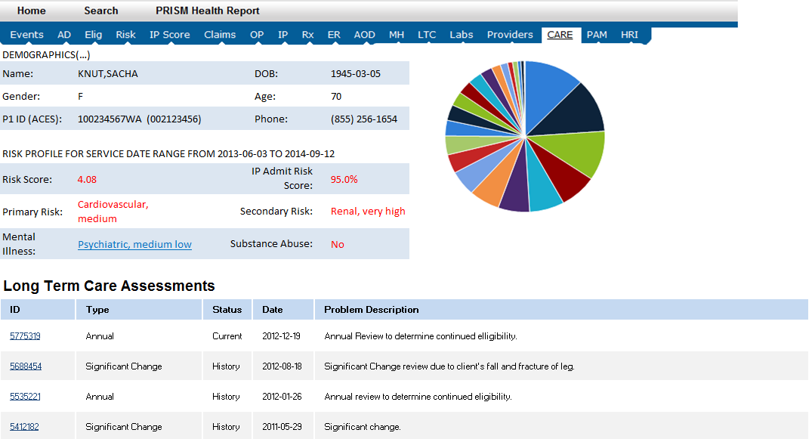
Identifying Long Term Care Services: the CARE Tab
Notes:
By opening the CARE tab you can see CARE assessment dates and the assessment types. The most recent assessment will be identified as “current” and all prior assessments will be indicated as “history” in the Status column of the screen.
The Problem Description column can provide insight as to why the assessment was completed. Sometimes assessments are completed as required by the LTSS program rules and are identified as Initial or Annual assessments.
At other times the assessment is completed due to a change in the client’s condition. These assessments are identified as Significant Change assessments.

Slide 110
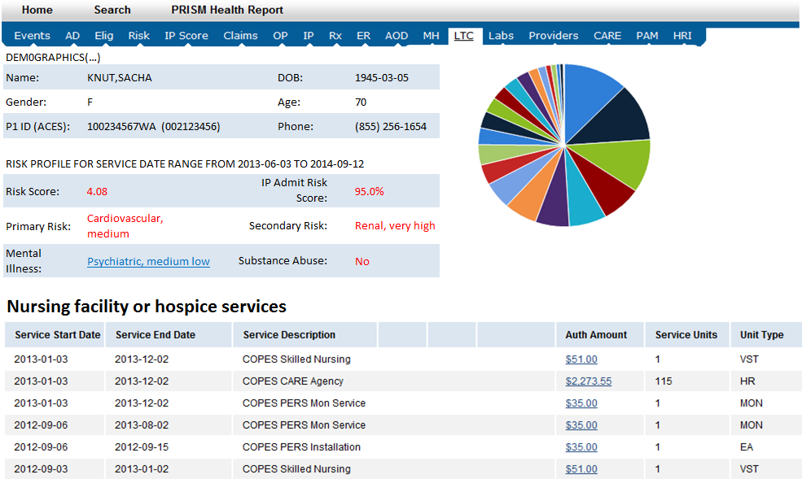
Long Term Care Payments
Payments may also be located under Claims screens
Notes:
As mentioned earlier authorizations for LTSS services were contained within the LTC PRISM screen.
Now claims for medical LTSS services are contained in the Claims screen. Non-medical LTSS claims are currently not available under the Claims screen. Some historical SSPS authorizations prior to 2016 will show within the LTC PRISM screen.

Slide 111
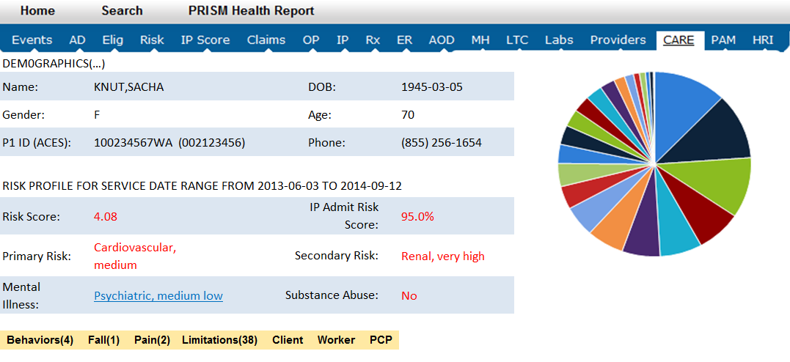
Identifying the LTSS Case Manager
Click on these links for name and contact information
Notes:
In the CARE detail screen Care Coordinators can locate the name and phone number of the case manager for HCS, DDA, and the AAA.
Note that CARE provides the names of the PCP. This may be another method of locating the client for initial outreach. Click on the PCP field which will display the physician’s name, address and phone number. If the client was recently assessed in CARE the name of the provider may be current and may help in locating clients.

Slide 112
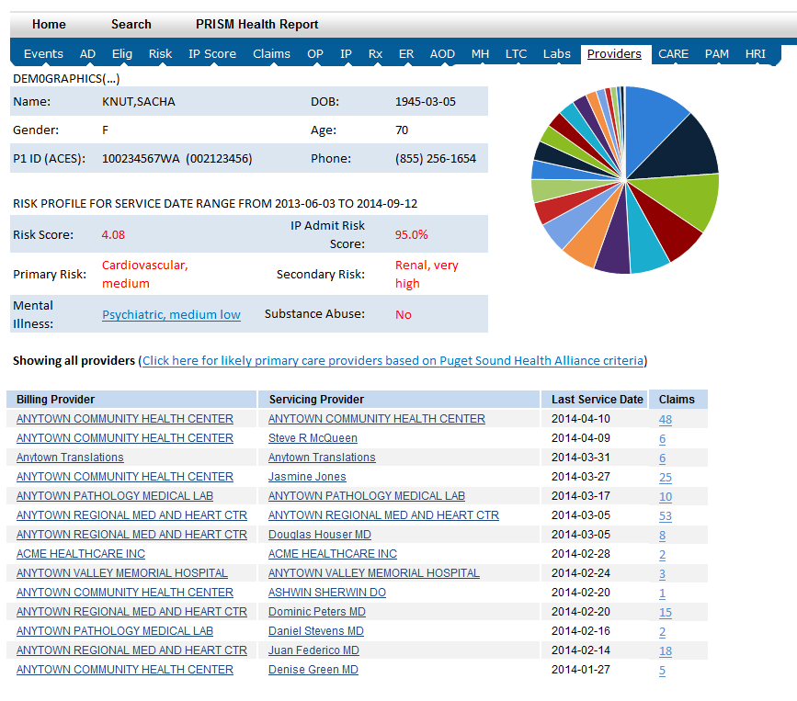
Another way to find the PCP
Notes:
Here is another method of identifying providers for locating the client for initial outreach. In the Provider screen, for each Billing and Performing Provider, you can drill down to find the physician’s name, address and phone number.
If you click on the link where the arrow is, you are taken to a listing of most likely primary care providers.

Slide 113
PRISM Health Report
See your training manual for an example for John Doe in the Reference section of your manual
Value of these reports:
  Helps promote self-management
  Supports the client as their own historian
  Provides a snapshot of the various look-back periods for the various screens
  Promotes continuity of care between health care providers

Slide 114
Let’s Pause the Video to Check for Understanding
Have you used PRISM in the past and what was your experience? How did you use the information about your client?
Do you have any questions?
Notes:
Instructor will pause the video to check for questions and understanding.

Slide 115
How to Make a Referral
If a Care Coordinator identifies someone who may benefit from Health Home services the Care Coordinator may:
  Contact your Lead Organization
    Leads have universal access and can access all client records
  If the client does not have a PRISM score of 1.5 consider if there are recent major changes to health which may qualify them
  Refer the case to their Lead Organization and include any additional information that may support the referral
Notes:
Resume the video.

Slide 116
How to Make a Referral (cont.)
The Lead will submit the referral to the Health Care Authority (HCA)
The Lead may be aware that the client is already assigned to another CCO
The Lead may refer the case to a different CCO if HCA approves services
The HCA may not approve the services
The HCA may choose to refer the case to another Lead

Slide 117
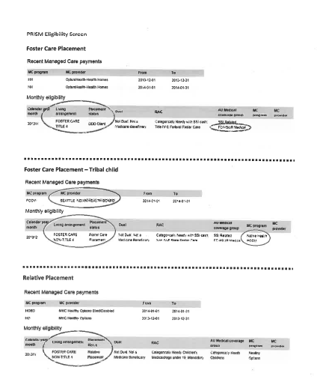
Reminder: Contact Requirements for Foster Children
To identify if a child is receiving foster care check the PRISM eligibility screen
Contact Children’s Administration, not the foster parent for initial outreach
TRAINING
Notes:
Lead Organizations are also informed if a child is in foster care on the 834 Report they receive from the Health Care Authority when new clients are assigned to the Lead.

Slide 118
Final Thoughts on PRISM
Use this tool to optimize Health Action Planning and client support
Report all suspected or actual security breaches to your Lead Organization immediately
PRISM is monitored continuously and access may be suspended or terminated for unusual or potentially unauthorized activity

Slide 119
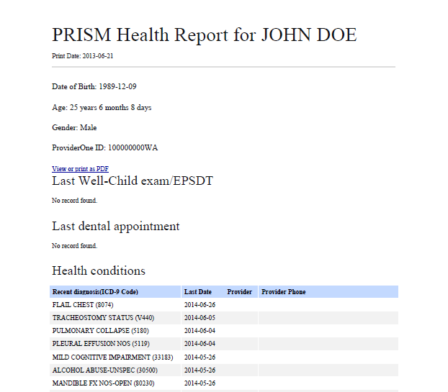
Final Thoughts on PRISM (cont.)
Review your clients only: violations of RCW and HIPAA may result in severe criminal or civil penalties
Do not release the client’s reports without the client’s written consent to release PRISM information
TRAINING

Slide 120
Where to Turn for Assistance
Notes:
If you are having difficulties logging into PRISM check with your Lead Organization/s. Your information must be precise, for example your e-mail address. If you have more than one e-mail address make certain that you are using the e-mail address you provided for PRISM access.

Slide 121
Where to Turn for Assistance
Contact your Lead Organization
PRISM Support (DSHS Research and Data Analysis)
prism.admin@dshs.wa.gov
Health Care Authority Health Home Program
healthhomes@HCA.wa.gov
Notes:
If you are still having problems with access please contact PRISM support.

Slide 122
Practice Using PRISM
Let’s return to our vignettes and begin our small group activity
    Sacha
    Carmella
    Luchita
    Tom
    Jacob
TRAINING
Notes:
Refer to the profiles for the vignettes in the Classroom Training Manual in the Reference section.

Slide 123
Small Group Work
Navigate and review the Excel spreadsheet to analyze your client’s use of services
What is PRISM Risk Score and IP Admit Risk Score?
What did you note about your client in reviewing the screens in PRISM?
What issues or gaps in care* did you identify that you would like to discuss with your client?
*Gaps in care means the identification, coordination, and processing of needed referrals to meet a client’s medical, behavioral health, and social service needs.
Notes:
End of video. Resume instruction with the small group work on PRISM.
Ask the trainees to return to their small breakout groups. For this activity use lap tops with the vignettes and Excel worksheets to do an analysis of the PRISM data and report back on a priority areas for this client from the Care Coordinators perspective. Record risk factors identified, patterns of use of services and gaps in services on the flip charts for each client. What questions may have been raised in analyzing the PRISM data?

Slide 124
Let’s Pause to Check for Understanding
If you have used PRISM in the past which screens did you find most helpful?
Do you have any questions?

Slide 125

The Patient Activation Measure® Coaching and Action Plan Development
Notes:
The Lead Organizations are required to purchase a license for the PAM through Insignia as this is a copyrighted product. The Lead Organization will be able to provide the scoring guides for the tools.
To access the PAM, CAM or PPAM contact your Lead Organization to the use name and password to the Insignia Website.
We are aware that there are cultural differences in the way some may interpret the words. The Insignia Website also includes translations of the activation measures for some languages other than English.
Check with your Lead Organizations to see if they have purchased the “Coaching for Activation” or the “Flourish” program. Purchase of these additional services is not required for the grant.
Lead Organizations will have various platforms for assessment so check with your Lead/s.

Slide 126
Review of the Patient Activation Measure®
The PAM¹ is a behavior measurement tool that
Reliably measures activation and the behaviors that underlie activation
Provides insight into how to improve unhealthy behaviors and grow/sustain healthy behaviors
Allows us to improve activation levels /behaviors, lower medical spending and improve health
¹ All references to the Patient Activation Measure in this presentation are the property of Insignia Health (copy and trademark).
Parts of this presentation were adopted from Insignia Health training materials.
Notes:
HCA went with this tool because it is not disease specific. The tool is based on research. This tool can also be used for clients with mental health conditions. If your client is in a crisis you may not be able to get reliable information. This assessment must be administered once during each four month activity period. If you do not administer the tool then document the reason for not administering the assessment and the date you attempted to administer the screening.

Slide 127

Types of PAMs
Patient Activation Measure – PAM®
  assesses the client’s activation level
Caregiver Activation Measure – CAM®
  assesses the caregiver’s activation level in caring for their client
Parent Patient Activation Measure – PPAM®
  assesses the parent’s activation level in caring for their child
TRAINING
Notes:
One of the advantages to using the PAM, PPAM or CAM is that the tools are universal for all chronic diseases. Other tools that have been developed by others may be specific to certain conditions, such as diabetes.
Emphasize that the three measures are proprietary and the Lead Organization possesses a license to use the three measures.
A PAM, CAM or PPAM must be completed during each four month activity period. The PAM, CAM or PPAM does not necessarily have to be completed on the same day as the HAP. Your Lead Organization can supply you with the conversion charts to determine the Level of Activation derived from the score.
Ask participants to pull out the PAM, CAM and PPAM from the Classroom Training Manual.
Document on the HAP the date the survey was completed, the activation score and the Level of activation. If the client, caregiver or parent declined to complete the survey note the date it was offered and note the reason the survey was not completed. This may also may be noted in the narrative section of the client’s file.
The PPAM must be administered for children age 4 through 17. Nothing precludes a child from taking the PAM in addition to the PPAM. Results can be documented in the comment section on the HAP and/or the electronic case file.

Slide 128
What is Client Activation?
Having the knowledge, skills, emotional support, and belief to:
Self manage health
Collaborate with providers
Maintain function and prevent declines
Access appropriate high quality care
Notes:
Activation is a defined term built through stakeholder consensus:
People with higher scores tend to have better interaction with their providers. Those with lower scores may feel as if they have little ability to effect their health or the provision of their healthcare services.
There is a parent activation measure if the parent is the decision maker. If 13 years old consider whether the adolescent should complete the PAM on a case by case basis because the adolescent must give consent. The tool was normed for 18 and older. Administer to the caregiver if the client is developmentally delayed and 18 years and older.
You can administer the PAM with an adult client and the CAM with that adult’s caregiver.

Slide 129
Administering the PAM
Emphasize that the tool is a health survey
It is all about helping the client
It is neither used to judge nor reduce or deny any benefits
Notes:
You may receive training on the tool by your Lead Organization which is provided by Insignia.

Slide 130
PAM 13 Question Survey
Let’s review the 13 Patient Activation Measure Statements now
TRAINING
Notes:
Ask participants to locate the PAM in their manuals and then ask the class to take turns reading the 13 questions on the PAM out loud.

Slide 131
Tips for Administering the Assessment Tool
It does not require a face-to-face contact to complete
This survey can be administered over the telephone
It could be mailed and completed in advance of the
first face-to-face visit
Check with your Lead regarding their policies related to administering this and other assessments

Slide 132
Tips for Administering the Assessment Tool (cont.)
Some people do a better job completing it themselves
Consider asking the caregiver to complete a CAM if the
client is unable to respond
If a client refuses offer again at a later date
You could provide a copy of the tool and ask the questions and record the answers
  This is helpful for clients with limited reading ability
Notes:
For example, Sacha ended up in a diabetic coma and was hospitalized. She has a paid caregiver. It may be helpful to assess the caregiver’s Level of Activation, especially if the caregiver is responsible for monitoring and administering Sacha’s insulin.

Slide 133
Tips for Administering the Assessment Tool
(cont.)
Ask the client how much they agree or disagree with the
13 statements
Always start with strongly disagree to strongly agree
Always ask the questions in order
Do not change the questions
Statements become increasingly more difficult to agree with

Slide 134
Tips for Administering the Assessment Tool (cont.)
Do not discuss responses to the statements while administering the PAM – this may improve scores
Allow the client to consider the statements, silence may indicate that they are thinking about their response

Slide 135
Tips for Administering the Assessment Tool (cont.)
If a client is unable to complete the survey or refuses document in the HAP
  The date the assessment was offered and declined
  If known, the reason the assessment was not administered
When a client, caregiver, or parent do not complete the tool offer it at a subsequent visit
Notes:
The goal is to complete a PAM, CAM or PPAM once within every four month activity period. Dates for this and any other required and optional screenings do not have to agree with the HAP begin date or begin date of a new trimester (four month activity period).

Slide 136
Tips for Administering the Assessment Tool (cont.)
Use the client’s responses as a springboard for further discussion (only after they have completed the survey)
  Consider using the responses to individual statements as
  a starting place for discussing health concerns which the
  client may wish to address in their HAP

Slide 137
Interpret PAM Results
Client Response | Interpretation
Agree Strongly | Yes – the question is true about me. This is a definite “yes”.
Agree | Sometimes this is true about me or is potentially true about me.
Disagree/Strongly Disagree | This is not true for me.
NA | This does not apply to me. I do not know how to answer. I refuse to answer.

Slide 138
Scoring
Scoring is the same for the PAM, CAM, and PPAM
Ask your Lead Organization for the scoring guide
  Most Leads have software that will score the tool
The activation score is converted to an activation level

Slide 139
PAM Segmentation Characteristics
Level 1: Disengaged and overwhelmed
Starting to take a role. Clients do not yet grasp that they must plan
to take an active role in their own health. They are disposed to being passive recipients of care.
Level 2: Becoming aware, but still struggling
Building knowledge and confidence. Clients lack the basic health related facts or have not connected these facts into larger understanding of their health or recommended health regimen.
Notes:
If the client does not feel responsible for their own health this is an important belief to follow up with. This is a value to make the client aware of without any judgment about their belief.
If you are accompanying a client to an appointment you may want to discuss roles before going to the appointment. Ask the client what role they want you to play at the visit. Physicians have reported that joint visits have been very helpful to them and provided them with a lot of information they were lacking about their client’s condition and beliefs. Joint visits can provide an opportunity to demonstrate how to interact with their medical providers.
At Level 1 you or other collaterals may be completing more of the action steps. At this level you may provide a lot of education and coaching to move the client to take a more active role in their short term goals and action steps.
At Level 2 you will see the client taking on more of the action steps. At this level education and coaching to better self-manage their health may be more effective than at Level 1.
If you over shoot a goal then change the goal to a smaller step.
Some people may never move beyond these levels but improvement within their level or increases in their activations score is success.

Slide 140
PAM Segmentation (cont.)
Level 3: Taking action
Clients have the key facts and are beginning to take action but may lack confidence and the skill to support their behaviors.
Level 4: Maintaining behaviors and pushing further
Clients have adopted new behaviors but may not be able
to maintain them in the face of stress or health changes.
Notes:
At Level 3 we are closing knowledge gaps and are starting to look at stretch goals. Start considering some short range goals that may involved a longer length of time to achieve.
At Level 4 clients are trying. Expect relapse and plan for further success. Goals may need to be adjusted with the addition of new diagnoses or treatments.
Use the levels as a tool in working with clients and meeting them where they are.

Slide 141
PAM Segmentation Characteristics
Roughly 45 to 50% of all Medicaid clients who have
completed the measure score at a Level 1 or Level 2
Level 1: Disengaged and overwhelmed
Level 2: Becoming aware, but still struggling
Review the client's activation score and level to tailor coaching that is appropriate to the client.

Slide 142
Elicit the Client’s Story Using Responses to PAM Questions
Select an item where their answers begin to move away
from strongly agree. Help the client discover:
What led them to select the response?
Why this level and not a lower level?
What would it take to reach the next level?
  Is this something we could work on together?
Notes:
Our role is not to diagnose. You may want to refer the client for services to work with them.

Slide 143
Elicit the Client’s Story Using Responses to PAM Questions (cont.)
With self-reflection the client makes an assessment of:
What the problem is
What will have to happen to alter this assessment
How the Care Coordinator can coach the client
to pursue behavioral changes

Slide 144
Tailor Your Coaching
Use responses to individual PAM items to get them to explain what is going on.
The client will make statements indicating what they think are the barriers or challenges.
Use perceived barriers to jointly problem solve throughout the coaching process.
Notes:
Again, do not address issues or concerns while administering the activation measure. Address the client’s, parent’s or caregiver’s concerns after the tool has been completed.

Slide 145
Analyze the Results Incorporating Motivational Interviewing Techniques
Notice when your client begins to disagree or strongly disagree with the statements
This can be a good place to begin discussion about identifying areas where the client or representative may want to consider the type of goal them may be interested in pursuing
Consider using motivational interviewing techniques to draw the client or representative out
Notes:
If you use a paper copy of the PAM, CAM or Parent PAM analyze where the client, caregiver or parent begin to agree less strongly with the statements. This can provide a clue as to which level of activation the client or representative may be reflecting.
Motivational interviewing has been shown to be most effective when used with clients who are less motivated to change and with those who are more angry and oppositional.

Slide 146
Motivational Interviewing Strategies
Start with where the person is and try to understand
how the client understands their own situation
Be empathetic and ask open ended questions
Listen and do reflective listening
“It sounds like you are feeling…”
“So, you are saying that you believe…”

Slide 147
Motivational Interviewing Strategies (cont.)
Express acceptance and affirmation of the client’s freedom of choice and self-direction
Elicit and selectively reinforce the client's own self motivational statements, expressions of problem recognition, concerns, desire, intention to change, and ability to change

Slide 148
PAM Activation Level 1
GOAL
Build self-awareness and confidence
Examples
Self-monitoring and awareness (e.g. how much they walk or how they cope with stress)
Start pre-behaviors (e.g. reading labels on food)
Cope with stress
Understand their role in the care process

Slide 149
PAM Activation Level 2
GOAL
Increase knowledge, confidence, and initial skill development
Examples
Make sure the knowledge dots are connected
Start with small behavioral steps (one step at a time)
Stress management and coping skills
Build problem solving skills

Slide 150
PAM Activation Level 3
GOAL
Initiation of new behaviors and develop problem solving skills
Examples
Initiation of specific realistic behaviors (e.g. walking 10 minutes
3 times a week)
Problem solving as it relates to the issues that emerge with the new behavior goals

Slide 151
PAM Activation Level 4
GOAL
Maintain behaviors and techniques to prevent relapse
Examples
Build confidence for coping and problem solving when situations throw them off track; self-monitor for those situations (e.g. new staff at the doctor’s office)
Plan for handling a specific type of situation (e.g. using medications while traveling)
Problem solve together

Slide 152
Perspectives on the PAM
The initial PAM score can be higher than subsequent PAM scores
The client does not know what they do not know
It is important to place the surveys side by side over time and work with the client on changed responses
Look and listen for change talk and change opportunities
Anticipate if the client may experience a decline or improvement
in score to coach and support them
Be aware of individual successes and failures and how they impact confidence with developing new or different skills
Notes:
Note that PAM will not provide longitudinal data so you may want to print your activation measures or determine if the history of scores will be accessible in your electronic case record.
It is a best practice to retain paper copies of the PAM so they can be shared with the client to review their progress when updating the HAP.

Slide 153
Where Do I Get Copies of the Tools?
Lead Organizations are required to purchase a license for these products through Insignia
For copies of the PAM, PPAM and CAM, the translated tools
and scoring guide contact your Lead to get Insignia’s:
Website address
User name
Password

Slide 154
Website Hosting PAM Versions
Ask your Lead Organization for the following to access this site:
URL: https://healthhomes.insigniahealth.com
User Name: - - - - -
Password: - - - - -
Notes:
You may provide the URL, user name, and password during the training for participants to write down. However, do not post this information on any Internet sites that can be accessed by the public.
Note: if this website is not functioning wait and attempt to open it a few hours later. Some have reported temporary problems accessing the website.
URL: https://healthhomes.insigniahealth.com
User Name: healthhomes
Password: Activation101

Slide 155
PAM® Small Group Work
What is the PAM® score for your client?
What is the client’s or parent’s Level of Activation?
What did you note about his/her responses to the PAM/PPAM®?
If available should the caregiver complete the CAM®?
How would you begin to work with your client
in relation to their responses and Level of Activation?
Notes:
Now that we have practiced engagement and PRISM review let’s take a look at the PAM scores and levels and do some more brainstorming about MEETING THEM WHERE THEY ARE for engagement and action planning.
What did you note about his/her responses to the PAM?
How would you begin to work with your client in relation to their responses and Level of Activation?
Ask the groups to form their small groups. The recorder should record the PAM score and level. Then the group will discuss and answer these questions.

Slide 156
Let’s Pause to Check for Understanding
How will awareness of a client’s PAM level help you work with your client?
Do you have any questions?

Slide 157
Goal Setting
Moving Toward Health Action Planning

Slide 158
Moving Toward Health Action Planning
Consider the client’s responses by reviewing and discussing the activation measure results
Responses may provide a clue as to changes the client would like to make
Consider using the Goal Setting and Action Planning Worksheet

Slide 159
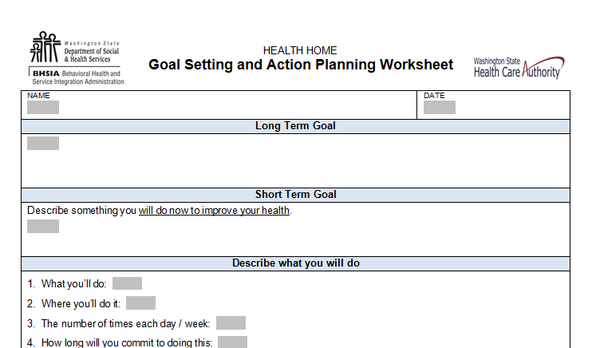
A Tool for Starting the Conversation
The Goal Setting and Action Planning Worksheet
TRAINING
Notes:
Ask the participants to pull out their copy of the Goal Setting and Action Planning Worksheet from the Classroom Training Manual.
This is an image of the Goal Setting and Action Planning Worksheet. It can serve as one method for recording the client’s thoughts about setting goals and their ability to commit to those goals.

Slide 160
Coaching and Action Planning
Goal Setting and Action Planning Worksheet
Start where the client is
Determine what the client wants to change
The action plan is negotiated and tied to the discussion
about the level of activation

Slide 161
Coaching and Action Planning (cont.)
Goal Setting and Action Planning Worksheet
The action plan is something achievable given the client's level of activation
At Levels 1 and 2 action plans focus on knowledge, belief, awareness and pre-behaviors
At Levels 3 and 4 action plans focus on the initiation of new behaviors and maintaining behaviors

Slide 162
Developing an Action Plan
Coach the client to select the Action Steps with the least number of barriers and prioritize them
Save the list of Action Steps so alternatives can be tried if
the first ones are not successful; reassure client that many problems are not easily solved and may take time and
multiple approaches

Slide 163
Develop Action Steps
Describe
What the client has agreed to do
What the Care Coordinator has agreed to do
Where they will do it
How often(each day/week)?
For how long?
Notes:
Use the client’s own words when recording their long term goals, short term goals, and action steps.
For example; client’s goal is to improve heart health.
Client makes a list of 10 favorite foods.
Client will note carbohydrates and calorie count for the 10 food during next shopping trip on chart provided by care coordinator. (this could also be client and caregiver will review…..)
Client and care coordinator will review this in two weeks.
In two weeks, this activity can be noted as complete.
The client can then establish new action steps such as:
Client will substitute whole wheat bread with peanut butter in the morning instead of fried egg and bacon sandwich for the next two weeks.
Client will walk around the block two times per day for the next two weeks with use of cane and companion of choice.

Slide 164
Questions to Consider
How important is it for you right now to...? On a scale from 0 - 10... what number would you
give yourself?
0_________________________________________________________________________10
CONVICTION SCALE
If you did decide to change, how confident are you that you would succeed? On a scale from 0 - 10... what number would you give yourself?
0_________________________________________________________________________10
CONFIDENCE SCALE
If you did decide to change, how ready are you to make this change? On a scale from 0 - 10...
what number would you give yourself?
0_________________________________________________________________________10
READINESS SCALE
Notes:
Importance is determined by what value a person places on making the change. Self-efficacy is the belief or confidence in one's ability to achieve change.
When clients think that change is beyond their capabilities, they may not try. People who are high on importance but low on confidence need encouragement that change is possible. They also need specific ideas about how to do it. This approach promotes engagement and allows greater self-efficiency and identifies the person's greatest needs and goals.
One of the methods to elicit change talk is using the Importance-Confidence Ruler When using this skill, it is extremely important to first pick a target behavior (e.g. smoking, marijuana use). The ruler must be focused on whatever the specific target behavior is, not on general behavior.
For example, when asked, “On a 0-10 scale with 10 being the most important, how important is it for you right now to quit smoking?” A client may say, “About a 6.” A follow up question might be, “What keeps it from being a 5?” This question will elicit some statements about the importance of changing the behavior.
After asking how confident the client feels about changing the behavior (let’s assume they say “5”), a follow up question may be, “What would it take for you to get to a 6?” The answer to this question may lead to the beginning of an initial treatment plan.
Asking the client about their level of readiness can lead to a discussion about the barriers the client perceives that is impacting their readiness to begin working on their self-management of their chronic diseases or other goals they have identified.

Slide 165
Coaching and the Health Action Plan
Use a coaching for activation approach to guide the client to:
Appropriate choices
Attainable goals
Action steps
Improved health
Notes:
Ask your Lead for access to the Insignia website that contains “Coaching for Activation” if the Lead has purchased this program.

Slide 166
The Health Action Plan (HAP)
Establishes:
Client and Care Coordinator identified:
  Long term goal
  Short term goal/s
  Action steps
Notes:
Consider the client’s level of activation.

Slide 167
Key Skills for Health Action Planning
Demonstrate positive belief in the client’s ability to take an active role to accomplish appropriate goals and action steps
Emphasize stress management and coping and resiliency skills
Ask the client to recall a former success: how did it feel?
Notes:
When the client indicates that they agree or strongly agree reinforce this with them and discuss what they have done that makes them positive about these health statements.

Slide 168
Key Skills for Health Action Planning (cont.)
Elicit the client’s story
Build rapport
Obtain a behavioral history, including past attempts
to change behavior
Identify barriers
  Use open-ended questions
  Focus on feelings
  Use reflections
Notes:
It sounds like . . .”
“It seems as if . . .”
“What I hear you saying . . .”
“I get a sense that . . .”
“It feels as though . . .”
“It wasn’t your idea to come to see me today”
-”You feel pretty discouraged right now”
-”You have mixed feelings about your drug use”
“Help me to understand. On the one hand you . . . and on the other hand . . .”

Slide 169
Analyze!
What do you think drives poor health and high costs
for your client?
85% of avoidable costs are due to behavioral, not
medical factors
Consider:
Client’s perspective
Results from assessment and screening tools
PRISM Risk Factors
Client’s Level of Activation
Notes:
Use the PRISM and PAM results to look at these issues.
Things to consider:
What does the client perceive as their most pressing health problem?
What might reduce the impact of the progression of illness and functional disability
What could maximize self-management skills and level of activation
Does the client lack access to needed healthcare services for enrollees with multiple chronic conditions? If so, how can the need for care be addressed?
Check for client's understand of appropriate use and understanding of prescription drugs
What action steps might reduce unnecessary emergency department visits
Are there ways to avoid preventable hospitalization?
Does the client have a caregiver? Would it help to engage him/her in the plan?

Slide 170
Use Active and Reflective Listening
Assure them that you can see their point of view
Acknowledge the struggles or difficulty involved
Acknowledge their success and their skills, abilities, and strengths
Thoughts
Beliefs and values
Behaviors
Use you statements – strength based approach
“You sound determined.”
Notes:
Affirming is to be a witness to another’s challenges and strengths. An affirmation is different from praising ; praising can be interpreted as being condescending (I am above you and can tell you, you are a “good girl or boy”). Praising can also focus too much on the counselor’s value system rather than the client’s value system. Affirmations are closely tied to values; what feels affirming to one person may feel false to another. Here, your choice of words are very important; tie the affirmation closely to the client’s perception of their experience.

Slide 171
Consider What Values Lie Behind
These Statements
I want to feel better
I want to be more independent
I want to be able to attend church with my family
I want to see my grandchildren grow up
Keep these in mind so you can later link these values to their long term goals, short term goals, and action steps
Notes:
Ask the group what value lies behind these goals:
I want to feel better - HEALTH, STRENGTH,
I want to be more independent – INDEPENDENCE, FREEDOM, CHOICE
I want to be able to attend church with my family – SPIRITUALITY, FAMILY
I want to see my grandchildren grow up – LONGEVITY, ENERGY, FAMILY

Slide 172
Emphasize Problem Solving
A Health Action Plan requires addressing problems through “action steps”
Adults learn best by “doing” rather than through reading materials or hearing information
Working through a problem using health coaching increases
and enhances retention
Identify their capacity for change and self-efficacy

Slide 173
Identify Barriers to Change
Ambivalence?
Understanding?
Support system?
Energy levels/sleep quality/pain?
Depression?
Health literacy?
Financial?
Confidence?
Social isolation?
Notes:
Are there others you would like to add to this list?
As the trainer you do not have to discuss every barrier on the slide, highlight one or two with examples from your own experience or refer to the following examples:
Ambivalence: for example on one hand I’d like to lose weight and on the other hand fresh food will cost more money.
Support system: is it helpful or not helpful to support their change?
Energy levels: how does fatigue caused by their diagnoses impact their energy levels?
Social isolation: this may happen in residential settings.

Slide 174
Explore Possible Solutions
ASK the client to review possible solutions, but not make a decision
just yet…
ASK the client to identify possible solutions, “do you have any ideas
on how you could solve this problem?”
ASK the client if they would like you to share your thoughts and/or provide ideas using Health Home resources.
ASK the client if they would like you to provide additional health education information; if so, review and discuss the information with them at the next visit.
Notes:
Consider filling out the Action Planning and Goal Setting Worksheet as you begin discussion about the goals of the HAP.
Make a list and see if the client has any action steps they want to try.
Ask them if they would like you to provide any ideas or information. Would they like you to make a referral to a service to help them gain education about their conditions?

Slide 175
Resistance
It’s human nature! Taking one side of a conflict can cause
a person to take the opposite stance. It’s normal…
Notes:
Don’t pick up the rope!
Resistance is normal! It is impossible to persuade or coerce the client to change; rather it is the client’s responsibility to decide for themselves whether or not to change and what steps they will take. But, you can help the client find their own reasons for change, provide information, support and offer alternative perspectives.
Resistance if often related to fear of the unknown, the fear of what change may bring.

Slide 176
Behavioral Change
Trying to convince another person to make a behavior
change can actually cause the person to be less likely
to make a change.
Even if you are successful in convincing someone to make
a behavioral change, the change is not be likely to last.
Notes:
Providing low-key feedback, rolling with resistance (e.g., avoiding arguments, shifting focus) and use of a supportive, warm, non-judgmental collaborative approach can be very effective. Conveying genuine empathy (understanding) through words and tone of voice, and demonstrating concern and an awareness of the client’s experiences reduces resistance!

Slide 177
Resist the Righting Reflex Exercise
Pair up and take turns as the speaker and the listener
Speaker
Share your thoughts and feelings about a behavioral change you have thought about making or a change you previously made but are having trouble maintaining
Listener
Ask open-ended questions
No closed-end questions
Neither agree nor disagree
Avoid sharing your opinions or experiences
Notes:
Ask participants to break into pairs. Each member will take a turn as the speaker and the listener. Allow about five minutes for each person to act as the speaker and the listener. Go to the next slide and ask participants to report how it went.

Slide 178
How Did It Go?
What was it like to be the listener… did you want to interject your experiences or thoughts?
Were there times when you wanted to jump in and offer advice or
“fix it”?
What was that like for you as the speaker… did you feel understood?
How did it feel to have someone place all of their focus on you and your concerns for even 5 minutes?
What did you learn from this interaction about your own style?
Notes:
Debrief with participants after the exercise. These questions optional and may be used to encourage discussion. They do not need to be discussed if the participants are willingly sharing their experiences.

Slide 179
Cultivate a Sense of Hope
Demonstrating a positive belief in your client has a positive impact on the client’s ability to accomplish their goals and action steps and sustain behavioral change.
Hope is one of the greatest contributions you make to your client as their Care Coordinator.
Notes:
Please emphasize this slide with participants, it is really important to stress how effective their work will be with their clients.

Slide 180
The Day in Review
Health Home fundamentals
Client outreach and engagement
PRISM
The Patient Activation Measure
Goal setting and action planning: moving toward the
Health Action Plan
Notes:
Set the stage by explaining that what was covered in Day One will prepare them for the Health Action Plan on Day Two.

Slide 181
Let’s Pause to Check for Understanding
How is the role of a Care Coordinator different than those you have had in the past?
What benefits do you see for your clients who engage in the program?
Do you have any questions about what we covered today?

Slide 182
Planning for Day Two
Start time for training
Location
Topics to cover
  The Health Action Plan
  Comprehensive Care Transitions
  Documentation
  Quality Assurance
  Resources and websites
  Ongoing training requirements
    Six required topics
Notes:
This slide ends Day One.

Slide 183
Welcome to Day Two
Do you have any questions about what we covered on Day One?
HH Fundamentals
Outreach and engagement
PRISM
PAM
Moving toward health action planning

Slide 184
The Health
Action Plan
TRAINING
Notes:
Refer participants to this section of their Classroom Training Manual to review the HAP and prepare for working with their clients to apply the PRISM data, activation scores and levels, and create a HAP. Refer to the HAP for Bobby Smith in the Classroom Training Manual while reviewing the data fields for the HAP form.
Lead Organizations may have different forms or electronic platforms but all of them will contain the same data elements for the HAP.

Slide 185
Most People Desire Better Health and Quality of Life
Each client is in charge of their own health
Their own Health Action Plan, and
Whether or not they make lifestyle changes

Slide 186
Help Identify a Long Term Goal
Use a person-centered approach to help the client identify:
What would they like to happen as a result of their
health changes?
What would they like be able to do that they can’t
currently do?
What their level of activation is and how it will help or hinder their ability to achieve their goal/s?
Notes:
For example, if a client says her long term goal is to be happy, ask the client how will you know when you are happy, what will that look like to you? What would need to change in order for you to be happy? Use motivational interviewing techniques to assist the client in defining what they want. Consider their level of activation and how much help, coaching and support may be needed to support them in making behavioral changes.

Slide 187
Help Identify a Long Term Goal (cont.)
Long term goals may relate more to social goals but by achieving them the client may:
Reduce medical costs
Slow the progression of chronic disease
Delay the onset of another chronic disease
Reduce avoidable ED visits and hospital admissions
and readmissions

Slide 188
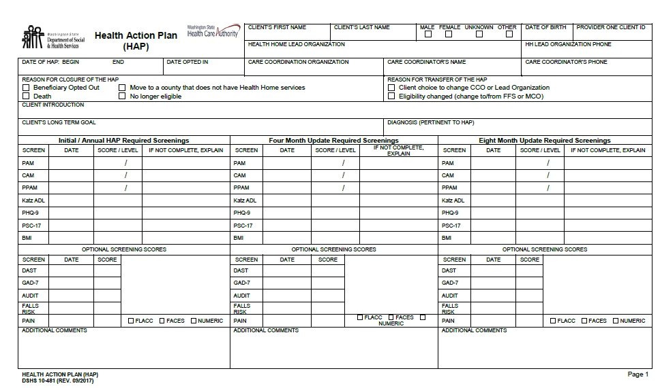
Health Action Plan: Page 1
Note: most Lead Organizations have a data platform that is used to capture the HAP. These platforms can print the HAP but it may not look like the paper form.
TRAINING
Notes:
Refer to the sample HAP completed for Bobby Smith in the Reference Section of the Classroom Training Manual during the presentation of the next slides reviewing the data fields for the HAP.
The blank HAP contained in the Forms and Tools Section of the Classroom Training Manual may be used for the breakout group for the HAP or the trainer may provide additional copies for this activity.
Use the updated form and instructions with a revision date of 9/2017. It is posted on the HCA Website and the DSHS Forms Website.
Check with your Lead and your organization to find out how and where the HAP and other documentation will be completed. You will need to determine if you are going to add health home records into existing client records or establish additional client records.
Lead Organizations may design a form or electronic system to gather this information and any additional information they may want.
Refer participants to the Classroom Training Manual and encourage them to review the Health Home Care Coordinator Documentation Guide on their own time.

Slide 189
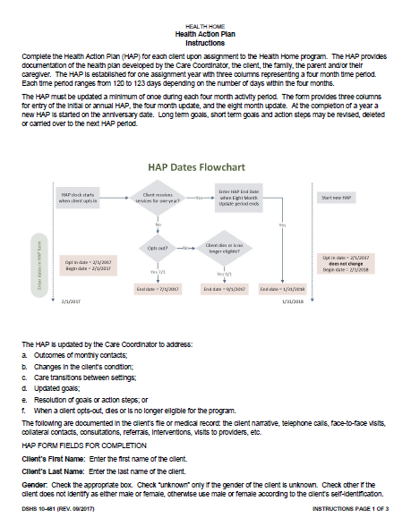
HAP Instructions
TRAINING
Notes:
Detailed instructions for the HAP can be found on DSHS form 10-481 Instructions on the HCA Website. The instructions will provide information needed to fill out every data field on the form.
The instructions are included in the Classroom Training Manual after the HAP form and should have a revision date of September 2017.

Slide 190
Additional Training on the HAP
Your Lead/s will provide operational training on how to use their software programs
Don’t hesitate to ask for technical assistance
Meetings are sponsored by the Leads to supplement this training
DSHS sponsors monthly webinars and a quarterly newsletter with information related to the program and your work

Slide 191
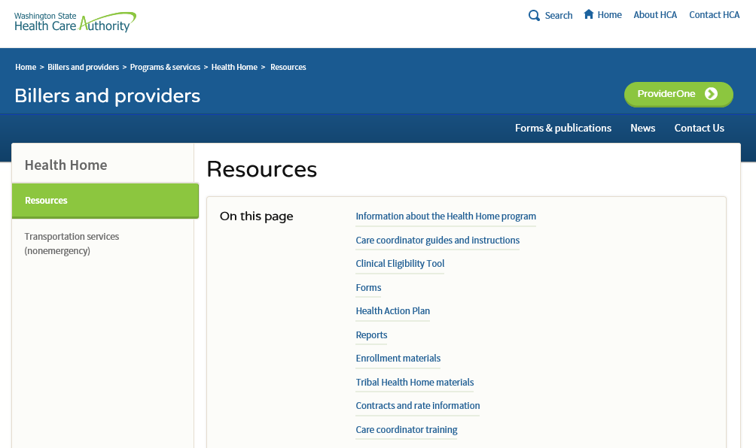
HAP Form and Instructions
The revised HAP and Instructions are located at the HCA Website:
https://www.hca.wa.gov/billers-providers/programs-and-services/resources-0
Notes:
There are no plans at this time to translate the HAP form. Care Coordinators may use an interpreter to review the finished HAP with the client and collaterals. Document how, when, and where the HAP was reviewed and when the client received a copy of the HAP. It is a requirement that the client must receive a copy of their HAP and any updated HAPs.

Slide 192
HAP Form Instructions
Each HAP spans a 12 month enrollment period consisting
of three separate four month updates or activity periods
All other documentation goes in the client record or file
TRAINING
Notes:
The Lead Organization and Care Coordination Organization will determine policies and procedures for documentation.

Slide 193
HAP Form Instructions (cont.)
The Health Action Plan is updated and modified at each monthly contact by the Care Coordinator and when necessary to support a care transition or when the client opts-out of the Health Home program.
The Health Action Plan is updated and modified as needed according to:
A change in the client’s condition
New immediate goals to be addressed
Completion of a short term goal and action steps
Notes:
The HAP is updated when the client opts out by entering an end date for the HAP and selecting the reason code indicating that the client opted out.

Slide 194
What is an Activity Period?

Slide 195
Activity Periods
First Activity Period
Second Activity Period
Third Activity Period
There are three activity periods in a yearly (12 month) cycle
Each activity period or trimester is four months
There are 120 to 123 days within an activity period
  Number of days in a month varies from 28 or 29 days for February and 30 to 31 days for other months
TRAINING

Slide 196
Activity Periods Example
Opts in 2/1/18
First activity period
2/1/2018- 5/31/2018
Third activity period 10/1/2018- 1/31/2019
Start date of the next HAP is 2/1/2019
Second activity period 6/1/2018- 9/30/2018
February March April May
June July August September
October November December January
Start date of next HAP is February 1, 2019

Slide 197
Individual or Group Activity
Activity Periods Worksheet
First Activity Period
Second Activity Period
Third Activity Period
TRAINING
Notes:
The months of the year are listed in the footer to help participants.
The Activity Period Worksheet is located in Section A – Agenda of the Classroom Training Manual.

Slide 198
Worksheet 3: Activity Periods
Opts in 5/1/18
First activity period for initial HAP
Third activity period
Start date of the new HAP yearly cycle
Second activity period
If the client opts in May 1, 2018:
  What are the dates for the first activity period?
  What are the dates for the second activity period?
  What are the dates for the third activity period?
  What is the start date for the next HAP year cycle?
January February March April May June July August September October November December

Slide 199
Worksheet 3: Activity Periods
Opts in 5/1/18
First activity period for initial HAP
Third activity period
Start date of the new HAP yearly cycle
Second activity period
May 1 thru August 31
September 1 thru December 31
January 1, 2019 thru April 30
May 1, 2019
January February March April May June July August September October November December
Notes:
What are the dates for the first activity period if the client opts in May 1, 2018
What are the dates for the second activity period?
What are the dates for the third activity period?
What is the start date for the next HAP year cycle?

Slide 200
Worksheet 3: Activity Periods
Opts in 7/13/18
First activity period for initial HAP
Third activity period
Start date of the new HAP yearly cycle
Second activity period
If the client opts in July 13, 2018:
  What are the dates for the first activity period?
  What are the dates for the second activity period?
  What are the dates for the third activity period?
  What is the start date for the next HAP year cycle?
January February March April May June July August September October November December

Slide 201
Worksheet 3: Activity Periods
Opts in 7/13/18
First activity period for initial HAP
Third activity period
Start date of the new HAP yearly cycle
Second activity period
July 13 thru November 12
November 13 thru March 12, 2019
March 13 thru July 12
July 13, 2019
January February March April May June July August September October November December
Notes:
If the client opts in July 13, 2018:
What are the dates for the first activity period?
What are the dates for the second activity period?
What are the dates for the third activity period?
What is the start date for the next HAP year cycle?

Slide 202
Worksheet 3: Activity Periods
What is the end date of the HAP if the client notifies the Care Coordinator that he no longer wants to participate in the program during a phone call on May 10, 2018?
May 10, 2018
The Care Coordinator made several calls to the client and sent a letter with no response from the client and the Lead approves closure of the HAP. The letter was mailed to the client on August 13, 2018 and the final call was made on August 17, 2018. What is the end date for the HAP?
        August 17, 2018

Slide 203
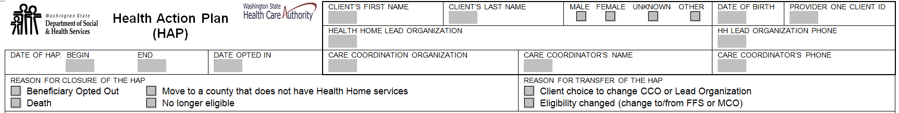
HAP Form Instructions (cont.)
Demographic data fields for name, gender, date of birth and ProviderOne ID
Date the HAP begins
Date the client Opts-in
This is the date the client agrees to participate in the program and begins development of the HAP.
This date becomes the client’s anniversary date. It triggers the start of a new HAP for the next HAP reporting year.
TRAINING
Notes:
Don’t get bogged down in the details of these screens. Inform the participants that the Instructions will be helpful when they begin to complete their first HAP. They may wish to refer to this PowerPoint as they begin their first HAP.

Slide 204
HAP Form Instructions (cont.)
Date the HAP ends:
At the end of a one year cycle (do not prepopulate this field)
The day the client opts out of the program
The date the HAP ends for other reasons as listed in the Reason for Closure of the HAP data field (check the appropriate box if one of the reasons apply)
Notes:
Encourage the participants to leave the HAP end date blank until the end of the one-year cycle. Do not enter the end date in advance as this can be misleading if another CCO inherits the HAP and thinks that it is closed.

Slide 205
HAP Form Instructions (cont.)
If a client is transferring for one of the reasons listed, then do not enter
a HAP end date as the HAP is still active until the end of the one year cycle even though it may be transferred.
Reasons for transfer of the HAP include:
Client choice to change CCO or Lead Organization
Eligibility changed:
  Client was enrolled with a Managed Care Organization (MCO) and transferred
  to a Fee-for-Service (FFS) Health Plan
  Was enrolled with as FFS and transferred to an MCO Health Plan

Slide 206
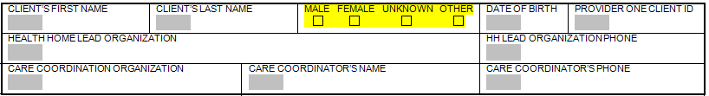
HAP Form Instructions (cont.)
Options for gender include:
Because clients have a right to change Lead Organizations
or Care Coordination Organizations the names and phone numbers are provided
Notes:
Options for gender include:
Male
Female
Unknown: check this field until the gender of the client becomes known
Other: client does not identify as male or female
May be transgender male to female
May be transgender female to male
These classifications align with the data fields for OneHealthPort, which is used to transport the HAP information to the state.
Gender impacts the scoring for what is considered acceptable levels of alcohol consumption for the AUDIT screening. AUDIT is the Alcohol Use and Disorders Identification Test. Males are allowed to consume more alcohol than females due to make up of their bodies and still be considered within acceptable amounts of consumption.

Slide 207
HAP Instructions (cont.)
Write a brief statement about the client
Develop a long term goal that is person-centered, based on what the client wants to achieve
Enter the diagnosis or diagnoses that are pertinent to the
long term goal
Notes:
The diagnosis field lists the pertinent client diagnosis or diagnoses being addressed by the client and care coordinator. This list should only include the diagnoses being addressed by the HAP and may not reflect all of the client’s diagnoses and health care needs.

Slide 208
Help the Client Identify Long Term and Short Term Goals
“Physically, what can you do best?”
“When are you strongest?”
“Who do you contact when you aren’t feeling well?”
“Which health concerns have the biggest impact on your life?”
“What are some ways you may increase your wellness?”
Notes:
These are some considerations in helping the client reach their goal. What did you do to be successful? What thoughts or actions did you have/take to get you to your goals?

Slide 209
HAP Form Instructions (cont.)
Required screenings: enter the dates and scores of the screening on the HAP
PHQ-9 – Patient Health Questionnaire (Depression Screening) or
Pediatric Symptom Checklist – 17 (PSC-17) ages 4-17
BMI – Body Mass Index
Katz Activities of Daily Living
Patient Activation Measure
  Patient Activation Measure (PAM) or
  Caregiver Activation Measure (CAM) or
  Parent Patient Activation Measure (PPAM)
Notes:
We will review the screening tools. The forms and software platforms for the screenings may vary from Lead to Lead. Any format may be used as long as it contains the same questions and scoring.
If the required screening is not completed you must include the reason in the narrative field to explain the reason that the screening was not administered or completed.

Slide 210
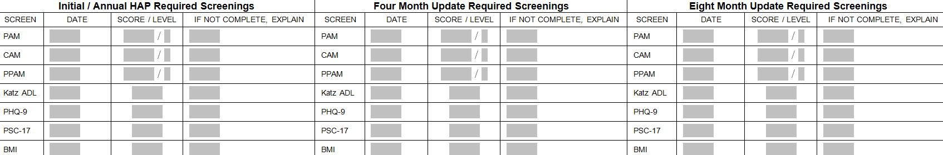
HAP Form Instructions (cont.)
Enter the date the screening was completed or offered but declined
Enter the activation score and level of activation for each type of activation measure completed
If the client, caregiver or family decline or are unable to complete the screening enter the date and the reason the screening was not completed
Screening must be completed at least once during each four month activity period or more often as clinically indicated
Notes:
Note: the HAP form will accept a PAM, PPAM and CAM.

Slide 211
Patient Activation Measures
The PAM is required for clients
Note the date, the activation score and activation level
on the HAP
If the client cannot complete the PAM
  Note the date the screening was offered and note the reason the PAM
  was not completed on the HAP OR
  Complete the CAM or PPAM (see next slides)
  The PAM dates may not be the same as the start date of the HAP or updates
  for each four month activity period

Slide 212
Caregiver Activation Measure
The CAM may be administered when the client is unable
or unwilling to complete the PAM
Caregivers may be informal or formal caregivers, or paid
or unpaid caregivers
Document in the case record the name and relationship
of the person who completed the CAM
Note the date the CAM was completed, the activation score, and activation level on the HAP
Notes:
The Lead Organizations and/or CCO may have policies and procedures that define documentation requirements.

Slide 213
Parent Patient Activation Measure
The PPAM must be administered to the parent or guardian
of children under the age of 18 years
Parents include: biological, adoptive, or foster
Note the date the PPAM was completed, the activation score and activation level on the HAP
Document in the case record the name and relationship of the person who completed the PPAM
If the parent or guardian declines to complete the PPAM note the date the assessment was offered and the reason the parent/guardian did not complete the screening

Slide 214
The Katz ADL
Score one point for each of the six ADLs that client reports that they can perform independently without assistance
If a client indicates that they are dependent and could use assistance with two or more ADLs consider a discussion about applying for LTSS
Referring the client to the DSHS Developmental Disabilities Administration or Home and Community Services Office in your area is an appropriate service for you to offer

Slide 215
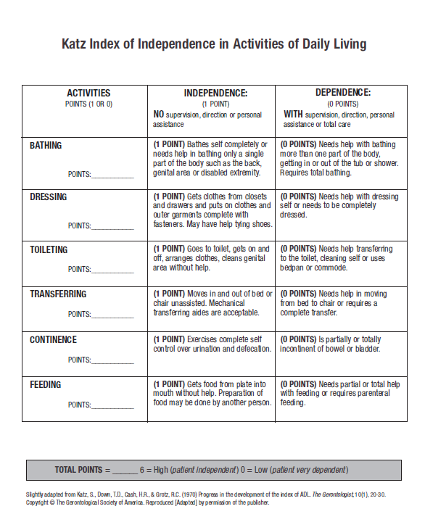
Katz Activities of Daily
Living (ADLs)
Link to 29 minute training video:
https://consultgeri.org/try-this/general-assessment/issue-2
Notes:
The Katz ADL screening tool is contained in the Classroom Training Manual. Recommend that participants view the video after the training at their convenience. Viewing the video during that training is not expected and there is no time allotted to in the agenda.
If the client receives LTSS the Care Coordinator may want to assure the client that this will not effect their current services and CARE scores.

Slide 216
PHQ-9 and PSC-17 Screens
Patient Health Questionnaire: nine item screening tool
for depression
  18 years and older
Pediatric Symptom Checklist: 17 item screening tool for moods and behaviors
  Ages 4 through 17 years
Notes:
DSHS has a PSC-17 screening tool and instructions but Care Coordinators are free to use other formats as long as they contain the same 17 questions.

Slide 217
PHQ-9 and PSC-17 (cont.)
The Care Coordinator’s role is to screen for possible behavioral health issues
Care Coordinator’s do not diagnose, counsel, or treat; they refer to qualified professionals and behavioral health resources for further assessment and treatment
Notes:
Even if a Care Coordinator possesses the credentials and licenses to provide counseling they should not provide evaluation and counseling as this blurs their role as a Care Coordinator who accesses services for the client.

Slide 218
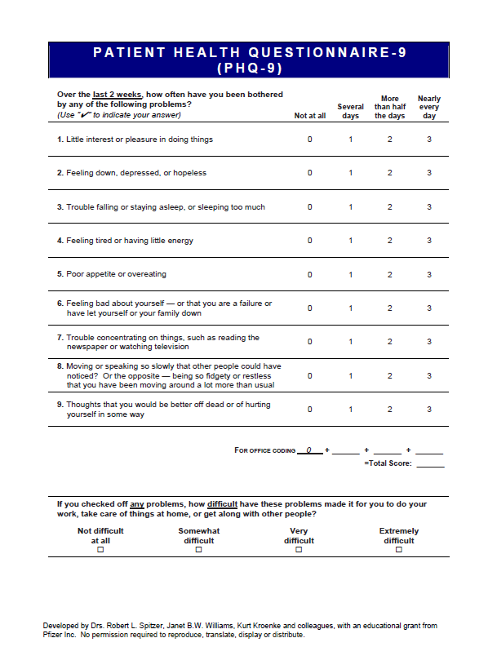
The PHQ-9 is a
Required Screening
Your manual also contains a copy of the GAD-7
TRAINING
Notes:
Check with your organization or Lead Organization for their policies related to scoring. What actions are required for high scores? What is the policy when a client reports suicide ideation?

Slide 219
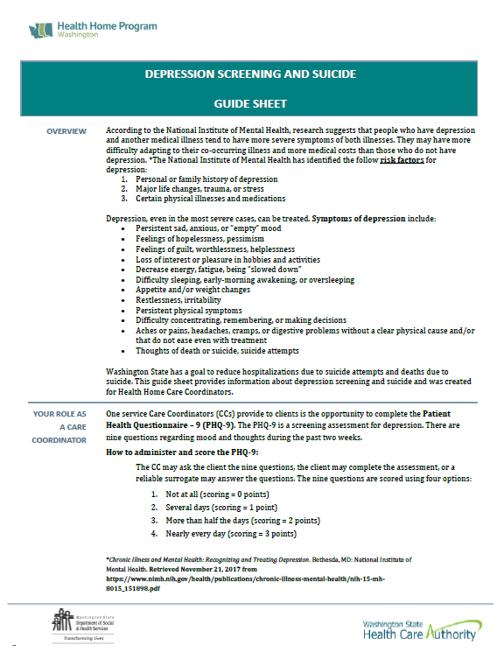
Guide Sheet on Depression
Screening and Suicide
Guide Sheet offers general guidelines
  Your agency may also have their own policies, procedures, and reporting requirements
Interpretation of results of PHQ-9: a score of 10 or higher indicates moderate depression
  Offer a referral to PCP or a behavioral health provider
  If a client expresses that they have thought about suicide, have a plan, and have the means seek help immediately
TRAINING
Notes:
Ask participants to go to the Depression Screening and Suicide Guide Sheet and review the Guide Sheet. Stress that participants should find out their agency’s policies on responding to suicide ideation. Their agency may have additional requirements and they should also follow those procedures.

Slide 220
Pediatric Symptom Checklist – 17
The PSC-17 must be completed for children ages 4 to 17 years of age
The screening is completed by the parent or guardian
  Scoring is based on the parent’s report of current behaviors
A child age 13 and over may self-administer the screening
Note in the comment section the name of the person who completed the screening and their relationship to the child. Enter the parent’s score in the HAP and note the child’s score in the case narrative
Notes:
Remember that children age 13 and older must provide their written consent to release the results of the PSC-17 as it contains mental health information about the client.
A parent may be the biological parent, adoptive parent and foster parent.

Slide 221
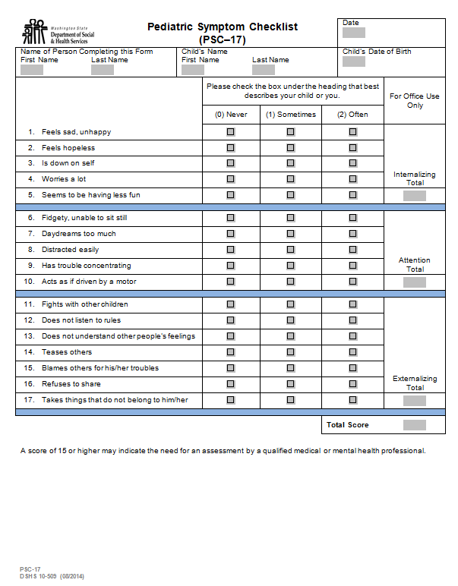
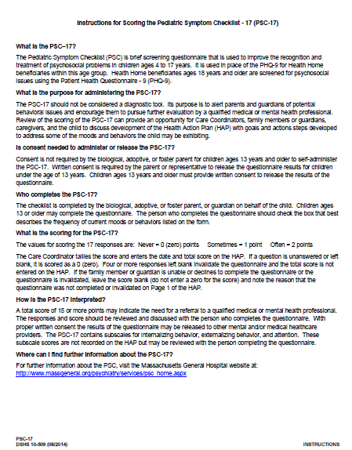
DSHS Form 10-509 PSC-17 & Instructions
TRAINING
Notes:
The PSC-17 and Instructions are in the Forms and Tools section of the Classroom Training Manual.

Slide 222
PSC-17 Considerations
The screening tool should not be used for diagnosing
A score of 15 or higher may indicate the need for further evaluation by a qualified professional
The screening tool offers three subscales for:
Internalizing behavior
Externalizing behavior
Attention
Notes:
A high score for one of the subscales may indicate the need for further evaluation by a qualified professional.

Slide 223

PSC-17 Website
For translations of the tool visit the Massachusetts General Hospital website located at: http://www.massgeneral.org/psychiatry/services/psc_home.
aspx

Slide 224
Body Mass Index (BMI)
This is required on the HAP
BMI chart is located in the Classroom Training Manual
BMI is not required for children under 2 years of age
If you are unable to get a recent or accurate weight record
the BMI and make a comment in the comment box
TRAINING
Notes:
Refer to the BMI scale contained in the Tools and Forms Section of the Classroom Training Manual. This chart contains only a portion of the BMI for adults.
One way to remember the earliest age for BMI is to recall how infants were given percentages for height and weight until the age of two.

Slide 225
BMI Online Charts
BMI Calculator for Children and Teens (2-19)
http://nccd.cdc.gov/dnpabmi/Calculator.aspx
BMI Calculator for Adults
http://www.cdc.gov/healthyweight/assessing/bmi/adult_bmi/
english_bmi_calculator/bmi_calculator.html
Notes:
For the complete BMI chart for adults and the BMI chart for children refer participants to these websites. These charts may be stored on the participant’s laptop or desktop as a shortcut.

Slide 226
HAP Form Instructions (cont.)
Optional screenings
Enter the dates and scores of the screenings on the HAP
DAST – Drug Abuse Screening Test
GAD-7 – Generalized Anxiety Disorder 7 item scale
AUDIT – Alcohol Use Disorders Identification Test
Falls Risk – My Falls-Free Plan identifies risk and provides suggestions to prevent falls
Pain Scales – Administration of appropriate pain scale
TRAINING
Notes:
Refer the screening tools in the Forms and Tools Section of the Classroom Training Manual. Additional training may be available from Lead Organizations. The DSHS Health Homes training website contains previous webinar PowerPoints on some of these screenings.
Some clients may be more receptive to completing the GAD-7 if it is offered as a tool to assess their stress versus anxiety.
Using the optional screenings can provide an opportunity to build awareness; consider it for health promotion, one of the core Health Home services.

Slide 227
When to complete an optional screening
Use your clinical judgment to determine the need and frequency for offering additional screenings
  Examples:
    If a client identifies a goal related to pain: one of the three pain screenings
    If a client voices concerns about their use of alcohol or drugs: the AUDIT or DAST
    If a client reports falls or fractures: falls risk
    If a client identifies a goal to reduce stress or anxiety: GAD-7
If the HAP includes goals or action steps related to one of the optional screenings then the screening must be offered and documented on the HAP
Notes:
For example, if a client reports pain and especially if pain is part of the long or short term goals it is expected that the pain assessment is completed and documented. The same applies to falls, anxiety and substance use.

Slide 228
PHQ-9 and GAD-7
Anxiety and depression are the most common mental disorders and often appear together. Screening tools
often used include:
The PHQ-9 which can identify potential depression
GAD-7 which can help identify potential anxiety
Both tools are most reliable when self-administered
A positive screening for either or both should lead to a referral to a behavioral health provider or PCP depending on client preference

Slide 229
PHQ-9 and GAD-7 Screening Tips
Normalize the screening; don’t make it a big deal
Some people respond better to terms like “stress” when talking about their anxiety or “sadness” rather than depression
Everyone experiences sadness and this tool might help identify how it might be impacting you
Remember the power that stigma holds - many people do not want to self-identify
Treatment can be very effective
Notes:
Any ideas on how to approach the issue of mental health conditions? How do you introduce the screening tools?
Check with your organization and/or Lead Organization for their policies and procedures regarding interpretation of the scores and required actions for high scores or clients reporting suicide ideation. What is their policy for addressing depression scores?

Slide 230
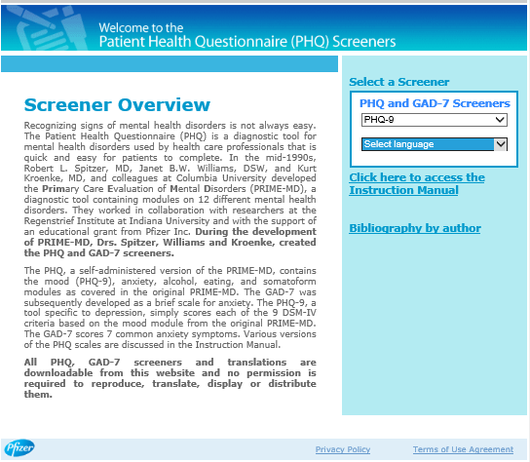
Translations of PHQ-9 and GAD-7
The website sponsored by Pfizer is located at:
http://www.phqscreeners.com/select-screener/36
Notes:
The PHQ-9 and GAD-7 are translated in over 70 languages.
The website also contains an Instructions Manual with information about scoring and interpretation.

Slide 231
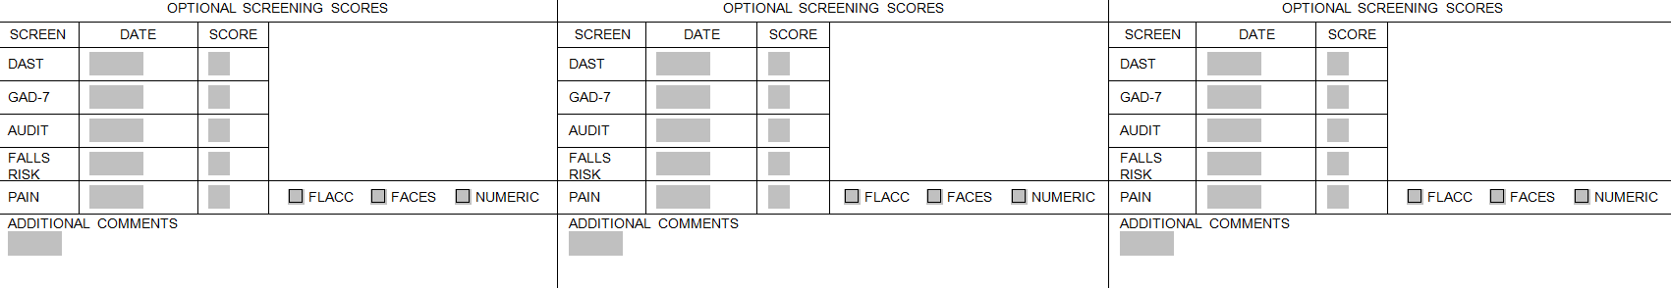
HAP Form Instructions (cont.)
Enter the date the screening was completed
Enter the score
Screening may be completed at any time during each four month activity period or more often as clinically indicated

Slide 232
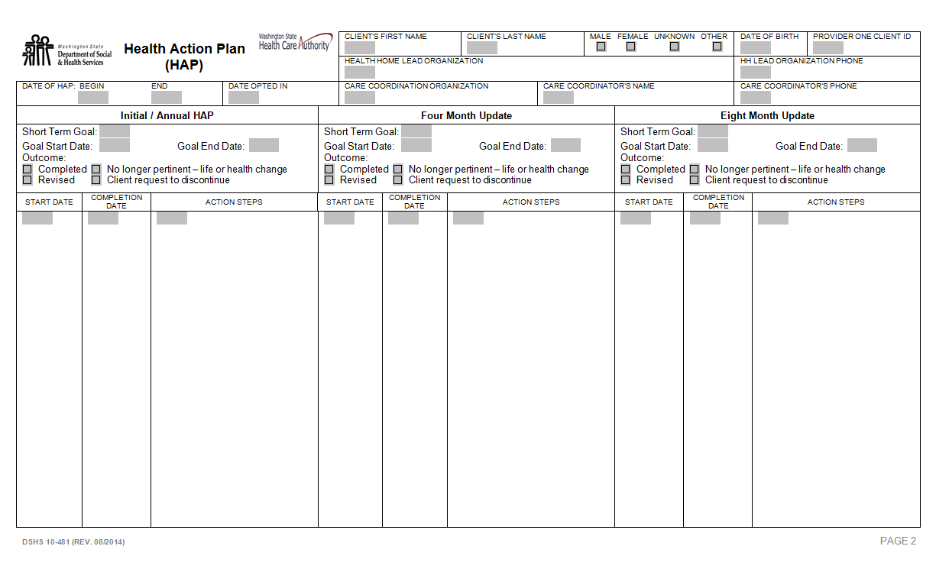
HAP: Pages 2 Through 7
Notes:
This is an image of pages two through seven. Use as many of them as needed to record short term goals and action steps for the one year cycle.

Slide 233
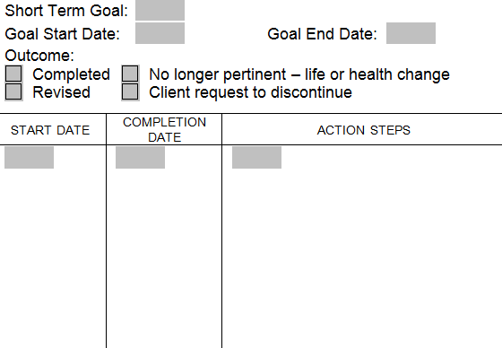
Short Term Goals
Enter the short term goal
Enter the short term goal begin date
When a goal ends enter the date and check the reason the goal ended
Enter the action steps, specifying who will complete the step and the start date
Goals that are not completed may be carried
over to the next four month activity period
Goals may be revised at any time to reflect
changes with the client
Notes:
Identifying the start date will help Care Coordinators keep track of when to contact the client or collateral to check on their progress toward meeting a goal. If an action step is not completed the short term goal and/or actions steps may need to be revised to be more realistic for the client and collaterals.

Slide 234
The Health Action Plan (HAP)
Develop goals and action steps that are SMART:
Specific
Measurable
Achievable
Relevant
Time-limited
SMART Goals
Level of Activation
Confidence
Readiness
Importance to the client
Notes:
Consider the client’s level of activation, their confidence

Slide 235
Health Action Plan – First Short Term Goal
Long Term Goal
Participate in church activities with my family.
Short Term Goal # 1
Debbie would like to improve stamina and gain strength
and be able to remain out of her bed for four hours or more each day.
Action Steps
Debbie and Care Coordinator will brainstorm common events in Debbie’s life that promote activity as well as those that promote inactivity.
Debbie will maintain activity log for two weeks and review with Care Coordinator during next visit on 10/7/18.

Slide 236
Health Action Plan – Second Short Term Goal
Long Term Goal
Participate in church activities with my family.
Short Term Goal # 2
Debbie would like to decrease use of pain medication.
Action Steps
Debbie will document use of pain medications, her activity, and functional ability daily starting 12/1/18 using the pain log provided by the Care Coordinator.
Debbie will make an appointment with PCP to discuss chronic pain management options by 12/20/18.
Care Coordinator will review the pain log and inquire about Debbie’s appointment with her PCP during the home visit schedule on 12/28/18.

Slide 237
Let’s Pause to Check for Understanding
What experiences have you had offering and administering these screenings in the past?
Do you have any questions?

Slide 238
Small Group Work
Considering your client’s PRISM results, PAM responses and Level
of Activation:
Fill out the HAP form (make up scores as needed for this activity)
Write the following on the flip chart:
  One long-term goal
  One short-term goal
  Actions steps to reach the short-term goal
    Who will complete the step and by when?
  Which of the 6 health home services might the client need now and
  in the near future?
  Which optional screenings might be helpful for your client?
Notes:
Ask participants to remove the blank copy of the HAP from their Classroom Training Manuals or provide a copy. Ask the breakout work groups to fill out the HAP. Explain that the groups will fabricate a long term goal, a short term goal and action steps based on the PRISM and PAM data. Small work groups will enter fictitious scores for the required screenings and optional screenings when appropriate.
Ask the recorder to make note on the flip chart to report to the large group after this exercise.
Small work groups will report to the large group:
the long-term and short-term goals and action steps
which of the six core services that client may require to meet their goals
which optional screens they might offer based on the client’s conditions and goals.
The purpose of filling out the HAP form is to give participants some experience filling out the paper form.

Slide 239
Maintaining Behavioral Change
Sustaining the gains with healthy strategies
Maintaining behavioral change takes time (usually 6 months
to two years)
Monitoring using relapse prevention and resiliency planning
Progressing by realizing that relapse is one step forward on the client’s journey
Pursuing new goals and activities
Notes:
Use this slide to emphasize how our work is not finished once a client meets a goal. Maintaining a behavioral change can be as difficult as beginning a behavioral change. Relapse is a part of recovery so support and planning for this is important.
Clients who have been successful meeting a goal may need your ongoing support to maintain the change. Consider offering Tier 3 services if the client suggests that they may be ready to leave the program.
Lifestyle changes are hard! Can you think of a lifestyle change that you made, and stuck with, 20 years ago?
How about 15 years ago? 10 years? Last 12 months?
Discussion about triggers and setting goals around how to handle them could be a new goal for a client after they have met their initial goal. For example: if a client meets the weight loss goal, how will they handle their big family dinners on Sunday? This could become a short term goal.
When a goal is met should it be carried into the next activity period with a relapse plan?
What new goals can be established to support improvements in health and help the client on their health plan?

Slide 240
Final Notes About the HAP
Provide the HAP information to the client, or with the client’s consent, to the caregiver and family
The HAP may be:
  Printed and mailed
  Delivered at the face-to-face visit
  E-mailed using secure mail and/or encryption
Each face-to-face visit or telephone contact provides an opportunity to discuss and review progress on the HAP
The HAP is a fluid document that changes with the client’s needs and preferences
Notes:
Language from the two contracts:
A completed and updated HAP with the enrollee’s goals and action steps must be provided to the enrollee and with the enrollee’s consent shared with the enrollee’s caregiver and family in a format that is easily understood.
Upon request, completed and updated HAPs must be shared with other individuals identified and authorized by the enrollee on the signed Health Home Participation Authorization and Information Sharing Consent form.

Slide 241
Let’s Pause to Check for Understanding
How can you work with your client to increase the value of the HAP?
Do you have any questions about the HAP?

Slide 242
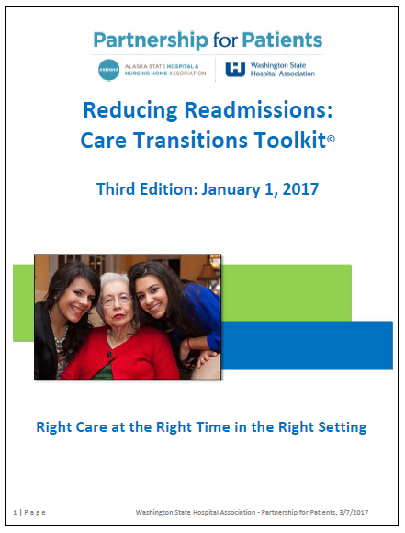
Care Transitions
“Health Care Without Complications”
All materials in this section are adopted from the “Reducing Readmissions:
Care Transitions Toolkit” from the WASHINGTON STATE HOSPITAL ASSOCIATION.
To download a copy of the toolkit go to
http://www.wsha.org/wp-content/uploads/WSHACareTransToolkit.pdf
TRAINING
Notes:
The Classroom Training Manual contains only three pages from the 51 page toolkit. The handout is located in the Reference section. Encourage participants to download the entire document to review at a later date. The manual also contains the Discharge-to-Home Discharge Guide and the Discharge Preparation Checklist.

Slide 243
Hospital Readmissions
As of January 1, 2017, our region’s 30-day readmission rate of 31.3 per 1,000 Medicare beneficiaries is better than the national average (52.5 per 1,000).
Research shows that 20% of patients in the U.S. are
re-hospitalized within 30 days of discharge.
Addressing social and resource barriers early in the admission not only prevents unnecessary readmissions, but also proactively prevents delayed discharges and unnecessary increases in the length of stay
Notes:
The region being referred to by the Partnership for Patients is Alaska and Washington states.

Slide 244

What Causes Readmissions?
Unresolved social or resource issues:
  Medical issues are not always the reason
Lack of strategies that incorporate both social and
medical factors resulting in poorly executed transitions and poor outcomes for the client which impact:
  Family and support systems
  Caregivers: paid and unpaid
  Client’s health and stability

Slide 245
Washington State Care Transitions
Washington State “Care Transitions” is a state-wide initiative to foster safe, timely, effective, and coordinated care as clients move between settings
Care Coordination includes collaborating on the discharge Plan of Care with the primary care physician (PCP) and multidisciplinary care team
Notes:
This includes not only hospitalized clients but clients in nursing facilities.
If client is receiving care transitions by another provider, such as the managed care plan, then the role of the Care Coordinator may be to ensure that the care transitions are being addressed without duplicating any of those services.

Slide 246
How Will You Know if a Client Has
Been Hospitalized?
Review PRISM data: there is a lag in submission of billing claims
Emergency Department Information Exchange (EDIE): find out if your Lead or agency subscribe to this service
Some Leads use PreManage, a system that notifies them of emergency department visits and hospital admissions and discharges
Find out who at your agency receives these alerts
Notes:
Review PRISM to identify if a client has used the ED and/or been admitted to the hospital. Contacts with the client provide an opportunity to discuss changes in the client’s condition and the need to revise the HAP.

Slide 247
Six Strategies for Care Transitions
1
Consistent plan of care with the PCP and home health care (if applicable) upon arrival and discharge from the hospital
Coordinated follow up call or visit at discharge
Timely visit to PCP
Reconciliation of medications soon after transition
Client, family, and caregiver education coordinated between settings
Support through increased care management for high-risk clients
2
3
4
5
6
Notes:
While six strategies are presented your client may not require all of these activities. At a minimum the Care Coordinator should check with the client to determine the client’s need and the level assistance the Care Coordinator may need to provide.

Slide 248
Social/Resource Barriers Assessment
Evaluate, assess, and complete a needs assessment of client’s home-going needs and barriers to care including support requirements.
The Katz ADL may be used as a tool for assessing the client’s abilities and care needs.

Slide 249
Social and Resource Barriers
Personal care needs
Other disabilities
Limited income
Financial reserves
Unstable or unsafe housing
Inaccessible housing
Coping skills
Employment
Health literacy or numeracy
Lack of an advance directive
Religious or spiritual support
Education
Substance use history
Psychiatric history
Availability of mental health
or SUD services
Demands on other family members or caregivers
Transportation
Notes:
Review of all of these barriers is not required, highlight a few with examples.
Ask participants if they can think of other barriers to add to the list.
Provide an example based on your prior experience.

Slide 250
Client, Family, and Caregiver Follow-up
What are the discharge orders?
Do they have a copy of the discharge orders and do they
understand them?
What warning signs or symptoms should be reported to the healthcare provider? Do they have the phone number to the 24 hour nurse line?
What follow-up is necessary?
Have the follow-up appointments been scheduled?
Is the client aware of these appointments and do they need transportation and/or an escort to the appointment/s?
What are the current medications?
Notes:
Discharge order and printed information should include:
When to seek emergency care and alternatives to emergency care
Specific signs and symptoms that warrant follow up with clinician
How to contact the PCP
Talk to your Lead Organizations regarding their requirements for documentation. Most likely they will want to see evidence of these actions and who did it.

Slide 251
Does the Client or Caregiver Know Which Red Flags May Require a Call to the Provider?
Chest pain or palpitations
Cough
Infection
Blurred vision, loss of vision
Headache
Fatigue
Insomnia or problems sleeping
Discharge
Warmth to an affected area
Fever
Pain
Nausea and/or vomiting
Poor appetite
Weight loss or weight gain
Bleeding
Constipation or diarrhea
Difficulty urinating or no urination
Dizziness
Falls
Notes:
Do not read the entire list, highlight one or two with examples of a case.
This is a partial list. Ask participants if they can think of other red flags or warning signs.

Slide 252
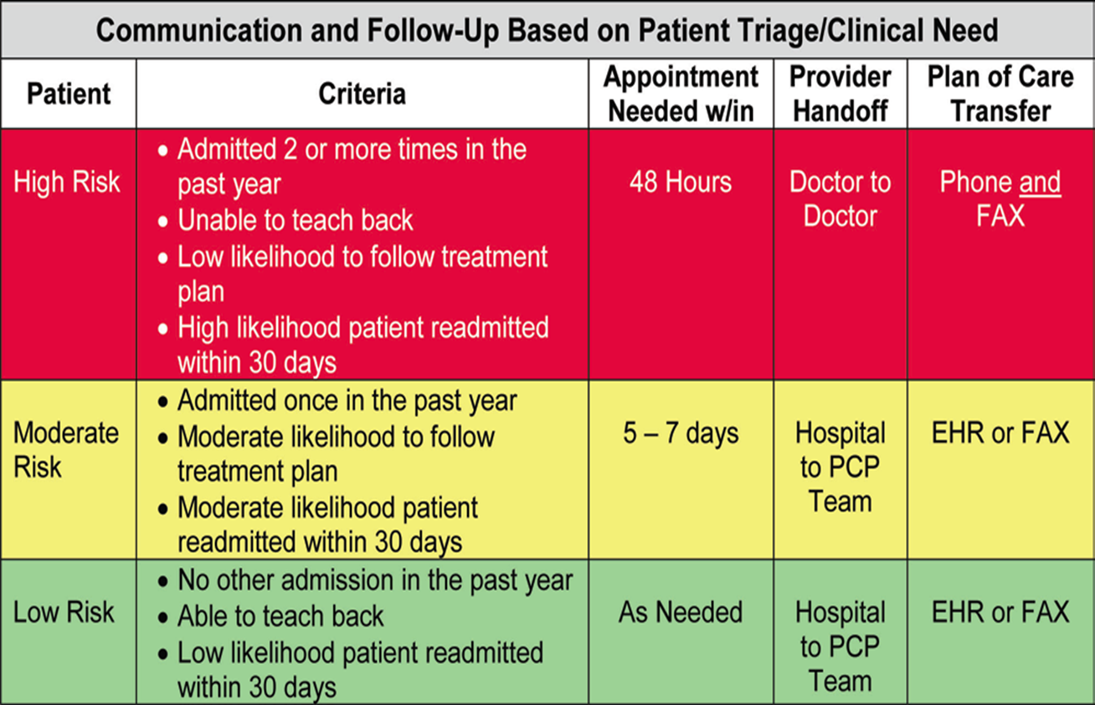
Triage Grid for Follow Up With PCP
Clients who are at very high risk need a quicker and stronger communication process between providers while those at lower risk do not need as intensive of care.
Created by WA physicians and hospitals with evidence from the Institute for Healthcare Improvement
Notes:
EHR is the Electronic Health Record.
Primary care physicians need quicker notification for
clients with moderate to high risk for re-hospitalization
Direct physician-to-physician communication is needed for
high risk clients
Use of the electronic health record or a FAX is recommended
PRISM data can identify those most at risk for readmission
Don’t assume that the home health agency received the referral or that the home health agency has accepted the client for home health services. Check with home health providers and any other service providers to ensure that referrals were received.

Slide 253
Medication Reconciliation Defined
Medication reconciliation is:
  A process of comparing the medications a client took prior to admission to a hospital, nursing facility, or other in-patient center with those ordered by the physician at the time of discharge.
  Should also be completed when the client visits their PCP to ensure that the medication record is accurate and up to date.
  Reduces the potential for administering the wrong dosage, administering a discharged medication, taking the same medication more than once (e.g. taking the name brand and the generic of the same medication), and/or using expired medications.

Slide 254
Medication Reconciliation
During the hospital stay: anticipate needs
Care Coordinator will provide or ensure that it is completed by a qualified professional
Note: clients who discharge from a facility against medical advice (AMA) do not receive their prescribed medications when they exit the facility. The need to follow up on medication orders and to fill prescriptions becomes even more critical.

Slide 255
Medication Reconciliation (cont.)
Who can help reconcile medications?
Primary care physicians (PCP)
  The PCP’s nurse or physician’s assistant (PA)
Family members
Pharmacists
Pharmacies that deliver bubble-packed medications to adult family homes
Home Health nurses
Adult Day Health Centers
Nurses in nursing facilities, assisted living, adult family homes,
and other institutions

Slide 256
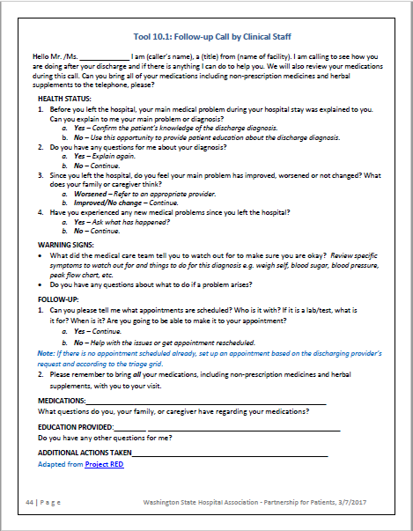
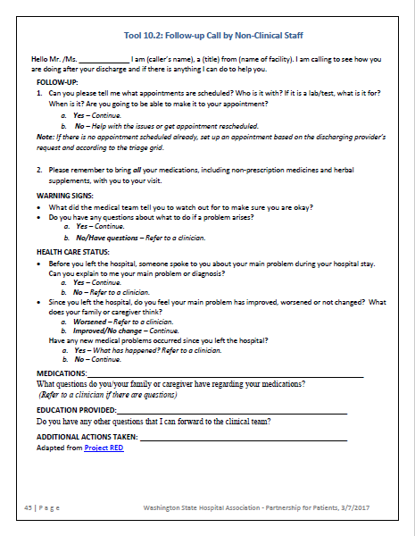
Follow-up Scripts from “Reducing Readmissions: Care Transitions Toolkit”
TRAINING
Notes:
The Care Transitions handout in the Reference section of the Classroom Training Manual contains scripts for clinical and non-clinical staff on pages 44 and 45 you may want to use when following up with your client. With some clients it may be more informative to visit the client while in the hospital so you can access their medical information prior to discharge.

Slide 257
“Teach Back”
Literature shows “Teach Back” is one of the most effective methods for educating clients. Teach Back involves asking
the patient, family, or caregiver to recall and restate in their own words what they thought they heard during education
or other instructions.
Be aware of the client or caregiver activation level when teaching or using “teach back” techniques.
An example of teach back is to ask your client if they can show you how to locate the number for the 24 –hour nurse helpline
TRAINING
Notes:
Refer to the first page of the Care Transitions handout for information on Teach Back.

Slide 258
Let’s Consider Our Vignettes
If Carmella was hospitalized what transition services might you provide?
How would you work with Sacha if she admits to the hospital and then to the nursing facility and is returning home?
NOTE: when entering a hospital, nursing facility, or other institution introduce yourself to staff each time you enter the facility so staff is aware of your role and services you may offer.
Notes:
Introducing yourself to staff is a professional courtesy and is important in establishing a good working relationship with staff. Be prepared to explain the Health Home Program and your role in working with the client, family, caregivers, and others such as the Area On Aging case manager. Explain that you are not there to duplicate services but ensure that services are in place and being delivered.

Slide 259
Let’s Pause to Check for Understanding
What experience have you had professionally or personally with effective discharge from a hospital or other inpatient setting?
Do you have any questions about Care Transitions?

Slide 260
Documentation, Quality Assurance, and Time Management

Slide 261
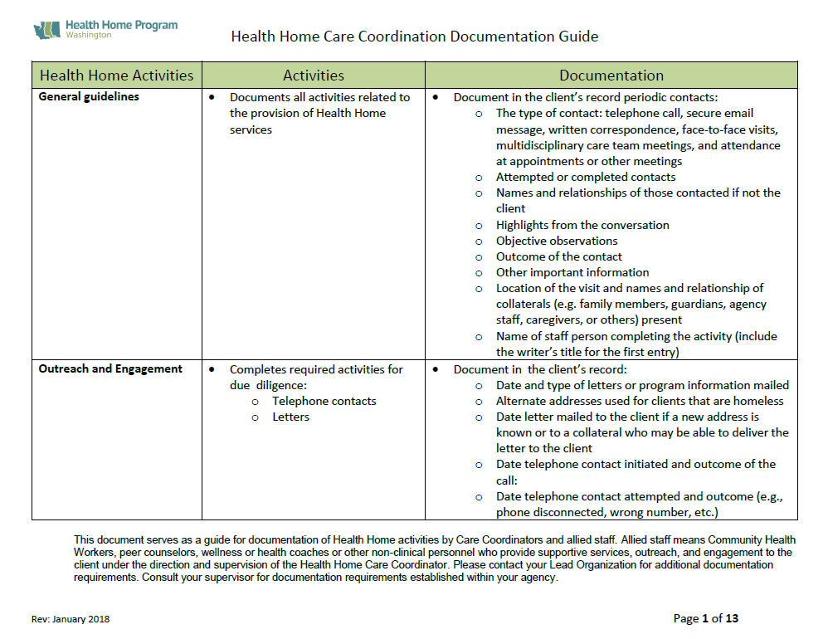
Documentation Guidelines
These are general guidelines
  Suggested practices
Ask your Lead/s for their guidelines
  Data platforms will vary
  Ask for their client file checklist
Consult your supervisor
  What are your agency’s requirements?
  What are best practices?
Professional standards for your credential and experience
TRAINING
Notes:
Ask participants to refer to their Documentation Guide contained in the Reference section of the Classroom Training Manual.

Slide 262
General Format for Documentation
Name and title of writer
Date
Type of contact
Core service provided
Highlights from the conversation
Objective observations
Other relevant comments
Plan for next steps or conclusion
  Specify due dates and who is responsible

Slide 263
Something to Consider
If another staff read your narrative would they understand the acronyms you use?
If someone assumed your case could they find a case history?
Would they know where to pick up after the previous Care Coordinator or allied staff?
  What referrals need to be completed or need to be managed?
  What actions steps are the client, Care Coordinator, or others doing and by when?

Slide 264
Quality Assurance
Leads complete their audits for client records
  Ask for their case file checklist
Health Care Authority (in partnership with DSHS)
  Audits 10-15 client files each year
  Proficiency rate is usually 90%
    Nine out of ten records reviewed meet the requirement
Leads often use the results of their internal audits and findings from HCA to develop training
  Ask your Lead for technical assistance
Notes:
Proficiency is a percentile. For example if ten files were reviewed for meeting the 90 day requirement and nine met the requirement proficiency would be 90% and would meet the standard.
For elements that are not met the Leads are required to complete a Corrective Action Plan for HCA to improve performance.

Slide 265
Core Services
Does the case narrative indicate which core service/s was provided during the month?
  If a core service was provided by another entity note this and describe how the Care Coordinator is coordinating services with other providers
    Care Coordinators do not duplicate services
  Indicate services provided by allied staff under the supervision or coordination of the Care Coordinator
    If allowed, allied staff should document their activities in the case narrative

Slide 266
Completion of Forms
Was the Participation Authorization and Information Sharing Consent Form completed, signed, and dated?
  If not is there a note in the case narrative citing the reason the form was not completed and signed by the client, parent, or guardian?
  Were additions and deletions dated and initialed by the client, parent, or client representative (POA, guardian)?
Was the Opt-Out Form completed, signed, and dated?
  If the client does not complete the form is there a narrative documenting the client’s verbal request to opt-out?
  Was a copy of the completed form mailed to the client (whether completed by the client or the Care Coordinator)
Notes:
Send a copy of the form to the client because it contains instructions on how to re-enroll in the Health Home Program if they change their minds.

Slide 267
Required and Optional Screenings
Document the date required screenings were completed and the score (and level for the Patient Activation Measures ®)
  If the client, parent, or guardian decline to complete a screening document the date it was offered. Also include the reason if known
    For example, a parent declined the PPAM ® because the child was ill and needed the parent’s care
  Optional screenings are required when applicable to the client’s health needs
    If the client, parent, or guardian decline to complete the optional screening document the date it was offered and the reason if known

Slide 268
HAP
Were all fields completed?
  If not, is there an explanation?
Were person-centered short and long term goals created?
Was HAP information shared with the client, parent, family member, or guardian?
  Formats vary depending on the Lead

Slide 269
Key Considerations to Document
In-person visit with the client to develop and finalize the HAP
Completion of the HAP within 90 days of enrollment with the Care Coordination Organization
Case narrative supports the Tier that was billed
Notes:
These were the elements audited to during the 2016 audit cycle and are subject to change in the future.
The 90 day requirement is a performance measure that HCA and DSHS have agreed to with CMS.

Slide 270
Key Considerations to Document (cont.)
Periodic in-person and telephonic interactions with the client
Initial score and level for PAM®, CAM®, or PPAM® as appropriate
Required screenings for the BMI, Katz ADL, PHQ-9 or PSC-17 scores or a reason the client declined the assessment or screening tool

Slide 271
Key Considerations to Document (cont.)
Completion of required screenings and update of the HAP at least once during every four month activity period or when there was change in the client’s health status, needs, or preferences
Completion of optional screenings to assist in determining gaps in care or changes in the client’s health

Slide 272
Key Considerations to Document (cont.)
Action steps to achieve the client’s prioritized short term goal and who is responsible to complete each step
Provision of services in a culturally competent manner with equal access for clients with language and communication barriers
Provision of services tailored to special needs such as functional impairment or environmental factors

Slide 273
Key Considerations to Document (cont.)
Services are delivered
  In the client’s primary language
  Recognizing cultural differences and obstacles faced by persons with a developmental disability
  Recognizing the dynamics of substance use
Development and/or coordination of multidisciplinary teams to provide assistance as needed

Slide 274
Key Considerations to Document (cont.)
Communication and coordination between the client and the client’s service providers and other support systems to address barriers and achieve health action goals
Development and execution of a cross-system team as needed
Provision of individual and family support through care coordination and care transition activities

Slide 275
Key Considerations to Document (cont.)
Provision of educational materials that:
  promote improved clinical outcomes
  increase self-management skills
  are appropriate to the level of activation
Use of peer supports to increase the client’s knowledge about their health conditions and adherence to treatment

Slide 276
Key Considerations to Document (cont.)
Discussion about advance care planning with the client, parent, or collateral
  Within the first year that the client agrees to participate in the Health Home Program
  If this was not completed by a previous Care Coordinator then document that a discussion was offered to the client, parent, family member, or guardian
Assistance provided to maintain the client’s eligibility for programs and services as needed
Notes:
HH FFS Contract:
Documents discussion of advance care planning within the first year of the Beneficiary’s agreement to participate in the Health Home program
Exhibit C:

Slide 277
Key Considerations to Document (cont.)
Referrals to available community resources to help achieve health action goals
Process for notification of the client’s admission or discharge from an emergency department or an inpatient setting
  Because we do not duplicate benefits, if another agency, such as the MCO, is providing care transitions, note this is the case narrative

Slide 278
Key Considerations to Document (cont.)
Provision of care transition to prevent avoidable readmissions after discharge from an inpatient facility and ensure proper and timely follow-up care
Participation by the Care Coordinator in all appropriate phases of care transition

Slide 279
What Were the Six Strategies for Care Transitions?
1
Consistent plan of care with the PCP and home health care (if applicable) upon discharge
Coordinated follow up call or visit at discharge
Timely visit to PCP
Reconciliation of medications soon after discharge
Client, family, and caregiver education coordinated between settings
Support through increased care management for high-risk clients
2
3
4
5
6
Notes:
Soon means within a week of moving between settings. While six strategies are presented your client may not require all of these activities. At a minimum the Care Coordinator should check with the client to determine the client’s need and the level assistance the Care Coordinator may need to provide.

Slide 280

Time Management
Plan your day/week by scheduling time for:
  Outreach calls and letters
  Face-to-face visits
  Follow-up calls
  Making and actively managing referrals
  Working with allied staff and multidisciplinary care teams
  Documentation
Schedule time for responding to EDIE or PreManage alerts
  Carve out time in your schedule and if no one has been hospitalized or admitted in the ED use this time for the above activities
Notes:
Experienced Care Coordinators have reported that they schedule the next face-to-face visit before they leave the client which results in better results in maintaining contact with the client and ensuring that they will be able to complete the next face-to-face. Others have reported that this has not been helpful so use your judgement.

Slide 281
Let’s Pause to Check for Understanding
What tips can you share that have helped you better manage your caseload?
Do you have any questions?

Slide 282
Resources
Notes:
If Internet Access is available visit the HCA and DSHS websites and highlight resources such as forms and client materials.

Slide 283

Advanced Home Care Aide
Specialist Pilot Program
Care Coordinators will be notified if their client enrolls in the program
Care Coordinators may need to answer questions about the program
Care Coordinators may work with the case manager, Individual Provider (IP), and client to incorporate the IP into the HAP
TRAINING
Notes:
This is a voluntary program for clients.

Slide 284
Community Integration Program
Adult Family Homes (AFH) may receive a rate increase to participate with qualifying residents
  Provider may assist their client to better integrate into their local communities
Possible roles for the Care Coordinator:
  Educate the client, family, or collaterals about this benefit
  Research opportunities for the client in their community
  Discuss with the AFH provider options
    Who will provide transportation?
    Who will make a referral or complete an application if needed?
  Integrate the activity into the HAP if appropriate
    Establish a short term goal and action steps

Slide 285
Non-emergency Medical Transportation (NEMT) Program
Transportation may be provided to Health Home clients for services when the client is homeless or lives in an unhealthy
or unsafe environment
A Care Coordinator may request NEMT to alternate locations to conduct care coordination services such as:
  obtaining consent to participate
  administering health assessments
  developing the HAP
TRAINING
Notes:
Refer to the Reference section of the Classroom Training Manual for the program description document and the FAQ document. See the Forms and Documents section of the manual for a copy of the referral form.

Slide 286

Interpreter Services
For information refer to the two documents at the end of Section B: Reference
  Ask your manager or accountant for your agency’s National Provider Identification (NPI) number so that you can schedule interpreters
    Your agency may have more than one NPI number so ask which number you should use for your Health Home clients
TRAINING

Slide 287
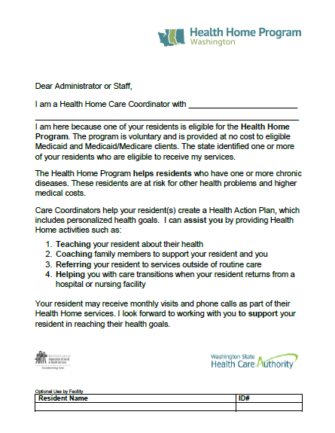
Working with Providers
Offer this letter when visiting your client at nursing facilities, hospitals, and other residential providers (assisted living facilities and adult family homes)
TRAINING

Slide 288
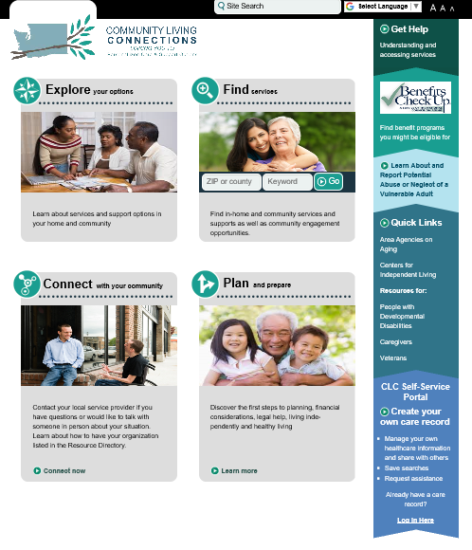
Community Living Connections (CLC)
Easy to navigate:
  Website is located at: https://washingtoncommunitylivingconnections.org/consumer/
  Enter zip for client’s location and select type of service

Slide 289

DSHS Health Home Website Quick Links: Care Coordinators Links
Contains Guide Sheets
  Advance Care Planning
  Advanced Home Care Aide Specialist Pilot
  Depression Screening and Intervention
Training schedules and invitations to monthly webinars
Educational materials for health promotion
Classroom Training Manual and PowerPoint Handout

Slide 290
Developing Relationships and Resources
Lead Organizations have completed outreach activities with local hospitals and institutions
Care Coordination Organizations are encouraged to complete their own outreach to community partners and medical and behavioral health providers to establish working relationships to aid in their care coordination activities
Be prepared to educate case managers and staff at HCS, DDA, AAAs, and other agencies about the program and your role

Slide 291
Review of the Learning Objectives
What are the six core Health Home Services?
Describe outreach and engagement strategies you will use.
Describe the key uses of PRISM in care coordination.
How could you use the results of the patient, parent, or caregiver activation measures in working with your client or their collaterals?

Slide 292
Review of the Learning Objectives (cont.)
What are the required and optional screens used in the HAP?
How does the HAP support the client to improve their health and self-management?
What are the crucial activities of comprehensive transitional care?

Slide 293
Let’s Pause to Check for Understanding
Do you have any questions about what we covered during Day One or Day Two?

Slide 294
Additional Training
Required Special-topic Training
Optional Training
Notes:
DSHS offers live Webinars on some of these topics. Review of the PowerPoints for the seven required topics within the first six months of hire as a Care Coordinator.

Slide 295
Required Training for Fee-for-Service and MCO Health Home Program
Special topic PowerPoints are located at the DSHS Duals website at:
https://www.dshs.wa.gov/altsa/home-and-community-services/washington-health-home-program-going-training
The mandated topics are:
Outreach and Engagement Strategies
Navigating the LTSS System: Part 1
Navigating the LTSS System: Part 2
Cultural and Disability Competence Considerations
Assessment Screening Tools
Coaching and Engaging Clients with Mental Health Needs
Medicare Grievance and Appeals (required if working for Duals)
Notes:
Care Coordinators who will not work with the dual eligible population will not be required to complete the training on “Medicare Grievances and Appeals.”
Some of the webinars are recorded and others are just the PowerPoint handouts from past live webinars.

Slide 296

Register and Join for Our Monthly Webinars
Ask your Lead for the link to register for each quarterly series or visit the DSHS Care Coordinators website
Notes:
Beginning in January 2018 webinars will have a unique link for each of the four three-month series. Participants will need to register for:
January through March
April through June
July through September
October through December

Slide 297

HCA Website is Located At: https://www.hca.wa.gov/billers-providers/programs-and-services/health-homes

Slide 298
DSHS Website is Located At: https://www.dshs.wa.gov/altsa/washington-health-home-program
Resources for Care Coordinators and Allied Staff

Slide 299
Let’s Pause to Check for Understanding
Do you have any final questions?

Slide 300

Please Complete the Training Evaluation
We appreciate
your feedback!
TRAINING
Notes:
Note to trainers: please share evaluation comments or suggestions to the DSHS Training Program Manager that will help improve the training for participants, or questions that are coming up consistently that would apply statewide.

