Slide 1
Confederated Tribes of Grand Ronde
Adult Foster Care Lodges

Slide 2
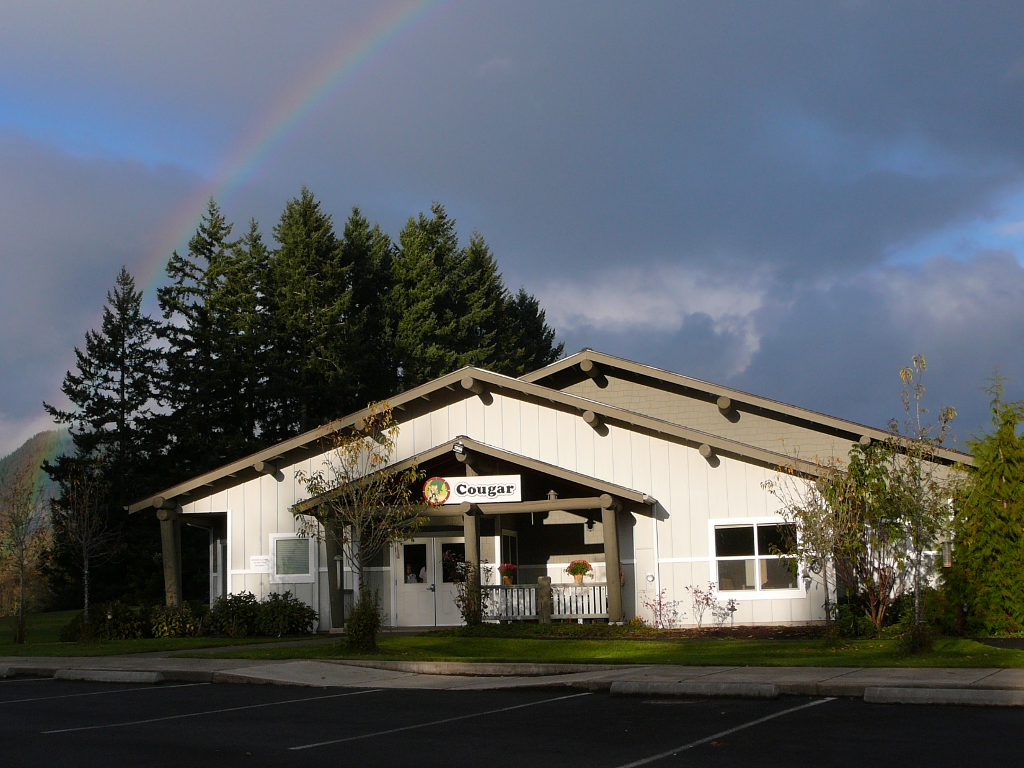

Slide 3
Adult Foster Care - AFC | Residential Care Facility - RCF
Any family home or other facility where residential care is provided in a home-like environment for compensation to FIVE or less adults. | A building, complex, or distinct part thereof, consisting of shared or individual living units in a homelike surrounding where SIX or more seniors and adult individuals with disabilities may reside.
Staffing does not have to include an RN but delegations and teaching tasks must be provided and documented by an RN. | Staffing must include an RN who is regularly scheduled for onsite duties at the facility and who is available for phone consultation. Delegation and teaching tasks must be provided and documented by an RN.
No medications including over the counter meds can be kept in the room or self-administered by a resident without a written doctor order. | Unless contraindicated by a physician or resident evaluation, residents may keep and use over-the-counter medications in their unit without a written order.
Must have a Licensee responsible for the facility operations that must be onsite at least 40 hours per week. Licensee requires 12 hours continuing education annually. | Must have a Facility Administrator, must be 21 or older, possess a high school diploma, and have at least 2 years management experience within the last five years in health or social service related fields or programs, or have a combination of experience and education. Or possess a Bachelor Degree in a health or social services field. Administrator requires 20 hours continuing education annually.
Shift caregivers have to submit same application to DHS as licensee, and require 12 hours continuing education annually. Caregivers must be 21 or older and have 2 years verifiable experience. | Caregivers require 12 hours of continuing education annually. Caregivers must be 18 years or older.
Fire Drills must be conducted every 90 days. Must conduct emergency preparedness drill/instruction once annually. Must be able to evacuate ALL residents in a fire drill, in under 3 minutes time. | Fire Drills must be conducted every other month. Fire and life safety instruction must be conducted and recorded on alternate months.
 | Must conduct a drill of the emergency preparedness plan at least twice a year. Must review and update emergency preparedness plan annually.

Slide 4
Funding
Sliding Scale fee of 75% of an Elder’s monthly income to AFC, not sale of assets.
Monthly income includes, but not limited to: Elder Pension, Per Capita, Social Security Benefits, Pensions.
Additional funding provided by CTGR.
Eligibility
CTGR Tribal Member
CTGR Elder (55 years or older)
Spouse of CTGR Tribal Member

Slide 5
In accordance with state regulations, Adult Foster Care homes are State of Oregon Department of Human Services licensed to provide care for individuals at one of three levels of care for Elders who need assistance with daily activities.
Activities of Daily Living (ADLs)
Mental status & behaviors
Bathing & personal hygiene
Dressing
Toileting
Mobility, ambulation & transfer
Eating & nutrition
Level 1 (lowest level of care) Resident needs occasional supervision, reminders to take medications and perform ADLs, but is independent in other activities.
Level 2 (moderate level of care) Resident requires substantial support with some ADLs (no more than 3), and medication administration is provided.
Level 3 (high level of care) Resident needs comprehensive assistance with ADLs, medication administration and monitoring effects of medications.
CTGR AFC is a Level 2

Slide 6
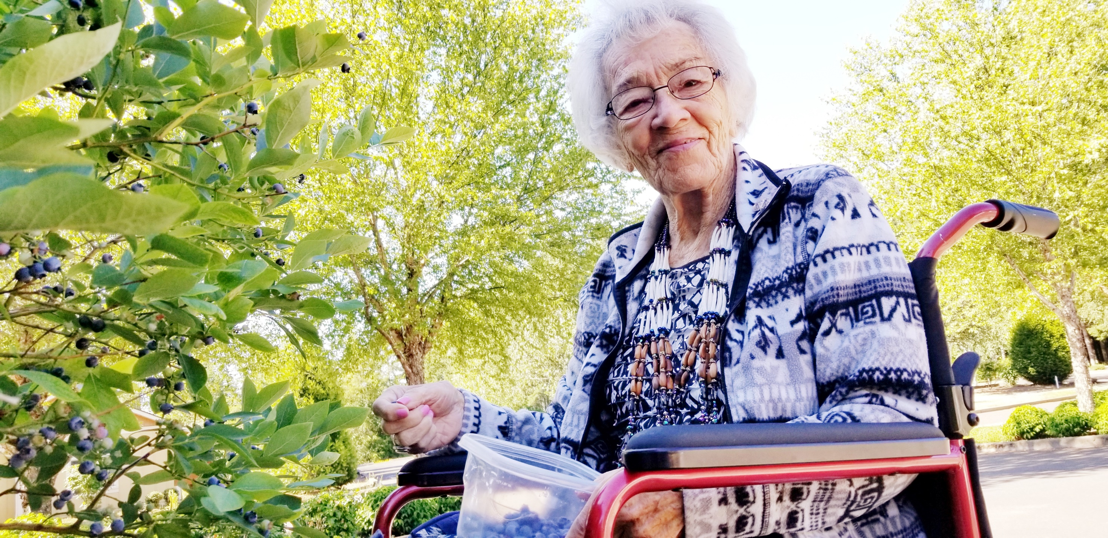

Slide 7
A PLACE TO CALL HOME
Living Arrangements
We know the quality of service you expect is as important as the quality of life you live. Our Adult Foster Lodges provide:
Private room with private bath & freedom to bring your own furnishings and decorations in addition to personal privacy with residential door locks
Private telephones and Dish TV with Netflix
A whirlpool bath in each Lodge
Three home-cooked meals served daily in our dining room & access to food at any time
Housekeeping, laundry, and maintenance services
Recreation and wellness activities planned around your interests
Medical & Recreational transportation coordination
Access to visitors at anytime
We provide bed, bedding, private dresser(s), closet space, lift recliner, flat screen TV
We work in their home, they don’t live at our work!

Slide 8
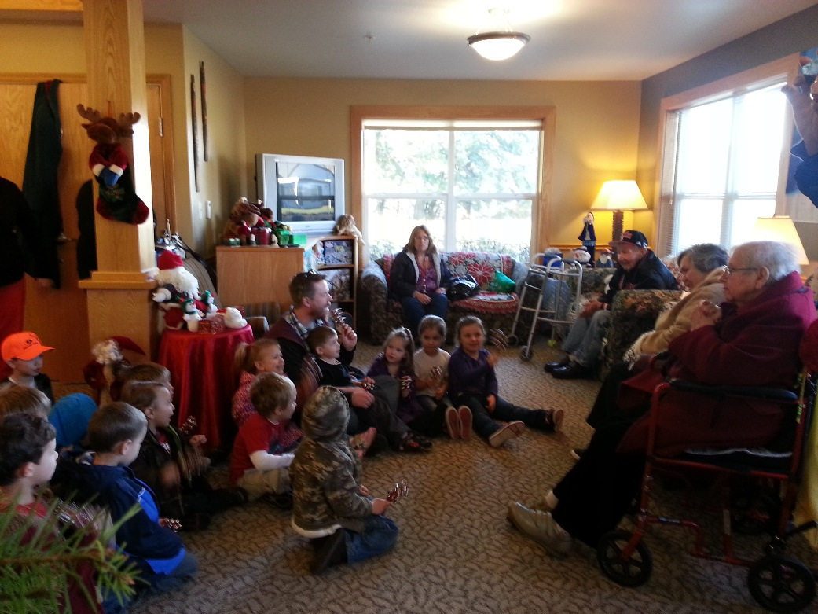
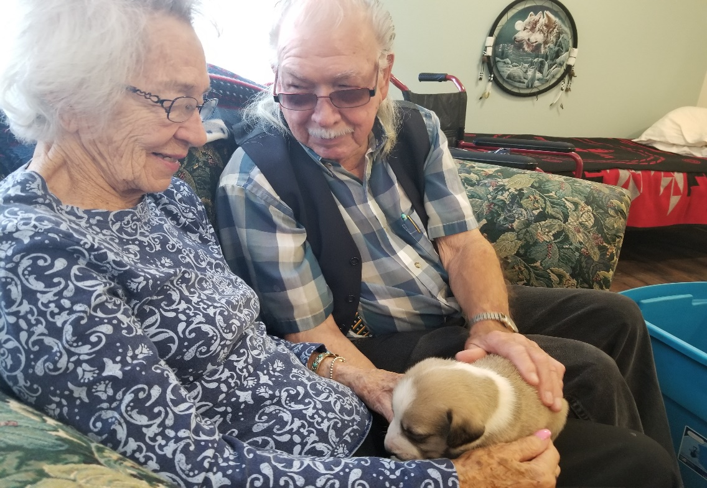
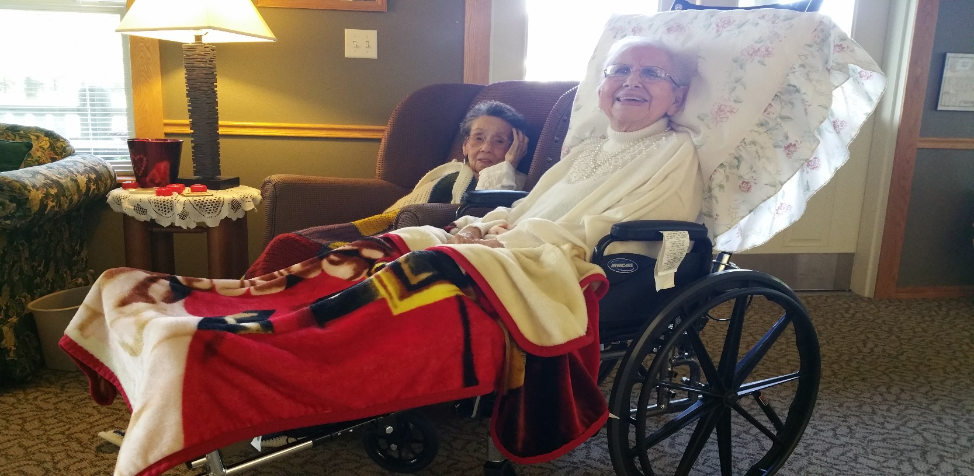
Common
Living
Room
Family visits
Movie night
Change of scenery
Visits from our littles

Slide 9
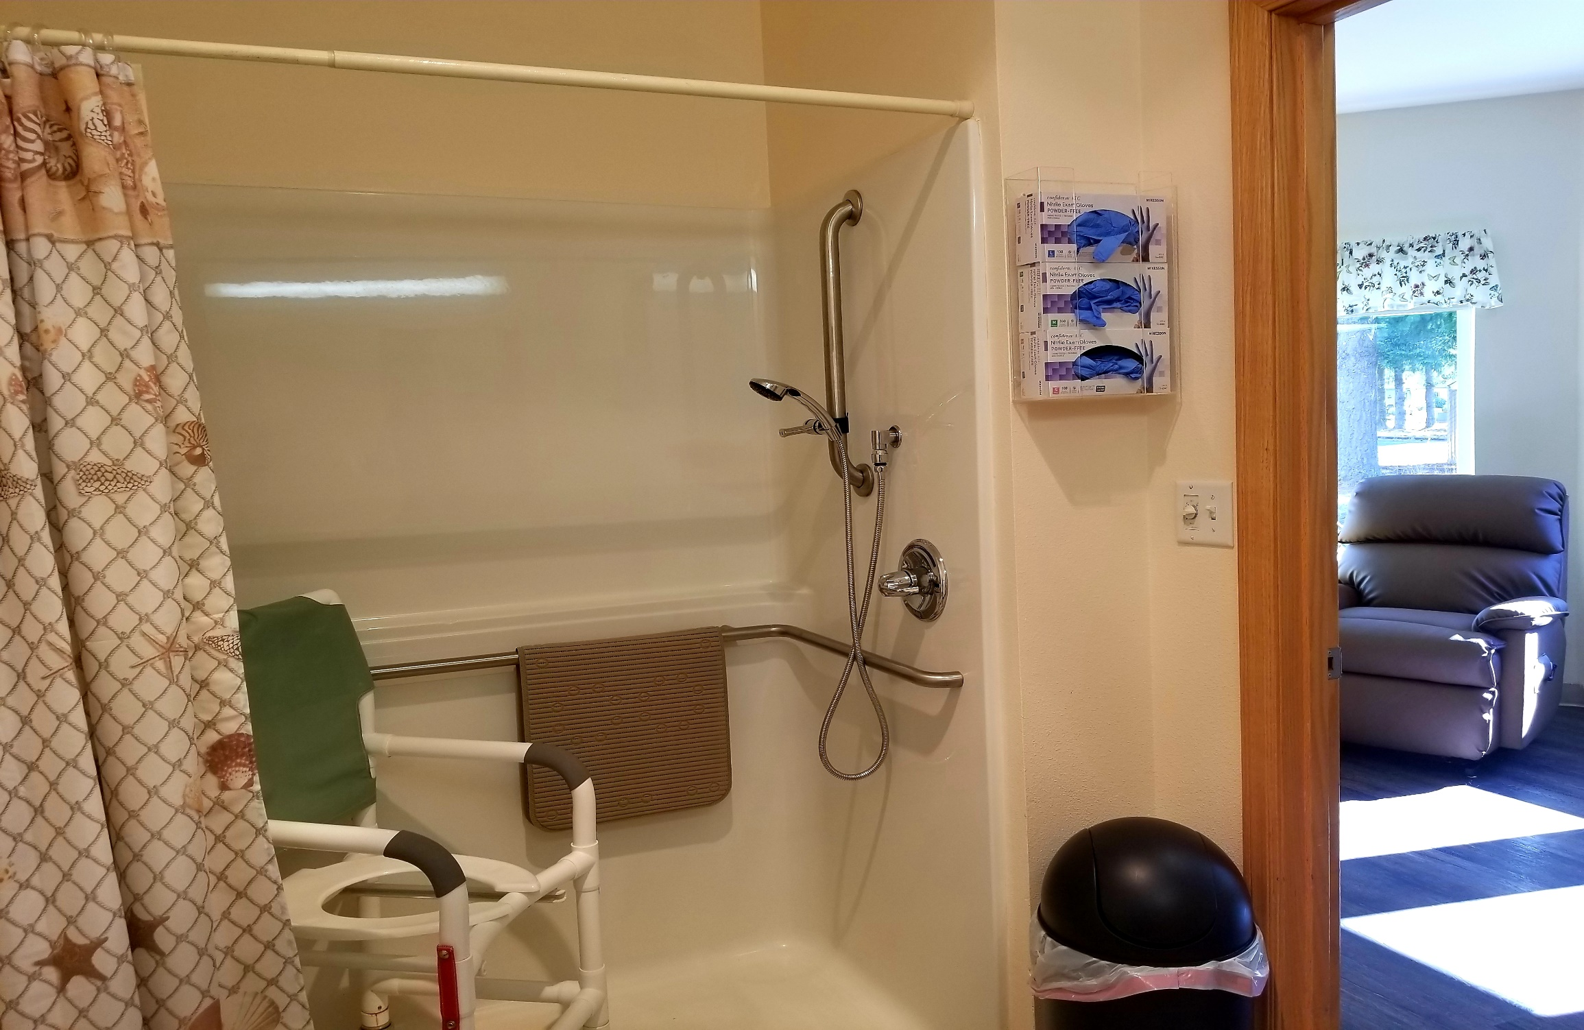

Slide 10
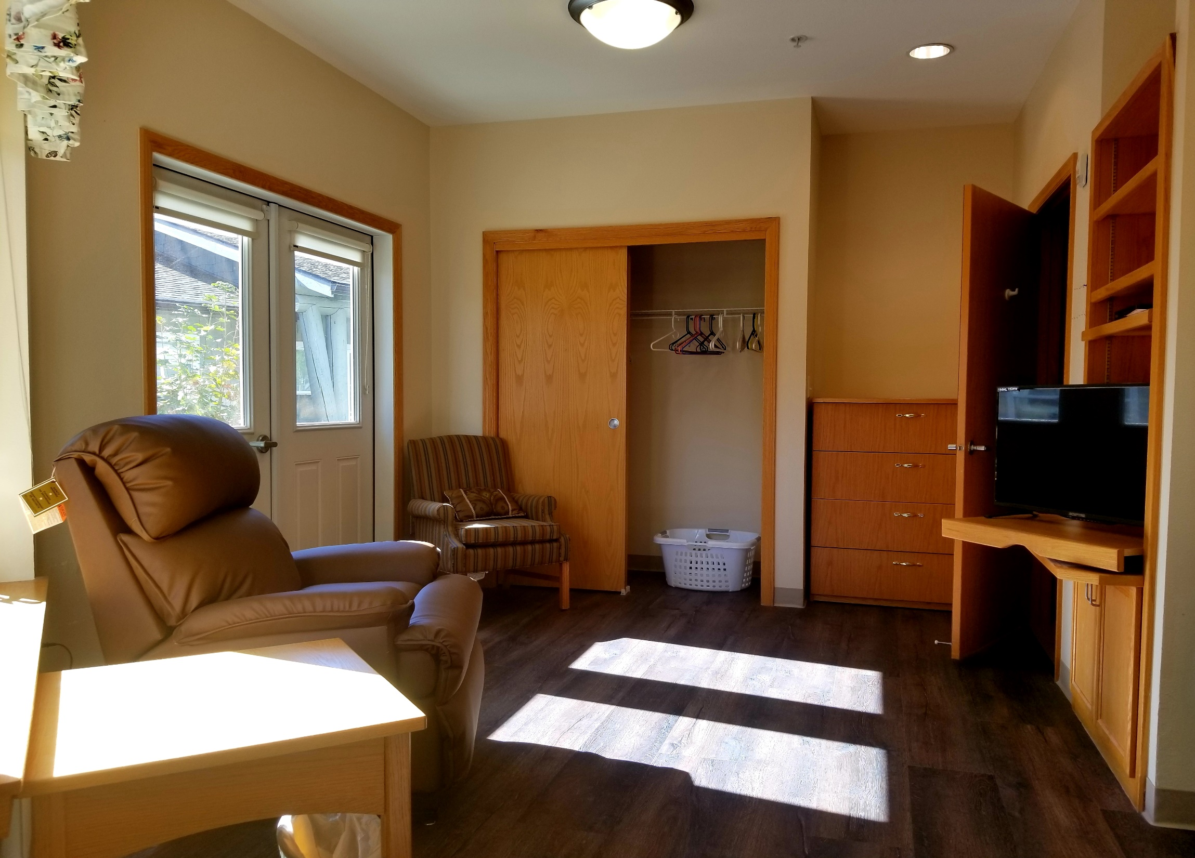

Slide 11
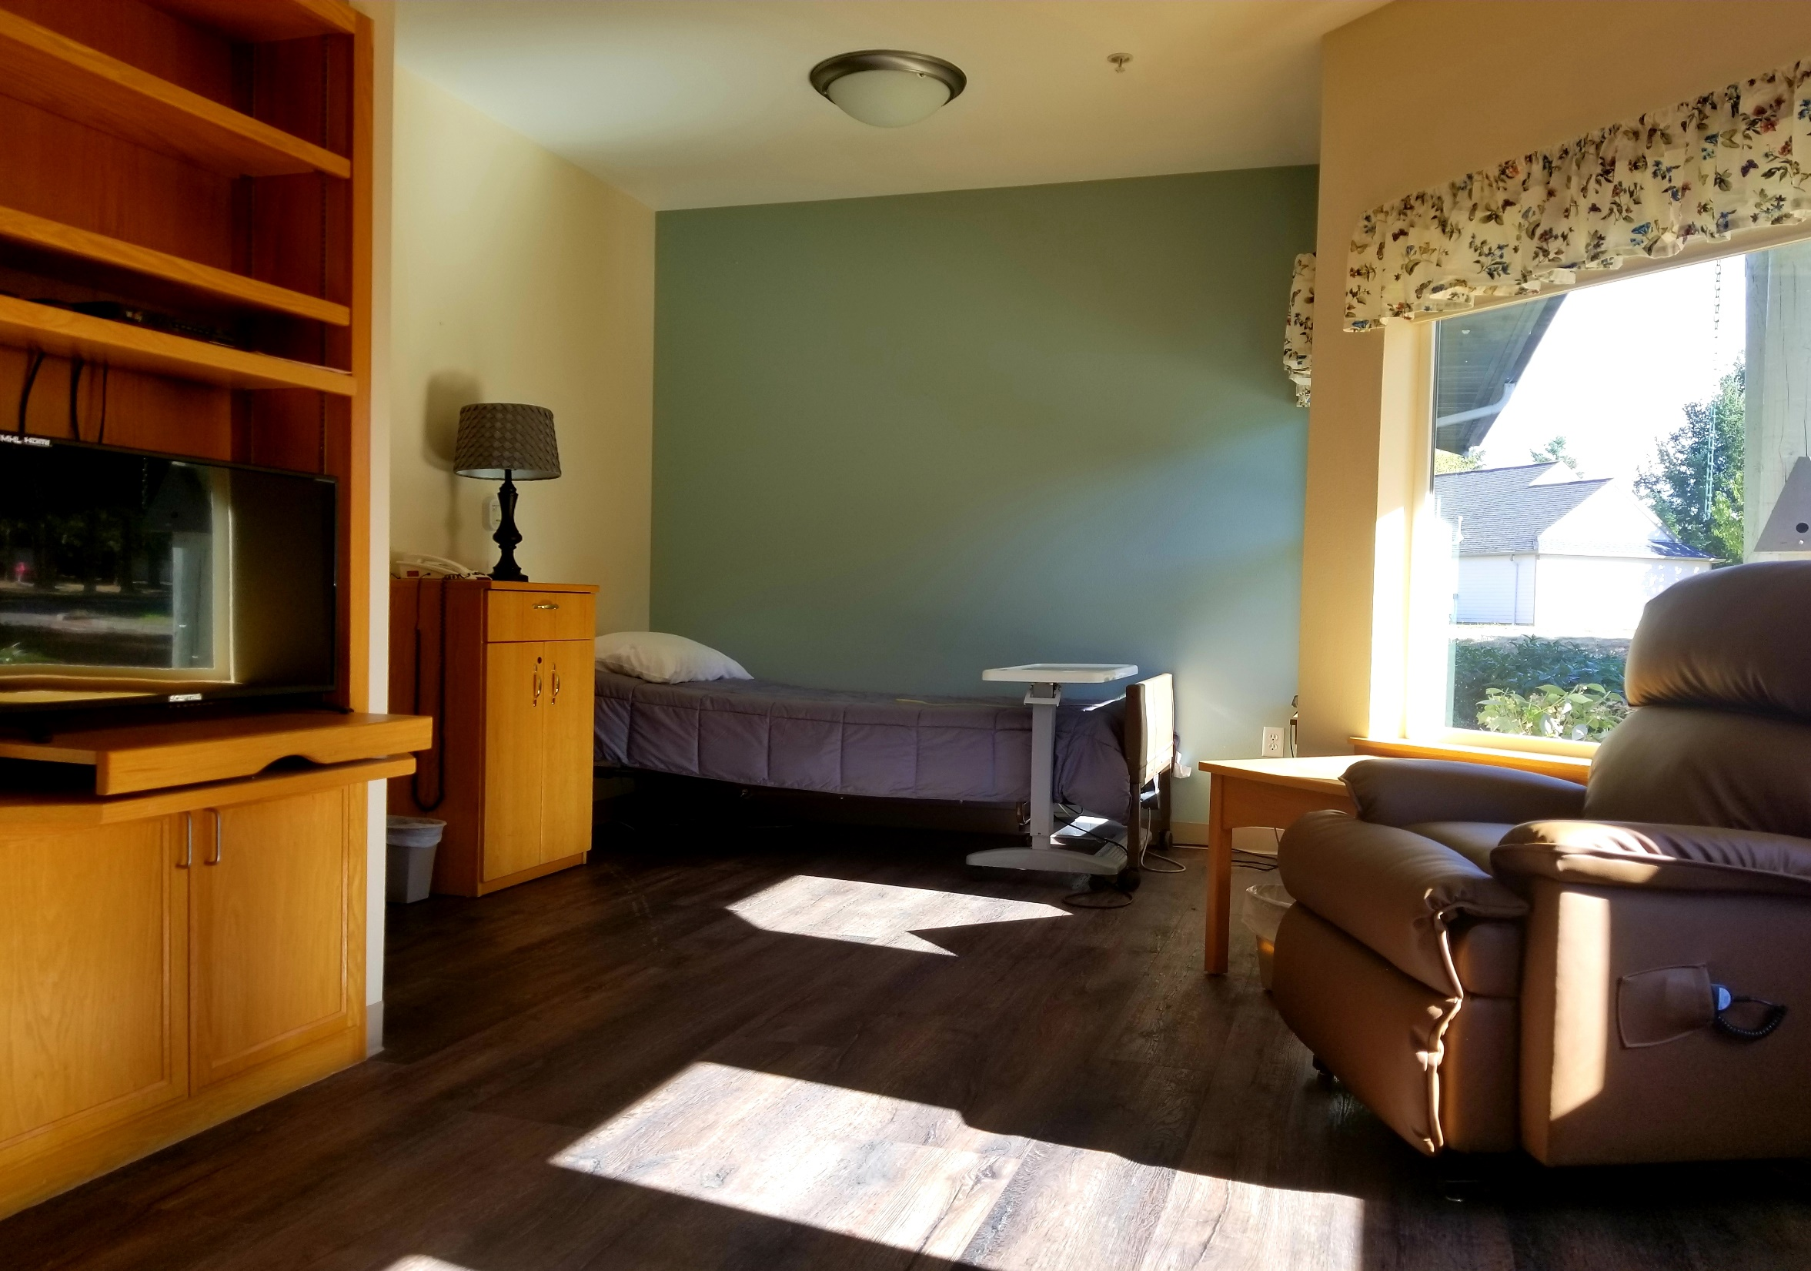

Slide 12
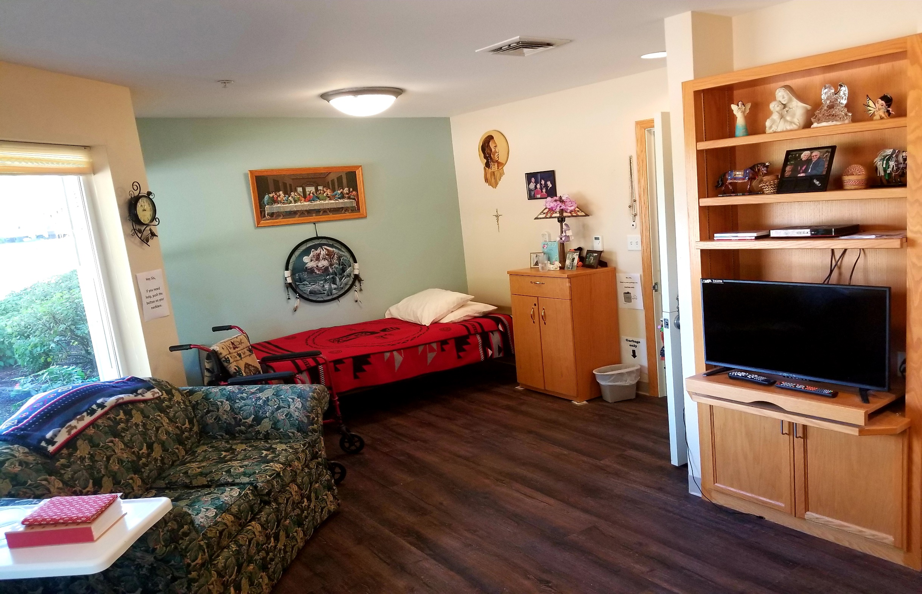

Slide 13
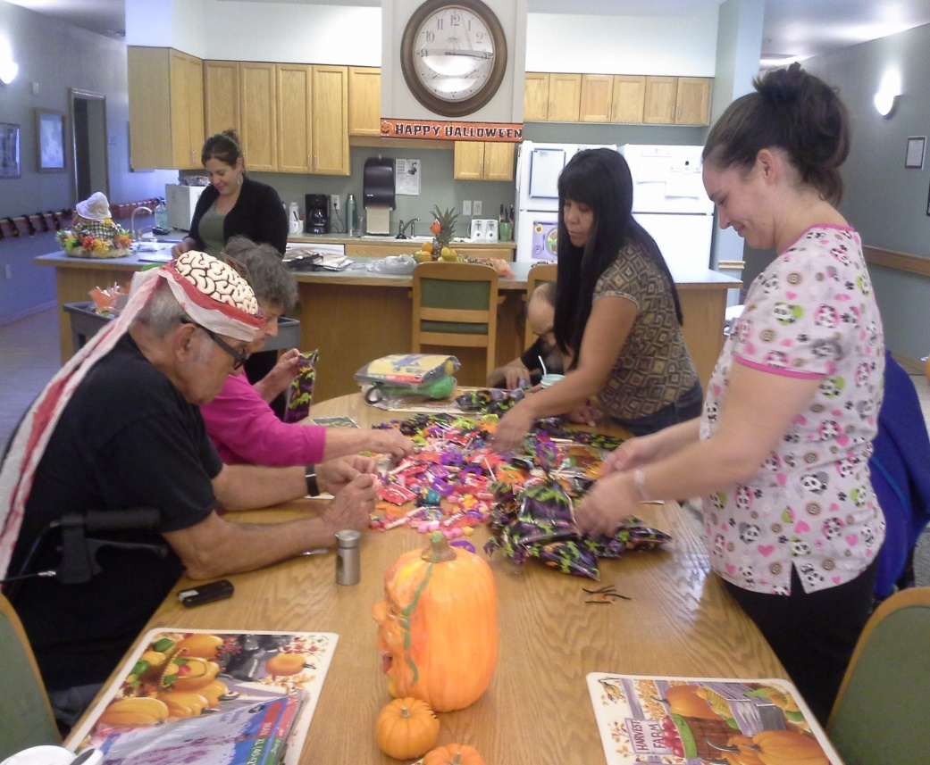
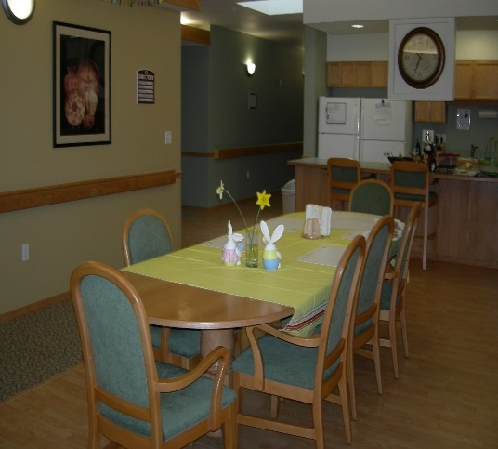
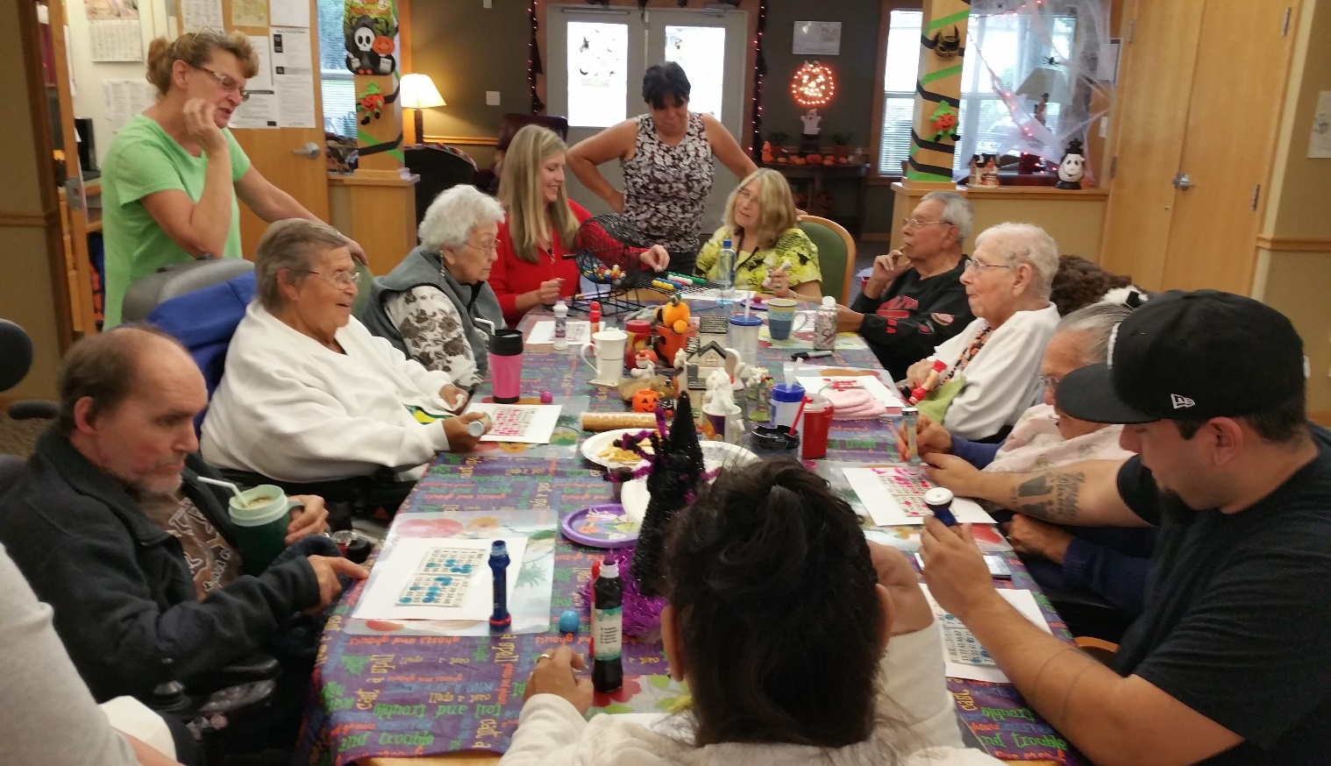
Common
Dining Room
Meals
Activities
Games
Puzzles
Beading
Painting rocks
Adult Color Books
Decorate sugar cookies
Scrapbooking photo albums
Coffee break
Bingo

Slide 15
