Slide 1


VA Indian Health Service (IHS)/Tribal Health Program (THP) Reimbursement Agreement
8/2020
Kara Hawthorne
Program Manager
Michelle Slusser
Program Analyst

Slide 2
Topics
VA-IHS/THP Reimbursement Agreement Background and Status
Key Stakeholders and Benefits
Payment Rates and Fees
Direct Care Services
Eligibility and Enrollment
Establishing a Reimbursement Agreement
Resources and Contact Information
Questions

Slide 3
Background
The VA Reimbursement Agreements with the Indian Health Service (IHS) and Tribal Health Programs (THP) pays the IHS and THP health care facilities for direct care services they provide onsite to eligible American Indian/Alaska Native (AI/AN) Veterans.
This program is part of a larger effort set forth in the ‘VA and IHS Memorandum of Understanding’ signed in October 2010 to establish access to care collaboration, resource sharing, and care coordination, for our nation’s eligible AI/AN Veterans.
In December 2012, VA signed a national ‘Reimbursement Agreement’ with IHS which promotes improved VA–IHS and Tribal program interactions. The Agreements provide easier access to healthcare within VHA, IHS, or Tribal health care systems, for eligible AI/AN Veterans.
VA - IHS National and THP Reimbursement Agreements has been extended to June 30, 2022.
Notes:
Read the slides.
VA-IHS National Reimbursement Agreement has 74 participating IHS healthcare facilities.
There are currently 116 THP healthcare facilities that are part of this reimbursement agreement program.
We are still in the process on onboarding more THP tribal facilities.

Slide 4
Key Stakeholders and Benefits
Benefit
Collaboration - Promotes quality health care through collaborative relationships both intergovernmental by sharing resources and with the community
Choice of Provider and Access - Eligible AI/AN Veterans can choose to receive their health care from the IHS/THP facility and/or VA facility closer to their homes in a culturally sensitive environment. In Alaska, due to the rural nature of the state and the limited presence of VA there, reimbursement agreements also cover eligible non-AI/AN Veterans
No Copayment – Pursuant to section 405(c) of the Indian Health Care Improvement Act (IHCIA), VA copayments do not apply to direct care services delivered by the IHS or THP healthcare facility to eligible AI/AN Veterans under agreements with VA.
No Outstanding Balances - For United States lower 48 states, IHS and THP medical facilities bill third parties prior to billing VA. This means VA is only responsible for the balance remaining after third party reimbursements. For Alaska, VA can be the primary payer, but VA payments are considered payment in full.
No Prior Authorization - IHS and THP facilities that are providing direct care services Eligible AI/AN Veteran does not require VA-preauthorization to receive reimbursement from the VA.
Pharmacy Benefit– Facilities will be reimbursed for outpatient medications dispensed by the facility that are on the VA’s formulary. This is not limited to emergent prescriptions
Notes:
Read slide.
IHS and THP facilities that are providing direct care services Eligible AI/AN Veteran does not require VA-preauthorization to receive reimbursement from the VA.

Slide 5
IHS/THP Agreements Versus Other MOUs
IHS/THP Agreements Versus Other MOUs
Reimbursement agreements:
Separate program from VA’s Community Care Network.
Apply only to AI/AN Veterans receiving direct care services, except in Alaska, non-natives can receive care with preauthorization
Do not relate to existing Memorandum of Understandings (MOUs) or sharing agreements.
Notes:
Read slides

Slide 6
Payment Rates and Fees - US Lower 48 States
Services | Based On | As Applicable
Outpatient | Outpatient IHS All Inclusive Rate (published in the federal registry)
Inpatient | Medicare Inpatient Prospective Payment System (IPPS)
Critical Access Hospital | Medicare Rate | IHS or THP Facility must provide Medicare rate letter to Region 5 NW POM
Ambulatory Care | Medicare Rate
Pharmacy (Outpatient) | Actual Cost | Pharmaceuticals must be in the VA formulary or prior approval has been acquired for Non-VA formulary from the VA pharmacy
Administrative Fee of $15 will be applied to Paper claims (except Pharmacy paper claims)

Slide 7
Payment Rates and Fees - Alaska THPs
Services | Based On | As Applicable
Outpatient | Outpatient IHS All Inclusive Rate (excluding Medicare) | Physician/other Practitioners Services – VA Fee Schedule (as applicable) Schedule (as applicable)
Inpatient | Inpatient Hospital Per Diem Rate (excludes Physician/Practitioners Services) IHS All Inclusive Rate
Ambulatory Care | Medicare Rate
Pharmacy (Outpatient) | Wholesale Acquisition Cost (WAC) + dispensing fee $ 21.28. Effective as of 7/1/2020 | Pharmaceuticals must be in the VA formulary or prior approval has been acquired for Non-VA formulary from the VA pharmacy
Clinical Services, including Certified Community Health Aide Services (CCHA) | Outpatient IHS All Inclusive Rate (excluding Medicare) | CCHA encounters are reimbursed at 85% of the rate

Slide 8
Direct Care Services
Reimbursement is for Direct Care Services
Direct Care Services are defined as any health service that is provided directly by IHS/THP. This does not include Contract Health Services, unless those services are provided within the walls of the IHS or THP facility.
VA will not reimburse for any services that are excluded from the Medical Benefits package or for which the eligible AI/AN Veteran does not meet qualifying criteria.

Slide 9
Eligibility and Enrollment
VA, IHS and THP are responsible for determining eligibility for health care services within their respective programs.
The eligible Veteran must also meet IHS eligibility requirements and be eligible for services in accordance with 42 C.F.R. Part 136.
Veterans must be enrolled in the VA system before a claim can be processed and reimbursed.
Notes:
Read slide
This program is population based – eligible Veteran has to be either Native American or Alaska Native Veteran with exception to Alaska Non-Veteran to participate in this program. They have to eligible for care not only in VA but also in the IHS or THP facilities.

Slide 10
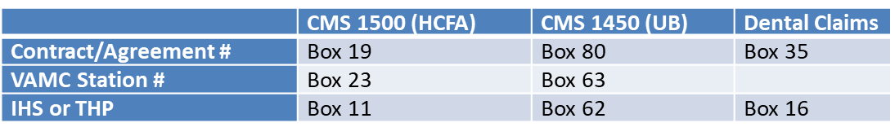
Claims Submission
VA has a centralized claims processing center for IHS/THP (Region 5 Northwest Payment Operations and Manager).
VA accept and encourages the use of electronica data interchange (EDI)
  VA requires “THP” or “IHS” in the SBR03 segment of the 837claim form for proper routing through the VA.
VA can also accept Paper claims submission,
  Generally required elements include:
VA’ provider guide and website have more detailed information on claims submission

Slide 11
Pharmacy Claims
VA will reimburse IHS/THP only for pharmaceutical drugs on the formulary used by VA. Requests for reimbursement of pharmaceutical drugs not on the VA formulary will be submitted for approval to the local VAMC Pharmacy in advance of the request for reimbursement.
Here is the link to the VA Formulary listing: http://www.pbm.va.gov/NationalFormulary.asp Search engine: http://www.pbm.va.gov/apps/VANationalFormulary
VA Criteria for Use for many Non-VA formulary drugs: http://www.pbm.va.gov/PBM/clinicalguidance/criteriaforuse.asp
IHS/THP must use CMS 1500 or EDI 837p to submit pharmacy claims and must contain the following:
Date of fill Pharmacy name Drug name (generic name) Amount paid by the other health plan or for Pharmacy | Quantity/Unit Dr.’s name Drug strength Retail price | Number of day’s supply National Drug Code (NDC) Prescription number
If the drug is a controlled substance, the Drug Enforcement Administration (DEA) number must also be provided.

Slide 12
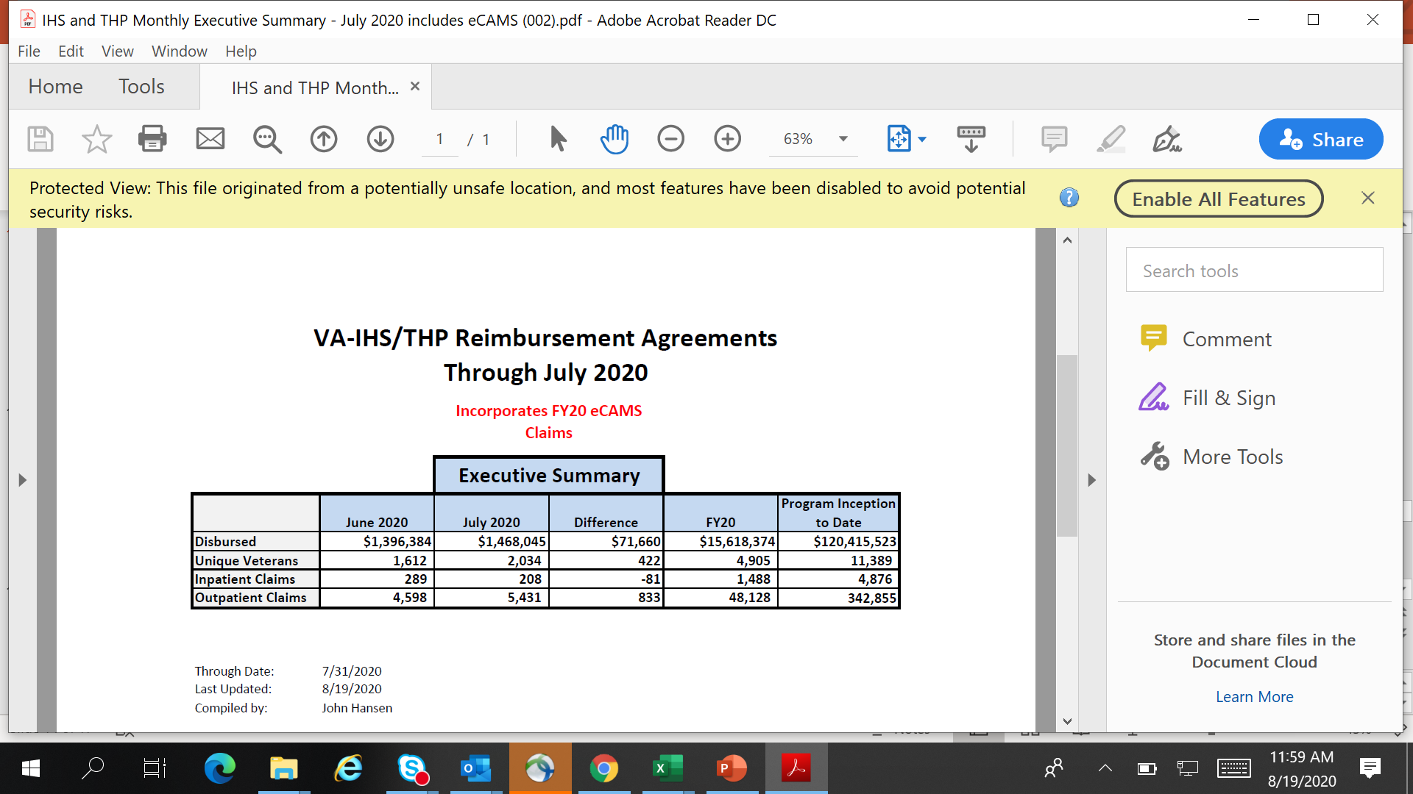
Status
As of 8/2020
73 IHS Sites 116 THP Sites
Notes:
To date, VA has reimbursed over $120 million for direct care services provided by IHS & THPs covering over 11000 eligible AI/AN Veterans.
IHS:74 Implementation plans signed.
THP: 116 signed agreements.
Read slide

Slide 13
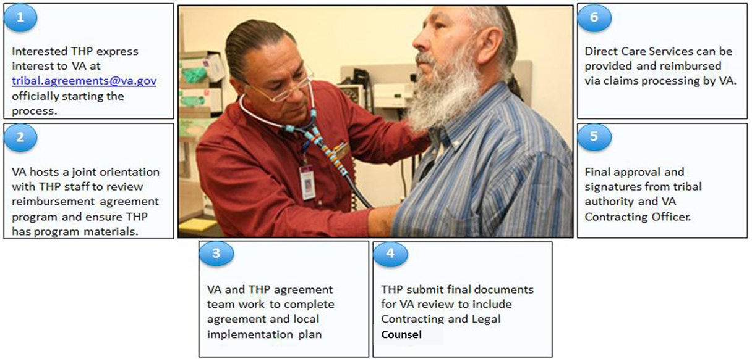
Establishing a Reimbursement Agreements
Notes:
This slide shows the process for establish THP Reimbursement Agreement with the VA.
Read 1-6 process
Using the agreement template, the VAMC, THP, and Contracting Officer work together to complete the draft reimbursement agreement.
The national template shall always be used.
Concurrently, the THP works to satisfy local implementation criteria.
Once the draft is complete, it will be reviewed by Office of Community Care, Network Contracting Office and Regional Counsel, respectively.
After final signatures, reimbursement for direct care can commence.
If THP provider approach your VAMC stating their interest in this program, please have them contact us at tribal.agreements@va.gov.

Slide 14
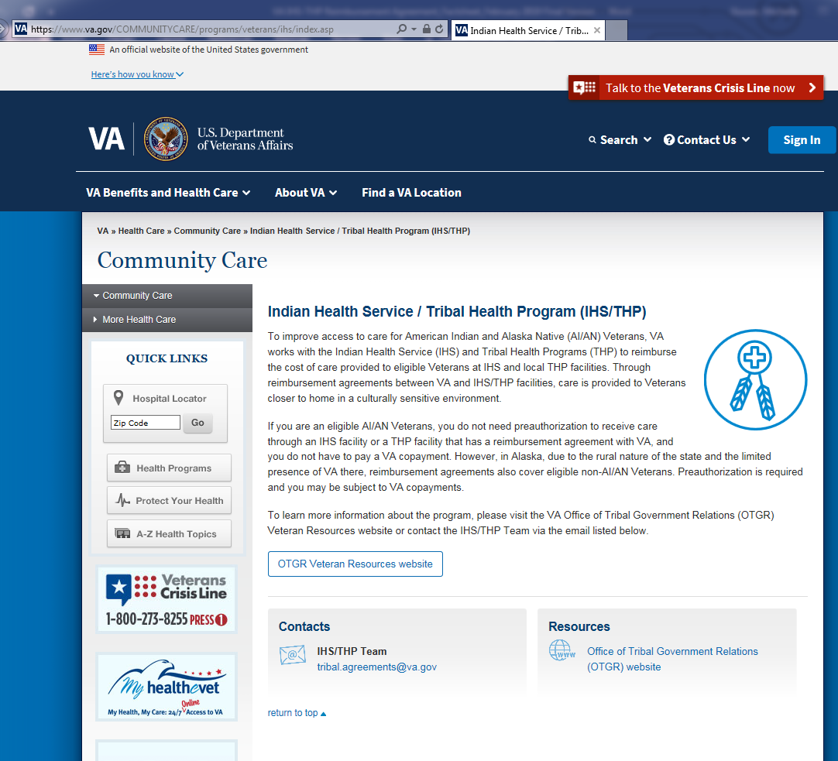
Resources and Contact Information
Information on how to establish agreements, guides about the program, and a summary video:
Website: https://www.va.gov/COMMUNITYCARE/providers/info_IHS-THP.asp
Video: https://youtu.be/8MzDeO3OQtg
To talk to someone in the IHS/THP RAP program, send an e-mail to
tribal.agreements@va.gov

Slide 15

Questions
Contact: tribal.agreements@va.gov

