Slide 1
MFPTI Annual Summit:
Social Services Billing
11/01/2018
Presented by:
Jacquelyn Pinkerton

Slide 2
Social Services Billing: Objective
It is the goal of DSHS and Case Management staff to ensure timely and accurate payments to our providers. The objectives for today’s presentation are to:
Review the relationship between social service authorizations and claims/payments in ProviderOne;
Introduce you to the resources available should you have any questions or need assistance in successfully submitting claims for payment.

Slide 3
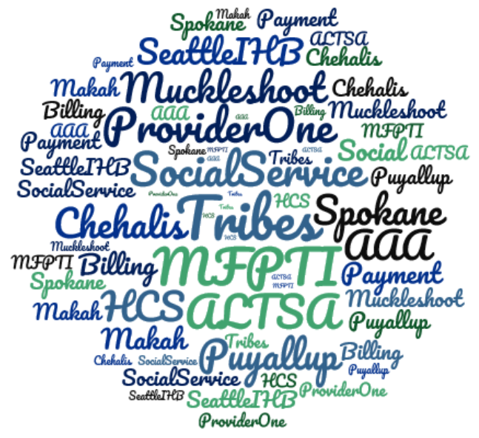
Social Services Billing: Agenda
Review of social service provider types.
Relationship between social service authorization and payment.
Where can you find more information and training material related to submitting claims in ProviderOne?

Slide 4
Social Services Billing: Agenda
Review of social service provider types.
Relationship between social service authorization and payment.
Where can you find more information and training material related to submitting claims in ProviderOne?

Slide 5
Social Service Provider Types
Social service medical providers
Social service non-medical provider
Typically receive a 1099 tax form from the State of Washington; other tax-types may be included (W2 are excluded).
Provide services to clients who are eligible for Medicaid services.
Have a contract with DSHS and a Core Provider Agreement (CPA) with HCA.
Licensed medical professional who delivers goods or services funded by DSHS.
Receive payment through use of a social services authorization or medical claims.
Have a National Provider Identifier (NPI).
Typically receive a 1099 tax form from the State of Washington; other tax-types may be included (W2 are excluded).
Provide services to clients who are eligible for Medicaid services.
Have a contract with DSHS.
Deliver goods or services that are funded by DSHS.
Receive payment through use of a social services authorization.
Notes:
Social service medical providers:
currently med billers who will be adding soc and or shared
for shared the only diff is they can add auth to claim and should it be paid by ah great then if denied for ah for certain reasons then should flip seamless to ss as a safety net up to the auth amt or med state rate
Social service only providers
for ss only diff prov profile claims different and more simple due ot not req’ing referring npi, dx, or other medical indicators instead use ss code, claim units up to amount auth on date of service ad nwill paid ontho the auth rate
domain using ss location on domain 01 or not the medical domain 00 which will get after they contract as a ss provider … that is the location nthey will use when submitting claiming talk allot about macscs and role of case management

Slide 6
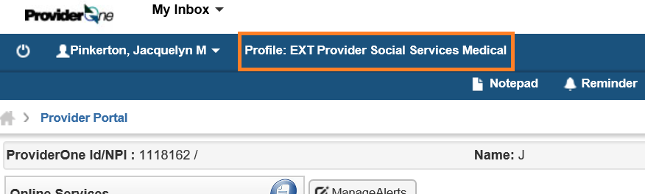
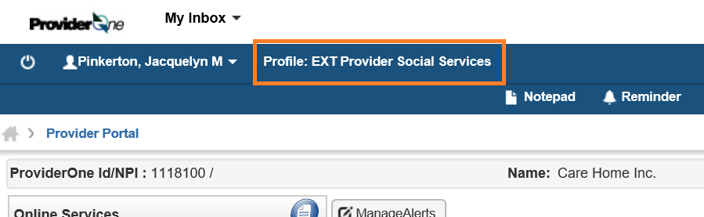
Social Service Provider Types: Claims
Social service medical providers
Social service non-medical provider
Provider Information (NPI, Taxonomy Code, Referring Provider NPI)
Subscriber/Client Information (Client ID, Last name, DOB, Gender)
Claim Information (Authorization Number
Claim data (Place of service, Diagnosis Code)
Service Line Items (Service From/To dates, Procedure Code, Modifier, Units)
Provider ID
Client ID
Authorization Number
Service From/To dates
Service Code
Modifier (if applicable)
Units
Notes:
Social service medical providers:
currently med billers who will be adding soc and or shared
for shared the only diff is they can add auth to claim and should it be paid by ah great then if denied for ah for certain reasons then should flip seamless to ss as a safety net up to the auth amt or med state rate
Social service only providers
for ss only diff prov profile claims different and more simple due ot not req’ing referring npi, dx, or other medical indicators instead use ss code, claim units up to amount auth on date of service ad nwill paid ontho the auth rate
domain using ss location on domain 01 or not the medical domain 00 which will get after they contract as a ss provider … that is the location nthey will use when submitting claiming talk allot about macscs and role of case management

Slide 7



Social Service Provider Types: Services
Social service medical
Social service non-medical
Equipment
Nursing Services
Rehabilitative Therapy
Home Health
Personal Care
PERS
ADC/ADH

Slide 8
Social Services Billing: Agenda
Review of social service provider types.
Relationship between social service authorization and payment.
Where can you find more information and training material related to submitting claims in ProviderOne?

Slide 9
Things to consider
Authorization and Payments
The client must coordinate with their care team to acquire needed goods and services. A client’s care team may include any or all of the following:
  Health care provider to acquire documentation of how the goods or services are medically necessary or will support client’s independence in the community;
  Payer (Third Party Insurance, Medicare, Apple Health Medicaid, or Managed Care Organization);
  Social services case worker.
It is your responsibility to be aware of the process and forms needed to request a prior authorization, exception to rule (ETR) or limit extension, as needed, under the client’s medical benefit and social services plan.
Notes:
The client’s self-identified needs should drive the procurement of goods and services. The client must work with their healthcare providers and social services case worker to develop their plan of care. You as the payee should know what benefit will be covering the needed goods and service and not to deliver the goods or services until coverage has been verified.
If something is going to be paid by DSHS there must be an authorization in ProviderOne in approved no error status. There are resources at the Health Care authority to assist in verifying/reviewing the client’s medical benefit and you can work collaboratively with your client’s case worker regarding their social services benefit.

Slide 10
Payment Hierarchy
Authorization and Payments
Private Insurance
Medicare
Medicaid
DSHS
Indian Health Service
Providers are required to bill other payment sources before claiming payment through Apple Health or a social service authorization.
Providers must not request additional payment through a social service authorization or private funds in an effort to supplement the Medicare or AH reimbursement rate.
The implementation of ProviderOne Phase 2 in 2015 brought functionality for authorizations and claims that enforce payment hierarchy rules and policies.
Notes:
Providers are required to bill other payment sources before claiming payment through Apple Health or a social service authorization.
Providers must not request additional payment through a social service authorization or private funds in an effort to supplement the Medicare or AH reimbursement rate.
Reminders about “last resort”:
–The vendor must first bill private insurance (third party liability-TPL) or Medicare when the individual and item are covered.
–When the client has Apple Health (AH) coverage and the item is a covered benefit or is “typically not covered”, last resort means that:
•you must follow all required processes to seek payment from the client’s other benefits which may include requesting a Prior Authorization (PA), Exception to Rule (ETR), or Limitation Extension (LE) when necessary. It is your responsibility to know how to follow these processes for Medicare, Apple Health, and coordinate with the client’s MCO when applicable.
•Last resort does not mean that an administrative hearing must be requested for every denial from Apple Health. Hearings should only be requested when it is believed the client meets Apple Health’s criteria, but the equipment was denied. Apple Health will send notification of the decision to pay, reject, or deny payment for a submitted claim. Only if the claim is denied can social services pay for the good or service if it has been identified on the client’s plan of care and has been authorzed by their case worker.

Slide 11
Note regarding denials
Authorization and Payments
A denial is not necessary if the goods or services are needed for independent living for the client and:
  The client’s medical benefit has been exhausted (including requesting a Limitation Extension when available); or
  The item is not covered by the client’s medical benefit.
This means for a good or service that is never covered by Medicaid, a denial is not necessary prior to creating the social service authorization.

Slide 12
General payer information
Authorization and Payments
Medicare
Apple Health Medicaid
Managed Care Organization (MCO)
https://www.medicare.gov/
What Medicare health plans cover
Forms and resources
https://www.hca.wa.gov/billers-providers-partners
Material from past provider trainings hosted by the Health Care Authority and DSHS.
Comprehensive billing guides.
Rates and fee schedules.
https://www.hca.wa.gov/billers-providers-partners/programs-and-services/managed-care
Authorization criteria may vary for each MCO and may be slightly different than HCA’s.
Each MCO has its own network of contracted vendors.
The contracted provider should work directly with the MCO to obtain necessary goods and services.
Notes:
Medicare: work with the client’s Medicare health plan for current coverage and payment information.
Medicaid: there is information at hca.wa.gov that covers navigating ProviderOne, submitting medical claims, working with Managed Care Organizations, and submitting claims for social services.
MCO: If the goods/services and the client are both covered by an Apple Health (AH) managed care benefit, the managed care organization (MCO) is responsible to provide it. MCOs have a requirement to simplify their processes; for example, they should not require monthly authorizations for on-going supplies. As with other medical plans, if the client is enrolled in an AH managed care plan, the DSHS case worker should not create an authorization for covered goods or services in ProviderOne. Just like with HCA, sometimes a denial (rejection) by an MCO is simply due to the plan needing additional documentation. The provider should supply the case worker a copy of the denial letter prior to a social services authorization being created.

Slide 13
What happens before an Authorization is created in ProviderOne?
Authorization and Payments
  Care Plan: Unmet Needs
  Financial RAC: Eligibility
  Functional RAC: Eligibility
  Allowed Provider Types
  Program Limits
  Header
  Service Line
Client
Goods and Services
Authorization
DSHS (ALTSA and DDA) is always the payer of last resort. Services are intended to support the client in their home and community not replace the benefits already available to them through their Long-Term Care Insurance, Medicare, Medicaid, or Managed Care Organization.
Notes:
You should not deliver goods or services that will be paid by DSHS without a social service authorization in approved, no error status in ProviderOne.

Slide 14
Social Services Billing: Agenda
Review of social service provider types.
Relationship between social service authorization and payment.
Where can you find more information and training material related to submitting claims in ProviderOne?

Slide 15
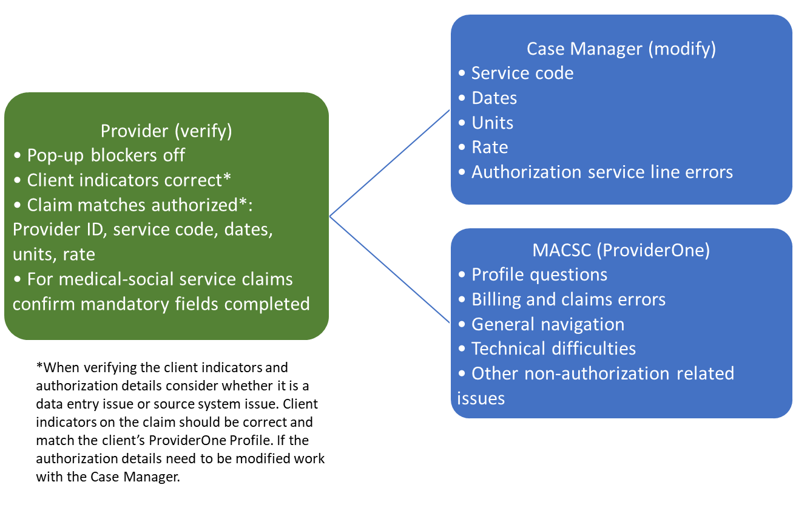
Resources and Training Materials
Troubleshooting billing/claims

Slide 16
Medicaid Assistance Customer Service Center (MACSC)
Resources and Training Materials
(MACSC) is available to assist providers with any questions they might have in regards to submitting claims, resolving claim errors, and getting paid through ProviderOne. There are many published user guides at the Health Care Authority’s website. These guides cover all of the basics as well as provide deep dives into details. Providers should review these guides first, as the answer to many questions are readily available there.
If you need help from MACSC we recommend using their secure web-form (it is like a secure, HIPAA-compliant e-mail), accessible at: https://fortress.wa.gov/hca/p1contactus/SSProvider_WebForm.
If need help from the MACSC and would like to speak to someone over the phone, call 1-800-562-3022 (and choose “provider services”).

Slide 17
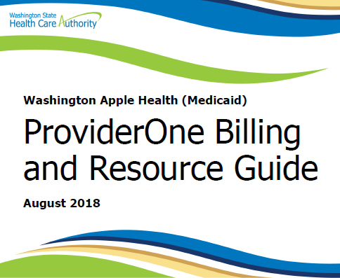
Medicaid Assistance Customer Service Center (MACSC)
Resources and Training Materials
Foundational ProviderOne Billing and Resource Guide is available at: https://www.hca.wa.gov/assets/billers-and-providers/providerone-billing-and-resource-guide.pdf.

Slide 18
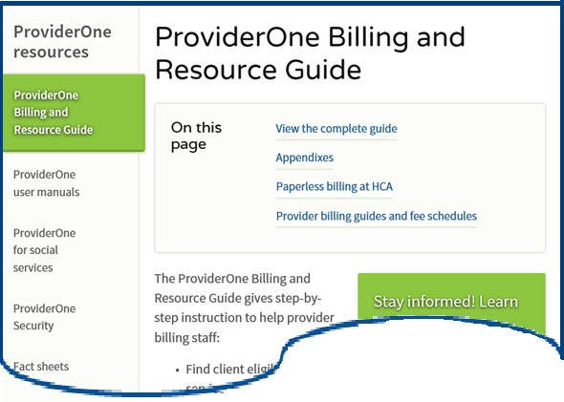
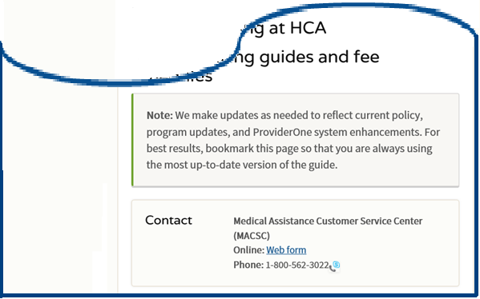
Medicaid Assistance Customer Service Center (MACSC)
Resources and Training Materials
Supplemental guides and additional information is located at: https://www.hca.wa.gov/billers-providers-partners/providerone/providerone-billing-and-resource-guide.

Slide 19
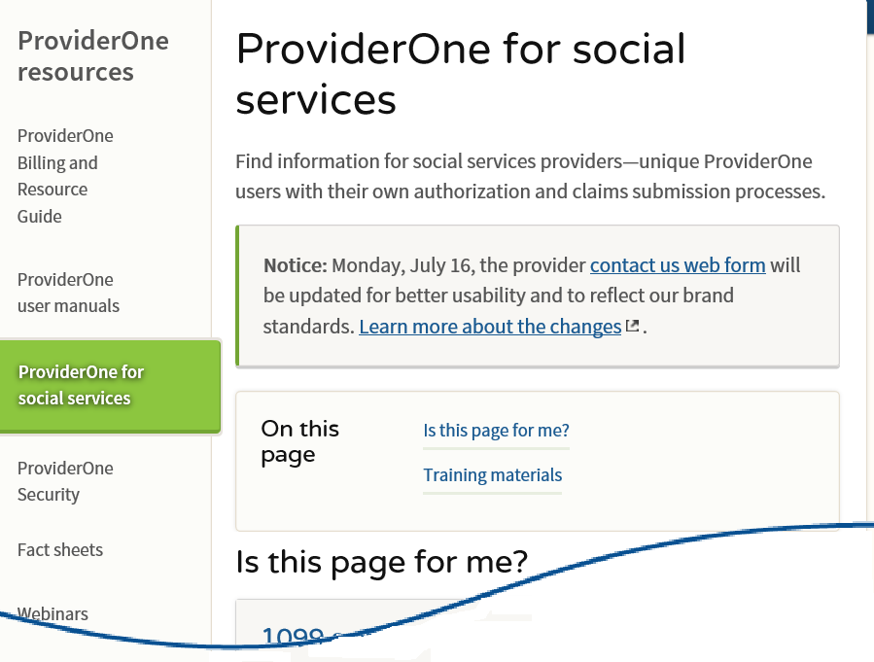
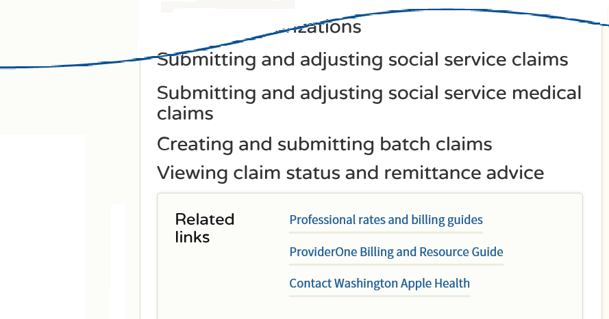
Medicaid Assistance Customer Service Center (MACSC)
Resources and Training Materials
Information specific to the submission of social service claims can be found at: https://www.hca.wa.gov/billers-providers-partners/providerone/providerone-social-services.

