Slide 1
King County Elders and Disabled Needs Assessment
Key Results
11/27/2018

Slide 2
Needs Assessment Overview
  Novel primary data gathering
  Mixed-method approach
  Multiple locations throughout King County
  Based on established key indicators of well-being

Slide 3
Demographics

Slide 4
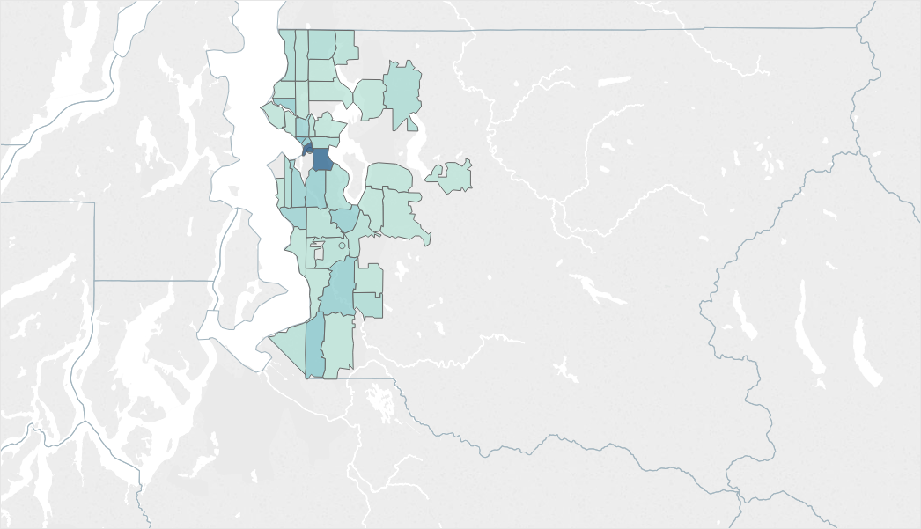
Geographic Distributions of Respondents
The majority of respondents came from along the I-5 corridor
30.4% of respondents came from the downtown Seattle area

Slide 5
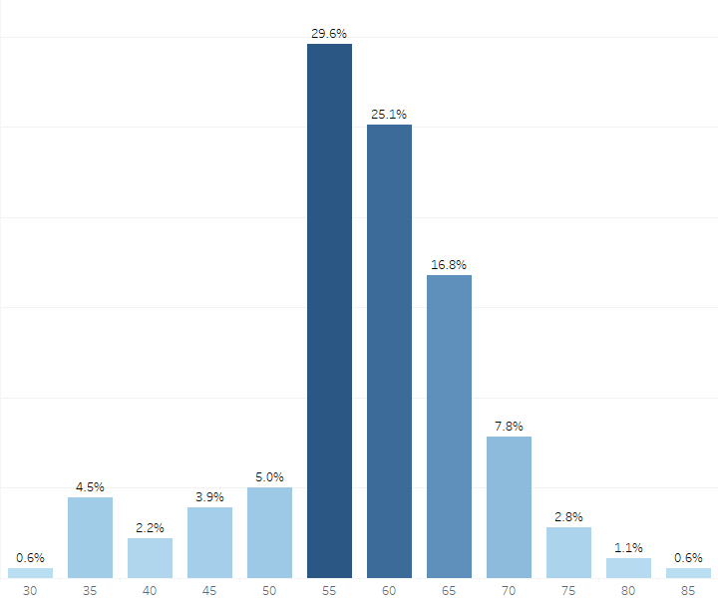
Respondents by Age and Gender
Majority of respondents female (56.2%)
Age of respondents followed a generally standard distribution
Ages ranged from 35 to 85
Majority of respondents aged 55 and older
Average age of 60.2

Slide 6
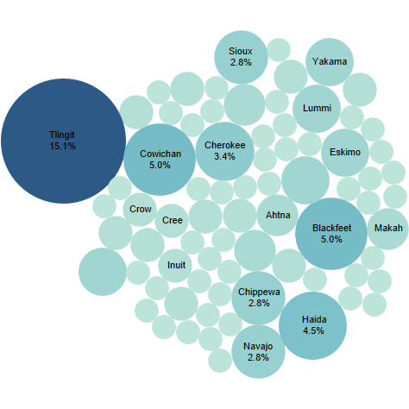
Respondents by Tribe
Notes:
Urban natives make up 60 – 70% of the native population, and often do not have access to services provided by tribal organizations. This is reflected in the over 30 different tribes were represented in the survey results. This also aligns with where respondents currently lived or had lived most of their lives. 78.4% of respondents indicated that they currently lived in an urban area, while 59.8% of respondents indicated that they had lived in urban areas most of their lives.

Slide 7
Community Input

Slide 8
Key Informant Interviews
Top Health Concerns:
Diabetes
Substance abuse
Mental health
Falls
Cancer
Nutrition
Top Health Needs:
Housing assistance
Transportation
Healthcare literacy/assistance
Traditional medicine/healing
Independent living assistance
Long-term care assistance
Notes:
Method:
Key informant interviews conducted amongst Seattle Indian Health Board’s elders program
One-on-one interviews with trained evaluators
Participants were AIAN aged 55 or older residing in King County
Participants asked about the most pressing health concerns and needs of the elders community as well as their own personal health concerns and needs

Slide 9
Community Voices
“I have a fear of falling because I always do fall at least once [in the winter] and I have to be careful… if I had better transportation, I wouldn't have to walk so far to get on a bus.”
“A lot of us are really thriving on this… the traditional medicine, but also the prayers and the openness of spirituality. Some of us are lost generations and I’m one of them, so it fits right into something we knew we were looking for, but we didn’t know quite what.”
“A lot of the [community] is getting back into the traditional medicine. I'm interested in learning everything and anything I can about that myself.”

Slide 10
Community Voices
“I myself have never actually been homeless, but I recognize what they're going through because I have friends who are homeless... They have so many things available to them here, but the waiting list is so long it isn't even funny. I live in a low-income housing building and I found out that there's actually a 13-year-wait to get an apartment in that building.”
“I have diabetes. There’s people that I can relate to, to talk to that have it also, you know?”

Slide 11
Social Determinants of Health
Notes:
Social determinants of health are conditions in the environments in which people are born, live, learn, work, play, worship, and age that affect a wide range of health, functioning, and quality-of-life outcomes and risks. Conditions (e.g., social, economic, and physical) in these various environments and settings (e.g., school, church, workplace, and neighborhood) have been referred to as “place.”5 In addition to the more material attributes of “place,” the patterns of social engagement and sense of security and well-being are also affected by where people live. Resources that enhance quality of life can have a significant influence on population health outcomes. Examples of these resources include safe and affordable housing, access to education, public safety, availability of healthy foods, local emergency/health services, and environments free of life-threatening toxins.
Understanding the relationship between how population groups experience “place” and the impact of “place” on health is fundamental to the social determinants of health—including both social and physical determinants.

Slide 12
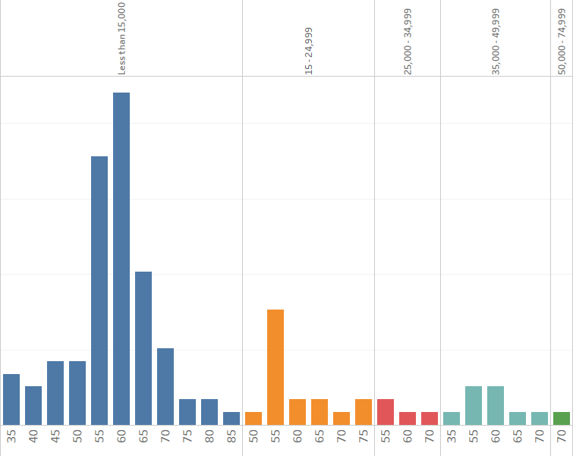
Respondent Income Levels by Age Category
Strong correlation between income and health
Most respondents earn less than $15,000 per year (73.7%)
Equivalent of only $7.2 per hour
Median household income in King County is $75,000
Notes:
Males – blue; female – orange; other - red

Slide 13
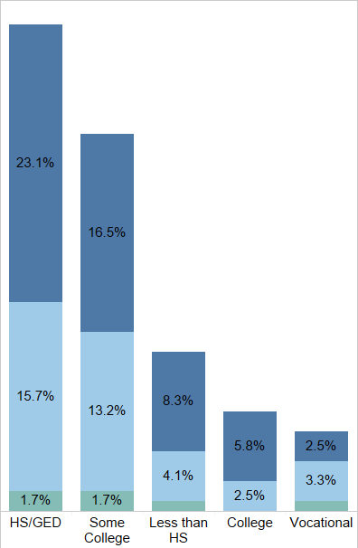
Education Level
Plays a significant role in socioeconomic status
Majority of respondents had a high school education or equivalent
Percentage of college graduates much lower than the King County average (47.9%)

Slide 14
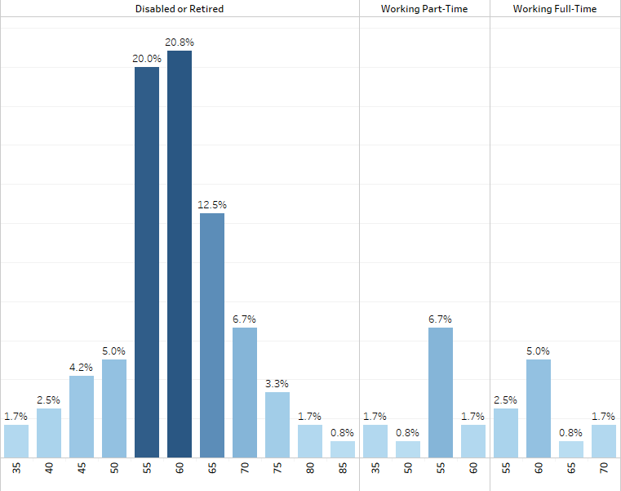
Employment Status
The majority of respondents were disabled or retired (79.2%)
21% of respondent were working part of full time
Potential indicator of need for income assistance

Slide 15
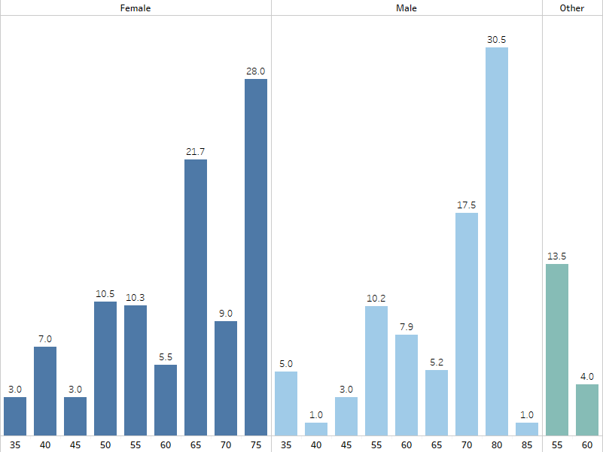
Social Interaction
Respondents indicated an average of 9.3 days per month of social interaction
Significantly higher levels of social interaction among older respondents
Similar trend in response to questions about feelings of isolation

Slide 16
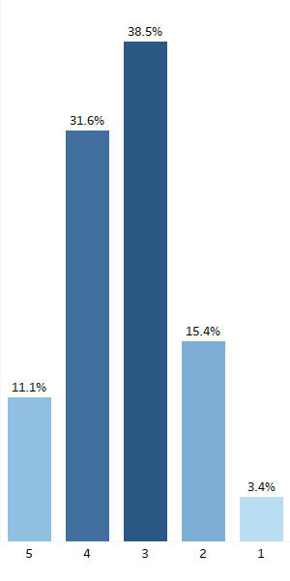
Cultural Interaction
Cultural connectivity is a key component of health and well-being
42.7% of respondents indicated that they participated in cultural activities often (4 and 5), while 38.5% indicated that they participated sometimes
18.4% indicated that the rarely participated or did not participate at all (2 and 1)
No statistically significant difference between genders
Higher participation rates among elders aged 55 - 70
Notes:
While not traditionally considered a SDOH, the importance of cultural connectivity was a key finding in our qualitative assessment and an important factor to the community. This coincides with concurrent research being conducted at UIHI on the importance of culture as a protective factor. Still, this is a relatively novel field and represents an opportunity for additional study.

Slide 17
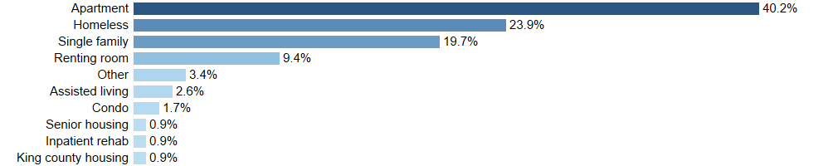
Housing
25% of respondents were either homeless or without permanent housing
3.5% lived in institutional housing
52.6% of respondents lived alone
Significantly higher number of homeless women, elders (over 55)

Slide 18
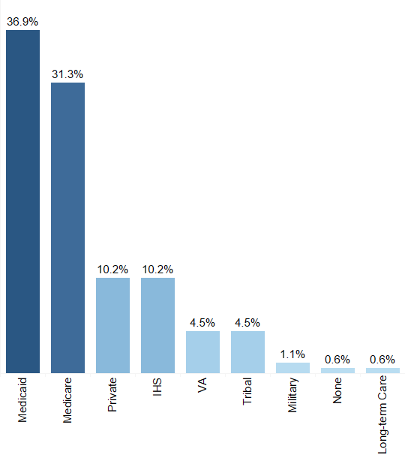
Health Insurance
99.4% of respondents indicated that they had some form of health insurance
68.2% indicated that they were on Medicare or Medicaid
A significantly higher number of respondents were receiving Medicaid than Medicare – corresponds to disability rates

Slide 19
Health Status
Notes:
This section highlights the most pressing health concerns of the population

Slide 20
Top Health Problems
Falls – 54.5%
Memory problems (due to disability) – 46.3%
Arthritis – 41.3%
Vision problems – 40.5%
Hypertension – 33.1%
Depression - 29.8%
Diabetes – 27.3%
Cancer – 18.9%
Asthma – 15.7%
COPD – 9.9%
Notes:
Respondents were asked a number of questions regarding common health problems. Many of these aligned with the health concerns expressed during the qualitative interviews.

Slide 21
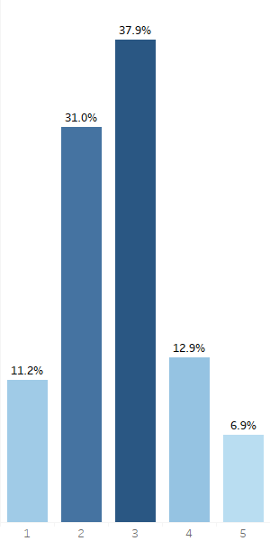
Physical Health
57.7% of respondents indicated that they were in good to excellent health (3 – 5)
42.3% of respondents indicated that they were in poor or fair health
Females more likely to be in good or excellent health than males

Slide 22
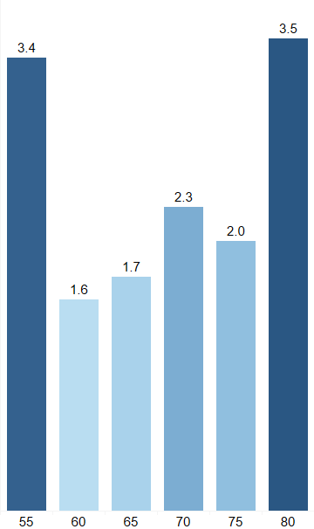
Falls
More than half of respondents reported experiencing at least one fall in the past year – nearly double the national average for AIAN
Percent increased with age
73.9% of falls resulted in injury
33.3% resulted in hospitalization
Males more likely to fall than other genders
U-Shaped age relationship
Notes:
Falls are an important health indicator among the elderly. The leading cause of fatal and nonfatal injuries among older adults are falls, which can result in severe injury, loss of independence, and death.

Slide 23
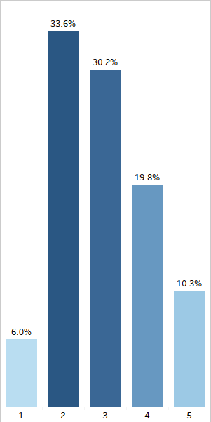
Mental Health
60.3% of respondents indicated that they were in good to excellent mental health (3 – 5)
39.7% indicated that they were in poor or fair mental health (1 – 2)
Females more likely to be in good or excellent mental health than other genders

Slide 24
Frailty

Slide 25
Overview
Frailty is generally recognized as vulnerability to the decline of biological functions, characterized by reductions in strength, endurance, and physiologic function
Associated with adverse health outcomes
Useful measure for identifying and mitigating potential health risks
Survey incorporated the VES-13 frailty assessment instrument
Assessed four indicators: age, self-reported health, difficulty with physical activities, and difficulties with activities of daily living
Points assessed for each area
Scored on a continuous scale of 0 - 9
Notes:
Frailty is generally recognized as vulnerability to the decline of biological functions, characterized by reductions in strength, endurance, and physiologic function. Frailty has been associated with adverse health outcomes such as falls, hospitalizations, institutionalization, functional decline, and. The presence of multiple chronic health conditions has been linked to frailty onset at earlier ages, which is concerning given the disproportionately high burden of chronic disease and multimorbidity among the AI/AN population.

Slide 26
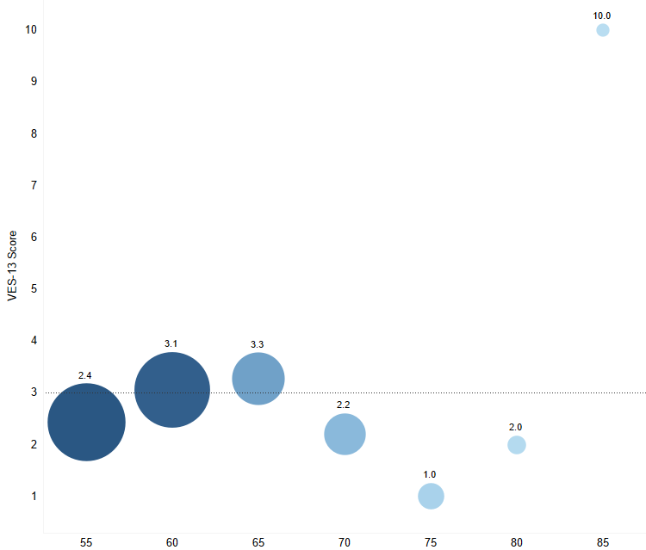
VES-13 Score by Age Category
Notes:
A total score of three or more indicates vulnerability, where higher VES-13 score is associated with higher probability of decline and death.
The average VES-13 score was over three for age groups
60-64, 65-69, and 85+

Slide 27
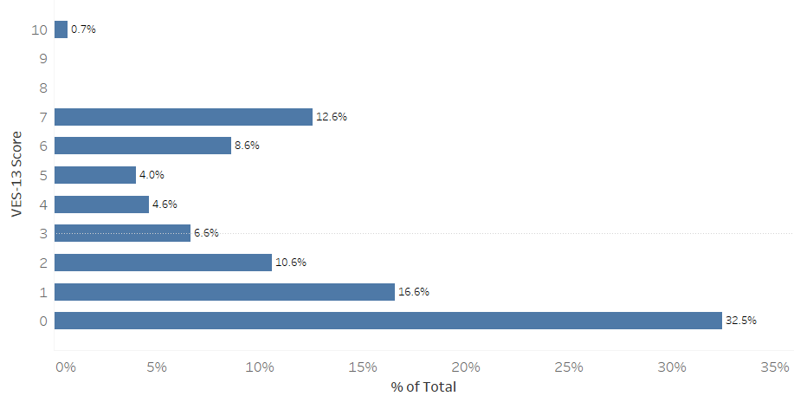
Average VES-13 Score
Notes:
A total score of three or more indicates vulnerability, where higher VES-13 score is associated with higher probability of decline and death.
37.1% of respondents scored three or more.

Slide 28
Results
Score of 3 or higher indicates vulnerability
4.2 times higher risk of functional decline and death for those scoring 3 or higher
31.2% of all participants scored 3 or higher
37.1% of all participants aged 55 and older scored 3 or higher
Still exploring relationship between age, gender, and score

Slide 29
Needs
Notes:
Respondents were asked a number of questions about their perceived health and quality of life-related needs. These included questions about financial, housing, and general service assistance. Respondents were asked to indicated if they were now using or would potentially use a given service.

Slide 30
Services Currently Used
Transportation – 26.2%
Case management – 39.8%
Income assistance – 21.6%
In-home caregiver – 17.5%
Advocacy – 13.9%
Respite care – 12.8%
Assisted living – 12.7%

Slide 31
Personal Care
51.7% of respondents reported using some sort of personal help in their daily activities
35.4% of respondents reported that a family member was providing that assistance
82.3% of family members providing assistance were unpaid
8.1% of respondents received assistance from a paid personal health care worker

Slide 32
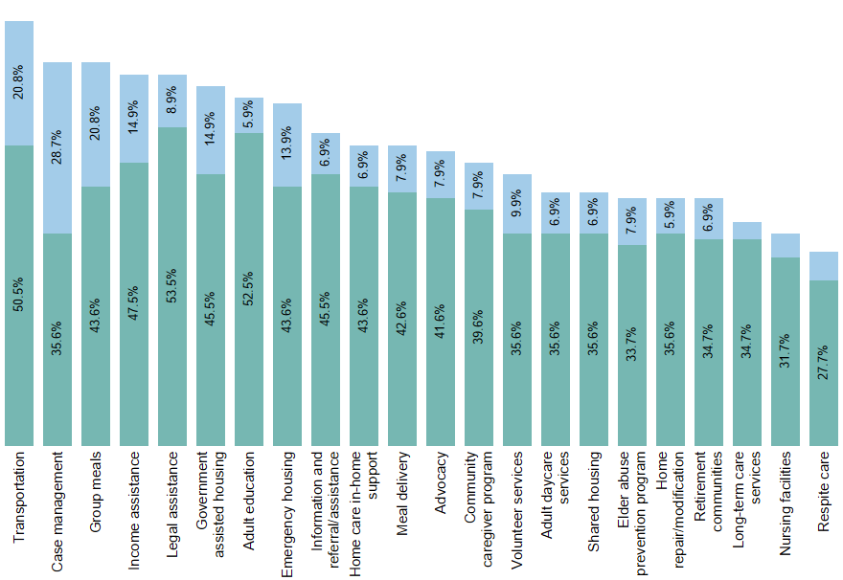
Assistance

Slide 33
Quality of Care

Slide 34
Quality of Care
90.1% of respondents indicated that they felt culturally respected by doctors and other healthcare providers
76.9% of respondents felt that their wishes for the kind of care they received were listened to and respected
90.9% of respondents received care at the Seattle Indian Health Board
Notes:
Cultural sensitivity and respect are often barriers to health care for the native community

Slide 35
Recommendations

Slide 36
Recommendations
Immediately explore options to address the dual-crisis of extreme poverty and homelessness among disabled and elder community members
Transportation assistance emerged as one of the most common concerns voiced by community participants. Options for improving transportation and mitigating related risks (falls specifically) should be further explored
Continue to support and reinforce SIHB the elders’ program; explore options for expanding or developing a similar program for disabled community members
Explore opportunities to develop a sustainable, culturally-competent long-term care program to provide for members of the urban disabled and elder AIAN community in King County
Identify members of the urban native disabled and elder community currently in institutional care or at risk of institutional placement for potential return to their communities
Notes:
Cultural sensitivity and respect are often barriers to health care for the native community

