Slide 1

Substance Use Treatment and Withdrawal Management:
Training for Jails
Presented by Kirsten Peebles, MA, LMHC
Erik Knudson, MS
For the Jail Technical Assistance Team
DSHS Office of Forensic
Mental Health Services
May 20, 2020
Notes:
Welcome, this training is primarily intended for jail staff. The presentation covers the recommended process for Screening and Assessment, both at intake and during the duration of incarceration, and is presented by the Office of Forensic Mental Health services. The presentation is about 30 minutes in length.

Slide 2
Overview
The DSHS Office of Forensic Mental Health Services Jail Technical Assistance Program provides informational and training support to Washington jails. Specific areas of information and training support include pre- and post-booking options, screening and access to treatment, substance use disorder treatment, transition planning, crisis de-escalation,
and more.
Notes:
The Office of Forensic Mental Health Services is part of the Behavioral Health Administration of the Department of Social and Health Services. It was established in 2015 for the purpose of providing leadership and management of Washington’s adult forensic mental health care system. Part of what we do at OFMHS is provide technical assistance to jails in current best practices.

Slide 3
Learning Objectives
Participants will learn:
1. Commonly used substances
2. Signs of intoxication
3. Common withdrawal symptoms and risks
4. Withdrawal management options
5. Recommended policies

Slide 4
SUD Stats in Washington State Jails
It’s estimated that more than 47,000 people in Washington regularly use opioids (heroin or prescription pain medications) and over half of them were incarcerated at some point in 2019
A review of jail deaths showed that substance use-related deaths and suicides made up 85% of the deaths that occurred within the first 72 hours of admission
(Columbia Legal Services, 2019)

Slide 5
SUD Stats in Washington State Jails
Most deaths that occurred within the first few days following booking were related to drugs or alcohol
60% of the deaths within the first week of admission involved drugs or alcohol
(Columbia Legal Services, 2019)

Slide 6

Alcohol
Beer
Wine
Liquor

Slide 7

Common Signs of Alcohol Intoxication
Breath that smells like alcohol
Enlarged pupils
Rapid heartbeat and slow breathing
Loss of balance, or inability to walk straight or stand still
Nausea and vomiting
Slurred or loud speech
Quick mood changes
Notes:
Maybe describe law enforcement experiences DUI, etc.

Slide 8

Common Signs of Withdrawal
Signs in the first 6-12 hours post consumption could include:
Agitation
Anxiety
Headaches
Shaking
Nausea and vomiting
Notes:
The length and severity of alcohol withdrawal symptoms will depend on the persons history of consumption.

Slide 9
Common Signs of Withdrawal cont.
Signs in the first 12-24 hours post consumption could include:
Disorientation
Hand tremors
Seizures

Slide 10
Common Signs of Withdrawal cont.
Possible signs that could present at about 48 hours post consumption could include:
Seizures
Insomnia
High blood pressure
Tactile, auditory, and visual hallucinations
High fever and excessive sweating
Delirium tremens
Notes:
Kirsten discuss DT’s
Some of these may require medical intervention.

Slide 11
Medical and Psychological Concerns with Alcohol Withdrawal
Medical intervention
Screening for depression
Suicidality
Notes:
If the individual is experiencing severe symptoms of withdrawal, to include seizures or DT’s, medical intervention is required
Depression is important to screen for and address. Issues with anxiety, which often have a physiological basis; Irritability, agitation, and mood swings could be of concern and depending on charges and length of stay could cause concerns for suicidality

Slide 12
Benzodiazepine
Benzodiazepines, or benzos, are commonly prescribed as a sedative to help those with anxiety, panic attacks, stress, or insomnia
People who abuse the substance often build a tolerance and progress to using extremely high doses to get the same effect
Notes:
Lower doses are commonly used as a sedative
Moderate doses are typically to address anxiety
High doses are often used as a hypnotic

Slide 13
Benzodiazepine
Common benzodiazepines include, but are not limited to:
Diazepam (Valium)
Alprazolam (Xanax)
Clonazepam (Klonopin)
Lorazepam (Ativan)
Chlordiazepoxide (Librium)

Slide 14
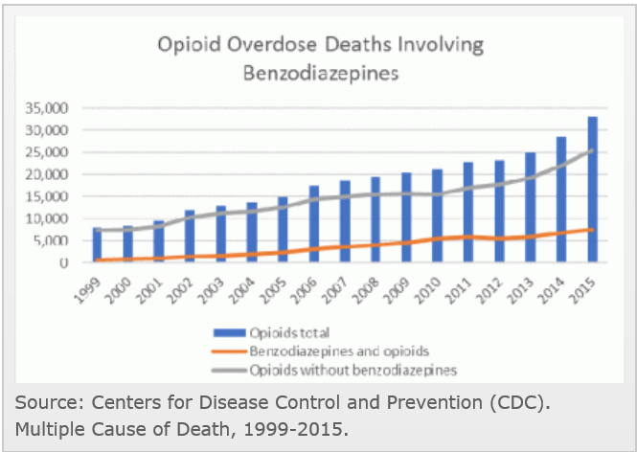
Benzodiazepine use with opiates

Slide 15
Common Signs of Benzodiazepine Intoxication
May be similar to signs of alcohol intoxication
Slurred speech
Unsteady movements/poor coordination
Stumbling
If benzodiazepines are used alone, blood/breath alcohol measurements should be zero

Slide 16
Common Signs of Benzodiazepine Withdrawal
Anxiety
Panic attacks
Difficulty sleeping
Nausea and/or vomiting
Psychomotor agitation (difficulty sitting still)
Racing heartbeat
Sweating
Tremors or shaking hands

Slide 17
Less Common and More Severe Signs of Benzodiazepine Withdrawal
Hallucinations: hearing, seeing, or feeling things that are
not there
Seizures
Psychosis
Increased risk of suicidal thoughts
Note: Withdrawal from benzodiazepines can be dangerous
and medical withdrawal management may be indicated

Slide 18
Opioids
Medical use:
Prescribed to treat moderate to severe pain
Prescribed to treat cough
Street use:
Heroin
Abuse of pharmaceuticals

Slide 19
Opioids
Commonly Prescribed Opioids:
Oxycodone (OxyContin®)
Hydrocodone (Vicodin®)
Codeine
Morphine
Illicit Opioids:
Heroin
Fentanyl (synthetic)

Slide 20
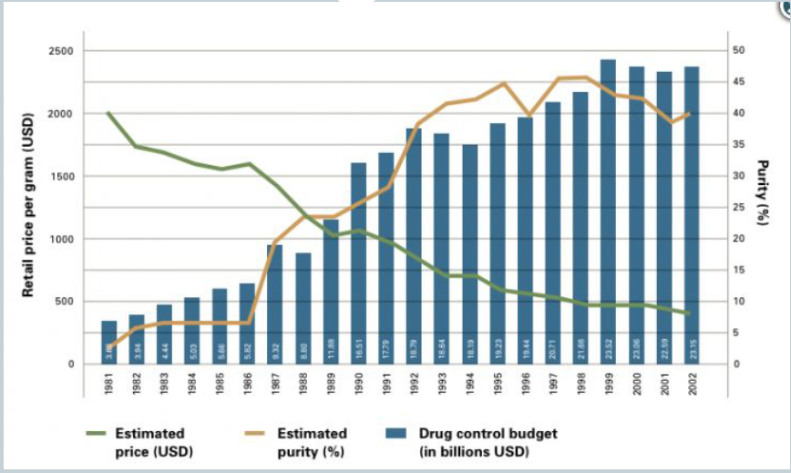
Trends in Opioid Purity

Slide 21
Common Signs of Intoxication
Altered mental status
Breathing problems
Lethargy (sleepiness or loss of alertness)
Nausea and/or vomiting
Small pupils
Notes:
Altered mental status, such as confusion, delirium, or decreased awareness or responsiveness
Breathing problems, such as breathing may slow, and eventually stop

Slide 22
Common Signs of Withdrawal
Early symptoms of withdrawal include:
Agitation
Anxiety
Muscle aches
Increased tearing
Insomnia
Runny nose
Sweating
Yawning

Slide 23
Common Signs of Opioid Withdrawal cont.
Late symptoms of withdrawal include:
Abdominal cramping
Diarrhea
Dilated pupils
Piloerection (goosebumps)
Nausea
Vomiting

Slide 24
Medical and Psychological Concerns with Opioid Withdrawal
Dehydration
Depression
Suicidality

Slide 25
Stimulants
Prescribed Stimulants:
Adderall
Ritalin
Concerta
Illicit Stimulants:
Cocaine
Crack
Methamphetamine

Slide 26
Common Signs of Intoxication
Dilated pupils
Restlessness
Hyperactivity
Weight loss
Sweating
Aggressive behavior or anger outbursts
Mood swings

Slide 27
Common Signs of Intoxication cont.
Jitteriness
Rapid heartbeat
Elevated blood pressure
Hyperfocus
Flight of ideas
Racing thoughts
Anxiety or nervousness

Slide 28
Common Signs of Withdrawal
Fatigue
Psychomotor retardation
or agitation
Unpleasant dreams
Inability to sleep or sleeping excessively
Increase in appetite

Slide 29
Common Signs of Withdrawal cont.
Dehydration
Weight loss
Chills
Cravings
Anxiety
Irritability
Impaired memory
Dulled senses
Lack of interest in fun activities
Lack of interest in social interactions

Slide 30
Medical and Psychological Concerns with Stimulant Withdrawal
Stroke
Cardiovascular collapse
Myocardial and other organ infarction
Paranoia
Violence
Severe depression
Suicide

Slide 31
Synthetic Drugs
Cannabinoids (K2/Spice)
Cathinones (Bath Salts)
MDMA (ecstasy)

Slide 32
Common Signs of Intoxication
Seizures
Hallucinations
Suicidal tendencies
and attempts
Homicidal tendencies
Delusions
Overstimulation
Aggression

Slide 33
Common Signs of Intoxication cont.
Paranoia
Chest pain
Overheating that causes a person to tear off clothes
Other self-destructive behavior like bashing one’s body
or head against walls

Slide 34
Common Signs of Withdrawal
Anxiety
Depression
Sleep disturbances
Fatigue
Paranoia
Headache
Loss of appetite
Difficulty concentrating
Tremors
Cravings for the substance

Slide 35
Medical and Psychological Concerns with Stimulant Withdrawal
Suicide attempts
Heart attack
Death

Slide 36
Club Drugs
PCP
GHB
Hallucinogens (LSD, mushrooms)

Slide 37
Common Signs of Intoxication
    Sweating
    Jerking movements of the eyes
    Impaired motor skills (ex. drunken-like walk, staggering)
    Rapid heartbeat/or decreased heartbeat (GHB)
    Dizziness
    Dilated pupils
    Confusion

Slide 38
Common Signs of Intoxication cont.
    Altered state of consciousness (tripping out)
    Agitation
    Terror
    Panic
    Randomness in thoughts and/or actions
    Severe anxiety and fear
    Mood swings
    Hostile and violent behavior

Slide 39
Common Signs of Withdrawal
Short-term effects could include:
Elevated body temperature
Seizures
Muscle twitching
Agitation
Hallucinations

Slide 40
Common Signs of Withdrawal cont.
Potential long-term symptoms could include:
Memory loss
Weight loss
Speech impairment
Cognitive impairment
Note: Symptoms and severity depend on the length of use

Slide 41
Medical and Psychological Concerns with Club Drug Withdrawal
Depression
Self-harm
Aggression

Slide 42
Withdrawal Management in Jail Settings

Slide 43
Withdrawal Management
Facilities with nursing care:
Use validated withdrawal severity screening tools
Conduct medical assessment (e.g., vital signs, risk of self-harm)
Provide care based on screening and assessment results

Slide 44
Withdrawal Management
Facilities without medical staff:
Establish protocols that guide staff in determining when medical intervention is necessary
Maintain agreements with community partners to respond
to medical calls at the facility

Slide 45
Withdrawal Management Protocols
• Assess for dehydration
• Assess for comorbidities including advanced age, underlying chronic diseases and malnourishment
• Begin targeted treatment for diarrhea and vomiting early
in the withdrawal process
• Hydrate using something that the person will actually drink
• Become buprenorphine certified and use it to treat severe opiate withdrawal

Slide 46
Medically Assisted Treatment Programs
Some facilities use medications to treat withdrawal and
to initiate treatment services that will be continued in the community
Additionally, some facilities refer individuals to MAT programs
According to the NCCHC Jail-Based Medication-Assisted Treatment guidelines, medication combined with psychological support improves recovery outcomes
Notes:
Mention MAT programs comfort drugs and treatment.
Beyond the scope of this training.
For further information contact us.

Slide 47
Policy Recommendations

Slide 48
What to Include in Policy
Procedure for SUD screening at intake
Procedure for assessment and referral to medical for severe withdrawal symptoms
Procedure for managing persons with SUD complications and needs (e.g., safe housing, frequent monitoring, open access
to hydration)

Slide 49
Resources
SAMHSA: Opioid Overdose Prevention TOOLKIT
Guide to Developing and Revising Alcohol and Opioid Detoxification Protocols
Managing Opiate Withdrawal: The WOWS Method
Medically Assisted Treatment Implementation Checklist
NCCHC Jail-Based Medication-Assisted Treatment Guidelines

Slide 50
Questions?

Slide 51
Thank you!
Please don’t forget to complete our training evaluation survey at https://www.research.net/r/KRD8QY8
A downloadable PDF version of this training and video is available at: https://www.dshs.wa.gov/bha/office-forensic-mental-health-services/jail-technical-assistance-program

Slide 52
References:
National Institute on Drug Abuse (NIDA).(n.d.). Retrieved April, 1, 2020, from https://drugabuse.gov/
Narconon: Drug Rehabilitation: Drug Education. (n.d.). Retrieved from https://narconon.org/
https://columbialegal.org/wp-content/uploads/2019/05/Gone-But-Not-Forgotten-May2019.pdf
Health Information from the National Library of Medicine (2020, April 1). Retrieved from https://medlineplus.gov

Slide 53
References:
National Commission on Correctional Health Care. (2018). Jail-based MAT: Promising practices, guidelines. Retrieved from https://www.ncchc.org/jail-based-MAT
Wilcox,T. (2016). Managing Opiate Withdrawal: The WOWS Method. Retrieved from https://ncchc.org

