Slide 1
Pre-Admission Screening and Resident Review (PASRR)
Information for Hospitals, Medical Offices, and Nursing Facilities
2021
Presented by: Beth Loska (HCA), Molly McClintock (RCS), Heidi Johnston (DDA), Debbie Hoeman (RCS), Terry Hehemann (DDA)
Notes:
BL
Welcome to the PASRR webinar this morning/afternoon. My name is Beth Loska and I am the Behavioral Health PASRR Program Manager with the Health Care Authority.
Before we start there are a couple of housekeeping items we would like to review:
You will be in “listen only mode” throughout the webinar.
If you have questions during the webinar, please type them into the “Chat” or “Question” feature. Please do not use any resident specific information. All questions will be answered at the end of the webinar. It is very likely that most questions will be covered in our presentation today, so we encourage you to wait until we are getting close to wrapping up and then submit your question.
A copy of this presentation will be emailed to you soon after we have had an opportunity to add any questions asked during both webinars. You are free to share the final presentation with your colleagues and partners

Slide 2
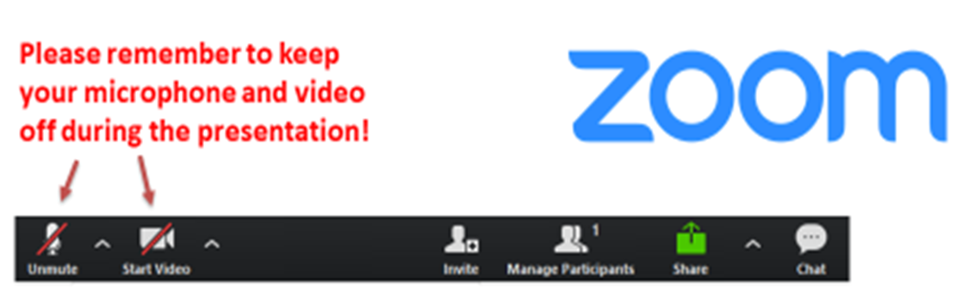
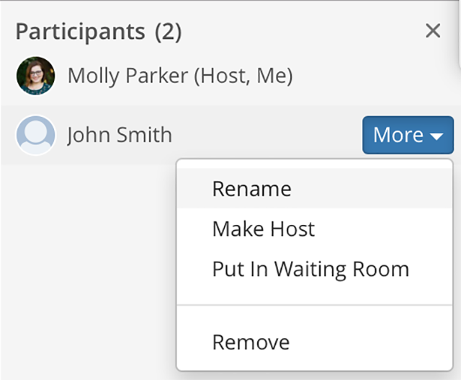
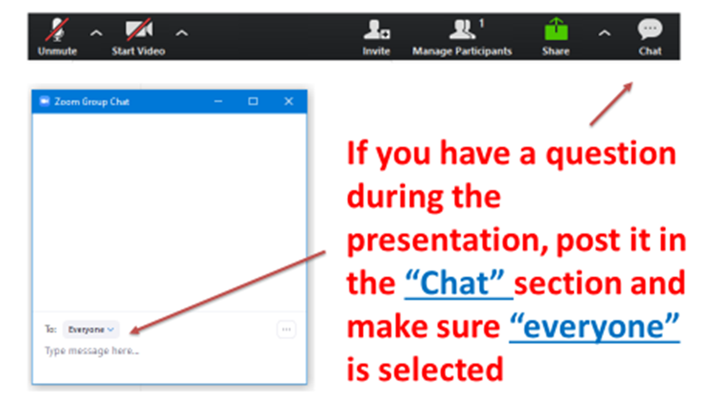
To rename yourself, pull up the participants list, find your name, and right click.
Notes:
Service Alternatives presents this information.
Neetu, Ali, or Martin

Slide 3

Introduction
Notes:
BL
Welcome!
So you know who is with us today, let’s go around the room and let everyone introduce themselves.
Hello! I’m Molly McClintock, from Residential Care Services. I am the Nursing Home Policy Program Manager.
Hi, I am Heidi Johnston, PASRR Program Coordinator with the Developmental Disabilities Administration.
Hello! I’m Terry Hehemann, PASRR Unit Manager for the Developmental Disabilities Administration.
Hi, I am Debbie Hoeman, Behavioral Health Policy Program Manager, with Residential Care Services.

Slide 4
For Your Information …
Today’s webinar will focus on the role of hospitals and nursing facilities in the PASRR process, person-centered practices and integrated care.
CEUs are available.
Notes:
BL
We hold PASRR webinars annually. With us today we have skilled nursing facilities, hospitals, DSHS staff (DDA, HCA, ALTSA) and HCA contractors.
The PASRR process here in Washington continues to grow and be refined. We plan to continue with periodic updates.
If you registered for and participate in today’s webinar or the next session you will be emailed a certificate with 1.5 CEU’s. If you are participating as a group, it is the responsibility of the individual who registered and logged in the today’s webinar to distribute the certificates to others who are in the room. Whomever registered may want to get emails for the others in the room if you are part of a very large organization.
Also important to note, that a resident who has a positive PASRR may have multiple case workers who are working with them. It is not unusual for this to occur, so we don’t want anyone to be surprised if this happens in their facility. ADDITIONALLY, THERE ARE TWO SEPARATE PASRR PROGRAMS: DDA PASRR for people with Intellectual Disabilities and Related Condition and Behavioral Health PASRR. When applicable, differences in the two programs will be highlighted.

Slide 5
Regulations Related to PASRR
Both the federal government and the State of Washington regulate PASRR.
  The federal rules related to PASRR can be found at: 42 C.F.R. 483.100 - 483.138 (Note: an annual PASRR is no longer required but Code of Federal Regulation has not been revised to reflect this change.)
  Washington Administrative Code addresses PASRR in two sections: 388-97-1910 through 388-97-2000 and Section 388-834.
Notes:
MM –
Hello, first I’d like to clarify the PASRR abbreviations. You might sometimes see Pre-Admission Screening and Resident Review abbreviated as P-A-S-R-R and sometimes it is spelled P-A-S-A-R-R. The two acronyms are used interchangeably. The federal rules formerly required an annual review and the second “A” in the P-A-S-A-R-R spelling stood for “annual.”
The requirement for an annual assessment was discontinued in 1996, though the Code of Federal Regulations, or CFRs, have not been updated to reflect the change.
So, a new PASRR is not required annually, but is required whenever a resident with Serious Mental Illness (SMI) or Intellectual Disability or Related Condition (ID/RC) experiences a significant change in condition, or if a resident is newly identified as having a SMI or ID/RC. Additionally, Developmental Disabilities Administration (DDA) completes follow-up evaluations for people who remain in a Nursing Facility longer than 90 days.
For your reference, this slide shows the federal and state rules related to PASRR.
For Washington State, rules are found in the Washington Administrative Code, known as WACs. For Nursing home specific rules, look at 388-97-1910 through 388-97-2000. Rules specifically related to Developmental Disabilities are at 388-834.
The federal regulation is found at 42 CFR 483.100 through 483.138. The guidance for those rules is found in Appendix PP, at F644 and F645.

Slide 6

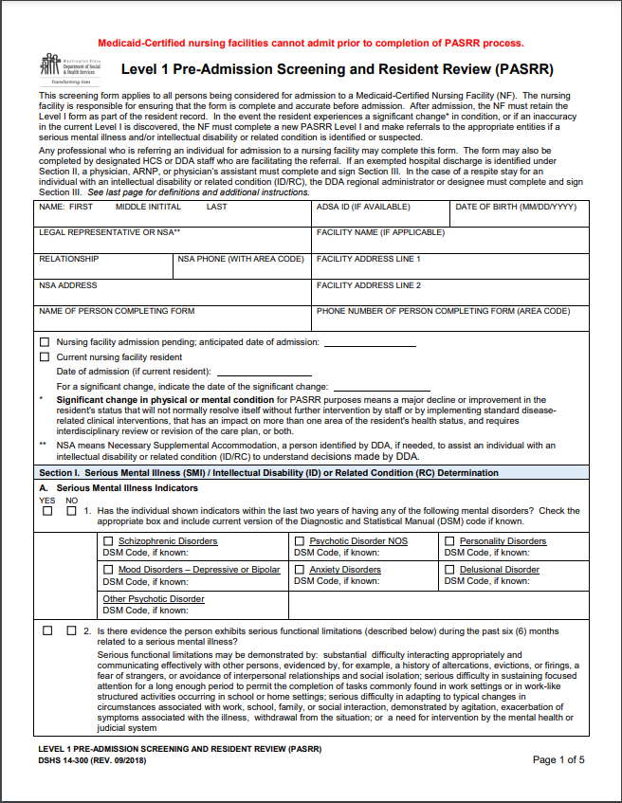
Department of Social and Health Services
Health Care Authority
Medicaid State Agency
Developmental Disabilities Administration (DDA)
Behavioral Health PASRR Program
We all use the same
Level I
Pre-Admission and Resident Review Form
Notes:
BL
PASRR Is a federal program, however, in Washington state, the responsibilities for PASRR are divided among different Agency’s. The Department of Social and Health Services administers their PASRR Program through DDA. The Health Care Authority administers the BH PASRR Program.
If a client has both an ID/RC and Serious Mental Illness concern, the Level I PASRR evaluation should be completed and sent to BOTH DDA and BH PASRR. Please direct your questions regarding Intellectual Disabilities and Related Conditions to DDA and your Serious Mental Illness questions to HCA.
Both sections of PASRR utilize the same Level I PASRR Pre-Admission and Resident Review Form, but there are a few key differences that are worth noting.
The DDA’s PASRR Program is
Staffed by state employees
Able to return to the facilities for regularly scheduled Follow-up
Most recommended services are arranged by DDA
The BH PASRR Program
Delegates authority to Contractors
Only return due to Significant Change in Condition or need for Follow-up
Recommended services are coordinated by the Skilled Nursing Facility

Slide 7
Status of Proposed Rule Changes
The Centers for Medicare and Medicaid Services (CMS) have proposed rule changes related to PASRR. As of now, a final rule has not been released.
Federal Register #2020-03081
Notes:
MM
This was talked about last year, the Centers for Medicare and Medicaid Services proposed amendments and additions to the federal PASRR rules. The proposed rules were placed on the Federal Register on February 20, 2020. Comments were accepted through May 20, 2020. The PASRR workgroup – representatives from Developmental Disabilities Administration, Health Care Authority, Residential Care Services, and Home and Community Services reviewed the proposed rules and submitted comments.
PASRR was first required with federal legislation that happened in 1987. The rules we are currently using were adopted in 1990. CMS wanted to update the rules to better reflect current nursing home practice. They also heard from stakeholders that some of the rules were unclear or illogical.
Facilities feed back included:
Improve clarity of who is required to have a Level I screen with Provisional admission,
Clean up the word “annual” and
clarifying timelines, such as how long after a significant change a facility has to report the change.
State Agencies feed back including:
Data reporting requirements
Timelines for completion of work
Face-to-face versus telework
With the Public Health Emergency, there has not been further action by CMS to formally adopt the rules. We have not heard any projected timeline for adoption. On the screen is the Federal Register number if you want to look at the proposed rules.

Slide 8

What does PASRR do?
PASRR has three goals:
  To identify people referred to nursing facilities who have an intellectual disability or related condition (ID/RC) or a serious mental illness (SMI);
  To determine that individuals are admitted appropriately; and
  To make sure individuals receive the services they need for ID/RC or SMI.
Notes:
MM
PASRR has three goals:
The first goal of PASRR is to identify people referred to nursing facilities who have an intellectual disability or related condition (ID/RC) or a serious mental illness (SMI);
The second goal is to ensure that the individuals with the serious mental illness, Intellectual disability or related condition are admitted appropriately. This means the person is admitted in a home that is the least restrictive setting that still meets their particular care needs.
The third goal of PASRR is for each person identified through the PASRR process to receive the services they need, if they are identified as needing services. The services I’m describing are services that are specific to their serious mental illness or intellectual disability or related condition.

Slide 9
Why is PASRR Important?
According to Medicaid.gov:
“PASRR can advance person-centered care planning by assuring that psychological, psychiatric, and functional needs are considered along with personal goals and preferences in planning long term care”.
PASRR can enhance nursing facility (NF) care by providing additional disability-related services not included in the NF daily rate and by making recommendations to the NF.
Notes:
MM
So, why is PASRR important?
PASRR can improve the quality of life for residents with Significant Mental Illness or Intellectual disability/Related Condition. PASRR advances person-centered care planning by assuring that psychological, psychiatric, and functional needs are considered along with personal goals and preferences in planning long term care. It also helps assure care is done in the least restrictive setting.
PASRR can enhance nursing facility care by providing additional disability-related services not included in the NF daily rate and by making recommendations to the nursing facility.
So, not only is the PASRR process important to ensure people with SMI or ID receive care in the least restrictive setting, it also provides evaluation and services to help ensure appropriate care is provided in a dignified and person-centered manner to those who reside at a nursing facility.

Slide 10
COVID-19 related PASRR Timelines
In March 2020, Washington received CMS approval of an 1135 waiver that impacts PASRR timelines.
This waiver allows that PASRR Level 1 and Level 2 assessments not be required for 30 days after admission.
Notes:
DDA--TH
In March 2020, Washington received CMS approval of an 1135 waiver that impacts PASRR timelines. An administrator letter was issued related to the waiver, but it appears some facilities remain confused about what the waiver does, and does not, mean.
This waiver allows that PASRR Level 1 and Level 2 assessments not be required for 30 days after admission.
Note that the state rules were changed to agree with the federal rules.
It is advantageous for the resident and facility to complete the Level 1’s as soon as possible to ensure services are obtained as soon as possible. It helps the facility to have the Level 1 completed as soon as possible to ensure required comprehensive assessments are completed timely.

Slide 11
What the 1135 Waiver Means:
A person may be admitted to a nursing facility without having a Level 1 or Level 2 PASRR prior to the admission.
The requirement is waived for an individual admission for 30 days.
The nursing home bears the responsibility to track such admissions and obtain a Level 1 and Level 2 (if indicated) when the 30 days has expired.
A facility could be cited for failing to obtain a PASRR Level 1 and (if indicated) a Level 2 after 30 days of residency.
If the hospital or nursing facility submits a Level 1 prior to or upon admission, PASRR will be responsible for completing the Level 2 as required.
Notes:
DDA--TH
A person may be admitted to a nursing facility without having a Level 1 or Level 2 PASRR prior to the admission.
The requirement is waived for an individual admission for 30 days.
The waiver allows postponement of the PASRR process for any individual for 30 days. It does not REQUIRE postponement. There is nothing prohibiting hospitals and nursing facility staff from following the regular timelines for PASRR completion.
The nursing home bears the responsibility to track such admissions and obtain a Level 1 and Level 2 (if indicated) when the 30 days has expired.
A facility could be cited for failing to obtain a PASRR Level 1 and a Level 2 (if indicated) after 30 days of residency.
If the hospital or nursing facility submits a Level 1 prior to or upon admission, PASRR will be responsible for completing the Level 2 as required.
We strongly encourage facilities to send a Level 1 upon admission if the hospital hasn’t already done so. The PASRR team will complete the process and the facility won’t need to track the 30 days.

Slide 12
What the 1135 Waiver Doesn’t Mean:
The PASRR process for an individual can be delayed more than 30 days.
A nursing facility can ignore PASRR requirements for the duration of the waiver.
PASRR is not an important requirement mandated by CMS regulations.
People don’t need PASRR services during the pandemic.
Facilities can bar PASRR personnel from the SNF.
Notes:
DDA-TH
What the 1135 Waiver Doesn’t Mean:
The PASRR process for an individual can be delayed more than 30 days.
A nursing facility can ignore PASRR requirements for the duration of the waiver.
PASRR is not an important requirement mandated by CMS regulations.
People don’t need PASRR services during the pandemic.
Some facilities appear to believe that the entire PASRR process has been suspended while the waiver is in effect. This is not true.
Completion of the Level 1 takes only a few minutes, and we highly encourage that facilities submit Level 1s upon admission, if the referring party has not done so already. By doing so, the facility frees itself from the responsibility of tracking the 30-day post-admission timeline.
In fact, completing Level 1s on admission is likely to be much less time-consuming than tracking all admissions to submit Level 1s within 30 days.

Slide 13
How Might COVID-19 Impact Resident Outcomes?
By postponing the PASRR process, critical services for people with intellectual disabilities or serious mental health conditions are delayed.
Residents with these conditions may be especially impacted by isolation and need help with coping strategies.
Staff at many NFs have collaborated with the PASRR team to help support good outcomes for clients.
PASRR has supplied therapeutic equipment, assistive technology, and remote behavioral health support during this time.
Notes:
DDA--HJ
By postponing the PASRR process, critical services for people with intellectual disabilities or serious mental health conditions are delayed.
Residents with these conditions may be especially impacted by isolation and need help with coping strategies.
Staff at many NFs have collaborated with the PASRR team to help support good outcomes for clients.
PASRR has supplied therapeutic equipment, assistive technology, and remote behavioral health support during this time.
Here are three examples of collaboration between Nursing Facility staff, DDA PASRR Assessors, and contracted providers:
Client #1: A PASRR Assessor worked with the NF staff regarding someone who is lonely and struggling with understanding why she is no longer able to see her family for visits, whom she missed terribly. The Assessor was able to get a DOH cell phone for the client to be able to speak and FaceTime with her family.
The NF staff spoke to the DDA PASRR Assessor about devices the woman could download books and movies on. DDA PASRR purchased a Kindle. Her family was able to buy her movies and books on tape from Amazon and the NF staff assisted in helping her to be able to use the device.
The same Client had Community Engagement and enjoyed going to the library to check out books and DVDs, although, she is no longer able to physically access the library, due to COVID restrictions. The Community Engagement provider was able to meet with the Client via FaceTime and worked with her to check out free books and movies through the library.
Client #2: Our DDA PASRR Assessor reported to us that the Pandemic is a time of “deepening connections with NF staff, and has been working with a person, their family, and the NF Speech Language Pathologist and the Occupational Therapist to meet the needs of the individual. Speaking with each other they were able to determine that the person is an excellent gamer and has been using the switch for his gaming platform to communicate with family. They are now working on a Bluetooth item that would allow him to connect the switch to his iPad so that he can communicate with greater ease and with what works best for him!
Client #3: A contracted Speech Language Pathologist has been working remotely with a gentleman on his iPad. The SLP reported the Nursing Facility and their activities department have been “awesome” to work with and they are going to start sending data sheets of the resident's progress.

Slide 14
Isolation and Loneliness
An article in the Journal of the American Medical Directors Association says that an “unfulfilled need for meaningful relationships and losing their self-determination because of institutionalization play crucial roles in feelings of loneliness” among nursing home residents.
This is true even when people are not seeing the current level of restrictions.
Notes:
DDA--HJ
NF staff have shared our concerns about people’s sense of well-being, especially during these times.
According to the Journal of the American Medical Directors Association,
“Preventing loneliness in institutionalized persons is at least as important as helping them with personal hygiene. This is especially important during the COVID-19 pandemic when residents must be protected from contact with other individuals to reduce the risk of infection. Implementation of some of the strategies listed in this article requires education of staff members and supply of required items; however, this effort can significantly improve the quality of life of residents affected by pandemic restrictions.”
DDA PASRR can help with necessary equipment for an individual, such as an iPad or other communication device. DDA PASRR can also provide resources to train activities staff, social workers, therapists, or other NF staff, to help support use of such equipment.
Please encourage your staff to reach out to the DDA PASRR team with any questions.

Slide 15
Other Ways DDA PASRR Can Help People with Intellectual Disabilities or Related Conditions
Assistive Technology
Therapeutic Supplies
Remote Services
Notes:
DDA--HJ
DDA PASRR assessors have purchased assistive technology such as iPads to help nursing facility residents stay in touch with friends and family, they may not be able to see.
Therapeutic supplies include items recommended by behavior professionals that help with self calming.
Some DDA PASRR services have continued to be provided by phone or teleconference. These include planning for community activities and skill development.
Communication with the PASRR Team is highly important for the resident, the PASRR Team and the nursing facility! Informing the PASRR Team when residents experience changes is HIGHLY important to ensure PASRR is providing the best services possible to the resident. It also helps the nursing facility remain compliant with requirements.
Let PASRR know as soon as possible if a PASRR resident:
Has a significant change in condition.
Is diagnosed with COVID.
Is hospitalized.
Is experiencing behavior challenges.
Is requesting supports in addition to regular NF care.
Passes away.

Slide 16
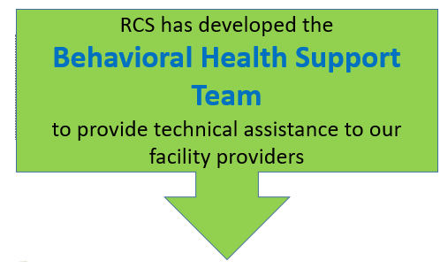
Behavioral Health Support
Notes:
DH

Slide 17
Behavioral Health Support
Do you or someone you know have…
…a resident who is difficult to care for due to behaviors?
…feeling overwhelmed by a resident’s behavioral health needs?
…struggling to come up with new ways to care for a resident with challenging behaviors?
…staff who want training about mental health, how to handle behaviors, regulations…or something else?
…regulatory questions, especially when it comes to caring for residents with challenging behaviors?
Notes:
DH

Slide 18
Behavioral Health Support
Are you preparing to admit a new resident with a history of challenging behaviors?
The Behavioral Health Team offers Preliminary Technical Assistance (PTA)
These preliminary consultations take a heavy regulatory focus.
Notes:
DH

Slide 19
Behavioral Health Support Team
Behavioral Health Quality Improvement Consultants (BQIC)
  Consultations are brief, focused work and may include one to two visits with the provider and/or staff.
Behavioral Health Training Specialist (BHTS)
  Offers behavioral health trainings to providers and their staff while referring to regulatory guidelines. Trainings that are offered include co-occurring disorders, professional boundaries, trauma informed care, crisis response and many more.
  You will learn techniques and strategies to address these behaviors and ways to meet regulatory guidelines.
Notes:
DH

Slide 20
Goals of the Behavioral Health Support Team
  Stability for residents with behavioral challenges who are living in a facility setting.
  Improved quality of care to meet the unique needs of this population.
  Increased compliance with state and federal regulations by the providers who care for residents with behavioral challenges.
Notes:
DH

Slide 21
Issues the Behavioral Health Support Team has Helped With
Residents who are aggressive with each other, staff or both.
Residents who frequently ‘call the state’ to make complaints.
Staff who are dealing with inappropriate comments from residents, including racist statements.
Weak care plans – or really good care plans that aren’t implemented consistently.
Notes:
DH

Slide 22
When to Consider a Referral to the Team
Facility staff have run out of ideas on how to provide care and services.
The resident is at risk of being discharged due to behaviors.
Staff are concerned about staying in compliance while serving a resident with behavioral health challenges.
There are no (or very limited) mental health supports involved.
Notes:
DH

Slide 23
Not Sure If You Should Refer?
That’s OK!
We Encourage You To Reach Out
and We Can Figure It Out Together!
Notes:
DH

Slide 24
How to make a referral
We just need a little information to get started. Call or email us the following, and a member of our team will be in touch!
    Referent name and contact information
    Facility name
    Resident name and date of birth
    Brief information about the issue
BHST Email: rcsbhst@dshs.wa.gov
BHST Referral Message Line: 360-725-3445
Notes:
DH

Slide 25
Significant Change of Condition
Significant change definition is in the Resident Assessment Instrument (RAI) Manual, in Chapter 2
Referrals to PASRR for significant change
Must be done promptly
Required for individuals who have been previously identified by PASRR as having mental illness (MI), or intellectual disability or related condition (ID/RC)
Required for those not previously identified.
Notes:
MM
What is meant by Significant change:
A “significant change” is a major decline or improvement in a resident’s status that:
1. Will not normally resolve itself without intervention by staff or by implementing standard disease-related clinical interventions, the decline is not considered “self-limiting”;
2. Impacts more than one area of the resident’s health status; and
3. Requires interdisciplinary review and/or revision of the care plan.
A significant change also is:
Interdisciplinary team determination
Self limiting – won’t normally resolve itself – if not resolved within 2 weeks, sig change assessment should occur. For PASRR referral, DO NOT wait until the Sig Change Assessment is needed (2 weeks) – make the referral as soon as the changes are evident.
Two or more areas of decline or improvement, though staff can decide if one area is significant enough to warrant an assessment
Referral required for residents who have been previously identified by PASRR to have mental illness, Intellectual Disability, or a related condition.
Referral also required for individuals not previously identified to have MI, ID or related condition, if the individual exhibits behavioral, psychiatric or mood symptoms that suggest MI, or if an ID was not previously identified and evaluated through PASRR
Referral required for a resident transferred, admitted or readmitted to a NF following an inpatient psychiatric stay or other equally intensive treatment
A final word about significant change
When making determination, it must be individualized – what is a sig change for one person may not be for another.

Slide 26
Referral to PASRR for significant change may not be necessary if…
The Resident is expected to return to baseline function within two weeks, and:
The interdisciplinary team (IDT) can initiate corrective action to address the symptoms, OR
A short-term illness is causing the symptoms, OR
Cyclical signs and symptoms are associated with a previous diagnosis.
Notes:
MM
When is a Significant Change not necessary?
Example of the IDT initiating corrective action to address symptoms:
When a resident is experiencing anticipated side effects from a psychoactive medication while the team is attempting to establish an effective dose level
Corrective action = the IDT can monitor, manage symptoms, and communicate with the physician to make further med adjustments if needed.
Example of short-term illness:
Resident has a mild fever secondary to a cold, and the IDT expects the resident to fully recover.
Example of cyclical signs and symptoms:
Resident with previous diagnosis of bi-polar disease shows signs of depressive symptoms.
It is always important for the IDT to document team discussion and the team’s rationale for determining whether a situation is a significant change for the resident or not. The team’s thinking should be obvious to someone who was not present at the team’s decision-making when documentation is reviewed.

Slide 27
Resident Centered Care Planning
Services
Best Outcome
Goals and Preferences
Notes:
MM:
At the bottom of the pyramid – the foundation, is the resident, and the resident’s goals and preferences
Care planning must set objectives for the best outcome for the resident – highest practicable physical, mental and psychosocial wellbeing.
Care planning must determine what interventions or services are needed to achieve the goals of the care plan
Federal and state rules require a care plan based on the assessment. The Care Plan must be:
Updated as resident needs change, and with a significant change, and reviewed at least quarterly.
Developed and completed by an interdisciplinary team – IDT’s allow different perspectives and expertise while collaborating effectively to create positive outcomes with resident goals.
Person Centered and individualized.
The resident or resident representative must be involved in the process of goal setting and care planning.

Slide 28

How do I incorporate PASRR recommendations from the Level II or follow-up into the care plan?
Notes:
MM:
Federal requirements at F656, CMS requires that PASRR recommendations be incorporated into the care plan.
When incorporating the recommendations into the care plan:
First, read the entire Level II report. It contains important information about the individual’s history, goals, preferences, strengths, and support needs. It can be a valuable tool to gain knowledge about the resident. Information in the PASRR report can help to strengthen your entire care plan.
For DDA PASRRs, review the “professional evaluations” section. If an evaluation by a professional is requested, the NF must have the evaluation completed and provided to the PASRR assessor within 30 days, along with a copy of the NF care plan. The professional evaluations are important to the assessor because they often help determine what Level 2 services would be most appropriate for the resident.
PASRR recommendations are centered around the needs of each individual and support the person-centered approach.

Slide 29

Resident Care and
PASRR
Notes:
MM:
PASRR helps support better health outcomes and increased satisfaction with care.
The PASRR evaluation and services are person centered and designed to improve the resident’s life. They are individualized to the resident’s wishes and needs.
PASRR services are integrated into the person-centered care plan.
If communication and coordination is effective, the resident, and facility and PASRR staff are all knowledgeable about the services provided to the resident.
At a minimum, when evaluating the care plan which is at least on a quarterly basis, it would be a good time to review PASRR specialized services and recommendations with the resident/resident representative. If changes are requested or needed sooner, talk with the PASRR Assessor and Evaluators about changes the resident would like to see.

Slide 30
BH PASRR Scenarios
Ms. Thomas has no history of SMI, is on no psychotropic medications and is displaying no signs/symptoms of depression, anxiety, etc.
  1.A.1. (Serious Mental Illness Indicators) marked “no”;
  1.A.2. (functional limitations) marked “no”;
  1.A.3. (inpatient psychiatric hospitalization or needing supportive services to prevent disruption to normal living situation, such as COPES for MH reasons) is marked “no”.
  On page 4, section IV, the first box is marked, “No Level II evaluation indicated.”
Notes:
BL
Based on feedback we received from last years webinar, we have included a few common scenarios that a facility may come across while considering the need for a BH PASRR Level I. Please note these following scenario’s do not apply to residents that require both ID/RC and Behavioral Health.
Ms. Thomas has no history of Serious Mental Illness, she is not on any psychotropic medications, and she is not displaying any signs or symptoms of depression or anxiety.
This instance would be a completely negative Level 1. Please ensure that all 3 sections noted, are marked “NO”
Lastly, On page 4, section IV, the first box would be marked, “No Level II evaluation indicated.”

Slide 31
BH PASRR Scenarios
2. Mr. Smith has a history of depression and has been on Celexa for 6 years, is accepting of his medical hospitalization and the plan for nursing facility placement.
  Section 1.A.1. (indicators) will be marked “yes”;
  1.A.2 (functional limitations) will be marked “no”;
  1.A.3. will most likely be marked “no.”
  Remember that diagnosis alone will NOT make this a positive L1, so page 4, IV, will have the first box marked, “No Level II evaluation indicated.” Under Additional Comments, please reiterate, “patient with history of depression, currently well-managed on medications.”
Notes:
BL
In this scenario
Mr. Smith has a history of depression, and he has been on Celexa for 6 years.
He is accepting of his medical hospitalization and the plan for an upcoming nursing facility placement.
This would be an example of a negative level 1. However, please ensure that all 3 sections are marked as indicated.
Additionally, page 4, section IV, will have the first box marked, “No Level II evaluation indicated.”
Under Additional Comments, it would be beneficial to reiterate that the patients symptoms are currently well-managed on his medication.

Slide 32
BH PASRR Scenarios
Mr. Brown has a history of depression and is on Celexa and is recuperating from a fall. This medical hospitalization has been rough for him, and he is displaying active symptoms of depression as exhibited by declining/refusing some days of therapies, is irritable with nursing staff, and is withdrawn. However, the medical team think that under normal circumstances, rehab will be less than 30 days.
Section 1.A.1. (indicators) will be marked “yes”;
1.A.2. (functional limitations) will now be marked “yes” – since his psychiatric symptoms/behaviors are negatively impacting his care
The criteria for Section IIA. “Exempted Hospital Discharge” is met and should be notated in as such in Section III.
Page 4, Section IV, the last box should be marked, “No Level II evaluation indicated at this time due to categorical determination.”
Notes:
BL
In this Scenario,
Mr. Brown has a history of depression, is on Celexa and is currently recuperating from a hip fracture.
this medical hospitalization has been rough for him and he is displaying active symptoms of depression as exhibited by declining or refusing some days of therapies, He is irritable with nursing staff, and is more withdrawn than he was before.
However, the medical team think that under normal circumstances, rehab will be less than 30 days.
This would be an example of a negative level 1. However, please ensure that all 3 sections are marked as indicated.
Even thought he has active symptoms of depression, the medical team thinks his overall stay will be less than 30 days, which is meets the criteria for “Exempted Hospital Discharge”
Additionally, Section IV, the 6th box down should be marked, “No Level II evaluation indicated at this time due to exempted hospital discharge”.
**Nursing facilities please take note: if rehab does not go as planned and Mr. Brown will stay beyond 30 days, the Level 1 does NOT need to be redone, but the hospital’s version needs to be faxed to the PASRR Contractor on day 25.

Slide 33
BH PASRR Scenarios
3. Mr. Clark has a history of depression and has active symptoms of depression. He is deconditioned and will require more than 30 days at the nursing facility.
Section 1.A.1. (indicators) will be marked “yes”;
1.A.2. (functional limitations) will be marked “yes”;
1.A.3. may be either yes or no.
Skip sections IIA, IIB, and III as these only pertain to <30 days.
Section IV will be the second box down, “Level II evaluation referral required for SMI.”
**In this circumstance, if the patient is identified while still in the hospital, the patient will need to be seen for the PASRR Level 2 Evaluation preadmission prior to admission to the nursing facility. The nursing facility can be cited for accepting a patient with a positive Level I without a completed Level 2.
Notes:
BL
In this Scenario, Mr. Clark has a history of depression and has active symptoms of depression. He is deconditioned and will require more than 30 days at the nursing facility.
This would be an example of a Positive level 1.
please ensure that all 3 sections noted below are marked as indicated.
Additionally Section IV, the second box down, “Level II evaluation referral required for SMI.” Will need to be selected.
**This is a circumstance under which if the patient is identified while still in the hospital, ideally, the patient will need to be seen for the PASRR Level 2 Evaluation, prior to admission to the nursing facility. The nursing facility can be cited for accepting a patient with a positive L1 without the L2 having been done.

Slide 34
BH PASRR Scenarios
4. Ms. Smith initially had a negative PASRR Level 1 and entered the nursing facility for rehab. Unfortunately, she had some set-backs resulting in a longer than anticipated stay. She became more depressed, withdrawn, and began losing weight. She scored 16/27 on the PHQ-9 and her Primary Physician was contacted regarding the possibility of starting an antidepressant.
This is an example of a Significant Change.
Complete a new PASSR Level 1, noting the significant change date (approximately) on page 1, and on Page 4.
Skip sections IIA, IIB and III as these only pertain to <30 days
Section IV, mark the 5th box down, “Level II evaluation referral required for significant change.”
No
Notes:
BL
In this scenario Ms. Smith initially had a negative PASRR Level 1 and entered the nursing facility for rehab. Unfortunately, she had some set-backs resulting in a longer than anticipated stay. She became more depressed, withdrawn, and began losing weight. She scored 16/27 on the PHQ-9 and her Primary Physician was contacted regarding the possibility of starting an antidepressant.
This is an example of a Significant Change.
In this instance, the facility will complete a new PASSR Level 1, noting the significant change date (approximately) on page 1, and on Page 4.
Additionally Section IV, the 5th box down, “Level II evaluation referral required for significant change. Will need to be selected.

Slide 35

Reinvestment Grants
Washington state participates in the Civil Money Penalty (CMP) Fund Grant Program.
https://www.dshs.wa.gov/altsa/civil-money-penalty-cmp-funds
Notes:
DDA--TH
Civil money penalties (CMPs) are fines imposed on nursing facilities that do not meet federal health and safety standards. Washington state receives a portion of the funds collected to be reinvested in support of projects that improve the overall quality of life and/or care of nursing facility residents.
Opportunities are available for nursing homes to participate in grant projects. More information is available at the link in the slide. Some facilities are using these funds to purchase equipment to assist residents to communicate with others outside of the facility including family and friends. PASRR has found that for residents who are able to communicate with family and friends it has reduced anxiety and increased stability for the resident.

Slide 36

A Final Thought
PASRR is a partnership between the resident, important people in the resident’s life, hospital, NF, and state agencies.
At its center is our common desire to provide person-centered, high-quality services for each individual we serve.
Notes:
MM:
I want to end with a final thought.
Look at PASRR as a partnership between the resident, important people in the resident’s life, hospital, NF, and state agencies.
At its center is our common desire to provide person-centered, high-quality services for each individual we serve.

Slide 37
Where can I find more information?
ID/RC PASRR Internet Site: www.dshs.wa.gov/dda/pasrr
SMI PASRR Internet Site: www.hca.wa.gov/pasrr
Behavioral Health Support for Providers:
www.dshs.wa.gov/altsa/residential-care-services/behavioral-health-support-providers
BHST Email: rcsbhst@dshs.wa.gov
BHST Referral Message Line: 360-725-3445
Notes:
DDA—HJ
HCA and DDA maintain PASRR internet sites. At these links, you can find contact information for the PASRR teams, helpful links, FAQs, and –soon- a copy of this presentation. We encourage you to send your staff to these sites, especially when turnover occurs.
Behavioral Health Support for Providers has a website, link to email and a referral line.

Slide 38
PASRR Contacts
Developmental Disabilities Administration (ID/RC): Terry Hehemann, ID/RC PASRR Unit Manager - teresa.hehemann@dshs.wa.gov; PASRR Program Coordinators, Heidi Johnston, heidi.johnston@dshs.wa.gov , and Wendy Einer, wendy.einer@dshs.wa.gov.
Health Care Authority (SMI): Beth Loska, PASRR Program Manager elizabeth.loska@hca.wa.gov ; Maureen Craig, Medical Assistance Program Specialist maureen.craig@hca.wa.gov
Residential Care Services: Molly McClintock, NH Policy Program Manager molly.mcclintock@dshs.wa.gov
Notes:
DDA—HJ
The next two slides supply information about how to contact people who work with PASRR in Washington State.

Slide 39
PASRR Contacts
RCS Behavioral Health Support Team: Debbie Hoeman, Behavioral Health Policy Program Manager debbie.hoeman@dshs.wa.gov
Home and Community Services: Julie Cope, System Change Specialist julie.cope@dshs.wa.gov
Department of Health: Liz Gordon, Clinical Care Supervisor, Investigation and Inspection - elizabeth.gordon@DOH.WA.GOV
Notes:
DDA--HJ

Slide 40
Questions and Answers
Notes:
DDA—HJ
We would like to thank you for your time today and we are now ready to answer your questions.

