Slide 1
Residential Services Curriculum
Chapter 10
Medication Management

Slide 2
Medications

Slide 5
Person
Medication
Dose / Amount
Time
Route

Slide 9
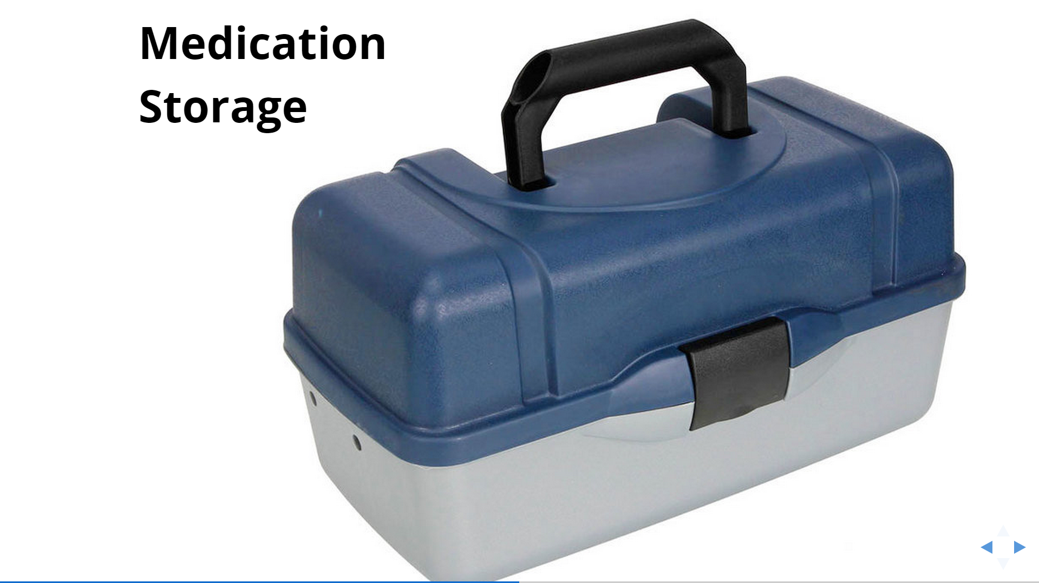

Slide 10
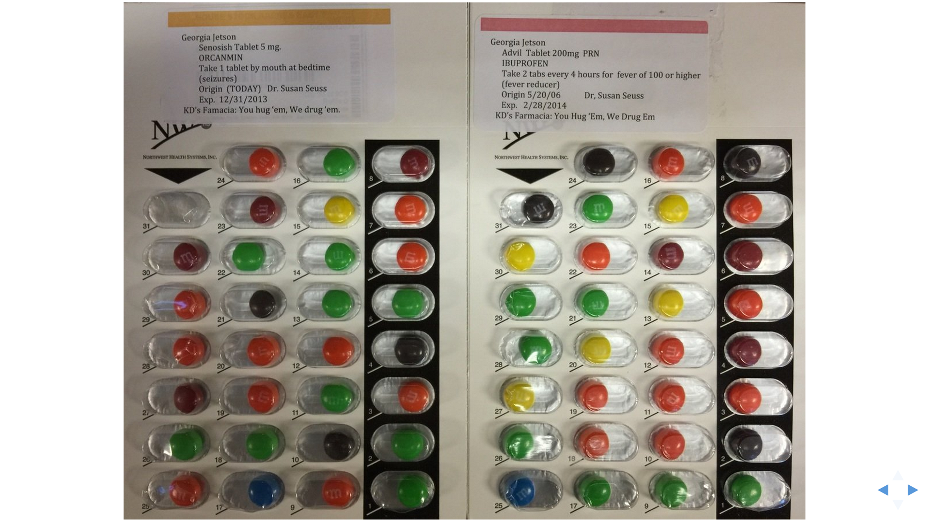

Slide 11
Medications
may
change

Slide 12
Nurse
Delegation

Slide 14
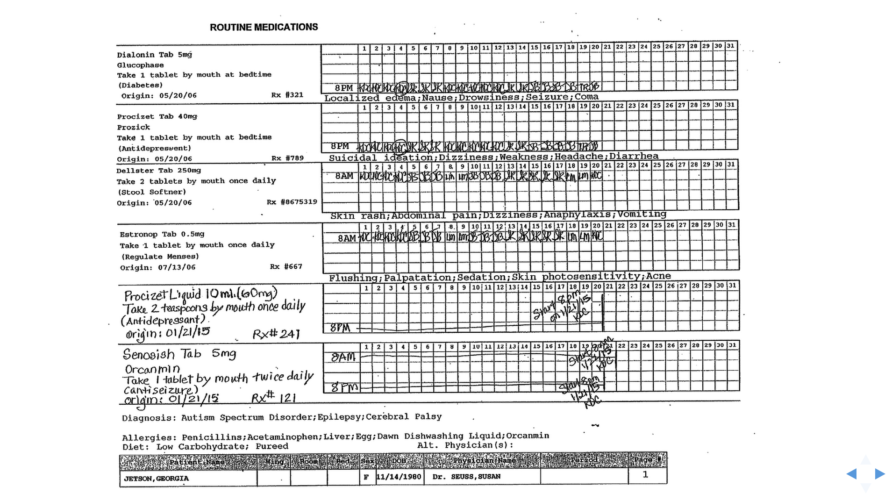

Slide 15
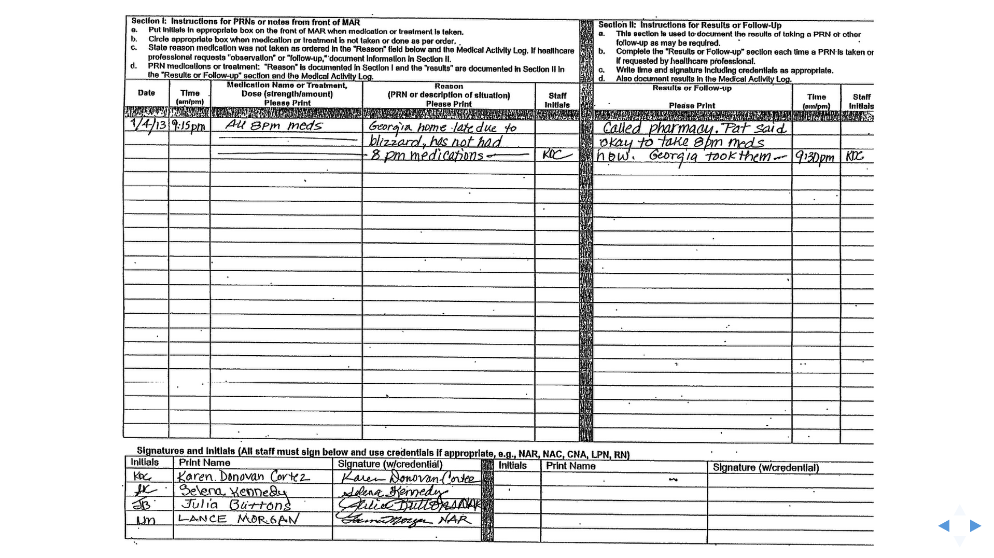

Slide 16
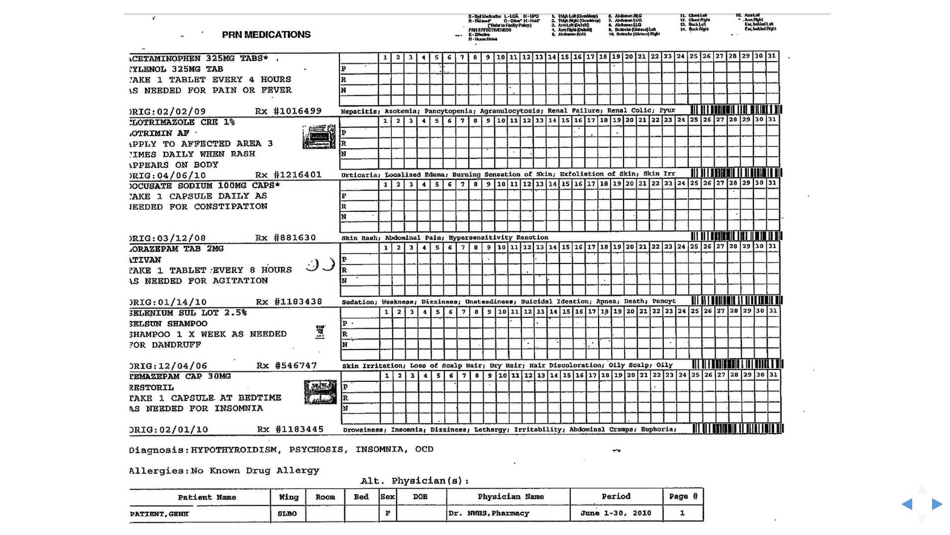

Slide 18
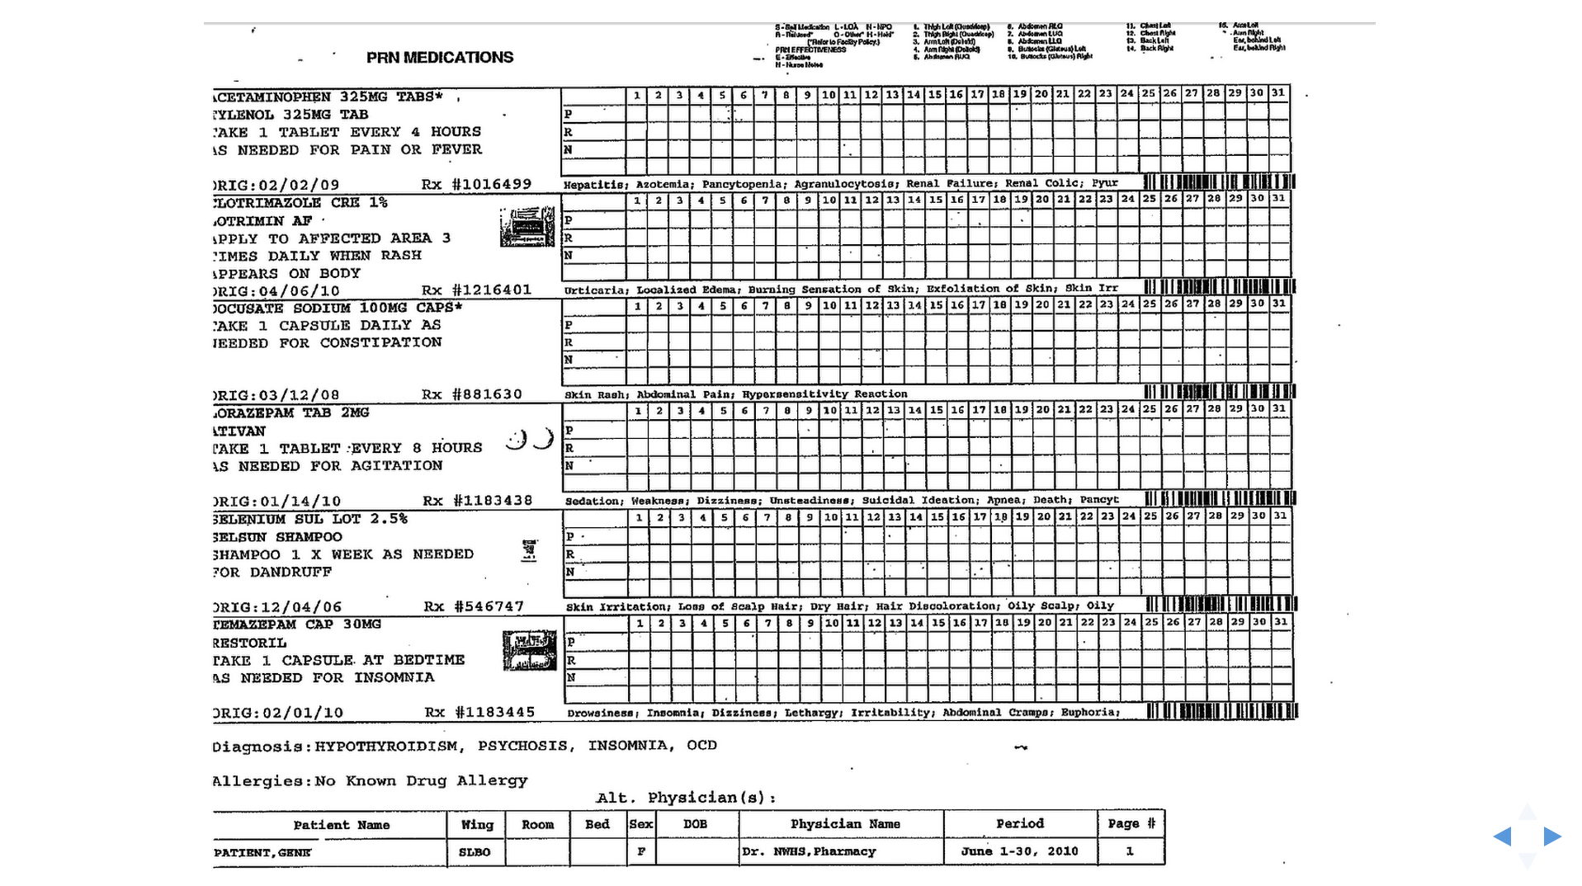

Slide 19
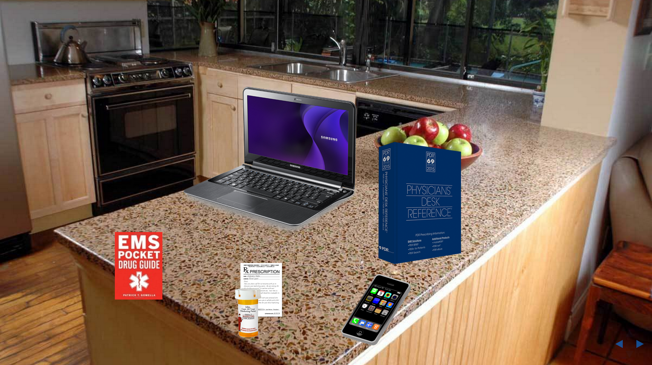

Slide 20
Review objectives Take the test Help clean up What’s next?

