Slide 1
Residential Services Curriculum
Chapter 11:
Emergency Preparedness
Notes:
Directions for completing this course:
Minimize distractions
Ensure your sound is working
Once you have completed the course and the work directed during the course; bring your work and certificate to your supervisor / trainer, review what you learned and have them sign your certificate (note: certificate of completion not valid for CE credits until signed by an approved trainer).

Slide 2
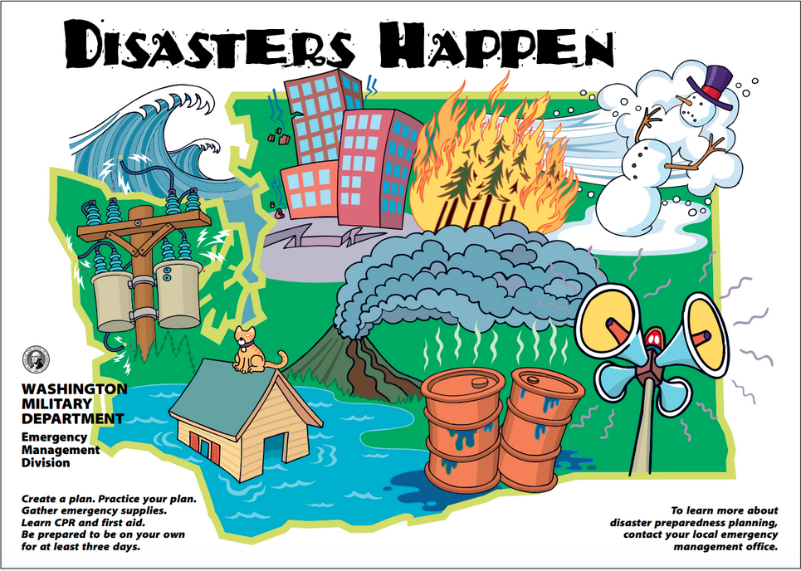

Slide 3
Countdown timer

Slide 15
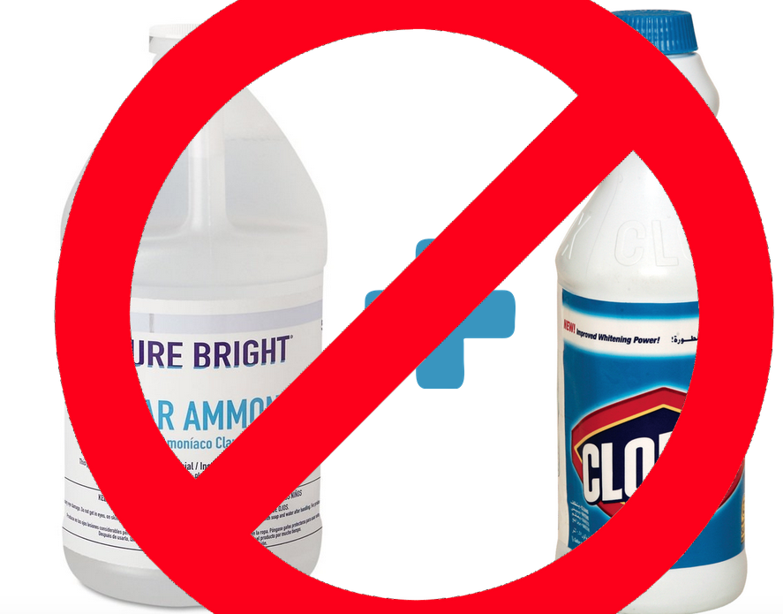

Slide 22
Please click on the link to show the video.
“Dry Scotch Pine Tree Fire”
https://www.youtube.com/watch?v=l_y9_AfeuSs

Slide 23
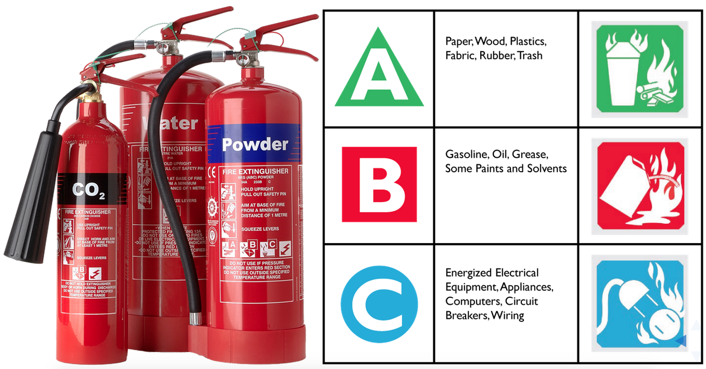

Slide 24
Please click on the link to show the video.
Putting Out a Grease Fire
https://www.youtube.com/watch?v=AFwkGTEles8

Slide 26
Please click on the link to show the video.
P.A.S.S. Fire Extinguisher Training
https://www.youtube.com/watch?v=aU35ioqiJmA

Slide 32
Review objectives Take the test Help with clean up What’s next?

