Slide 1
Residential Services Curriculum
Chapter 12:
Personal Care
Skills Acquisition and Support
Notes:
Directions for completing this course:
Minimize distractions
Ensure your sound is working
Once you have completed the course and the work directed during the course; bring your work and certificate to your supervisor / trainer, review what you learned and have them sign your certificate (note: certificate of completion not valid for CE credits until signed by an approved trainer).

Slide 3
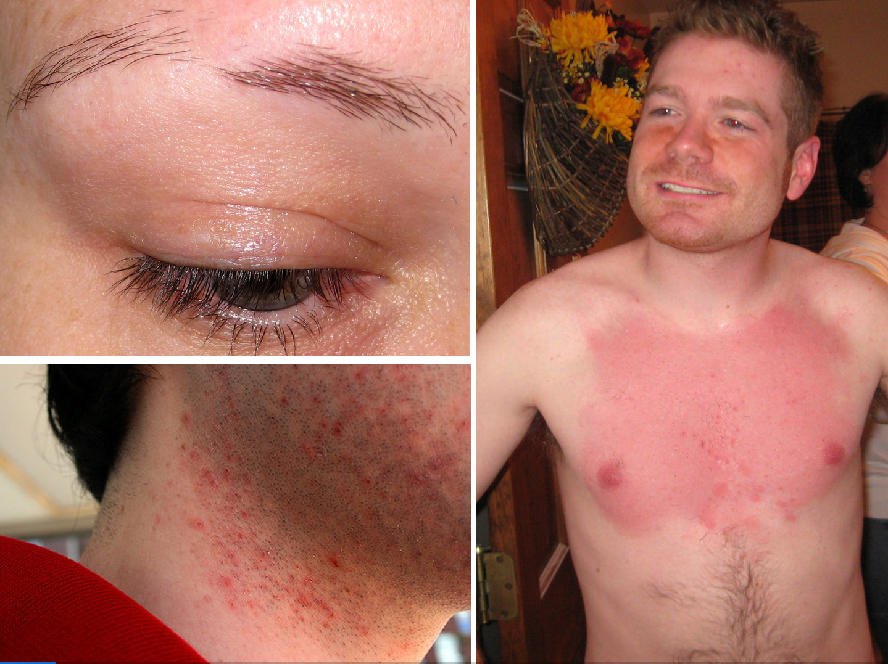

Slide 5
Bringing Dignity Back to Activities of Daily Living Discussion
Discussion Questions:
How does good hygiene preserve someone’s dignity?
How is hygiene related to social skills and social isolation?
One of DDA’s Guiding Values is Power and Choice. Why is it important for us to remember this value when we assisting others with personal hygiene or activities of daily living?
(example—eating, grooming, etc)

Slide 9
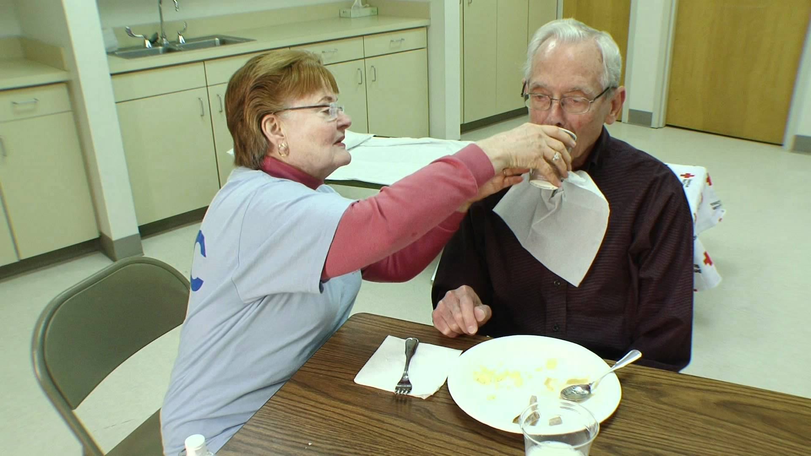

Slide 14
Please click on the link to show the video.
Pericare (Male and Female)
https://www.youtube.com/watch?v=Qp78x7NxUho

Slide 15
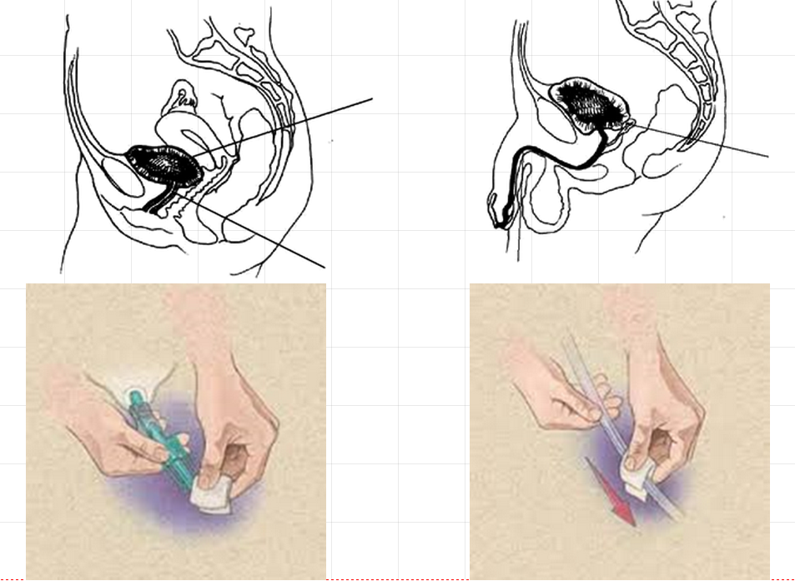

Slide 16
Please click on the link to show the video.
Catheter Care Video
https://www.youtube.com/watch?annotation_id=annotation_692058&feature=iv&src_vid=Q2--bAg5rSA&v=XzQTDUEpx0w

Slide 18
Please click on the link to show the video.
Shower Video
https://www.youtube.com/watch?v=QHeodQ-XBXY
Please click on the link to show the video.
Bed Bath
https://www.youtube.com/watch?v=xYOxfPyutOI

Slide 21
Please click on the link to show the video.
Compression Stocking Video
https://www.youtube.com/watch?v=id_txYKSCs4

Slide 23
Please click on the link to show the video.
Passive Range of Motion Video
https://www.youtube.com/watch?v=XORFTjO9Dgk

Slide 25
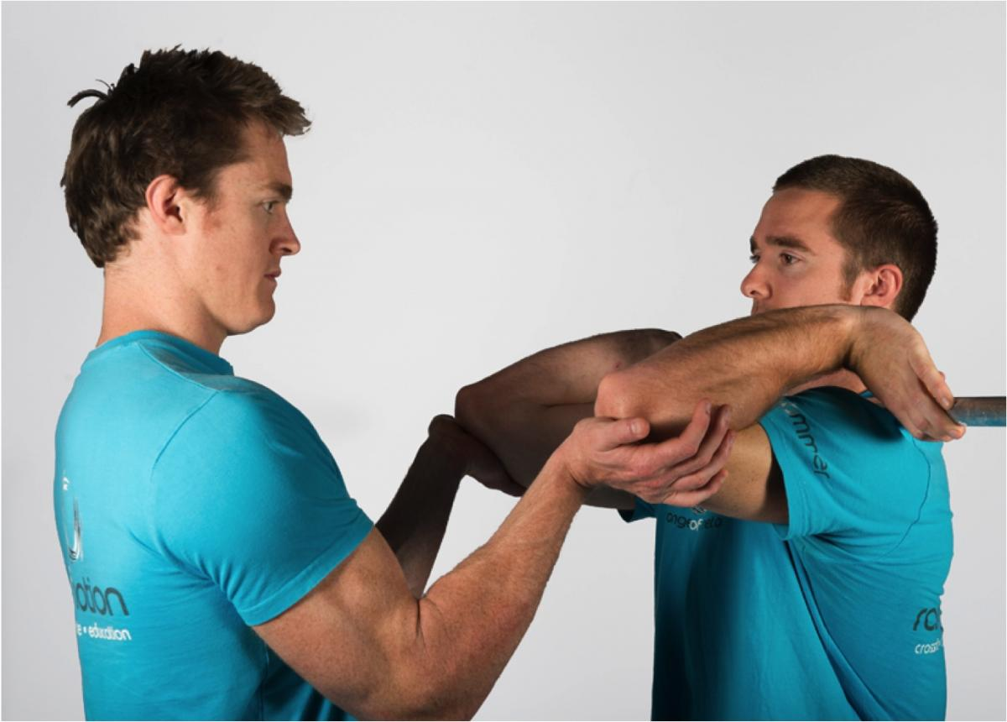

Slide 26
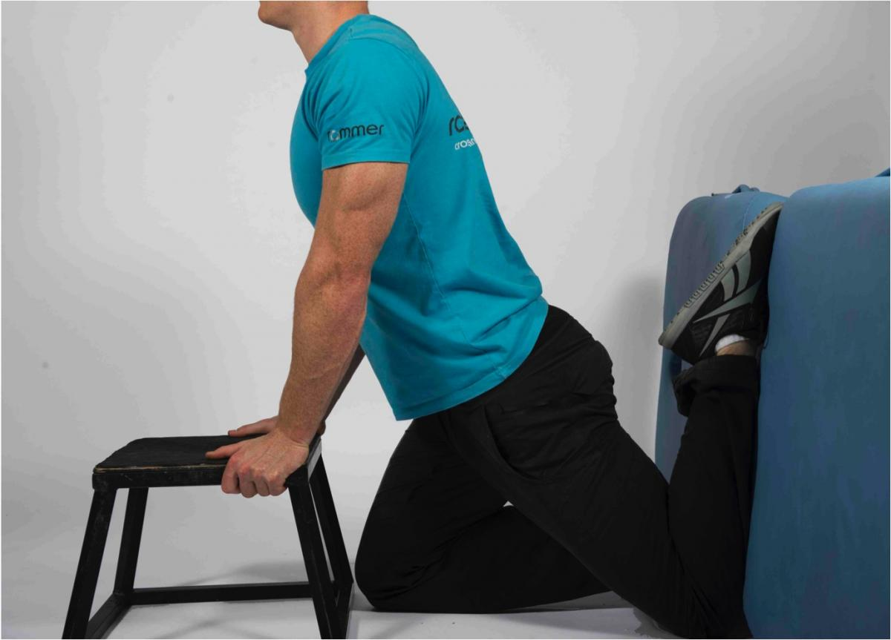

Slide 27
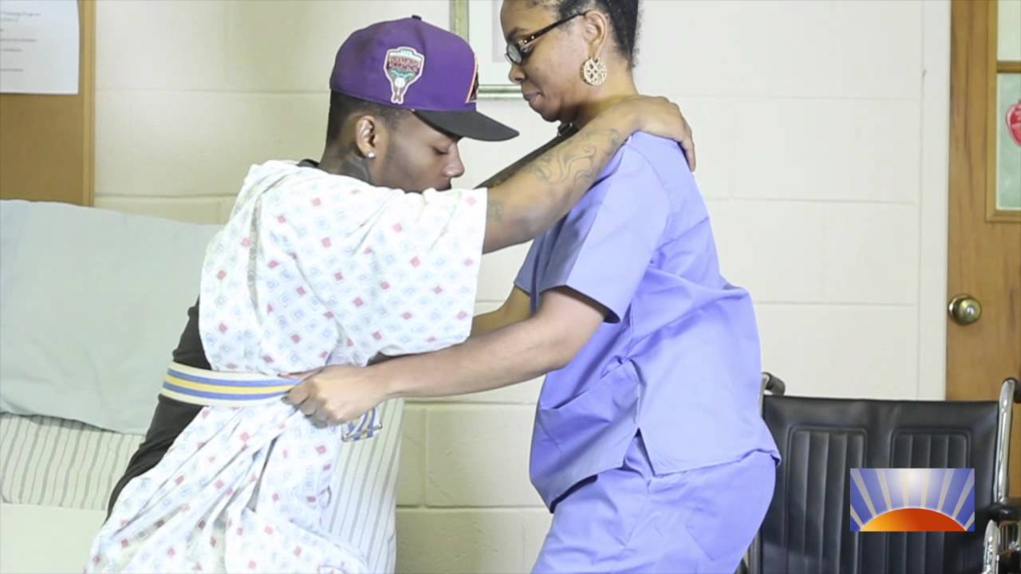

Slide 29
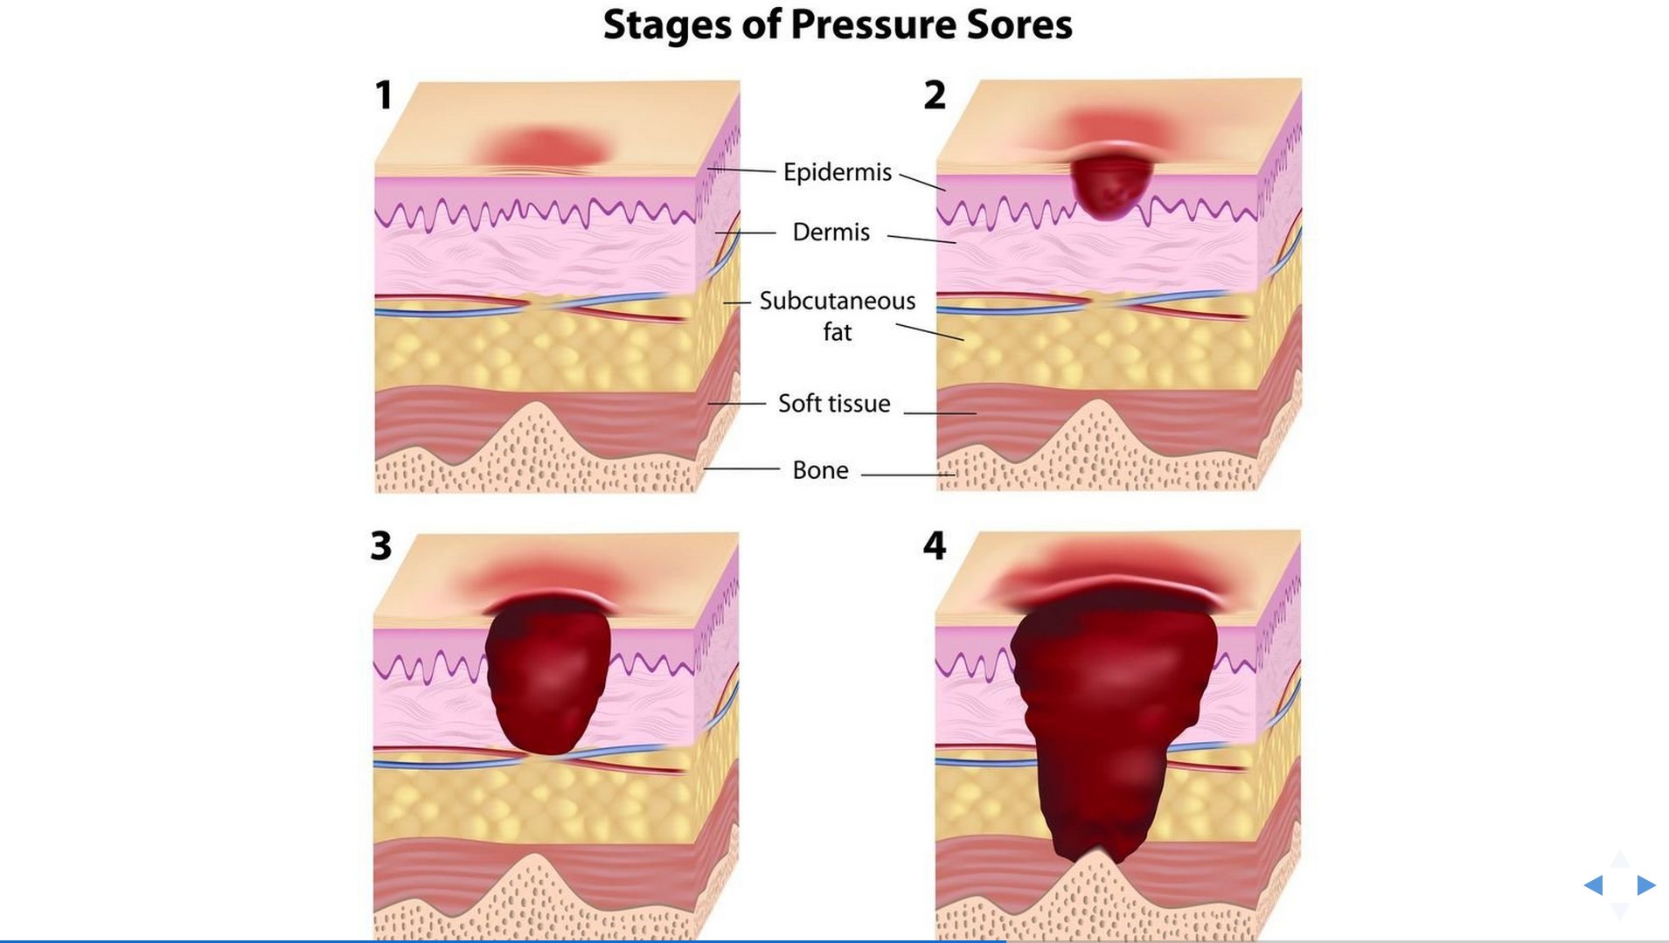

Slide 30
Please click on the link to show the video.
Turning and Repositioning Video
https://www.youtube.com/watch?v=QlUpI-bznWA

Slide 31
Please click on the link to show the video.
Wheelchair Transfer Video
https://www.youtube.com/watch?v=_irfJdCL2Dw

Slide 32
→Review the Learning Objectives →Complete End of Chapter Assessment

