Slide 1
Residential Services Curriculum
Chapter 13:
Confidentiality (HIPPA)
Notes:
Directions for completing this course:
Minimize distractions
Ensure your sound is working
Once you have completed the course and the work directed during the course; bring your work and certificate to your supervisor / trainer, review what you learned and have them sign your certificate (note: certificate of completion not valid for CE credits until signed by an approved trainer).

Slide 2


Slide 3


Slide 4
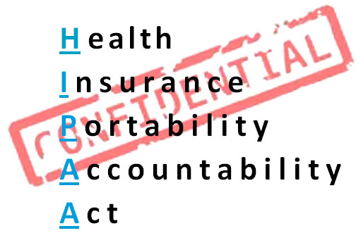

Slide 5


Slide 6
Guardian Interaction Discussion:
What Would You DO?
Discussion Questions:
Scenario:
You are the only person on shift and it’s a Saturday. A guardian calls you and starts demanding information about the medication the individual you work with is on, demands you read her doctor’s orders over the phone.
What would you do?
What if the guardian showed up for the home and demanded to see the individual’s medical record?

Slide 7
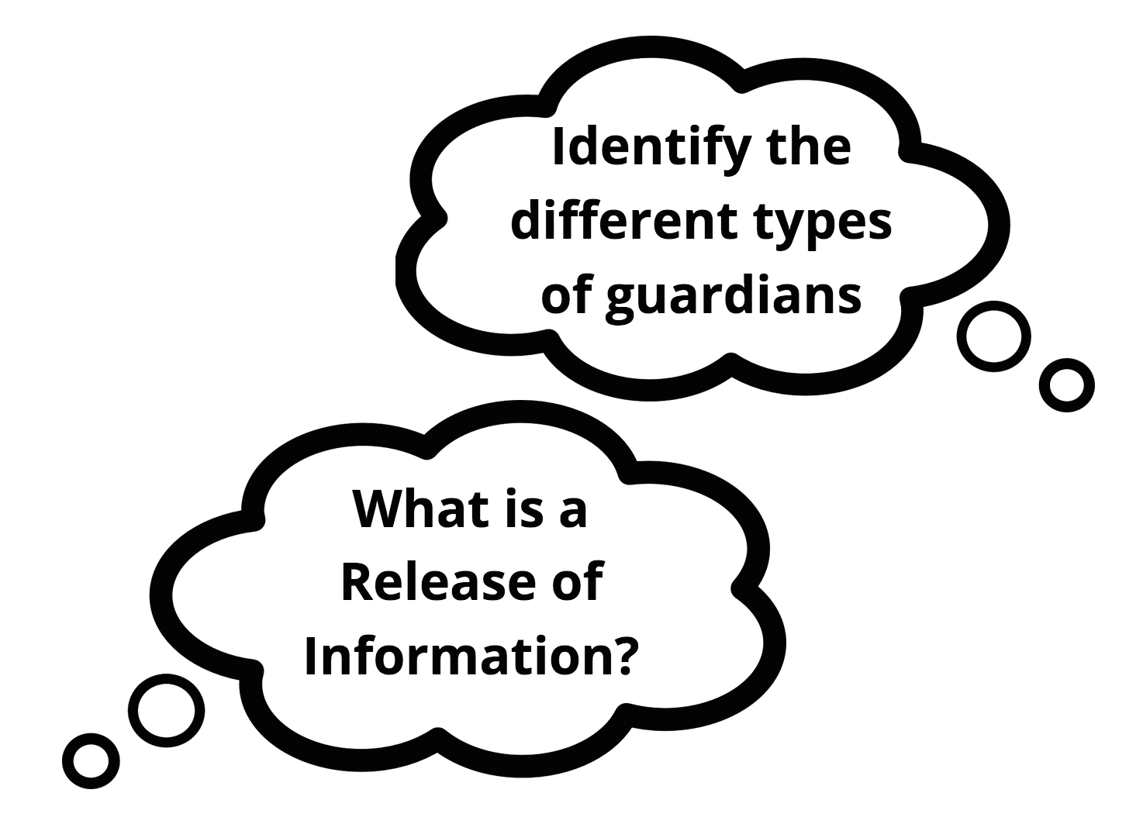

Slide 8
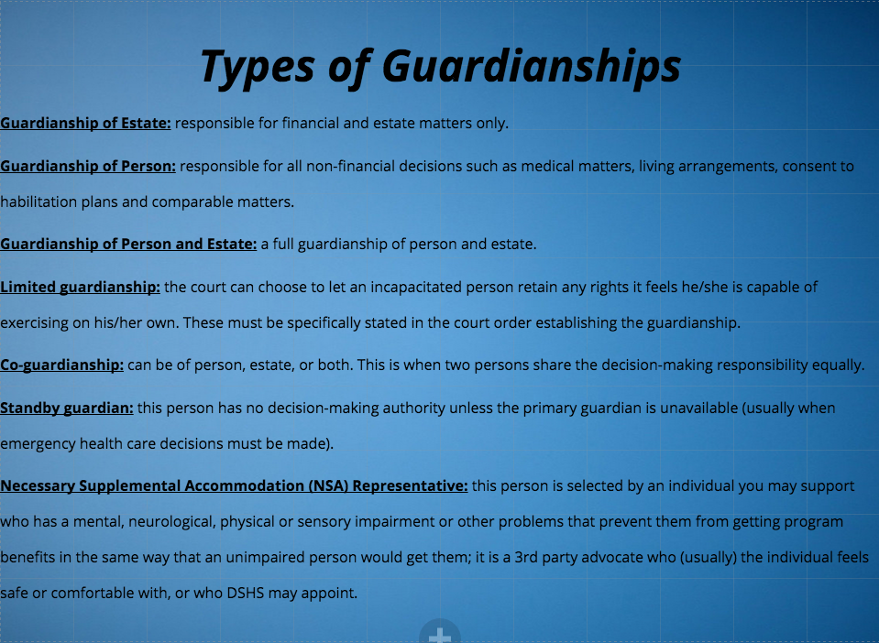

Slide 9

Social Media Activity

Slide 10
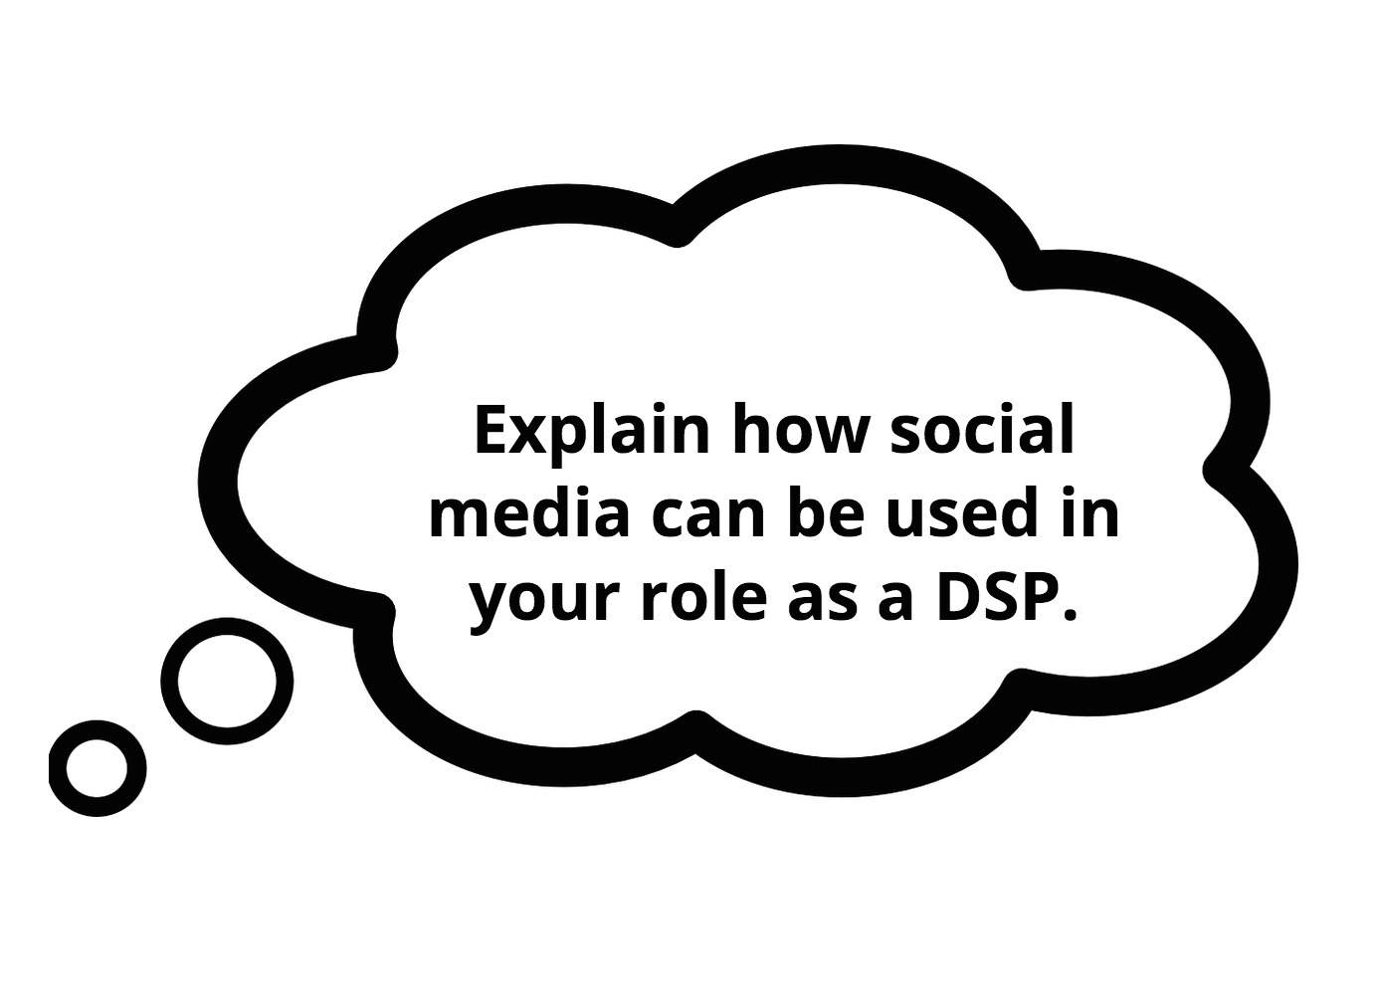

Slide 11
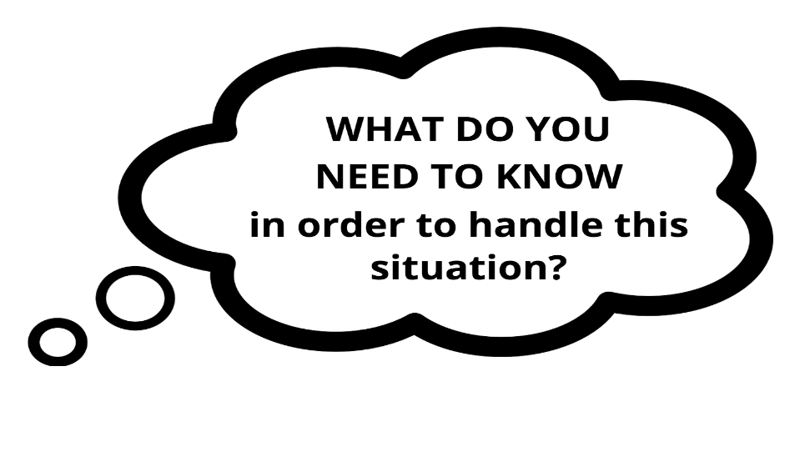
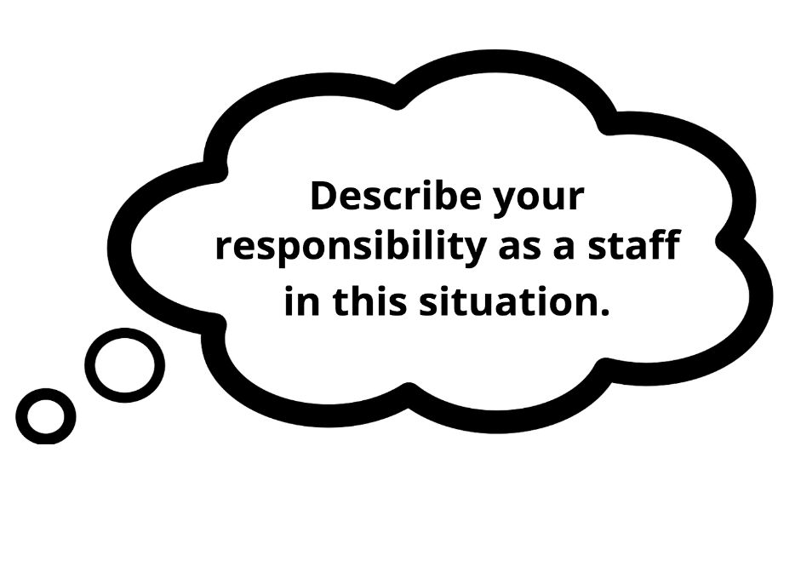
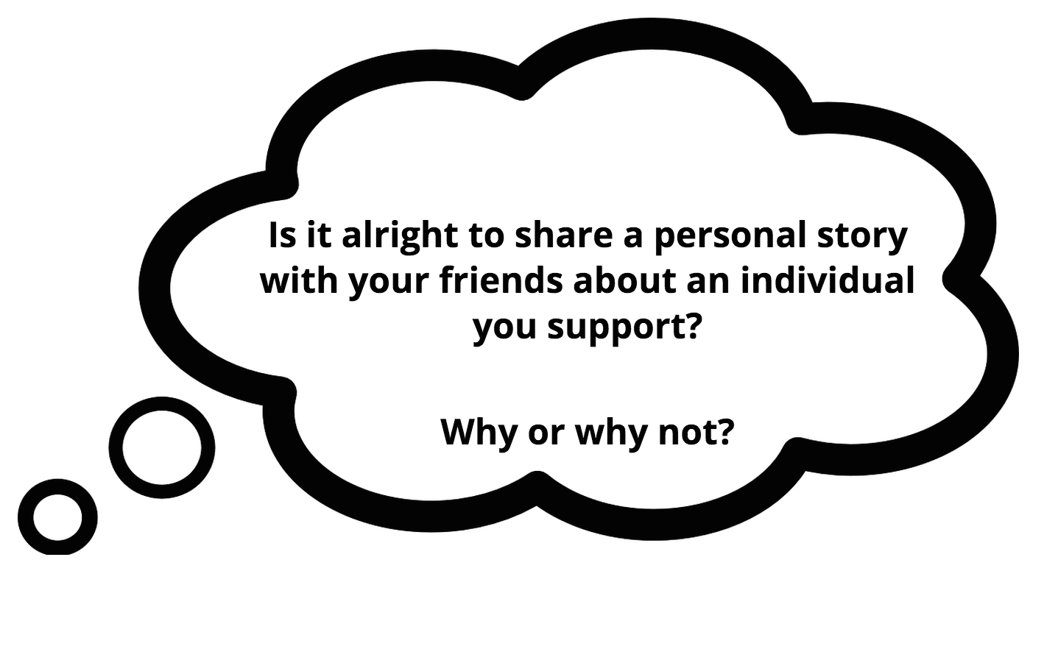
Confidentiality Activity: What Would You DO?

Slide 12


Slide 13
→Review the learning objectives
→Questions?
→Time for Assessment

