Slide 1
Residential Services Curriculum
Chapter 3
Residential Guiding Values and Individual Services

Slide 2


Slide 3


Slide 4


Slide 5


Slide 6
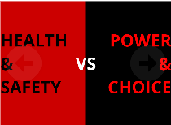

Slide 8
→Review the learning objectives
→Questions?
→Time for Assessment

