Slide 1
Residential Services Curriculum
Chapter 6:
Habilitation Skills
Notes:
Directions for completing this course:
Minimize distractions
Ensure your sound is working
Once you have completed the course and the work directed during the course; bring your work and certificate to your supervisor / trainer, review what you learned and have them sign your certificate (note: certificate of completion not valid for CE credits until signed by an approved trainer).

Slide 2


Slide 3
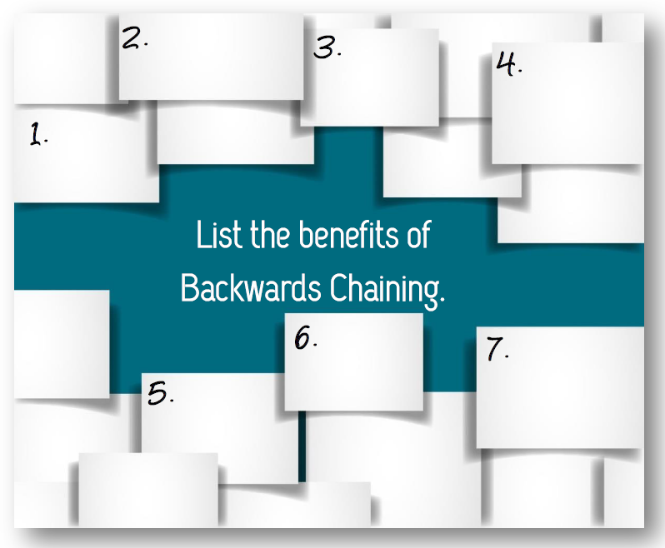

Slide 4
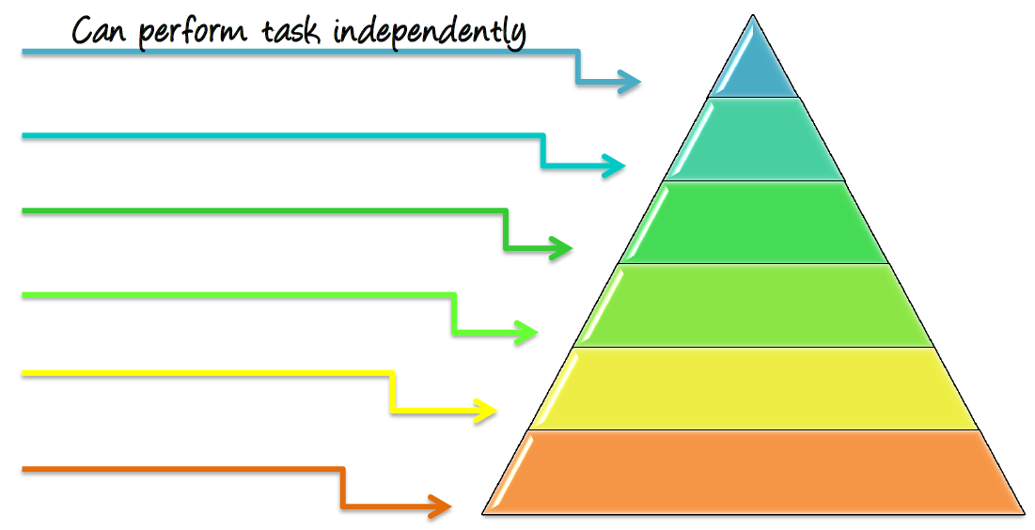
Indirect verbal/nonverbal
Direct verbal/nonverbal
Modeling
Partial physical Assist
Full physical assist

Slide 5
Review the Objectives
Take the Test
Help clean up
What’s Next?

