Slide 1
Residential Services Curriculum
Chapter 7:
IISP and Support Plans

Slide 4
You’re Invited

Slide 6
Please click on the link to show the video.
“Make a Difference Workshop” (Seth)
https://www.youtube.com/watch?v=1lbFnPYoaz4

Slide 8
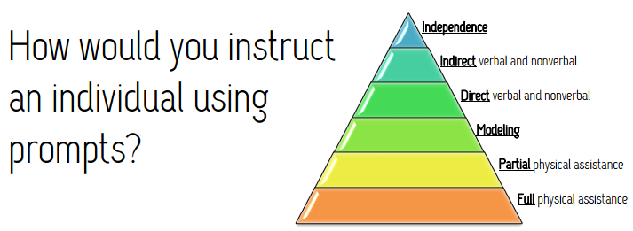

Slide 9
Review the Objectives Take the Test Help clean up What’s Next?

