Slide 1
Residential Services Curriculum
Chapter 8:
Nutrition and Dietary Guidelines

Slide 7
Diabetes Dietary Solutions Discussion
Discussion Questions:
Think of your favorite foods. Does it involve bread, sugar, dairy? Imagine if you were told you could never eat these foods again. How would you feel?
How many of your eat Birthday cake for birthdays, or special sweets around holidays? What if you could not consume these traditional foods? How would you feel?
What are some creative ideas for helping individuals with Diabetes be both healthy and still have some of their favorite foods?
How would you empower the person to make choices around the food the eat?

Slide 8
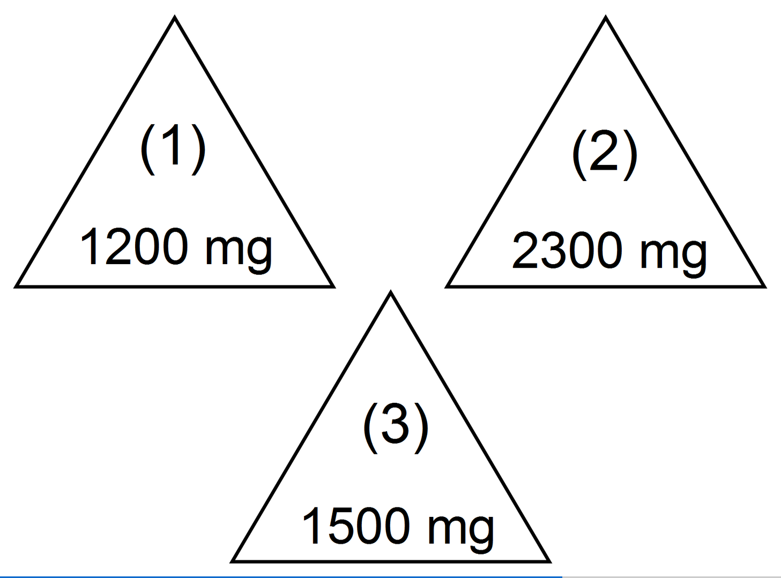

Slide 11
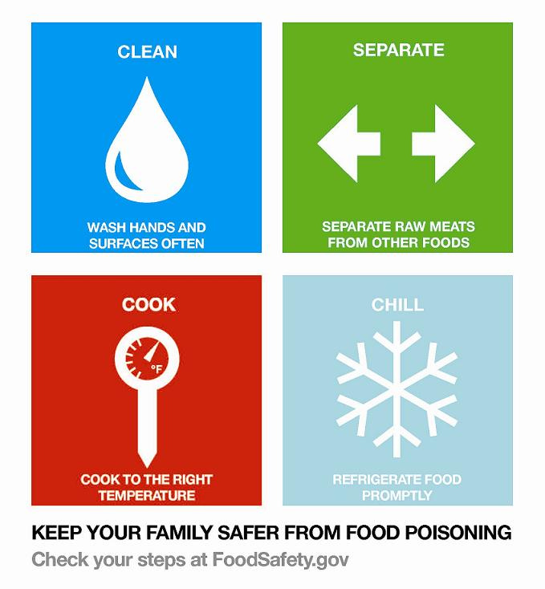

Slide 12
Please click on the link to show the video.
VIDEO TITLE: “Nutrition & Dietary Guidelines 4 Step Food Safety”
https://www.youtube.com/watch?v=8ud0EMyKWyc

Slide 15
→Review the learning objectives →Questions? →Time for Assessment

