Slide 1
Residential Services Curriculum
Chapter 9
Healthcare/Health Management
Notes:
Directions for completing this course:
Minimize distractions
Ensure your sound is working
Once you have completed the course and the work directed during the course; bring your work and certificate to your supervisor / trainer, review what you learned and have them sign your certificate (note: certificate of completion not valid for CE credits until signed by an approved trainer).

Slide 2
Discussion Questions:
What are common signs or symptoms of illness?
How should a Direct Support Professional (DSP) respond if they suspect someone they support is ill or sick?
What could happen if a DSP does not respond timely when they see signs or symptoms of illness.

Slide 5
Preparation
Advocacy
Empowerment
Doctor’s Visit Activity

Slide 6
Please click on the link to show the video.
Video Title: “Can Toilet Germs Reach Your Toothbrush”
https://www.youtube.com/watch?v=EG_PnRCLe9A

Slide 7
Please click on the link to show the video.
Video Title: “Tonic Clonic Siezure SD”
Please click on the link to show the video.
https://www.youtube.com/watch?v=0AyTyNK_L-c

Slide 9
Please click on the link to show the video.
Video Title: “Laughter Yoga: Laughing Away The Stress”
https://www.youtube.com/watch?v=lGNOF8DVIPQ

Slide 10
Please click on the link to show the video.
Video Title: “What Is Drug Abuse?”
https://www.youtube.com/watch?v=1KjyzcF2Fzc

Slide 11
Please click on the link to show the video.
Video Title: “What is Substance Abuse?”
https://youtu.be/uFVyQ3Z_Pq0

Slide 14
Please click on the link to show the video.
Video Title: “Mental Health: In Our Own Words
https://www.youtube.com/watch?v=_y97VF5UJcc

Slide 15
Mental Health Empathy Discussion
Discussion Questions:
Sometimes mental illness is known as an invisible disability.
What you think invisible disability means?
Why might a person living with depression hide that from friends, co-workers and others?
How does mental illness impact your workplace? Colleagues? Individuals you support?

Slide 16
Advocacy works!

Slide 17
Aging Empathy Discussion
Discussion Questions:
As all individuals age what are some of the advantages to aging? Challenges?
As we work hard to support and empower those in our programs, what do we need to consider as the individual we work with ages?
More help with daily activities? Name them.
Increased medical needs? What could this be?
Normal memory loss? Is there a risk of this being ignored because an individual has a developmental disability?

Slide 18
Please click on the link to show the video.
Video Title: “Aging, Retirement and End of Life for People with Intellectual and Developmental Disabilities?”
https://www.youtube.com/watch?v=yAJO_yGa9nA

Slide 20
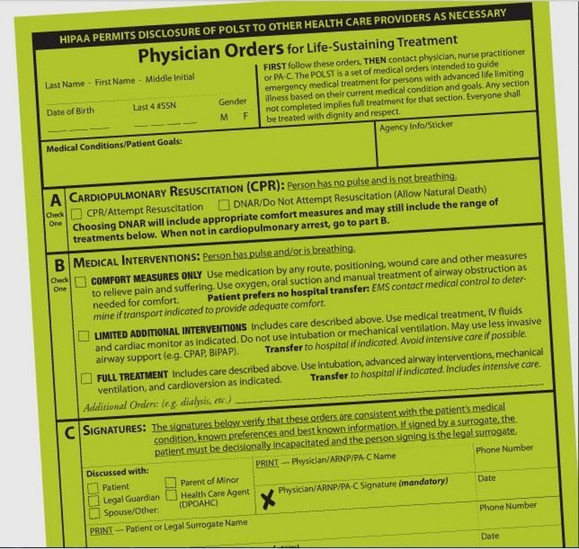

Slide 22
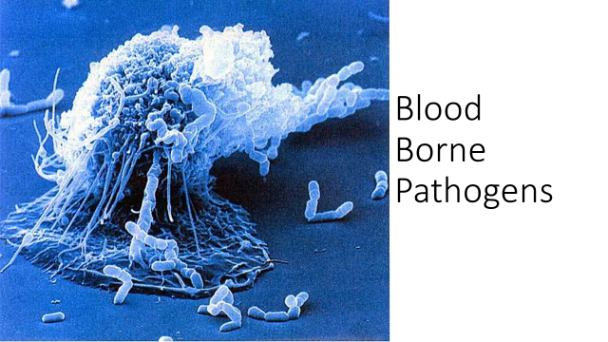

Slide 26
How blood borne pathogens are spread in the workplace​
Can be spread by:
A needle stick or puncture wound
Helping a person who is bleeding
Changing lines that are contaminated with blood or other bodily fluids
Helping to clean vomit, urine or feces
Changing or dressing a wound
contact with mucous membranes (mouth, nose and eyes)
CANNOT be spread by:
Providing care using standard precautions
Sharing eating utensils, plates or glasses
Sharing bathrooms
Through the air
Hugging, shaking or holding hands

Slide 27
Exposed?
Your eyes
Flush immediately with water for 5 minutes. Rise under clean running water.
Blood or body fluids in your mouth
Rinse mouth with 50/50 hydrogen peroxide and water. Rinse with clean water. Get medical attention.
Both eyes and mouth
Immediately rinse as above and seek medical attention

Slide 28
Exposed?
Needle stick or puncture wound
Wash thoroughly with soap and water or pour small amount of hydrogen peroxide on the wound. Get medical help for further attention.
Any bit, scratch or lesion that may have had blood or body fluid exposure.
Wash the area thoroughly with soap and water and pour a small amount of hydrogen peroxide on the wound. Cover wound with sterile dressing. Get medical attention.

Slide 30
→Review the learning objectives →Questions? →Time for Assessment

