Slide 1
Small Group Discussion

Slide 2
Introduce Yourself
Name
Neighborhood you live in
Relationship to Fircrest Campus

Slide 3
Share Your Thoughts on the Master Plan
What is your interest in the Master Plan and process?

Slide 4
Share Your Thoughts on the Master Plan
What is working well on campus?

Slide 5
Share Your Thoughts on the Master Plan
What are your thoughts/opinions on the proposed site plan?

Slide 6
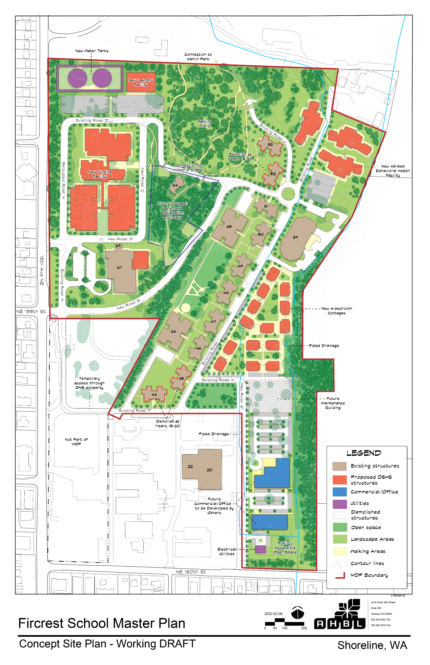

Slide 7
Share Your Thoughts on the Master Plan
What key issues do you hope DSHS will consider when developing and considering master plan options?

Slide 8
Share Your Thoughts on the Master Plan
What kinds of recreational opportunities would you like to see on the campus?
Notes:
Walking paths, trails, bicycle infrastructure

Slide 9
Potential Uses in the Southern Portion of the Site
Are there specific uses/developments you would like to see in the undeveloped southeast corner of the site, and why?
Notes:
Fire Station
Offices
Retail
Community Center
Café/restaurant
Mini-park
Medical offices/daycare
Multi-family

Slide 10
Potential Uses in the Southern Portion of the Site
Visual Preference Survey
What kind of design character would you like to see for new development in the southeast corner of the site?
This short visual preference survey may help!
Notes:
Fire Station
Offices
Retail
Community Center
Café/restaurant
Mini-park
Medical offices/daycare
Multi-family

Slide 11
Visual Preference Images
For each image – pick one option:
5. Great example!
4. Good design
3. Indifferent – but nothing about it should be prohibited
2. Undesirable – maybe consider prohibiting part of the design
1. Unacceptable – the design should be prohibited
After collecting scores from all the participants, discuss WHY you liked or disliked images?
Notes:
Participants to verbally give scores for each and scribes collect scores to come up with an average.
After getting scores – ask why participants liked or disliked images – character, massing, materials, detailing, landscaping, orientation, other?

Slide 12
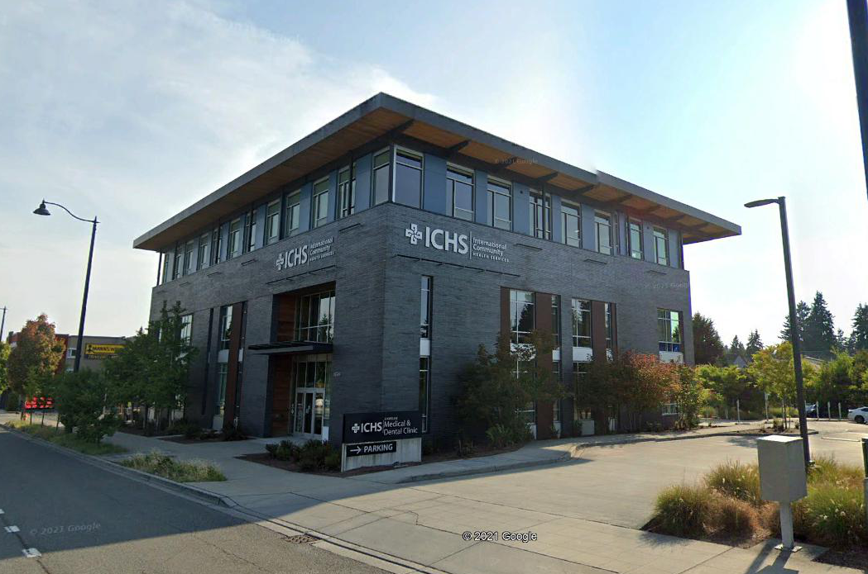
1

Slide 13
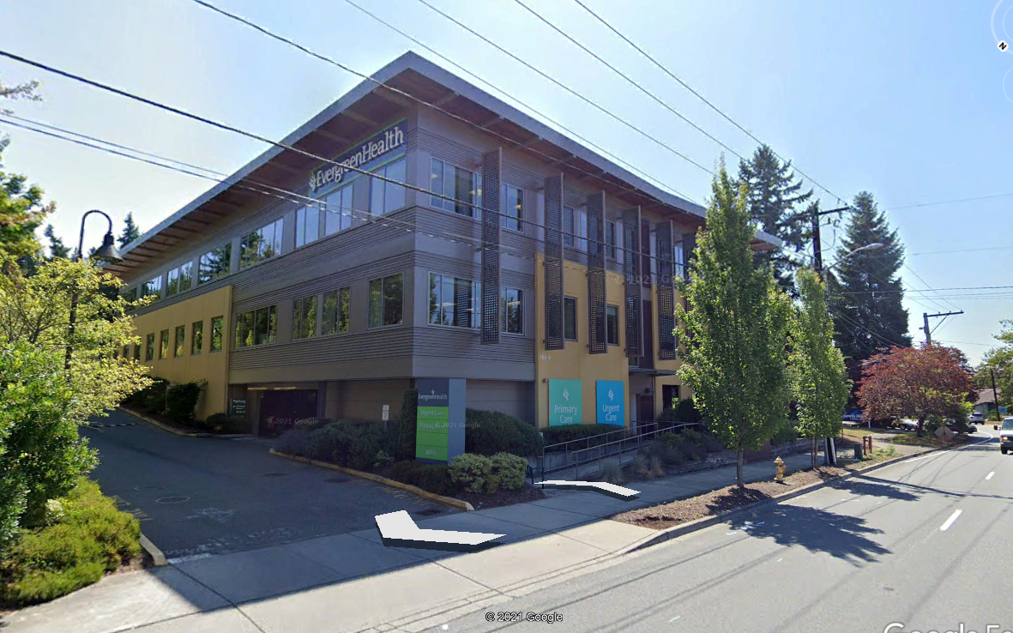
2

Slide 14
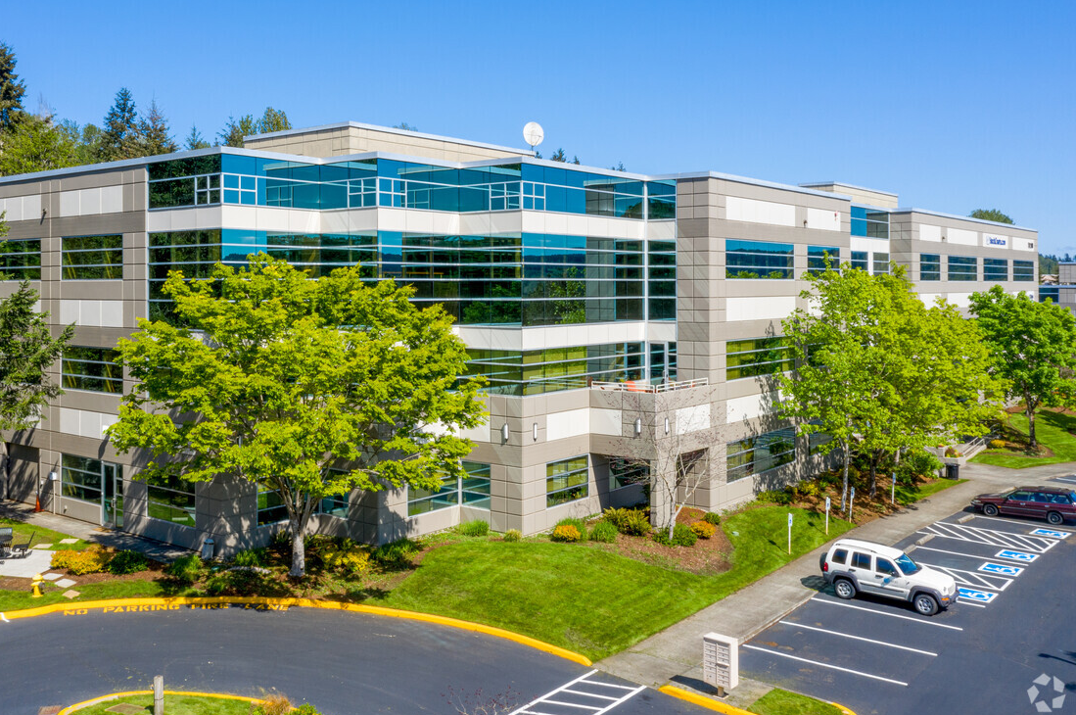
3

Slide 15
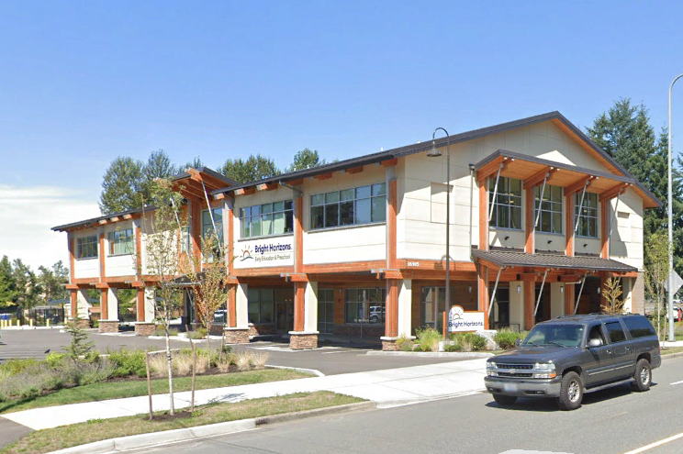
4

Slide 16
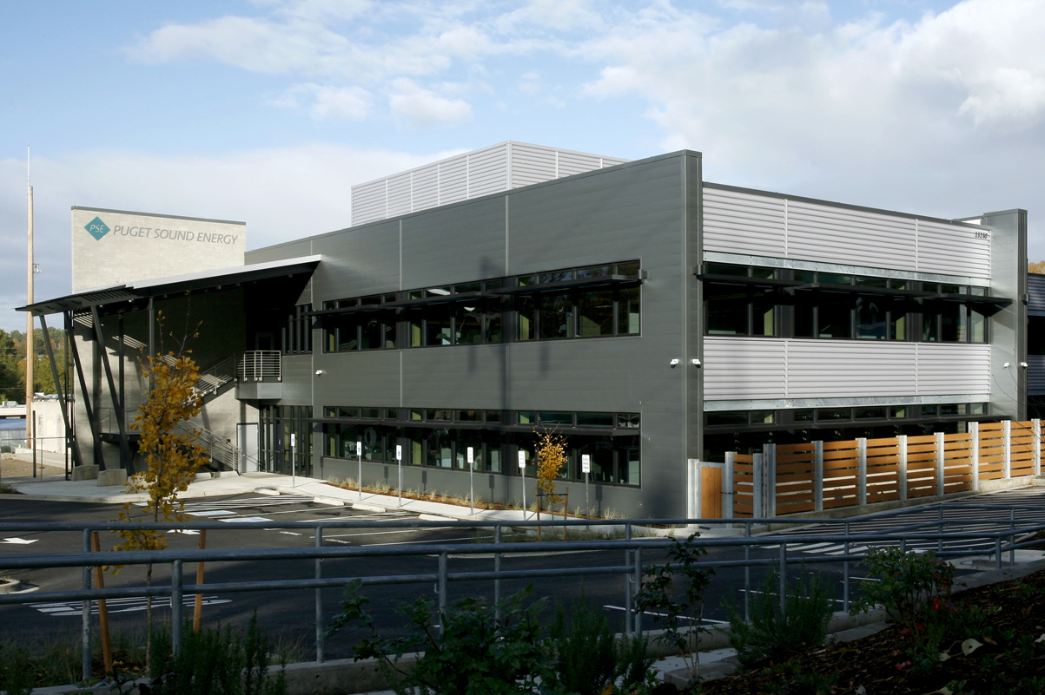
5

Slide 17
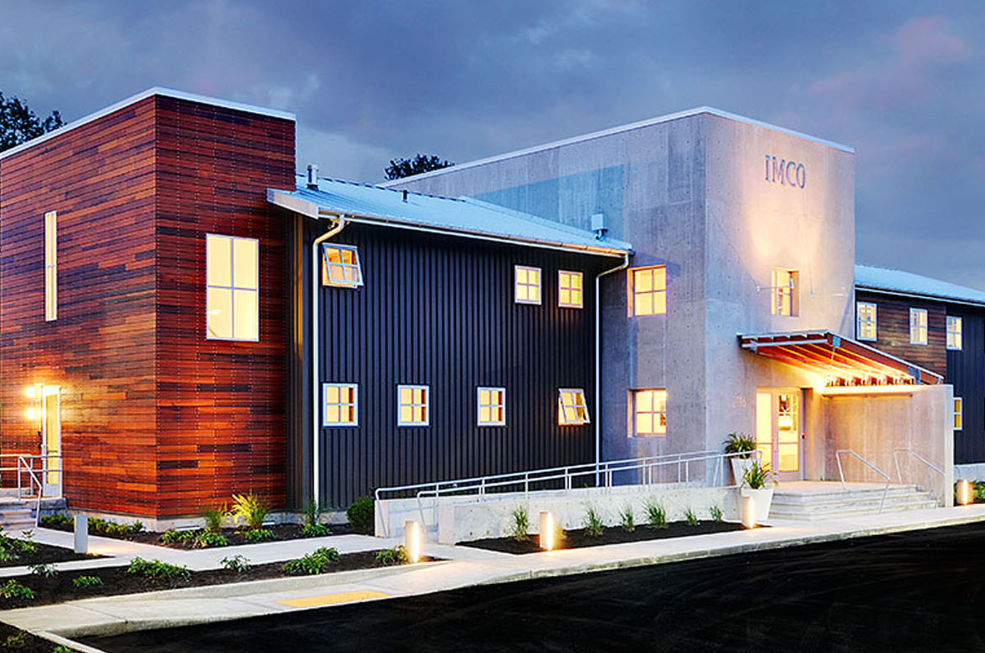
6

Slide 18
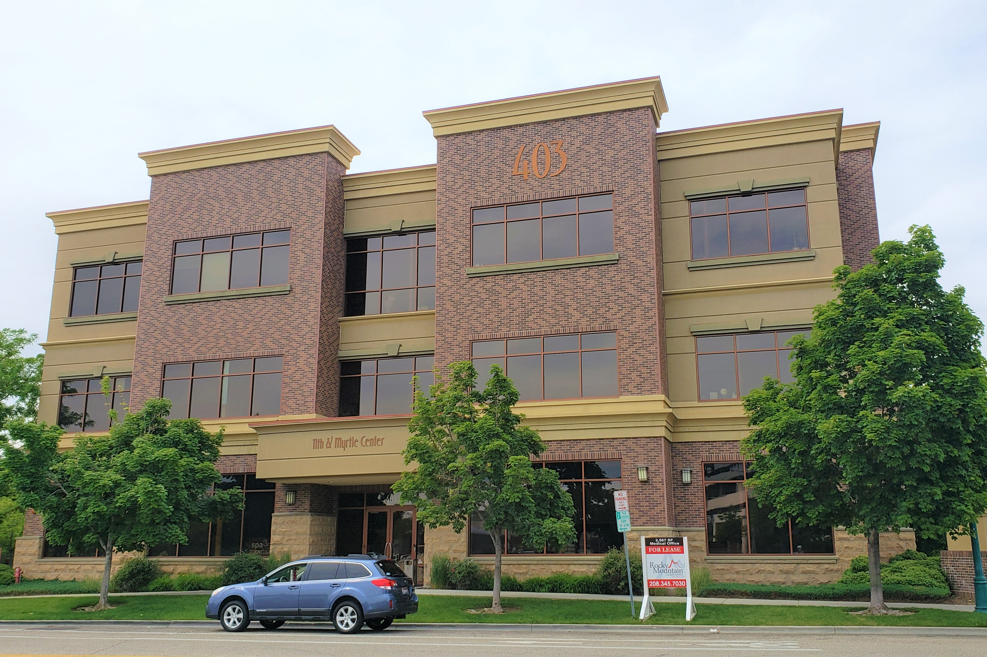
7

Slide 19
Other Thoughts?

