Slide 1
Fircrest School Development Master Plan
Early Community Input Meeting
March 8, 2022
Notes:
Welcome Slides/ Zoom: Helen

Slide 2
Zoom Guidelines
All participants have been muted upon entry. Please remain muted during the presentation until the question and answer session.
During the question and answer session, please “Raise Your Hand” to indicate that you would like to speak.
Please mute yourself after you have finished speaking.
We will be recording this meeting and a recording will be available upon request.

Slide 3
Zoom Guidelines
Here’s how to raise your hand if you’re using your computer:
Click on the Participants section, at the bottom of your screen.
Click on the small icon in the shape of a hand, labeled “Raise Hand”.
Your hand is now raised, which means that the hosts and other participants will see that you have something to say.
If you’re using the Zoom app on iOS or Android:
Scroll to the bottom left corner.
Tap on the icon labeled “Raise Hand”.

Slide 4
Zoom Guidelines
If you’re calling in:
Press *9 to raise your hand, and then *9 to lower your hand.
Press *6 to mute/unmute
If you are unable to raise your hand:
Please wait until the host has indicated that all participants who have raised their hands have had an opportunity to speak. The host will then invite call-in users to un-mute themselves and ask their questions/provide comments on the proposal.
You may also type questions in the chat box during the question and answer and small group discussions.

Slide 5
Introductions
DSHS/Fircrest
Larry Covey
Upkar Mangat
Jeanne Rodriguez
Lisa Pemberton
Bob Hubenthal
Dean Heglund
DSHS/BHA
Brian Waiblinger
Jenise Gogan
Sjan Talbot
Jeneva Cotton
DNR
Carrie Nelson
Kari Fagerness
AHBL
Brittany Port
Wayne Carlson
Helen Stanton
MAKERS
Bob Bengford
Katy Saunders
City of Shoreline
Steve Szafran
Andrew Bauer
Jim Hammond
Notes:
Introduction - Upkar

Slide 6
Agenda (estimated times)
6:10pm - Presentation Begins
Early Community Input Meeting Overview
DSHS / Fircrest School Introduction
Master Development Plan
Project Permits
Site Development Plan
Potential Commercial Development
6:40pm - Question and Answer Session
6:55pm - Short Break
7:00pm - Small Group Discussions
8:00pm - Meeting Conclusion
Notes:
Brittany

Slide 7
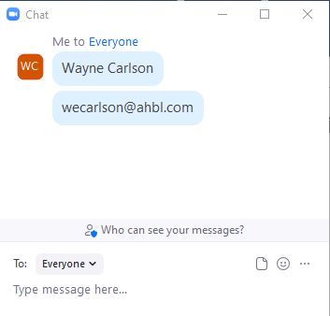
Early Community Input Meeting
Please sign in
Open chat and enter name and email.
This meeting is required by the City of Shoreline to allow the public to learn about the Plan and provide input to DSHS and the City of Shoreline Planning Department.
Notes:
Brittany

Slide 8
Early Community Input Meeting
Comments received tonight will be reviewed as part of the Master Plan process
Additional comments can be provided to the City of Shoreline.
Shoreline City Hall - 3rd Floor 17500 Midvale Ave N Shoreline, WA 98133
Phone: (206) 801-2500 Fax: (206) 801-2788 Email: pcd@shorelinewa.gov
Comments can also be provided to FircrestSchoolProject@dshs.wa.gov
Notes:
We appreciate your participation and we will be incorporating feedback and comments into future planning efforts.

Slide 9
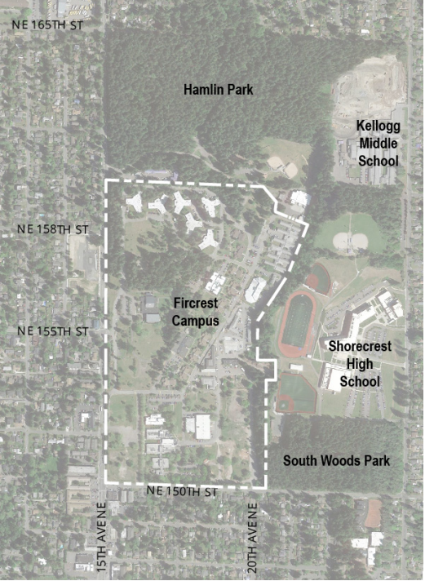
DSHS/Fircrest School
Originally constructed as a Naval Hospital, early 1940s
There are a number of buildings that remain from the original construction of the campus.
Roadway circulation is similar to the original construction of a Naval Hospital.
1949: Tuberculosis Hospital, called Firlands
Treated patients until 1973
At one point population grew to 750 patients
1952: Fircrest School Residential Habilitation Center was established.
Fircrest had a population of nearly 500 residents at one point. Today we care for approximately 200 residents.
The entire campus is approximately 90 acres.
Source: https://www.historylink.org/File/10144
Notes:
* Seattle Navel Hospital

Slide 10
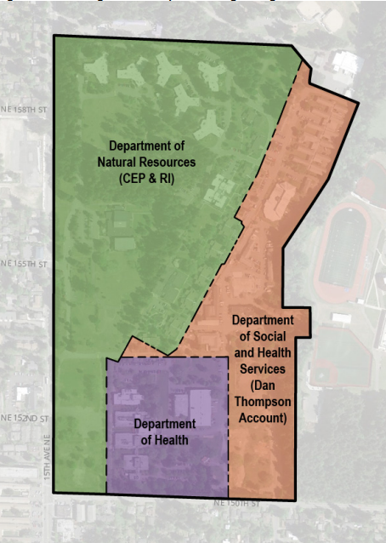
DSHS/Fircrest School-Land Lease & Trusts
Three owners (DNR, DOH, and DSHS)
Two trusts
Charitable Education, Penal and Reformatory Institutions (CEP&RI)
Generates revenue and provides support for state institutions managed by the Department of Corrections and DSHS
Dan Thompson Trust
Created in 2005 to provide family support and/or employment/day services to eligible persons with developmental disabilities who can be served by community-based services.
Both DNR and DSHS are responsible to manage these trusts to develop long term revenue in support their trustees.
DSHS currently leases land from DNR to operate the Fircrest RHC.

Slide 11
DSHS/Fircrest School-Current Facilities/Programs
DSHS/Fircrest School operates 45 Buildings that make up 400,000 gross square feet.
Building uses include:
Skilled nursing
Residential
Commercial Kitchen/Dietary
Active skill development and training
Activities (Recreation) Building
Clinic spaces to treat residents on site
Historic Naval Chapel
Administration office spaces
Facilities Maintenance
Commissary
Programs
Skilled Nursing Program
Currently caring for 109 residents
5 star program
Habilitative (Skilled Training) Services
Currently caring for 87 residents
Person-Centered care model
Individuals are the center of the process
Provide care to residents who will ultimately leave Fircrest for a less restrictive environment, preferably in a community setting

Slide 12
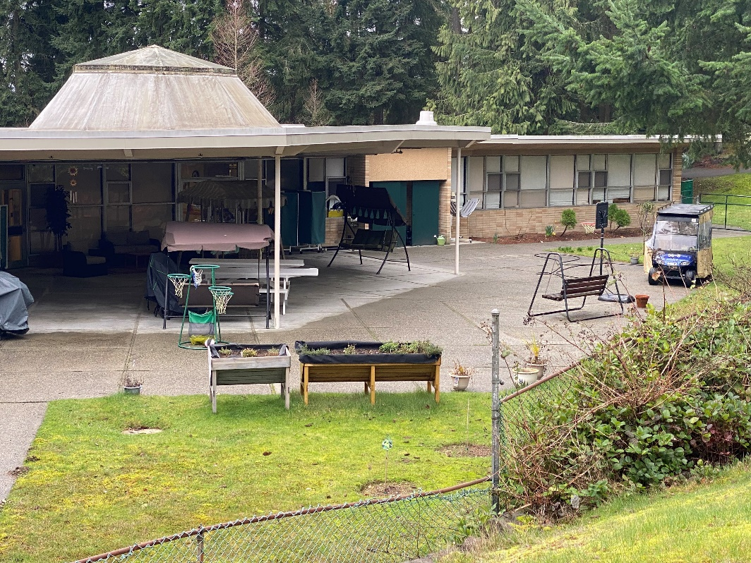
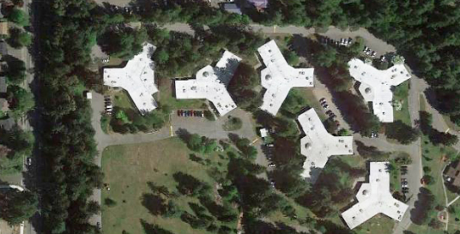
DSHS/Fircrest School – New Nursing Facility
120 Bed Nursing facility
License for the new nursing facility is the same as the existing.
Existing skilled nursing facility comprises six “Y” shaped buildings.
New skilled nursing facility currently is planned as a single building.
DSHS in process of selecting designers and contractors for the building.
Construction is anticipated to begin Spring 2023
Move in Spring 2025
Providing 5 Star Care in a 5 Star Building

Slide 13
Master Development Plan
The Master Development Plan is a land use permit required by the City of Shoreline prior to developments on properties zoned as “Campus.” The Fircrest Campus is zoned “Fircrest Campus Zone (FCZ).”
The State will include all potential uses of the site in the Master Plan for the next 20 years.
Development Standards codified in the City’s municipal code include:
Density limit: 48 units per acre
Height limit: 65 feet
New building bulk shall be massed to minimize impact on neighboring single-family neighborhood(s) and development on campus
New development subject to City’s site planning, landscaping standards, and tree preservation standards.
Notes:
Wayne

Slide 14
Prior Planning Efforts

Slide 15
Master Development Plan
2018
The Master Development Plan process began in 2018
Oct. 2018 and Sep. 2019
Early Community Input Meetings were held in October 2018 and September 2019
late 2019
Planning process paused in late 2019 due to delays in State Legislation
late 2021
DSHS relaunched the Master Planning process in late 2021
April
Application Date April 2022
Notes:
Wayne

Slide 16
Permits
Master Development Plan
Market Analysis, Nursing Pre-Design Study
Special Use Permit
SEPA Environmental Review
Tree Survey, Stormwater TIR, Traffic Impact Analysis, Critical Areas Report
Demolition
Site Development
Building
Notes:
Tree survey, stormwater, traffic impact analysis,

Slide 17
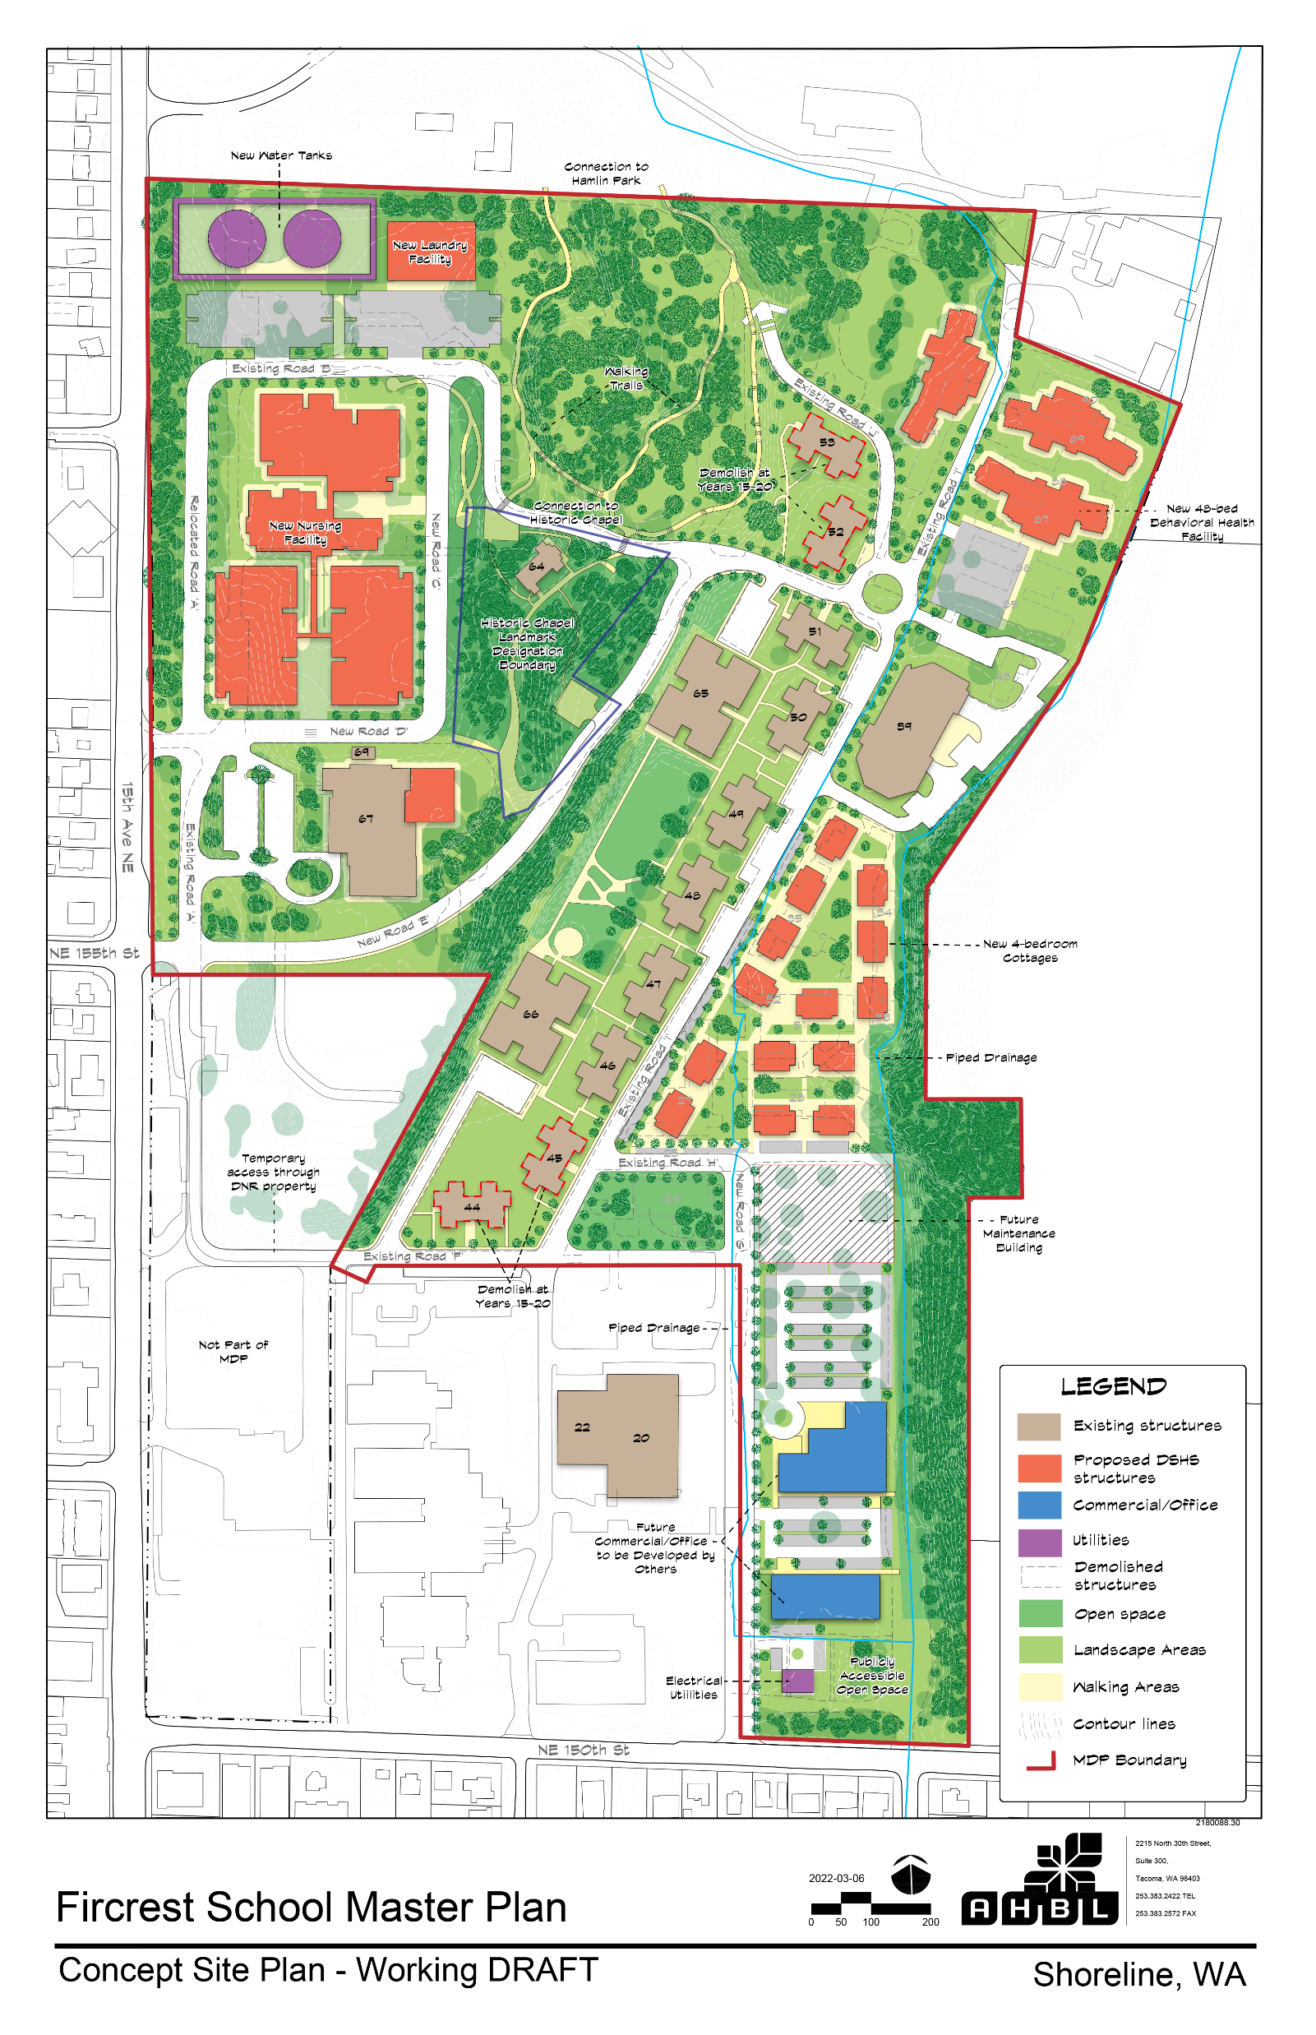
Site Development Plan
20-year Site Plan
Building and circulation locations are approximate
Southwest corner not included in Master Plan
Notes:
Brittany
Slight modifications to buildings and internal circulation (10%)
Access on 15th and 50th will be fixed through this process
New and existing, walking trails, buffers, circulation.

Slide 18
Northwest Quadrant
New Nursing Facility
New Water Tanks
New Laundry Facility
New Walking Trails
Historic Chapel
Activities Building (Building #67)

Slide 19
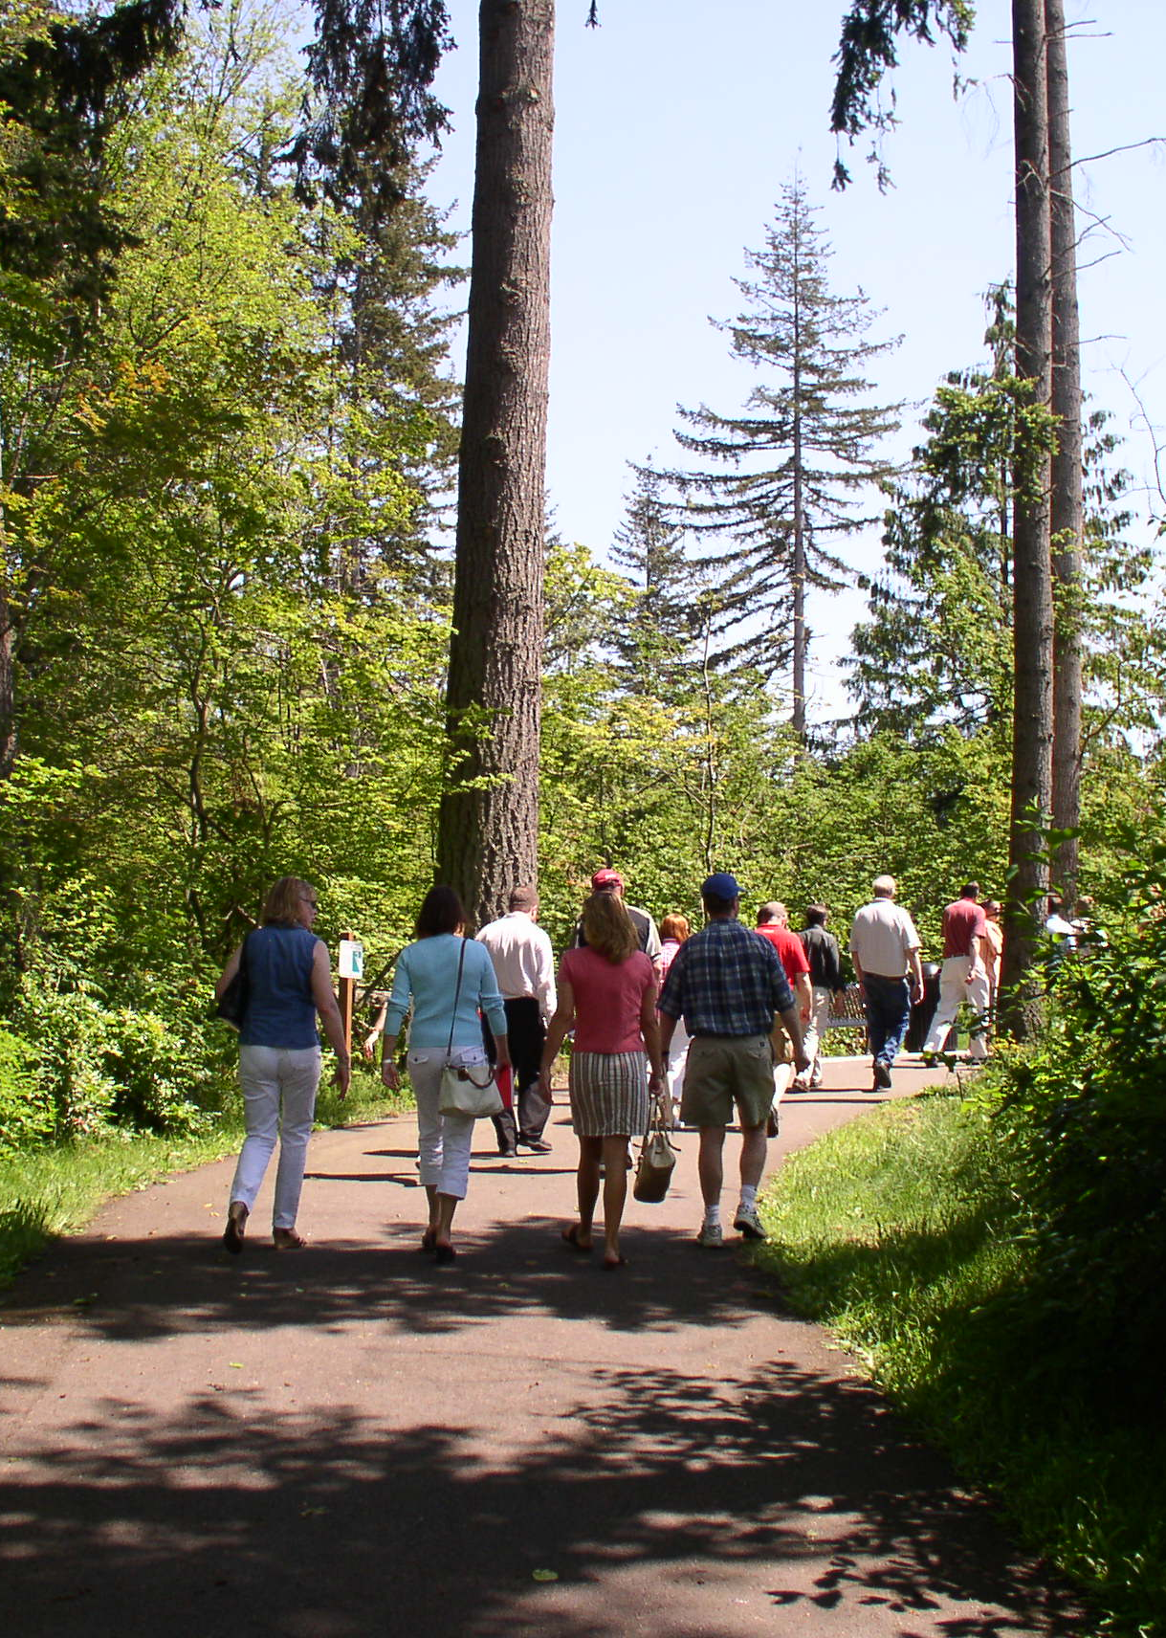
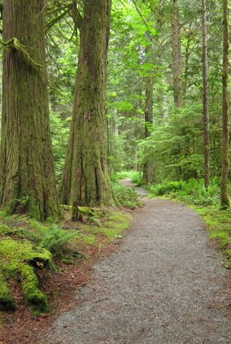
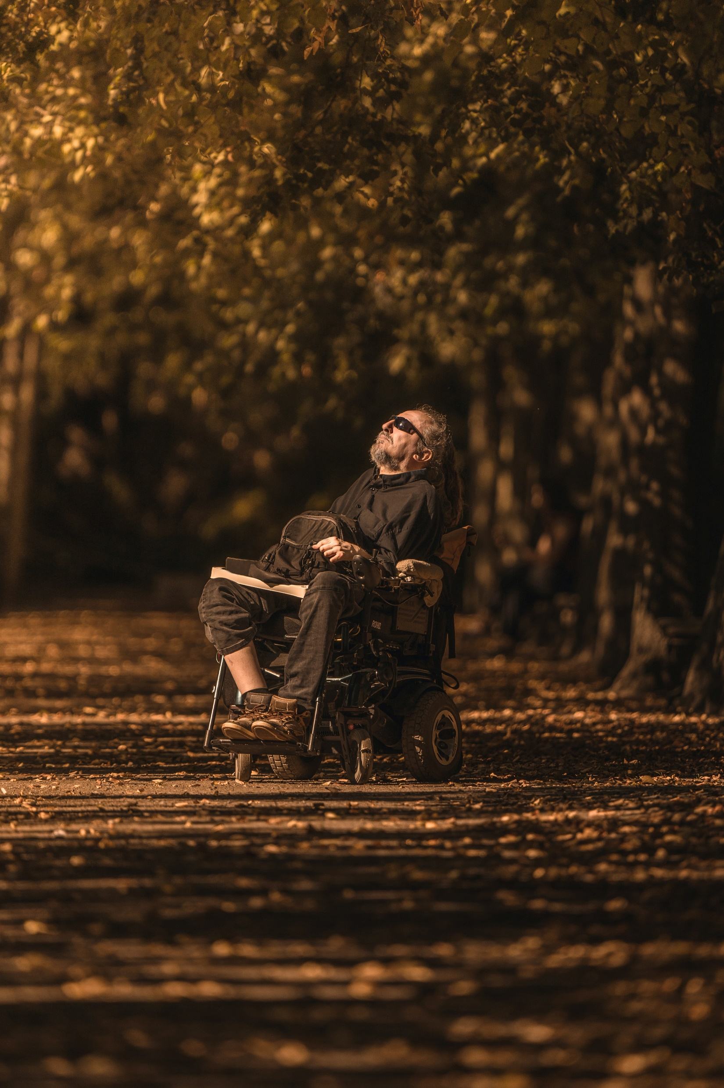
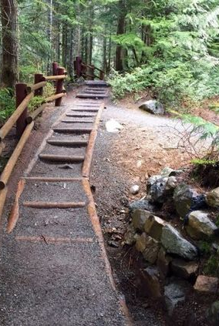
Character Images of Walking Trails

Slide 20
Northeast Quadrant
New Behavioral Health Facility
Demolition of Adult Training Program building
Demolition of ICF cottages #52 and #53 (15 to 20-year horizon)

Slide 21
Central Campus Quadrant
Construction of new 4-bedroom ICF cottages
Demolition of old ICF cottages #44 and # 45 (15 to 20-year horizon)
New Maintenance Building
Notes:
Intermediate Care Facility

Slide 22
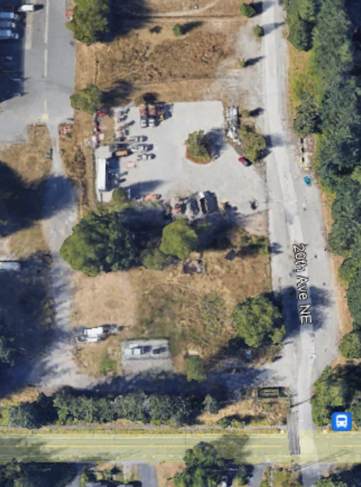
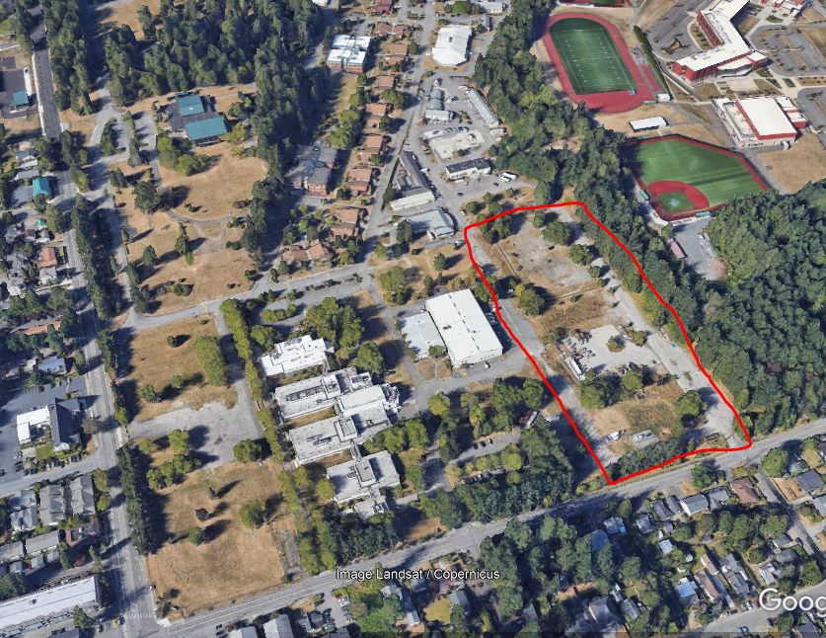
Southeast Campus Quadrant
Notes:
BOB TO DO FIRST THREE SLIDES - HERE ARE MY PRELIMINARY TALKING POINTS WHICH SHOULD BE CHECKED WITH TEAM/LARRY: The SE parcel – has no foreseeable plans for campus facilities, thus the thought here is that the land could be developed and leased by others. Thus, the list of permitted uses and development standards are key to providing economically viable options future revenue for the trust combined with uses that are compatible both with the campus and surrounding neighborhoods. MAYBE WE POINT OUT ELECTRICAL FACILITIES, DNR CAMPUS…..NOT SURE WE WANT/NEED TO EVEN MENTION THE DOG PARK?

Slide 23
SE Parcel Market Context
Residential - Market demand for this site and entire region is greatest for residential development
Professional office – Speculative office development unlikely here, but an owner-user, non-profit, or other unique use case could be opportunities
Retail – Poor visibility & access of site make retail very unlikely to be proposed on a standalone basis
Notes:
Seattle-based real estate advisory and investment firm “Heartland” is supporting the team on market issues – particularly related to any excess lands on the campus

Slide 24
Envisioned Permitted Uses
Same as current Fircrest Campus uses, except changes are tracked:
State-owned/operated office or laboratory
Medical-related office or clinic
Nursing facility
Church, synagogue, temple
Housing for disabled persons
Child & adult care services
Library
Personal services
Social services provider
Recreational facility
Research development & testing
Light industrial
Food storage, warehousing & distribution (primary use)
Professional office
Parks & trails
General retail trade, services
School district support facility
Veterinary clinic & hospital
Notes:
Bob to quickly go through list & highlight what has changed.
To add Heartland’s thoughts:
1 - In general, we encourage more flexibility rather than less in allowed uses to ensure the broadest range of possible respondents to an RFP.
2 – Retail/trade/services - as long as the allowed uses under the “general retail trade / services” definition don’t risk incompatibility with DSHS, seems fine to us to include

Slide 25
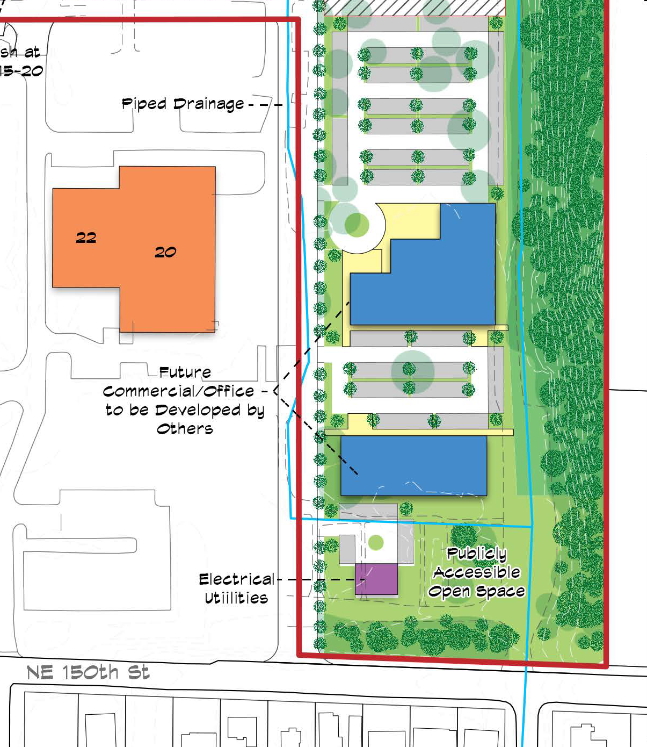
Southeast Campus Quadrant
Future Commercial/Office Development
Publicly accessible open space
Notes:
KATY

Slide 26
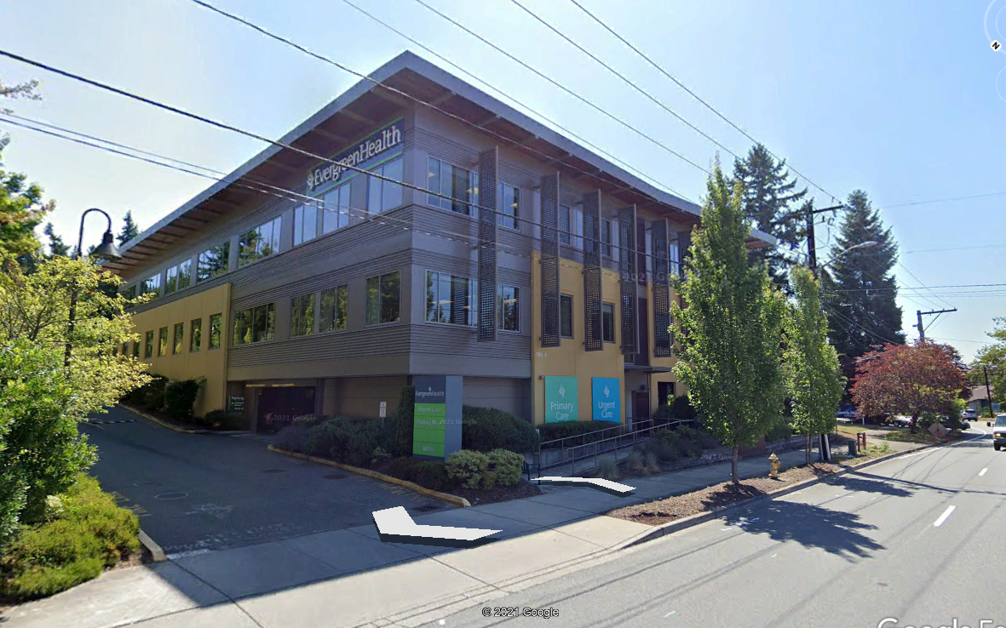
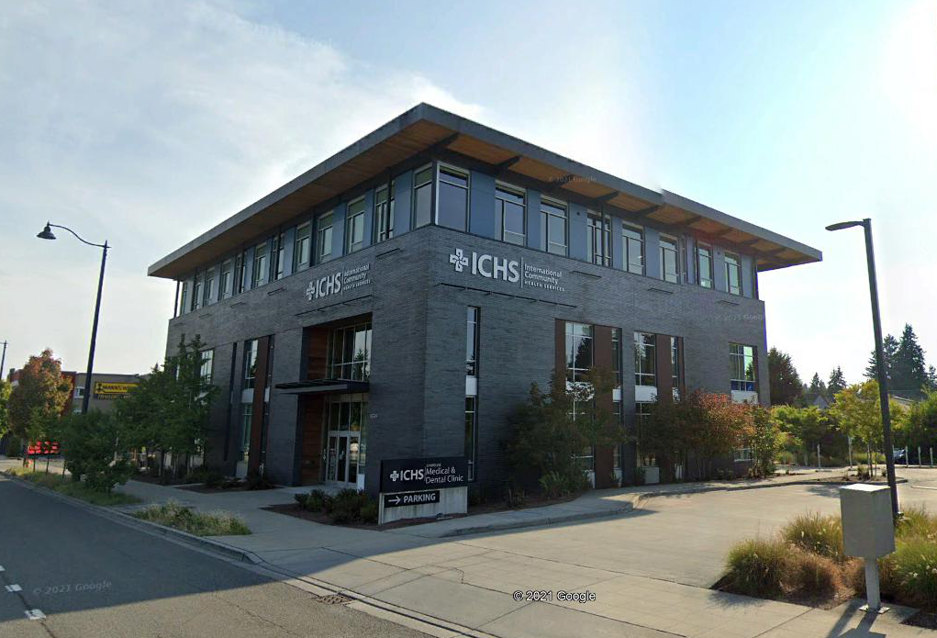
Use & Character Examples
Medical office buildings
Notes:
Bob to take this next slides

Slide 27
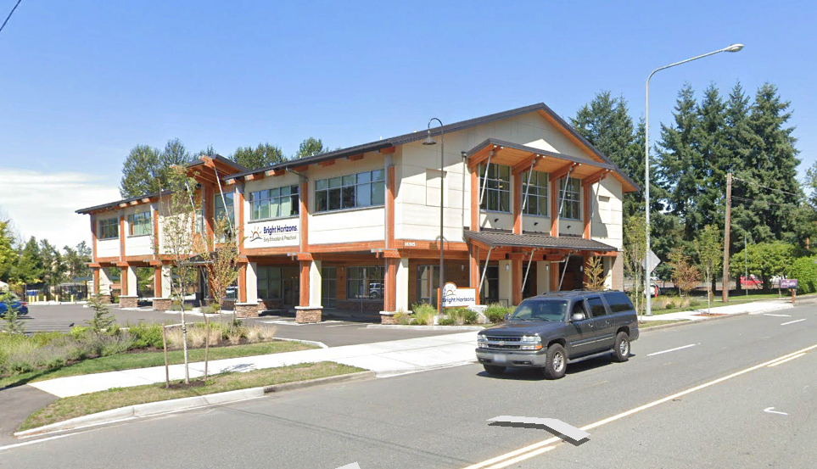
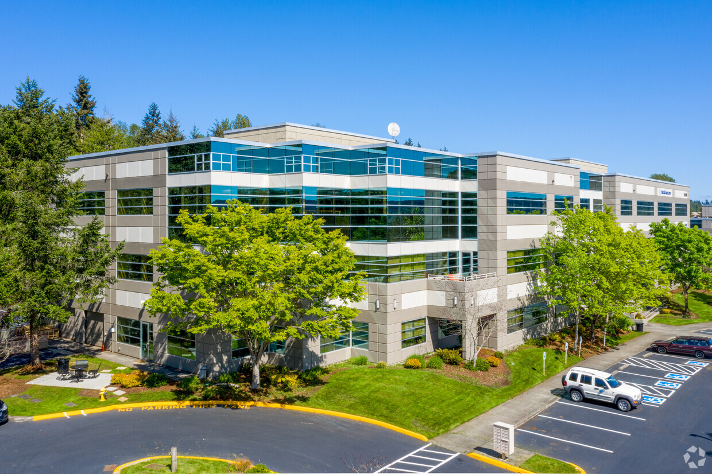
Use & Character Examples
Early education/pre-school
uses like this seem more likely
Large corporate office - perhaps too big to fit on site

Slide 28
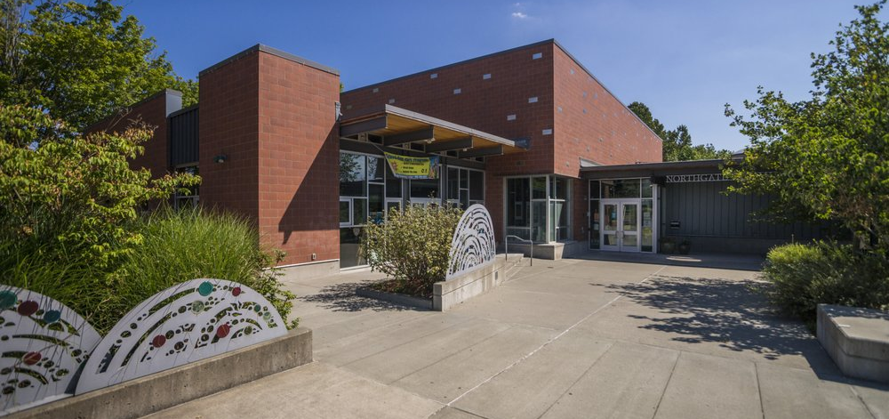
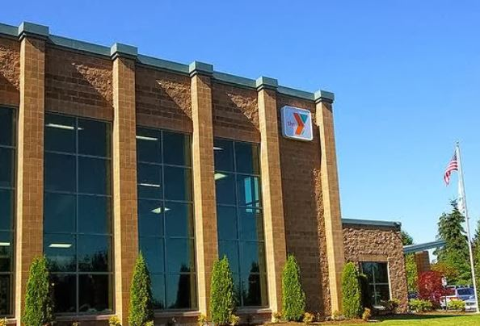
Use & Character Examples
Community-related uses
Notes:
Community-related uses – Northgate Community Center left image and Mill Creek Family YMCA, right image

Slide 29
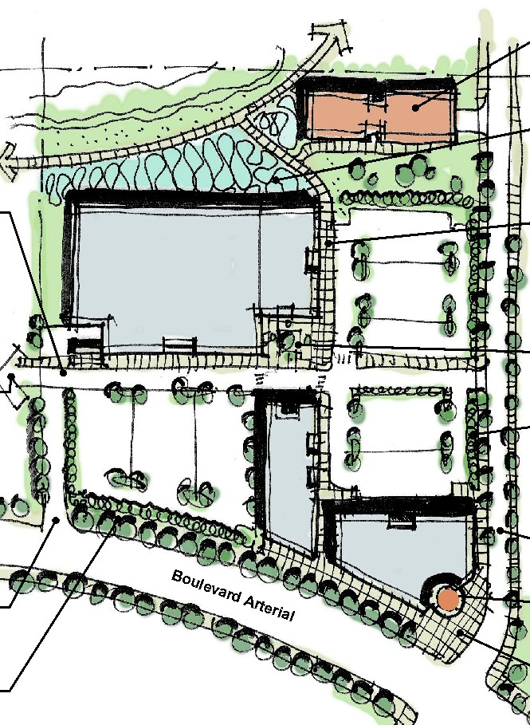
Design Standards
Design character & sustainable design
Site layout and access
Building design
Landscaping
Notes:
It’s expected that design standards will be developed with this MDP – these will address the same set of issues at citywide design standards – but if approved by City, would supersede those standards as they will be crafted specifically for this campus
Sustainable design – required to be at least LEED on all developments (already required for State-funded developments)

Slide 30
Procedural/Timeline Questions?
Notes:
Brittany/Helen
Process/timing questions.
Questions directed at DSHS

Slide 31
5 Minute Break
Notes:
Helen to create breakout rooms
1) Larry C/Jeanne R (scribe)/Kari F (DNR)/ Steve S (City)/
2) Brittany P/Andrew L (scribe)/Carrie N (DNR)/ Jim H (City)
3) Wayne C/Dean P (scribe), Lisa P (DSHS/Fircrest)
4) Katy S/Ian C (scribe)/Andrew B (City)
5) Bob B/Upkar M (DSHS/Fircrest)/Scott B (scribe)/
6) BHA Breakout room: Sjan Talbot (host), Bob Hubenthal, Jeneva Cotton, Jenise Gogan, Dean Heglund, Brian W (DSHS/BHA), Megan Celedonia will be the scribe,

Slide 32
Small Group Discussions

Slide 33
Staying Engaged
Project website: https://www.dshs.wa.gov/dda/fircrest-school-project
Project Email Address: FircrestSchoolProject@dshs.wa.gov

