Slide 1
The Person- Centered Perspective
Module A

Slide 2
What does it mean to be Person-centered

Slide 3
Click on the picture below to find out……

Slide 4
Think about yourself…..
What are the things that are important to you in your life? How do you make that happen for yourself? Do you rely on anyone else to make it happen?
A time when you were told you were important, but others’ actions told you otherwise
A time when you had the experience of really being put “first” and having your needs and preferences considered

Slide 5
Think about someone your agency supports…..
What do you think is important in their life? How do they get that? What do you notice about it in comparison to your experience?
What does your agency do to support people to have lives that are important to them?
Where do you do a good job at ensuring the client is the focus and supports are built to meet their needs and preferences?
What is one thing you can change to become more person-centered?

Slide 6
Let’s take a look at the values in action (click below)

Slide 7
Key Points to making a Person-Centered Plan
1. Start with the person – help them figure out what they want in their life
2. What supports are needed to get what they want?
3. What capacities does the person already have to get some of these needs met without paid supports?
4. What supports can you provide to enhance the life they desire?

Slide 8
Consider…..
Why is person-centered planning important?
How do you know if a plan is truly person-centered?

Slide 9
Using the Tools (click below)

Slide 10
Using a Person-Centered Approach
A person-centered process is more than just putting the person’s name at the beginning of each sentence
There is the difference between a process and forms – a person centered approach is more than just completing certain forms or posters

Slide 11
Ask yourself…..
How do you ask people what they want in a way that invites them to share?
How do you encourage and support the desired future for people you support?
How do you help people to find their voice and share their thoughts?

Slide 12
Tools
There are a variety of tools that you can use to help the person identify their strengths, capacities, and what they want in their life to be more meaningful.
A plan is not useful unless it has action to it! The plan should result in goals and develop specific action plans that help the person reach their desired life
Several of the tools are given as examples later in this training
You don’t have to use every tool, and you may find others that work better

Slide 13
The examples used in this training include some tools which you can use – it is not a complete list, nor do you need to use ever tool when doing Person-Centered Planning
This is not an all-inclusive list nor an endorsement of any particular products.
The links below are provided to give you a starting point for some available information
For more information, please visit:
http://www.helensandersonassociates.co.uk
http://sdaus.com/toolkit
http://mylifeplan.guide

Slide 14
Residential Service Guidelines
Washington has promoted the benefits of the “Residential Guidelines” since 1988. These benefits continue to support DDA’s mission and core values today.

Slide 15
Residential Service Guidelines
As you look at these benefits; think about how a person-centered approach would help a person to experience these benefits
You can use these guidelines as broad areas to explore with the person areas where they may want to expand their experiences

Slide 16
Residential Service Guidelines
A Range of Experiences Which Help People Participate in the Physical & Social Life of Their Communities
Competence to manage daily activities and pursue personal goals
Health and Safety
Personal Power & Choice
Personal Value & Positive Recognition by Self and Others
Good Relationships with friends and relatives

Slide 17
Involving Others in Person-Centered Planning
The person being supported (the client) is the most important person to include in the planning process
A good way to remember this is:
Nothing about me without me
The more people involved who know and care about the client; the greater opportunity for a broad range of ideas and support
Involve anyone the client identifies as wanting to be involved. Consider: guardian, family, friends, staff who work with them
If it doesn’t make sense for everyone to attend a meeting; gather information by phone, mail, email or surveys

Slide 18
“Important To” and “Important For”
All of us strive for a balance between what is important to us and important for us.
It is essential to learn what is important to a person – they may tell us this, or you may see this in their actions.
What is important for a person includes things that help them become or stay safe and healthy; which may or may not be important to them.
Finding the balance means that our lives are not just about what we choose, but also what we know needs to happen for us to be safe and healthy.

Slide 19
Putting it in Practice
On a piece of paper, write down:
Things that are Important To you:
(Hint: think of those things you really enjoy, have prioritized in your life or budget, or you would be really upset without)
Things that are Important For you:
(Hint: think of those things that you know are good for you, but you have to push yourself to do or maybe aren’t doing as much or as well as you should)

Slide 20
In order to really understand who the person is and to build a useful tool, you should know:
Daily Routine – what is important to the person about their routine (eg. – drinking coffee before showering )
Capacities, gift & interests (so that these can be built upon)
What works for the person (so you can do more of it)
What doesn’t work (so you don’t include in the plan or list as something to avoid)

Slide 21
One-Page Profile
One really useful tool is a one-page profile that document’s some of the most important information for a person such as their likes (preferences), dislikes, skills & abilities, communication style and goals.
The process to get information and know what is important to put on a one-page profile may take some work to discover who the person is and what is important to them / to know when working with them.
The person should develop it, or be as involved as they can in developing it whenever possible.

Slide 22
One-Page Profile
This profile can be a part of the IISP, and if using the suggested template; it is the first page of the IISP.
It should, of course, include accurate information unique to the person.
It is a great starting point for determining areas of focus, matching and teaching staff to work with the person, and developing plans.
This tool should be revised and updated as you learn more with the person and as they change!
The following slides are a few examples of One-Page Plans

Slide 23
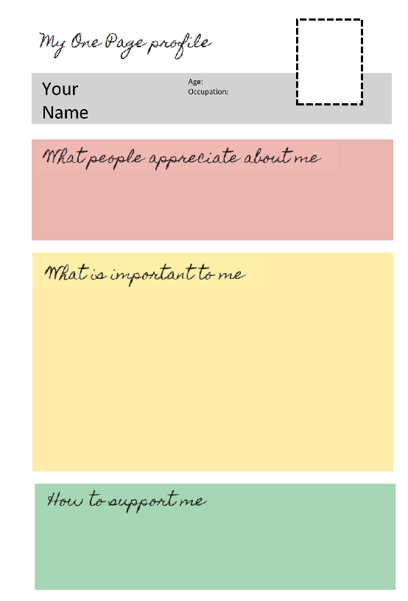

Slide 27
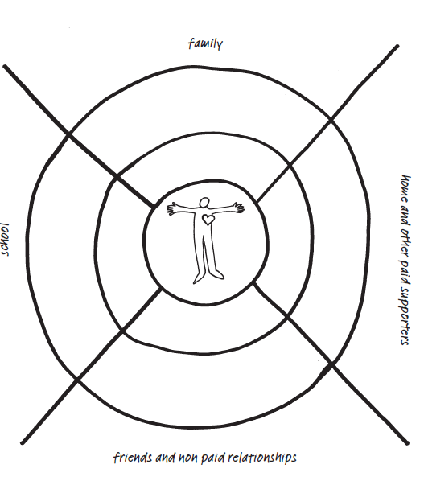
Circles of Support / Relationship Circle
This tool can be helpful to see who is important in a person’s life, determine if there are issues around relationships, or identify relationships to strengthen or support
To complete the diagram:
Write names of people who are closest in each category closest to the person. Those not as close go in outer rings / outside of circle

Slide 28
Putting it into Practice….
Draw the diagram for yourself listing the people in your life
Now complete this diagram for someone you support

Slide 29
- How do the relationship maps look different? - Do you have as many paid people in your life? Family? Close relationships? - Are there opportunities to expand on relationships?
Look at the diagrams you completed:

Slide 30
What’s Working
Another approach to use is to make a chart to look at what is working and is not working from different people’s perspectives. This can serve as a bridge between what was learned in looking at important to / important for and developing an action plan. It can look something like this:
What’s Working | What’s not working
What needs to happen next to build on what’s working & change what’s not working?
Person’s Perspective
Family’s Perspective
Staff’s Perspective

Slide 31
Putting the Plan into Action
The purpose for making a plan is to create action!
Through this plan, you have helped the person to:
identify what they want more of in their life
Identify skills, capacities & interests
Identify potential barriers to getting what they want
Identify where / how they can contribute to family, friends and community
NOW – the action steps should be around what to do with this information – how to build on these interests & capacities, which will lead to a more meaningful life.
From this, goals will be set.

Slide 32
The Person’s GOALS
The term “goals” gets used often with different meanings
In relation to person-centered planning; we are talking about those things the person wants – other frequently used term is “Desired Outcomes”
A good goal / outcome:
Is personal – not expressed from a service perspective
Is something that person has influence or control over
Is measurable and specific
Note: there may be an obstacle to overcome to reach goal / desired outcome – when that is the case, focus may be on removing the obstacle or barrier

Slide 33
Getting to the heart of the Goal
Ask these questions about each stated goal to clarify what the person wants & why they want it
If you got your goal –
What would it give you?
What would it do for you?
What would it make possible for you?
Where, when & with whom do you want it?
This helps clarify the focus to be on what is most important to the person, and may help to write the goal in a way that is specific and measurable

Slide 34
What to focus on to achieve GOAL
Once goals are clear – look at what it will take to reach it
Ask –
What do I need to learn to accomplish this goal?
What resource do I need to accomplish this goal?
What item or activity do I need / would I do to accomplish this goal?
Designate who will be responsible to support the resources, activities, or learning activities
NOTE: Not all goals will necessarily be supported by a residential agency (some may be the person’s, family’s, other supports)

Slide 35
Examples
Bob wants to get a job working at a nice restaurant
Resources needed:
Food Handler’s card
Transportation
He needs to learn:
Interview skills
Basic food handling facts (to get permit)
Etiquette skills
Transportation routes to job
To achieve this goal, Bob’s team can support him by first learning some of the skills needed to get and keep a job and obtain needed resources

Slide 36
Examples
Maria would like to take the train by herself to visit her family
Resources needed:
$350.00
Cell phone to call in case she needs help
………………………………………………
She needs to learn:
How to find & schedule a train ride and purchase the tickets
What she can pack
How to find her seat on the train
Personal safety skills – what to do if a stranger approaches her
………………………………………………
To achieve this goal, Maria’s team can support her to learn skills needed, assist to plan & save money for the trip and obtain resources

Slide 37
IISP Goals
Residential providers are required to develop an IISP which has a certain number of goals that will be supported by the residential staff
Goals identified through PCP planning process get recorded on the ISP
Goals in the person’s ISP for which the residential provider is responsible must be included in the IISP
Goals should be dynamic – changing as the person achieves the goal, as needed to facilitate goal achievement, and as requested
If you find the person is frequently “refusing to work on their goals” – that means that it is a good time to re-visit the person-centered planning process

Slide 38
Time for self-evaluation…
Think about how you / your agency gets this information
What is working that you want to keep doing?
What do you need to change?
What should you start doing?

Slide 39
Using what you have learned
Whether you and your agency have done person-centered planning for a long time, or if this concept was new to you – hopefully you gained some ideas on how to find out more about the person you work with and help them find what is important to them, how they want to be supported, and how they want to live.
However you document this information; the most important thing is that you USE the information when developing plans and supporting the person

Slide 40
The Next Steps….
After completing this training, you can register for the IISP training modules.
When you attend this training; you should bring the following things for one client that you will use throughout the remainder of the courses in developing their IISP and measured goals:
A copy of the current ISP
Person-Centered information that you have gathered
Current IISP (if any)
Be sure you have their consent to bring this information, which will be treated confidentially. Alternatively, you can redact the information before the class

Slide 41
Questions / Contact Info
If you have questions about the IISP training modules, please email Sandi Miller, Residential Quality Assurance Coordinator:
millesj@dshs.wa.gov

