Slide 1


The Buzz on Adult Learners!

Slide 2
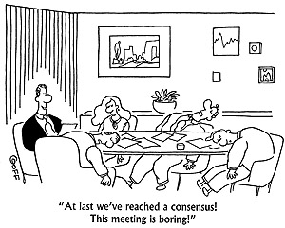
Train the Trainer

Slide 3
Purpose
In order to be the most effective trainer you can be, it is imperative that you understand how adults learn and how to structure a training experience that will transform the lives of those you support within Developmental Disabilities Administration.

Slide 4
Learning Objectives
Demonstrate principles of Adult Education
Apply three learning styles to training
Engage participants through interactive learning
Respect and value cultural, generational and gender learning style differences
Integrate effective facilitation into training
Produce participants who can repeat what they learned two weeks after they were trained

Slide 5

What’s the buzz?
Relevant
Immediately useful
Engaging
Respectful
Address multiple learning styles
Acknowledge what people already know
Shows awareness of generational differences

Slide 6
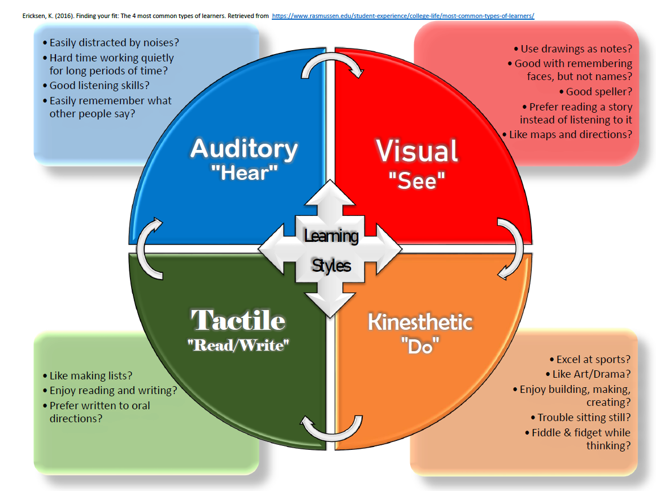
Learning Styles Activity

Slide 7
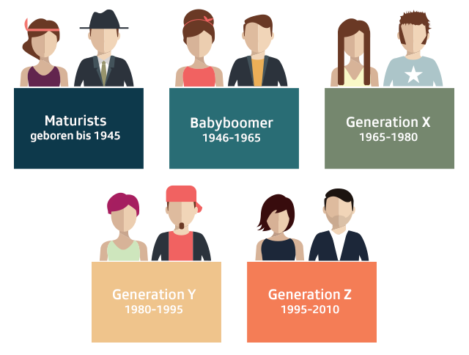
Considering Generational Learning Differences

Slide 8


Alike but different
Gender

Slide 9
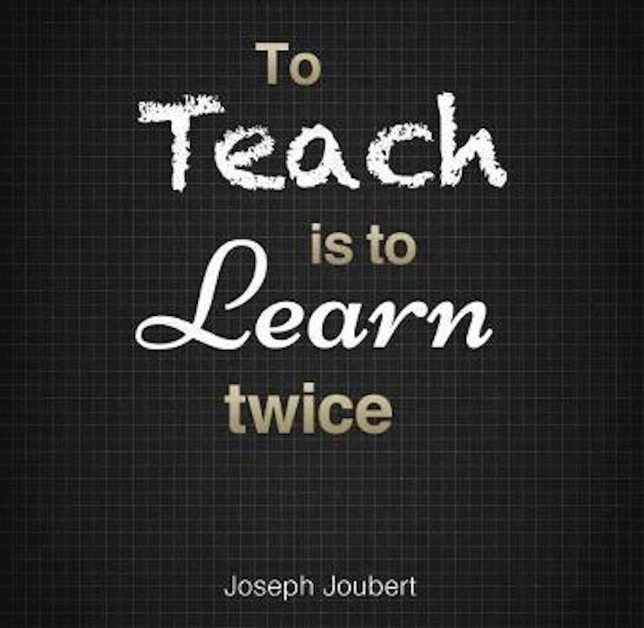
Best Practices for Teaching
Mental Set or Hook
Instruction
Modeling
Guided Practice
Independent Practice
Checks for Understanding
Evaluation

Slide 10

The Hook

Slide 11
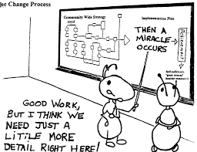
Modeling

Slide 12

Instruction

Slide 13
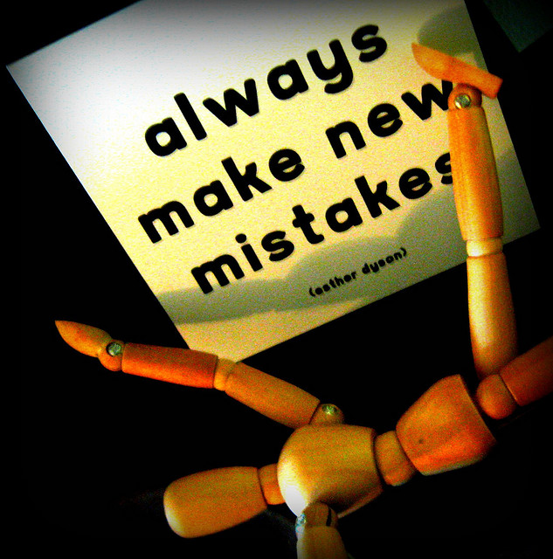
Guided Practice

Slide 14

Independent Practice

Slide 15

Evaluation

Slide 16
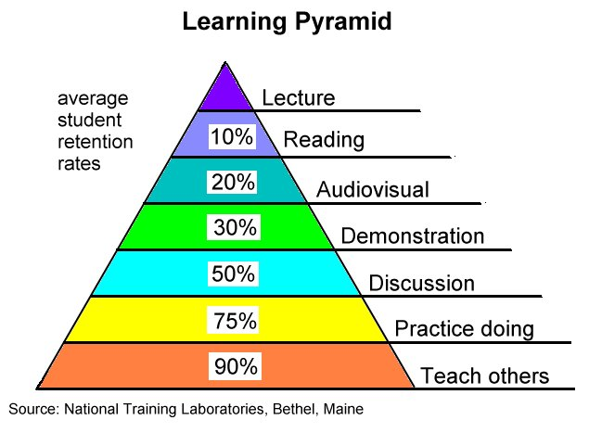
Check for Understanding

Slide 17
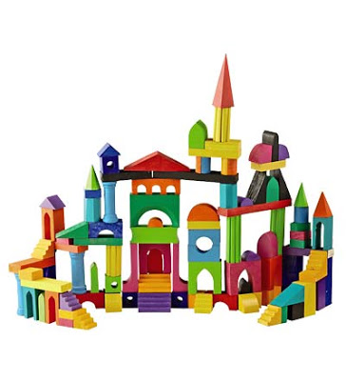
Activity
In small groups of 3-4 grab a bag of blocks. As a team you will build a tower
The tower should be as tall as you can make it without knocking it down.
It should have:
  one window and one door
  Two distinct roof lines
  Three stories at a minimum
  It must rise up off of the table
  Use all of your blocks
  You may not borrow blocks from other teams.

Slide 18
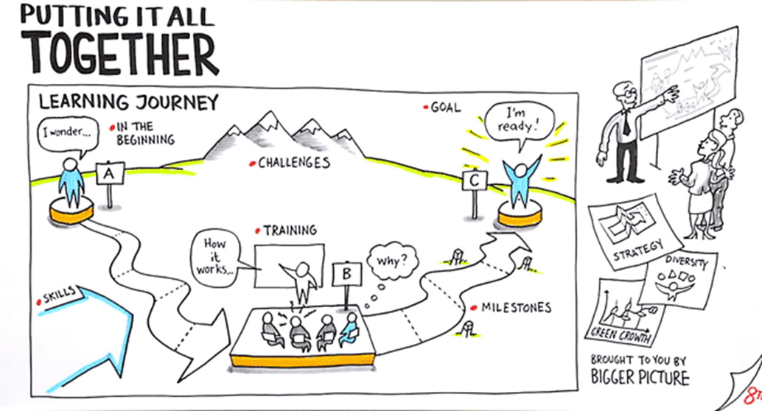
Graphic Facilitation

Slide 19

What competencies do I need to achieve as a Trainer?

Slide 20


Sarah Blanchette
Residential Services Training
Program Manager
360-407-1540
BlancSR@dshs.wa.gov

Slide 21


Trainer Responsibilities
CRS Training
Questions:
Sarah Blanchette
Residential Services Training
Program Manager
360-407-1540
BlancSR@dshs.wa.gov
Notes:
Review the handouts.

