Slide 1

2022 Child Support Order Review
Presented
March 10, 2023
John Mallea – DSHS/ESA/EMAPS

Slide 2

Introduction:
John Mallea – DSHS/ESA/EMAPS
2022 Child Support Order Review
Report Summary Pages 3 and 4
  Highlights of the Report

Slide 3
Purpose for the Review:
45 CFR 302.56 requires the state to review the child support guidelines every four years
RCW 26.19.025 describes that Division of Child Support shall convene a workgroup to:
  Review the child support guidelines
  Review the Child Support Review Report
  Review data required
  Determine if the application of the child support guidelines results in appropriate support orders

Slide 4

Creating the Sample (1):
  Universe of Orders: 93,662 Washington Orders entered between 8/1/2018 – 07/31/2022
  Types of orders:
    Court
    Administrative
  Sources of orders:
    Active and formerly active cases
    Payment Services Only cases
    Federal Case Registry cases
  IVD vs Non-IVD

Slide 5
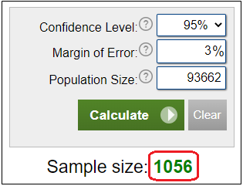
Creating the Sample (2):
  Sample Size Calculator
  95% Confidence Level
  ±3% Margin of Error
  Random sample of 1056 orders

Slide 6

Order Review:
Support Enforcement Officers (SEO)
  All volunteers
  Read each order and worksheets
  Answer questions about orders
    Appendix II
  Online Tracking Tool
  1,038 valid reviews completed

Slide 7
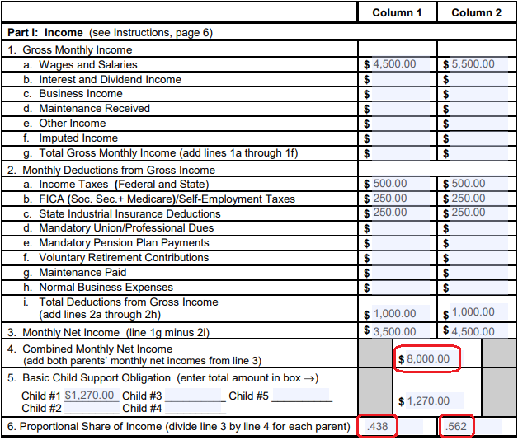
Worksheet Basics – Part I:

Slide 8
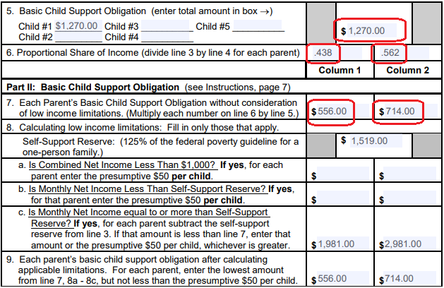
Worksheet Basics – Part II:
Basic Child Support Obligation without consideration for low income defined for each parent (Line 7)
Low Income limitations are considered via Self Support Reserve (Lines 8a thru 8c)
Basic Child Support Obligation with consideration for low income defined for each parent (Line 9)

Slide 9
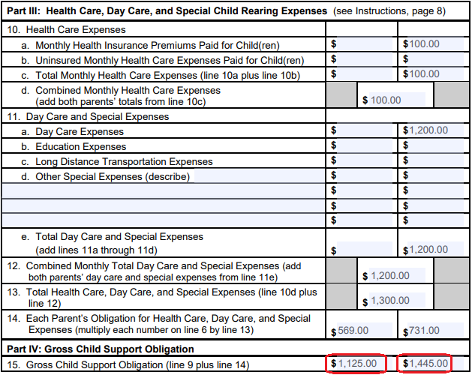
Worksheet Basics – Part III and Part IV:
Part III:
  Monthly Health Insurance premiums
  Uninsured Monthly Health care Expenses
  Day Care Expense
  Education Expenses
  Long Distance Transportation Expenses
  Other Special Expenses
Part IV:
  Creates Gross Child Support Obligation

Slide 10
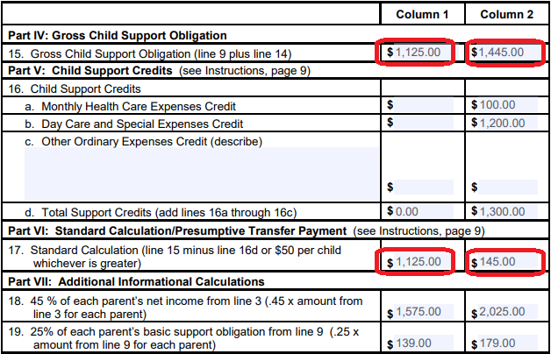
Worksheet Basics – Part V, VI, VII:
Part V calculates Credits:
  Monthly Health Care Expenses
  Day Care and Special Expenses
  Other Ordinary Expenses
Part VI:
  Creates Standard Calculation/ Presumptive Transfer Payment
Part VII
  Additional informational Calculations

Slide 11
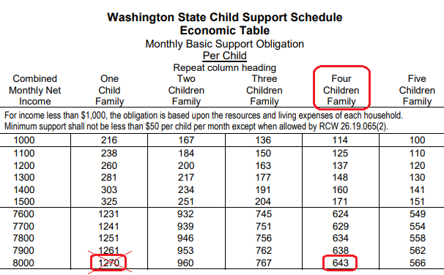
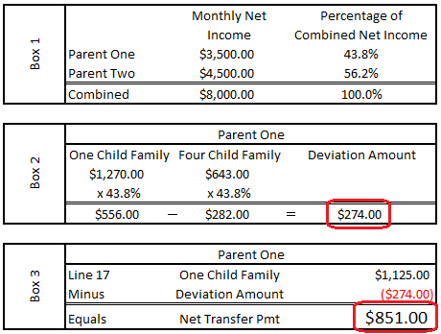
Deviations (Whole Family):

Slide 12
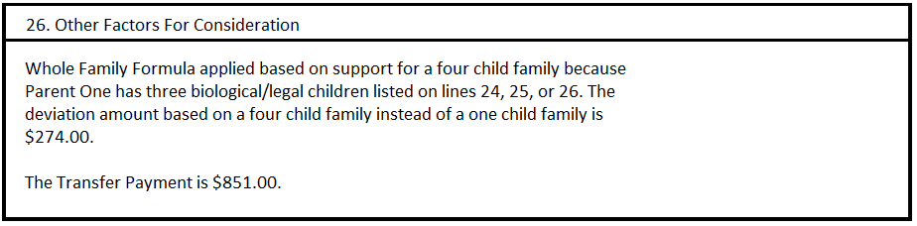
Deviations (Whole Family):

Slide 13
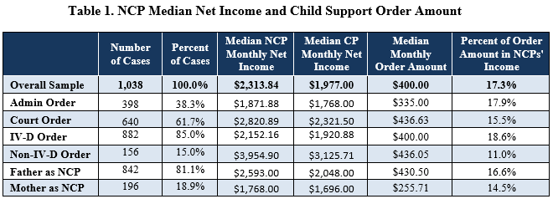
Exploratory Data Analysis:

Slide 14
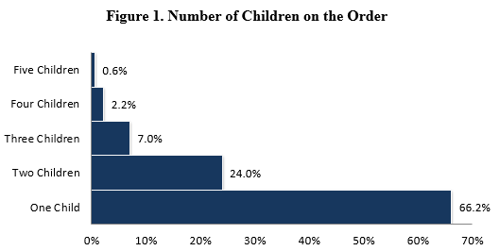
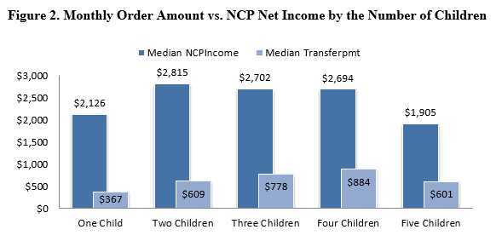
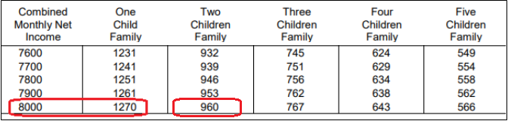
Exploratory Data Analysis:

Slide 15
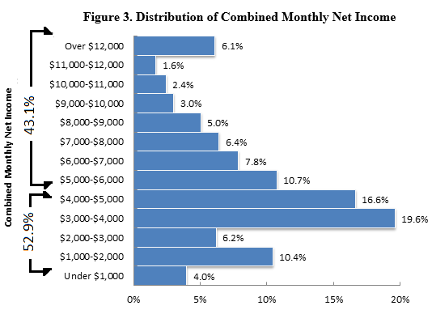
Exploratory Data Analysis:
Combined Monthly Net Income (CMNI):
52.9% of orders between $1000 and $5000 CMNI
43.1% of orders have CMNI greater than $5000
89.9% of orders have CMNI in the range of WSCSS Economic Table
10.1% of orders have CMNI below $1000 or greater than $12000
43.1% use actual income for both Parties

Slide 16
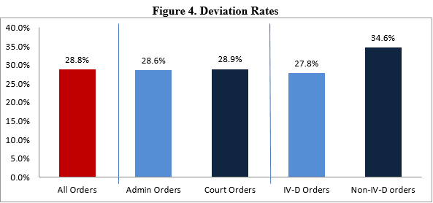
Deviation:
Reasons for Deviation - RCW 26.19.075:
Sources of income and tax planning (including nonrecurring income)
Debt and high expenses
Residential schedule
Costs incurred in reunification efforts
Children from other relationships
Unjust to apply the presumptive minimum payment
Unjust to apply the self-support reserve

Slide 17
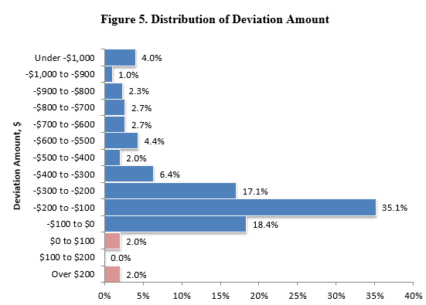
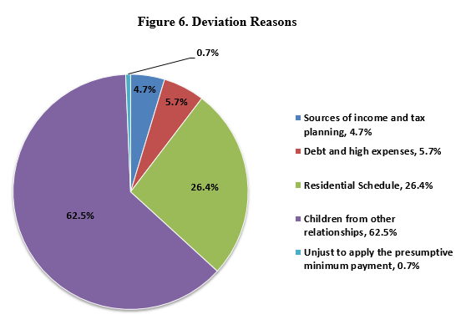
Deviation continued:

Slide 18
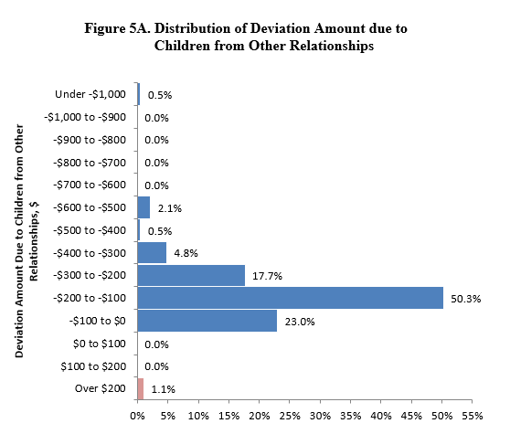
Deviation continued:
Children from other relationships:
73.3% of downward deviations were $200 or less.
95.7% of downward deviations were $400 or less.
2.7% of downward deviations in $400 - $600 range.

Slide 19
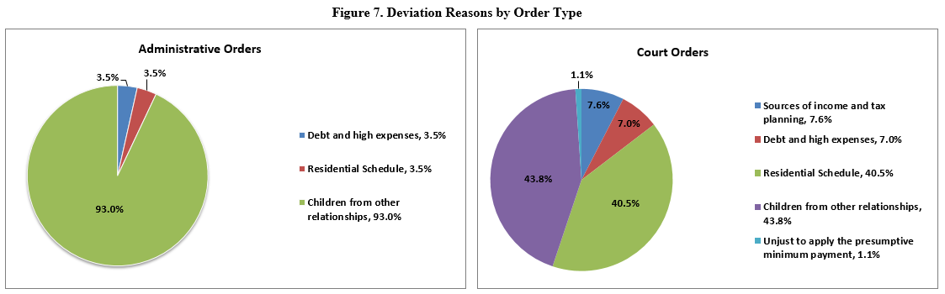
Deviation continued:

Slide 20

Adjustments:
Presumptive minimum obligation is $50.00 per month per child
Self-Support Reserve = 125% of federal poverty level for a one-person family
  2023 SSR = $1519.00 per month
45% Limitation
Health Care, Daycare, Special Expenses
Child Support Credits
Income above the Economic Table amounts

Slide 21
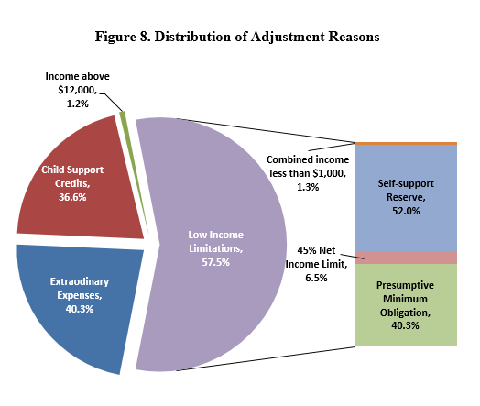
Adjustment Reasons:
402 orders contained Adjustments (38.7% of the 1038 Orders reviewed)
  41.2% of Administrative Orders
  37.2% of Court Orders
  60.4% of Orders adjusted for single reason
  39.6% of Orders adjusted for 2 or 3 reasons
  36.6% adjusted for Child Support Credits
  40.3% adjusted for Extraordinary Expenses
  1.2% adjusted as CMNI exceeded $12,000
  57.5% adjusted for Low Income Limitations
Low Income Limitations:
  Self-Support Reserve was 52.0%
  Presumptive Minimum Obligation was 40.3%
  45% Net Income Limitation 6.5%
  Combined Income less than $1000 1.3%

Slide 22

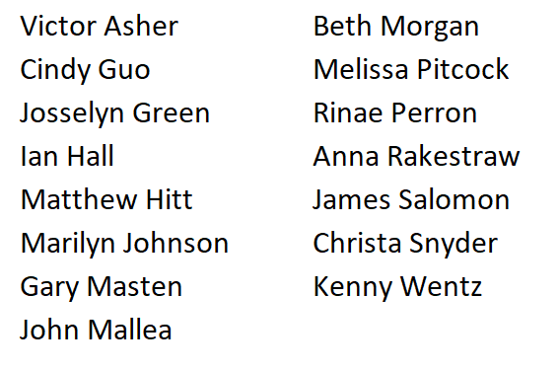
Contributors:

