Slide 1

Open Public Meetings and Records
February 24, 2023

Slide 2
Open Public Meetings Act
RCW 42.30
Public agencies exist to aid in the conduct of people’s business and actions/deliberations should be open.
All meetings of the governing body of a public agency shall be open and public and all persons shall be permitted to attend any meeting except as otherwise provided in law.
An email exchange can constitute a meeting.

Slide 3
The Public Records Act
RCW 42.56
All records of an agency are subject to disclosure.
Agencies must respond promptly and provide fullest assistance to requestors.
Agencies must have a specific exemption/statute to redact or withhold any information.
Records from this workgroup are subject to disclosure thus supportschedule@dshs.wa.gov
Notes:
RCW 26.23.120
RCW 74.04.060

Slide 4






What is a public record?
Any writing containing information relating to the conduct of government or the performance of government function…
…Writing includes pretty much anything recorded for communication that is prepared, owned, used or retained by any state or local agency regardless of physical form or characteristics (RCW 42.56.010(3)).
Email
Text Messages
Sticky Notes
Photos
GPS Coordinates
Voice Recordings
Notes:
In Nissen, the Supreme Court held that an elected county prosecutor’s work-related text messages prepared on his private cell phone in his official capacity and within the scope of his employment were public records subject to disclosure under the PRA. 183 Wn.2d at 882-83, 888. The court rejected the argument that an agency employee can create a public record only when using agency property. Id. at 877. The court stated that “employees can use their own property and still be within the scope of their employment.”
In Vermillion, this court held that e-mails a Puyallup City Council member sent and received on his personal computer through a personal e-mail account were subject to disclosure under the PRA if they otherwise met the definition of a public record.
If an employee claims that information in personal accounts are not public records, he or she must submit an affidavit or declaration stating facts sufficient to support that claim. Nissen, 183 Wn.2d at 886.

Slide 5
Is it a public records request?
Yes
By any form or method including verbal
For identifiable records
For existing records
Even if confidential
“All my DSHS records” or “all with my name”
No
Requests for information
Not Yet Created
Discovery/Lawsuits
Sharing with workgroup

Slide 6
ESA Public Disclosure Unit (PDU)
The PDU processes public records requests for DCS. As a workgroup member you may:
Receive a call or email from the PDU asking for records
Have a question about public records
Receive a request for records from a citizen
  Immediately send that request to the PDU
  Remember verbal requests count!
ESAPRR@dshs.wa.gov
Mainline: (360) 725-4777

Slide 7
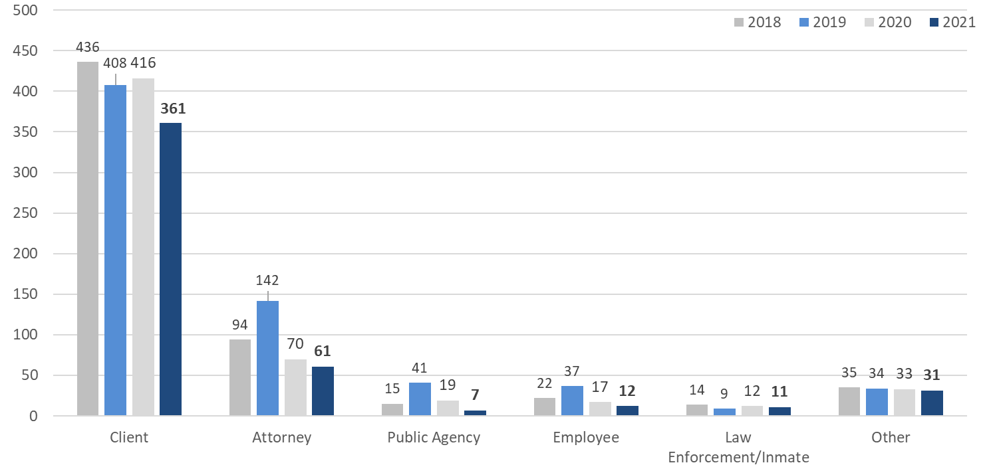
2021 – 2022 Requester Type for DCS
DCS received 546 public disclosure requests and 188 address disclosure requests in 2021. Clients and attorneys representing clients consistently make the most requests in DCS.

Slide 8

What questions do you have?
Contacts:
Marla Randall, ESA Public Records Office: 360-664-8908
Barbara Parry, ESA Risk Manager: 360-480-9044
Angel Vasilev, ESA Risk Mitigation Manager: 360-584-5333

