Slide 1

The Basics of Child Support for Employers
Division of Child Support
800-562-0479 (DCS Employer Relations)
www.childsupportonline.wa.gov
DCS-ERT@dshs.wa.gov

Slide 2



Slide 3

Agenda
Basic Understanding of Employer Responsibilities & Options
Recent changes in legislation and policy
EFT payment options
Resources
COVID Specific Scenarios
Q&A
Notes:
Washington State Child Support can be complicated and confusing.
Filling out required paperwork can be time consuming.
DCS can show you how to cut through the paper and respond quickly, saving you time.

Slide 4

Nationwide, child support lifts a million people out of poverty every year.
Notes:
Child support is an important source of income for these families. It lifts a million people out of poverty every year and represents, on average, 40 percent of the income of poor custodial parents and their children when they receive it.2 However, less than half of poor custodial families receive child support.
Department of Social and Health Services (DSHS) provides some type of shelter, care, protection and/or support to 2.2 million of our state's 6.8 million people.

Slide 5

You Make an Impact!
DCS receives over 370,000 payments each month
Employers account for 76.5% payments received
Nationwide – 14.7 Million Children served in 2018
Employers reduce WA tax burden by $137 million a year
FFY 2019 Collected $4.08 / $1 Spent
Notes:
Payments do not include IRS intercepts
1 of 5 children in the US served by child support enforcement
TANF – 1.8 Milion in 2018

Slide 6
Your Responsibilities
Report new hires and rehires within 20 days
Answer withholding notices within 20 days
Begin withholding next pay date
Remit within 7 days
Enroll dependents in medical plan
Notify DCS when employee stops working
Notes:
The withhold amounts are stated in the first page of the notice
It is broken down into the possible pay cycles:
Weekly
Biweekly (every two weeks)
Semimonthly (twice per month)
Monthly

Slide 7

New Hire Reporting
New Hire Reporting

Slide 8
New Hire Reporting
What is New Hire Reporting?
  ALL New Hired and Rehired employees must be reported within 20 days
  Rehired - Employees returning after more than 60 days or need a new W-4
Who is responsible to report?
  Employers (payroll service)
Why is reporting important?
  Timely enforcement of child support
  Saves millions in overpayments
Notes:
1.8 million reports annually
Information shared nationally
Easy, fast and free
BIG results
NH Fed Law is part of PWORA (AKA: Welfare Reform) of 1996. CFR 45.
WA State Statute is RCW 26.23.040
CS collections reimburse public assistance and help to reduce government spending by helping otherwise needy families stay off of public assistance.
New Hire information helps to detect and prevent fraudulent Unemployment Compensation and Labor and Industries benefits payments.
Fraudulent claims cost the state of Washington millions of dollars per year.

Slide 9

What To Report
Report the following employee data elements
    Name
    Address
    Social Security Number
    Date of Birth
    Date of Hire (the date the employee first works for pay)
  Report Employer information
    Name and mailing address
    FEIN
Notes:
Within 20 days of hire or rehire
If your first time, report everyone hired since your last quarterly reporting to ES
If the employee returning to work is required to complete a new W-4 form, or has been separated from your employment for at least 60 consecutive days, you should report the individual as a New Hire.
The fine for failing to report is $25 per newly hired employee. If the employer and employee agree not to report, the penalty increases to $500.

Slide 10
How to Report
Report within 20 days via:
Online Reporting:
  Internet: https://secure.dshs.wa.gov/dcsonline
  Upload large files, confirmation email
Fax: 800-782-0624
Phone: 800-562-0479
Mail: POB 9023, Olympia WA 98507-9023
Multi-State Notification: 410-277-9470
www.newhire.wa.gov
Notes:
Immediate and interactive feedback re: the correctness and validity of the data entered.
Optional confirmation email that may be used as a record keeping tool.
Savings on postage and media.
Immediate, more efficient processing of the information reported.
Good Customer Service through web-based documentation and email contact with the webmaster.
Access to a list of the last 6 months history of new hire reporting.

Slide 11
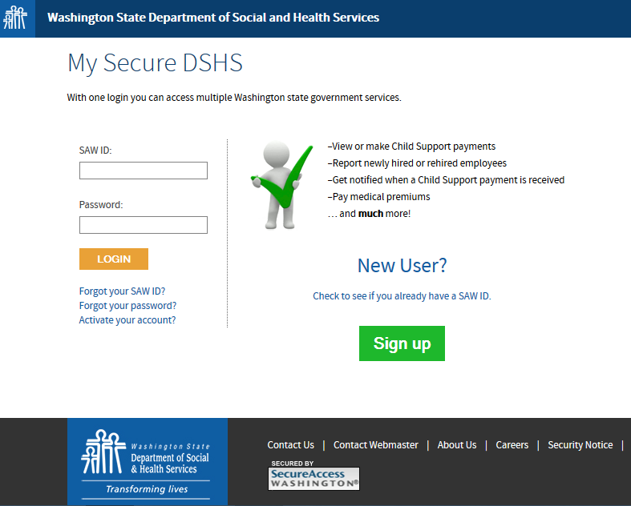
https://secure.dshs.wa.gov/dcsonline
Notes:
SAW login and sign up page

Slide 12
Frequently Asked Questions
Isn't this information available through quarterly wage reporting?
Quarterly wage data can be outdated by six months or more. With New Hire Reporting, information is available within 20 days

Slide 13
I am a Multistate Employer
Do I have to report to each state in which I have employees?
You may select one state where you have employees working to report all New Hires
  Online Multistate Notification Form: https://ocsp.acf.hhs.gov/OCSE/
  Call 410-277-9470
Notes:
There are other employer programs provided through ACF that we will touch on later.

Slide 14

I’m Not Sure if I Submitted Everyone
What should I do?
Submit all of the employees you hired or rehired since your last quarterly reporting

Slide 15

Oops, I Made a Mistake!
How should I fix it?
If it is the same day and through DCS Online, you can edit your report
In all other situations, just resubmit

Slide 16

New Hire Reporting
Questions?
www.newhire.wa.gov
dcshire@dshs.wa.gov
1-800-562-0479

Slide 17
Income Withholding
In this section you will learn:
  Child Support laws and requirements
  How to process and answer Income Withholding Orders
  Where and when to send withheld funds
Income Withholding and Medical Support
In this section you will learn:
  Child Support laws and requirements
  How to process and answer Income Withholding Orders (IWOs)
  Where and when to send withheld funds
  The basics of the National Medical Support Notice

Slide 18

Most child support is collected through income withholding when the non-custodial parent is working.
Notes:
The national child support program collects substantial amounts of child support every year. In FY 2010, it collected $26 billion. Wa collected $650 million.
Most child support is collected through automatic income withholding and thus the child support program works well for families in which the parent living apart from the children (referred to as a noncustodial parent) is steadily employed. The program is less effective for families when the noncustodial parent does not have a steady job.

Slide 19
Withholding Basics
Effective the day the withhold is received
Withhold from the next paycheck
Withhold on employer pay schedule
  Broken down on the notice
Withhold from net earnings
  Mandatory Deductions Only
Withhold amount up to 50% of net
Remit within 7 days

Slide 20
Day Labor Withholding Changes
Past: Withhold 50% daily until the monthly amount is withheld
Effective October 15, 2018:
Withhold 50% of their pay each day until the weekly prorated amount is withheld each work week

Slide 21

What About Bonuses and
Other Lump Sums?
Are addressed in the Order to Withhold
May not be required
Options to Report These Payments
https://www.acf.hhs.gov/css/employers/child-support-portal
Email: LSC@dshs.wa.gov
Call: 360-664-5246
Notes:
Payment arrangement can be due to a court order, agreement with the Support Enforcement officer or the Prosecuting Attorney
Only report bonuses for employees you are already w/h from

Slide 22

Information to Report
Employer name
Employer contact information
Employee names
SSN or case numbers
If known
  Bonus Amounts
  Payout Dates
Notes:
Please give us a week to review all of this
Again, only report those employees who already have w/h in place

Slide 23
What Has Changed?
Effective December 2017
One Income Withholding Order (IWO)per case
Federal mandate
Implementation by Employer
Can send in one response
Add up all of the withholding amounts
Send in one payment
Notes:
70% + of people only have one case,
Remember to apply the 50% limit

Slide 24
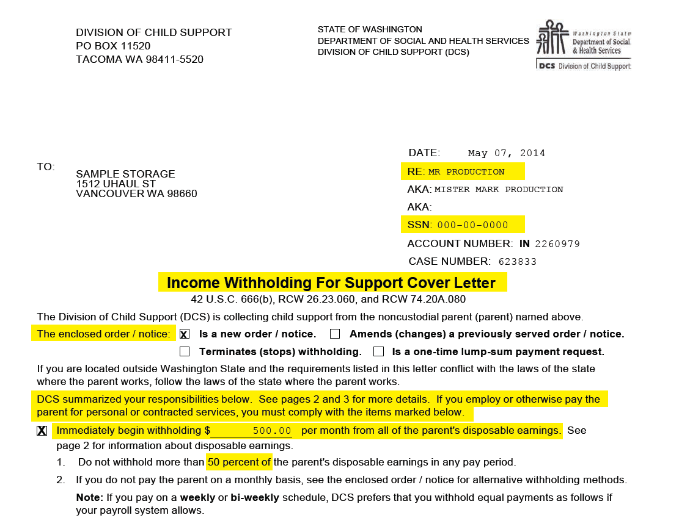
OLD Cover Letter
Notes:
DCS used to issue one IWO for all cases combined. Now we issue one IWO per case. Easier to track your withholding by case. Most states have been doing IWOs this way for a long time, so it is the standard.

Slide 25
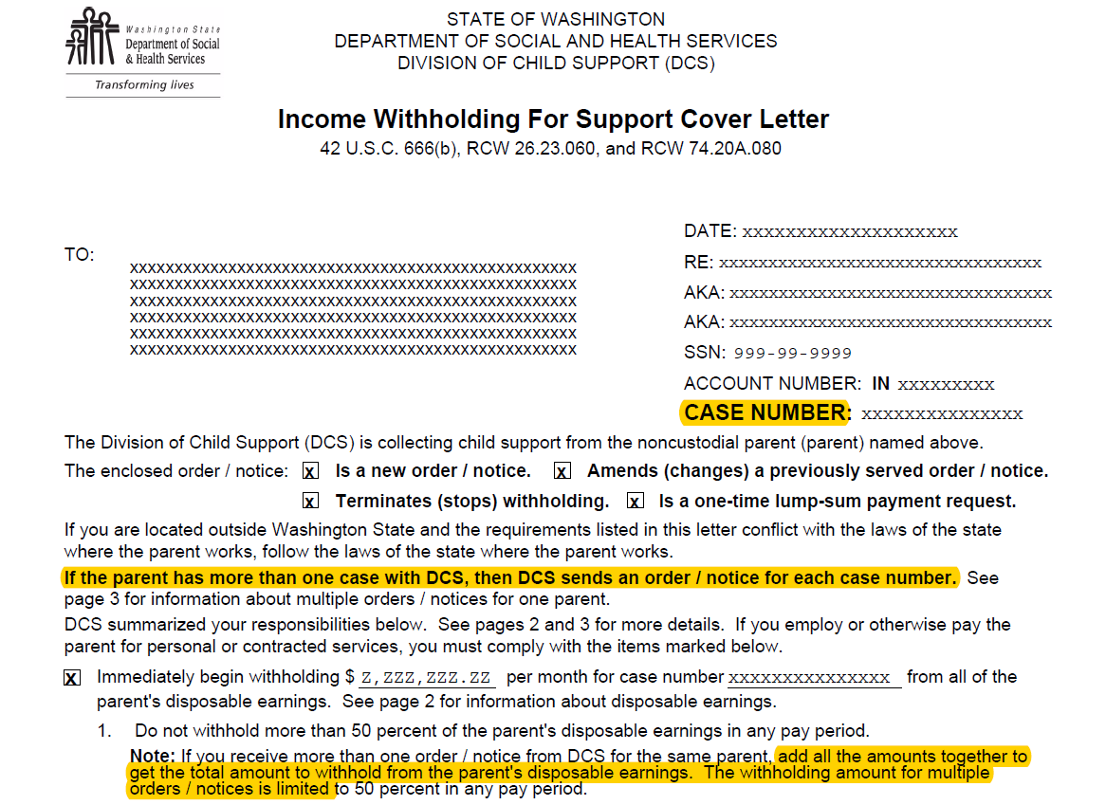
NEW Cover Letter for one IWO
per case
Notes:
Added One IWO per case information.

Slide 26
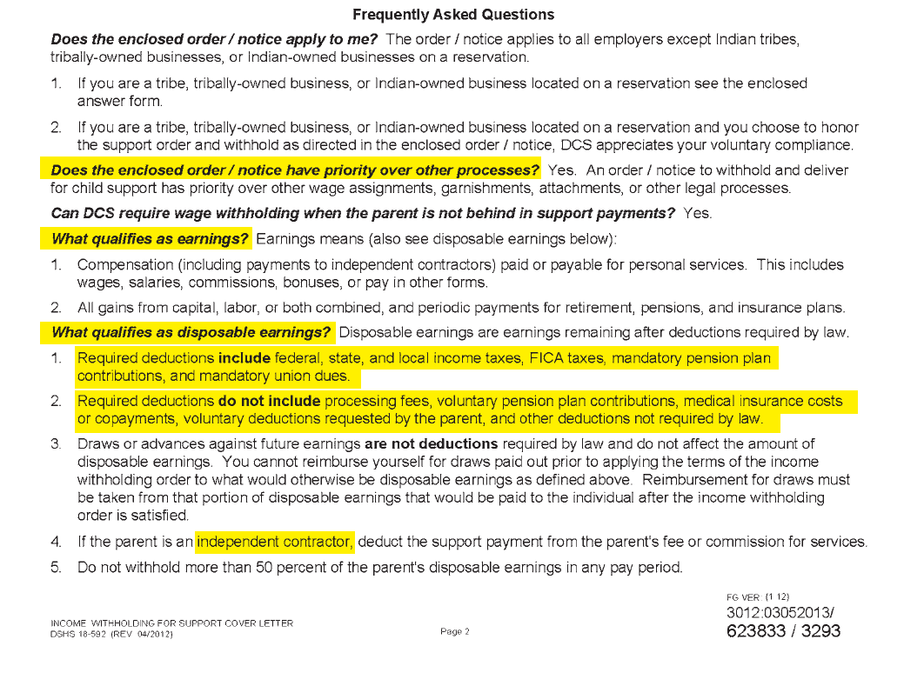

Slide 27
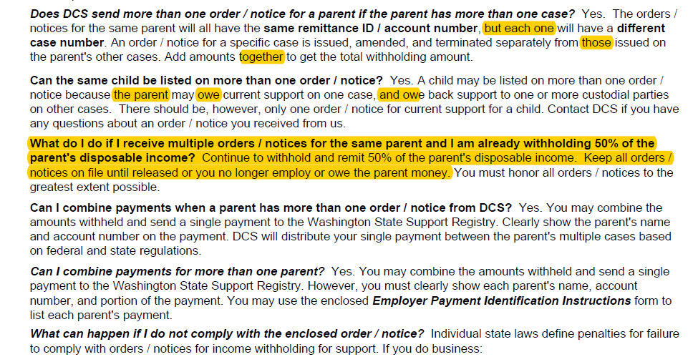
Added FAQs for one IWO

Slide 28
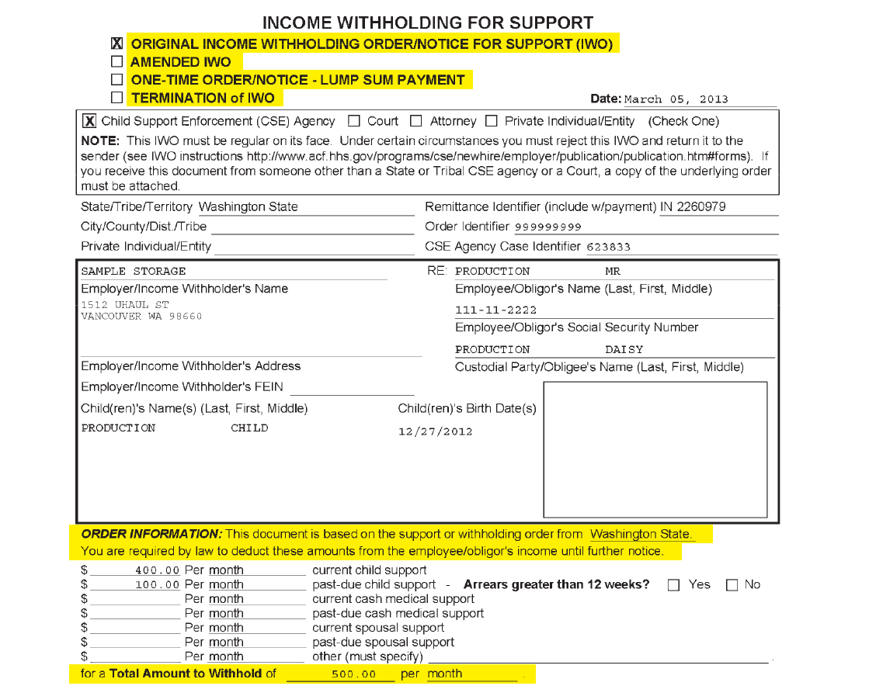
12
Notes:
Transition to one IWO per case on older cases happens during normal course of business as changes are made.

Slide 29
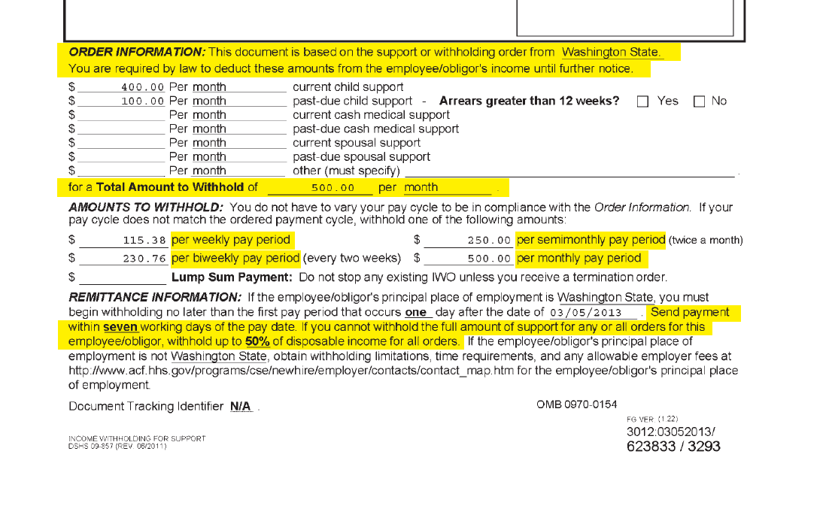
Notes:
DCS also sends a copy of IWO to the NCP

Slide 30
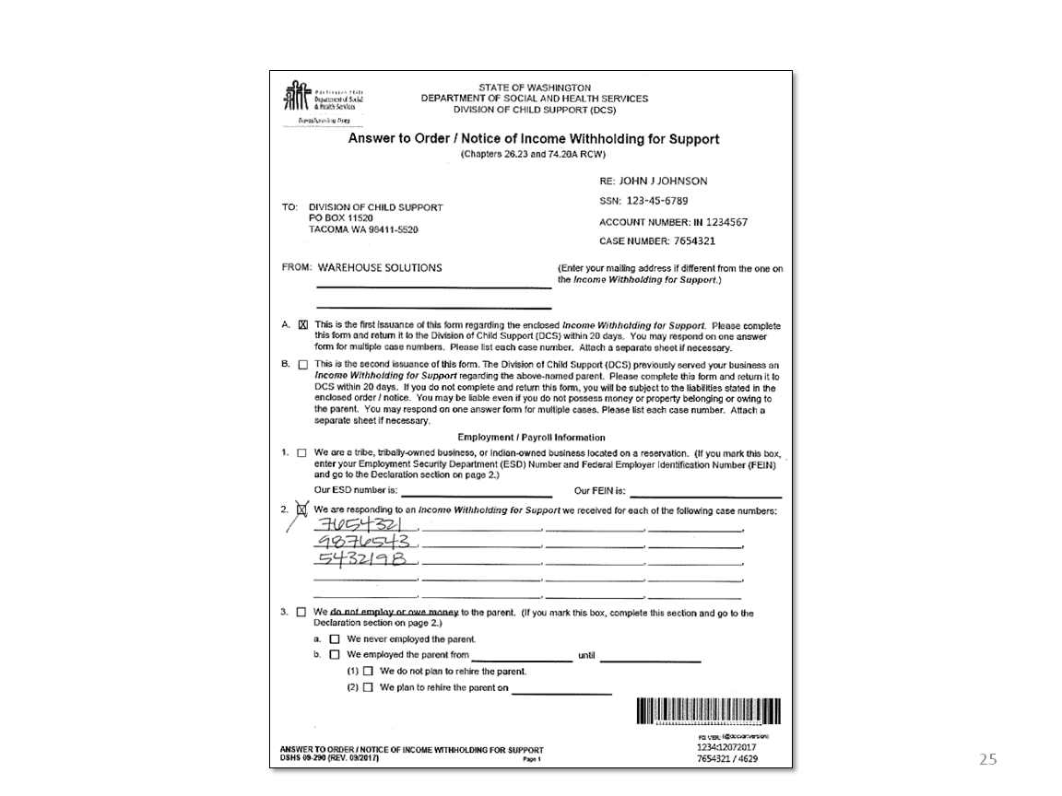
New Answer Form for one IWO per case

Slide 31
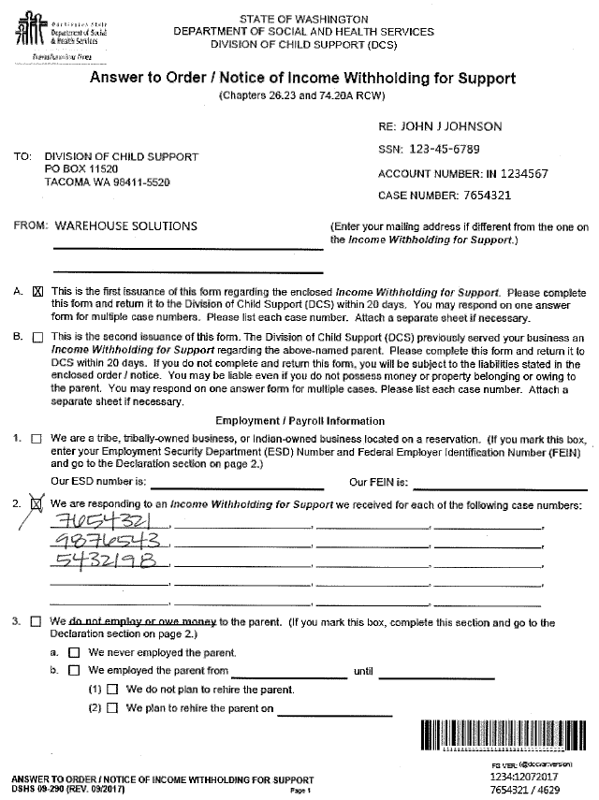
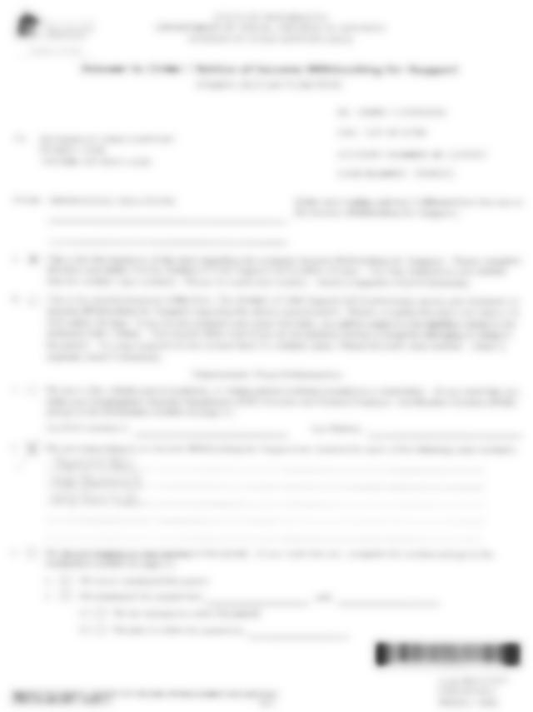
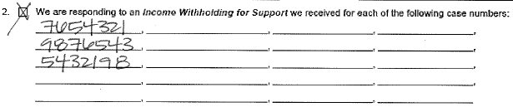
Notes:
Slide Topic: Visual Response Steps
Timeframe: 1 minute
Key Points:
9-290 may include reference to all cases that the response is for, if multiple.
Resources: None
Transition: None
Additional Notes: None

Slide 32
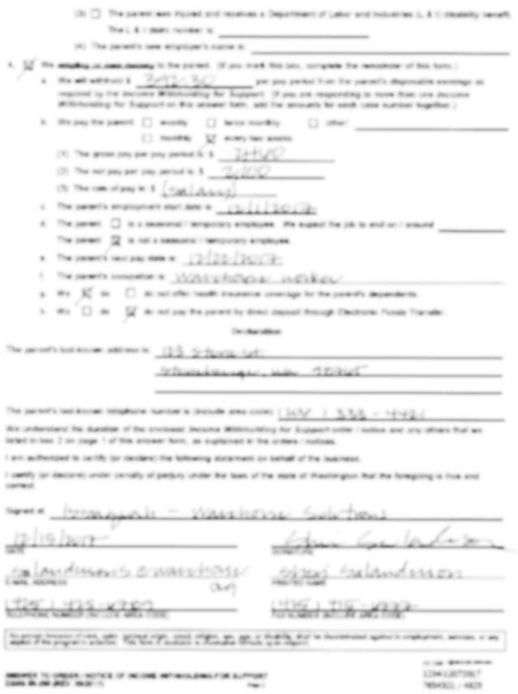
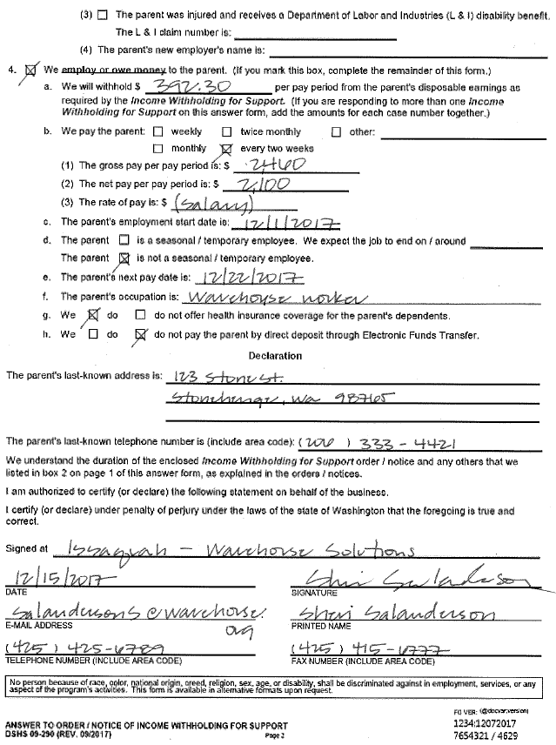
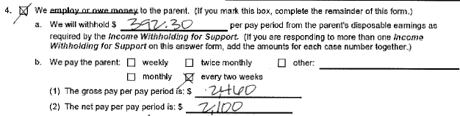
Notes:
Slide Topic: Visual Response Steps
Timeframe: 1 minute
Key Points:
9-290 may include reference to total IWO amount, if multiple.
Clarify: For a 9-290 to cover more than one IWO, it must have multiple D#s included or accurate combined IWO amount.
Resources: None
Transition: None
Additional Notes: None

Slide 33

What do you know?
An employer has ___ days to answer a withholding notice.
20 days
Notes:
33

Slide 34
What do you know?
An employer has __ working days to remit withheld funds.
7 days
Notes:
34
The withhold amounts are stated in the first page of the notice
It is broken down into the possible pay cycles:
Weekly
Biweekly (every two weeks)
Semimonthly (twice per month)
Monthly

Slide 35
What do you know?
True or False: An employer is required to notify DCS when an employee stops working?
True. If an employer is withholding child support and the employee stops working, notify DCS.
Notes:
35

Slide 36
What do you know?
An employee asks you to stop withholding child support because his child graduated from high school. Do you stop withholding based on this information?
NO! Only stop withholding when you receive a written notice from DCS.
Notes:
36
Even if they give you a high school diploma, continue to withhold.
They may have debt to pay off, there may be post secondary support

Slide 37
What do you know?
True or False: Child Support withholding orders take priority over most other garnishments
True, with the exception of the IRS. Contact DCS if there is a question.
Notes:
37

Slide 38
Medical Support Enforcement
National Medical Support Notices
May be sent with IWOs or on their own
Requires employers to:
  Enroll children into health insurance programs
  Respond with insurance information
Provides the employer with the premium limitation

Slide 39
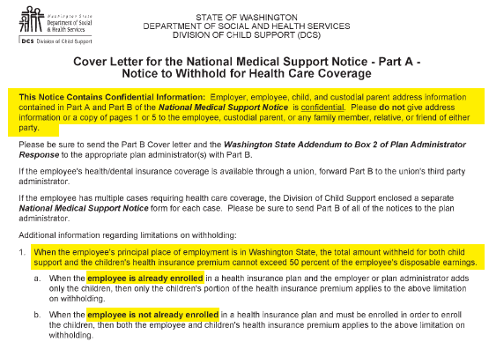
Notes:
IMPORTANT: DO NOT give a copy of this notice to your employee! Some of the information is CONFIDENTIAL!

Slide 40
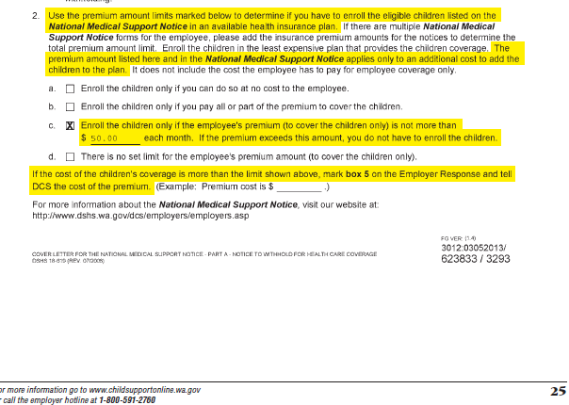

Slide 41
Part A Employers
  For Employers Handling Their Own Enrollments
  Enroll kids in medical plan within premium limit
  Complete Response Forms
  Notify DCS when child removed from coverage
Notes:
Four parts

Slide 42
Part B Plan Administrator/Employer
Enrollments handled by third party or union
  Forward Part B to third party or union
  Enroll kids in medical plan within premium limit
  Complete Response Forms
  Notify DCS when child removed from coverage
Notes:
Five parts

Slide 43
Income Withholding and the National Medical Support Notice
Questions?
800-562-0479
DCS-ERT@dshs.wa.gov
www.childsupportonline.wa.gov

Slide 44

Payments
Remit within 7 days of withholding the funds

Slide 45
Mandatory Electronic Payments
Effective January 2019
Mandatory Electronic Payments for most employers
The new law applies to all companies who:
Have 10 or more employees
Have less than 10 employees, but receive IWOs for more than one employee
Use a payroll processing company
Are required to electronically file and pay taxes to DOR

Slide 46

Benefits of Electronic Payments
You Save Time and Money!
Fewer steps, less paper
Safer and less expensive
Accuracy and security built into the process
Public Savings
Reduced processing cost
Families receive money more quickly

Slide 47

It takes 10-15 employees each day to process the 17% of payments we receive by check
Notes:
5,000 paper checks received daily

Slide 48
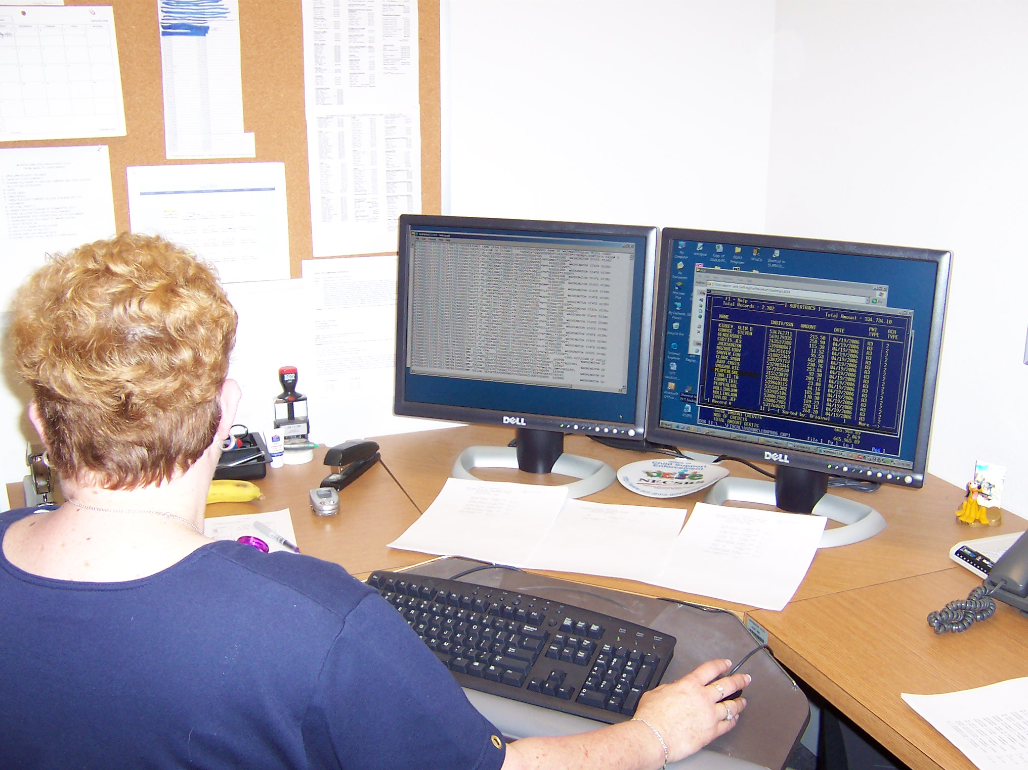
One employee processes the 83% of child support payments electronically
Notes:
85% of employer payments are received electronically

Slide 49
Payments FAQ
How soon must I send the child support payment that was withheld from an employee’s paycheck?
You must send the payment within 7 working days of paying wages to the employee.

Slide 50
Payments FAQ
Can I charge a processing fee to the employee?
Yes. Employers can charge a setup fee of $10 for the first withholding and $1 for each withholding thereafter.

Slide 51
Payments FAQ
I received a child support withhold from another state. Should I send payments directly to the other state?
Yes. You must send payments to the state that issued the income withholding order.
If you are already withholding for this employee for WA, please contact us.

Slide 52
Any Questions?
Electronic Payments
800-468-7422
Other Questions
800-562-0479
DCS-ERT@dshs.wa.gov
www.childsupportonline.wa.gov

Slide 53
COVID 19 - FAQ
If I layoff employees do I need to tell DCS even if I plan to rehire them?
Yes, if they have an OWI in place, let DCS know
  Email: DCS-ERT@DSHS.WA.GOV
  FAX: 360-586-3274
  Call: 1-800-562-0479

Slide 54
COVID 19 - FAQ
What do I do when an employee working reduced hours asks me to stop withholding because DCS is getting their unemployment?
Keep withholding and ask your employee to contact DCS
  DCS may release one of the actions
  Provide the employee your contact information
  Remember the 50% limit
Notes:
- We handle this situation the same as when someone gets a second job.

Slide 55
COVID 19 - FAQ
When a laid off employee starts working again, do I need to report them as a New Hire or can I just start withholding again?
Yes, you can start withholding
If you rehire them within 60 days, then you do not need to report them as a new hire
  Refer the employee to DCS if they have any questions

Slide 56

Support from the Federal OCSE
Free Online Options
Electronic Withholding Orders
Online Termination Reporting
Bonus and Lump Sum Reporting
More information
Visit: https://www.acf.hhs.gov/css/employers
E-mail the Federal Employer Services Team at employerportal@acf.hhs.gov for demonstration
Notes:
e-IWO allows employers to receive and respond to income withholding orders electronically.

Slide 57


Other Resources for Employers
Guide to Doing Business in Washington
www.business.wa.gov
www.bizguide.wa.gov
DCS Employer Info, Webinars & Workshops
www.childsupportonline.wa.gov
8/25/2020
Copyright 2010, DSHS Division of Child Support
57
Notes:
57

Slide 58

Employer Relations Team
We are here to help
1-800-562-0479
DCS-ERT@dshs.wa.gov
EFT Payments: 800-468-7422
www.childsupportonline.wa.gov
www.newhire.wa.gov

Slide 59
Thank You For Attending
Division of Child Support
800-562-0479 (DCS Employer Relations)
www.childsupportonline.wa.gov
DCS-ERT@dshs.wa.gov

