Slide 1
Long-Term Services and Supports Trust
Governor’s Indian Health Advisory Council
August 13, 2020

Slide 2
Agenda
Why the LTSS Trust program is important
State agency roles and responsibilities
How the LTSS Trust Act applies to Tribal governments
Discussion on potential paths forward
Q&A
Notes:
Bea
The Trust Act Commission will determine the rate of pay, which can be up to $0.58 per $100 of income.
The premium rate will be set by the pension funding council starting 1/1/24 and biennially thereafter – the rate must be set at the lowest amount necessary to maintain trust solvency, but will be no more that $.58 per $100
Trust Account Overview
$ collected by ESD
Deposited into the Trust Account
$ managed in the custody of the state treasurer
Benefits are disbursed from the account by DSHS
Funds in the account are invested by the state investment board

Slide 3
Why the LTSS Trust Program is Important
More than 90% of seniors are uninsured for long-term care.
The majority of Washingtonians will need long-term services and supports as they age.
Seniors without long-term care insurance must rely on family members or Medicaid to provide care.
Seniors must spend their life savings down to poverty levels in order to access long-term care through Medicaid.
Family caregivers who leave the workforce to provide unpaid long-term services and supports lose their own income and health and retirement benefits.
Notes:
Bea
The Trust Act Commission will determine the rate of pay, which can be up to $0.58 per $100 of income.
The premium rate will be set by the pension funding council starting 1/1/24 and biennially thereafter – the rate must be set at the lowest amount necessary to maintain trust solvency, but will be no more that $.58 per $100
Trust Account Overview
$ collected by ESD
Deposited into the Trust Account
$ managed in the custody of the state treasurer
Benefits are disbursed from the account by DSHS
Funds in the account are invested by the state investment board

Slide 4
What the Law Will Do Trust Contributions
Washington workers will pay up to $0.58 per $100 of earnings.
Every employee contributes – employers do not.
If you are self-employed, you can opt into the Trust.
If you have private long-term care insurance, you can apply for an exemption from 10/1/2021 thru 12/31/2022.
Someone who makes $750 per week will pay $4.35 into the Trust.
Notes:
Bea
The Trust Act Commission will determine the rate of pay, which can be up to $0.58 per $100 of income.
The premium rate will be set by the pension funding council starting 1/1/24 and biennially thereafter – the rate must be set at the lowest amount necessary to maintain trust solvency, but will be no more that $.58 per $100
Trust Account Overview
$ collected by ESD
Deposited into the Trust Account
$ managed in the custody of the state treasurer
Benefits are disbursed from the account by DSHS
Funds in the account are invested by the state investment board

Slide 5
What the Law Will Do The Benefit
Each person who is eligible to receive the benefit can access services and supports costing up to $36,500.
The nominal value of this benefit will increase over time to maintain purchasing power.
Someone who makes $750 per week will pay $4.35 into the Trust.
Notes:
Bea
The value of the benefit will increase with inflation.

Slide 6
What the Law Will Do The Benefit
The benefit can be used for a range of services and supports, including:
Professional care in your home, a licensed residential facility or a nursing facility
Training, pay and support for family members who provide care
Adaptive equipment and technology like wheelchair ramps and medication reminder devices
Home-delivered meals
Home safety evaluations
Rides to the doctor
Notes:
Bea

Slide 7
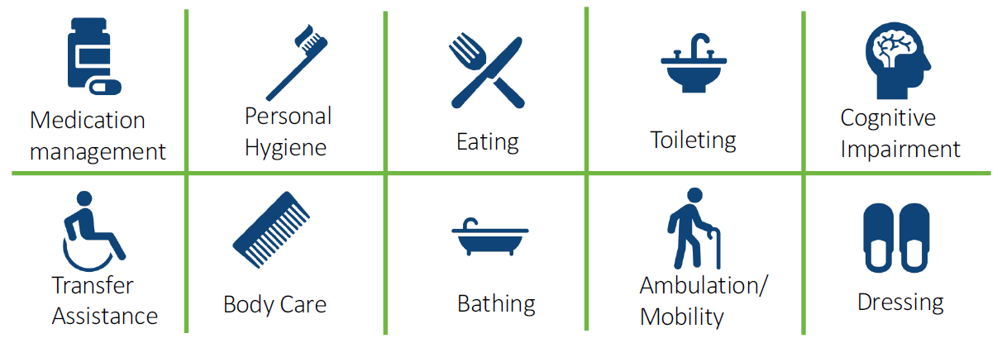
What the Law Will Do Vesting in the Trust
To receive the benefit, you must :
Have worked at least three of the last six years or ten years without a break of five or more years
Have worked at least 500 hours per year during those years, and
Need assistance with at least three activities of daily living
Notes:
Bea
ADL requirements are consistent with the state’s Medicaid eligibility (3 ADLS or 2 if you have cognitive needs)

Slide 8
What the Law Will Do Established Bodies
Trust Commission
21 Members
Stakeholders
Administrating Agencies
Legislators
Trust Council
12 Members
Investment Strategy Subcommittee
14 Members
Non-partisan Investment Experts
Notes:
Jeremy
Trust Commission - 21 members:
4 Washington State Senators
(D) Karen Keiser and Steve Conway
(R) Curtis King and Judy Warnick
4 Washington State Representatives
(D) Laurie Jinkins and Nicole Macri
(R) Paul Harris and Drew MacEwen
DSHS Secretary (or designee) Chair of the Commission
ESD Commissioner (or designee)
HCA Director (or designee)
10 Governor Appointees – stakeholder representatives, including employers
Trust Council - 12 members:
8 Washington State Senators and Representatives members of the Commission
DSHS, HCA and ESD members of the Commission
OFM Director (or designee) Chair of the Council
Investment Strategy Subcommittee - 14 members:
4 Washington State Senators on the Commission
4 Washington State Representatives on the Commission
DSHS Secretary (or designee)
ESD Commissioner (or designee)
4 Governor Appointees - experienced and qualified in the field of investments (non-voting members)

Slide 9
Roles and Responsibilities
Trust Commission
The Commission will make recommendations on:
Criteria for determining who is a qualified individual
Criteria for minimum qualifications for providers
Payment maximums for each service
Rules changes to improve the operation of the program
Actions necessary to maintain trust solvency
Adjustments to the benefit unit
Refunding premiums of a deceased qualified individual with a dependent with a developmental disability
Whether or not to extend coverage to individuals who became disabled before the age of 18
Notes:
Jeremy

Slide 10
Roles and Responsibilities
Trust Commission
The Commission is responsible to:
Establish an investment strategy subcommittee
Monitor agency administrative expenses and recommend a method of calculating future agency administrative expenses
Provide annual report to the legislature starting December 1, 2026
Assist the State Actuary with periodic reports
Notes:
Jeremy
Commission meetings are at the call of the chair

Slide 11
Roles and Responsibilities
Trust Council
Responsible to determine adjustments to the benefit unit
Investment Strategy Subcommittee
Responsible to provide guidance and advice to the state investment board on investment strategies for the LTSS Trust account.
Notes:
Jeremy
Trust Council meets at least once annually

Slide 12
Roles and Responsibilities
ESD
Collect Premiums & Wage Reports
HCA
Process payments
State Actuary
DSHS
Administer benefits
Determine qualified individuals
Manage providers
Apply for demo waiver from CMS
Track benefit usage
Coordination of benefits
Provide actuarial analysis to support Trust Fund solvency
Notes:
All Notes in the Appendix Handout
Carla: ESD Responsibilities
Jeremy: DSHS Responsibilities
Dennis: HCA Responsibilities
Jeremy: State Actuary Responsibilities

Slide 13
Roles and Responsibilities
Employment Security Department
Assisting the Commission, Council and State Actuary in monitoring the solvency and financial status of the program
Determining compliance of premium payments
Determining an individual’s status as a “qualified individual” (January 1, 2025)
Adopting rules, policies, and procedures for the program
Receiving reports and collecting premiums from employers (January 1, 2022)
Accepting applications for exemptions (October 1, 2021 through December 31, 2022)
Notes:
All Notes in the Appendix Handout
Carla: ESD Responsibilities
Jeremy: DSHS Responsibilities
Dennis: HCA Responsibilities
Jeremy: State Actuary Responsibilities

Slide 14
Roles and Responsibilities
Employment Security Department
Phase 1: Exemptions, processing of exemption requests, employee responsibilities
Rulemaking will be in three phases
Phase 2: Premium collection and reporting, employees covered by a CBA, election of coverage by self-employed individuals, refunds
Phase 3: Audit functions, state actuary/ESD functioning, determinations on individual status, appeals
Notes:
All Notes in the Appendix Handout
Carla: ESD Responsibilities
Jeremy: DSHS Responsibilities
Dennis: HCA Responsibilities
Jeremy: State Actuary Responsibilities

Slide 15
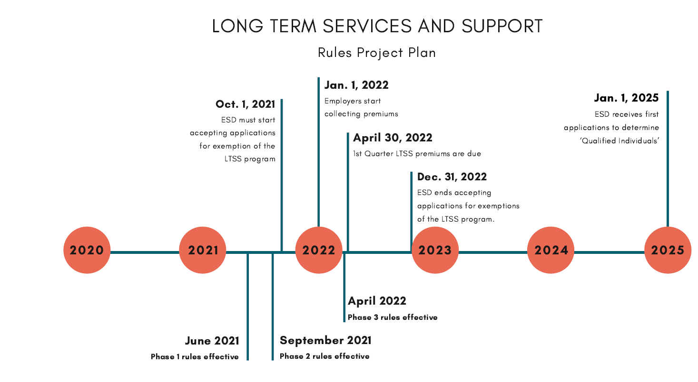

Slide 16
Roles and Responsibilities
Department of Social and Health Services
Determining which long-term services and supports are eligible for payment
Registering/deregistering long-term services and supports providers
Determining individuals’ eligibility for benefits
Disbursing payments of benefits to providers
Communicating with beneficiaries and the public
Adopting rules and procedures for the program
Chairing the Commission and providing administrative and operational support
Tracking data useful in monitoring and informing the program
Providing customer service to address questions, complaints and referrals to other agencies
Determining potential savings in Medicare expenditures
Applying for a demonstration waiver with CMS to share in Medicaid and Medicare savings
Notes:
All Notes in the Appendix Handout
Carla: ESD Responsibilities
Jeremy: DSHS Responsibilities
Dennis: HCA Responsibilities
Jeremy: State Actuary Responsibilities

Slide 17
Roles and Responsibilities
Health Care Authority
Payment of services for eligible individuals under the LTSS trust
Making the necessary payment system changes
Tracking use of lifetime benefit units
Verifying that approved services are provided
Establishing criteria for payment of benefits
Adopting rules and procedures to implement HCA responsibilities under the act, including coordination of benefits when beneficiaries have coverage for the services from multiple payers (LTSS trust, Medicaid, long-term services insurance, long-term care and support programs)
Notes:
All Notes in the Appendix Handout
Carla: ESD Responsibilities
Jeremy: DSHS Responsibilities
Dennis: HCA Responsibilities
Jeremy: State Actuary Responsibilities

Slide 18
Roles and Responsibilities
State Actuary
Making recommendations to the Council and Legislature on actions necessary to maintain trust solvency (including options to adjust the benefit unit and/or approved services)
Performing biennial actuarial valuations of the LTSS Trust Fund starting January 1, 2024
Provide cash-flow projections to the WSIB to assist in the development of an ongoing asset allocation policy for the Trust Fund
Making recommendations to the Pension Funding Council on changes to the premium rate
Notes:
All Notes in the Appendix Handout
Carla: ESD Responsibilities
Jeremy: DSHS Responsibilities
Dennis: HCA Responsibilities
Jeremy: State Actuary Responsibilities

Slide 19
Implementation Timeline
January 1, 2021
LTSS Trust Commission begins to deliver guidance
October 1, 2021
Private long-term care policy holders can permanently opt-out
Opt-out ends December 2022
January 1, 2022
Employers deduct premiums from workers’ wages
January 1, 2025
Eligible beneficiaries begin using Long-Term Services and Supports from the Trust
December 2026
LTSS Trust Commission begins annual reporting on solvency
Self-employed can opt-in
Notes:
Jeremy
Trust Council meets at least once annually

Slide 20
Applicability to Tribal Governments
RCW 50B.04.080 and RCW 50B.04.010 describe ESD’s responsibility for assessing premiums and define who participates.
“Employer” has the same definition used in Paid Family and Medical Leave (RCW 50A) and does not include Tribal governments. In PFML, there is an opt in clause to allow Tribal employer participation. This clause does not exist for the LTSS Trust.
For LTSS Trust
Premiums will not be assessed for Tribal governments as employers.
Employees of a Tribal government do not have a path in current law either to contribute or to receive benefits
Notes:
Bea
The Trust Act Commission will determine the rate of pay, which can be up to $0.58 per $100 of income.
The premium rate will be set by the pension funding council starting 1/1/24 and biennially thereafter – the rate must be set at the lowest amount necessary to maintain trust solvency, but will be no more that $.58 per $100
Trust Account Overview
$ collected by ESD
Deposited into the Trust Account
$ managed in the custody of the state treasurer
Benefits are disbursed from the account by DSHS
Funds in the account are invested by the state investment board

Slide 21
Applicability to Tribal Governments
Access to benefits in the LTSS program is predicated on vesting.
‘Qualified individual’ is someone who has paid into the LTSS program for the equivalent of either:
10 years, 5 of those years without interruption, working at least 500 hours during each of the 10 years, or
3 years within the last 6 years working at least 500 hours during each of the 3 years.
Tribal members who are employees of non-Tribal employers will have the same access as other employees who have paid into the program for the required time period.
All premiums are tied to a wage. There is no mechanism to allow tribes to pay a premium to ESD on behalf of all Tribal members.
The employee is responsible for payment of the premium through payroll deduction – it isn’t shared between the employee and employer.
Notes:
Bea
The Trust Act Commission will determine the rate of pay, which can be up to $0.58 per $100 of income.
The premium rate will be set by the pension funding council starting 1/1/24 and biennially thereafter – the rate must be set at the lowest amount necessary to maintain trust solvency, but will be no more that $.58 per $100
Trust Account Overview
$ collected by ESD
Deposited into the Trust Account
$ managed in the custody of the state treasurer
Benefits are disbursed from the account by DSHS
Funds in the account are invested by the state investment board

Slide 22
Potential Path Forward
Statutory change likely needed to allow Tribal governments to opt-in as employers
Notes:
Bea
The Trust Act Commission will determine the rate of pay, which can be up to $0.58 per $100 of income.
The premium rate will be set by the pension funding council starting 1/1/24 and biennially thereafter – the rate must be set at the lowest amount necessary to maintain trust solvency, but will be no more that $.58 per $100
Trust Account Overview
$ collected by ESD
Deposited into the Trust Account
$ managed in the custody of the state treasurer
Benefits are disbursed from the account by DSHS
Funds in the account are invested by the state investment board

Slide 23
Questions?

Slide 24
Thank You
Notes:
Jeremy – How does this group want to receive information going forward?

