Slide 1

Fundamentals of Supported Employment in Vocational Rehabilitation
Development of this training was funded by:
Services for Individuals Who Experience
Developmental Disabilities: 2

Slide 2
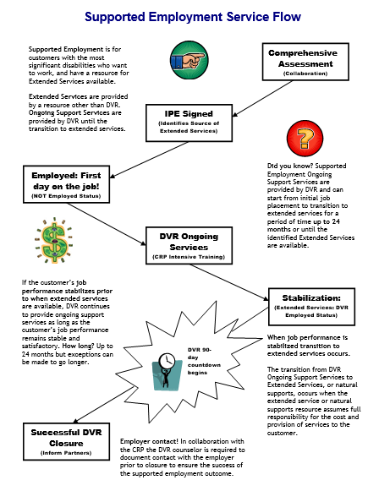

Services Flow Chart
Notes:
Before we begin the content of this training module let’s review the supported employment model that the D.S.H.S. Division of Vocational Rehabilitation, or D.V.R., must carry out. As an employment consultant serving these customers, it is important that you understand the steps of supported employment that D.V.R. must follow and your role in the process. Let’s review each step briefly.
D.V.R. supported employment services are provided to customers with the most significant disabilities who want to get and keep a permanent job. These customers require intensive support to obtain employment, as well as long term support to achieve and maintain successful job performance. Federal rules for supported employment require D.V.R. to provide the upfront vocational rehabilitation, or V.R. services known as on-going services, that a customer requires to get and learn a job. After that, a separate source will provide the extended support or long term supports the customer needs to keep their job once D.V.R. services end. All D.V.R. supported employment customers go through the same application and eligibility determination process. Once an individual is determined eligible for D.V.R. their V.R. counselor works with them to conduct a comprehensive assessment of their vocational rehabilitation needs, including whether the customer will require supported employment to get and keep a job of their choice. The comprehensive assessment often includes a community based assessment that is provided by a community rehabilitation program, or C.R.P., such as the one you work for. After the comprehensive assessment has been completed, the D.V.R. customer is assisted by their V.R. Counselor to develop an individualized plan for employment, or I.P.E. The I.P.E. identifies the customer’s employment goal along with the steps and the D.V.R. services they will require to achieve their goal. The I.P.E. must also identify the customer’s need for supported employment and what their source of long term support or extended services will be. If the source of extended services is unknown when the I.P.E. begins, there must be a strong expectation that a source will be identified within 24 months. D.V.R. services identified in the I.P.E. begin once the plan is signed by the D.V.R. customer and their V.R. counselor. Typically, the first step of an I.P.E. is for D.V.R. to authorize job placement services to assist the supported employment customer in becoming employed. Once the customer is employed then D.V.R. authorizes intensive training services to assist the customer in learning how to perform their job satisfactorily. However, once a customer reaches a stable level of satisfactory job performance, they must begin receiving their extended services from a source outside of D.V.R.. If a supported employment customer achieves stable job performance sooner than their extended services will be available, D.V.R. will continue providing ongoing support for up to 24 months. Once extended services have begun, D.V.R. keeps the case open during the first ninety days that these services are provided to make sure they meet the customer’s needs. If the customer is doing well on their job at the end of this ninety days and their extended services continue without interruption, then the customer’s D.V.R. case is closed.

Slide 3
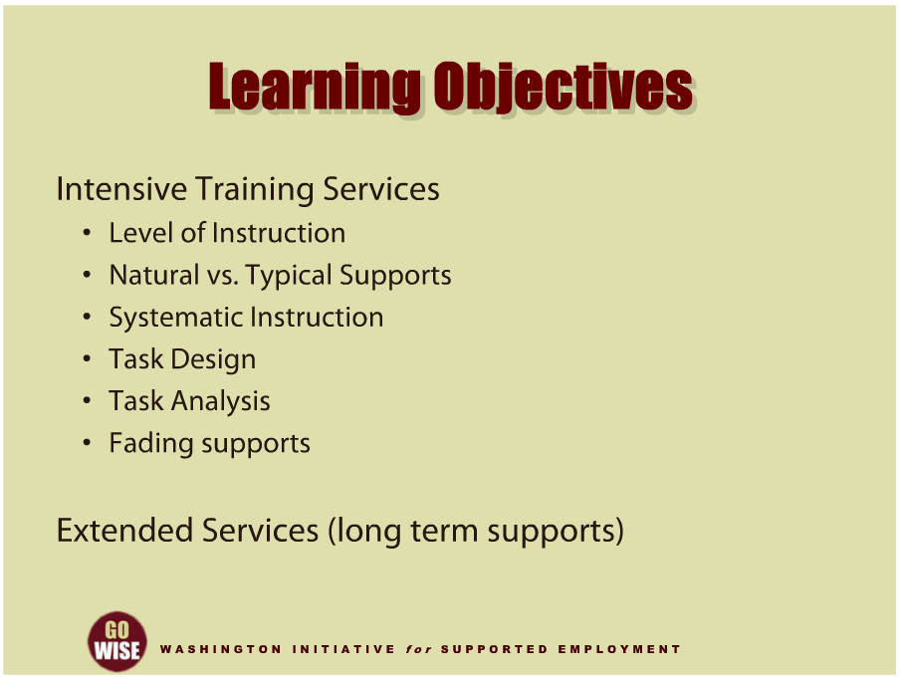
Learning Objectives
Notes:
This training will cover the services a customer may receive from the Division of Vocational Rehabilitation, or DVR, in order to learn their job, as well as gain an understanding of the support they will need to maintain their job in the future. The main service category we will cover is intensive training services. We will also spend time thinking about extended services, also known as long term supports, that are provided to supported employment customers once VR services have ended. We will specifically look at the role of an employment consultant, as well as a few models that have proven successful for individuals with developmental disabilities in supported employment. For example, we will look closer at the level of instruction when providing intensive training services, natural verses typical supports at the worksite, systematic instruction, task design, task analysis and fading supports. We will also examine a few important components of setting up extended services in the DVR system. We hope that by the end of this training, you will have a better understanding of the services you can provide your future customers, and a few ideas about how to support them to reach their employment goals.
When DVR is serving a supported employment customer, the training and support the individual receives immediately after they start their job is purchased by DVR from a Community Rehabilitation Program, or CRP, as intensive training service. This service is provided to assist the customer in learning all aspects of their job with enough support so that they achieve a stable and satisfactory level of performance. When that level is reached, DVR stops funding intensive training services and the individual’s extended services, or “long term support” must begin. Extended services will be funded and provided by an array of possible sources. When a DVR customer is referred to you for job placement and it is known the individual will require some type of extended services to maintain employment after their DVR case is closed, it is the role of the DVR Counselor and customer to identify the source of those services before you begin job placement, or be very confident that a source will be available by the time the individual goes to work. As an employment consultant you are not responsible for locating the customer’s source of extended services, but you will play a critical role in helping identify what type of long term support they are going to need after you have placed them in to a job.

Slide 4
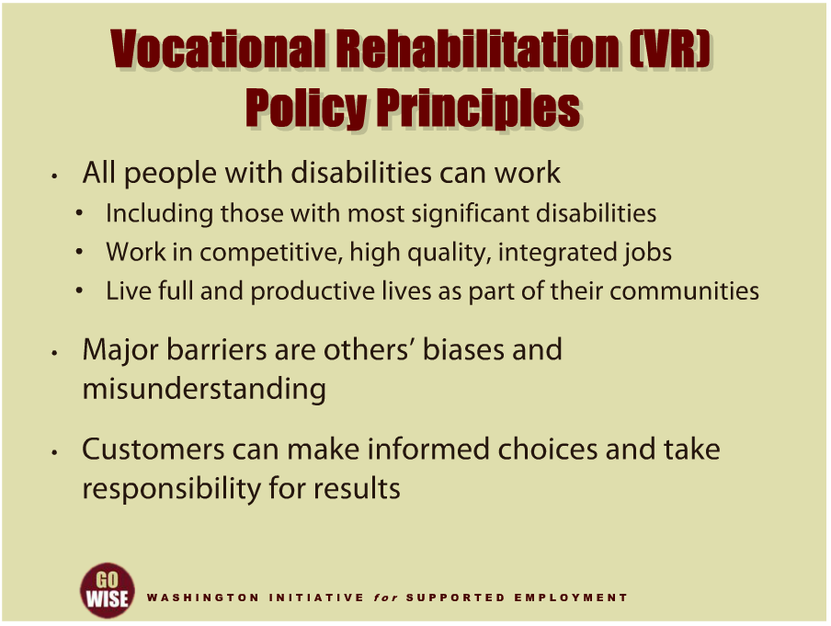
VR Policy Principles
Notes:
Before we dive into intensive training services, we want to take a moment to look at the principles and values behind current-day supported employment services. This information will give you a framework for the services you are providing to people with developmental disabilities. The Federal Rehabilitation Services Administration has developed policy principles to guide the vocational rehabilitation services that are provided to its customers. Amongst them are some that speak particularly well to supported employment services for individuals with developmental disabilities. For example, one policy principle is that all people with disabilities can work, including those customers who experience significant disabilities. This principle goes on to state that those with significant disabilities do have the ability to work in competitive, high quality, integrated jobs, and live full and productive lives as part of their communities. Another policy principle cites that some major barriers to employment are actually the result of other peoples’ biases and misunderstandings about people with disabilities. And one final example of a policy principle that guides services particularly well for those with significant disabilities is that people with disabilities can make informed choices and take responsibility for the results. These are examples of the principles that direct and give meaning to vocational rehabilitation services. You will see how important these principles are as you gain more experience as an employment consultant and help individuals with developmental disabilities benefit from vocational rehabilitation services.

Slide 5
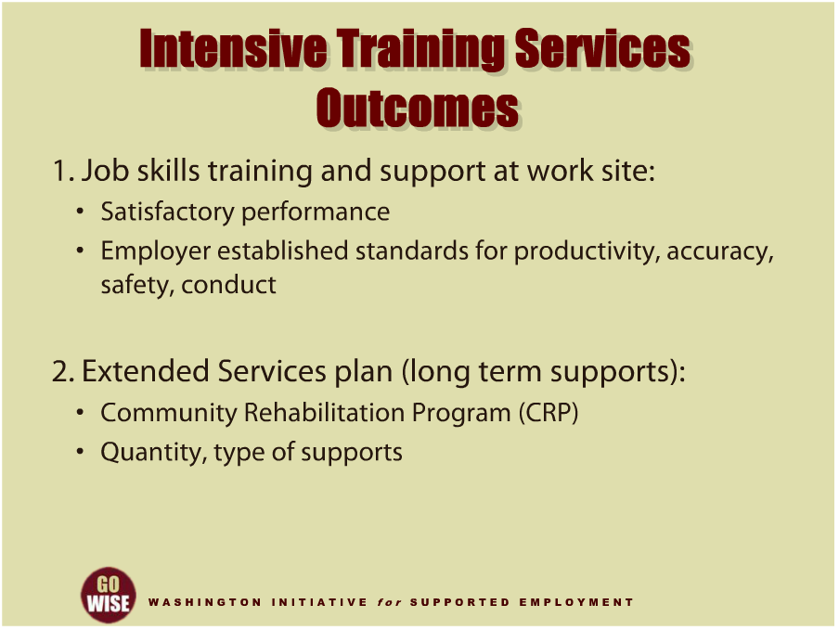
Intensive Training Services Outcomes
Notes:
Now, let’s explore the service category intensive training services to help you gain a strong understanding of what this service is for. Overall, the objective of this service category is twofold. First, you will help the customer learn to do their job to the necessary standard, called job stabilization. This basically means that you will provide your customer with one-on-one job skills training and support at their employment site so that they learn to successfully perform their job. However there are several components to providing this service, and these are important to you as an employment consultant since these are the things you will focus on when you do your work. For example, your responsibility will be to help your customer learn how to perform satisfactorily at their job. This means that you will help your customer reach the employer-established standards for productivity, accuracy, safety and conduct. We will cover more on learning and training later. The second main function of intensive training services is to help your customer develop a plan for the support they will need in order to maintain their job over in the long term. DVR uses the term extended services to explain the employment supports someone will use long-term in order to maintain their job. One important distinction about extended services is that these services will be provided once DVR services end, because DVR services are time-limited. A funding source other than DVR must pay for and provide these extended services. In order to help your customer move from DVR to extended services, you will be responsible for determining the quantity and type of supports they will need to maintain their job in the future. We will go more in depth about this later in the training.

Slide 6
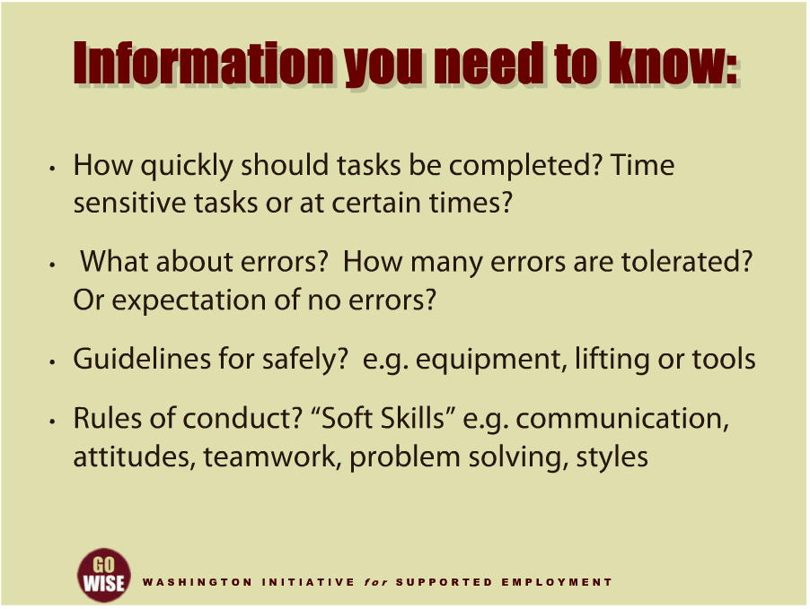
Information you need to know
Notes:
Now that you understand the overall goals for providing this service, let’s look at the types of things you will want to focus on when you are providing intensive training. First, you will want to have some information about the job that you are helping your customer learn. You want to have this information before beginning to help your customer learn the tasks they will be responsible for. In fact, information gathered during the initial job analysis and job development phases should include some vital sources of information you will need to do your job. Most of this information revolves around the employer expectations and what they understand satisfactory performance to mean. For example, some of the questions you should be able to answer include:
How quickly should the new supported employee be expected to complete their tasks?
Are there certain tasks that are time sensitive, or that need to be completed at certain times during their work day or shift?
What if they make an error?
How big of a deal is it to make an error, and how many errors are tolerated, or is the expectation that there be no errors?
Are there guidelines for completing their work tasks safely?
For example, if your customer has to operate equipment as part of their job, does the employer have guidelines for how to operate that equipment?
What about heavy lifting or using tools, do they have guidelines for those types of situations?
Is your customer expected to follow rules of conduct? As an employment consultant, you may hear these referred to as “soft skills:”
For example, does the worksite have certain ways to communicate, such as: everyone uses email? Are there styles of communication that their particular worksite uses more often, or not at all?
Are there shared beliefs of values and expected conduct they should know about? This is often referred to as workplace culture.
How about teamwork and problem solving?
To learn more about the soft skills concept, please go to the Office of Disability Employment Policy, or ODEP website listed at the end of this training in the resources section.

Slide 7
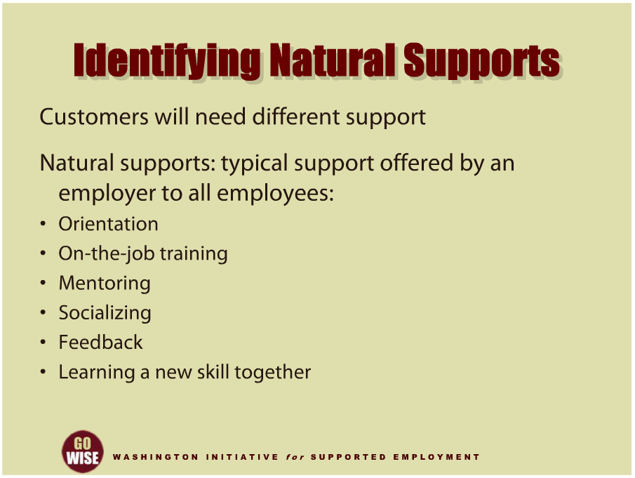
Identifying Natural Supports
Notes:
Your customer will need individualized support from you to learn their job. Thinking about the individual needs of your customer will be vital to your customer’s success, as well as to your own success as an employment consultant. For example, some people learn fairly quickly with initial instruction and observation while others may need more systematic and consistent instruction and feedback. This type of intensive and consistent training is called Systematic Instruction, and we will cover it in more detail soon. But first, let’s think about a concept that will most likely be necessary for anyone you are providing intensive training services to. It’s very important when you are helping someone learn their job to consider the typical supports offered by the employer to all of their employees, regardless of disability status. These types of supports are often referred to as natural supports. Some examples of natural supports are new employee orientation, existing on-the-job coaching and mentoring, socializing at breaks or after work, co-workers providing feedback on job performance, or learning a new skill together. We know that if you can assist your customer to utilize these natural supports, the individual and their employer will benefit.

Slide 8
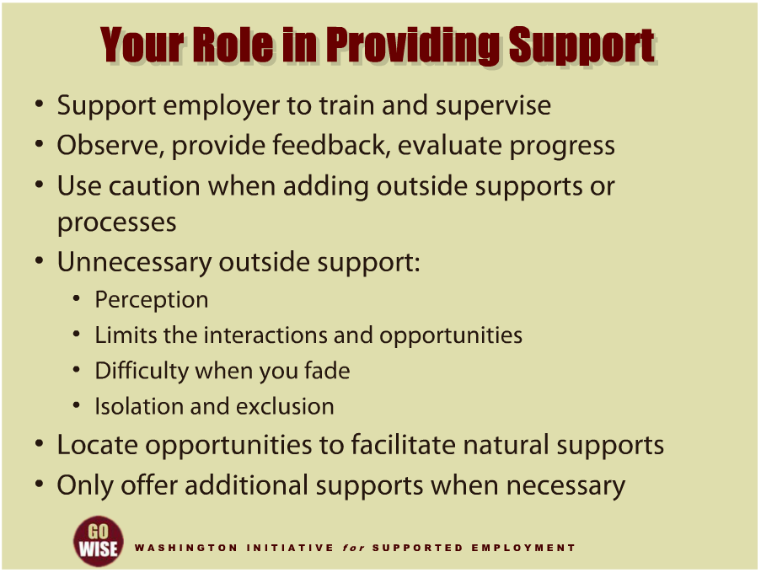
Your Role in Providing Support
Notes:
Let’s think a little more about your role as am employment consultant in providing intensive training services to DVR customers, especially in helping an individual get the most from the natural supports an employer offers to all of the employees at the worksite. These natural supports help to build direct relationships between your customer and their co-workers. This is particularly important because some traditional models of supported employment focused on the relationship between the co-workers and the employment consultant. We are moving away from this model for obvious reasons, and turning the employment consultant role into supporting the employer in training and supervising their new employee. This means that you will be observing your customer as they go through the process, providing feedback as needed, and evaluating your customer’s progress. While providing extra supports is part of your job, you will also need to use caution in adding outside supports or processes that are not typical to others at the worksite. There are a few reasons for this precaution. For example, extra supports and processes give the perception that the supported employee is different, and, that difference often limits the interactions and opportunities your customer will have to build relationships with their co-workers. Setting up unnecessary supports can also cause difficulty when it comes time for you to fade from the worksite, because you may have unknowingly built your help or supports into the job, which means your customer cannot be successful without you. And obviously, if the customer doesn’t have relationships with their co-workers, or has outside supports that are not necessary, they can often become isolated or excluded at their job.
We now know a few key elements to helping a customer be successful and integrated at their job. For example, the employment consultant will need to locate opportunities for natural supports in the work environment. We also know that the employment consultant should only offer additional supports to their customer when necessary.

Slide 9
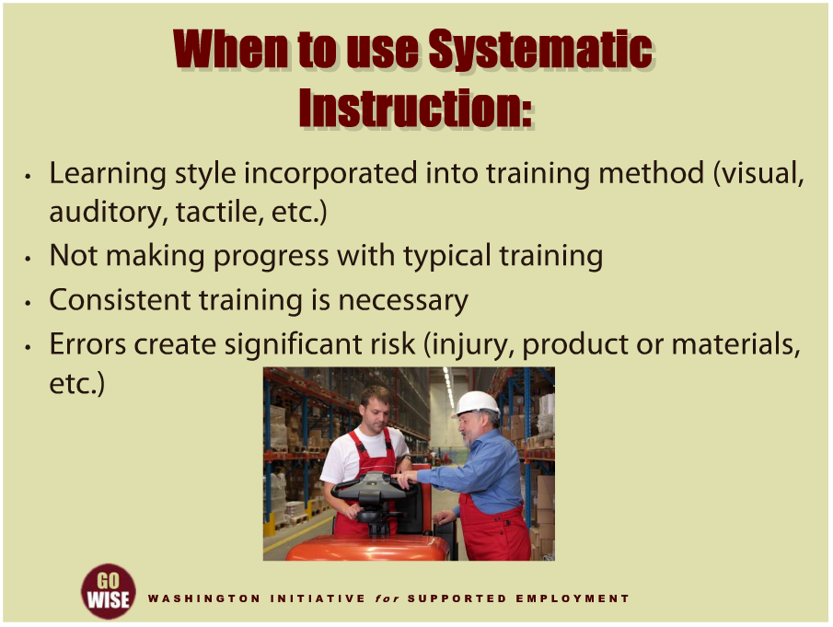
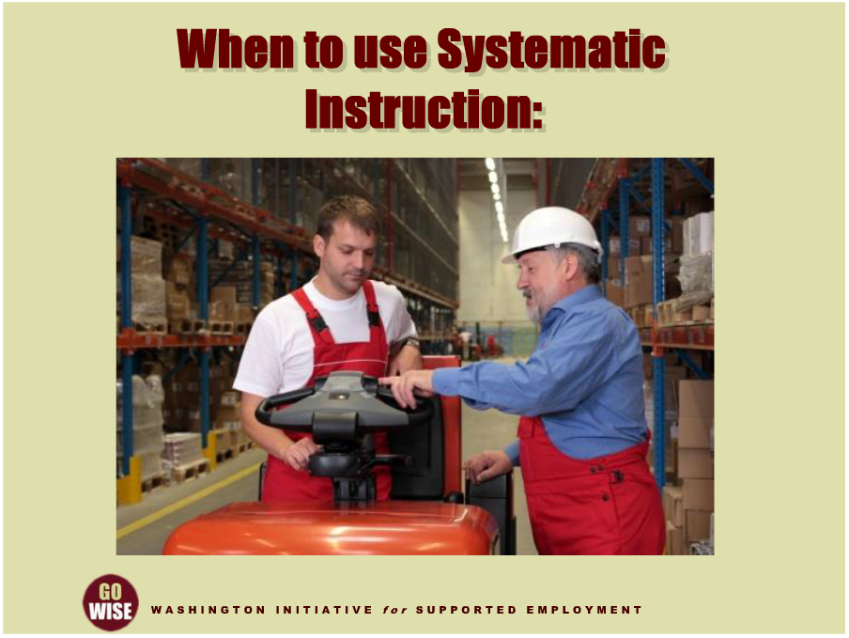
When to use Systematic Instruction:
Notes:
For some customers you serve, you’ll find that the way a particular person learns, or the complexity of a particular task they have to learn will call for something called systematic instruction. Systematic instruction is one proven successful way of helping someone become independent and accurate at performing their tasks. While you could take several days of training to learn about systematic instruction in more detail, it’s worth briefly covering a few main points to help you understand the basic components of this model. First, systematic instruction takes into account someone’s learning style. We all know that there are multiple ways to learn one task. It’s important for you as an employment consultant to consider what approach will work best for the individual and the environment they are working in. For example, a visual approach may work best, where your customer has the chance to observe how the task is done, look at pictures or read instructions of how to complete it successfully. Or one other approach may be tactile, where, for example, your customer would touch the task and learn through using their hands. These are just examples, and the specific training method you choose will depend on your customer and the work environment. Systematic instruction takes into account how your customer best learns, and incorporates that style into your training method. You may also realize that systematic instruction is called for in a particular instance, if your customer is not making progress in learning the new tasks of their job. For example, the employee may be learning some parts of the job, but not reaching the required level of independence on all of the tasks they are expected to learn. Maybe your customer has been working at their job for several days and has learned how to do most of their required tasks, but one task in particular, loading paper into the copy machines, is giving her a lot of trouble. Another way you may know that systematic instruction is appropriate is if your customer typically needs consistent training in order to learn steps. You may actually know this before they begin their job, and have the training set up to support them from the beginning. And finally, employment consultants typically utilize this model if errors at the particular worksite will create a significant risk. For example, the risk could mean possible injury to the employee if they operate machinery incorrectly, or if they misuse harmful chemicals. There could also be risks to the employer’s product or materials. For example, it may be that if your customer makes an error, the machinery could be damaged and costly to the employer. Systematic instruction minimizes those potential risks and is also a valuable tool in addressing employer concerns regarding safety.

Slide 10
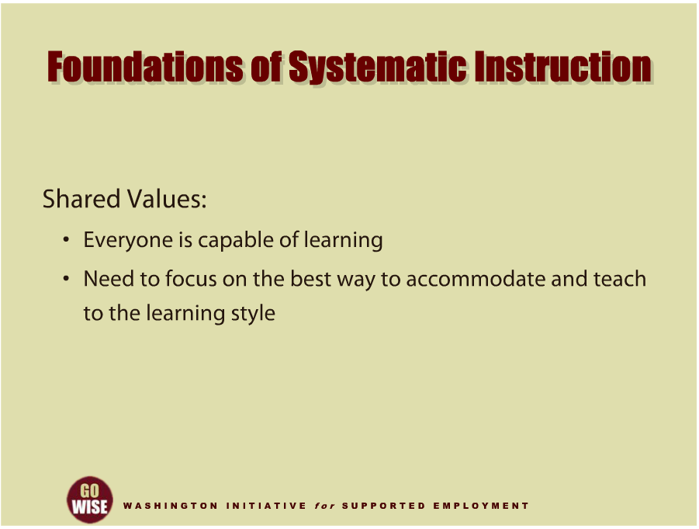
Foundations of Systematic Instruction
Notes:
Let’s look a little closer at the beginnings of systematic instruction. First, systematic instruction is an evidence-based approach to teaching new skills to people with developmental disabilities. The belief that this population of people could not learn new tasks was common in the 1960s and 1970s. At that time, there was an unfortunate myth that if someone had a low IQ score then they did not have the ability to learn. This way of thinking led to decades of no-or-low expectations for people with developmental disabilities. Since most people believed that this segment of society could not learn, there was no attempt to teach or help them learn. However, in the late 1960s and 1970s several researchers across the United States focused on developing teaching strategies and supports to include all learners, specifically those believed to have the most significant challenges to learning. These researches developed programs to teach people to do a task. For example, Marc Gold developed learning technology called Try Another Way. Other researchers working on similar teaching methods were Paul Wehman from Virginia Commonwealth University and Lou Brown from the University of Wisconsin. Here in Washington State, we were greatly influenced by a man named Doctor Tom Bellamy from the University of Oregon. Regardless of which researcher a community focused on at that time, they shared a common set of values. These researchers believed that everyone is capable of learning. They also believed that we needed to focus on the best way to accommodate and teach to the learning style for each individual. These are the same values that form the foundation of the Vocational Rehabilitation Policy Principles you were introduced to at the beginning of this training. To learn more about the history of supported employment for individuals with developmental disabilities, please watch the training module, TA Historical Overview of Supported Employment for Individuals with Developmental Disabilities, in this training series.

Slide 11
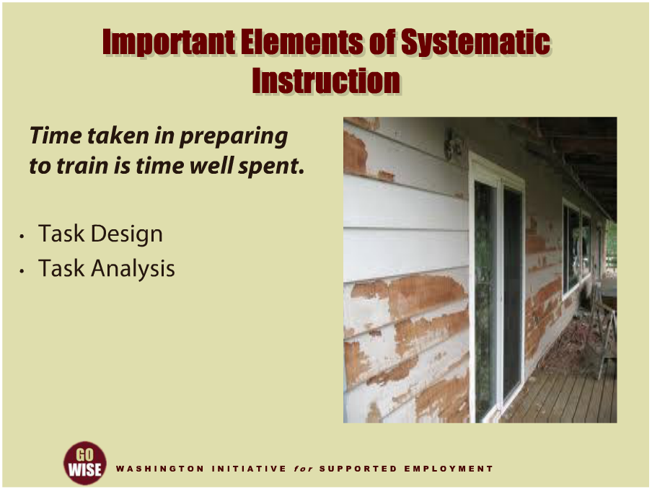
Important Elements of Systematic Instruction
Notes:
There are two key elements to systematic instruction. These stem from the belief that preparing to teach someone their job is valuable.
One analogy to better understand this concept is to think about the picture of the wall on your screen. If you’ve ever been in charge of a big paint job like this one, you may know that it’s tempting to jump straight into painting once you have the paint cans in your hands. And initially that may seem to work well and appear effective. But if you skipped the initial steps of scraping, sanding and priming, then your paint job won’t endure. Often a rushed paint job results in lost time, money and resources in the overall picture. Similarly, skipping opportunities for two key elements, task design, and task analysis, will result in less effective training. Here again, you could spend several days learning the two following elements and still need more training, however we want to give you a brief overview of task design and task analysis so that you are aware of the work you may do in the future. Task design involves, for you as the employment consultant, working in collaboration with the employer to determine the most appropriate method of completing the specific task your customer needs to learn. And as we’ve been saying throughout this training, the most appropriate method will be individualized to your specific customer. The second tool is called task analysis and involves breaking the task down into teachable steps, listing the steps, and tracking progress by indicating independent performance. Now let’s look a little closer at each of these tools.

Slide 12
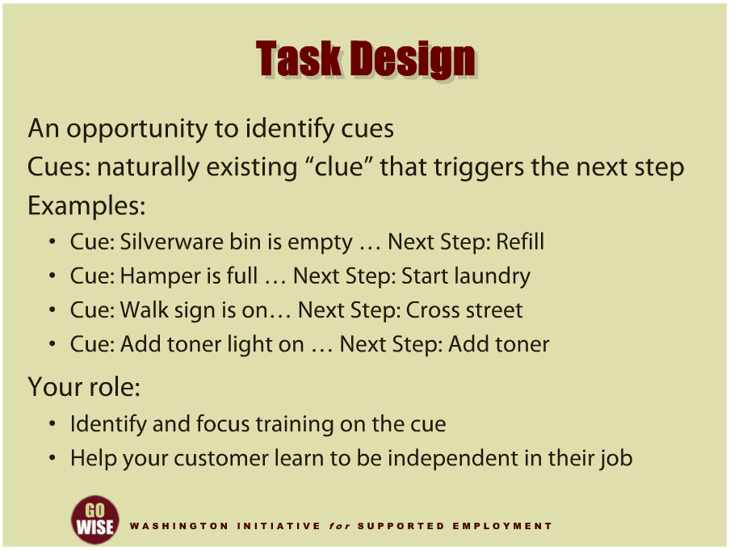
Task Design
Notes:
Task Design is the process of identifying the cues to complete a task or activity. Every task and activity has naturally existing cues that trigger the next step. The cue is the “clue” that leads to the next step. Some examples of cues are:
Seeing that the silverware bin is empty will cue someone to refill it.
Noticing a full basket of dirty laundry cues the employee to start washing the laundry.
When the crosswalk sign turns green, you know to cross the street.
When the toner light comes on the copy machine, you know to add toner.
It’s important for you as the employment consultant to identify what the natural cue is for your customer at their work task, and focus your training on the cues in the task. If you don’t help your customer learn the naturally occurring cues in their job from the moment you start training, you run the risk of becoming the cue yourself. And if you have ever “become the cue”, you know that your customer will look to you for information on how to move forward, or what to do next. When your customer learns to look for you in order to move forward, we say they have become cue dependent on the trainer. The goal is to help them become independent by understanding the naturally occurring cue that is contained in the task or activity they are learning to do. This way they will be able to perform their job when you are not there.

Slide 13
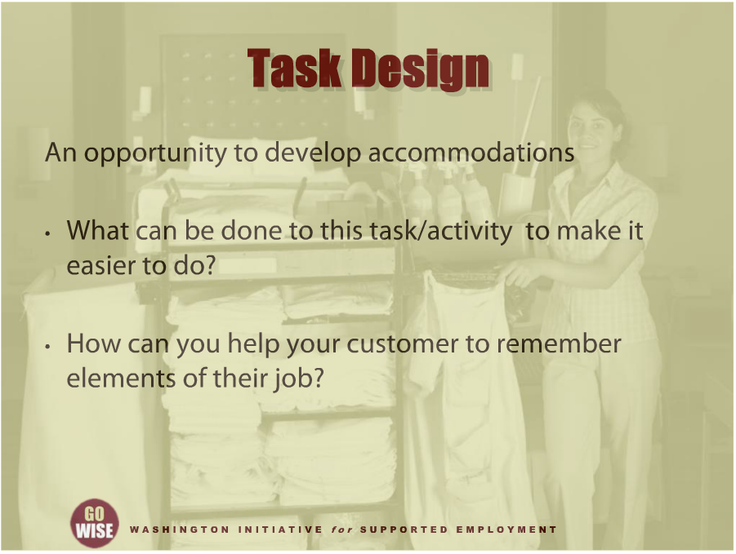
Task Design
Notes:
Task design also gives you as the employment consultant an opportunity to develop accommodations your customer will need to be successful at their job. When thinking about accommodations, you may want to ask yourself a few questions. For example, what can be done to this task or activity to make it easier to do? What you realize when you consider this question can be simple or complex. For example, you may find that accommodations help with the physical demands of a task, such as setting up fixtures to hold materials while you are working with them, or developing a template to help guide placement of materials. Another question you may ask yourself in task design is, how can you help your customer to remember elements of their job? Completing and remembering tasks is a common challenge people face, and it can often times be accommodated quite easily. For example, you could set up fixtures to assist with counting and organizing a task, you may utilize assistive technology such as an iPod to put visual and auditory checklists in place, you can supplement written instructions with pictures, or you can highlight existing cues with color or arrows to draw extra attention to them. Task design has proven to be useful to more than just supported employees, and these types of accommodations are being developed in all types of work environments. For example, terms such as universal design and self-management strategies are being put in to place to help employees do their job more efficiently and independently.

Slide 14
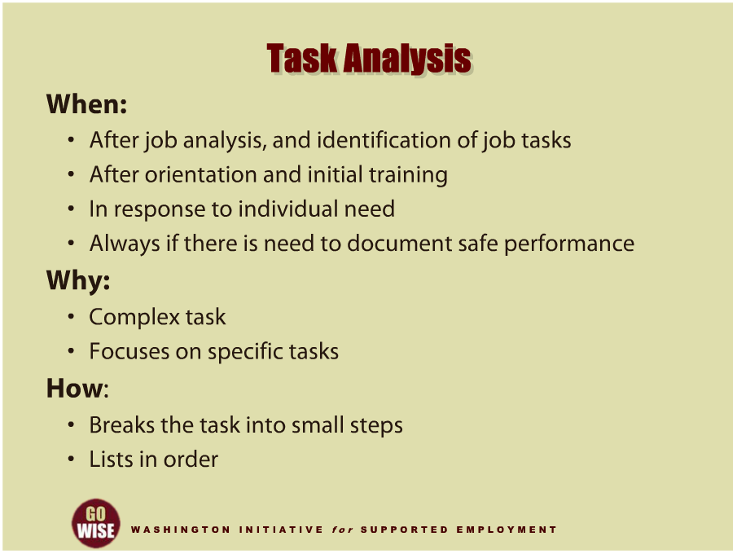
Task Analysis
Notes:
Task analysis is the second element in systematic instruction. Let’s briefly look at the when, why and how of task analysis. When should you utilize task analysis? First you need to have a strong understanding of the job to be done, also called a job analysis, and you need to have identified the tasks that need to be done. Task analysis may be needed after your customer has been through orientation and their initial training. In addition, task analysis should be utilized in response to your customer’s individual needs, mainly, if your customer is not making progress with the typical level of training on their task. You should also use task analysis when there is a need to document safe performance. Documentation similar to task analysis is often standard practice for many employers when there is a potential risk of injury or damage while performing the task.
Why should you utilize task analysis? Task analysis can be useful when the activity is so complex that it is challenging to learn, because the analysis helps you focus attention on the specific tasks. This will help you help your customer learn.
For example, when we help someone learn to clean a hotel room, they may be required to learn several steps and skills, all the way from making a bed to vacuuming.
And finally, how is a task analysis developed? Task analysis breaks a particular task in to small steps. In some jobs, the task may appear to be quite simple however there are actually multiple steps to complete it. The numerous steps are often the reason someone has difficulty learning to do their job, so we break them down and teach each one.
For example, when your customer is learning to clean a hotel room, one task may be changing the garbage bag. When we think about how to change a plastic garbage bag, we may come up with ten different steps to completing that task. The number of steps will of course depend on the work site and how your customer learns to do the task. Task analysis helps break an activity into smaller steps required to complete the task and puts all of the steps in order. And it is individualized to meet the needs of your customer. Task analysis is useful to prepare and document learning when you help your customer in intensive training services. While the ability to write and implement task analysis is a valuable skill and should be in the tool kit of every employment consultant, please note that it is not necessary to use a task analysis for every customer at every employment site for every job task.

Slide 15
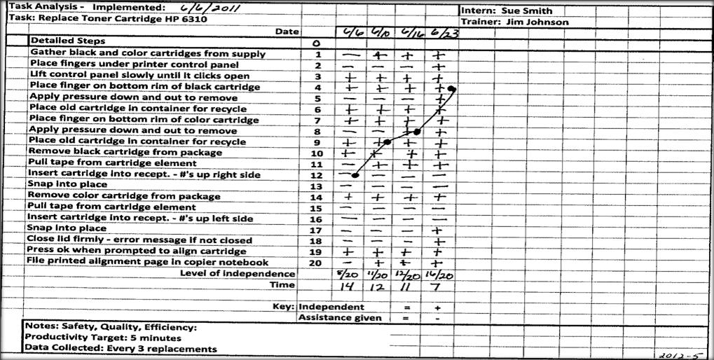
Task Analysis Form
Efficient, low cost method for data collection
(skill acquisition, safety, productivity)
Notes:
Now let’s look at an example of a task analysis form. This task analysis was developed in response to the difficulty a customer was having when trying to learn how to replace the toner cartridge in a printer. The employment consultant broke the task into small teachable steps and utilized the data collected to create a graph showing skill acquisition. Data was recorded every third time the customer inserted a cartridge. The employment consultant placed a minus sign to indicate that the customer needed assistance to complete the step and a plus sign to indicate that the customer completed the step independently and accurately. The task analysis form also shows the customer’s level of independence and speed over a period of training sessions.

Slide 16











Delivering
Assistance
Notes:
We have already touched on the different learning styles people utilize to learn new activities. Let’s revisit that concept to consider your delivery and degree of assistance when training someone. For example, if someone learns best from verbal assistance, you may decide to describe or tell them how to do the task. When delivering this type of assistance, it’s important to keep the verbal information you are sharing specific to the task your customer is trying to learn. For example, while training, it is typically a good idea to stay away from social conversation so that you can both concentrate on learning. You will also want to provide time and space for your customer to process the verbal information you are sharing, so be sure to avoid overloading them with too much at once. And remember that your role as the employment consultant is to fade from the customer, so make decisions about your training method based on that overall goal. Another type of assistance is physical guidance, also referred to as hand-on-hand. When you provide this type of assistance you, as the employment consultant, are physically guiding your customer through the task. This assistance can range from light touch, for example, to give information about movement, all the way to full guidance or moving someone’s hands or body. This type of assistance requires close proximity and physical contact so we want to introduce caution with this type of assistance. While some customers will find physical guidance very reinforcing and helpful, others can find it very distracting and even controlling. It’s very important to continually assess how your customer is responding to this form of assistance and modify your delivery as needed. And remember, again, your role is to fade your assistance and help over time, so be sure that if you are providing physical guidance, your customer is learning to do their task in a way that they will be independent when you are no longer there. Physical prompts and gestures are another form of assistance. This type of training may include pointing or motioning with your hands to help your customer learn. For example, you may point to an empty napkin dispenser to direct your customer’s attention to the cue that it is empty and needs to be refilled. Modeling is when you show someone how to do the task by doing it yourself. This type of assistance can be very effective if the customer is a visual or tactile learner. Written and visual assistance is when you utilize pictures or words to explain a task. This type of assistance can also show the order of steps for someone that has trouble remembering what to do next in their job. Please remember that every customer is different, and some people will be successful with a mix of several different types of assistance, while others may do best with one specific type.

Slide 17
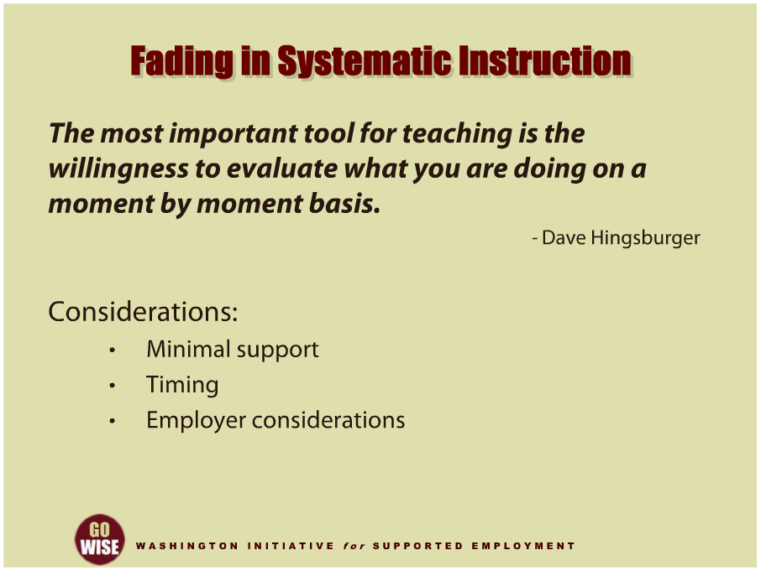
Fading in Systematic Instruction
Notes:
As we’ve learned over the last few minutes, systematic instruction includes tools such as task design and task analysis, as well as different forms of assistance. All of these components will help prepare you, as the employment consultant, to train your customer on a new activity. Dave Hingsburger once said, “The most important tool for teaching is the willingness to evaluate what you are doing on a moment-by-moment basis.” Your attention and actions should always include a focus on fading as you train someone. This means you should be continually thinking about opportunities to fade from your customer, even when you are first helping them learn to do their job. Systematic instruction also involves different methods of effectively decreasing or fading your training assistance. Specifically, employment consultants have learned that paying particular attention to concepts such as minimal support, timing and employer considerations will help your customer successfully learn to do their job. Let’s spend a few minutes looking at these different concepts to give you an understanding of how you can approach this phase of intensive training services.

Slide 18
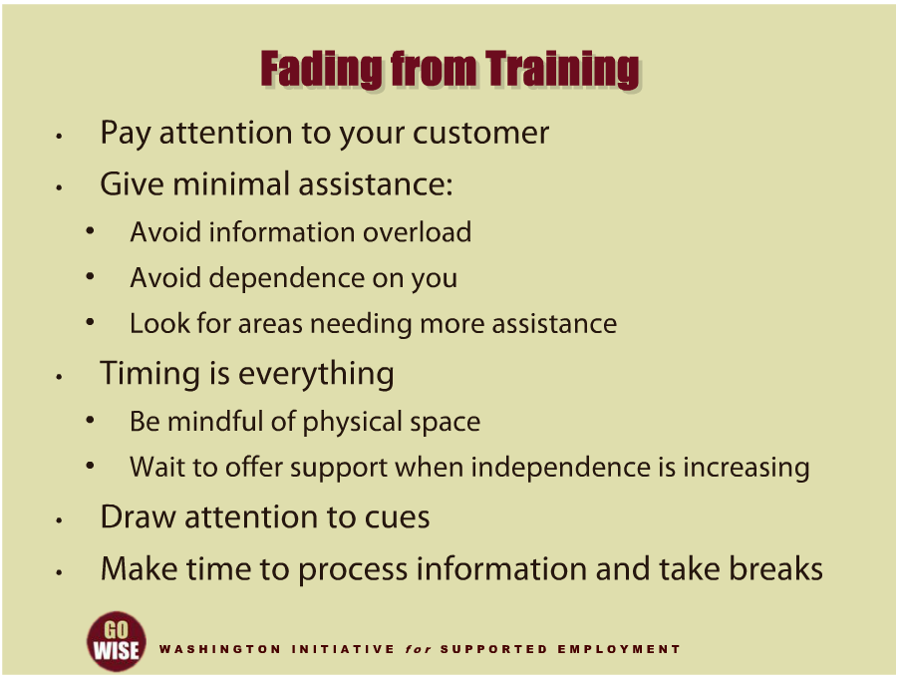
Fading from Training
Notes:
Let’s examine a few key methods involved with fading. First, we know that the best way to help someone become independent at their job is to pay attention to how they are progressing and responding to your assistance. In addition, only give the minimum assistance necessary to help your customer learn. If you give more assistance than your customer needs, they may become confused or overloaded with information. If you provide too much assistance, your customer may have to depend on you to do their job. You only want to provide the minimum assistance necessary, and let your customer do as much as they can on their own. Keeping your assistance to a minimum will help you see when your customer’s learning and independence increase, and will also help you see what parts of the activity your customer may need more assistance to perform. Another important component of training is timing. Specifically, it’s important to know when you should step aside or step in to assist. When your customer is learning a new task, it is important to anticipate and avoid errors that will be hard to relearn later, so helping them establish the correct patterns and steps early in their learning is important. It is equally important to consider the physical space you put between yourself and your customer during training. For example, when you see your customer’s independence increase, make an effort to physically move away from them. This helps send the message that the customer does not need you to be physically present to continue working on the task. And as your customer shows increasing independence, extend the time you wait before you offer assistance. This can seem a bit awkward at first, but it allows you time to assess whether the customer truly needs your assistance or has become dependent on your help to do their job. Knowing when to assist is like practicing how to dance, so be patient but stay alert and ready to respond when needed. When you do offer assistance, make sure you draw the customer’s attention to the cue in the task. This way, your customer will learn what to look for and how to respond to the cues in their job, so that when you fade away from the work site they will have learned how to perform independent from you. For example, if you stand next to the person and provide support the entire time the person is learning, they will most likely need your assistance to be successful in the future.
And finally, everyone needs time to process new information. Learning can be hard for all of us, and none of us can learn well when we are not given the time to process and take breaks from training. Make sure your customer has an opportunity to take breaks and rest in between training sessions.
Please remember that decisions about when and how to fade from training should be based on your customer’s performance. If you wait to start fading for a week or two, you will find that some customers have become dependent on you to do their job. So be sure to think about fading from the very first day, and pay attention to your customer to see how they are progressing and how you can assist them to become more independent.

Slide 19
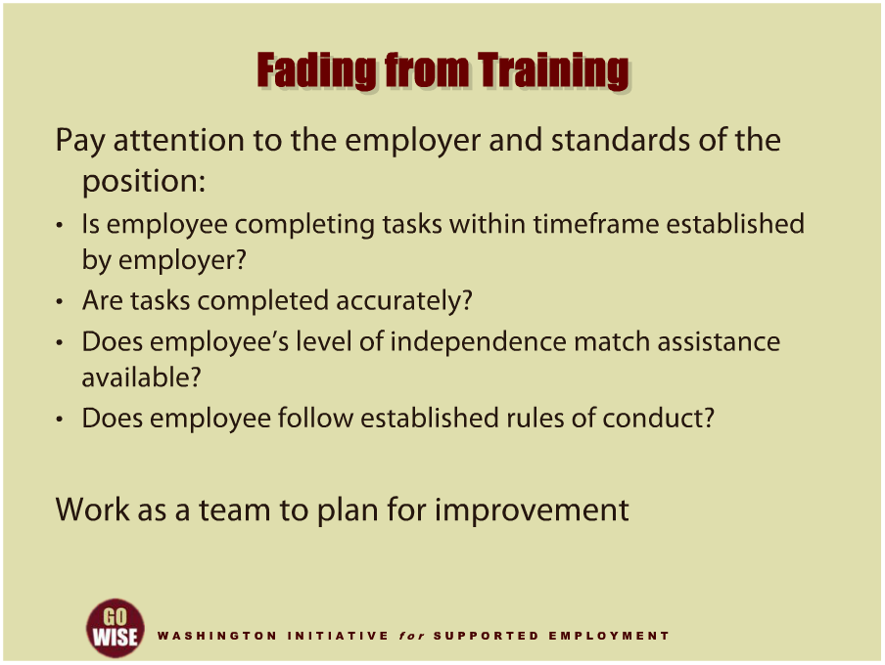
Fading from Training
Notes:
It’s also really important to pay attention to the employer during this phase of intensive training services. Not only will you be fading your assistance to your customer, but you will also be fading from the employer. In order to help them feel comfortable in supporting their new employee, you should review progress regularly with them, and measure how well the customer is meeting the employer’s standards for the job. Some questions you may ask during this phase are:
Is the employee completing tasks within the timeframe established by the employer?
Are the tasks completed accurately?
Does the employee’s level of independence match the assistance available?
Doing this alongside the customer and their employer will help you, as a team, identify any areas of concern and involve both of them in a plan to improve the situation.

Slide 20
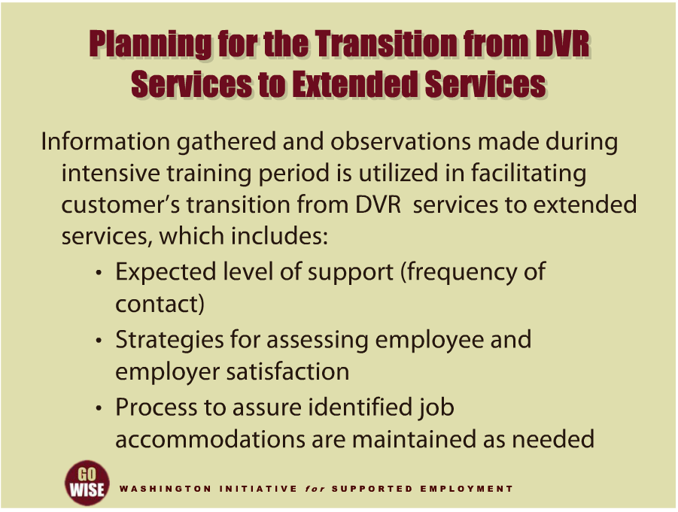
Planning for the Transition from DVR Services to Extended Services
Notes:
As we introduced at the very beginning of this training, the goal of intensive training services is to help your customer learn to do their job and successfully transition from DVR services to the extended services they will need to maintain their job. In order to help your customer move from DVR to extended services, you will be responsible for determining the quantity and type of supports they will need to maintain their job in the future. You will be expected to determine the level of support, including the frequency of contact that your customer will need in the long term, the strategies to assess both your customer’s and their employer’s satisfaction, and the process to maintain the job accommodations that have been set up. While this information will vary depending on your specific customer, job, and source for extended services, you will want to be sure and provide clear information to ensure your customer has what they need to stay successfully employed at their job. You will be reporting this information to the customer and DVR Counselor.

Slide 21
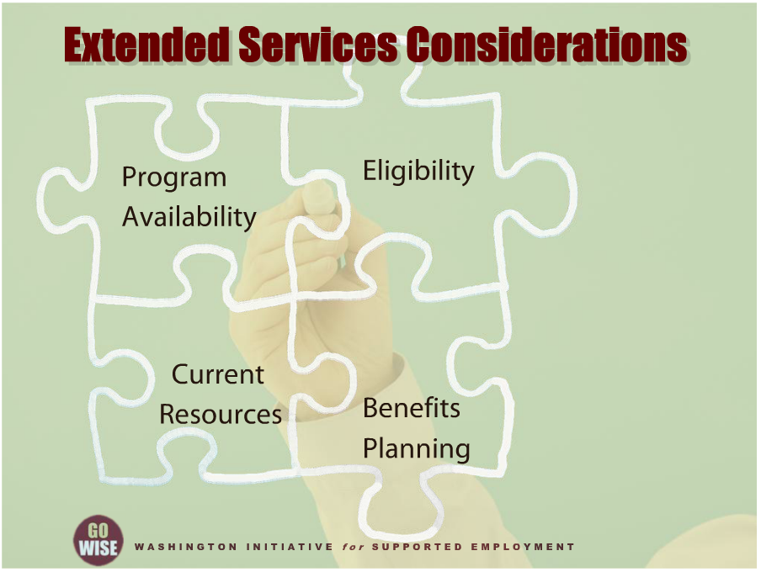
Extended Services Considerations
Notes:
Without getting too complex, we want to give you a few important pieces of information to remember as you begin thinking about extended services for your supported employment customers. There are a few different programs that can provide extended services, including county employment services, Social Security work incentives and self-pay. Which program your customer accesses will depend on several factors. First, the services your customer can access are always dependent on the availability of any given program at a particular time. You may find that there are waitlists for some services, while others are available once the customer is determined eligible. This introduces the second concept, eligibility. Your customer may or may not be eligible for specific programs. Determining eligibility early on in supported employment services will help your customer and their team plan for extended services. The third component of accessing extended services has to do with other resources your customer may have access to. Here again, looking into this information early on will help your customer prepare for the long term and avoid confusion or surprises about how they will keep their supports once DVR services have ended. And this brings us to the final but possibly one of the most important elements of determining extended services: benefits planning.
Benefits planning should have been conducted by DVR before the customer was referred to you for job placement. This information will be extremely important to helping your customer identify how they will obtain extended services to keep their job. To learn more about benefits planning, please watch, The Importance of Benefits Planning, which is another training module in this training series. It is the role of the DVR counselor to work with the customer early in the VR process to identify what source will provide the individual’s extended services. This should be determined by the time you begin providing intensive training services to the customer so that you can assist the individual in making a smooth transition from DVR services to extended services when that time comes. If you become aware of any circumstances that will delay or jeopardize the customer’s transition to extended services, it is crucial that you contact the DVR counselor immediately so that the situation can be addressed.

Slide 22
DVR Language
Employment Consultant: also known as an employment specialist, job coach, job developer, etc.
Community Rehabilitation Program (CRP): also known as employment agency, employment provider, vendor, etc.
Customer: also known as client, consumer, person with a disability, supported employee, etc.
Extended Services: also knows as long term supports, follow along services, etc.

Slide 23
Resources
Division of Vocational Rehabilitation (DVR): http://www.dshs.wa.gov/dvr/
Systematic Instruction of Functional Skills for Students and Adults with Disabilities. Keith Storey, PhD. & Craig Miner, PhD., 2011. Charles C. Thomas Publisher, LTD.
USDOL, ODEP, Integrated Employment Toolkit: http://www.dol.gov/odep/ietoolkit/
Soft Skills to Pay the Bills: Mastering Soft Skills for Workplace Success: http://www.dol.gov/odep/topics/youth/softskills
Teri Johnson Training and Consultation: teri431@Comcast.net
  Content for this training was developed by Teri Johnson from Teri Johnson Training and Consultation.

