Slide 1

Fundamentals of Supported Employment in Vocational Rehabilitation
Development of this training was funded by:
Services for Individuals Who Experience Mental Illness: 1

Slide 2
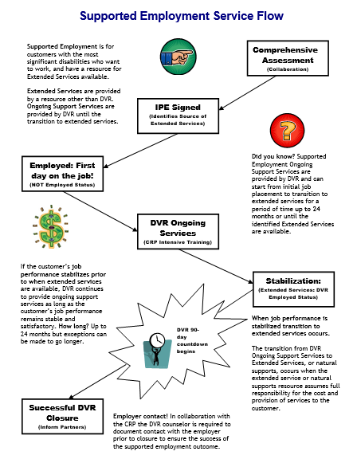

Services Flow Chart
Notes:
Before we begin the content of this training module let’s review the supported employment model that the D.S.H.S. Division of Vocational Rehabilitation, or D.V.R., must carry out. As an employment consultant serving these customers, it is important that you understand the steps of supported employment that D.V.R. must follow and your role in the process. Let’s review each step briefly.
D.V.R. supported employment services are provided to customers with the most significant disabilities who want to get and keep a permanent job. These customers require intensive support to obtain employment, as well as long term support to achieve and maintain successful job performance. Federal rules for supported employment require D.V.R. to provide the upfront vocational rehabilitation, or V.R. services known as on-going services, that a customer requires to get and learn a job. After that, a separate source will provide the extended support or long term supports the customer needs to keep their job once D.V.R. services end. All D.V.R. supported employment customers go through the same application and eligibility determination process. Once an individual is determined eligible for D.V.R. their V.R. counselor works with them to conduct a comprehensive assessment of their vocational rehabilitation needs, including whether the customer will require supported employment to get and keep a job of their choice. The comprehensive assessment often includes a community based assessment that is provided by a community rehabilitation program, or C.R.P., such as the one you work for. After the comprehensive assessment has been completed, the D.V.R. customer is assisted by their V.R. Counselor to develop an individualized plan for employment, or I.P.E. The I.P.E. identifies the customer’s employment goal along with the steps and the D.V.R. services they will require to achieve their goal. The I.P.E. must also identify the customer’s need for supported employment and what their source of long term support or extended services will be. If the source of extended services is unknown when the I.P.E. begins, there must be a strong expectation that a source will be identified within 24 months. D.V.R. services identified in the I.P.E. begin once the plan is signed by the D.V.R. customer and their V.R. counselor. Typically, the first step of an I.P.E. is for D.V.R. to authorize job placement services to assist the supported employment customer in becoming employed. Once the customer is employed then D.V.R. authorizes intensive training services to assist the customer in learning how to perform their job satisfactorily. However, once a customer reaches a stable level of satisfactory job performance, they must begin receiving their extended services from a source outside of D.V.R.. If a supported employment customer achieves stable job performance sooner than their extended services will be available, D.V.R. will continue providing ongoing support for up to 24 months. Once extended services have begun, D.V.R. keeps the case open during the first ninety days that these services are provided to make sure they meet the customer’s needs. If the customer is doing well on their job at the end of this ninety days and their extended services continue without interruption, then the customer’s D.V.R. case is closed.

Slide 3
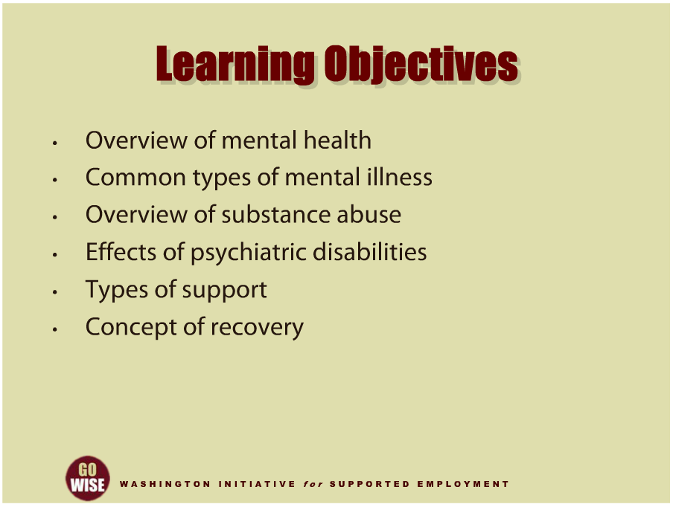
Learning Objectives
Notes:
This training will introduce you to basic concepts you will utilize as an employment consultant providing Community Rehabilitation Program services through the Division of Vocational Rehabilitation, or DVR, to customers who experience mental illness. We will begin with an introduction to mental health and common types of mental illness, including substance abuse. We will then explore the meaning of psychiatric disability, including the effects these disabilities can have on individuals’ lives. We will conclude the training by covering treatment options and the emergence of recovery as a guiding principle in the delivery of mental health and substance abuse services. We hope that by the end of this training you will have a stronger understanding of general challenges someone with mental illness may face, as well as a firmer grasp on how you, as an employment consultant, can assist your DVR customer in their supported employment efforts.

Slide 4
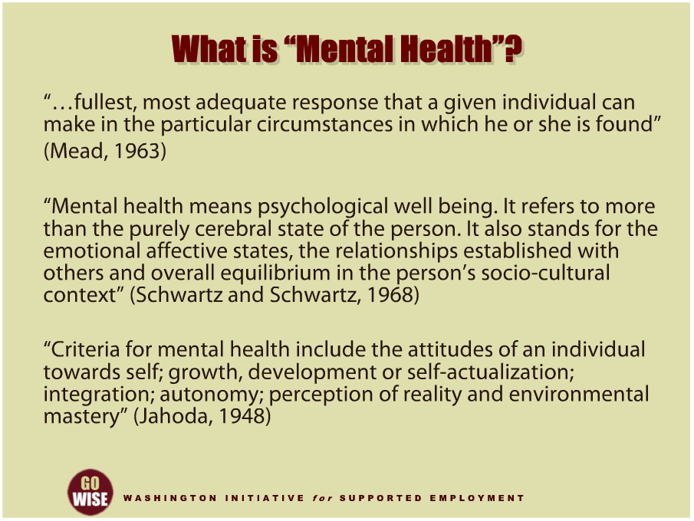
What is “Mental Health”?
Notes:
A few historical definitions of mental health provide us with a good starting point. Margaret Mead must have known about what we now call recovery when she spoke of the, “fullest, most adequate response that a given individual can make in the particular circumstances in which he or she is found.” Mead also recognized that the responses any of us may make will vary depending on the person and the environments the person is in. Schwartz and Schwartz recognized the importance of a person’s relationships with others to mental health. Specifically, mental health must be viewed through a social and cultural lens. This was an early call to the need for cultural competence on the part of mental health service providers. “Mental health means psychological well-being. It refers to more than the purely cerebral state of the person. It also stands for the emotional affective states, the relationships established with others and overall equilibrium in the person’s socio-cultural context.” And finally, Jahoda summarized beautifully the internal and external ingredients necessary to mental health: “Criteria for mental health include the attitudes of an individual towards self; growth, development or self-actualization; integration; autonomy; perception of reality and environmental mastery.” As you will learn in the next several minutes, the absence of any of these may be seen as a sign of possible mental illness.

Slide 5
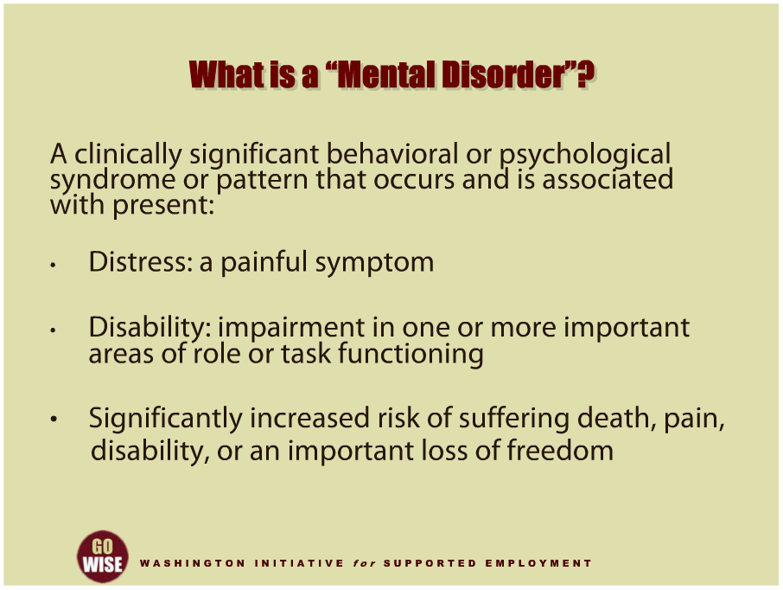
What is a “Mental Disorder”?
Notes:
You or someone you know may have recently asked, What is a mental disorder? Mental disorders are characterized as clinically significant behavioral or psychological syndromes or patterns that occur in a person. In addition, these syndromes and patterns are associated with three elements: distress, disability and risk of suffering. Distress means a painful syndrome. Disability means an impairment in one or more important areas of role or task functioning. This second element, disability, is important because for many people, a serious mental disorder often impairs their ability to work, maintain healthy social relationships, and sometimes the ability to take care of him or her-self. And finally, the third element of a mental disorder includes a significantly increased risk of suffering death, pain, disability, or an important loss of freedom.

Slide 6
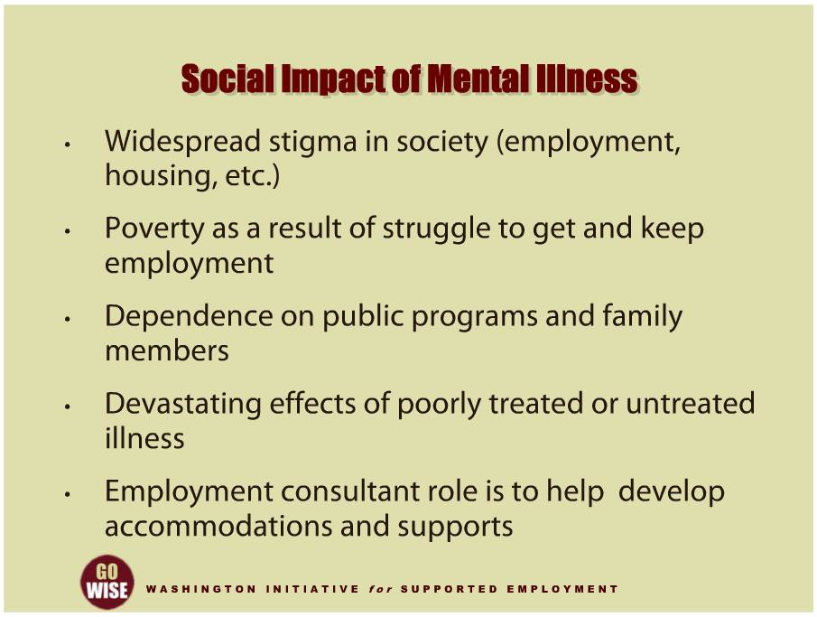
Social Impact of Mental Illness
Notes:
Let’s pause for a few minutes to consider how mental illness can impact someone’s life. First, as you may have already noticed, mental illness is often stigmatized in our society. Stigma contributes to a lack of support for mental health services and makes it harder for people to get the help they need. Stigma also contributes to discrimination in employment, housing and other important areas of community living. In addition, people with mental illness often face poverty due to the struggles they encounter when trying to get and keep employment. There are several factors to explain why and how this happens. For example, serious mental illness typically surfaces when people are in adolescence or early adulthood. And for many people, the onset of mental illness gets in the way of developmental milestones such as completing school or finding employment. These young adults often become vocationally disabled, making them eligible for disability income and health care coverage through federal programs such as Social Security and Medicaid. As we often see, people who depend on these programs often fall into poverty since their sole sources of income and health coverage are minimal. People with mental illness are also often forced to depend on their family members for help. And we see families sometimes grow weary of the demands of caregiving and challenges in accessing services. For those who experience poorly treated or untreated mental illness, there can be devastating results such as homelessness, and encounters with law enforcement and the court system. To deal with this downward spiral, the field of mental illness is moving towards a recovery-driven system. You will learn more about recovery later in this training. Ultimately, it’s important to note that the sooner someone experiencing mental illness gets the services they need, the better their outcome and success will likely be. These social factors are obviously important to you as an employment consultant since you will be responsible to help your customer establish accommodations and supports at their worksite. Ultimately, your thoughtful consideration of the social aspects your customer will face will most likely support their success in obtaining and maintaining a job.

Slide 7
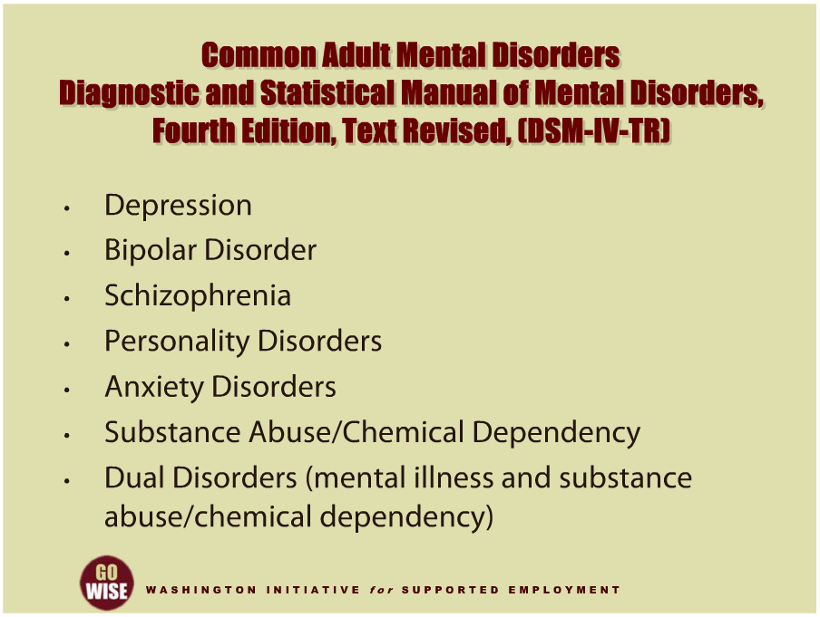
Common Adult Mental Disorders
Notes:
Now let’s briefly explore the major mental illnesses that some of your customers may experience. The following information comes from the Diagnostic and Statistical Manual of Mental Disorders, Fourth Edition, Text Revised, or DSM IV-TR. Please note that the information in this training is intended to provide you with basic knowledge of various illnesses and an understanding of the impacts they may have on someone’s life. This training is not intended to train you to be a clinician. If you would like to learn more about a particular topic in this training, please go to the resources section at the end of this module or request additional training from your supervisor. In addition, you are encouraged to watch the second training module in this series, Services for Individuals Who Experience Mental Illness: 2, to learn more about how DVR customers access services, as well as proven models that have effectively helped people obtain and maintain employment. The common mental disorders are depression, bipolar disorder, schizophrenia, personality disorders, anxiety disorders, substance abuse or chemical dependency, and dual disorders of mental illness and substance abuse or chemical dependency. While there are many other mental disorders, these are the ones most likely to be encountered in your work as an employment consultant. Now let’s look more closely at each one.

Slide 8
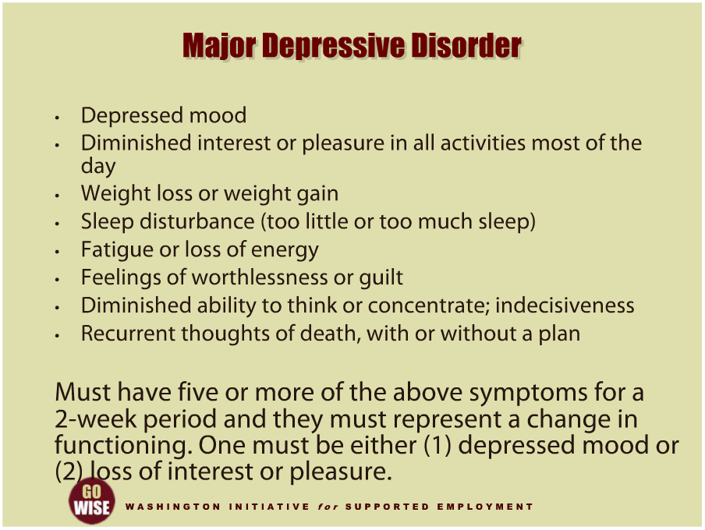
Major Depressive Disorder
Notes:
Major depressive disorder, also called major depression, is the most common mental illness. It is also the one that we know the most about and have the most effective treatments for. People who experience this disorder may have a depressed mood, a diminished interest or pleasure in all activities during most of the day, they may have weight loss or weight gain, sleep disturbance where they get too little or too much sleep, fatigue or loss of energy, feelings of worthlessness or guilt, a diminished ability to think or concentrate; indecisiveness, or recurrent thoughts of death, with or without a plan. Technically, people who experience this disorder will have five or more symptoms for a two-week period and they must represent a change in functioning. One must have either a depressed mood or loss of interest or pleasure. Please note that the definition states “a change in functioning.” This is how most serious mental illnesses reveal themselves.

Slide 9
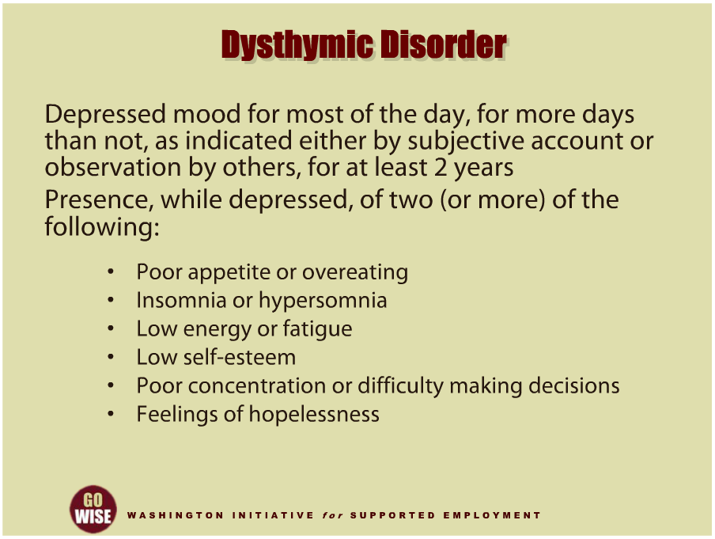
Dysthymic Disorder
Notes:
Dysthymic Disorder, while not as severe as major depression, can still be quite disabling. Dysthymic disorder is when someone experiences a depressed mood for most of the day, for more days than not, as indicated either by subjective account or observation by others, for at least two years. It also includes the presence, while depressed, of two or more of the following: poor appetite or overeating, insomnia or hypersomnia, low energy or fatigue, low self-esteem, poor concentration or difficulty making decisions and or feelings of hopelessness. Please note that symptoms must have existed for at least two years. As an employment consultant, you may be responsible for helping someone who is experiencing these symptoms. While it’s obvious that these symptoms could interfere with a customer’s ability to work, the concept that they experienced them for at least two years compounds the challenges and the supports needed to help them become successful.

Slide 10
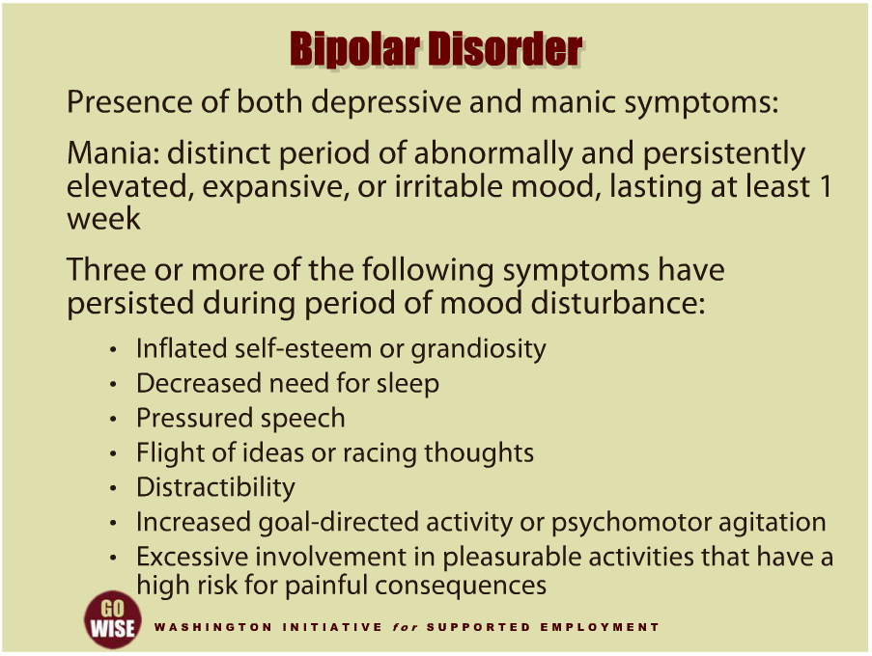
Bipolar Disorder
Notes:
Bipolar disorder used to be known as manic depressive illness. It includes the features associated with major depression and the following manic symptoms: Mania is defined as a distinct period of abnormally and persistently elevated, expansive, or irritable mood, lasting at least one week. In addition, three or more of the following symptoms will have persisted during a period of mood disturbance: inflated self-esteem or grandiosity, decreased need for sleep, pressured speech, flight of ideas or racing thoughts, distractibility, increased goal-directed activity or psychomotor agitation, and excessive involvement in pleasurable activities that have a high risk for painful consequences. Here again, these symptoms may greatly impact the type or degree of supports you provide to your customer if they are experiencing bipolar disorder. For example, consider how an abnormally and persistently elevated mood, which lasts at least one week, would impact on someone’s ability to maintain their job.

Slide 11
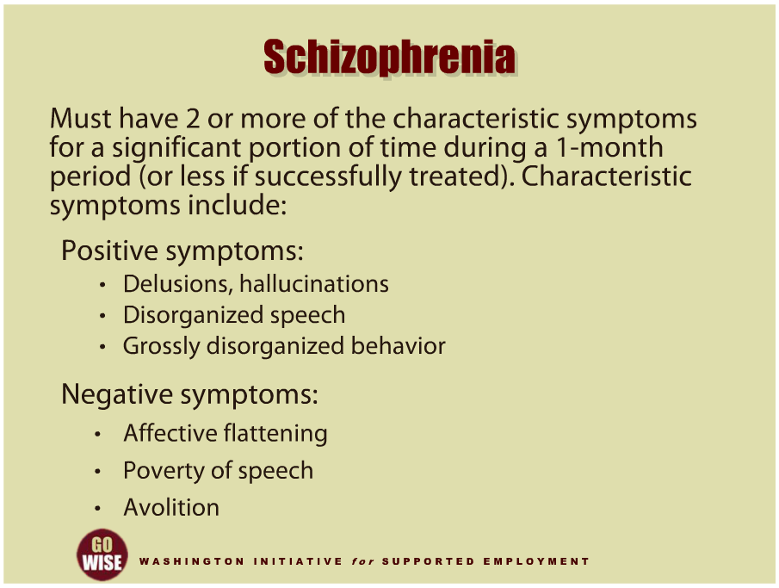
Schizophrenia
Notes:
Schizophrenia is a psychotic disorder, meaning that there are disturbances in cognition or thinking. It is characterized by both positive and negative symptoms. Schizophrenia is characterized by someone experiencing two or more symptoms for a significant portion of time during a one-month period, or less if successfully treated. Characteristic positive symptoms include: delusions, which are fixed beliefs that are not grounded in reality. For example, people experiencing delusions may believe they are being followed, monitored or persecuted by others or the government. Hallucinations are a sensory misperception, such as hearing voices. Delusions and hallucinations can make schizophrenia quite disabling. In addition, disorganized speech and grossly disorganized behavior can be positive symptoms of schizophrenia. Negative symptoms are also present in most cases of schizophrenia. These symptoms include affective flattening or a reduction in the range and intensity of emotional expression, poverty of speech, avolition or the reduction, difficulty, or inability to initiate and persist in goal-directed activity.

Slide 12
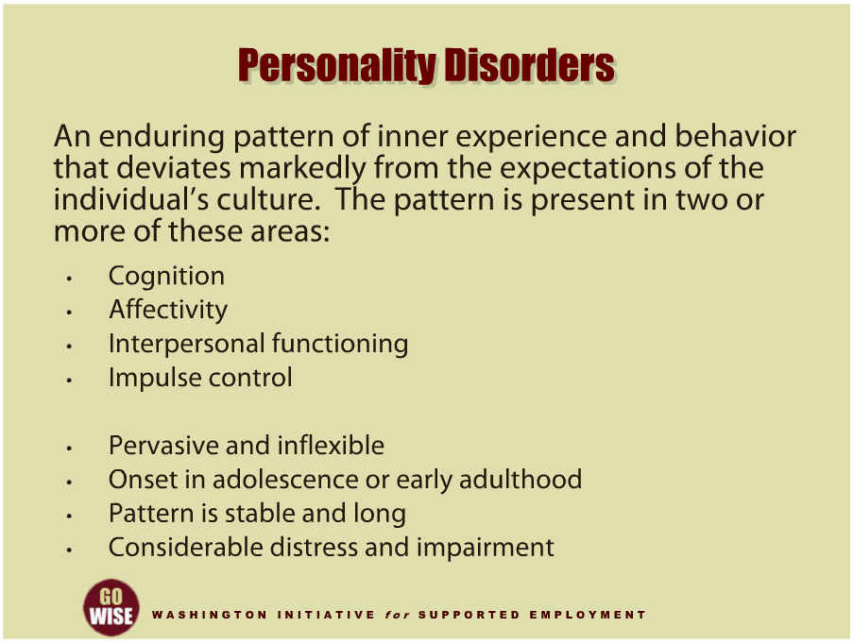
Personality Disorders
Notes:
Personality disorders differ from the previous disorders in significant ways. We first covered depression, which is a disorder of mood. Schizophrenia is a psychotic disorder that impacts cognition or thinking. A personality disorder is more about a person’s way of being or how they present to the world. Someone’s inner experience and behavior is significantly different from the expectations of the individual’s culture. The pattern is present in two or more of the following areas: cognition or how someone perceives and interprets themselves, others, and events, affectivity or the range, intensity, likeliness of change, and appropriateness of emotional response, interpersonal functioning, and or impulse control. Personality disorders are pervasive and inflexible and the onset occurs in adolescence or early adulthood. The enduring pattern is stable and of long duration. Personality disorders often lead to considerable distress and impairment. They can be difficult to treat and are often quite disabling.

Slide 13
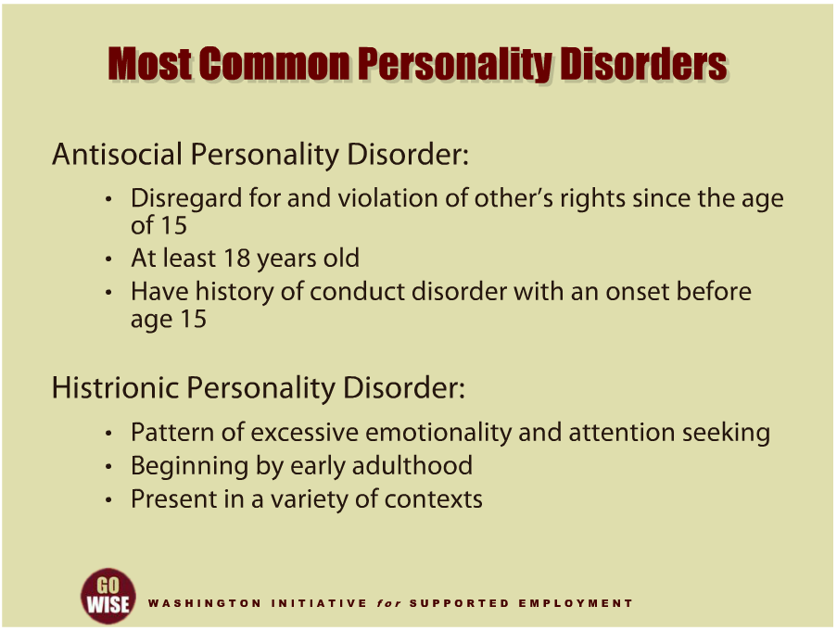
Most Common Personality Disorders
Notes:
Now let’s briefly look at the most common personality disorders. First, Antisocial Personality Disorder is characterized by a pervasive pattern of disregard for, and violation of, the rights of others since the age of fifteen. In addition, someone experiencing antisocial personality disorder will be at least eighteen years old and have a history of conduct disorder with an onset before age fifteen. Histrionic Personality Disorder is characterized by a pervasive pattern of excessive emotionality and attention seeking behavior, beginning by early adulthood and present in a variety of contexts.

Slide 14
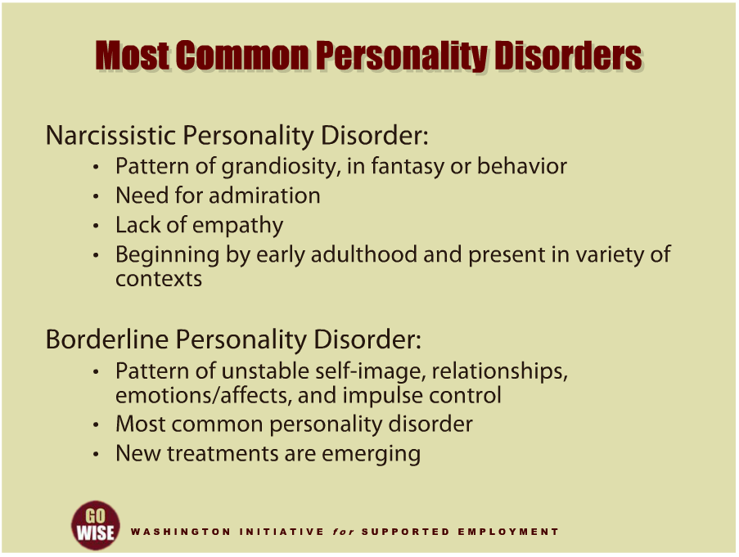
Most Common Personality Disorders
Notes:
Narcissistic Personality Disorder is characterized by a pervasive pattern of grandiosity, in fantasy or behavior, the need for admiration, and lack of empathy, beginning by early adulthood and present in a variety of contexts. Borderline Personality Disorder is characterized by a pattern of unstable self-images, relationships, emotions and affects, and impulse control. Please note that Borderline Personality Disorder, or BPD, is the most common of these and thankfully, new treatments are emerging that are effective for treating this disorder, providing a stronger foundation for recovery, including employment.

Slide 15
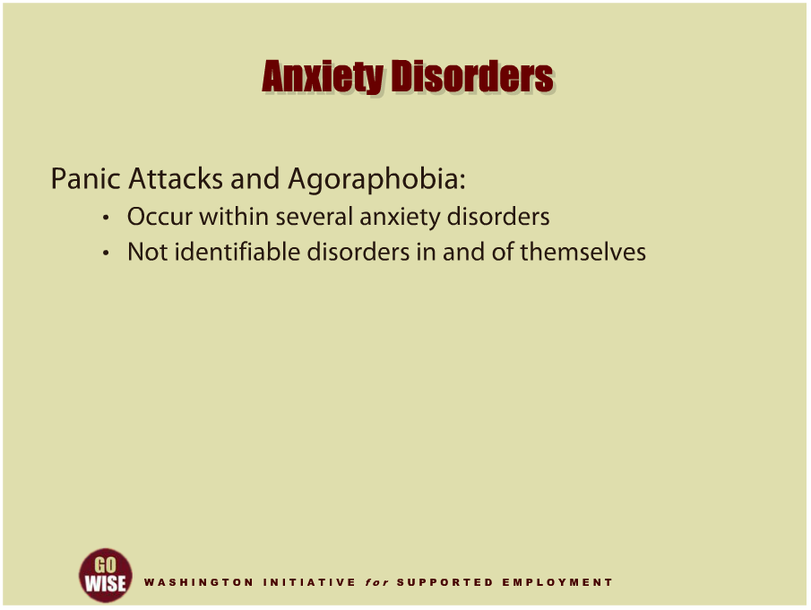
Anxiety Disorders
Notes:
Next let’s examine anxiety disorders. First, it’s important to note that anxiety disorders are very common and they vary according to how disabling they may become. Panic attacks and agoraphobia are the first of these, and occur within several different anxiety disorders. In fact, panic attacks and agoraphobia are not identifiable disorders in and of themselves.

Slide 16
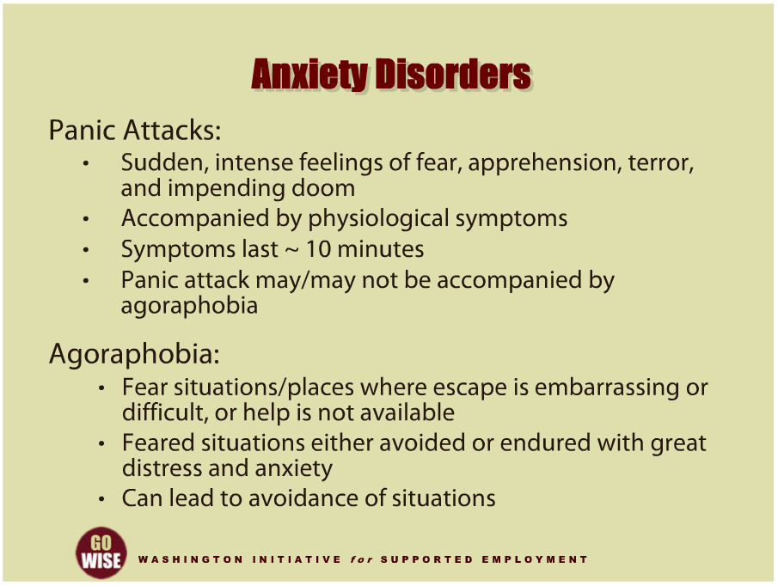
Anxiety Disorders
Notes:
Panic Attacks are the sudden onset of intense feelings of fear, apprehension, terror, and impending doom, accompanied by physiological symptoms. A person may fear he or she is going crazy. The symptoms last for a discrete period of about ten minutes. A panic attack may or may not be accompanied by agoraphobia. Agoraphobia consists of fears about being in situations or places where escape would be embarrassing or difficult or help would not be available if a panic attack were to occur. The feared situations are either avoided or endured with great distress and anxiety that a panic attack will occur. This can lead people to avoid a variety of situations. For example, a person with agoraphobia may fear being away from home, riding in a car, riding in an elevator, etc.

Slide 17
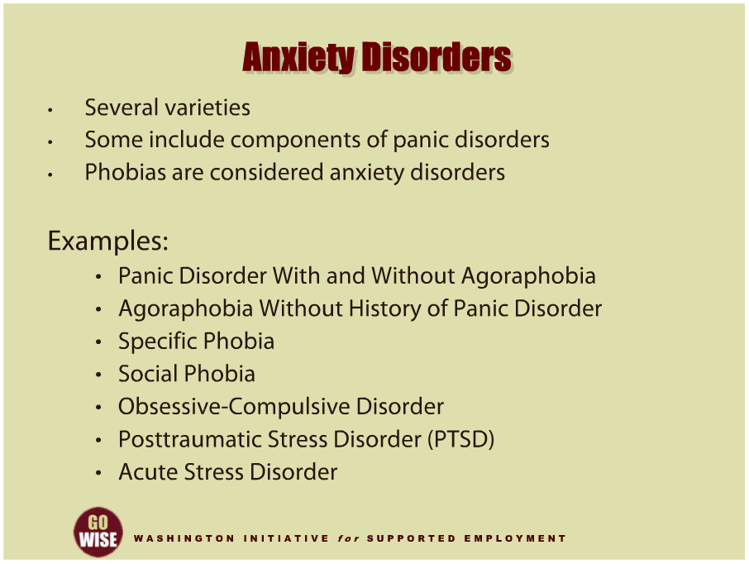
Anxiety Disorders
Notes:
As an employment consultant, it’s important for you to know that there are several varieties of anxiety disorders. Some of these disorders include components of panic disorders, and phobias are also considered anxiety disorders. For example, there are panic disorders with and without Agoraphobia, which tend to show symptoms of recurrent, unexpected panic attacks with or without accompanying Agoraphobia. People may also experience Agoraphobia without a history of Panic Disorders where the person has a presence of Agoraphobia or panic-like symptoms but without a history of Panic Disorder. Some people also experience specific phobias where they have anxiety and fear about a specific object or situation that they usually avoid. Social phobias occur when an individual has anxiety about exposure to certain social or performance situations; and they typically tend to avoid those situations. Obsessive-Compulsive Disorder occurs when an individual has obsessions or thoughts, and or compulsions or actions that serve to neutralize anxiety. Posttraumatic Stress Disorder, also known as PTSD, results from exposure to a traumatic event. Symptoms include flashbacks of the traumatic event, increased arousal, and avoidance of stimuli associated with the trauma. Onset of symptoms can be delayed for days, months, or years. PTSD is often in the news as combat veterans and victims of natural disasters learn to cope. And finally, Acute Stress Disorder poses symptoms similar to PTSD, but the symptoms occur immediately after exposure to a traumatic event.

Slide 18
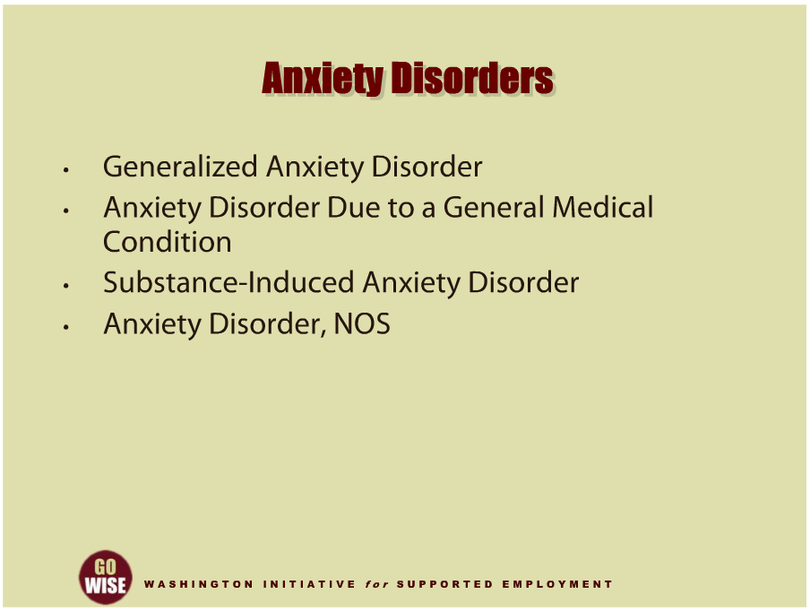
Anxiety Disorders
Notes:
And finally, here are a few more types of anxiety disorders that people may experience. Generalized Anxiety Disorder involves persistent, excessive anxiety and worry that last at least six months. Generalized anxiety disorder is quite common and may or may not result in disability. Many people tolerate these symptoms with little, if any, disturbance in role or task functioning. Anxiety disorders can also be the result of a general medical condition. Substance-induced anxiety disorders occur when anxiety is a direct physiological consequence of exposure to a drug, medication, or toxin. And sometimes anxiety symptoms do not meet the criteria for any specific anxiety disorder.

Slide 19
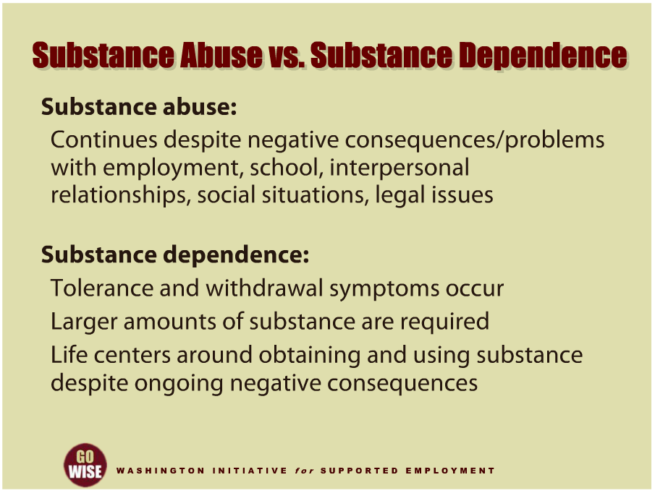
Substance Abuse vs Dependence
Notes:
Now we will explore the concepts and differences between substance abuse and substance dependence. Substance abuse is a maladaptive pattern of abuse leading to significant impairment in functioning or distress. An individual will continue to abuse substances despite the consequences and problems that result in terms of their employment, school, interpersonal relationships, social situations, and or legal issues. An important element here is that the abuse continues in spite of adverse or negative consequences to their life. It is fairly easy to understand how much substance abuse can and does interfere in one’s ability to work. The second term, substance dependence, may involve a physiological tolerance where increasing amounts of substances are required to become intoxicated. Substance dependence also involves withdrawal symptoms. In this instance, an individual takes larger amounts of the substance while trying to cut down or control their substance use. Often, the individual’s life centers around obtaining and using the substance despite the ongoing negative consequences. The chief difference is that substance dependence involves increasing the amount of substance that is required to achieve intoxication and avoid withdrawal. This is where things can really spiral out of control as one is consumed with obtaining and using substances despite more and more negative consequences. Please remember that the power of substance dependence is probably stronger than any one person’s words. That is, until the right treatment is provided.

Slide 20
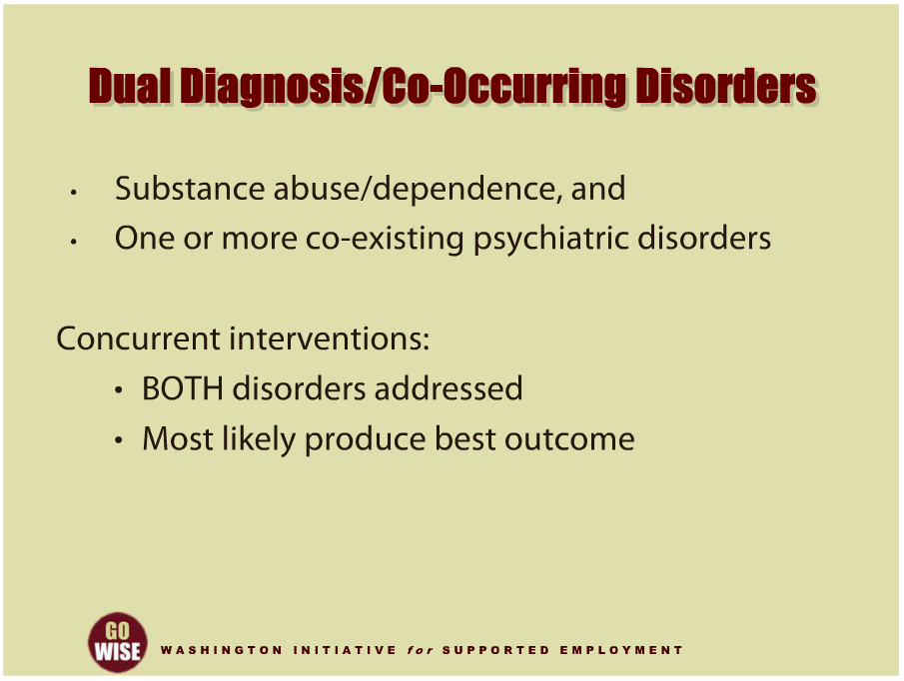
Dual Diagnosis / Co-Occurring Disorders
Notes:
An individual who has a dual diagnosis or co-occurring disorder has both a substance abuse or dependence problem and one or more co-existing psychiatric disorders. Dual diagnosis or co-occurring disorders are very common and it is difficult to determine which comes first, the mental illness or the substance abuse or dependence. What is known is that concurrent treatment interventions that address BOTH disorders will most likely produce the best outcome for the individual.

Slide 21
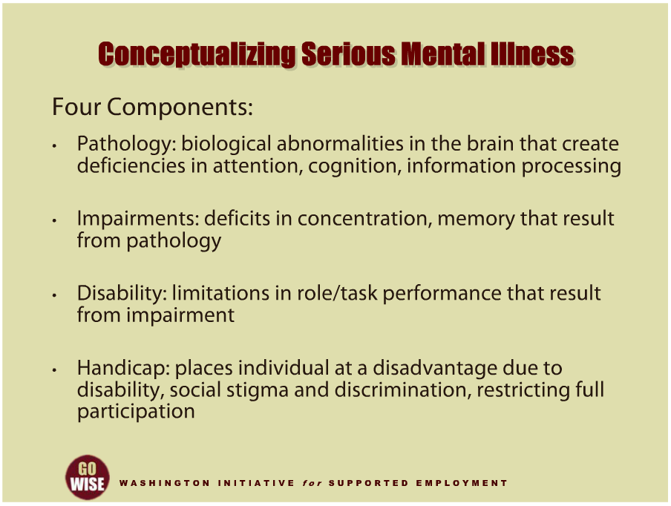
Conceptualizing Serious Mental Illness
Notes:
The Center for Psychiatric Rehabilitation at Boston University conceptualized serious mental illness as consisting of four components. First, they cite the importance of pathology, or where the illness comes from. This can take the form of biological abnormalities in the brain that create deficiencies in attention, cognition and or information processing. For example, an individual may have differences in their brain chemistry, such as their levels of dopamine or serotonin. The second component is impairment, or the deficits in concentration, memory and other symptoms that result from the pathology. For example, an individual may experience delusions, hallucinations, anxiety and depression like we have already discussed. The third component is disability, which is the result of the impairments and limits the individual’s performance in role or task performance. This is often where you come in as an employment consultant since you are responsible to help your DVR customer develop accommodations and supports to overcome their barriers to obtaining and maintaining employment. The forth component is handicap, which is a result of the individual’s disability, and places them at a disadvantage in society, often restricting someone from fully participating. Handicap is often the result of stigma and discrimination, as was discussed earlier. Understanding the components of mental illness and your role in supporting your DVR customers is at the heart of a psychiatric rehabilitation approach.

Slide 22
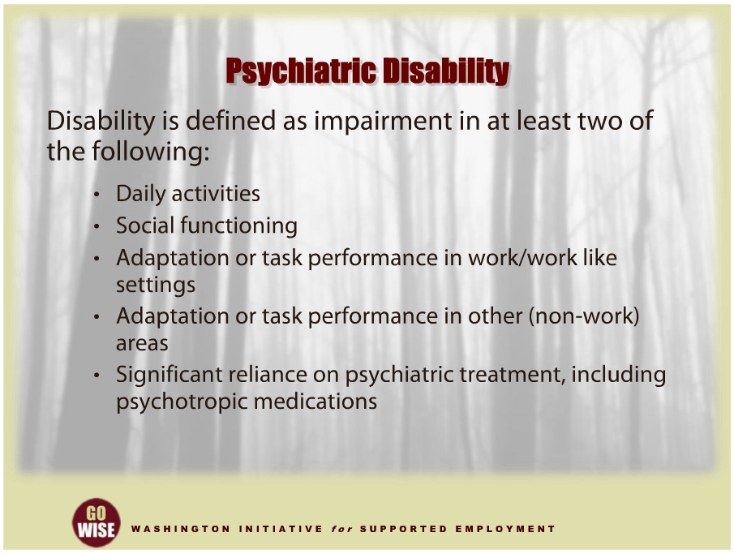
Psychiatric Disability
Notes:
Psychiatric disabilities impact much more than an individual’s ability to work. An individual may have challenges in their daily activities, or the basic tasks involved with caring for themselves. They may face challenges in social functioning or interacting with others. Your customer may need supports to help them be successful at their job or in other settings that they frequent. And finally, depending on the significance of their disability, they may have to depend on psychiatric treatment to live in the community. For some, this treatment may include psychotropic medications.

Slide 23
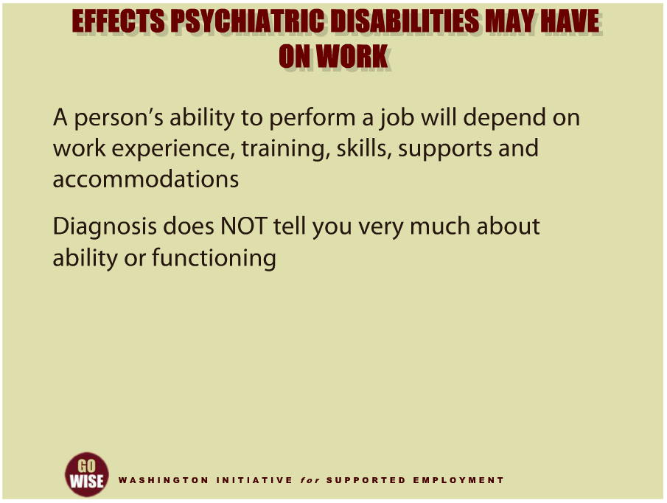
Effects Psychiatric Disabilities May Have on Work
Notes:
Let’s take a few moments to consider how a psychiatric disability may impact your DVR customers’ ability to work. Before we begin, please remember that it’s impossible to generalize the characteristics of all people with psychiatric disabilities, and that your individual customer will experience their disability in their own way. There is no one size fits all approach. Some workers with psychiatric disabilities explain that they have difficulty maintaining concentration. Some workers who take medications to control their psychiatric symptoms report having side effects such as hand tremors, excessive thirst, or blurred vision. And some individuals report difficulty in focusing on multiple tasks at the same time, particularly when the environment has a lot of noise and or distractions. Of course, the strengths and weaknesses of each applicant or employee must be assessed individually, regardless of the presence of a disability. The worker's ability to perform a job will depend on his or her work experience, training, skills, and the supports and accommodations you have helped them establish. Their ability is not only dependent on the presence or absence of a psychiatric diagnosis. In addition, please remember that a diagnosis does not tell you very much about the individual’s abilities or functioning. Individualized assessment will help determine the direction and best types of support for success. Next, let’s look at a few models that have proven successful in serving individuals who experience psychiatric disabilities.

Slide 24
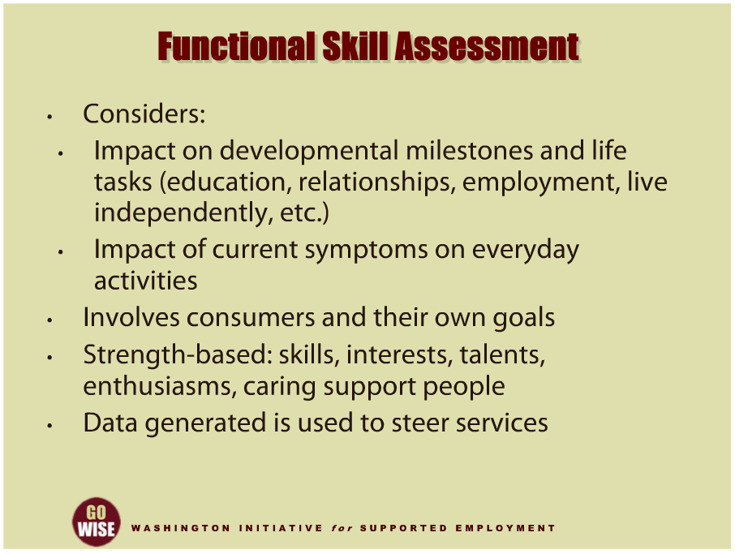
Functional Skill Assessment
Notes:
Functional skill assessment is one tool that has proven useful in serving individuals who experience psychiatric disabilities. This is especially true when serving individuals within the field of supported employment. Let’s examine why. First, Functional Skill Assessments take into consideration how illness has impacted the customer’s developmental milestones and life tasks. For example, the assessment may examine how the illness effected their educational goals, relationships, employment or ability to live independently. The Functional Skill Assessment also considers how someone’s current symptoms interfere with everyday activities. In addition, this tool includes the DVR customer in setting their own personal goals. And finally, Functional Skill Assessment utilizes a strengths-based approach to assessment. By incorporating the individual’s internal and environmental strengths, including their skills, interests, talents, enthusiasms, and caring support people as resources, we have seen how service planning and service delivery can support customers in their employment efforts. One final element to functional skill assessment is that data is generated to help steer services in the right direction, in response to the unique strengths and needs of the customer.

Slide 25
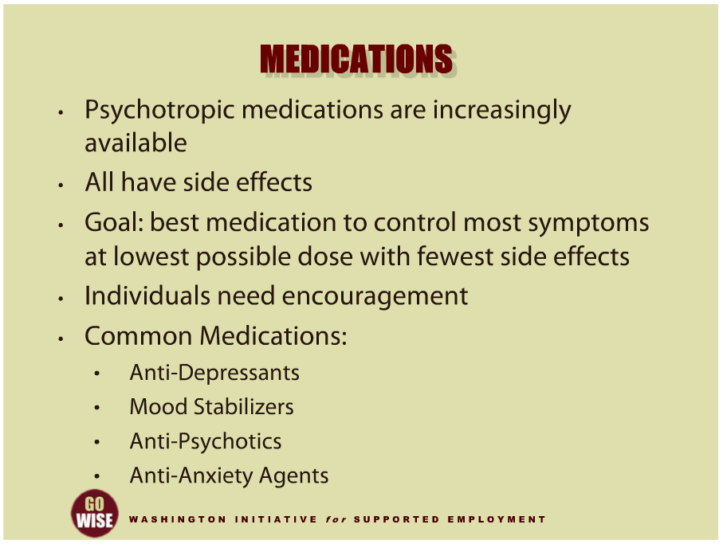
Medications
Notes:
Next let’s briefly cover medication that may be utilized to help someone with serious mental illness. First, it’s important to realize that an increasing number of psychotropic medications are becoming available and all medications have side effects. In fact, many psychotropic medications have significant side effects. Side effects can include sedation, dryness of mouth, sexual side effects, weight gain, toxicity, nausea, blurred vision, constipation, hypertension, and headache. Side effects can vary depending on the individual, the medication prescribed and the dosage. Prescribers and patients must balance the anticipated side effects against the anticipated symptom relief. The goal is to select the best medication to control the most symptoms at the lowest possible dose with the fewest side effects. As you will also learn, medications often take time to work and individuals need encouragement to hang in there when taking a new medication. The medications most commonly prescribed are anti-depressants, mood stabilizers, anti-psychotics and anti-anxiety agents. The best outcomes are often achieved by a combination of treatment approaches. Any one alone may fall short in helping someone recover.

Slide 26
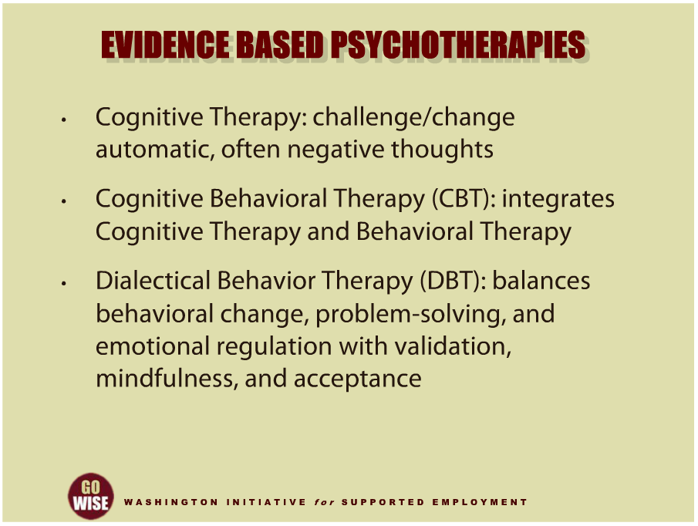
Evidence Based Psychotherapies
Notes:
Evidence based practices are growing in popularity and for good reason. Rigorously researched, these therapies have demonstrated utility and proven outcomes. The following are a few examples of the different types of therapies that someone you serve may undergo in their road to recovery. Cognitive Therapy seeks to challenge and change automatic, often negative, thoughts. Cognitive Behavioral Therapy, or CBT, is perhaps one of the most frequently used psychotherapeutic orientations, and considerable research supports its effectiveness and adaptability in clinical practice. As the name implies, CBT integrates the rationale and techniques from both cognitive therapy and behavioral therapy, taking advantage of their complimentary relationship. For example, as cognitive therapy seeks to change behavior by challenging maladaptive thoughts, behavioral therapy employs more direct, yet complimentary methods, such as pairing reinforcing stimuli with a desired behavior or aversive stimuli with an undesired behavior. This approach has been very helpful, particularly for people who experience depression and schizophrenia. Dialectical Behavior Therapy, or DBT, is a cognitive-behavioral treatment approach that emphasizes balancing behavioral change, problem-solving, and emotional regulation with validation, mindfulness, and acceptance of patients. DBT has been found to be very helpful to people who experience borderline personality disorder and substance abuse.

Slide 27
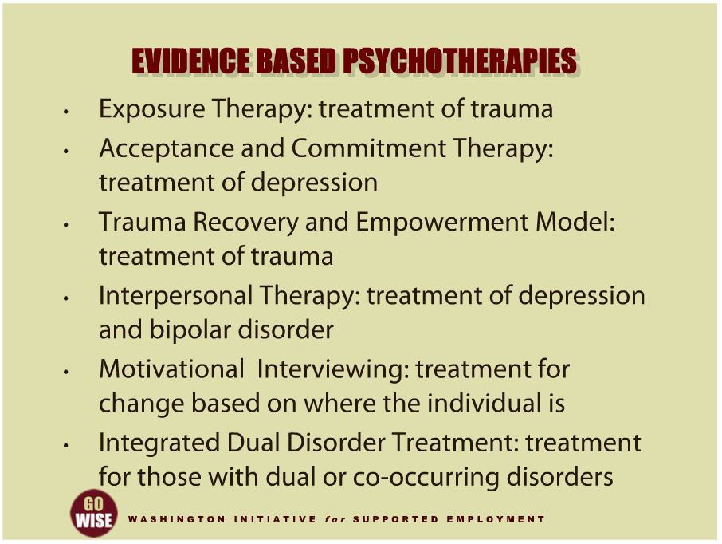
Evidence Based Psychotherapies
Notes:
Exposure Therapy is an evidence-based practice in the treatment of trauma, especially post-traumatic stress disorder. Acceptance and Commitment Therapy is an evidence-based practice for the treatment of depression. Trauma Recovery Empowerment Model is another evidence-based practice for the treatment of trauma. Interpersonal Therapy is an evidence-based practice for the treatment of depression and bipolar disorder. Motivational Interviewing is an evidence-based practice utilized for almost everything that needs changing. It assesses the stage of change for a person and directs the practitioner to deliver interventions based on exactly where the consumer is, not behind, nor ahead of him or her. Integrated Dual Disorder Treatment is an evidence-based practice for those with dual or co-occurring disorders.

Slide 28
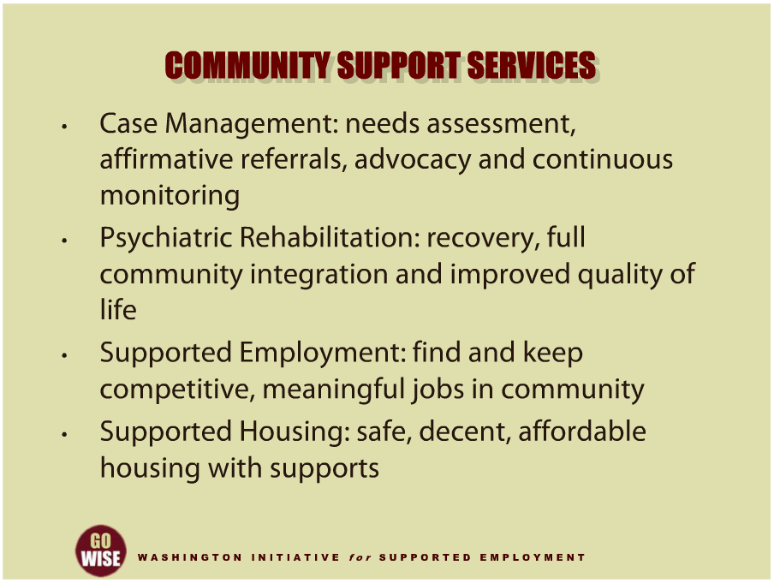
Community Support Services
Notes:
Community support services are another form of assistance that many individuals choose to access in their path to recovery. While these services may look different depending on the specific community, we want to give you a general understanding of what types of supports are available to assist individuals. Case management was developed as a result of the challenges during the early days of community mental health. The intention of this service model is to arrange for the delivery of all of the services someone may need in order to live in the community. Case management stresses comprehensive assessment of needs, affirmative referrals for needed services, advocacy to assure needed linkages are made, and continuous monitoring to assure that needed linkages are made and sustained. Psychiatric rehabilitation promotes recovery, full community integration and improved quality of life for persons who have been diagnosed with any mental health condition. Psychiatric rehabilitation services are collaborative, person-directed and individualized, and are an essential element of the health care and human services spectrum. They should be evidence based, with a focus on helping individuals develop skills and access the supports and other resources needed to increase their capacity to be successful and satisfied in the living, working, learning, and social environments of their choice. Supported Employment helps people with mental illnesses find and keep meaningful jobs in the community. Eligibility is based on consumer choice, and services are integrated with comprehensive mental health treatments. Competitive employment is the goal in supported employment, and personalized benefits counseling is provided as a key component for individuals who depend on medical benefits to live in the community. The Individual Placement and Support Model of Supported Employment, or IPS, is an evidence based practice. And finally, there are several models of supported housing currently used in the community. Embedded in all of these is the recognition that everyone should have safe, decent and affordable housing and receive the right mix of supports to sustain themselves in that housing. Psychiatric rehabilitation approaches are often utilized within Supported Housing to assist individuals to obtain the skills needed for more independent living, and receive supports in those areas that are needed.

Slide 29
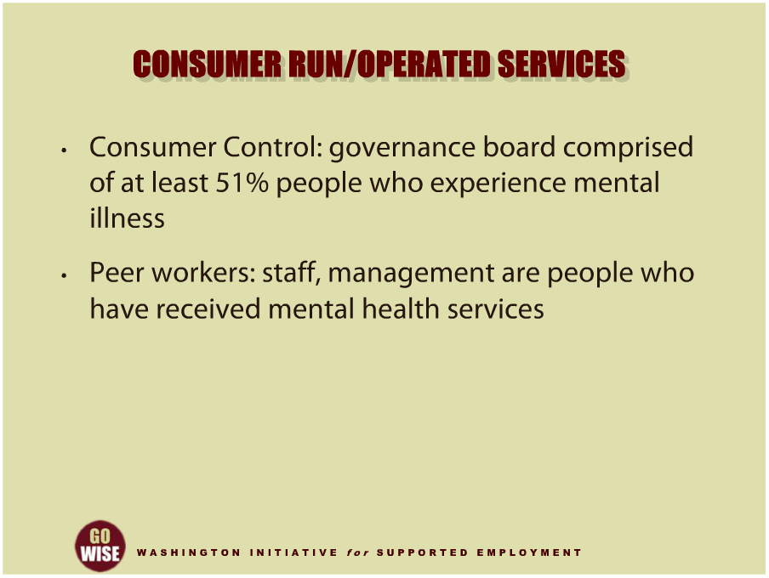
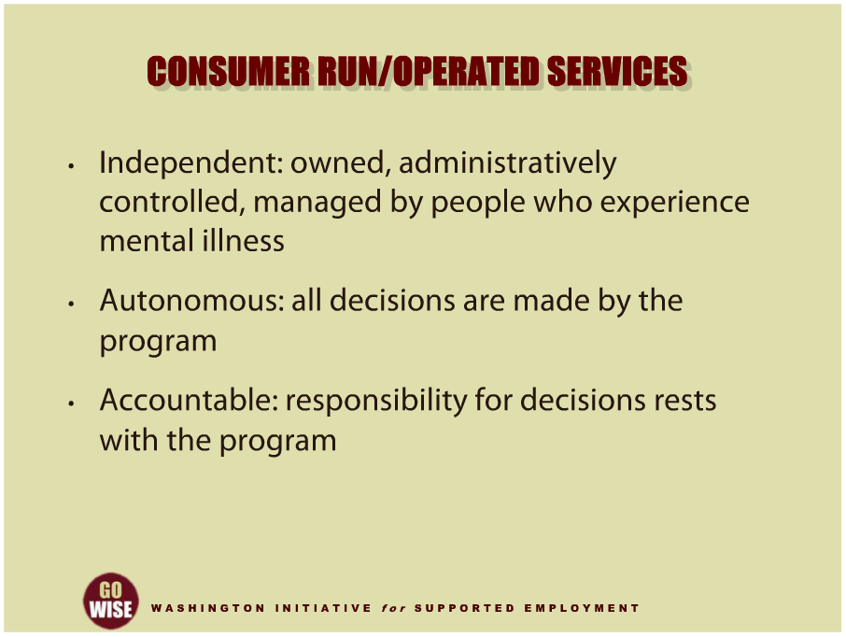
Consumer Run / Operated Services
Notes:
The consumer movement has come full circle with the voice and participation of consumers now firmly in place at all levels of the system, including the operation of mental health services. The following elements typically characterize a consumer run or consumer operated service provider. The organization is independently owned, administratively controlled, and managed by people who experience mental illness. The organization is autonomous, meaning all decisions are made by the program. The organization is accountable, and responsibility for decisions rests with the program. It is consumer controlled, so the governance board is comprised of at least 51% of those who experience mental illness. And finally, the concept of peer workers are utilized, which means staff and management are actually individuals who have received mental health services. In fact, many people who work in consumer operated organizations have completed training in the provision of mental
health services and passed an exam in order to become a Certified Peer Counselor. They bring unique and critically important perspectives to providing services and are a welcome addition to the workforce. Since they have the experience of living with mental illness, they are often able to reach individuals that traditional service providers cannot.

Slide 30
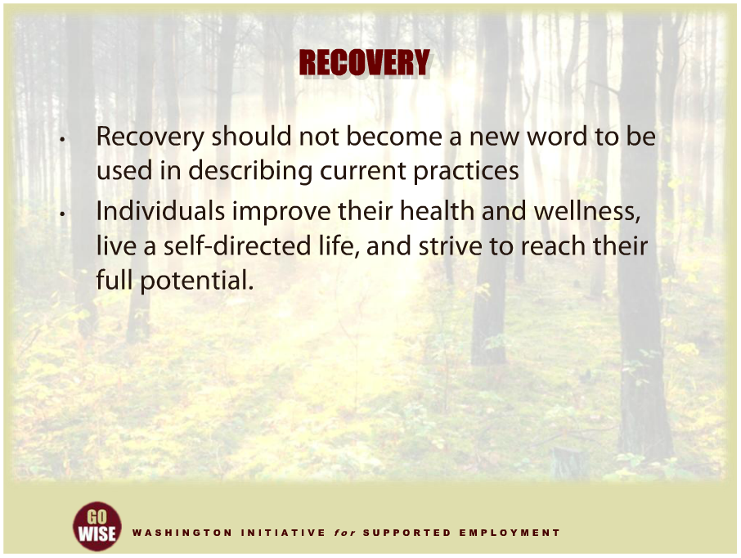

Recovery
Notes:
We are going to end this training by examining the notion of recovery. Recovery has rapidly and broadly permeated the American behavioral health system, especially since it was identified as the most important aim of behavioral health services by both the 1999 Surgeon General's Report on Mental Health and the 2003 President's New Freedom Commission. Recovery should not be mistaken for a passing fad. Indeed, its roots stretch to the birth of psychiatry in the 18th century. The reintroduction of recovery is intended to bring about a fundamental transformation of behavioral health care. In the phrase of the 2005 Federal Action Agenda, A Revolution in Care, recovery should not become simply a new word to be used in describing current practices. So what is recovery in relation to behavioral illness? And what implications does recovery have for transforming behavioral health services to become recovery oriented? Recovery from mental disorders and or substance use disorders is a process of change through which individuals improve their health and wellness, live a self-directed life, and strive to reach their full potential. Now let’s look closer at the four dimensions that support a life in recovery.

Slide 31
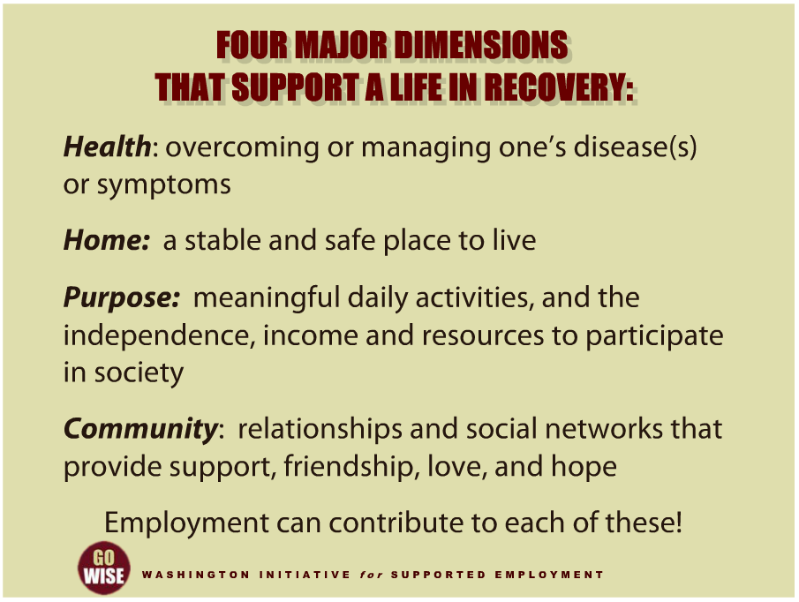
Four Major Dimensions
Notes:
The Federal Substance Abuse and Mental Health Service Administration, or SAMHSA delineates four dimensions that support a life in recovery. “Health,” is overcoming or managing one’s diseases or symptoms. For example, abstaining from use of alcohol, illicit drugs, and non-prescribed medications if one has an addiction problem, and for everyone in recovery, making informed, healthy choices that support physical and emotional well-being. Second is “home,” which means a stable and safe place to live. Third is “purpose,” which includes meaningful daily activities, such as a job, school, volunteerism, family caretaking, or creative endeavors, and the independence, income and resources to participate in society. And fourth is “community,” which includes relationships and social networks that provide support, friendship, love, and hope. Employment can be a contributor to each and all of these dimensions.

Slide 32
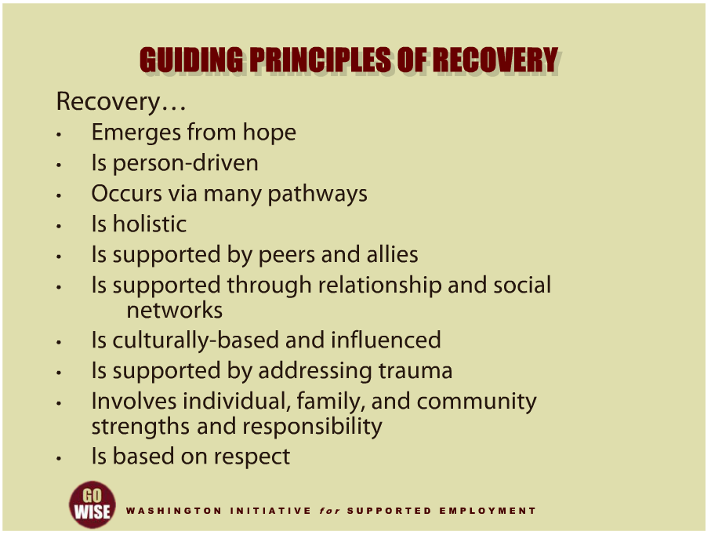
Guiding Principles of Recovery
Notes:
Looking closer at recovery, we identify 10 guiding principles. First, recovery emerges from hope. The belief that recovery is real provides the essential and motivating message of a better future; that people can and do overcome the internal and external challenges, barriers, and obstacles that confront them. Hope is internalized and can be fostered by peers, families, providers, allies, and others. Hope is the catalyst of the recovery process. Recovery is person-drive. Self-determination and self-direction are the foundations for recovery, as individuals define their own life goals and design their unique paths towards those goals. Individuals optimize their autonomy and independence to the greatest extent possible by leading, controlling, and exercising choice over the services and supports that assist their recovery and resilience. In so doing, they are empowered and provided the resources to make informed decisions, initiate recovery, build on their strengths, and gain or regain control over their lives. Recovery occurs via many pathways. Individuals are unique with distinct needs, strengths, preferences, goals, culture, and backgrounds, including traumatic experiences that affect and determine their pathways to recovery. Recovery is built on the multiple capacities, strengths, talents, coping abilities, resources, and inherent value of each individual. Recovery pathways are highly personalized. Recovery is holistic. Recovery encompasses an individual’s whole life, including mind, body, spirit and community. This includes addressing: self-care practices, family, housing, employment, education, clinical treatment for mental disorders and substance use disorders, services and supports, primary healthcare, dental care, complementary and alternative services, faith, spirituality, creativity, social networks, transportation and community participation. The array of services and supports available should be integrated and coordinated. Recovery is supported by peers and allies. Mutual support and mutual aid groups, including the sharing of experiential knowledge and skills, as well as social learning, play an invaluable role in recovery. Peers encourage and engage other peers and provide each other with a vital sense of belonging, supportive relationships, valued roles, and community. Through helping others and giving back to the community, one helps one’s self. Recovery is supported through relationship and social networks. An important factor in the recovery process is the presence and involvement of people who believe in the person’s ability to recover; who offer hope, support and encouragement; and who also suggest strategies and resources for change. Family members, peers, providers, faith groups, community members, and other allies form vital support networks. Through these relationships, people leave unhealthy and/or unfulfilling life roles behind and engage in new roles that lead to a greater sense of belonging, personhood, empowerment, autonomy, social inclusion, and community participation. Recovery is culturally-based and influenced. Culture and cultural background in all of its diverse representations, including values, traditions and beliefs, are keys in determining a person’s journey and unique pathway to recovery. Services should be culturally grounded, attuned, sensitive, congruent, and competent, as well as personalized to meet each individual’s unique needs. Recovery is supported by addressing trauma: the experience of trauma, such as physical or sexual abuse, domestic violence, war, disaster, and others, is often a precursor to or associated with alcohol and drug use, mental health problems, and related issues. Services and supports should be trauma-informed to foster safety and trust, as well as promote choice, empowerment, and collaboration. Recovery involves individual, family, and community strengths and responsibility. Individuals, families and communities have strengths and resources that serve as a foundation for recovery. In addition, individuals have a personal responsibility for their own self-care and journeys to recovery. Individuals should be supported in speaking for themselves. Families and significant others have responsibilities to support their loved ones, especially for children and youth in recovery. Communities have responsibilities to provide opportunities and resources to address discrimination and to foster social inclusion and recovery. Individuals in recovery also have a social responsibility and should have the ability to join with peers to speak collectively about their strengths, needs, wants, desires, and aspirations. Recovery is based on respect: community, systems, and societal acceptance and appreciation for people affected by mental health and substance abuse problems, including protecting their rights and eliminating discrimination, are crucial in achieving recovery. There is a need to acknowledge that taking steps toward recovery may require great courage. Self-acceptance, developing a positive and meaningful sense of identity, and regaining belief in one’s self are particularly important.

Slide 33

Summary
Notes:
This training introduced you to basic concepts you will utilize as you serve DVR customers who experience mental illness and or psychiatric disabilities. As you have just learned, there are several types of mental illness, including substance abuse. Along with the various illnesses come a diverse range of effects these disabilities can have on individuals’ lives. There are also a large number of treatment options to assist individuals, including the supported employment services you will provide. And finally, recovery is a concept that is being utilized to help steer the mental health field, and supported employment can play an important role in recovery when appropriate. We hope that this training has given you a firm understanding of how the services you will provide can promote recovery, as you assist your DVR customers to obtain their vocational goals and be successful.

Slide 34
DVR Language
Employment Consultant: also known as an employment specialist, job coach, job developer, etc.
Community Rehabilitation Program (CRP): also known as employment agency, employment provider, vendor, etc.
Customer: also known as client, consumer, person with a disability, supported employee, etc.
Extended Services: also knows as long term supports, follow along services, etc.

Slide 35
Resources
Division of Vocational Rehabilitation (DVR): http://www.dshs.wa.gov/dvr/
Mental Health: A Report of the Surgeon General: http://www.mentalhealth.org/cmhs/surgeongeneral/surgeongeneralrpt.asp
The National Institute on Mental Health: www.nimh.nih.gov
The National Alliance on Mental Illness: www.nami.org
United States Psychiatric Rehabilitation Association: www.uspra.org
International Center for Clubhouse Development: www.iccd.org
The Center for Psychiatric Rehabilitation at Boston University: http://cpr.bu.edu
Substance Abuse and Mental Health Services Administration: http://www.samhsa.gov/
Dartmouth University IPS Supported Employment Center: http://www.Dartmouth.edu/~ips/
The Washington Institute for Mental Health Research and Training: http://depts.Washington.edu/washinst/index.html
  Content for this training was developed by Jonathan R. Beard, LICSW, CPRP, of the Washington Institute for Mental Health Research and Training.
Notes:
These resources will provide you with additional information about mental illness, substance abuse and treatment options. You can also access considerable information about psychiatric disability and the practices of psychiatric rehabilitation in addressing disability and promoting recovery. The SAMHSA website has many resources available on a wide variety of topics ranging from supported employment, recovery, consumer operated services and clinical treatments. The IPS Supported Employment Center at Dartmouth University is the go to site for information about evidence based supported employment.

