Slide 1

Fundamentals of Supported Employment in Vocational Rehabilitation
Development of this training was funded by:
Services for Individuals Who Experience Mental Illness: 2

Slide 2
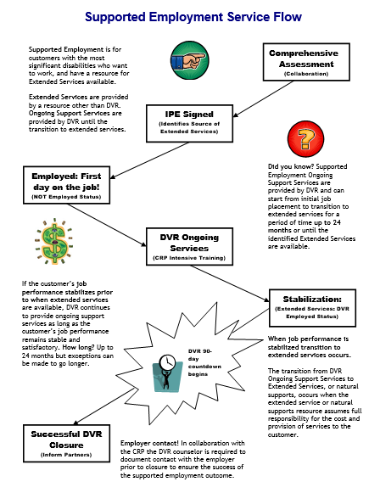

Services Flow Chart
Notes:
Before we begin the content of this training module let’s review the supported employment model that the D.S.H.S. Division of Vocational Rehabilitation, or D.V.R., must carry out. As an employment consultant serving these customers, it is important that you understand the steps of supported employment that D.V.R. must follow and your role in the process. Let’s review each step briefly.
D.V.R. supported employment services are provided to customers with the most significant disabilities who want to get and keep a permanent job. These customers require intensive support to obtain employment, as well as long term support to achieve and maintain successful job performance. Federal rules for supported employment require D.V.R. to provide the upfront vocational rehabilitation, or V.R. services known as on-going services, that a customer requires to get and learn a job. After that, a separate source will provide the extended support or long term supports the customer needs to keep their job once D.V.R. services end. All D.V.R. supported employment customers go through the same application and eligibility determination process. Once an individual is determined eligible for D.V.R. their V.R. counselor works with them to conduct a comprehensive assessment of their vocational rehabilitation needs, including whether the customer will require supported employment to get and keep a job of their choice. The comprehensive assessment often includes a community based assessment that is provided by a community rehabilitation program, or C.R.P., such as the one you work for. After the comprehensive assessment has been completed, the D.V.R. customer is assisted by their V.R. Counselor to develop an individualized plan for employment, or I.P.E. The I.P.E. identifies the customer’s employment goal along with the steps and the D.V.R. services they will require to achieve their goal. The I.P.E. must also identify the customer’s need for supported employment and what their source of long term support or extended services will be. If the source of extended services is unknown when the I.P.E. begins, there must be a strong expectation that a source will be identified within 24 months. D.V.R. services identified in the I.P.E. begin once the plan is signed by the D.V.R. customer and their V.R. counselor. Typically, the first step of an I.P.E. is for D.V.R. to authorize job placement services to assist the supported employment customer in becoming employed. Once the customer is employed then D.V.R. authorizes intensive training services to assist the customer in learning how to perform their job satisfactorily. However, once a customer reaches a stable level of satisfactory job performance, they must begin receiving their extended services from a source outside of D.V.R.. If a supported employment customer achieves stable job performance sooner than their extended services will be available, D.V.R. will continue providing ongoing support for up to 24 months. Once extended services have begun, D.V.R. keeps the case open during the first ninety days that these services are provided to make sure they meet the customer’s needs. If the customer is doing well on their job at the end of this ninety days and their extended services continue without interruption, then the customer’s D.V.R. case is closed.

Slide 3
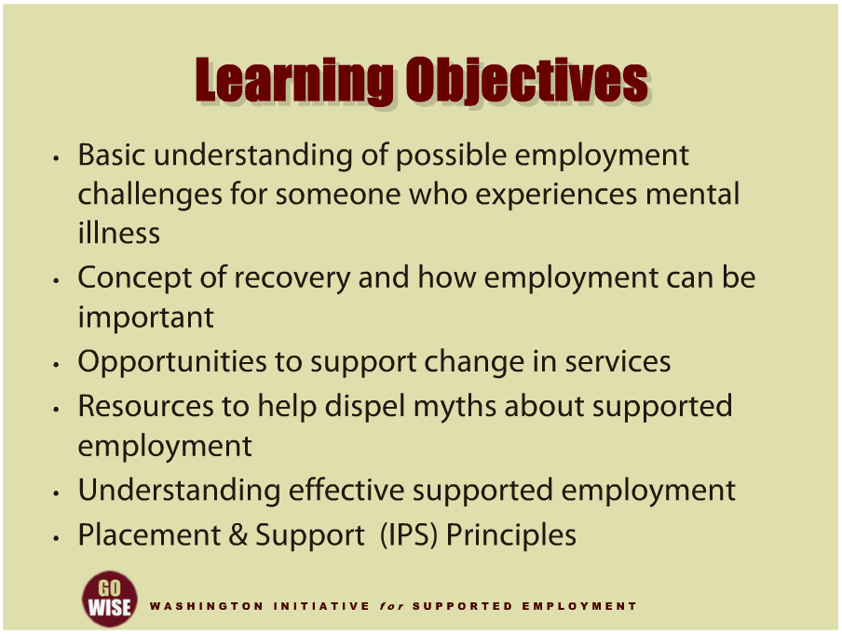
Learning Objectives
Notes:
This training will cover some basic concepts involved with providing supported employment services to individuals who experience mental illness. We will begin with a general overview of the common challenges someone may face as they try obtain or maintain employment, as well as review the concept of recovery, gaining a better understanding of how employment can be an important part of someone’s path to recovery. We will give you a few specific examples of opportunities you have to support change for people who experience mental illness. In doing so, we will share some resources that may come in useful as you dispel myths and misinformation about supported employment. And finally, we will examine the aspects of effective supported employment by exploring the eight principles of Individual Placement & Support, or IPS. We hope that through this training you will learn how supported employment not only promotes mental health recovery, but also enriches the texture of American community and work.

Slide 4
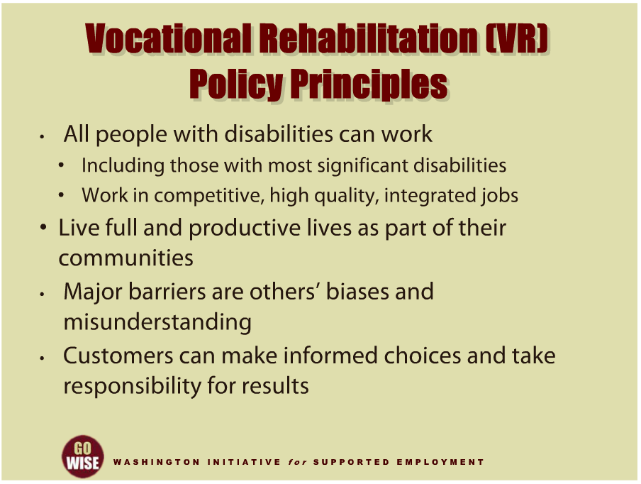
VR Policy Principles
Notes:
Understanding the principles and values behind current-day supported employment services will give you a framework for the services you are providing to people who experience mental illness. The Federal Rehabilitation Services Administration has developed policy principles to guide the vocational rehabilitation services that are provided to its customers. Amongst them are some that speak particularly well to supported employment services for individuals who experience mental illness. For example, one policy principle is that all people with disabilities can work, including those customers who experience significant disabilities. This principle goes on to state that those with significant disabilities do have the ability to work in competitive, high quality, integrated jobs, and live full and productive lives as part of their communities. Another policy principle sites that some major barriers to employment are actually the result of other peoples’ biases and misunderstandings about people with disabilities. And one final example of a policy principle that guides services particularly well for those with significant disabilities is that people with disabilities can make informed choices and take responsibility for the results. These are examples of the principles that direct and give meaning to vocational rehabilitation services. You will see how important these principles are as you gain more experience as a CRP employment consultant and help individuals who experience mental illness benefit from vocational rehabilitation services.

Slide 5
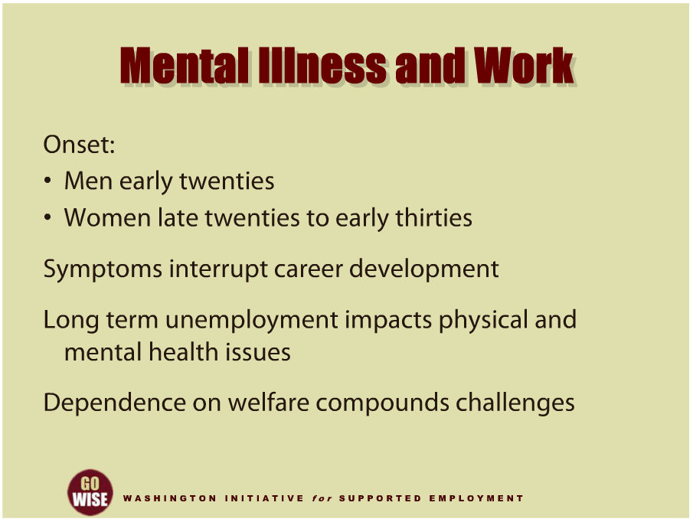
Mental Illness and Work
Notes:
Now let’s briefly discuss why someone who experiences mental illness may need help finding or keeping a job. As you probably already know, individuals who experience disabilities, including mental illness, face significantly higher unemployment rates than the rest of society. Let’s start by thinking about how and why this is true. The onset of a mental illness typically occurs in early adulthood. Men often experience their first symptoms in their early twenties and women typically first show signs of disease in their late twenties and early thirties. At a time when most people are finding their direction in life, individuals who experience mental illness may face significant obstacles, including stigma, loss of hope, rejection and discrimination. In fact, early symptoms frequently interrupt an individual’s ability to develop their career, by limiting their opportunities and disrupting their goals. And for many people, onset symptoms can result in unemployment. We also know that long term unemployment can have a significant impact on an individual’s physical and mental health. For example, without income or insurance coverage from employment, people are often forced to depend on government benefits and programs to support themselves, to pay for treatment and get access to expensive medications. What’s more, dependence on welfare systems can compound an individual’s challenges. For example, it often takes three to five years to become eligible for Supplemental Security Income, also known as SSI, or Social Security Disability Insurance, often referred to as SSDI. It’s common that once an individual becomes eligible for SSI or SSDI, they become fearful of employment because they are concerned about losing their cash and medical benefits. Understanding the difficult situations a person experiencing mental illness can face will help you, as an employment consultant, approach your work from a place of empathy and knowledge.

Slide 6
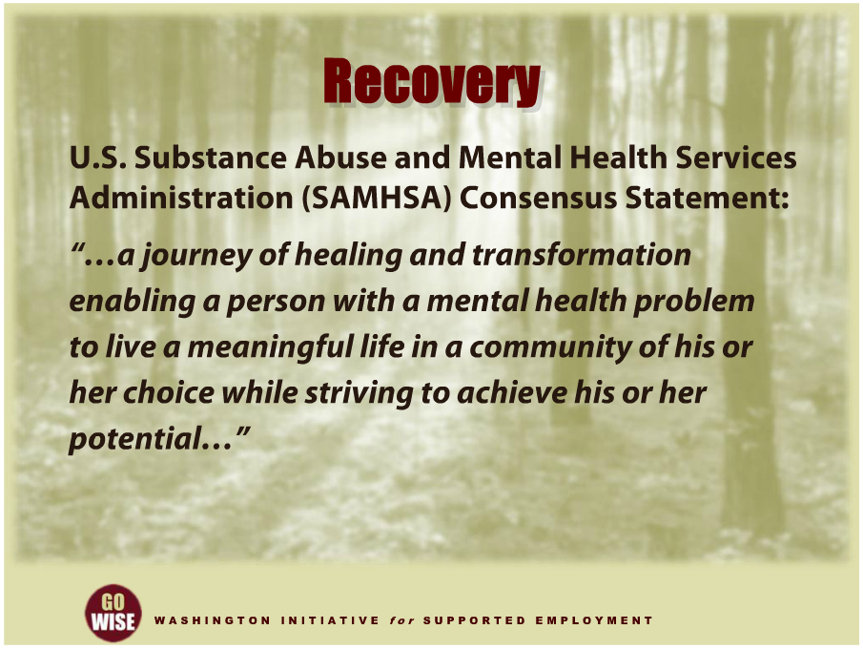
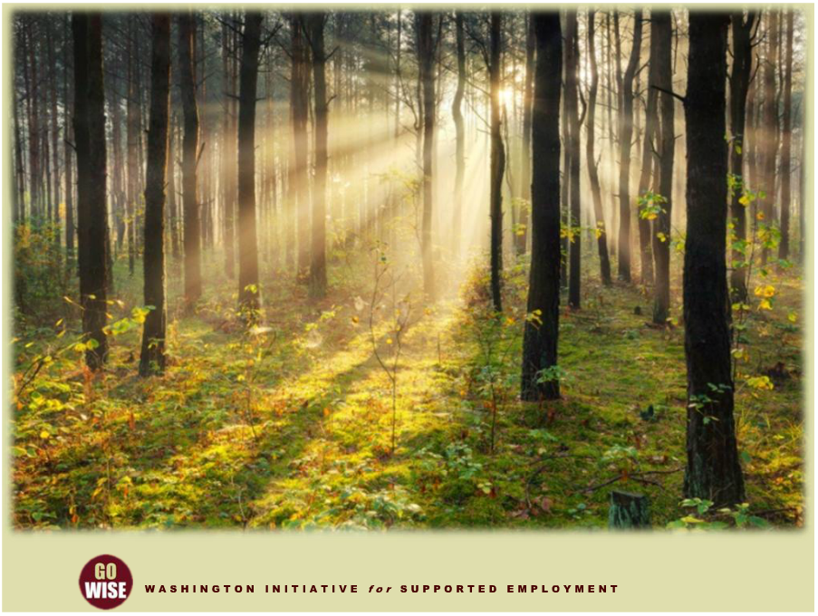
Recovery
Notes:
This brings us to the concept of recovery. Recovery has permeated the American behavioral health system, especially since it was identified as the most important aim of behavioral health services by both the 1999 Surgeon General's Report on Mental Health and the 2003 President's New Freedom Commission. The U.S. Substance Abuse and Mental Health Services Administration, also known as SAMHSA (Sam-sa), developed a consensus statement that defines mental health recovery as, “a journey of healing and transformation enabling a person with a mental health problem to live a meaningful life in a community of his or her choice while striving to achieve his or her potential.” To learn more about SAMHSA please go to the resources section at the end of this training. As you probably already know, the journey towards recovery is very challenging. One element that is gaining increasing support in terms of helping people through recovery is the concept of employment. In fact, employment is increasingly believed to help individuals recover. To learn more about recovery and employment, you can also watch Services for Individuals Who Experience Mental Illness One, another module within this training series.

Slide 7
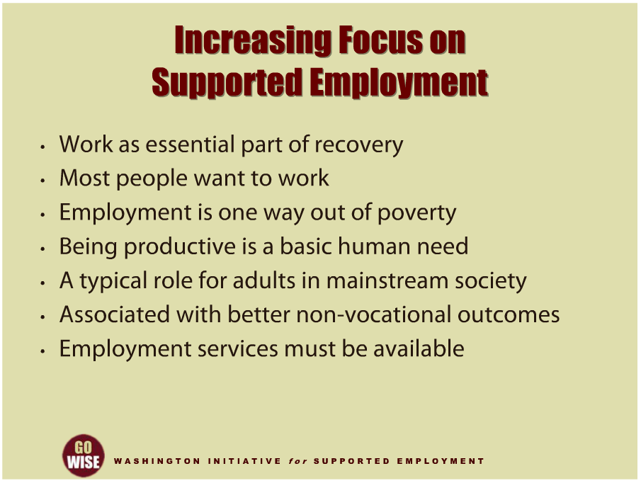
Increasing Focus on Supported Employment
Notes:
Let’s put the concept of work into perspective to help you see why more and more people are starting to focus on supported employment. First, as we just discussed, increasing numbers of people are beginning to believe that work can be an essential part of recovery for people who experience mental illness. We have listed some articles in the resources section at the end of this training if you are interested in reading about the perspective of someone who found work to be an important part of their recovery. In addition, most people want to work, because they understand that working will give them access to money. As a whole, individuals who experience mental illness have a higher incidence of poverty, and access to money is one way out of poverty. Aside from the need for money, being productive is also a basic human need. And obviously working is an important and typical activity for adults in mainstream society. As we discussed a little earlier, we know that people who work have access to better non-vocational outcomes such as health and relationships. And while you may hear the argument that people who experience mental illness should not be forced to work, please remember that employment is each person’s choice, and if someone wants to work, they must be given the tools and supports they need to do so. Now let’s take a brief look at some of the ideas and activities that have surfaced as more and more people believe in the power of employment for individuals who experience mental illness.

Slide 8
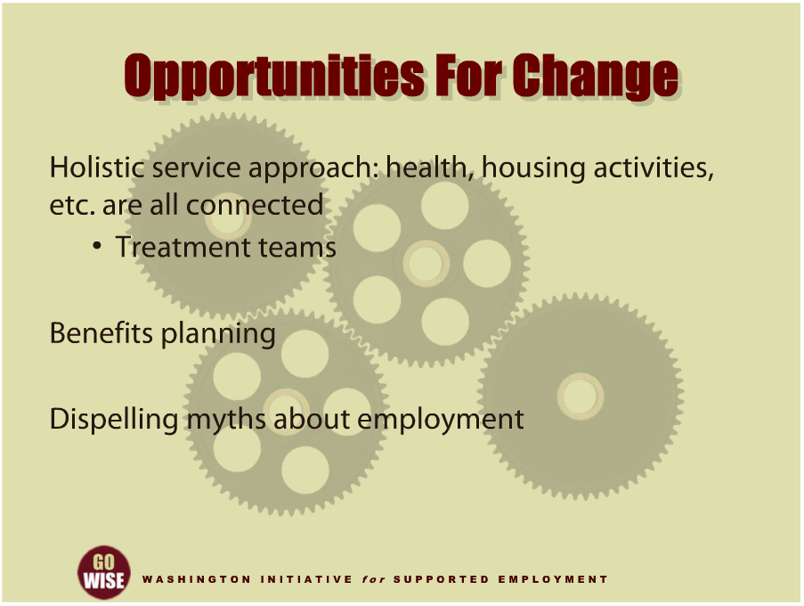
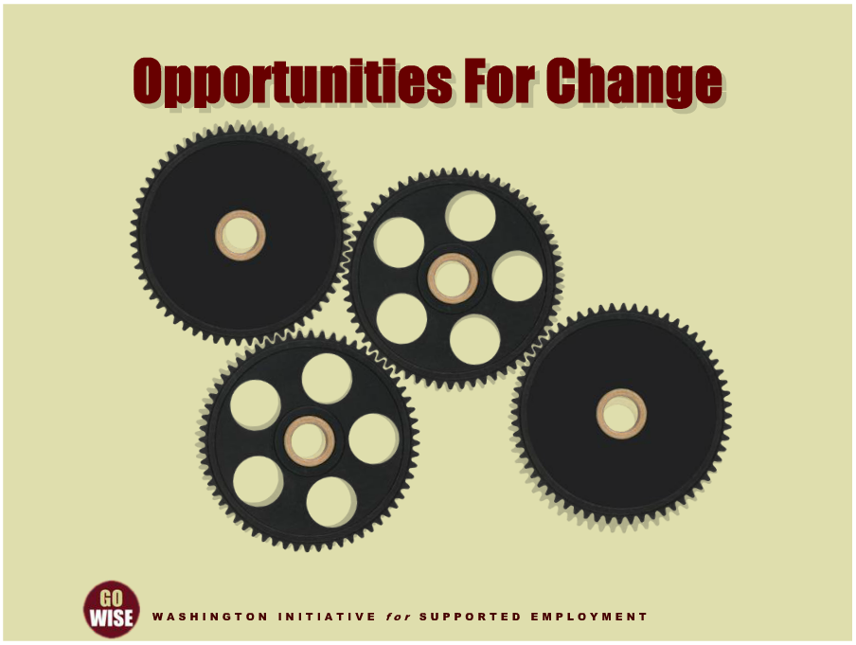
Opportunities for Change
Notes:
Now is a really exciting time to be in the field of supported employment because there are so many changes in the services provided to people who experience mental illness. This is important to you because as a CRP employment consultant you will have the chance to increase and support these changes on a regular basis, ultimately helping more people who experience mental illness to be successfully employed in their communities. Let’s consider different ways you may be able to do this. First, the mental health system is starting to think holistically by considering the whole person. When we say the system is considering the whole person, we mean that mental health practitioners are realizing a person’s health, housing, what do they do during the day, and other activities are all connected and important to a person’s recovery. This realization is changing the services people receive. For example, treatment teams are being formed as a way of considering how all the different aspects of a person’s life have to work together, including employment, to make sure the person is supported in the different aspects of their life. We will give you more information about your role on a treatment team later in this presentation. Along these same lines of thinking about people holistically, we know that Social Security, Medicaid, and other government entitlement programs are also vital to an individual’s success and to their employment. In order to help someone consider how their benefits will be impacted by work, they need benefits planning. DVR counselors and CRP employment consultants play key roles in helping customers access ongoing benefits planning. We will go more in depth about benefits planning later in this training, but please understand this is one practice that will be vital to your customers’ success. And one final example of how you have the opportunity to help increase supported employment efforts is by dispelling myths about supported employment. While practitioners in the field of mental health are working to increase efforts around employment services, there are still many who believe that employment can have a negative impact on individuals with serious mental illness. As a CRP employment consultant, you may need to help dispel these types of myths. Let’s look closer at this topic since you will most likely be confronted with it soon if you haven’t already.

Slide 9
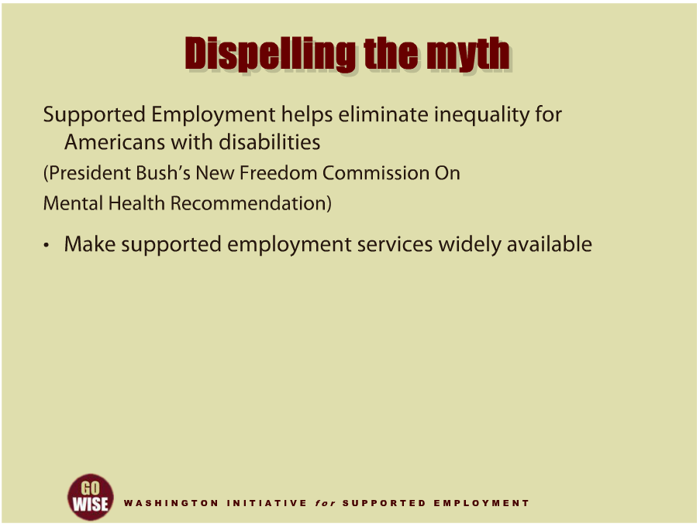
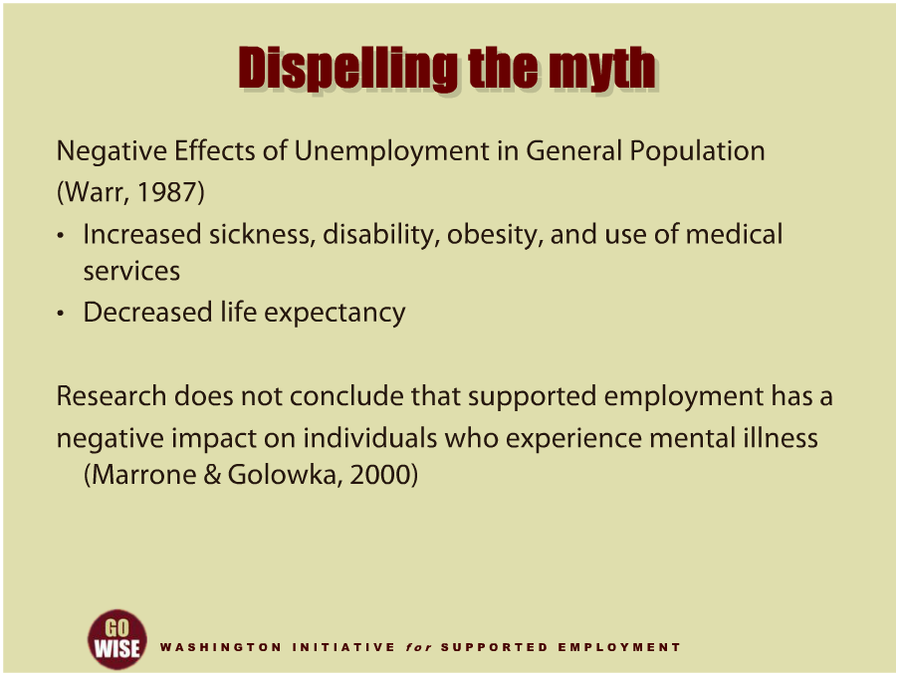
Dispelling the Myth
Notes:
Several efforts have been made to help dispel the myth that supported employment has a negative impact on people who experience mental illness. To do this, people often consider the experiences of people who are unemployed. For example, we know that people who are unemployed experience more sickness, disability, obesity, use of medical services and decreased life expectancy. We can also consider the findings of an extensive literature review done in 2000 to try and locate research that supports the belief that employment has a negative impact on people who experience mental illness. The authors of this study concluded that they did not find research to support the myth. The name of the article is If Work Makes People with Mental Illness Sick, What Do Unemployment, Poverty, and Social Isolation Cause? One additional source of information to dispel myths can be found in a national effort to examine supported employment. President George W. Bush established the President’s New Freedom Commission on Mental Health in April 2002 as part of his commitment to eliminate inequality for Americans with disabilities. The President directed the Commission to identify policies that could be implemented by Federal, state and local governments to maximize the utility of existing resources, improve coordination of treatments and services, and promote successful community integration for adults with serious mental illness and children with serious emotional disturbances. From June 2002 to April 2003, twenty two commissioners met monthly to analyze the public and private mental health systems, visit innovative model programs across the country and hear testimony from the systems’ many stakeholders, including dozens of individuals who utilize mental health services, their family members, advocates, public and private service providers, administrators and mental health researchers. Overall, the recommendation from the Commission was to make supported employment services widely available. Documents like these are often helpful to employment consultants as they do their work and come across misinformation in the field of supported employment. To find information about the three sources we just covered, please go to the resources section at the end of this training.

Slide 10
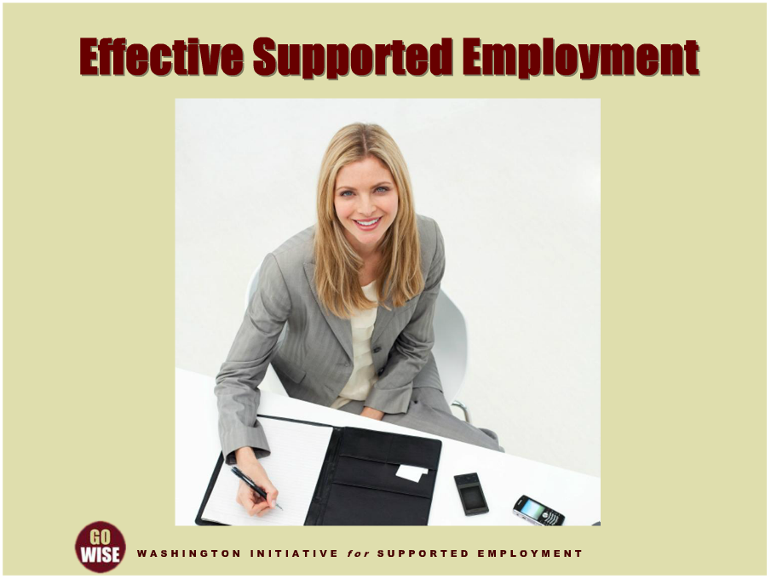
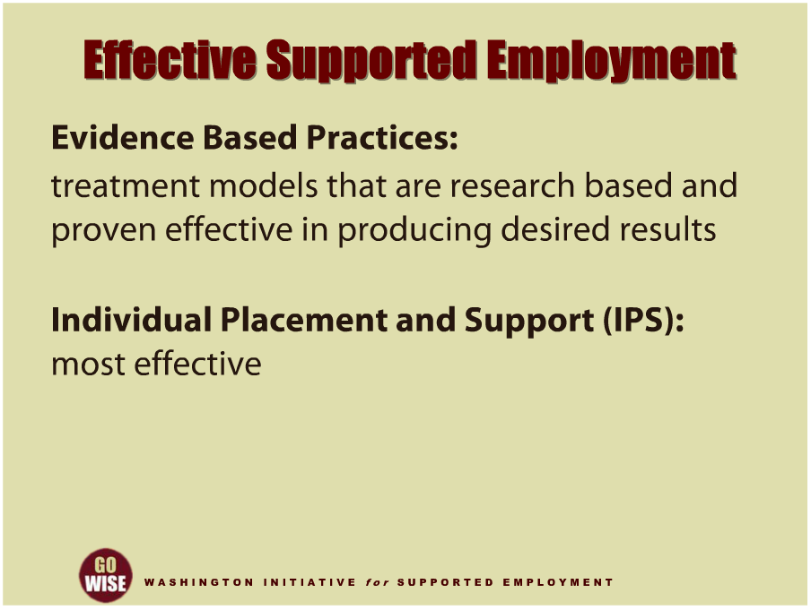
Effective Supported Employment
Notes:
Now let’s look at a few concepts that will be very helpful as you craft your skill in providing supported employment services. As you are most likely well aware, the services funded by tax payer dollars are increasingly scrutinized to prove their effectiveness and reach outcomes. SAMSHA has identified a number of treatment models that are research based and proven to be effective in producing the desired results. These treatment models, known as Evidence Based Practices, provide a set of principles and fidelity standards on which services should be based. Supported employment, also called Individual Placement and Support, commonly referred to as IPS, has proven to be the most effective approach for helping people gain competitive employment. Let’s look closer at how we know that IPS is the most effective approach to date.

Slide 11
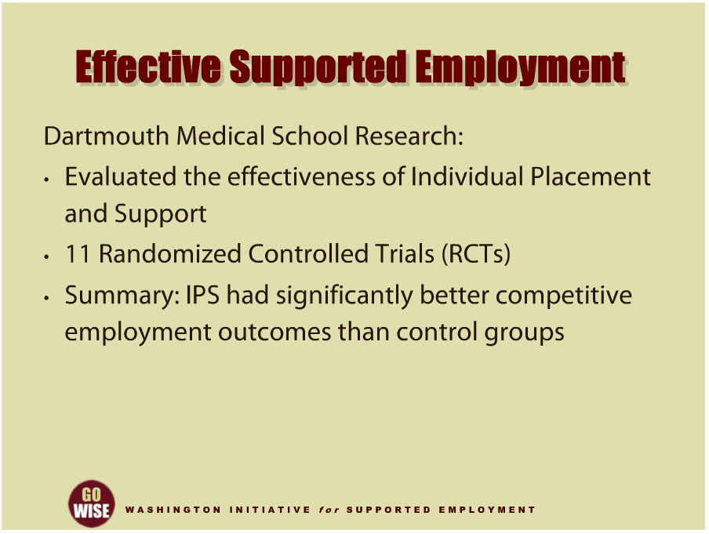
Effective Supported Employment
Notes:
Supported employment is effective, in part due to the fact that it is one of the most researched programs to date. For example, Gary Bond, a Professor of Psychiatry at Dartmouth Medical School, and a mental health services researcher, worked with his colleagues on a project to evaluate the effectiveness of Individual Placement and Support, or IPS. He and his team evaluated eleven separate randomized controlled trials, or RTCs, which are known as the gold standard in research. The team utilized fidelity principles to measure effectiveness of IPS and found that in all eleven studies, IPS had significantly better competitive employment outcomes than the control groups that were involved in other types of programs or services. To learn more about this research, please go to the resources section at the end of this training and look for Evidence-based mental health practice: A textbook. You can also find IPS information at the Dartmouth University IPS Supported Employment Center or through the link to the SAMHSA website.

Slide 12
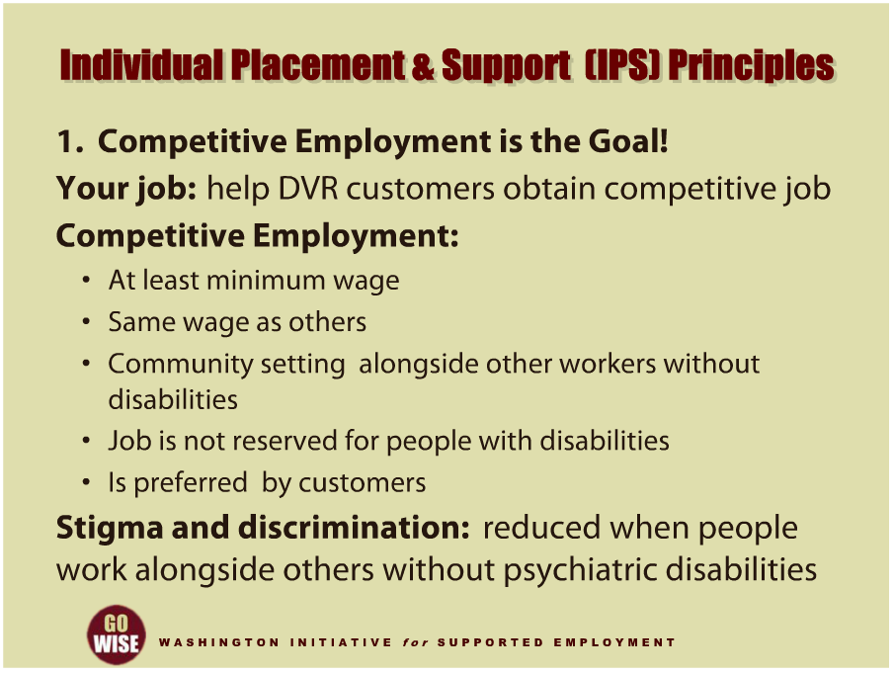
IPS Principles
Notes:
In the next part of this training we are going to look closely at the eight principles that make up the Individual Placement and Support, or IPS, model of supported employment for individuals who experience mental illness. Before looking at these principles, it is important to point out that DVR supported employment does not completely follow the IPS model. To learn more about the difference between the DVR and IPS supported employment models, you can also watch Supported Employment Systems Collaborating for Outcomes,, another module within this training series.
The IPS principles are implemented primarily by mental health agencies that offer a supported employment program to their consumers. When serving DVR customers you will follow DVR’s model of supported employment and deliver services as described in the Community Rehabilitation Program, or CRP, contract. However, the IPS principles are being presented in this training to familiarize you with a model of supported employment that is a proven, effective supported employment method. Being familiar with the eight IPS principles will help you be more effective when serving your DVR customers who experience mental illness.
The first IPS principle is that competitive employment is the goal. The term competitive employment means that the job pays at least minimum wage. In addition, the wage is the same as what others receive who perform the same work, it’s based in community settings alongside other workers without disabilities, and the job is not reserved for people with disabilities. We know that for most DVR customers, competitive employment is more preferred and for society, stigma and discrimination are reduced when people have the chance to work alongside others without psychiatric disabilities.

Slide 13
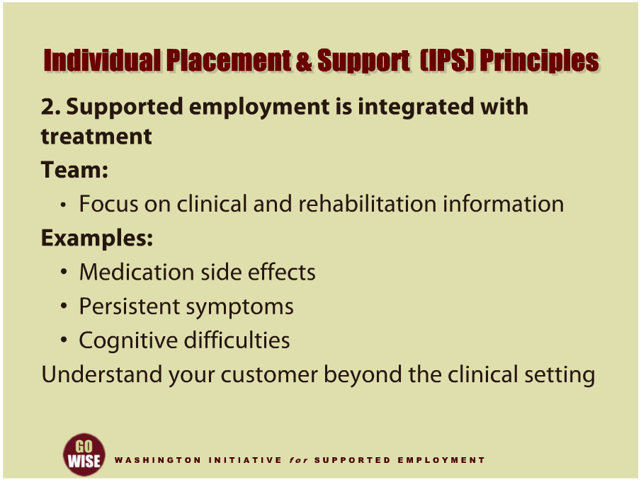
IPS Principles
Notes:
The second principle of IPS supported employment is that it is integrated with the individual’s mental health treatment team. The team discussions include clinical and rehabilitation information that is relevant to employment, such as medication side effects, persistent symptoms, cognitive difficulties, or other rehabilitation needs. Each team member is responsible to share information and develop ideas to help the customer improve their functional recovery. It’s important to remember to look beyond how the customer presents in a clinical setting, since people utilize their various skills and resources depending on their surroundings.
If you a serving a DVR customer who is also receiving services from a mental health agency, you should become engaged in the treatment team that is providing mental health treatment to the individual. Since your job is to help your customer become successfully employed, you will want to understand their various skills and how they do in different environments. Being engaged with the treatment team will provide some of this information, as well as enable you to help your customer take a holistic approach to their recovery.

Slide 14
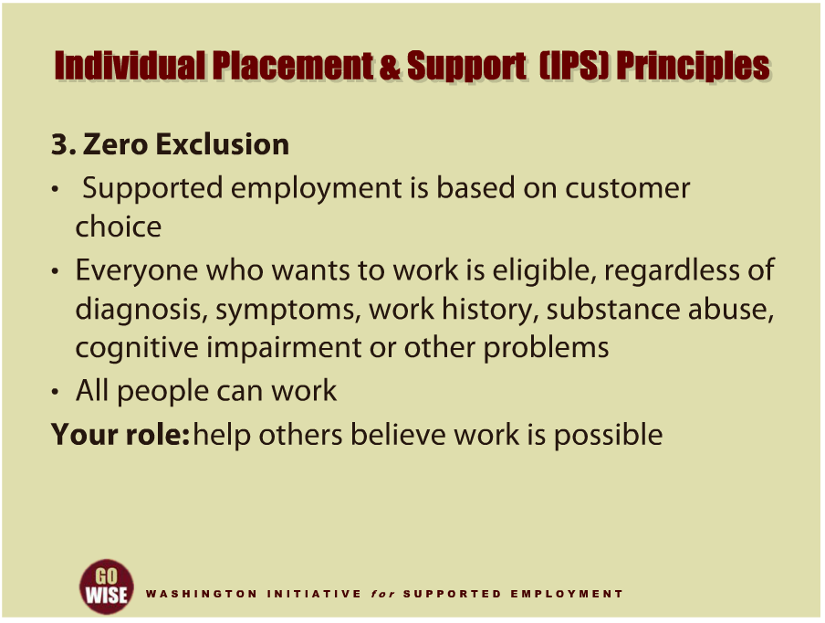
IPS Principles
Notes:
Third, there is zero exclusion, which means that supported employment is based on the customer’s choice. More specifically, every person with severe mental illness who wants to work is eligible for IPS supported employment when it is offered by a mental health agency, regardless of their psychiatric diagnosis, symptoms, work history, or other problems, including substance abuse and cognitive impairment. The core philosophy of IPS supported employment is that all persons with a disability can work at competitive jobs in the community without prior training, and that no one should be excluded from this opportunity. If you participate as a member of a multidisciplinary team within a mental health agency, part of your role as a CRP employment consultant is to promote a culture of work so that other mental health providers will also encourage and believe that their customers can work.

Slide 15
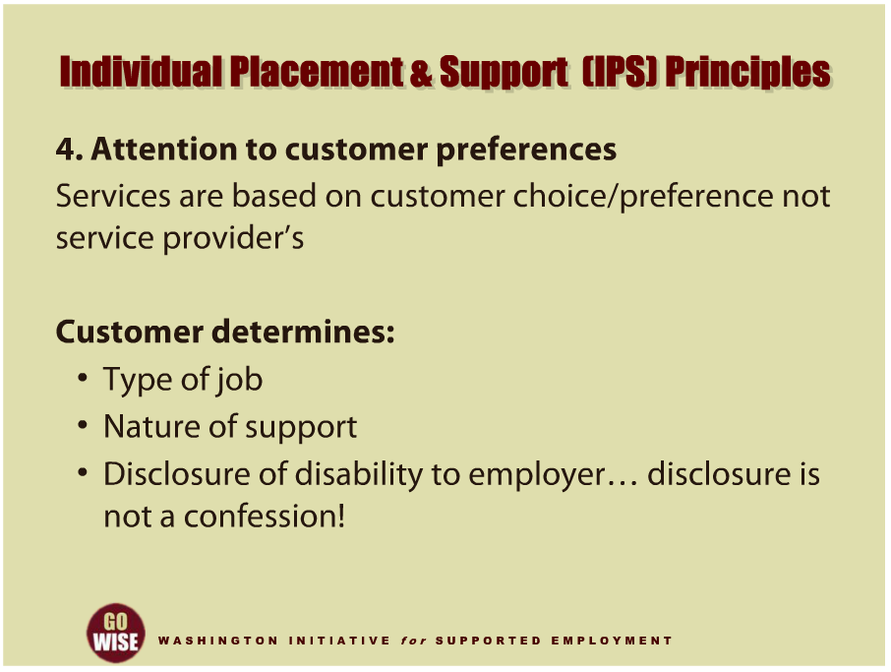
IPS Principles
Notes:
Fourth, significant attention is given to customer preferences. This means that services are based on a customer’s preferences and choices, rather than on the service providers’ judgments. Customer preferences help determine the type of job that is sought, the nature of support provided by the employment consultant and team, and whether to disclose the aspects of an individual’s psychiatric disability to their employer. If you are not already, please be aware that disclosure is a very important topic for you to discuss with your DVR customer before you approach employers about a specific individual. Disclosure is not the same as a confession, and in order to serve your DVR customer well, you must understand their preferences and choices.

Slide 16
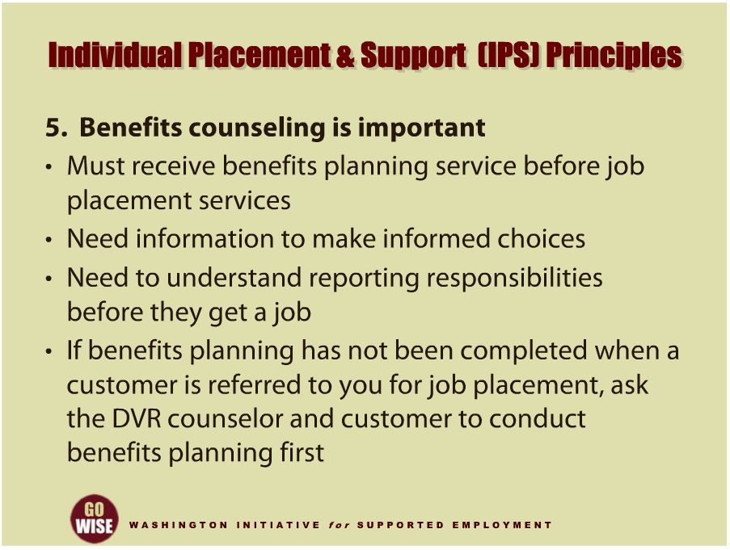
IPS Principles
Notes:
The fifth IPS principle is that benefits counseling is important to your DVR customer. DVR counselors and CRP employment consultants help customers access ongoing guidance regarding Social Security, Medicaid, and other government entitlement programs. As we discussed earlier, the fear of losing benefits is a major reason that customers may not want to seek employment. DVR customers must receive benefits planning services before they are referred to a Community Rehabilitation Program, or CRP, for job placement services. This is important for a few different reasons. The customer needs information from the benefits planning process to consider their financial and medical needs so that they can make informed choices when they develop their vocational plan. The customer also needs to understand what their reporting responsibilities will be before they get a job so that they can avoid a crisis once they start earning a wage. If you receive a referral from DVR for CRP job placement services and the customer is receiving Social Security Disability Insurance, known as SSDI, or Supplemental Security Income, known as SSI, make sure they have completed benefits planning and understand how earned income may impact their benefits. It is critical that the customer learns how employment earnings may affect their SSDI, SSI and or other public benefits before you begin job placement activities. If benefits planning has not been completed when a customer is referred to you for job placement, do not accept the referral. Instead, ask the DVR counselor and customer to conduct benefits planning and then re-submit the referral when that has been completed. To learn more about benefits planning, please watch, The Importance of Benefits Planning, which is another training module in this training series.

Slide 17
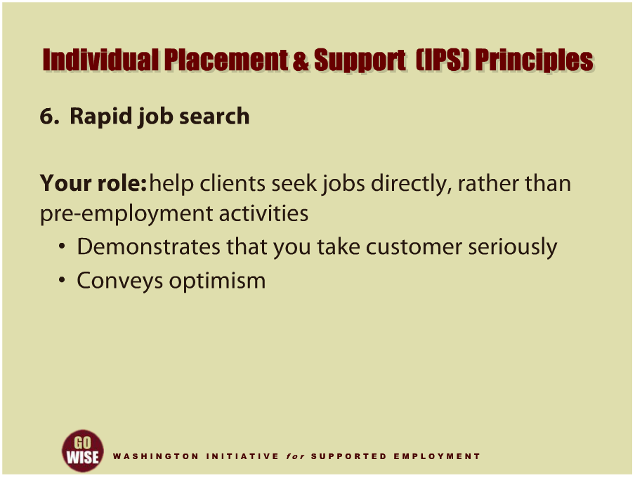
IPS Principles
Notes:
Rapid job search is the sixth principle of IPS. This principle dispels the myth that individuals with mental illness need to be symptom free or completely free of drugs and alcohol before pursuing employment. Beginning the job search process early demonstrates to customers that their desire to work is taken seriously, and conveys optimism that there are multiple opportunities available in the community for customers to achieve their employment goals. Often, DVR Counselors ask customers to participate in various assessments to help the individual understand their vocational interests, talents and abilities so they can make an informed selection of their employment goal as well as the steps and VR services needed to achieve that goal. This may include a community based assessment, or CBA, that you will provide as a CRP employment consultant. When conducting a CBA with a customer who experiences mental illness it is very important to be mindful of how long the assessments last and how it is structured so that the individual can begin job search activities as quickly as possible.

Slide 18
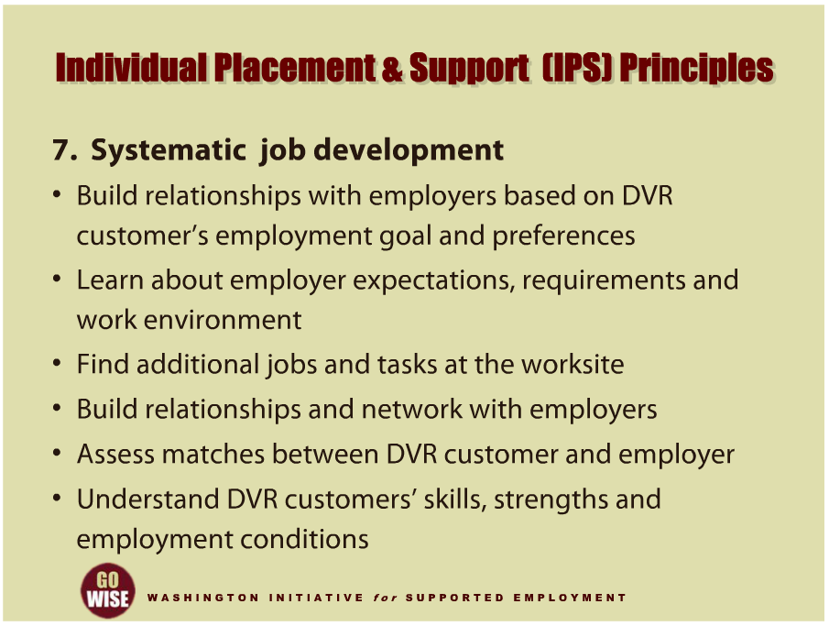
IPS Principles
Notes:
The seventh principle of IPS is systematic job development. Systematic job development is when you, as the CRP employment consultant, develop relationships with employers, based upon the DVR customer’s employment goal and work preferences. The relationship is typically built with face-to-face meetings and can take multiple visits. In addition, you will aim to learn about the employers’ expectations, requirements and the work environment, so that you can develop a strong partnership with the business. You will want to find out about jobs and tasks that may not be obvious upon first glance at the worksite. Knowing this information will help you make a strong match between your customer and the right employer. CRP employment consultants continue to make periodic visits because building relationships and networking with employers is how people find jobs. They gather information about the nature of job opportunities and assess whether their DVR customer may be a good job fit. In order to do this, you will need to understand your DVR customers’ skills, strengths and the working conditions that will be best for them.

Slide 19
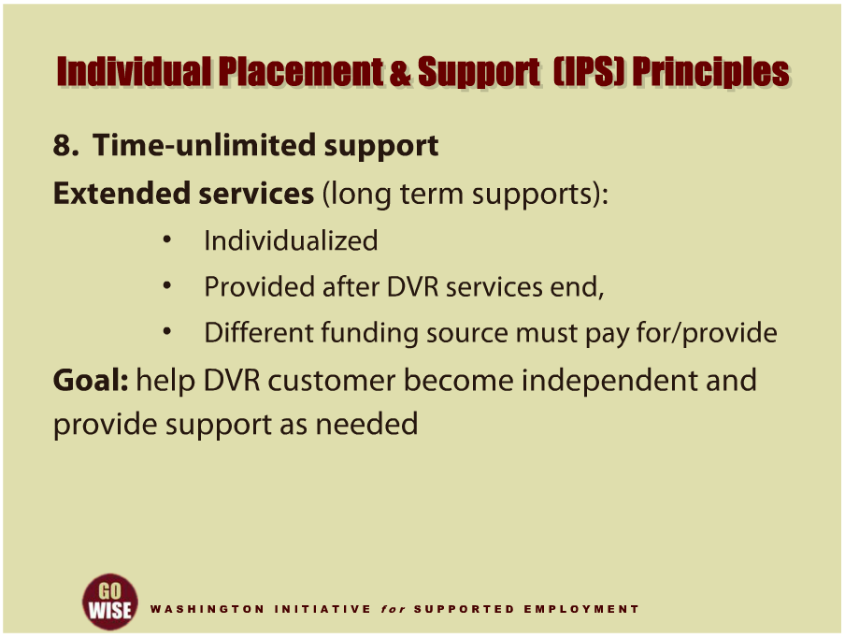
IPS Principles
Notes:
And the final principle of IPS is time-unlimited support. Extended services, commonly referred to as long term support, are individualized to the customer, and continue for as long as the individual wants and needs the support to maintain their job. One important distinction about extended services is that these services will be provided once DVR services end, because DVR services are time-limited. A funding source other than DVR must pay for and provide these extended services. It is the role of the DVR Counselor, together with the customer, to identify the source of extended services at the time they are developing the Individualized Plan for Employment, or IPE. By the time you begin providing CRP job placement services to the customer, their source of extended services should be already known, and these extended services should be arranged to be available when the individual begins working and achieves a consistent level of performance. In rare cases, a DVR counselor may ask you to begin providing job placement services to a customer before the source of extended services has been confirmed. However, in these cases, the DVR counselor and customer will be confident that a source for extended services is going to be available but still need to finalize details. Overall, your goal is to help your DVR customer become as independent as possible while providing support and assistance as needed. As the customer learns their new job and achieves a level of consistent performance, the support you have been providing will be turned over to whoever provides their extended services.

Slide 20
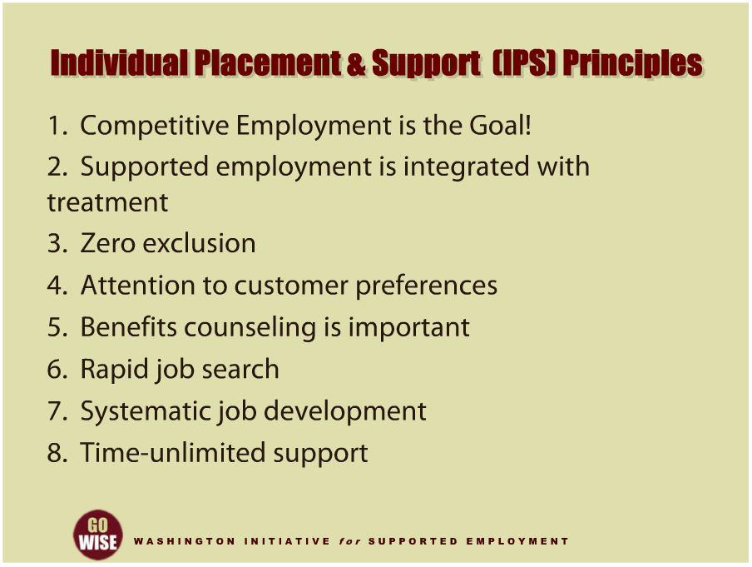
IPS Principles
Notes:
These eight principles of Individual Placement and Support, or IPS, provide you with the infrastructure for how to approach your job as an employment consultant. You will no doubt hear more about them as your gain more experience in the field. You may also want to review them in the future as you consider specific situations and help more people access supported employment. Please find a link to them under Dartmouth University IPS Supported Employment Center in the resources section at the end of the training.

Slide 21
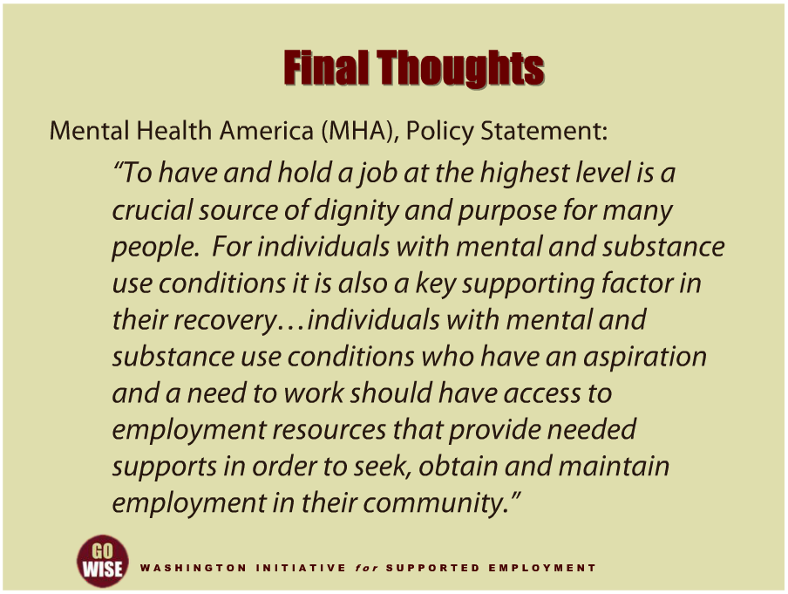
Final Thoughts
Notes:
We want to leave you with a few final thoughts about the supported employment services you provide. First, there a belief gaining momentum as it spreads across the mental health field. The belief is that supported employment services should be available to those who want them. According to a Policy Statement from Mental Health America, commonly referred to as MHA, “To have and hold a job at the highest level is a crucial source of dignity and purpose for many people. For individuals with mental and substance use conditions it is also a key supporting factor in their recovery. Individuals with mental and substance use conditions who have an aspiration and a need to work should have access to employment resources that provide needed supports in order to seek, obtain and maintain employment in their community.” You will find the link to Mental Health America’s website in the resources section at the end of this presentation.

Slide 22
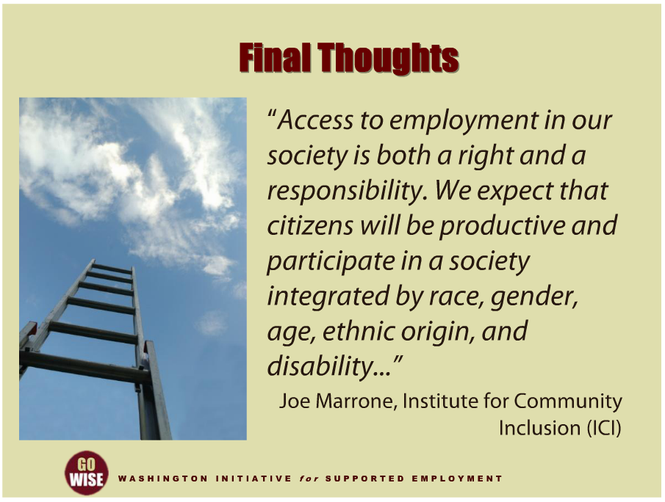
Final Thoughts
Notes:
And second, supported employment is consistent with societal goals. According to Joe Marrone from the Institute for Community Inclusion or ICI, “Access to employment in our society is both a right & a responsibility. We expect that citizens will be productive and participate in a society integrated by race, gender, age, ethnic origin, & disability…” To learn more about the Institute for Community Inclusion, please go to the resources section at the end of this presentation.

Slide 23
DVR Language
Employment Consultant: also known as an employment specialist, job coach, job developer, etc.
Community Rehabilitation Program (CRP): also known as employment agency, employment provider, vendor, etc.
Customer: also known as client, consumer, person with a disability, supported employee, etc.
Extended Services: also knows as long term supports, follow along services, etc.

Slide 24
Resources
Division of Vocational Rehabilitation (DVR): http://www.dshs.wa.gov/dvr/
If Work Makes People with Mental Illness Sick, What Do Unemployment, Poverty, and Social Isolation Cause? Joe Marrone & Ed Golowka. 2000. Cornell University ILR School.
Substance Abuse and Mental Health Services Administration: http://www.samhsa.gov/
Warr, P. (1987). Work, unemployment, and mental health. Oxford: Oxford University Press.
J. Bailey, “I’m an Ordinary Person, ‘Psychiatric Rehabilitation Journal, 22, (1998), 8-10.
Rogers, J.A. (1995). Work is key to recovery. Psychosocial Rehabilitation Journal, 18(4), 5-10.
Steele, K., & Berman, C. (2001). The day the voices stopped. New York: Basic Books.
Institute for Community Inclusion (IC): http://www.communityinclusion.org/
Mental Health America (MHA): http://www.mentalhealthamerica.net/go/home
President’s New Freedom Commission on Mental Health: http://govinfo.library.unt.edu/mentalhealthcommission/index.htm
Bond, G.R., & Jones, A. (2005). Supported employment. R.E. Drake, M.R. Merrens & D. David Lynde (Eds.), Evidence-based mental health practice: A textbook. WW Norton & Company.
Dartmouth University IPS Supported Employment Center: http://www.Dartmouth.edu/~ips/
  Content for this training was developed by representatives from the Division of Behavioral Health and Recovery.

