Slide 1

Fundamentals of Supported Employment in Vocational Rehabilitation
Development of this training was funded by:
CRP Service Delivery Outcome Plans & Reports

Slide 2
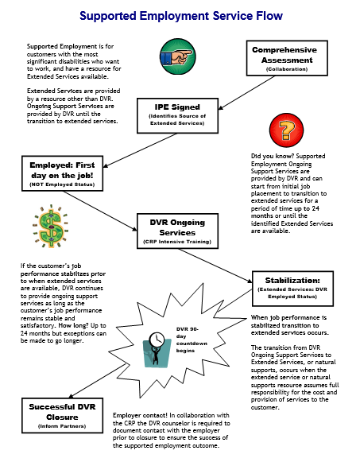

Services Flow Chart
Notes:
Before we begin the content of this training module let’s review the supported employment model that the D.S.H.S. Division of Vocational Rehabilitation, or D.V.R., must carry out. As an employment consultant serving these customers, it is important that you understand the steps of supported employment that D.V.R. must follow and your role in the process. Let’s review each step briefly.
D.V.R. supported employment services are provided to customers with the most significant disabilities who want to get and keep a permanent job. These customers require intensive support to obtain employment, as well as long term support to achieve and maintain successful job performance. Federal rules for supported employment require D.V.R. to provide the upfront vocational rehabilitation, or V.R. services known as on-going services, that a customer requires to get and learn a job. After that, a separate source will provide the extended support or long term supports the customer needs to keep their job once D.V.R. services end. All D.V.R. supported employment customers go through the same application and eligibility determination process. Once an individual is determined eligible for D.V.R. their V.R. counselor works with them to conduct a comprehensive assessment of their vocational rehabilitation needs, including whether the customer will require supported employment to get and keep a job of their choice. The comprehensive assessment often includes a community based assessment that is provided by a community rehabilitation program, or C.R.P., such as the one you work for. After the comprehensive assessment has been completed, the D.V.R. customer is assisted by their V.R. Counselor to develop an individualized plan for employment, or I.P.E. The I.P.E. identifies the customer’s employment goal along with the steps and the D.V.R. services they will require to achieve their goal. The I.P.E. must also identify the customer’s need for supported employment and what their source of long term support or extended services will be. If the source of extended services is unknown when the I.P.E. begins, there must be a strong expectation that a source will be identified within 24 months. D.V.R. services identified in the I.P.E. begin once the plan is signed by the D.V.R. customer and their V.R. counselor. Typically, the first step of an I.P.E. is for D.V.R. to authorize job placement services to assist the supported employment customer in becoming employed. Once the customer is employed then D.V.R. authorizes intensive training services to assist the customer in learning how to perform their job satisfactorily. However, once a customer reaches a stable level of satisfactory job performance, they must begin receiving their extended services from a source outside of D.V.R.. If a supported employment customer achieves stable job performance sooner than their extended services will be available, D.V.R. will continue providing ongoing support for up to 24 months. Once extended services have begun, D.V.R. keeps the case open during the first ninety days that these services are provided to make sure they meet the customer’s needs. If the customer is doing well on their job at the end of this ninety days and their extended services continue without interruption, then the customer’s D.V.R. case is closed.

Slide 3
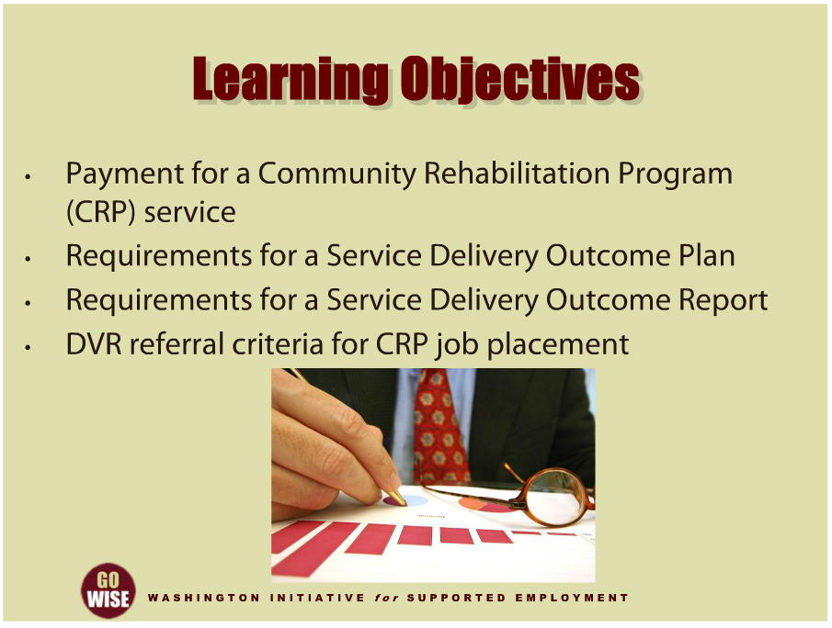
Learning Objectives
Notes:
This training module will teach you how the Department of Social and Health Services Division of Vocational Rehabilitation, or DVR, pays for services purchased from a Community Rehabilitation Program, or CRP. It will also explain the Division’s requirements for Service Delivery Outcome Plans and Reports to be prepared each time that a CRP service is purchased for a DVR customer. This will include an overview of your role and responsibilities in preparing these required plans and reports. Finally, the training will cover specific criteria that DVR uses in determining which customers to refer to a CRP for job placement services.

Slide 4
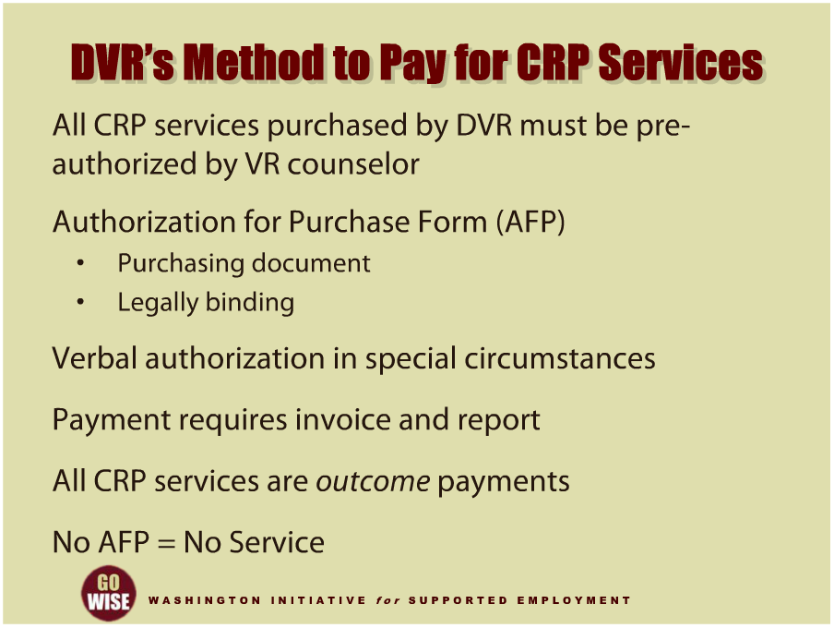
DVR’s Method to Pay for CRP Services
Notes:
All of the Community Rehabilitation Program, or CRP, services that DVR purchases for its customers are bought under a CRP contract that the Division has with an array of service providers. The contract specifies the CRP services that will be provided to DVR customers, payment amounts, service delivery procedures, specific reporting requirements, and other important information. The contract includes many details that will not be covered in this training. If you have not yet read the CRP contract to learn all of its requirements, you should request a copy from your employer. You can also find a copy of the CRP contract by using the link to the DVR webpage that is provided at the end of this training. While DVR purchases all CRP services under a contract, the specific CRP services provided to an individual customer must be pre-authorized and paid for by a VR counselor. The term “pre-authorized” means that a VR counselor must approve the purchase of a CRP service before it is provided to a customer. This is done when the VR counselor issues an Authorization for Purchase form, or AFP, which is provided to the CRP as a purchasing document. The AFP is a legally binding document that includes specific information describing the CRP service DVR is purchasing for its customer as well as the dates of service, amount of funds authorized, and other conditions related to the service and or payment. Under special circumstances, a VR counselor may verbally pre-authorize the purchase of a CRP service. But when this is done the VR counselor is required to issue an AFP to the CRP no later than five working days after verbal authorization was given. When the time comes for DVR to pay for a CRP service, after it has been provided to a customer, an invoice must be submitted along with a written Service Delivery Outcome Report, or SDOR. The SDOR will be covered in more detail later in this training presentation. When a VR counselor receives a CRP’s invoice and report, both are carefully reviewed to assure they are accurate and complete. If they are, then the invoice is paid within five working days. If either the invoice or report are inaccurate or missing information, the VR counselor or their Rehabilitation Technician will notify the CRP to discuss the situation. DVR makes outcome payments for all CRP services. The amount of these payments varies according to service category. The outcome fees that DVR pays are set in the CRP contract that DVR has initiated with your employer. In addition, that contract defines the specific services, terms and conditions that must be fulfilled when you serve DVR customers. If you are not already familiar with the CRP contract you may access it by using the hyperlink at the end of this training presentation. As a CRP employment consultant, you will serve many different DVR supported employment customers that will be referred to you by a number of VR counselors. There is one important rule to remember in every case. Do not begin providing any CRP service to a customer until after you have received an AFP from their VR counselor. If you begin service delivery before an AFP has been issued for the service, DVR will not be able to pay you because Federal and State procurement rules prohibit DVR from paying for any service after the fact. In addition, a Service Delivery Outcome Plan must be developed before any CRP service begins, and that is our next topic.

Slide 5
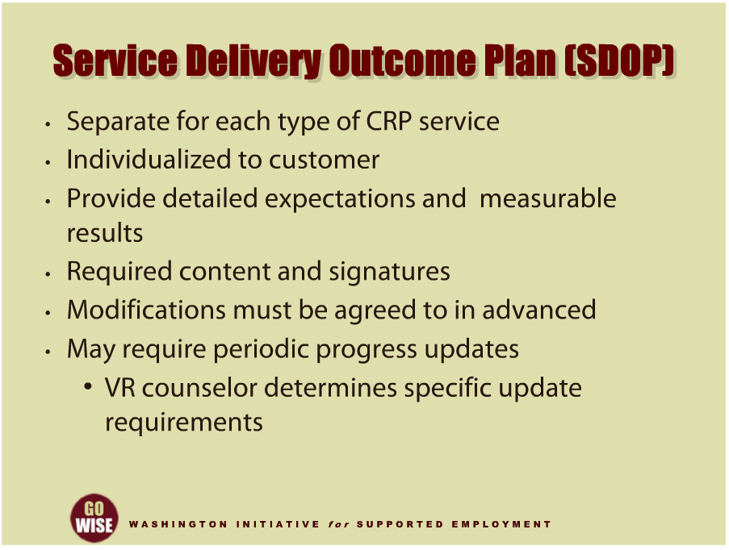
Service Delivery Outcome Plan (SDOP)
Notes:
After DVR issues an Authorization for Purchase to authorize a CRP service to be provided to customer, a Service Delivery Outcome Plan, or SDOP, must be developed before the service can be delivered. The SDOP (S –D –O –P) is a form that DVR uses for all CRP services provided to its customers. A separate SDOP must be developed for each different CRP service that is provided to a DVR customer. For example if a customer receives and Community Based Assessment and later receives Job Placement services, a separate SDOP must be developed for each service. DVR is not allowed to combine CRP services on the same SDOP. DVR has a standard SDOP form for all CRP services. The SDOP is initiated by the VR counselor and developed jointly with the customer and CRP employment consultant. The details of the SDOP are tailored to the unique needs of the customer and the content must include the expected outcome and measurable result that you will achieve with the customer. More than one expected outcome may be included on a plan when the outcomes are within the same service category. The SDOP must also identify when the service will begin and end, the specific activities that will be carried out by the customer, the VR counselor, and you as the CRP employment consultant, as well as the criteria that will be used to determine if the expected outcome has been achieved. Finally, the SDOP must be signed and dated by the customer, VR counselor, and CRP employment consultant. Modifications to an existing SDOP may be made when circumstances change and they are discussed and agreed to in advance by the customer, VR counselor, and CRP employment consultant. Minor modifications may be made on an existing SDOP when all parties have initialed and dated the changes on the plan. Examples of minor changes include extending the end date of a service or modifying an expected outcome so long as it remains consistent with the overall plan. However, any modifications that will require a new AFP to be issued, such as changing payment amounts, require a new SDOP to be developed and signed. Always check with the VR counselor before making any changes to how you implement an SDOP. As you are serving a DVR customer, the VR counselor will want to know how things are going and may require you to give them periodic progress updates. If so, they will let you know the method and frequency you will use to keep them updated on your services, and the customer’s progress. When the SDOP is complete, you will submit a written Service Delivery Outcome Report that identifies the results of your service delivery to a customer. That report is our next training topic.

Slide 6
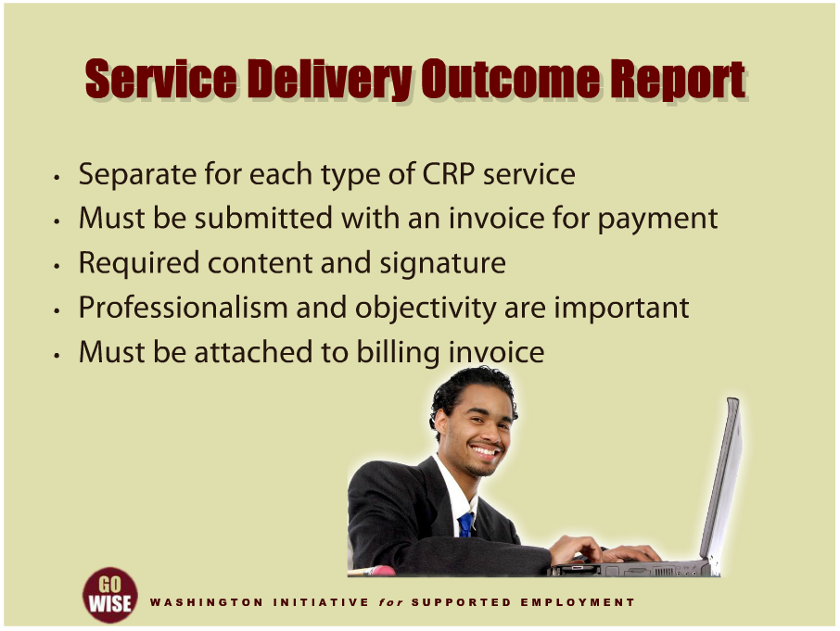
Service Delivery Outcome Report
Notes:
As a CRP employment consultant, you will be required to submit a written report to DVR each time you bill for an outcome fee for a service that you provided to a DVR customer. This report must be written on a Service Delivery Outcome Report form, or SDOR, that DVR uses for all CRP services. The SDOR must be submitted along with your billing invoice. Content for the SDOR includes the following information: the name of the DVR customer and VR counselor who authorized the services, the name of the CRP representative completing the report and the name of Community Rehabilitation Program, the CRP service category and AFP number that correspond to an CRP Service Delivery Outcome Plan, the overall timelines of the plan, and the report time line, the outcomes being reported, which must correspond to the expected outcomes listed on the CRP Service Delivery Outcome Plan, and the CRP representative’s signature and the date. Additional content for the SDOR will be identified in the CRP contract specific to the particular CRP service that you provided to the customer. It’s important for you to be familiar with these contract requirements when writing your report. In addition, your report must also include any information specified in the Service Delivery Outcome Plan, or SDOP, for the customer you served. The VR counselor will discuss your report with the DVR customer so the individual is familiar with its content, and they will use it to determine the individual’s next steps in the VR process. It’s important to realize that the tone of your report may impact the direction your customer goes in their career path. Employment consultants constantly need to consider their level of professionalism and objectivity when writing reports on behalf of a DVR customer. As already mentioned, the SDOR must be attached to an invoice when a CRP bills for services and the VR counselor must be satisfied with the report before payment is made. The VR counselor will let you know if they have any questions about the report or feel that it is missing any required information. The billing invoice that is attached to the SDOR must include the CRP name, mailing address, description of services provided, total billing amount, and date. When a VR counselor receives the SDOR and the CRPs invoice, the VR counselor initiates payment if the report contains all of its required information. Advance payments are prohibited. A VR counselor approves payment within seven calendar days of receiving a CRP Service Delivery Outcome Report and the billing invoice. If a VR counselor does not approve payment because the SDOR is not satisfactory, then the CRP will be notified with a written explanation of the specific reasons the request for payment is not approved. The SDOR will then be revised and re-submitted by the CRP for payment.

Slide 7
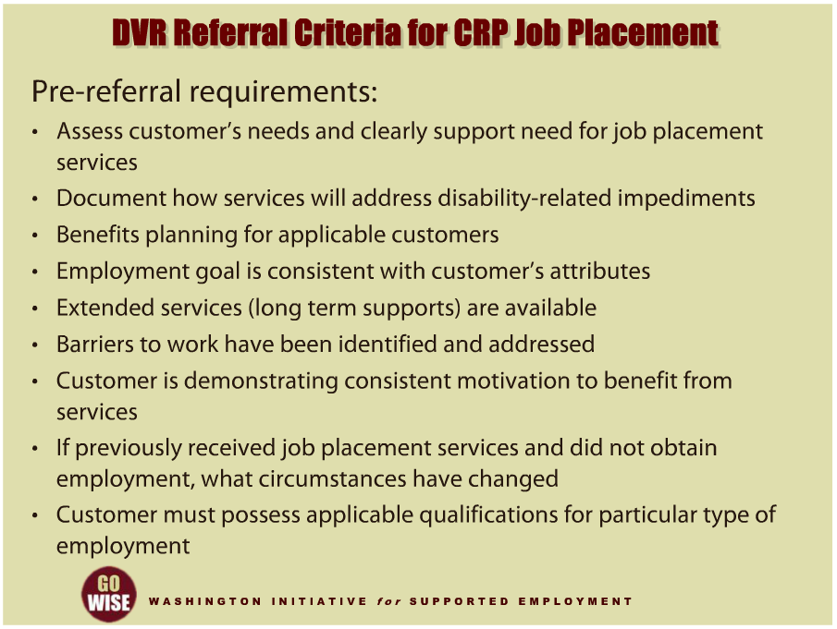
DVR Referral Criteria for CRP Job Placement
Notes:
It’s worth taking a few moments to consider what needs to happen before DVR refers a customer to a Community Rehabilitation Program for job placement services. There are pre-referral requirements that VR counselors must follow to ensure that customers are prepared for the job placement activities you will be conducting with them as a CRP employment consultant. A VR counselor must have taken the following actions before they refer a customer to you for job placement. An assessment of the customer’s needs for VR services must be completed and clearly support the need for CRP job placement services. Documentation must be in the DVR case file that explains how CRP job placement services will address the customer’s disability-related impediments to employment. For customers receiving Social Security Disability Insurance or Supplemental Security Income, a thorough benefits planning must be completed by the VR counselor or a benefits planner. Sufficient information must be in the DVR case file to verify that the customer’s selected employment goal is consistent with the individual’s strengths, interests, abilities, capabilities, concerns, resources, needs and informed choice. When a customer requires supported employment, there must be documentation in the DVR case file that extended services, often called long term supports, will be available to the individual when they become employed. Or, there must be a documented reasonable likelihood that long term support will become available by the time the customer starts working. All of the customer’s barriers to work, which will impact CRP job placement services, need to have been identified and addressed by DVR. For example, barriers may include a criminal history, drug or alcohol issues, independent living skills, lack of transportation, child care needs, etc. The VR counselor needs to determine that the customer is demonstrating consistent motivation and follow through necessary to benefit from CRP job placement services. If a customer has previously received CRP job placement services and did not obtain employment, the VR counselor must determine what circumstances have changed that will lead to a different outcome. And if a customer will seek a type of employment that requires particular credentials, education, skills, experience or other qualifications, the individual must possess the applicable qualifications.

Slide 8
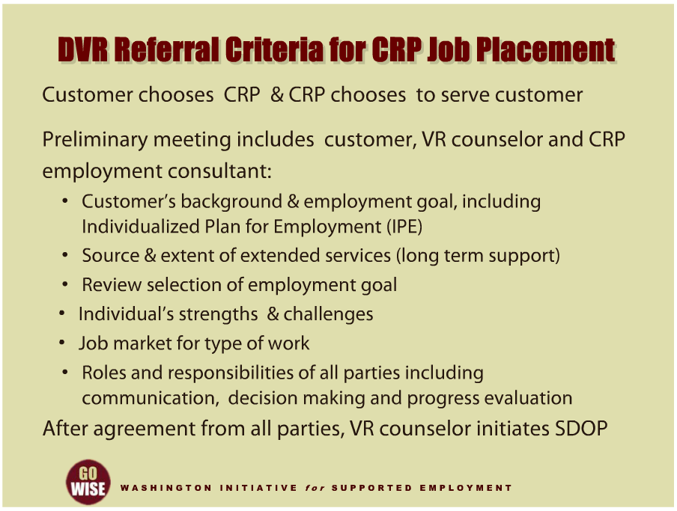
DVR Referral Criteria for CRP Job Placement
Notes:
Aside from the pre-referral requirements that the DVR counselor is responsible for, it’s also important to understand the choice and agreement involved with the CRP job placement services. When DVR refers a customer for CRP job placement services, it is up to the customer to choose the CRP they will be served by. It is also up to the CRP to decide if they will serve the customer. A meeting between the DVR customer, VR counselor and CRP employment consultant must be held to decide whether the customer and CRP will work together. This meeting will include the following topics. The customer’s background and employment goal will be reviewed, including their Individualized Plan for Employment, or IPE. When the customer requires supported employment the source and extent of their extended services, or long term support, will be thoroughly discussed. The meeting participants will review the information that led to the customer’s selection of the particular employment goal, including the individual’s strengths and challenges as well as the job market for the type of work they will be seeking. The meeting will cover the roles and responsibilities of the customer, VR counselor and CRP employment consultant. And there will be a discussion about how all parties will communicate, make decisions and evaluate progress. The joint meeting with the VR counselor and CRP employment consultant gives the customer an opportunity to ask about the job placement services you provide, your background and success in providing job placement services, and other information that will enable them to decide whether you will be a good match for their needs. Likewise, this meeting is your opportunity to ask questions of the customer to decide if they are a good match for you. If the DVR customer chooses to be served by you and you agree, the VR counselor will initiate development of an SDOP after the initial meeting. To prepare for developing an SDOP you will receive copies of the customer’s IPE, documentation supporting the selection of their employment goal, and any other information that is relevant or necessary to support your job placement efforts. As explained earlier, once an SDOP is developed and signed by all parties, you and the customer will begin working together on job placement activities.

Slide 9

Summary of Key Points
Notes:
This training introduced you to the CRP Service Delivery Outcome Plans, or SDOPs, that you will develop with DVR customers and VR counselors as well as the CRP Service Delivery Outcome Reports, or SDORs, that you will be writing when you bill for services. We also explained how DVR uses the Authorization for Purchase, or AFP, as the purchasing document for all CRP services. As an employment consultant, there are a few key points to remember. Make sure that before you begin providing a CRP service to a DVR customer, you have received an AFP from the VR counselor and that an SDOP has been signed by the VR counselor, DVR customer and you. The SDOP is developed to guide your service delivery and only one SDOP can be written for one CRP service category. So make sure the SDOP clearly describes the outcomes you will be expected to achieve with the customer. Before DVR pays for any CRP service, an invoice and written SDOR must be submitted by the CRP. This report must be satisfactory to the VR counselor in order from them to approve payment. The VR counselor will share the results of the SDOR with the DVR customer. The report will also be used to determine the customer’s next steps in the VR process. There is very important information in the CRP contract that describes in more detail the information that must be included in SDOPs and SDORs for each type of service you may provide. To be successful in your role as a CRP employment consultant, you must be familiar with this information. A link to access the DVR website where you can find the DVR contract is at the end of this training. And finally, when DVR customers are referred for CRP services, the customer chooses the CRP they will be served by. When CRP job placement services are needed by a customer, there are actions that a VR counselor must take before making a referral to ensure that the customer is well prepared to engage in job placement activities. The DVR customer, VR counselor and CRP employment consultant will meet before a SDOP is developed so that the customer and CRP can each decide if they are a good match for working together.

Slide 10
DVR Language
Employment Consultant: also known as an employment specialist, job coach, job developer, etc.
Community Rehabilitation Program (CRP): also known as employment agency, employment provider, vendor, etc.
Customer: also known as client, consumer, person with a disability, supported employee, etc.
Extended Services: also knows as long term supports, follow along services, etc.

Slide 11
Resources
Division of Vocational Rehabilitation (DVR): http://www.dshs.wa.gov/dvr/
  Content for this training was developed by representatives from the Division of Vocational Rehabilitation.

