Slide 1
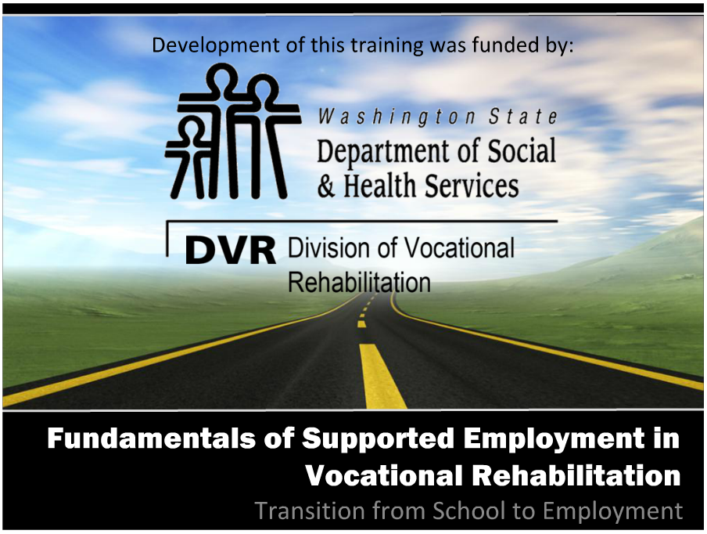

Fundamentals of Supported Employment in Vocational Rehabilitation
Development of this training was funded by:
The Importance of Benefits Planning

Slide 2
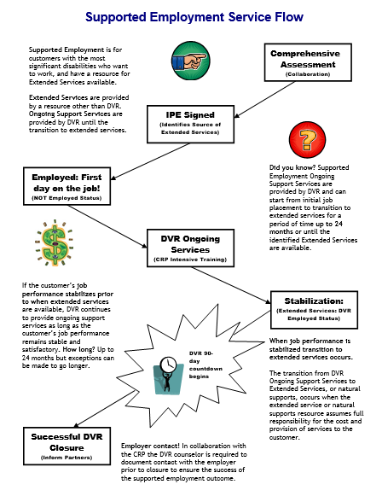

Services Flow Chart
Notes:
Before we begin the content of this training module let’s review the supported employment model that the D.S.H.S. Division of Vocational Rehabilitation, or D.V.R., must carry out. As an employment consultant serving these customers, it is important that you understand the steps of supported employment that D.V.R. must follow and your role in the process. Let’s review each step briefly.
D.V.R. supported employment services are provided to customers with the most significant disabilities who want to get and keep a permanent job. These customers require intensive support to obtain employment, as well as long term support to achieve and maintain successful job performance. Federal rules for supported employment require D.V.R. to provide the upfront vocational rehabilitation, or V.R. services known as on-going services, that a customer requires to get and learn a job. After that, a separate source will provide the extended support or long term supports the customer needs to keep their job once D.V.R. services end. All D.V.R. supported employment customers go through the same application and eligibility determination process. Once an individual is determined eligible for D.V.R. their V.R. counselor works with them to conduct a comprehensive assessment of their vocational rehabilitation needs, including whether the customer will require supported employment to get and keep a job of their choice. The comprehensive assessment often includes a community based assessment that is provided by a community rehabilitation program, or C.R.P., such as the one you work for. After the comprehensive assessment has been completed, the D.V.R. customer is assisted by their V.R. Counselor to develop an individualized plan for employment, or I.P.E. The I.P.E. identifies the customer’s employment goal along with the steps and the D.V.R. services they will require to achieve their goal. The I.P.E. must also identify the customer’s need for supported employment and what their source of long term support or extended services will be. If the source of extended services is unknown when the I.P.E. begins, there must be a strong expectation that a source will be identified within 24 months. D.V.R. services identified in the I.P.E. begin once the plan is signed by the D.V.R. customer and their V.R. counselor. Typically, the first step of an I.P.E. is for D.V.R. to authorize job placement services to assist the supported employment customer in becoming employed. Once the customer is employed then D.V.R. authorizes intensive training services to assist the customer in learning how to perform their job satisfactorily. However, once a customer reaches a stable level of satisfactory job performance, they must begin receiving their extended services from a source outside of D.V.R.. If a supported employment customer achieves stable job performance sooner than their extended services will be available, D.V.R. will continue providing ongoing support for up to 24 months. Once extended services have begun, D.V.R. keeps the case open during the first ninety days that these services are provided to make sure they meet the customer’s needs. If the customer is doing well on their job at the end of this ninety days and their extended services continue without interruption, then the customer’s D.V.R. case is closed.

Slide 3
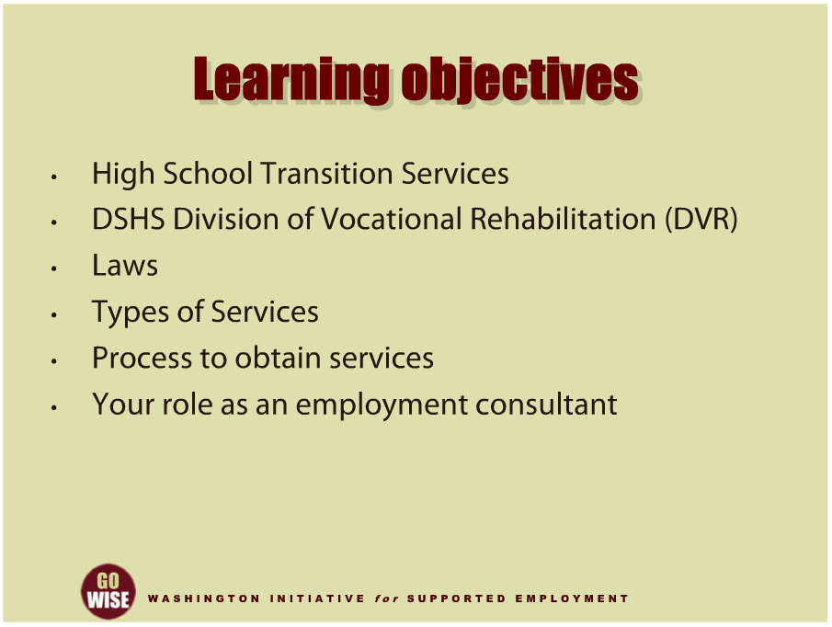
Learning Objectives
Notes:
We are including High School Transition as a topic in this series of supported employment training modules because many graduating students with disabilities obtain supported employment positions after they finish high school. “High School Transition” is the term used by the Department of Social and Health Services Division of Vocational Rehabilitation, or DVR, for services provided to high school students to prepare for life after high school. This training will introduce you to the main players and service providers that collaborate with DVR to help high school students transition to the world of employment and careers.
We will focus on the vocational rehabilitation services that DVR provides. We will introduce you to the laws that mandate transition services, as well as the types of services you may provide as an employment consultant. We will also cover the process a transition student may go through to obtain services and where you may enter in to that process. Finally, we will help you understand the vital role you play in helping a young adult reach their employment goals as they exit the school system and begin life as an adult.

Slide 4
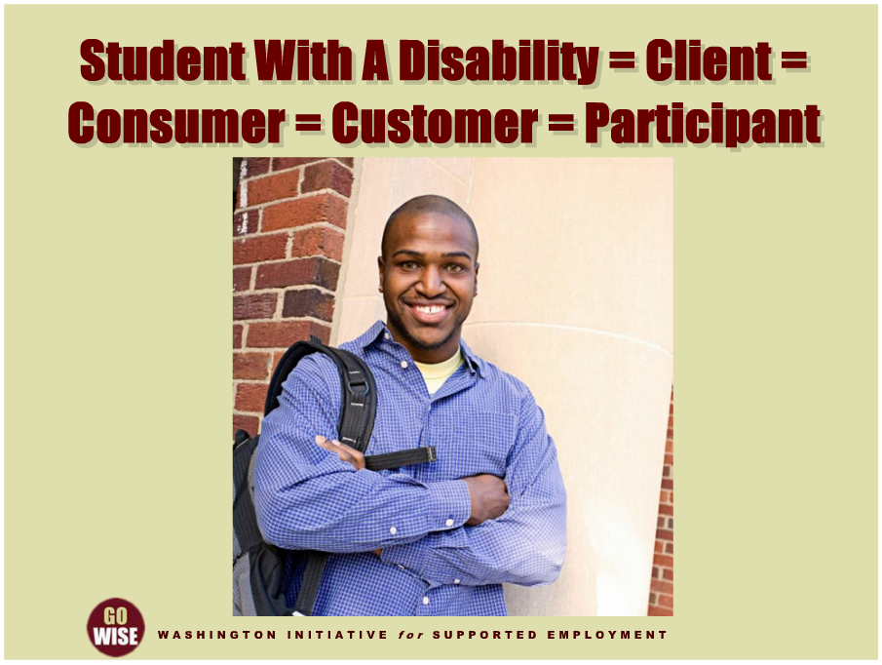
Important Terms
Notes:
Before we get too far into the content of this training, let’s make sure you understand a few important terms. As you’ll soon learn, there is more than one entity involved in providing transition services. As a result, young adults that receive transition services may be referred to by different terms depending on who you are talking to. For example, you may hear a transition student referred to as a student, a client, a consumer, a customer and or a participant. These terms will most likely be used interchangeably amongst the different people involved with the student, and can be confusing when you are new to transition services. Ultimately, as an employment consultant, they will be your customers.

Slide 5
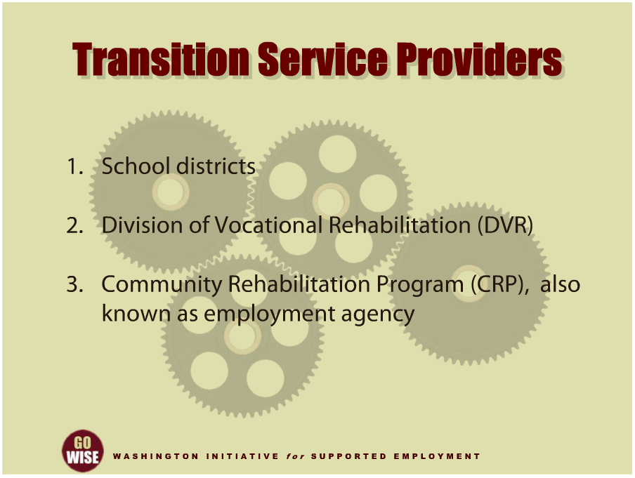
Transition Service Providers
Notes:
Let’s start with a quick run-down of who actually provides transition services. Then we will look more in depth at what these different entities do and why they do it. The obvious first provider of transition services are school districts, since this is where students are when they begin transitioning to adult life.
DVR also provides transition services. DVR may provide transition services directly to a customer, or, DVR may purchase services from another entity. This is where you come in. In some instances, DVR contracts with community rehabilitation programs, or CRPs. You may also hear CRPs referred to as an employment agency or vendor. CRPs are organizations that DVR contracts with to provide various assessment, job placement, and intensive training services to its customers, including high school transition students. As an employment consultant at one of these CRPs, you will likely be serving some of these DVR customers.

Slide 6
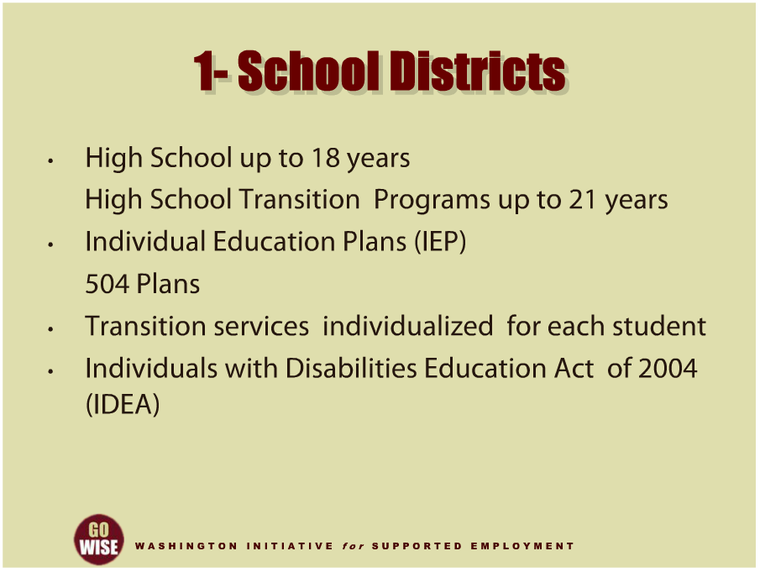
School Districts
Notes:
Now let’s look closer at what school districts do and why. High schools in Washington State typically serve youth up to age eighteen, and high school transition programs in Washington State typically serve young adults up to age twenty one. Both of these programs include students who are eligible for an Individual Education Plan, known as an IEP, through the special education system, as well as those who are eligible for a 504 Plan which provides reasonable accommodations to students with disabilities to enable them to participate in classroom and learning activities. There are many different types of services a student may receive from the school district. And services are individualized according to the needs, strengths, preferences and interests of each student. Some service examples include instruction, related services, community experiences, the development of employment and other post-school adult living skills, and when appropriate, acquisition of daily living skills and functional vocational evaluation. For more information about school based transition services and resources in your area please visit the Center for Change in Transition Services website listed in the resources section at the end of this training. You can also locate your school district’s special education coordinator, by going to the link in the resources section. Finally, the law that guides school districts to provide transition services is the Individuals with Disabilities Education Act of 2004, commonly called IDEA. A link to more information about IDEA is in the resources section as well.

Slide 7
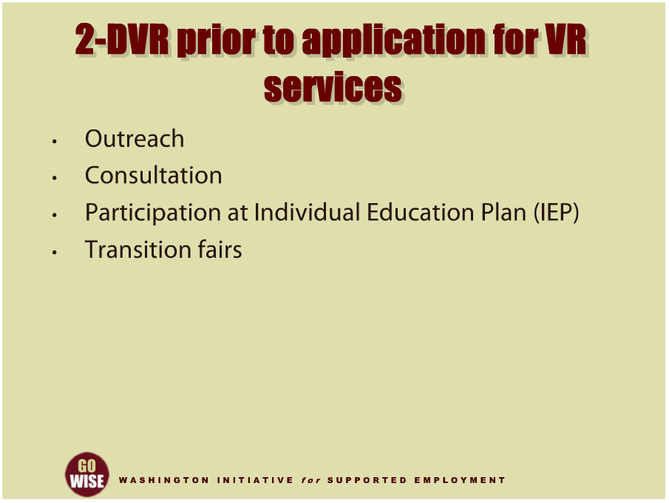
Prior to application for VR services
Notes:
Next, let’s look at what services DVR provides to transition students and programs before a student actually applies for or begins receiving DVR services. DVR counselors are involved with transition students in various ways while those students are still in the high school and or school-based transition programs. Before a student applies for DVR services, DVR staff can be helpful to a student and their team when planning for the student’s future. For example, DVR is available to provide outreach and identify students that may benefit from VR services. A DVR counselor may also provide vocational consultation when requested by the high school, the student or the parent. When invited, a DVR counselor can participate in the student’s annual Individual Education Plan, typically called an IEP, to assist the school and student in planning for their vocational future. You may also see DVR counselors at transition fairs and other events where students and their advocates network and learn about available services. All of these services can be provided to students before a student formally applies for DVR services, or any formal plans for DVR service are in place.

Slide 8
2-DVR Services
2-DVR Services
Vocational counseling
Benefits planning
Job placement
Post-secondary education
Introduction to other providers
DVR Transition Liaisons for each high school
Notes:
While students with disabilities are still in high school their school is responsible for the instruction and support services they require to prepare for and successfully transition to the world of work. However, DVR provides pre-employment transition services and other vocational rehabilitation services before students with disabilities graduate. Any student with a disability who is eligible or potentially eligible for DVR may receive pre-employment transition services as early as age 14. To receive other DVR services, a DVR counselor will determine if the student is eligible for vocational rehabilitation services, and if so, what a suitable employment outcome for that particular student may be. In addition to pre-employment transition services, the other services a customer may obtain from DVR while they are in high school include vocational counseling and guidance, benefits planning related to employment, and other vocational rehabilitation services not otherwise provided by their school. After a customer graduates from high school DVR will provide additional services, such as job placement, intensive training, assistive technology and other vocational rehabilitation services required by the individual to further prepare for, get or keep a permanent job of their choice. DVR counselors have been identified as Transition Liaisons for every high school in Washington State. DVR’s Transition Liaisons are vocational rehabilitation counselors who provide outreach in cooperation with local school staff to identify students with disabilities who are in need of transition services and when requested and appropriate, technical assistance and vocational rehabilitation services. Outreach includes at a minimum, a description of the purpose of vocational rehabilitation, eligibility requirements, application procedures and scope of services. To find a specific high school’s DVR transition liaison counselor, visit the link in the resources section at the end of this training.

Slide 9
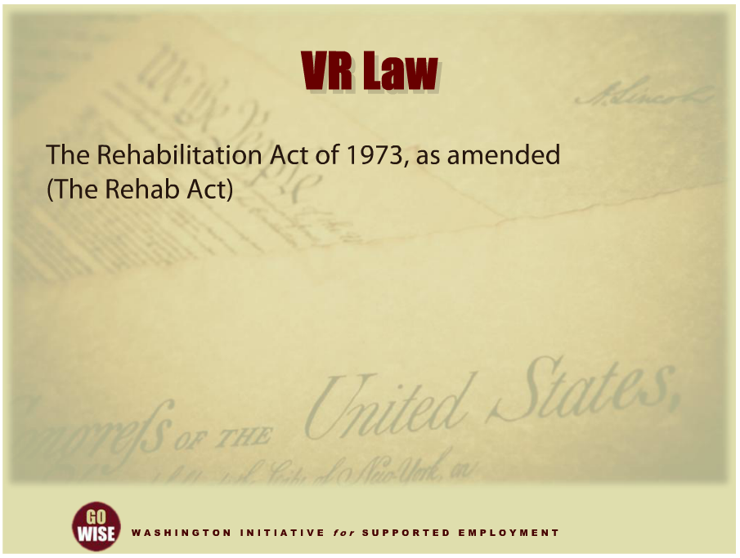
VR Law
Notes:
It is important to have a general understanding of why Washington State’s VR system provides transition services so that you are aware of the system you are contributing to. DVR is guided to provide transition services through the Rehabilitation Act of 1973, as amended. The Rehabilitation Act was the first major, national law to help individuals with disabilities receive different types of services, including help to find and keep employment. The Rehabilitation Act of 1973 has been amended several times since its inception. Please note for the purposes of this training, we will refer to the Rehabilitation Act of 1973 with all of its amendments as the “Rehab Act” from this point on. There is a link at the end of this presentation if you want to learn more about the Rehab Act.

Slide 10
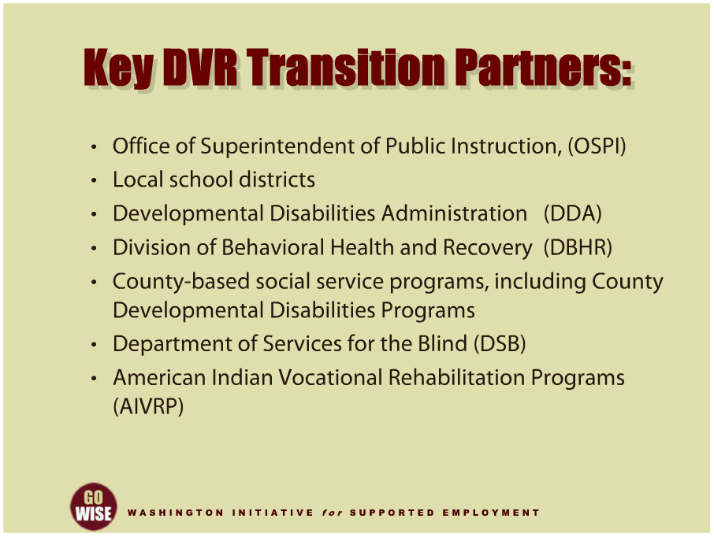
Key DVR Transition Partners
Notes:
The Federal Rehabilitation Act and Individuals with Disabilities Education Act, or IDEA, requires DVR and the Office of Superintendent of Public Instruction, called OSPI (O-S-P-I), to have an interagency agreement that describes how the two agencies will work together to serve high school transition students, including the different services that each will provide to transition students. This ensures clarity and agreement on how they will cooperate and coordinate activities to promote successful transitions for students who are eligible for special education services as well as DVR services. Transition responsibilities were included in the Rehab Act and IDEA to minimize gaps in services received by students with disabilities as they prepare for careers, get closer to the time they will leave the high school setting, and or are ready to begin vocational activities when employment is their primary focus. Other government entities that also collaborate with DVR and OSPI are local school districts, other adult agency partners such as the DSHS Developmental Disabilities Administration or DDA, known as the Division of Developmental Disabilities, or DDD prior to 2013, the DSHS Division of Behavioral Health and Recovery, or DBHR, county-based social service programs and County Developmental Disabilities Programs, the Washington State Department of Services for the Blind, or DSB, and American Indian Vocational Rehabilitation Programs, or AIVRP. These providers serve transition customers based on their individual circumstances. The collaboration among all of these programs is essential to promote a results oriented process that prepares students for an engaged, integrated and productive life after high school. It’s also important for you to realize that you may interact with some or all of these entities as you provide transition services.

Slide 11
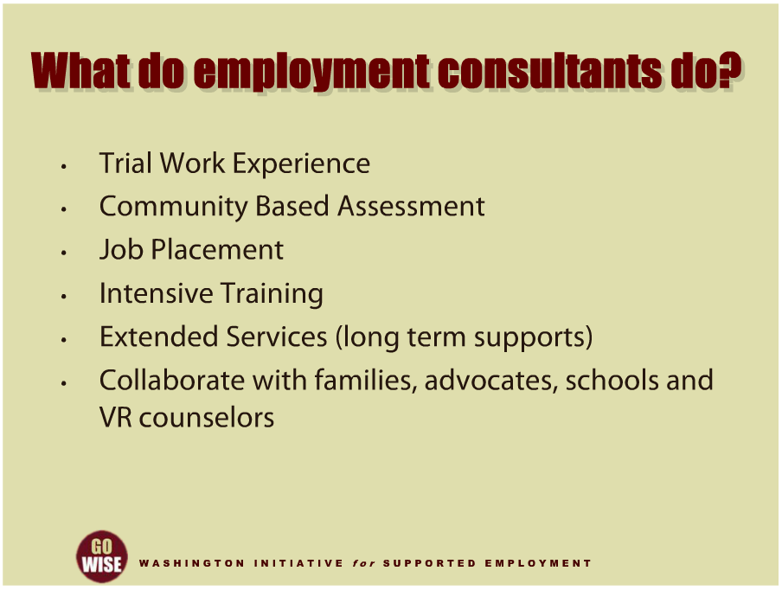
What do employment consultants do?
Notes:
When you are serving a DVR supported employment customer who is transitioning from school to work, you will essentially serve the individual no differently than DVR adult customers, except that you will be interacting with parents and high school personnel who are involved in the student’s transition to adulthood. You will be tasked with providing the same Community Rehabilitation Program services that you otherwise deliver to DVR adult customers. Depending on the circumstances, you may provide the following services:
trial work experience,
community based assessment,
job placement,
intensive training services.
And, you will assist the customer in transitioning from DVR supported employment services to the long term support services provided by another entity after DVR services end. To learn more about these services, please watch the trainings offered in this training series that cover specific types of service, such as Services for Individuals Who Experience Mental Illness 1 & 2, or Services for Individuals Who Experience Developmental Disabilities 1 & 2.
In addition to providing services to your customer, your job as an employment consultant is to collaborate with the customer’s family members and advocates, school district personnel, DVR counselors, and the other entities we have mentioned who are serving your common customer.

Slide 12
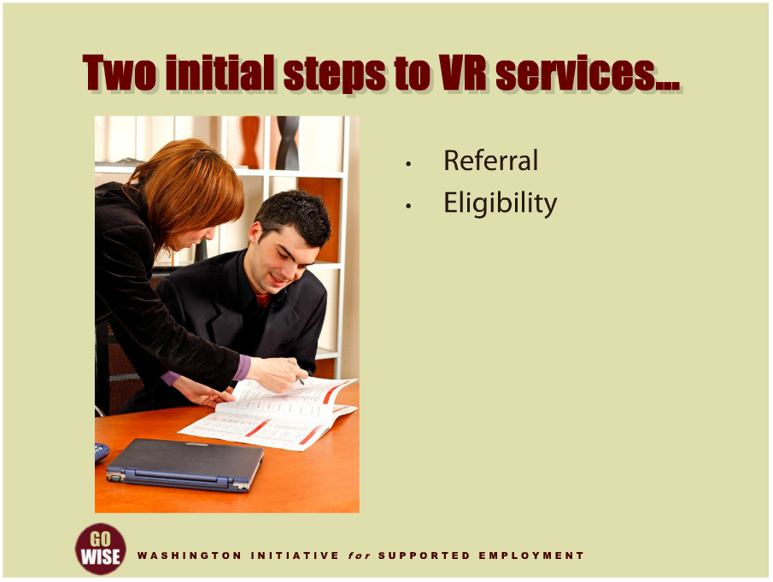
Two initial steps
Notes:
Next, let’s get a general understanding of the initial steps someone in high school transition will go through when they want services from DVR. The two main steps are referral and eligibility.

Slide 13
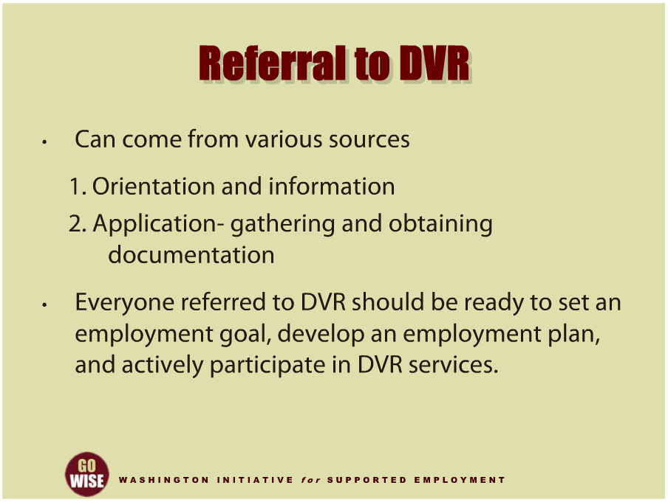
Referral to DVR
Notes:
Referral to DVR may be initiated by anyone, which is why referrals tend to come from a lot of different sources. As you have learned so far, DVR has various agreements with school districts and other entities. Typically, the agreements include a process for referring students to DVR and the roles of everyone involved. A student can also self-refer, as can their family member, a representative from a local community agency such as a county developmental disabilities program coordinator or a representative from a CRP, or state agency personnel such as a case manager from DDA. The process for referring students to DVR starts with discussing the potential referral with the student and their parents or guardians to share general information and make sure everyone is on the same page.
Generally people referred to DVR begin with an invitation to attend orientation at the local DVR office. In some areas DVR will provide one to one orientation and may include an intake afterward if the youth is interested in working with DVR. If the student is in school, DVR coordinates with the school and may provide those services on site. The next step in the referral process is to gather information for the application. For students in transition programs, information from the school can assist DVR in determining eligibility and identifying necessary components for the student’s vocational planning process. For example, DVR may ask the school to provide psychological and medical reports, copies of IEPs or 504 plans, school transcripts, and other information about the student’s vocational activities through the school. The DVR counselor may also coordinate with the school to order additional assessments when necessary. It’s important to note that DVR applicants must be ready to engage in the activities necessary to establish an employment goal, develop an employment plan, and participate in vocational services to get a job. If they do not want to engage in these activities, they should wait to apply for services until they are ready to focus on employment.

Slide 14
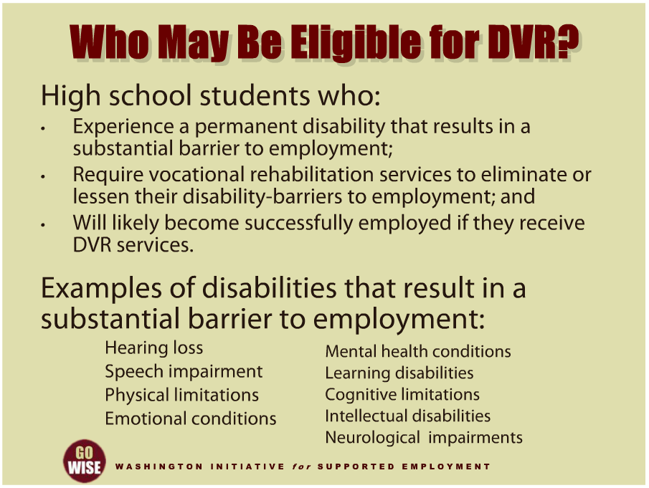
Who may be eligible for DVR?
Notes:
Eligibility is the second step towards obtaining DVR services. As we learned earlier in this training, it is the responsibility of the DVR counselor to determine if someone is eligible for services. An individual is eligible for DVR services if: they experience a permanent disability that results in a substantial barrier to them getting, keeping or advancing in employment; and the individual requires substantial vocational rehabilitation services to prepare for, secure, retain or regain employment that is consistent with their strengths, resources, priorities, concerns, abilities, capabilities and interests; and the individual can benefit in terms of an employment outcome from the provision of vocational rehabilitation services.
First, let’s understand who might be eligible for DVR services. There is a broad range of students with a variety of disabilities who may be eligible for DVR. This range includes but is not limited to students who experience mild conditions such as a hearing loss, a speech impairment, physical limitations that preclude them from some activities, emotional or mental health conditions, students with learning disabilities, students with cognitive limitations, students with intellectual disabilities, students with neurological impairments, and students with other disabilities. High school students served by DVR include youth within the special education system, as well as youth within the general education system. In fact, students referred to DVR may participate in special, career and technical, or general education programs while in the school system.

Slide 15
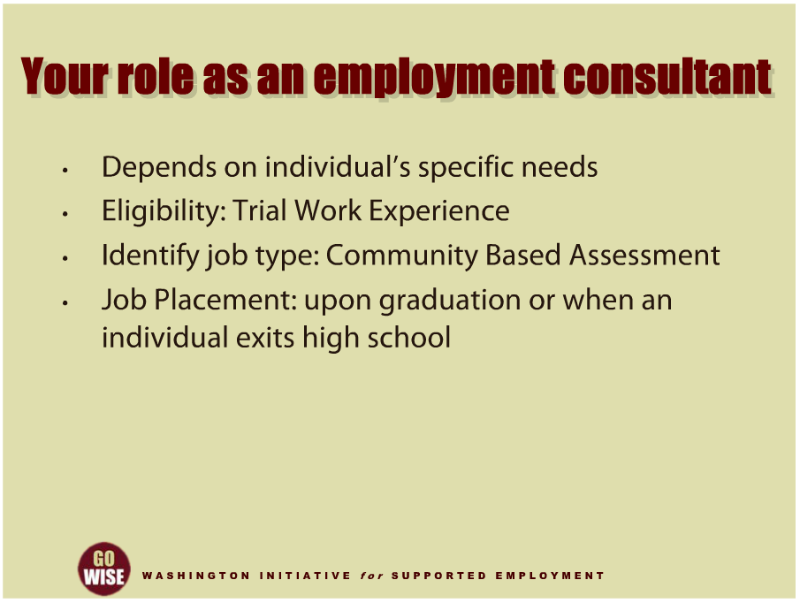
Your role as an employment consultant
Notes:
Finally, let’s consider how and when the employment consultant may enter the picture for a particular high school transition student. As you’ve learned, transition services are individualized, so exactly when you begin participating will depend on the individual’s specific needs. For example, in some instances, employment consultants come on board when the student is going through eligibility determination. In this scenario, the employment consultant may be engaged to provide a trial work experience to help determine if an individual can benefit from DVR services. In other instances, the student may already be determined eligible for service by the time you meet them. In this scenario, the student may need to participate in various vocational assessments and activities to determine what type of job they would be successful at, so you would provide a community based assessment. In another scenario, the employment consultant may provide job placement to assist the customer in obtaining employment upon graduation or afterwards.

Slide 16
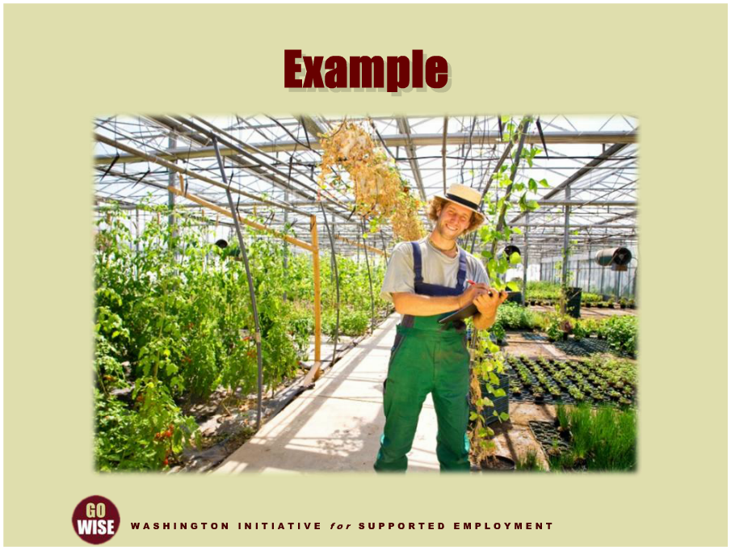
Example 1
Notes:
To conclude this training, we want to give you a few examples of how a transition student may get services from DVR. First, let’s look at a scenario where the student did not require CRP services so they were not involved with an employment consultant. Michael was a senior in his high school program and graduated at age eighteen. Just before graduation, his school guidance counselor told him about DVR. During the summer after he graduated, Michael got a temporary job as a landscaper for three months and did very well. At that same time, Michael and his mother set up a meeting with a DVR counselor to discuss his plans for getting a permanent job now that he was out of school. In the fall, Michael applied for DVR services and was determined to be eligible. Once eligible, Michael worked with his DVR counselor to explore different career options. He decided that he wanted to keep on working in the landscaping or horticulture industry rather than go to college or attend any post-secondary training program. Michael selected an employment goal as a horticultural assistant and developed a DVR employment plan to obtain employment and receive some assistive technology that would be needed for him to do this type of work. Michael attended a few DVR workshops that helped him write his resume and prepare for interviews. His DVR counselor helped him apply for jobs that they both agreed he would be good at. Michael got a job at a local nursery several months after he began looking for work. His new employer was impressed by Michael’s enthusiasm and work ethic, but felt he lacked some essential knowledge and skills needed for the job; however, the employer was willing to train Michael on the job. The DVR counselor paid the employer for providing some specialized on-the-job training to Michael during his first ninety days of employment. The training was successful and Michael remains employed. Since his DVR case was closed, he has returned to DVR for some post-employment services that enabled him to take a few community college horticultural courses. With this additional training Michael has received several promotions and pay raises from his employer.

Slide 17
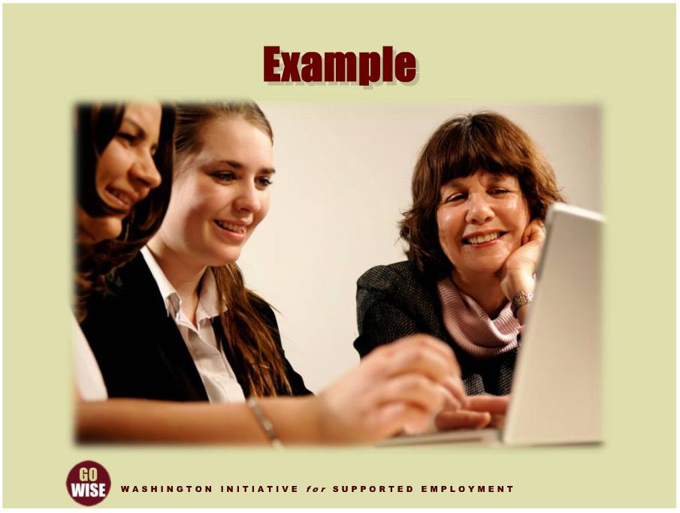
Example 2
Notes:
Now let’s look at an example of how a transition student may work with an employment consultant while receiving services from DVR in their last year of their high school transition program. Aubrey was enrolled in a transition program in her local school district and she planned to exit when she turned 21 years old. During her last year of school, her teacher encouraged her to invite a DVR counselor to her IEP meeting to talk about the type of work she would like to do when school was over. After the IEP meeting, Aubrey went through the referral and eligibility process to receive services from DVR. Her DVR counselor gave her a list of community rehabilitation programs, or CRPs to contact in order to meet an employment consultant she would like to work with. With the help of her parents, Aubrey interviewed a few CRPs and chose her new employment consultant, Bonnie. Aubrey’s DVR counselor authorized her for a community based assessment, so Bonnie developed a few different work experiences for Aubrey to try out work. Bonnie developed one experience at a business office where Aubrey had the chance to do some filing and collating. The other worksite was at a restaurant where she helped set tables and a salad bar before it opened for business. During the CBA, Aubrey and Bonnie worked to figure out accommodations and supports that Aubrey needed to perform the work successfully. They also got a better understanding of the type of job and work environment Aubrey would like to work at in the future. At the end of the CBA, Bonnie wrote a comprehensive report about the services and supports she had provided during the experience. Then Aubrey, her DVR counselor, her parents, and Bonnie, met to talk about next steps. The DVR counselor authorized Aubrey for job placement services and the team wrote a plan that outlined the type of work she would most likely be successful doing.

Slide 18
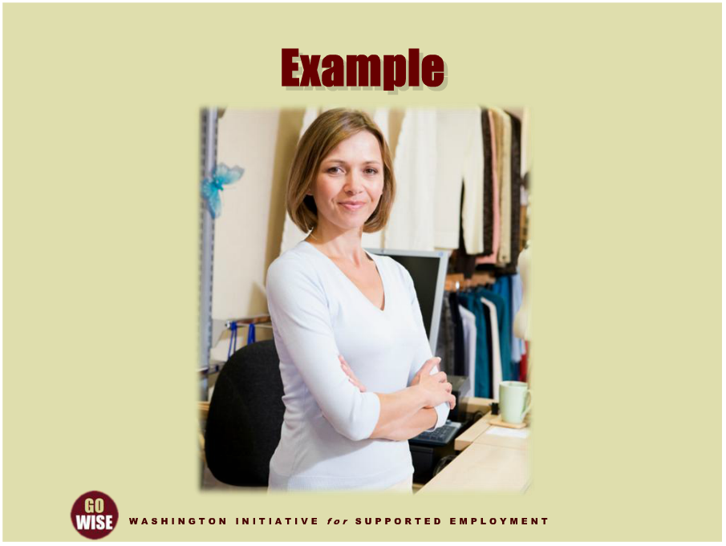
Example 3
Notes:
And finally, here is an example of how DVR services may be provided after a student has just graduated from high school. Lisa was enrolled in the high school transition program and graduated when she turned 21 years old. The spring before her last year of school, she applied for and became eligible for DVR services. During Lisa’s last year in school her DVR counselor authorized a community based assessment where Lisa could try out retail work at two different locations since she liked fashion and people. Lisa selected a CRP and began working with John as her employment consultant. In the spring prior to Lisa’s graduation, John developed community based assessments for Lisa at a clothing shop in the mall and a jewelry store downtown. He supported Lisa as she learned how to do the different tasks at the worksites. At the end of the summer when her community based assessment was finished, John wrote a report to explain the types of supports he provided to Lisa and how she progressed during the assessment. Lisa and her DVR counselor agreed that Lisa would do well working in a retail setting where she could interact with people. They also agreed that the worksite would need to have strong natural supports so that Lisa could ask for help when she needed direction, and that she would need long term support to be provided by the county developmental disabilities program. Since Lisa had graduated from high school and was ready to get a permanent job, her DVR counselor authorized CRP job placement and intensive training services for Lisa. John and Lisa began efforts to find a job that Lisa would be successful at. Lisa began a job with a department store helping unpack new freight and stocking the sales floors. She received intensive training from the CRP until she learned to do her job well. Her county DD program then began funding her long term support and DVR closed her case as a successful rehabilitation ninety days after that. Lisa continues to be employed by the department store.
This has been an overview of “High School Transition,” the term used by the Department of Social and Health Services Division of Vocational Rehabilitation, or DVR, for services provided to high school students to prepare for life after high school. You play a vital role in helping a young adult reach their employment goals as they exit the school system and begin life as an adult.
This training introduced you to the main players and service providers that collaborate with DVR to help high school students transition to the world of employment and careers, and focused on the vocational rehabilitation services that DVR provides, the laws that mandate transition services, and the types of services you may provide as an employment consultant.

Slide 19
DVR Language
Employment Consultant: also known as an employment specialist, job coach, job developer, etc.
Community Rehabilitation Program (CRP): also known as employment agency, employment provider, vendor, etc.
Customer: also known as client, consumer, person with a disability, supported employee, etc.
Extended Services: also knows as long term supports, follow along services, etc.

Slide 20
Resources
Division of Vocational Rehabilitation (DVR): http://www.dshs.wa.gov/dvr/
Center for Change in Transition Services website: http://www.seatleu.edu/ccts
Individuals with Disabilities Education Act (IDEA) of 2004: http://idea.ed.gov
High school’s DVR Transition Liaison: http://www.dshs.wa.gov/dvr/QuickLinks/SchoolTransition/Transition.aspx
School district special education coordinator: http://www.k12.wa.us/SpecialEd/publications.asp
WIOA Rehabilitation Act: http://www2.ed.gov/policy/speced/reg/narrative.html
Washington State Division of Vocational Rehabilitation School Transition: http://www.dshs.wa.gov/dvr/QuickLinks/SchoolTransition/Transition.aspx
  Content for this training was developed by representatives from the Division of Vocational Rehabilitation.

